Slide 1
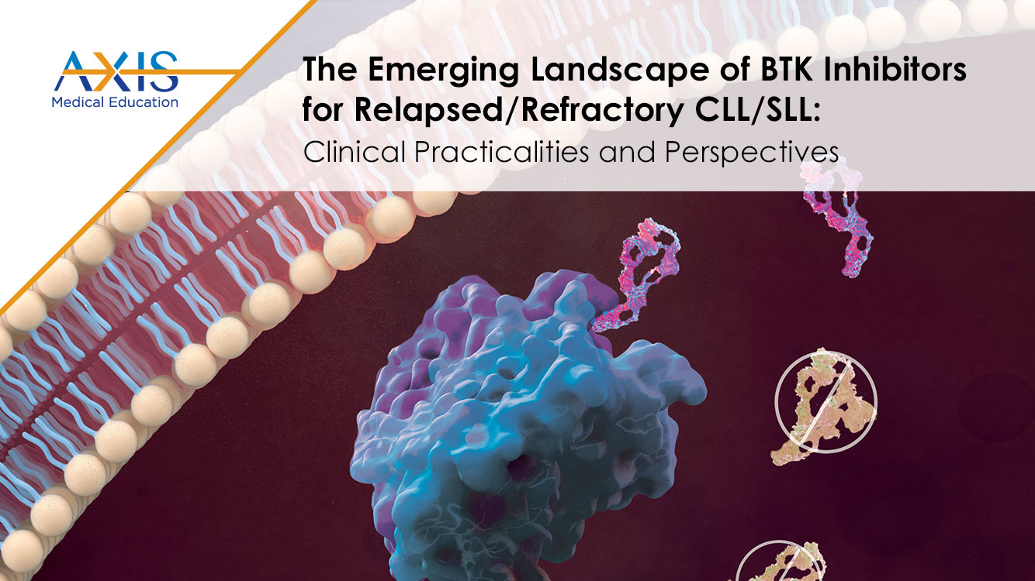

Slide 2
DISCLAIMER
This slide deck in its original and unaltered format is for educational purposes and is current as of March 2023. All materials contained herein reflect the views of the faculty, and not those of AXIS Medical Education, the CME provider, or the commercial supporter. Participants have an implied responsibility to use the newly acquired information to enhance patient outcomes and their own professional development. The information presented in this activity is not meant to serve as a guideline for patient management. Any procedures, medications, or other courses of diagnosis or treatment discussed or suggested in this activity should not be used by clinicians without evaluation of their patients’ conditions and possible contraindications on dangers in use, review of any applicable manufacturer’s product information, and comparison with recommendations of other authorities.

Slide 3
DISCLOSURE OF UNLABELED USE
This activity may contain discussion of published and/or investigational uses of agents that are not indicated by the FDA. The planners of this activity do not recommend the use of any agent outside of the labeled indications.
The opinions expressed in the activity are those of the faculty and do not necessarily represent the views of the planners. Please refer to the official prescribing information for each product for discussion of approved indications, contraindications, and warnings.
USAGE RIGHTS
This slide deck is provided for educational purposes and individual slides may be
used for personal, non-commercial presentations only if the content and references
remain unchanged. No part of this slide deck may be published in print or
electronically as a promotional or certified educational activity without prior written
permission from AXIS. Additional terms may apply. See Terms of Service on
www.axismeded.com for details.

Slide 4
Disclosure of Conflicts of Interest
Anthony Mato, MD, MSCE, reported a financial interest/relationship or affiliation in the form of Consulting or advisory role: AbbVie; Acerta Pharma/AstraZeneca; Adaptive Biotechnologies; Celgene Corporation; DTRM Biopharma; Genentech; Genmab A/S; Johnson & Johnson Services; Nurix Therapeutics; Octapharma Plasma; Pharmacyclics; Sunesis Pharmaceuticals; TG Therapeutics; Verastem. Grant/Research support: AbbVie; Acerta Pharma/AstraZeneca; Adaptive Biotechnologies; DTRM Biopharma; Genentech; Genmab A/S; Johnson & Johnson Services; Loxo Oncology; Nurix Therapeutics; Octapharma Plasma; Pharmacyclics; Regeneron Pharmaceuticals; Sunesis Pharmaceuticals; TG Therapeutics. Data and safety monitoring board: AbbVie; Acerta Pharma/AstraZeneca; Adaptive Biotechnologies; Celgene Corporation; DTRM Biopharma; Genentech; Genmab A/S; Johnson & Johnson Services; Nurix Therapeutics; Octapharma Plasma; Pharmacyclics; TG Therapeutics; Sunesis Pharmaceuticals; Verastem.
Notes:
Anthony Mato, MD, MSCE
Medical Expert
New York, New York

Slide 5
Learning Objectives
Upon completion of this activity, participants should be better able to:
Discuss barriers to optimal CLL/SLL care associated with BTK inhibitors, such as therapeutic intolerance and resistance
Summarize clinical evidence and guidelines supporting the use of BTK inhibitor strategies for relapsed/refractory CLL/SLL
Create current and potential future treatment plans for relapsed/refractory CLL/SLL that include novel and emerging BTK inhibitors based on prognostic factors and safety and selectivity differences among BTK inhibitors

Slide 6
BTK Inhibitors in the
Front-line Setting
A Brief Overview

Slide 7
Major Phase 3 Trials Support the Use of Targeted Agents in Treatment Naive and R/R CLL
Ibrutinib¹⁻⁴
Acalabrutinib⁵⁻⁷
Zanubrutinib^{8,9}
Venetoclax¹⁰⁻¹²
RESONATE-2: superior PFS and OS vs Clb in older patients
iLLUMINATE: superior PFS vs GClb
ECOG 1912: superior PFS and OS vs FCR in younger patients
ALLIANCE: superior PFS vs BR in older patients
ELEVATE TN: superior PFS for acalabrutinib regimens vs GClb
ASCEND: improved PFS vs IdelaR or BR
ELEVATE RR: noninferior PFS vs ibrutinib and improved safety profile
SEQUOIA: superior PFS vs BR
ALPINE: improved safety profile vs ibrutinib
CLL14: VenG superior to GClb in unfit patients
CLL13 VenG superior to FCR/BR in fit patients
MURANO: VenR superior to BR
Continuous BTKi
FD BCL2i combination
BR, bendamustine + rituximab; BTKi, Bruton tyrosine kinase inhibitor; Clb, chlorambucil; CLL, chronic lymphocytic leukemia; FCR, fludarabine + cyclophosphamide + rituximab; FD BCL2i, fixed duration B cell lymphoma-2 inhibitor; GClb, obinutuzumab + chlorambucil; IdelaR, idelalisib + rituximab; OS, overall survival; PFS, progression-free survival;
R/R, relapsed/refractory; VenG, venetoclax + obinutuzumab; VenR, venetoclax + rituximab.
1. Shanafelt TD et al. Blood. 2022;140:112-120. 443. 2. Woyach JA et al. N Engl J Med. 2018;379:2517-2528. 3. Moreno C et al. Lancet Oncol. 2019;20:43-56.
4. Burger JA et al. Leukemia. 2020;34:787-798. 5. Sharman JP et al. Lancet. 2020;395:1278-1291. 6. Ghia P et al. J Clin Oncol. 2020;38:2849-2861.
7. Byrd JC et al. J Clin Oncol. 2021;39:3441-3452. 8. Tam CS et al. Lancet Oncol. 2022;23:1031-1043. 9. Brown JR et al. N Engl J Med. 2023;388:319-332.
10. Al-Sawaf O et al. J Clin Oncol. 2021;39:4049-4060. 11. Eichhorst B et al. ASH 2021. Abstract 71. 12. Kater AP et al. J Clin Oncol. 2020;38:4042-4054.
Notes:
Shanafelt TD, Wang XV, Hanson CA, et al. Long-term outcomes for ibrutinib-rituximab and chemoimmunotherapy in CLL: updated results of the E1912 trial. Blood. 2022;140(2):112-120. doi:10.1182/blood.2021014960
Woyach JA, Ruppert AS, Heerema NA, et al. Ibrutinib regimens versus chemoimmunotherapy in older patients with untreated CLL. N Engl J Med. 2018;379(26):2517-2528. doi:10.1056/NEJMoa1812836
Moreno C, Greil R, Demirkan F, et al. Ibrutinib plus obinutuzumab versus chlorambucil plus obinutuzumab in first-line treatment of chronic lymphocytic leukaemia (iLLUMINATE): a multicentre, obinutuzumab, open-label, phase 3 trial. Lancet Oncol. 2019;20(1):43-56. doi:10.1016/S1470-2045(18)30788-5
Burger JA, Barr PM, Robak T, et al. Long-term efficacy and safety of first-line ibrutinib treatment for patients with CLL/SLL: 5 years of follow-up from the phase 3 RESONATE-2 study. Leukemia. 2020;34(3):787-798. doi:10.1038/s41375-019-0602-x
Sharman JP, Egyed M, Jurczak W, et al. Acalabrutinib with or without obinutuzumab versus chlorambucil and obinutuzmab for treatment-naive chronic lymphocytic leukaemia (ELEVATE TN): a randomised, controlled, phase 3 trial. Lancet. 2020;395(10232):1278-1291. doi:10.1016/S0140-6736(20)30262-2
Ghia P, Pluta A, Wach M, et al. ASCEND: Phase III, randomized trial of acalabrutinib versus idelalisib plus rituximab or bendamustine plus rituximab in relapsed or refractory chronic lymphocytic leukemia. J Clin Oncol. 2020;38(25):2849-2861. doi:10.1200/JCO.19.03355.
Byrd JC, Hillmen P, Ghia P, et al. Acalabrutinib versus ibrutinib in previously treated chronic lymphocytic leukemia: results of the first randomized phase III trial. J Clin Oncol. 2021;39(31):3441-3452. doi:10.1200/JCO.21.01210
Tam CS, Brown JR, Kahl BS, et al. Zanubrutinib versus bendamustine and rituximab in untreated chronic lymphocytic leukaemia and small lymphocytic lymphoma (SEQUOIA): a randomised, controlled, phase 3 trial. Lancet Oncol. 2022;23(8):1031-1043. doi:10.1016/S1470-2045(22)00293-5
Brown JR, Eichhorst B, Hillmen P, et al. Zanubrutinib or ibrutinib in relapsed or refractory chronic lymphocytic leukemia. N Engl J Med. 2023;388(4):319-332. doi:10.1056/NEJMoa2211582
Al-Sawaf O, Zhang C, Lu T, et al. Minimal residual disease dynamics after venetoclax-obinutuzumab treatment: extended off-treatment follow-up from the randomized CLL14 study. J Clin Oncol. 2021;39(36):4049-4060. doi:10.1200/JCO.21.01181
Eichhorst B, Niemann C, Kater AP, et al. A randomized phase III study of venetoclax-based time-limited combination treatments (RVe, GVe, GIVe) vs standard chemoimmunotherapy (CIT: FCR/BR) in frontline chronic lymphocytic leukemia (CLL) of fit patients: first co-primary endpoint analysis of the international intergroup GAIA (CLL13) Trial. Blood. 2021;138(1)(suppl):71. doi:10.1182/blood-2021-146161
Kater AP, Wu JQ, Kipps T, et al. Venetoclax plus rituximab in relapsed chronic lymphocytic leukemia: 4-Year Results and evaluation of impact of genomic complexity and gene mutations from the MURANO phase III study. J Clin Oncol. 2020;38(34):4042-4054. doi:10.1200/JCO.20.00948

Slide 8
Targeted Therapy:
FDA Approvals and Current Status in CLL
Agent | Target |  | Status in CLL/SLL
Ibrutinib¹ | BTK | Covalent | Approved
Acalabrutinib² |  |  | Approved
Zanubrutinib³ |  |  | Approved
Pirtobrutinib |  | Noncovalent | Phase 3 BRUIN CLL-321 Phase 3 BRUIN CLL-322 Phase 3 BRUIN CLL-313 Phase 3 BRUIN CLL-314
Nemtabrutinib |  |  | Phase 2 BELLWAVE-001 Phase 3 BELLWAVE-008
Venetoclax⁴ | BCL-2 |  | Approved
Idelalisib⁵ | PI3K |  | Approved
Duvelisib⁶ |  |  | Approved
BTK, Bruton tyrosine kinase; CLL, chronic lymphocytic leukemia; FDA, Food and Drug Administration; SLL, small lymphocytic lymphoma.
1. Imbruvica (ibrutinib) Prescribing Information. 2. Calquence (acalabrutinib) Prescribing Information. 3. Brukinsa (zanubrutinib) Prescribing Information. 4. Venclexta (venetoclax) Prescribing information. 5. Zydelig (idelalisib) Prescribing information. 6. Copiktra (duvelisib) Prescribing information.
Notes:
Imbruvica. Prescribing information. AbbVie; 2022. Accessed February 23, 2023.
https://www.rxabbvie.com/pdf/imbruvica_pi.pdf
Calquence. Prescribing information. AstraZeneca; 2022. Accessed February 23, 2023.
https://den8dhaj6zs0e.cloudfront.net/50fd68b9-106b-4550-b5d0-12b045f8b184/e2a005a7-65a0-4388-a671-dc887815a938/e2a005a7-65a0-4388-a671-dc887815a938_viewable_rendition__v.pdf
Brukinsa. Prescribing information. BeiGene; 2023. Accessed February 23, 2023.
https://www.brukinsa.com/prescribing-information.pdf
Venclexta. Prescribing information. AbbVie; 2022. Accessed February 23, 2023. https://www.rxabbvie.com/pdf/venclexta.pdf
Zydelig. Prescribing information. Gilead; 2022. Accessed February 23, 2023.
https://www.gilead.com/~/media/Files/pdfs/medicines/oncology/zydelig/zydelig_pi.pdf
Copiktra. Prescribing information. Secura Bio, Inc.; 2021. Accessed February 23, 2023.
https://copiktra.com/pdf/COPIKTRA-PI-USCPR2007403.pdf

Slide 9
Despite These Advances, Real-World Data
Suggest More Work Needs to Be Done
European Research Initiative on CLL (ERIC)¹
  N = 9173 patients
  Although practice patterns have shifted since 2014, CIT was used as frontline treatment in 60% of patients in this real-world analysis
Flatiron Health database analysis from 280 US cancer clinics²
  N = 3654 patients with CLL initiating first-line treatment between 2015 and 2020
  Although 46% received first-line targeted therapy, 33% received CIT and 20% received anti-CD20 monotherapy
CIT, chemoimmunotherapy; CLL, chronic lymphocytic leukemia.
1. Chatzikonstantinou T et al. ASH 2021. Abstract 2635. 2. Mato A et al. ASH 2021. Abstract 4086.
Notes:
Chatzikonstantinou T, Scarfo L, Demosthenous C, et al. Real-world evidence on therapeutic strategies and treatment-sequencing in patients with chronic lymphocytic leukemia: an international study of Eric, the European Research Initiative on CLL. Blood. 2021;138(1)(suppl):2635. doi:10.1182/blood-2021-148738
Mato A, Ravelo A, To TM, et al. Real-world treatment patterns and outcomes of patients with chronic lymphocytic leukemia (CLL) receiving first-line (1L) therapy in the United States (US). Blood. 2021;138(1)(suppl):4086. doi:10.1182/blood-2021-148472

Slide 10
Covalent BTK Inhibitors in Frontline Therapy
Ibrutinib
As monotherapy
+ rituximab
Acalabrutinib
As monotherapy
Zanubrutinib
As monotherapy
+ obinutuzumab
+ obinutuzumab
BTK, Bruton’s tyrosine kinase.
NCCN Guidelines. CLL/SLL (Version 2.2023). https://www.nccn.org/professionals/physician_gls/pdf/cll.pdf.
Notes:
NCCN. Clinical Practice Guidelines in Oncology. Chronic Lymphocytic Leukemia/Small Lymphocytic Lymphoma, version 2.2023. Accessed February 23, 2023. https://www.nccn.org/professionals/physician_gls/pdf/cll.pdf

Slide 11
BTK Inhibitors in Very-High-Risk CLL
With TP53 Aberration

Slide 12
Ibrutinib in Patients With del(17p)/TP53 Mutation^{1,2}
Ibrutinib ± R vs BR
 | No TP53 Mutation | TP53 Mutation
HR (95% CI) | 0.39 (0.27-0.55) | 0.07 (0.03-0.18)
Interaction P | .0006
l
l
l
l
l
l
+
+
1.0
+
+
+
+
+
+
+
l
+
+
l
+
+
+
+
l
l
+
+
+
+
+
+
+
+
l
+
+
+
l
+
+
l
l
+
l
l
l
l
l
l
l
l
+
+
l
l
l
+
l
+
+
l
+
+
l
l
l
l
l
l
l
l
l
l
l
l
l
l
l
+
+
+
+
+
+
+
+
+
+
+
+
+
+
+
+
+
+
+
+
+
+
+
+
+
+
+
+
+
+
+
+
+
+
+
+
+
+
+
+
+
+
+
+
+
+
+
+
+
+
+
+
+
+
+
+
+
+
+
+
+
+
+
+
+
+
+
+
+
+
+
+
+
+
+
+
+
+
+
+
+
+
+
+
+
 | Without Mutation | With Mutation
Median time, mo | NE | NE
HR (95% CI) Log-rank P-value | 0.931 (0.322-2.692) .8945
+
+
PFS, %
+
+
+
+
+
+
+
+
+
PFS Probability, %
+
+
+
+
+
+
+
+
+
+
+
+
+
+
+
+
+
+
+
+
+
+
+
+
+
Without del(17p) or TP53 mutation
With del(17p) or TP53 mutation
Time, mo
Time, mo
No. at Risk
Without mutation | 95 | 91 | 88 | 88 | 84 | 83 | 80 | 75 | 73 | 71 | 67 | 67 | 62 | 60 | 52 | 41 | 15
With mutation | 18 | 17 | 17 | 16 | 16 | 15 | 14 | 14 | 14 | 14 | 14 | 13 | 12 | 10 | 7 | 6 | 2
Group | Events/Total
BR, no TP53 abnormality | 63/133
I/IR, no TP53 abnormality | 72/264
BR, TP53 abnormality | 13/19
I/IR, TP53 abnormality | 9/34
+ Censored
BR, bendamustine + rituximab; del, deletion; HR, hazard ratio; I, ibrutinib; IR, ibrutinib + rituximab; NE, not evaluable; PFS, progression-free survival; R, rituximab; TP53, tumor protein p53.
1. Moreno C et al. Haematologica. 2022;107:2108-2120. 2. Woyach J et al. ASH 2021. Abstract 639.
Notes:
Moreno C, Greil R, Demirkan F, et al. First-line treatment of chronic lymphocytic leukemia with ibrutinib plus obinutuzumab versus chlorambucil plus obinutuzumab: Final analysis of the randomized, phase III iLLUMINATE trial. Haematologica. 2022;107(9):2108-2120. doi:10.3324/haematol.2021.279012
Woyach JA, Ruppert AS, Heerema NA, et al. Long-term results of Alliance AO41202 show continued advantage of ibrutinib-based regimens compared with bendamustine plus rituximab (BR) chemoimmunotherapy. Blood. 2021;138(1)(suppl):639. doi: 10.1182/blood-2021-153146

Slide 13
ELEVATE-TN Study: A vs A + G vs GClb in Patients With TP53 Aberration¹
+
+
+
+
+
+
+
+
+
+
+
+
+
+
89%
Median PFS: NR
+
+
+
+
+
+
+
+
+
+
+
+
+
+
+
+
+
+
+
+
+
+
+
+
+
+
+
+
+
+
+
+
+
+
+
+
+
+
+
+
+
+
+
+
+
+
+
+
+
78%
Median PFS: NR
+
+
+
+
+
+
+
+
+
+
+
+
+
+
+
+
+
+
+
+
+
+
+
+
+
+
Median PFS: NR
76%
+
+
+
+
+
+
+
+
+
75%
Median PFS: NR
PFS, %
+
+
+
+
26%
Median PFS: 28 mo
+
+
+
+
+
+
+
+
+
+
+
+
+
+
+
+
+
+
+
+
+
A + G, with del(17p) and/or mTP53
A + G, without del(17p) and/or mTP53
+
A, with del(17p) and/or mTP53
A, without del(17p) and/or mTP53
18%
Median PFS: 17.5 mo
GClb, with del(17p) and/or mTP53
GClb, without del(17p) and/or mTP53
Time, mo
No. at Risk
A + G, with del(17p) and/or mTP53
A, with del(17p) and/or mTP53
GClb, with del(17p) and/or mTP53
A + G, without del(17p) and/or mTP53
A, without del(17p) and/or mTP53
GClb, without del(17p) and/or mTP53
25 | 24 | 23 | 22 | 22 | 22 | 22 | 22 | 21 | 21 | 21 | 21 | 21 | 19 | 16 | 9 | 8 | 3 | 1 | 0 | 0
23 | 22 | 21 | 21 | 20 | 20 | 20 | 19 | 18 | 18 | 18 | 18 | 18 | 15 | 15 | 11 | 9 | 5 | 2 | 1 | 0
25 | 21 | 19 | 19 | 18 | 15 | 10 | 9 | 9 | 9 | 6 | 6 | 5 | 5 | 4 | 3 | 2 | 0 | 0 | 0 | 0
154 | 152 | 148 | 146 | 142 | 141 | 138 | 135 | 135 | 134 | 132 | 131 | 129 | 122 | 116 | 76 | 51 | 30 | 11 | 2 | 0
156 | 145 | 142 | 137 | 136 | 135 | 133 | 131 | 131 | 128 | 124 | 123 | 118 | 115 | 108 | 68 | 52 | 30 | 14 | 3 | 0
152 | 142 | 137 | 134 | 121 | 110 | 100 | 91 | 77 | 73 | 61 | 60 | 50 | 43 | 38 | 19 | 11 | 6 | 2 | 1 | 0
A, acalabrutinib; del, deletion; G, obinutuzumab; GClb, chlorambucil + obinutuzumab; NR, not reached; PFS, progression-free survival; TP53, tumor protein p53.
ª Hazard ratio was based on unstratified Cox proportional hazards model. ^{b} P value was based on unstratified log-rank test.
1. Sharman JP et al. Leukemia. 2022;36:1171-1175.
Notes:
Sharman JP, Egyed M, Jurczak W, et al. Efficacy and safety in a 4-year follow-up of the ELEVATE-TN study comparing acalabrutinib with or without obinutuzumab versus obinutuzumab plus chlorambucil in treatment-naïve chronic lymphocytic leukemia. Leukemia. 2022;36(4):1171-1175. doi:10.1038/s41375-021-01485-x

Slide 14
SEQUOIA Cohort 2: Zanubrutinib in Patients
With del(17p) Only
Median observation time: 30.5 months¹
Cohort 2: PFS Per IRC Assessment in Patients With del(17p)
+
+
+
+
+
+
+
+
+
+
+
+
+
+
+
+
+
+
+
+
+
+
+
+
+
+
+
+
+
+
+
+
+
+
+
+
+
+
+
+
+
+
+
+
+
+
+
+
+
+
+
+
+
+
+
+
+
PFS Probability
Median follow-up: 30.5 mo
24-mo PFS: 88.9% (95% CI, 81.3-93.6)
+
Censored
95% CI
Time, mo
del, deletion; IRC, Institutional Review Committee; PFS, progression-free survival.
1. Tam CS et al. Lancet Oncol. 2022;23:1031-1043.
Notes:
Tam CS, Brown JR, Kahl BS, et al. Zanubrutinib versus bendamustine and rituximab in untreated chronic lymphocytic leukaemia and small lymphocytic lymphoma (SEQUOIA): a randomised, controlled, phase 3 trial. Lancet Oncol. 2022;23(8):1031-1043. doi:10.1016/S1470-2045(22)00293-5

Slide 15
Retrospective Real-world Data on del(17p) CLL in First-line Ibrutinib Patients
Median overall survival, time to next treatment, and time to treatment discontinuation
Outcome | Group | Number of patients | Number of events | Median months | 95% CI months | Log-rank P value
OS | All Del(17p) present Del(17p) absent | 1,069 254 815 | 160 64 96 | NR 57.7 NR | 63.2-NR 51.8-NR NR-NR | - 0.0006 -
TTNT | All Del(17p) present Del(17p) absent | 1,069 254 815 | 259 86 173 | NR 49.4 NR | 49.4-NR 38.0-NR NR-NR | - 0.0330 -
TTD* | All Del(17p) present Del(17p) absent | 1,069 254 815 | 343 95 248 | 38.6 32.5 42.9 | 33.4-42.9 24.0-39.4 38.1-48.4 | - 0.3370† -
*Time to treatment discontinuation was estimated using non-parametric maximum likelihood estimator. †Calculated with the Sun log-rank test for interval censoring.
CI, confidence interval; Del(17p), 17p deletion; NR, not reached; OS, overall survival; TTNT, time to next treatment; TTD, time to treatment discontinuation.
Mato et al. Haematologica. 2022;107(11):2630–2640.
Notes:
Mato AR, Tang B, Azmi S, et al. A clinical practice comparison of patients with chronic lymphocytic leukemia with and without deletion 17p receiving first-line treatment with ibrutinib. Haematologica. 2022;107(11):2630-2640. Published 2022 Nov 1. doi:10.3324/haematol.2021.280376

Slide 16
Adverse Events With
BTK Inhibitors

Slide 17
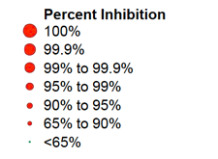
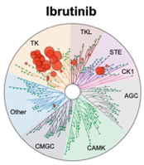
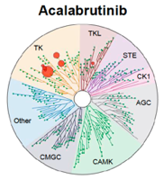
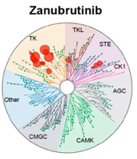
Selectivity of BTK Inhibitors (Average IC₅₀ nmol/L)¹
TEC Kinases | Ibrutinib | Acalabrutinib | Zanubrutinib
BTK | 1.5 | 5.1 | 0.5
TEC | 10 | 126 | 44
BMX | 0.8 | 46 | 1.4
TXK | 2.0 | 368 | 2.2
ERBB2/HER2 | 6.4 | ~1000 | 88
EGFR | 5.3 | >1000 | 21
ITK | 4.9 | >1000 | 50
JAK3 | 32 | >1000 | 1377
BLK | 0.1 | >1000 | 2.5
BLK, B lymphocyte kinase; BMX, bone marrow tyrosine kinase gene in chromosome X, BTK, Bruton tyrosine kinase; EGFR, epidermal growth factor receptor; ERBB2/HER2, erb-b2 receptor tyrosine kinase/human epidermal growth factor receptor 2; IC, inhibitory concentration; ITK, interleukin-2-inducible T-cell kinase; JAK3, Janus kinase 3; TEC, tyrosine kinase expressed in hepatocellular carcinoma; TXK, T and X cell expressed kinase.
1. Kaptein A et al. Blood. 2018;132(suppl 1):1871. Reproduced with permission of Kaptein A et al in the format of electronic publication via Copyright Clearance Center.
Notes:
Kaptein A, de Bruin G, Emmelot-van Hoek M, et al. Potency and Selectivity of BTK Inhibitors in Clinical Development for B-Cell Malignancies. Blood. 2018;132(1)(suppl):1871. doi:10.1182/blood-2018-99-109973

Slide 18
AE Profiles of Different BTK Inhibitors
AE ≥ CTC Grade 3 | Ibrutinib |  |  | Acalabrutinib | Zanubrutinib
 | E1912 (I + Rituximab)¹ | RESONATE-2² | ALLIANCE³ | ELEVATE-TN⁴ | SEQUOIA⁵
Median observation time, months | 70 | 60 | 38 | 47 | 24
Hypertension, % | 11.4 | 8 | 29 | 2.8 | 6.3
Cardiac, % | 7.7 | N/A | N/A | 8.4 | N/A
AF, % | 4.5 | 5 | 9 | 1.1 | 0.4
Neutropenia, % | 28.4 | 13 | 15 | 11.2 | 11.3
Infection, % | 11.4 | 12ª | 19 | 16.2 | 16.3
AE, adverse events; AF, atrial fibrillation; CTC, Common Terminology Criteria; I, ibrutinib.
ª Pneumonia only.
1. Shanafelt TD et al. Blood. 2022;140:112-120. 2. Barr PM et al. Blood Adv. 2022;6:3440-3450. 3. Woyach JA et al. N Engl J Med. 2018;379:2517-2528. 4. Sharman JP et al. Lancet. 2020;395:1278-1291. 5. Tam C et al. ASH 2021. Abstract 396.
Notes:
Shanafelt TD, Wang XV, Hanson CA, et al. Long-term outcomes for ibrutinib-rituximab and chemoimmunotherapy in CLL: updated results of the E1912 trial. Blood. 2022;140(2):112-120. doi:10.1182/blood.2021014960
Barr PM, Owen C, Robak T, et al. Up to 8-year follow-up from RESONATE-2: first-line ibrutinib treatment for patients with chronic lymphocytic leukemia. Blood Adv. 2022;6(11):3440-3450. doi:10.1182/bloodadvances.2021006434
Woyach JA, Ruppert AS, Heerema NA, et al. Ibrutinib regimens versus chemoimmunotherapy in older patients with untreated CLL. N Engl J Med. 2018;379(26):2517-2528. doi:10.1056/NEJMoa1812836
Sharman JP, Egyed M, Jurczak W, et al. Acalabrutinib with or without obinutuzumab versus chlorambucil and obinutuzmab for treatment-naive chronic lymphocytic leukaemia (ELEVATE TN): a randomised, controlled, phase 3 trial. Lancet. 2020;395(10232):1278-1291. doi:10.1016/S0140-6736(20)30262-2
Tam CS, Giannopoulos K, Jurczak W, et al. SEQUOIA: results of a phase 3 randomized study of zanubrutinib versus bendamustine + rituximab in patients with treatment-naïve chronic lymphocytic leukemia/small lymphocytic lymphoma. Blood. 2021;138(1)(suppl):396. doi:10.1182/blood-2021-148457

Slide 19

Retrospective Analysis on Time to Treatment Discontinuation of Ibrutinib or Acalabrutinib¹
Retrospective database analysis in 2509 patients with CLL with a median observation time of 15.9 months
Time to Treatment Discontinuation for Patients With CLL/SLL Treated With Acalabrutinib or Ibrutinib After ATT Weighting
Acalabrutinib
Ibrutinib
Censored
Proportion of Patients on Treatment, %
Median TTD, mo (95% CI)
Acalabrutinib (n = 353): NR (25.1-NR)
Ibrutinib (n = 364): 23.4 (18.1-28.7)
Median TTD, mo (95% CI)
Acalabrutinib (n = 353): 23.6 (21.3-26.0)
Ibrutinib (n = 364): 21.4 (19.8-23.1)
Hazard Ratios (95% CI)
Weighted: 0.70 (0.53-0.92)
Weighted with adjustment: 0.59 (0.43-0.81)
No. at Risk
Acalabrutinib | 353 | 157 | 63 | 22 | 13 | 5 | 0
Ibrutinib | 364 | 175 | 66 | 27 | 11 | 5 | 1
Time, mo
ATT, average treatment effect among the treated; CLL, chronic lymphocytic leukemia; TTD, time to treatment discontinuation; NR, not reached; SLL, small lymphocytic lymphoma.
1. Roecker L et al. ASH 2022. Abstract 1808.
Notes:
Roeker L, DerSarkissian M, Ryan KJ, et al. Comparing acalabrutinib and ibrutinib in the real world: A study of 2,509 patients with chronic lymphocytic leukemia. Abstract presented at: Annual Meeting of the American Society of Hematology; December 10, 2022; New Orleans, LA. Abstract 1808. https://ash.confex.com/ash/2022/webprogram/Paper167213.html

Slide 20
BTK Inhibitors:
Head-to-Head Comparisons

Slide 21
ELEVATE-RR (Acalabrutinib vs Ibrutinib): PFS and OS¹
PFS
OS
+
+
+
+
+
+
+
+
+
+
+
+
+
+
+
+
+
+
+
+
+
+
+
+
+
+
+
+
+
+
+
+
+
+
+
+
+
+
+
+
+
+
+
+
+
+
+
+
+
+
+
+
+
+
+
+
+
+
+
+
+
+
+
+
+
+
+
+
+
+
+
+
+
+
+
+
+
+
+
+
+
+
+
+
+
+
+
+
+
+
+
+
+
+
+
+
+
+
+
+
+
+
+
+
+
+
+
+
+
+
+
+
+
+
+
+
+
+
+
+
+
+
+
+
+
+
+
+
+
+
+
+
+
+
+
+
+
+
+
+
+
+
+
+
+
+
+
+
+
+
+
+
+
+
+
+
+
+
+
+
+
+
+
+
+
+
+
+
+
+
+
+
+
+
+
+
+
+
+
+
+
+
+
+
+
+
+
+
+
+
+
+
+
+
+
+
+
+
+
+
+
+
+
+
+
+
+
+
+
+
+
PFS, %
OS, %
 | Events, n (%) | Median (95% CI) | HR (95% CI)
Acalabrutinib | 143 (53.4) | 38.4 (33.0-38.6) | 1.00 (0.79-1.27)
Ibrutinib | 136 (51.3) | 38.4 (33.0-41.6)
 | Events, n (%) | Median (95% CI) | HR (95% CI)
Acalabrutinib | 63 (23.5) | NE (NE-NE) | 0.82 (0.59-1.15)
Ibrutinib | 73 (27.5) | NE (NE-NE)
Time, mo
Time, mo
No. at Risk
Acalabrutinib
Ibrutinib
No. at Risk
Acalabrutinib | 268 | 259 | 247 | 242 | 236 | 231 | 223 | 218 | 210 | 207 | 201 | 196 | 183 | 155 | 127 | 95 | 59 | 32 | 18 | 4 | 0
Ibrutinib | 265 | 252 | 241 | 233 | 227 | 220 | 212 | 205 | 203 | 194 | 191 | 186 | 173 | 143 | 121 | 88 | 60 | 28 | 15 | 2 | 0
268 | 250 | 235 | 227 | 219 | 207 | 200 | 193 | 173 | 163 | 148 | 110 | 84 | 59 | 31 | 21 | 13 | 3 | 1 | 0
265 | 240 | 221 | 205 | 186 | 178 | 168 | 160 | 148 | 142 | 130 | 108 | 81 | 66 | 41 | 26 | 15 | 8 | 2 | 0
HR, hazard ratio; OS, overall survival; PFS, progression-free survival.
1. Byrd JC et al. J Clin Oncol. 2021;39:3441-3452.
Notes:
Byrd JC, Hillmen P, Ghia P, et al. Acalabrutinib versus ibrutinib in previously treated chronic lymphocytic leukemia: results of the first randomized phase III trial. J Clin Oncol. 2021;39(31):3441-3452. doi:10.1200/JCO.21.01210

Slide 22
ELEVATE-RR: Cardiac AEs of Interest¹
Atrial Fibrillation
Hypertension
Cumulative Event Rate, %
HR = 0.52 (95% CI, 0.32-0.86)
Cumulative Event Rate, %
HR = 0.34 (95% CI, 0.21-0.54)
Acalabrutinib
Ibrutinib
Acalabrutinib
Ibrutinib
l
l
l
l
l
l
l
l
l
l
l
l
l
l
l
l
l
l
l
l
l
l
l
l
l
l
l
l
l
l
l
l
l
l
l
l
l
l
l
l
l
l
l
l
l
l
l
l
l
l
l
l
l
l
l
l
l
l
l
l
l
l
l
l
l
l
l
l
l
l
l
l
l
l
l
l
l
l
l
l
l
l
l
l
l
l
l
l
l
l
l
l
l
l
l
l
l
l
l
l
l
l
l
l
l
l
l
l
l
l
l
l
l
l
l
l
l
l
l
l
l
l
l
l
l
l
l
l
l
l
l
l
l
l
l
l
l
l
l
l
l
l
l
l
l
l
l
l
l
l
l
l
l
l
l
l
l
l
l
l
l
l
l
l
l
l
l
l
l
l
l
l
l
l
l
l
l
l
l
l
l
l
l
l
l
l
l
l
l
l
l
l
l
l
l
l
l
l
l
l
l
l
l
l
l
l
l
l
l
l
l
l
l
l
l
l
l
l
l
l
l
l
l
l
l
l
l
l
l
l
l
l
l
l
l
l
l
l
l
l
l
l
l
l
l
l
l
l
l
l
l
l
l
l
l
l
l
l
l
l
l
l
l
l
l
l
l
l
l
l
l
l
l
l
l
l
l
l
l
l
l
l
l
l
l
l
l
l
l
l
l
l
l
l
l
l
l
l
l
l
l
l
l
l
l
l
l
l
l
l
l
l
l
l
l
l
l
l
l
l
l
l
l
l
l
l
l
l
l
l
l
l
l
l
l
l
l
l
l
l
l
l
l
l
l
l
l
l
l
l
l
l
l
l
l
l
l
l
l
l
l
l
l
l
l
l
l
l
l
l
l
l
l
l
l
l
l
l
l
l
l
l
l
l
l
l
l
l
l
l
l
l
l
l
l
l
l
l
l
l
l
l
l
l
l
l
l
l
l
l
l
l
l
l
l
l
l
l
l
l
l
l
l
l
l
l
l
l
l
l
l
l
l
l
l
l
l
l
l
l
l
l
l
l
l
l
l
l
l
l
l
l
l
l
l
l
l
l
l
l
l
l
l
l
l
l
l
l
l
l
l
l
l
l
l
l
l
l
l
l
l
l
l
l
l
l
l
l
l
l
l
l
l
l
l
l
l
l
l
l
l
l
l
l
l
l
l
l
l
l
l
l
l
l
l
l
l
l
l
l
l
l
l
l
l
l
l
l
l
l
l
l
l
l
l
l
l
l
l
l
l
l
l
l
l
l
l
l
l
l
l
l
l
l
l
l
l
l
l
l
l
l
Time, mo
Time, mo
No. at Risk
Acalabrutinib
Ibrutinib
268
263
255
241
240
224
231
208
228
199
218
185
206
176
197
166
188
156
183
143
172
136
167
128
142
117
115
96
89
73
58
56
35
26
19
18
8
8
0
0
No. at Risk
Acalabrutinib
Ibrutinib
266
263
246
230
229
203
220
183
216
170
205
153
193
141
184
130
176
120
169
111
157
104
153
98
136
85
114
69
89
48
60
40
34
27
17
15
5
7
0
1
0
0
AEs, adverse events; HR, hazard ratio.
1. Byrd JC et al. J Clin Oncol. 2021;39:3441-3452.
Notes:
Byrd JC, Hillmen P, Ghia P, et al. Acalabrutinib versus ibrutinib in previously treated chronic lymphocytic leukemia: results of the first randomized phase III trial. J Clin Oncol. 2021;39(31):3441-3452. doi:10.1200/JCO.21.01210

Slide 23
ELEVATE-RR: AE Burden Score
(Defined by Duration and Weighted Severity of the AE)¹
TEAE | Patients With Event, n (%) |  | Grades 1-4 |  | Grades 1-5
 |  |  | AE Burden Score, Mean (SD) |  | AE Burden Score, Mean (SD)
 | Acalabrutinib (n = 266) | Ibrutinib (n = 263) | Acalabrutinib | Ibrutinib | Acalabrutinib | Ibrutinib
Atrial fibrillation/flutter | 25 (9) | 42 (16) | 0.03 (0.187) | 0.08 (0.316) | 0.03 (0.187) | 0.08 (0.316)
Cardiac events | 64 (24) | 79 (30) | 0.11 (0.355) | 0.26 (1.059) | 0.11 (0.354) | 0.26 (1.053)
Hypertension | 25 (9) | 61 (23) | 0.07 (0.336) | 0.24 (0.682) | 0.07 (0.336) | 0.24 (0.682)
Hemorrhage | 101 (38) | 135 (51) | 0.15 (0.377) | 0.26 (0.568) | 0.18 (0.667) | 0.26 (0.568)
Major hemorrhage | 12 (5) | 14 (5) | 0.02 (0.143) | 0.01 (0.153) | 0.05 (0.576) | 0.01 (0.153)
Infections | 208 (78) | 214 (81) | 0.37 (1.056) | 0.36 (0.797) | 0.46 (1.513) | 0.41 (0.904)
Fatigue | 54 (20) | 44 (17) | 0.088 (0.2683) | 0.095 (0.4005) | 0.088 (0.2683) | 0.095 (0.4005)
Diarrhea | 92 (35) | 121 (46) | 0.112 (0.5370) | 0.108 (0.3245) | 0.112 (0.5370) | 0.108 (0.3245)
Headache | 92 (35) | 53 (20) | 0.084 (0.2960) | 0.076 (0.4396) | 0.084 (0.2960) | 0.076 (0.4396)
Musculoskeletal events | 79 (30) | 98 (37) | 0.142 (0.3727) | 0.346 (1.1026) | 0.142 (0.3727) | 0.346 (1.1026)
AE, adverse event; HR, hazard ratio; SD, standard deviation; TEAE, treatment emergent AE.
1. Seymour J et al. ASH 2022. Abstract 3133.
Notes:
Seymour JF, Byrd JC, Munir T, et al. Assessing the burden of adverse events in a head-to-head trial of acalabrutinib versus ibrutinib in previously treated chronic lymphocytic leukemia (CLL). Abstract presented at: Annual Meeting of the American Society of Hematology; December 12, 2022; New Orleans, LA. Abstract 3133. https://ash.confex.com/ash/2022/webprogram/Paper157060.html

Slide 24
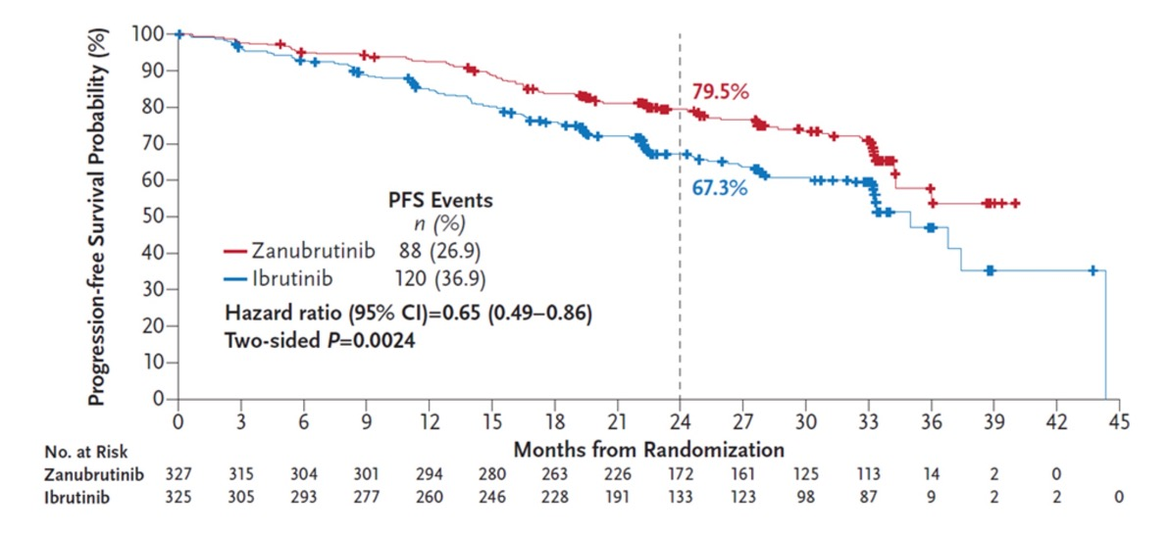
ALPINE: Improved ORR and PFS
With Zanubrutinib vs Ibrutinib in R/R CLL/SLL¹
After a median follow-up of 29.6 months, improved PFS with
zanubrutinib intent-to-treat population
CLL, chronic lymphocytic leukemia; ORR, overall response rate; PFS, progression-free survival; R/R, relapsed/refractory; SLL, small lymphocytic lymphoma.
1. Brown J et al. ASH 2022. Abstract LBA-6.
Notes:
Brown JR, Eichhorst B, Hillmen P, et al. Zanubrutinib demonstrates superior progression-free survival (PFS) compared with ibrutinib for treatment of relapsed/refractory chronic lymphocytic leukemia and small lymphocytic lymphoma (R/R CLL/SLL): Results from final analysis of ALPINE randomized phase 3 study. Abstract presented at: Annual Meeting of the American Society of Hematology; December 13, 2022; New Orleans, LA. Abstract LBA-6. https://ash.confex.com/ash/2022/webprogram/Paper171538.html

Slide 25
ALPINE: Safety Analysis Showed Lower Rates of AF/Flutter With Zanubrutinib¹
AF/Flutter
 | Incidence, %
Zanubrutinib | 2.5
Ibrutinib | 10.1
2-sided P = .0014 Compared with prespecified alpha of .0099 for interim analysis
Cumulative Event Rate, %
Zanubrutinib
Ibrutinib
Censored
+
+
+
+
+
+
+
+
+
+
+
+
+
+
+
+
+
+
+
+
+
+
+
+
+
+
+
+
+
+
+
+
+
+
+
+
+
+
+
+
+
+
+
+
+
+
+
+
+
+
+
+
+
+
+
+
+
+
+
+
+
+
+
+
+
+
+
+
+
+
+
+
+
+
+
+
+
+
+
+
+
+
+
+
+
+
+
+
+
+
+
+
+
+
+
+
+
+
+
+
+
+
+
+
+
+
+
+
+
+
+
+
+
+
+
+
+
+
+
+
+
+
+
+
+
+
+
+
+
+
+
+
+
+
+
+
+
+
+
+
+
+
+
+
+
+
+
+
+
+
+
+
+
+
+
+
+
+
+
+
+
+
+
+
+
+
+
+
+
+
+
+
+
+
+
+
+
+
+
+
+
+
+
+
+
+
+
+
+
+
+
+
+
+
+
+
+
+
+
+
+
+
+
+
+
+
+
+
+
+
+
+
+
+
+
+
+
+
+
+
+
+
Time From First Dose, mo
No. at Risk
Zanubrutinib | 204 | 197 | 194 | 190 | 187 | 114 | 40 | 9 | 0 | 0
Ibrutinib | 207 | 190 | 179 | 168 | 160 | 91 | 26 | 3 | 3 | 0
AF, atrial fibrillation
1. Hillmen P et al. EHA 2021. Abstract LB1900.
Notes:
Hillmen P, et al. First interim analysis of ALINE Study: Results of a phase 3 randomized study of zanubrutinib vs ibrutinib in patients with relapsed/refractory chronic lymphocytic leukemia/small lymphocytic lymphoma. Abstract presented at: Annual Meeting of the European Hematology Association; June 11, 2021. Abstract LB1900. https://library.ehaweb.org/eha/2021/eha2021-virtual-congress/330170/peter.hillmen.first.interim.analysis.of.alpine.study.results.of.a.phase.3.html

Slide 26
ALPINE: Adverse Events of Special Interest*
(Safety Population; N=648)
AESI, n (%) | Any Grade |  | Grade ≥3
 | Zanubrutinib (n=324) | Ibrutinib (n=324) | Zanubrutinib (n=324) | Ibrutinib (n=324)
≥1 AESI | 294 (90.7) | 300 (92.6) | 186 (57.4) | 184 (56.8)
Anemia | 50 (15.4) | 53 (16.4) | 7 (2.2) | 8 (2.5)
Atrial fibrillation and flutter | 17 (5.2) | 43 (13.3) | 8 (2.5) | 13 (4.0)
Hemorrhage | 137 (42.3) | 134 (41.4) | 11 (3.4) | 12 (3.7)
Major hemorrhage | 12 (3.7) | 14 (14.3) | 11 (3.4) | 12 (3.7)
Hypertension | 76 (23.5) | 74 (22.8) | 49 (15.1) | 44 (13.6)
Infections | 231 (71.3) | 237 (73.1) | 86 (26.5) | 91 (28.1)
Opportunistic infection | 7 (2.2) | 10 (3.1) | 5 (1.5) | 5 (1.5)
Neutropenia† | 95 (29.3) | 79 (24.4) | 68 (21.0) | 59 (18.2)
Secondary primary malignancies | 40 (12.3) | 43 (13.3) | 22 (6.8) | 17 (5.2)
Skin cancers | 21 (6.5) | 28 (8.6) | 7 (2.2) | 4 (1.2)
Thrombocytopenia | 42 (13.0) | 50 (15.4) | 11 (3.4) | 17 (5.2)
Tumor lysis syndrome | 1 (0.3) | 0 | 1 (0.3) | 0
*Specific related MedDRA preferred terms were pooled for each AESI category and summarized.
†Febrile neutropenia was reported in 4(1.2%) vs 3(0.9%) patients treated with zanubrutinib and ibrutinib, respectively.
AESI, adverse events of special interest.
Brown et al. N Engl J Med 2023; 388:319-332.
Notes:
Brown JR, Eichhorst B, Hillmen P, et al. Zanubrutinib or ibrutinib in relapsed or refractory chronic lymphocytic leukemia. N Engl J Med. 2023;388(4):319-332. doi:10.1056/NEJMoa2211582

Slide 27
Sequential Management After Covalent BTKi Therapy in CLL
What are the unmet needs in the R/R setting?
Limitations of covalent BTK inhibitors?
Is there a standard of care for double-refractory disease?

Slide 28
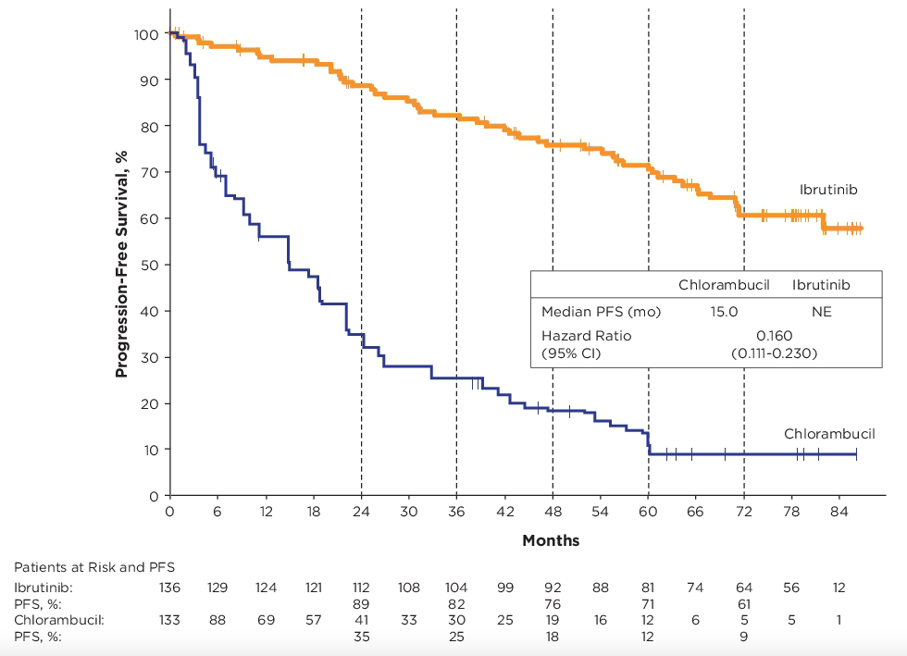
Up to 7 Years of Follow Up in the RESONATE-2 Study of Ibrutinib for Patients With TN CLL: Efficacy
Efficacy
Ibrutinib-treated patients had an 84% reduction in risk of progression or death
Ibrutinib led to a 97% reduction in risk of PD or death in patients with del(11q) and 80% for those without del(11q) vs chlorambucil
Ibrutinib led to an 89% and 80% reduction in risk of PD or death in patients with unmutated and mutated IGHV, respectively, vs chlorambucil
PFS: Ibrutinib vs Chlorambucil
PFS in Patient Subgroups of Interest
Overall discontinuation rate at 7 years = 53%
CLL, chronic lymphocytic leukemia; del, deletion; ECOG, Eastern Cooperative Oncology Group; IGHV, immunoglobulin heavy chain gene; NE, not evaluable; PD, progressive disease; PFS, progression-free survival; TN, treatment naïve; TP53, tumor protein p53.
Barr PB, et al. ASCO 2020. Abstract 7523.
Notes:
Barr PM, Owen C, Robak T, et al. Up to seven years of follow-up in the RESONATE-2 study of first-line ibrutinib treatment for patients with chronic lymphocytic leukemia. J Clin Oncol. 2021;39 (15)(suppl):7523. doi:10.1200/JCO.2021.39.15_suppl.7523

Slide 29
Long-Term Results From RESONATE-2:
AEs Are the Main Reason for Ibrutinib Discontinuation
53% discontinuation rate overall¹
 | First-Line Ibrutinib (N = 136)
Median duration of ibrutinib treatment, y (range) | 6.2 (0.06-7.2)
Continuing ibrutinib on study, n (%) | 64 (47)
Discontinued ibrutinib, n (%) AE PD Death Withdrawal by patient Investigator decision | 31 (23) 16 (12) 11 (8) 9 (7) 4 (3)
AEs, adverse events; PD, progressive disease.
1. Barr PM et al. ASCO 2021. Abstract 7523.
Notes:
Barr PM, Owen C, Robak T, et al. Up to seven years of follow-up in the RESONATE-2 study of first-line ibrutinib treatment for patients with chronic lymphocytic leukemia. J Clin Oncol. 2021;39 (15)(suppl):7523. doi:10.1200/JCO.2021.39.15_suppl.7523

Slide 30
Ibrutinib Discontinuation for Intolerance
Toxicities and outcomes of 616 ibrutinib-treated patients in the United States:
a real-world analysis
Reason for ibrutinib discontinuation | Ibrutinib in front-line (n=19) | Ibrutinib in relapse (n=231)
Toxicity | 63.1% (n=12) | 50.2% (n=116)
CLL progression | 15.8% (n=3) | 20.9% (n=49)
Other/unrelated death | 5.3% (n=1) | 12.1% (n=28)
Physician’s or patient’s preference | 10.5% (n=2) | 6.7% (n=15)
RT DLBCL | 5.3% (n=1) | 4.6% (n=10)
Stem cell transplantation/CAR T-cell | 0 | 3.3% (n=8)
Financial concerns | 0 | 0.8% (n=2)
Secondary malignancy | 0 | 0.8% (n=2)
RT Hodgkin lymphoma | 0 | 0.4% (n=1)
41% of patients discontinued ibrutinib at a median follow-up of 17 months
Toxicity accounted for the majority of discontinuations (over half) in both F/L and R/R CLL patients
Most common toxicities in R/R population:
  Atrial fibrillation 12.3%
  Infection 10.7%
  Pneumonitis 9.9%
  Bleeding 9%
  Diarrhea 6.6%
This study identified covalent BTK inhibitor intolerance as a major emerging issue in the field of CLL
BTK, Bruton tyrosine kinase; CAR T-cell, chimeric antigen receptor T-cell; CLL, chronic lymphocytic leukemia; DLBCL, diffuse large B-cell lymphoma; F/L, first line; R/R, relapsed/refractory; RT, Richter transformation.
Mato et al. Haematologica 2018;103:874-879.
Notes:
Mato AR, Nabhan C, Thompson MC, et al. Toxicities and outcomes of 616 ibrutinib-treated patients in the United States: a real-world analysis. Haematologica. 2018;103(5):874-879. doi:10.3324/haematol.2017.182907

Slide 31
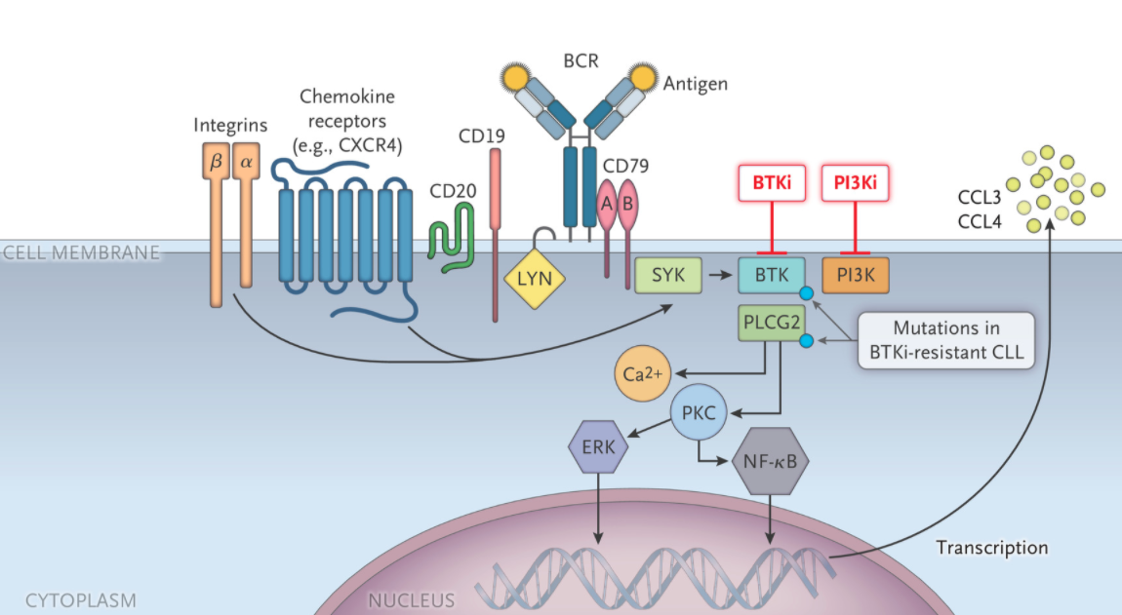
Acquired Resistance to Covalent BTKi¹⁻⁷
Majority of patients have identified mutations in BTKC481 at the time of disease progression on ibrutinib
  ~53-87% of patients
Mutations also identified in PLCG2, immediately downstream of BTK
BTKC481 mutations are also mechanism of resistance for acalabrutinib
  69% of patients
BTK, Bruton tyrosine kinase; BTKi, Bruton tyrosine kinase inhibitor; PLCG2, phospholipase C gamma 2.
1. Burger JA. N Engl J Med. 2020;383:460-473. 2. Woyach JA et al. N Engl J Med. 2014;370:2286-2294. 3. Woyach JA et al. J Clin Oncol. 2017;35:1437-1443. 4. Scarfo L et al. EHA 2020. Abstract S161. 5. Ahn IE et al. Blood. 2017;129:1469-1479. 6. Woyach J et al. ASH 2019. Abstract 504. 7. Burger J et al. Nat Commun. 2016; 7: 11589. Reproduced with permission of Woyach AJ et al in the format of electronic publication via Copyright Clearance Center.
Notes:
Burger JA. Treatment of chronic lymphocytic leukemia. N Engl J Med. 2020;383(5):460-473. doi:10.1056/NEJMra1908213
Woyach JA, Furman RR, Liu TM, et al. Resistance mechanisms for the Bruton's tyrosine kinase inhibitor ibrutinib. N Engl J Med. 2014;370(24):2286-2294. doi:10.1056/NEJMoa1400029
Woyach JA, Ruppert AS, Guinn D, et al. BTK^{C481S}-mediated resistance to ibrutinib in chronic lymphocytic leukemia. J Clin Oncol. 2017;35(13):1437-1443. doi:10.1200/JCO.2016.70.2282
Scarfo L, et al. BTK and PLCG2 Mutations in patients with chronic lymphocytic leukemia relapsing on ibrutinib: A European Research Initiative On CLL (ERIC) study based on real-world evidence. Abstract presented at: Annual Meeting of the European Hematology Association; June 12, 2020. Abstract S161. https://library.ehaweb.org/eha/2020/eha25th/294981/lydia.scarf.btk.and.plcg2.mutations.in.patients.with.chronic.lymphocytic.html?f=menu%3D6%2Abrowseby%3D8%2Asortby%3D2%2Ace_id%3D1766%2Amarker%3D756
Ahn IE, Underbayev C, Albitar A, et al. Clonal evolution leading to ibrutinib resistance in chronic lymphocytic leukemia. Blood. 2017;129(11):1469-1479. doi:10.1182/blood-2016-06-719294
Woyach JA, Huang Y, Rogers K, et al. Resistance to acalabrutinib in CLL is mediated primarily by BTK mutations. Blood. 2019;134(1)(suppl):504. doi:10.1182/blood-2019-127674
Burger JA, Landau DA, Taylor-Weiner A, et al. Clonal evolution in patients with chronic lymphocytic leukaemia developing resistance to BTK inhibition. Nat Commun. 2016;7:11589. Published 2016 May 20. doi:10.1038/ncomms11589

Slide 32
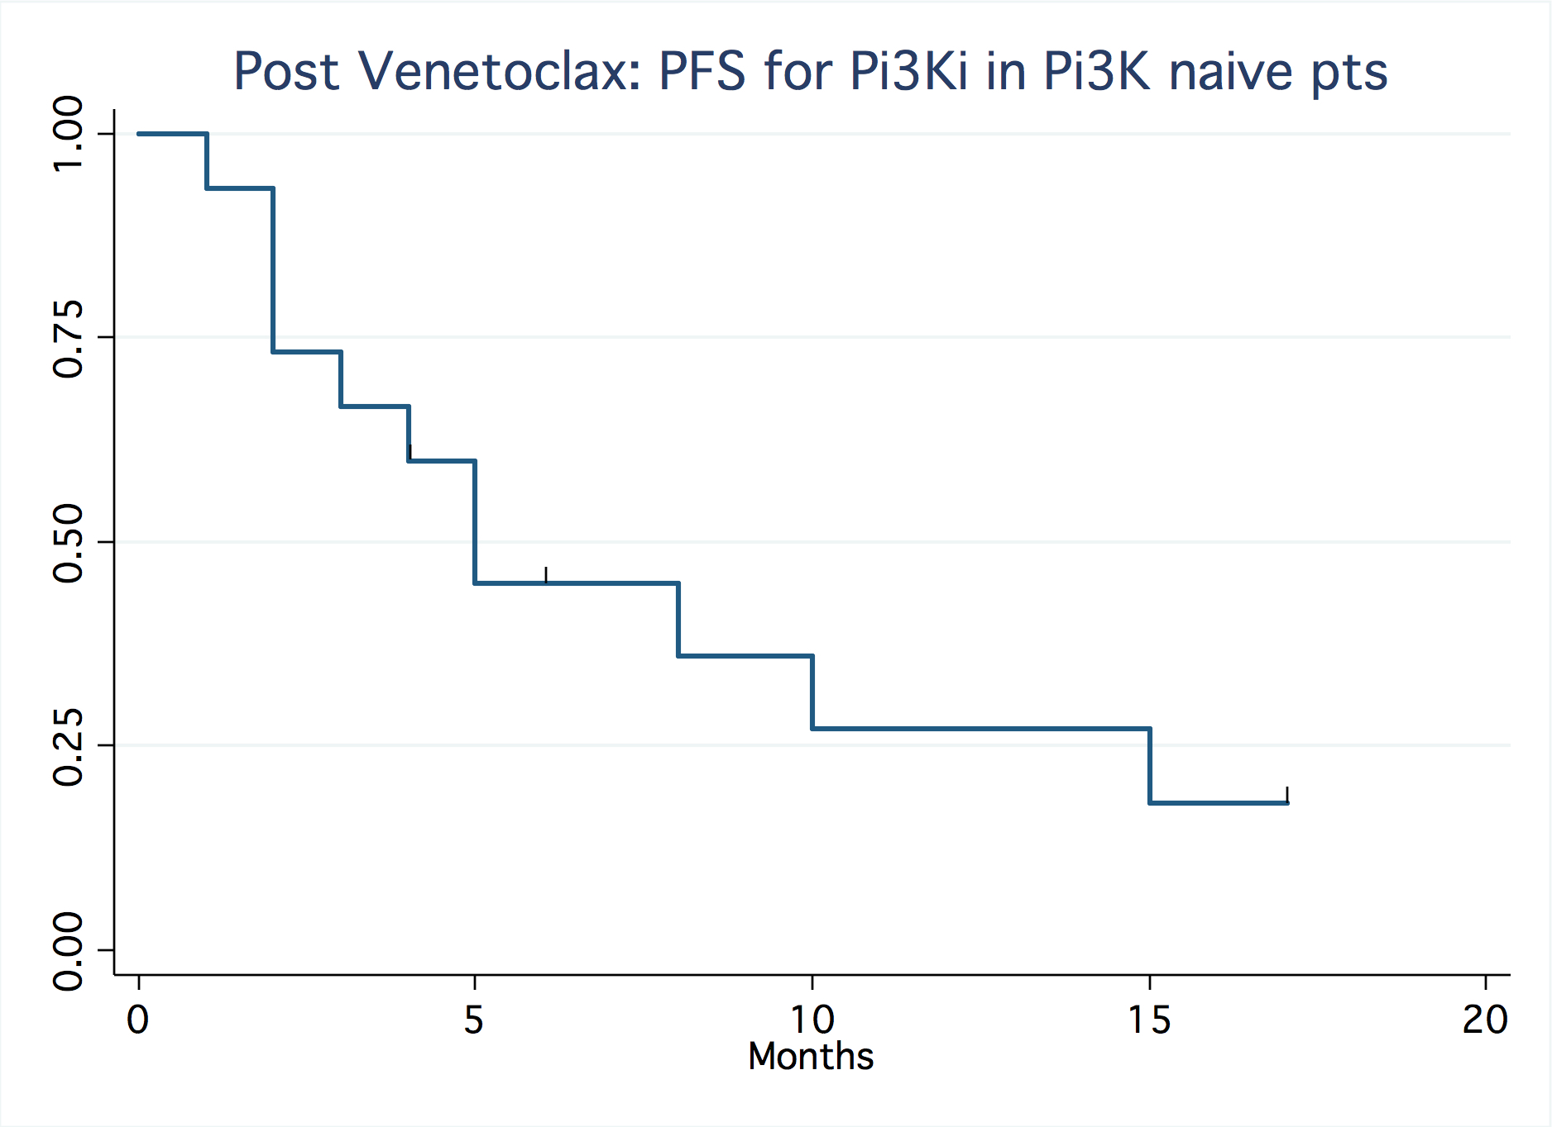
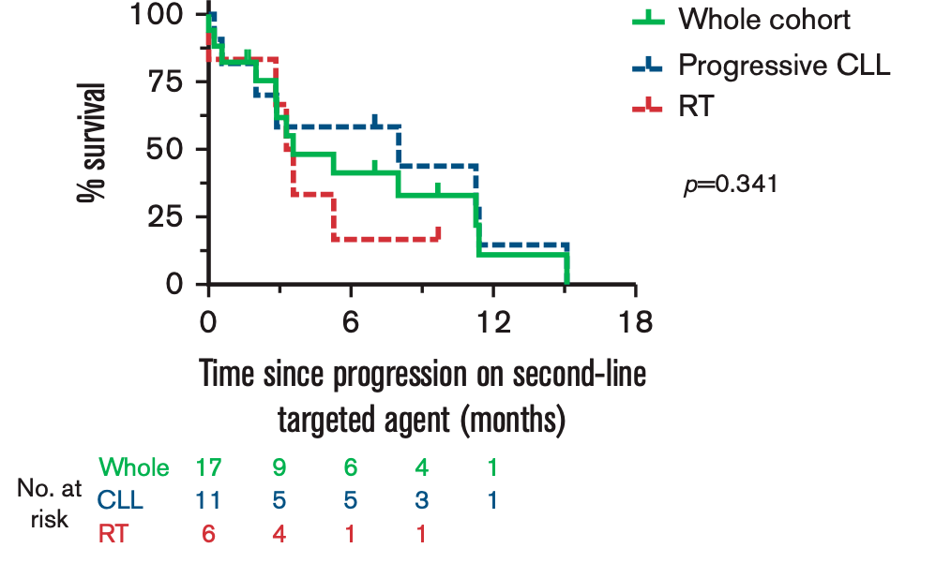
Outcomes of Patients with CLL Sequentially Resistant to Both BCL2 and BTK Inhibition
After BTKi → venetoclax: PI3Ki do not result in durable remissions and therefore is not an acceptable SOC in the 3rd line setting in modern era
Post Venetoclax: PFS for PI3Ki
in PI3K naïve pts
Double Refractory Pts
Median PFS = 4 months¹
Median OS = 3.6 months²
BCL 2, B-cell lymphoma 2; BTK, Bruton’s tyrosine kinase; CLL, chronic lymphocytic leukemia; i, inhibitor; OS, overall survival; PFS, progression-free survival; PI3K, phosphoinositide 3-kinase; RT, Richter transformation; SOC, standard of care.
1. Mato AR et al. Clin Cancer Res. 2020;26:3589-3596. 2. Lew TE et al. Blood Adv. 2021;5:4054-4058.
Notes:
Mato AR, Roeker LE, Jacobs R, et al. Assessment of the Efficacy of Therapies Following Venetoclax Discontinuation in CLL Reveals BTK Inhibition as an Effective Strategy. Clin Cancer Res. 2020;26(14):3589-3596. doi:10.1158/1078-0432.CCR-19-3815
Lew TE, Lin VS, Cliff ER, et al. Outcomes of patients with CLL sequentially resistant to both BCL2 and BTK inhibition. Blood Adv. 2021;5(20):4054-4058. doi:10.1182/bloodadvances.2021005083

Slide 33
Resistance and Intolerance Limit Outcomes
With Covalent BTK Inhibitors in CLL
Ibrutinib Discontinuation Over
Four Prospective Studies¹
Ibrutinib-Acquired Resistance in
Patients With Progressive CLL²
Other event
Transformation
CLL progression
PLCG2
mutants
8%
Other events: 25%
BTK and
PLCG2 mutants
16%
BTK mutants
56%
Cumulative Incidence of Discontinuation of Ibrutinib Therapy
BTK and PLCG2
not identified
20%
Progression: 19%
BTK C481 mutations are the dominant reasons for progressive CLL after covalent BTK inhibitors¹⁻⁸
BTK C481 mutations prevent covalent BTK inhibitors from effective target inhibition¹⁻⁶
Time, y
No. at Risk | 308 | 274 | 247 | 226 | 206 | 179 | 118 | 90 | 64 | 40 | 24 | 5 | 0
BTK, Bruton tyrosine kinase; CLL, chronic lymphocytic leukemia; PLCG2, phospholipase C gamma 2.
1. Woyach JA et al. J Clin Oncol. 2017;35;1437-1443. 2. Lampson BL, Brown JR. Expert Rev Hematol. 2018;11:185-194. 3. Burger JA et al. Leukemia. 2020;34:787-798. 4. Byrd JC et al. N Engl J Med. 2016;374:323-332. 5. Hershkovitz-Rokah O et al. Br J Haematol. 2018;181:306-319. 6. Woyach JA et al. N Engl J Med. 2014;370:2286-2294. 7. Woyach JA et al. Blood. 2019;134(suppl 1):504. 8. Xu L et al. Blood. 2017;129:2519-2525.
Notes:
Woyach JA, Ruppert AS, Guinn D, et al. BTK^{C481S}-mediated resistance to ibrutinib in chronic lymphocytic leukemia. J Clin Oncol. 2017;35(13):1437-1443. doi:10.1200/JCO.2016.70.2282
Lampson BL, Brown JR. Are BTK and PLCG2 mutations necessary and sufficient for ibrutinib resistance in chronic lymphocytic leukemia?. Expert Rev Hematol. 2018;11(3):185-194. doi:10.1080/17474086.2018.1435268
Burger JA, Barr PM, Robak T, et al. Long-term efficacy and safety of first-line ibrutinib treatment for patients with CLL/SLL: 5 years of follow-up from the phase 3 RESONATE-2 study. Leukemia. 2020;34(3):787-798. doi:10.1038/s41375-019-0602-x
Byrd JC, Harrington B, O'Brien S, et al. Acalabrutinib (ACP-196) in relapsed chronic lymphocytic leukemia. N Engl J Med. 2016;374(4):323-332. doi:10.1056/NEJMoa1509981
Hershkovitz-Rokah O, Pulver D, Lenz G, Shpilberg O. Ibrutinib resistance in mantle cell lymphoma: clinical, molecular and treatment aspects. Br J Haematol. 2018;181(3):306-319. doi:10.1111/bjh.15108
Woyach JA, Furman RR, Liu TM, et al. Resistance mechanisms for the Bruton's tyrosine kinase inhibitor ibrutinib. N Engl J Med. 2014;370(24):2286-2294. doi:10.1056/NEJMoa1400029
Woyach JA, Huang Y, Rogers K, et al. Resistance to acalabrutinib in CLL is mediated primarily by BTK mutations. Blood. 2019;134(1)(suppl):504. doi:10.1182/blood-2019-127674
Xu L, Tsakmaklis N, Yang G, et al. Acquired mutations associated with ibrutinib resistance in Waldenström macroglobulinemia. Blood. 2017;129(18):2519-2525. doi:10.1182/blood-2017-01-761726

Slide 34
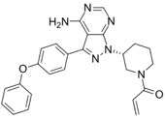
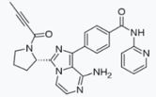
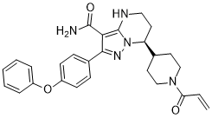

Acquired Resistance to Covalent BTK Inhibitors Is Generally Driven by Mutations in BTK at the C481 Site
BTK C481 mutations also confer resistance to the covalent BTKi acalabrutinib and zanubrutinib
Ibrutinib
Acalabrutinib
Zanubrutinib
Y223
C481
Y551
PH
TH
SH3
SH2
Kinase
Structure of the Bruton tyrosine kinase
K430
M477
D539
E475
Y476
In sum, BTK resistance contributes to disease progression
and diminishes the efficacy of all covalent BTK inhibitors¹⁻⁸
BTKi, Bruton tyrosine kinase inhibitor; PH, pleckstrin homology domain; TH, TEC homology domain; SH, SRC homology domain.
1. Woyach JA et al. J Clin Oncol. 2017;35;1437-1443. 2. Lampson BL, Brown JR. Expert Rev Hematol. 2018;11:185-194. 3. Burger JA et al. Leukemia. 2020;34:787-798. 4. Byrd JC et al. N Engl J Med. 2016;374:323-332. 5. Hershkovitz-Rokah O et al. Br J Haematol. 2018;181:306-319. 6. Woyach JA et al. N Engl J Med. 2014;370:2286-2294. 7. Woyach JA et al. Blood. 2019;134(suppl 1):504. 8. Xu L et al. Blood. 2017;129:2519-2525.
Notes:
Woyach JA, Ruppert AS, Guinn D, et al. BTK^{C481S}-mediated resistance to ibrutinib in chronic lymphocytic leukemia. J Clin Oncol. 2017;35(13):1437-1443. doi:10.1200/JCO.2016.70.2282
Lampson BL, Brown JR. Are BTK and PLCG2 mutations necessary and sufficient for ibrutinib resistance in chronic lymphocytic leukemia?. Expert Rev Hematol. 2018;11(3):185-194. doi:10.1080/17474086.2018.1435268
Burger JA, Barr PM, Robak T, et al. Long-term efficacy and safety of first-line ibrutinib treatment for patients with CLL/SLL: 5 years of follow-up from the phase 3 RESONATE-2 study. Leukemia. 2020;34(3):787-798. doi:10.1038/s41375-019-0602-x
Byrd JC, Harrington B, O'Brien S, et al. Acalabrutinib (ACP-196) in relapsed chronic lymphocytic leukemia. N Engl J Med. 2016;374(4):323-332. doi:10.1056/NEJMoa1509981
Hershkovitz-Rokah O, Pulver D, Lenz G, Shpilberg O. Ibrutinib resistance in mantle cell lymphoma: clinical, molecular and treatment aspects. Br J Haematol. 2018;181(3):306-319. doi:10.1111/bjh.15108
Woyach JA, Furman RR, Liu TM, et al. Resistance mechanisms for the Bruton's tyrosine kinase inhibitor ibrutinib. N Engl J Med. 2014;370(24):2286-2294. doi:10.1056/NEJMoa1400029
Woyach JA, Huang Y, Rogers K, et al. Resistance to acalabrutinib in CLL is mediated primarily by BTK mutations. Blood. 2019;134(1)(suppl):504. doi:10.1182/blood-2019-127674
Xu L, Tsakmaklis N, Yang G, et al. Acquired mutations associated with ibrutinib resistance in Waldenström macroglobulinemia. Blood. 2017;129(18):2519-2525. doi:10.1182/blood-2017-01-761726

Slide 35
BTKi Resistance and Intolerance:
What Are the Options?

Slide 36
Sequential Use of Acalabrutinib in Patients With Ibrutinib Intolerance Is an Effective and Safe Option¹
AE | No. of Patients With Ibrutinib Intoleranceª | Acalabrutinib Experience for Same Patients, n
 |  | Total | Lower Grade | Same Grade | Higher Grade
AF | 16^{b} | 2 | 2 | 0 | 0
Diarrhea | 7 | 5 | 3 | 2 | 0
Rash | 7 | 3 | 3 | 0 | 0
Bleeding^{c,d} | 6 | 5 | 3 | 2 | 0
Arthralgia | 7e | 2 | 1 | 1 | 0
Total | 41 | 24 | 18 | 6 | 1
AE, adverse event; AF, atrial fibrillation.
ª Among 60 patients meeting the study enrollment criteria, 41 patients had a medical history of ≥1 (43 events in total) of the following categories of ibrutinib-intolerance events: AF, diarrhea, rash, bleeding, or arthralgia. ^{b} Includes patients with atrial flutter (n = 2). ^{c} Events categorized as bleeding included ecchymosis, hemorrhage, epistaxis, contusion, hematuria, and subdural hematoma. ^{d} All but 1 patient experienced a different type of bleeding event with acalabrutinib compared with ibrutinib treatment. ^{e} Includes 1 patient with arthritis.
1. Rogers KA et al. Haematologica. 2021;106:2364-2373.
Notes:
Rogers KA, Thompson PA, Allan JN, et al. Phase II study of acalabrutinib in ibrutinib-intolerant patients with relapsed/refractory chronic lymphocytic leukemia. Haematologica. 2021;106(9):2364-2373. doi:10.3324/haematol.2020.272500

Slide 37
Similarly, Zanubrutinib Is Effective in the Setting of BTK Inhibitor Intolerance
Prior evidence has shown that zanubrutinib was effective in B-cell cancer patients intolerant of ibrutinib or acalabrutinib¹
For example, of 87 ibrutinib-intolerant events, 72 intolerant events (83%) did not recur
ASH 2022: zanubrutinib in acalabrutinib-intolerant patients with B-cell malignancies²
Disease was controlled in 13 (93%) of 14 efficacy-evaluable patients treated with zanubrutinib, and 11 (65%) did not experience any recurrence of prior intolerance events
ASH, American Society of Hematology; BTK, Bruton’s tyrosine kinase.
ª No intolerance AEs recurred at a higher grade.
1. Shadman M et al. ASCO 2021. Abstract e19506. 2. Shadman M et al. ASH 2022. Abstract 1587.
Notes:
Shadman M, Sharman JP, Levy MY, et al. Preliminary results of the phase 2 study of zanubrutinib in patients with previously treated B-cell malignancies intolerant to ibrutinib and/or acalabrutinib. J Clin Oncol. 2021;39(15)(suppl): e19506. doi:10.1200/JCO.2021.39.15_suppl.e19506
Shadman M, Flinn IW, Kingsley EC, et al. Zanubrutinib in acalabrutinib-intolerant patients (pts) with B-cell malignancies. Abstract presented at: Annual Meeting of the American Society of Hematology; December 10, 2022; New Orleans, LA. Abstract 1587. https://ash.confex.com/ash/2022/webprogram/Paper159726.html

Slide 38
What Strategies Can We Use
Against BTK Inhibitor Resistance in CLL?
Supported by Current Evidence
Venetoclax: efficacious, but complicated administration and not appropriate for all patients Noncovalent BTK inhibitors: initial evidence suggests potent efficacy against resistance mutations and in the setting of progressive disease
Limited Evidence
PI3K inhibitors: limited benefit in this population and significant toxicity burden Chemoimmunotherapy: limited benefit in this population, and most current patients have already received these regimens
Not Appropriate
Covalent BTK inhibitor retreatment: only effective in the context of covalent BTK intolerance, not progression
BTK, Bruton’s tyrosine kinase; PI3K, phosphoinositide 3-kinases.
Notes:
Treatment Sequencing and Overcoming BTKi Resistance: Venetoclax

Slide 39
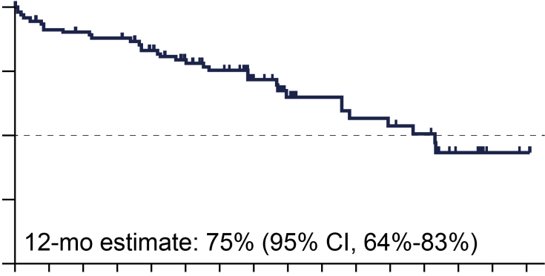
Venetoclax Is an Active Approach in
Ibrutinib-Refractory CLL/SLL^{1,2}
100
Progression-Free Survival
N = 91
Median of 4 prior therapies
47% with del(17p)
ORR: 70%
ORR of 61% (28 of
46 patients) in the del(17p) or TP53-mutated subset
75
Patients Without Progression, %
50
25
Median PFS was 24.7 months
12-mo estimate: 75% (95% CI, 64-83)
0
0
2
4
6
8
10
12
14
16
18
20
22
24
26
28
30
No. at Risk | 91 | 81 | 79 | 77 | 70 | 61 | 53 | 36 | 28 | 23 | 20 | 18 | 16 | 7 | 4 | 3
No. Censored | 0 | 2 | 3 | 3 | 6 | 12 | 17 | 32 | 37 | 42 | 42 | 42 | 44 | 51 | 55 | 56
Del, deletion; CLL, chronic lymphocytic leukemia; ORR, overall response rate; PFS, progression-free survival; SLL, small lymphocytic lymphoma, TP53, tumor protein 53.
1. Kater AP et al. ASH 2020. Abstract 125. 2. Jones JA et al. Lancet Oncol. 2018;19:65-75.
Notes:
Kater AP, Kipps TJ, Eichhorst﻿, et al. Five-year analysis of murano study demonstrates enduring undetectable minimal residual disease (uMRD) in a subset of relapsed/refractory chronic lymphocytic leukemia (R/R CLL) patients (Pts) following fixed-duration venetoclax-rituximab (VenR) therapy (Tx). Abstract presented at: Annual Meeting of the American Society of Hematology; December 5, 2020. Abstract 125. https://ash.confex.com/ash/2020/webprogram/Paper136109.html
Jones JA, Mato AR, Wierda WG, et al. Venetoclax for chronic lymphocytic leukaemia progressing after ibrutinib: an interim analysis of a multicentre, open-label, phase 2 trial. Lancet Oncol. 2018;19(1):65-75. doi:10.1016/S1470-2045(17)30909-9

Slide 40
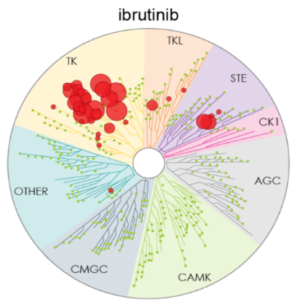



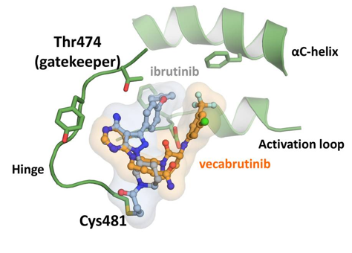
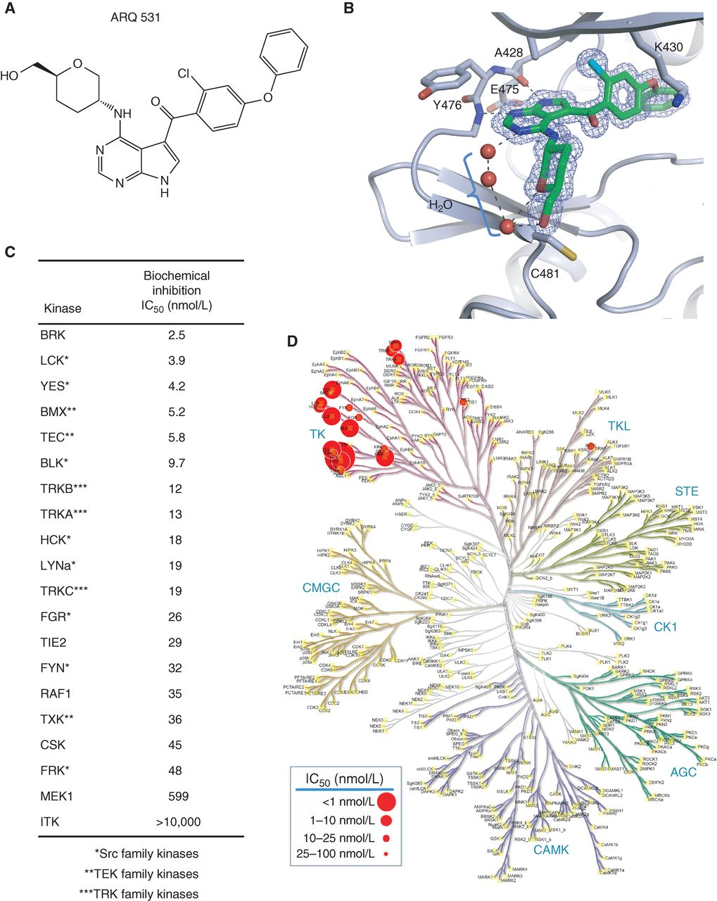
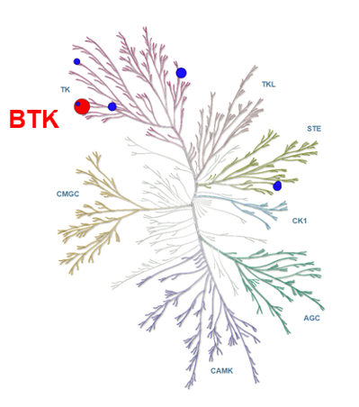
Several BTKi Options to Consider With Differences in BTKi Specificity, MOA, and Potential for Off-target Effects
Irreversible
Ibrutinib
Acalabrutinib
Zanubrutinib
Reversible
Vecabrutinib
Nemtabrutinib/ARQ-531
Pirtobrutinib/LOXO-305
BTKi, Bruton tyrosine kinase inhibitor; MOA, mechanism of action.
Kaptein A et al. Blood. 2018;132(suppl 1):1871. Reproduced with permission of Tkaptein A et al in the format of electronic publication via Copyright Clearance Center.
Notes:
Kaptein A, de Bruin G, Emmelot-van Hoek M et al. Potency and Selectivity of BTK Inhibitors in Clinical Development for B-Cell Malignancies. Blood 2018;132(suppl 1):1871.

Slide 41
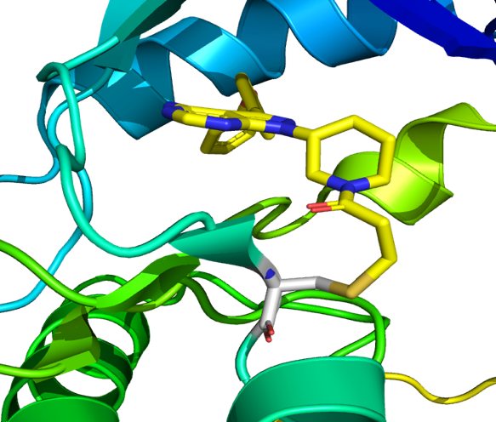
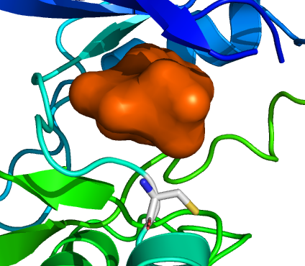
How Noncovalent BTK Inhibitors Overcome Resistance
Covalent BTK Inhibitors (Ibrutinib, Acalabrutinib,
and Zanubrutinib) Require WT BTK for Activity¹
Pirtobrutinib Is a Noncovalent BTK Inhibitor That Is Potent Against Both WT and C481-Mutated BTK²
Ibrutinib
BTK inhibition,
regardless of BTK mutation
Pirtobrutinib
C481
Covalently
bound to C481
C481
Does not require C481 to bind to the kinase domain
BTK, Bruton tyrosine kinase; WT, wild type.
1. Wang E et al. N Engl J Med. 2022;386:735-743. 2. Aslan B et al. Blood Cancer J. 2022;12:80. Reproduced with permission of Wang E et al in the format of electronic publication via Copyright Clearance Center.
Notes:
Wang E, Mi X, Thompson MC, et al. Mechanisms of Resistance to Noncovalent Bruton's Tyrosine Kinase Inhibitors. N Engl J Med. 2022;386(8):735-743. doi:10.1056/NEJMoa2114110
Aslan B, Kismali G, Iles LR, et al. Pirtobrutinib inhibits wild-type and mutant Bruton's tyrosine kinase-mediated signaling in chronic lymphocytic leukemia. Blood Cancer J. 2022;12(5):80. doi:10.1038/s41408-022-00675-9

Slide 42
Efficacy of Pirtobrutinib in Covalent BTK-Inhibitor Pre-Treated Relapsed/Refractory CLL/SLL: Additional Patients and Extended Follow-up from the Phase 1/2 BRUIN Study
Anthony R. Mato¹, Jennifer A. Woyach², Jennifer R. Brown³, Paolo Ghia⁴, Krish Patel ⁵, Toby A. Eyre⁶, Talha Munir⁷, Ewa Lech-Maranda⁸, Nicole Lamanna⁹, Constantine S. Tam¹⁰, Nirav N. Shah¹¹, Catherine C. Coombs¹², Chaitra S. Ujjani¹³, Manish R. Patel¹⁴, Bita Fakhri¹⁵, Chan Y. Cheah¹⁶, Alvaro J. Alencar¹⁷, Jonathon B. Cohen¹⁸, James N. Gerson¹⁹, Ian W. Flinn²⁰, Shuo Ma²¹, Deepa Jagadeesh²², Joanna M. Rhodes²³, Francisco Hernandez-Ilizaliturri²⁴, John F. Seymour¹⁰, Pier Luigi Zinzani²⁵, Minna Balbas²⁶, Binoj Nair²⁶, Paolo Abada²⁶, Chunxiao Wang²⁷, Amy S. Ruppert²⁷, Denise Wang²⁶, Donald E. Tsai²⁶, William G. Wierda²⁸, Wojciech Jurczak²⁹
¹Memorial Sloan Kettering Cancer Center, New York, USA; ²The Ohio State University Comprehensive Cancer Center, Columbus, USA; ³Dana-Farber Cancer Institute and Harvard Medical School, Boston, USA; ⁴Università Vita-Salute San Raffaele and IRCCS Ospedale San Raffaele, Milan, Italy; ⁵Center for Blood Disorders and Cellular Therapy, Swedish Cancer Institute, Seattle, USA; ⁶Oxford University Hospitals NHS Foundation Trust, Churchill Cancer Center, Oxford, UK; ⁷Department of Haematology, St. James's University Hospital, Leeds, UK; ⁸Institute of Hematology and Transfusion Medicine, Warsaw, Poland; ⁹Herbert Irving Comprehensive Cancer Center, Columbia University, New York, USA; ¹⁰Peter MacCallum Cancer Centre and the University of Melbourne, Melbourne, Australia; ¹¹Medical College of Wisconsin, Milwaukee, USA; ¹²University of North Carolina at Chapel Hill, Chapel Hill, USA; ¹³Fred Hutchinson Cancer Center, University of Washington, Seattle, USA; ¹⁴Florida Cancer Specialists/Sarah Cannon Research Institute, Sarasota, USA; ¹⁵University of California San Francisco, San Francisco, USA; ¹⁶Linear Clinical Research and Sir Charles Gairdner Hospital, Perth, Australia; ¹⁷University of Miami Miller School of Medicine, Miami, USA; ¹⁸Winship Cancer Institute, Emory University, Atlanta, USA; ¹⁹Lymphoma Program, Abramson Cancer Center, University of Pennsylvania, USA; ²⁰Sarah Cannon Research Institute/Tennessee Oncology, Nashville, USA; ²¹Robert H. Lurie Comprehensive Cancer Center, Division of Hematology-Oncology, Northwestern University Feinberg School of Medicine, Chicago USA; ²²Cleveland Clinic, Cleveland, USA; ²³Northwell Health Cancer Institute, Donald and Barbara Zucker School of Medicine at Hofstra/Northwell Health, New Hyde Park, USA; ²⁴Lymphoma Section, Department of Medical Oncology, Roswell Park Comprehensive Cancer Center, Buffalo, USAY; ²⁵Institute of Hematology Seràgnoli, University of Bologna, Bologna, Italy; ²⁶Loxo@Lilly, Indianapolis, USA; ²⁷Eli Lilly and Company, Indianapolis, USA; ²⁸MD Anderson Cancer Center, Houston, USA; ²⁹Maria Sklodowska-Curie National Research Institute of Oncology, Krakow, Poland
Mato AR et al. Blood (2022) 140 (Supplement 1): 2316–2320.
Notes:
Mato AR, Woyach JA, Brown JR, et al. Efficacy of pirtobrutinib in covalent BTK-inhibitor pre-treated relapsed / refractory CLL/SLL: Additional patients and extended follow-up from the phase 1/2 BRUIN study. Blood. 2022;140 (1)(suppl):2316-2320. doi:10.1182/blood-2022-159497

Slide 43
Pirtobrutinib in Covalent BTK-Inhibitor Pre-Treated R/R CLL/SLL
Phase 1/2 BRUIN Study: Design, Eligibility and Enrollment
Phase 1 3+3 design
Phase 1 Escalation + Expansion (25 to 300 mg QD)
Phase 2 (200 mg QD)
N=773
28-day cycles
Intra-patient dose escalation allowed
Cohort expansion permitted at doses deemed safe
CLL/SLL
n=317
MCL
n=166
Other^{b}
n=290
Eligibility
Age ≥18
ECOG PS 0-2
Active disease and in need of treatment
Previously treated
Safety population
Prior BTKi
n=282
BTKi Naïve
n=35
Key endpoints
Safety/tolerability
Determine MTD and recommended phase 2 dose
Pharmacokinetics
Efficacy according to ORR and DOR (iwCLL) as assessed by IRC
Enrolled after
5 November 2021
Supplemental Cohort
n=35
Primary efficacy populationª
Enrolled in phase 1 or 2
Treated with prior BTK inhibitor containing regimen
Received one or more doses of pirtobrutinib monotherapy
Primary Efficacy population
Prior BTKiª
n=247
BTK, Bruton’s tyrosine kinase; BTKi, Bruton tyrosine kinase inhibitor; ECOG PS, Eastern Cooperative Oncology Group Performance Status; BTKi, Bruton’s tyrosine kinase inhibitor; CLL, chronic lymphocytic leukemia; DOR, duration of response; IRC, institutional review committee; iwCLL, International Workshop on Chronic Lymphocytic Leukemia; MCL, mantle cell lymphoma; MTD, maximum tolerated dose; ORR, objective response rate; SLL, small lymphocyctic lymphoma.
Mato AR et al. Blood (2022) 140 (Supplement 1): 2316–2320.
Notes:
Mato AR, Woyach JA, Brown JR, et al. Efficacy of pirtobrutinib in covalent BTK-inhibitor pre-treated relapsed / refractory CLL/SLL: Additional patients and extended follow-up from the phase 1/2 BRUIN study. Blood. 2022;140 (1)(suppl):2316-2320. doi:10.1182/blood-2022-159497

Slide 44
Phase 1/2 BRUIN Study: CLL/SLL Patient Characteristics
Characteristics | n=247
Median age, years (range) | 69 (36-88)
Male, n (%) | 168 (68)
Histology CLL SLL | 246 (>99) 1 (<1)
Rai stagingª 0-II III-IV | 131 (53) 102 (41)
Bulky Disease ≥5 cm, n (%) | 78 (32)
ECOG PS, n (%) 0 1 2 | 133 (54) 97 (39) 17 (7)
Median number of prior lines of systemic therapy, n (range) | 3 (1-11)
Prior therapy, n (%) BTK inhibitor Anti-CD20 antibody Chemotherapy BCL2 inhibitor PI3K inhibitor CAR-T Allogeneic stem cell transplant | 247 (100) 217 (88) 195 (79) 100 (41) 45 (18) 14 (6) 6 (2)
Median time from diagnosis to first dose, years (IQR) | 11 (8-15)
Baseline Molecular Characteristics^{b}
Mutation status, n/n available (%) BTK C481-mutant BTK C481-wildtype PLCG2-mutant PLCG2-wildtype | 84/222 (38) 138/222 (62) 18/222 (8) 204/222 (92)
High Risk Molecular Features, n/n available (%) 17p deletion TP53 mutation 17p deletion and/or TP53 mutation Both 17p deletion and TP53 mutation IGHV unmutated Complex Karyotype 11q deletion | 51/176 (29) 87/222 (39) 90/193 (47) 48/170 (28) 168/198 (85) 24/57 (42) 44/176 (25)
Reason for prior BTKi discontinuation^{c}, n (%)
Progressive disease Toxicity/Other | 190 (77) 57 (23)
Data cutoff date of 29 July 2022. ª14 patients had missing data for Rai staging data. ^{b}Molecular characteristics were determined centrally and are presented based on data availability, in those patients with sufficient sample to pass assay quality control. ^{c}In the event more than one reason was noted for discontinuation, disease progression took priority.
BCL-2, B cell lymphoma-2; BTK, Bruton tyrosine kinase; BTKi, Bruton tyrosine kinase inhibitor; CAR-T, chimeric antigen receptor-T-cell therapy; CLL, chronic lymphocytic leukemia; ECOG PS, Eastern Cooperative Oncology Group performance status; IGHV, immunoglobulin heavy chain gene; IQR, interquartile range; PI3K, phosphoinositide-3-kinase; PLCG2, phospholipase C gamma 2; SLL, small lymphocytic lymphoma; TP53, tumor protein p53.
Mato AR et al. Blood (2022) 140 (Supplement 1): 2316–2320.
Notes:
Mato AR, Woyach JA, Brown JR, et al. Efficacy of pirtobrutinib in covalent BTK-inhibitor pre-treated relapsed / refractory CLL/SLL: Additional patients and extended follow-up from the phase 1/2 BRUIN study. Blood. 2022;140 (1)(suppl):2316-2320. doi:10.1182/blood-2022-159497

Slide 45
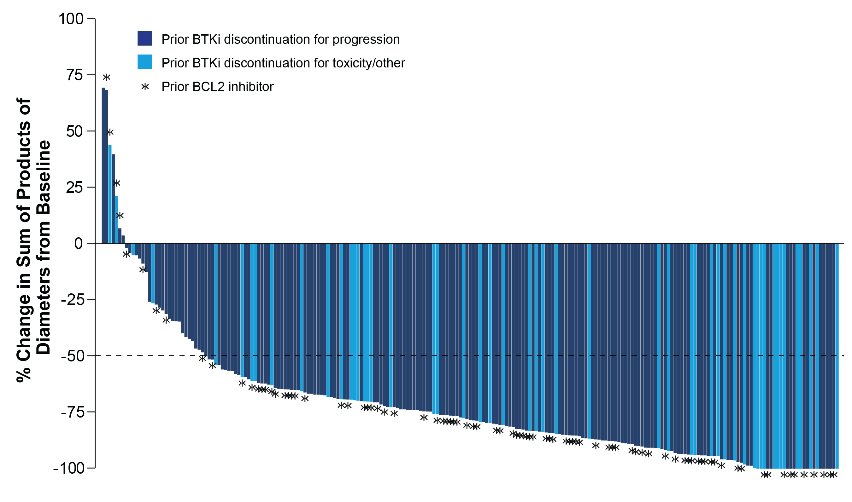
Phase 1/2 BRUIN Study: Pirtobrutinib Efficacy in CLL/SLL Patients who Received Prior BTKi Treatment
 | Prior BTKi n=247 | Prior BTKi+BCL2i n=100
Overall Response Rate, % (95% CI)ª | 82.2 (76.8-86.7) | 79.0 (69.7-86.5)
Best Response
CR, n (%) | 4 (1.6) | 0 (0.0)
PR, n (%) | 177 (71.7) | 70 (70.0)
PR-L, n (%) | 22 (8.9) | 9 (9.0)
SD, n (%) | 26 (10.5) | 11 (11.0)
Data cutoff date of 29 July 2022. Data for 24 patients are not shown in the waterfall plot due to no measurable target lesions identified by CT at baseline, discontinuation prior to first response assessment, or lack of adequate imaging in follow-up. ªORR includes patients with a best response of CR, PR, and PR-L. Response status per iwCLL 2018 according to independent review committee assessment.
BCL-2, B cell lymphoma-2; BTKi, Bruton tyrosine kinase inhibitor; CLL, chronic lymphocytic leukemia; CR, complete response; PR, partial response; PR-L, partial response with rebound lymphocytosis; SD, stable disease; SLL, small lymphocytic lymphoma.
Mato AR et al. Blood (2022) 140 (Supplement 1): 2316–2320.
Notes:
Mato AR, Woyach JA, Brown JR, et al. Efficacy of pirtobrutinib in covalent BTK-inhibitor pre-treated relapsed / refractory CLL/SLL: Additional patients and extended follow-up from the phase 1/2 BRUIN study. Blood. 2022;140 (1)(suppl):2316-2320. doi:10.1182/blood-2022-159497

Slide 46
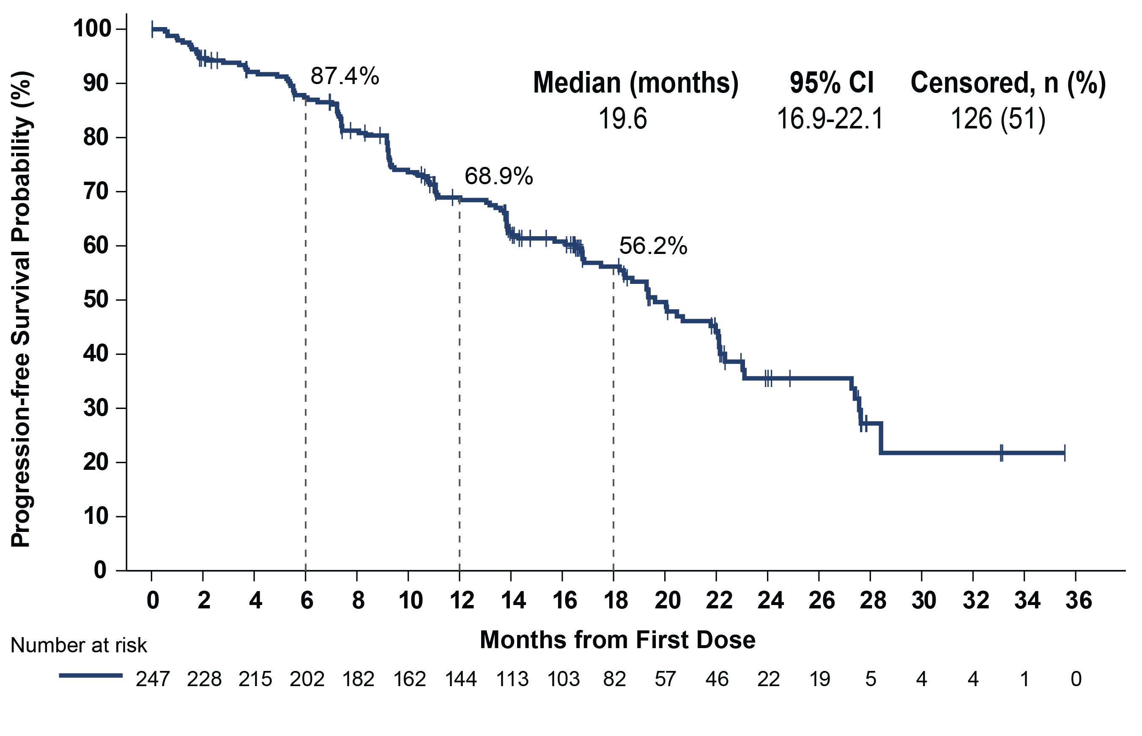
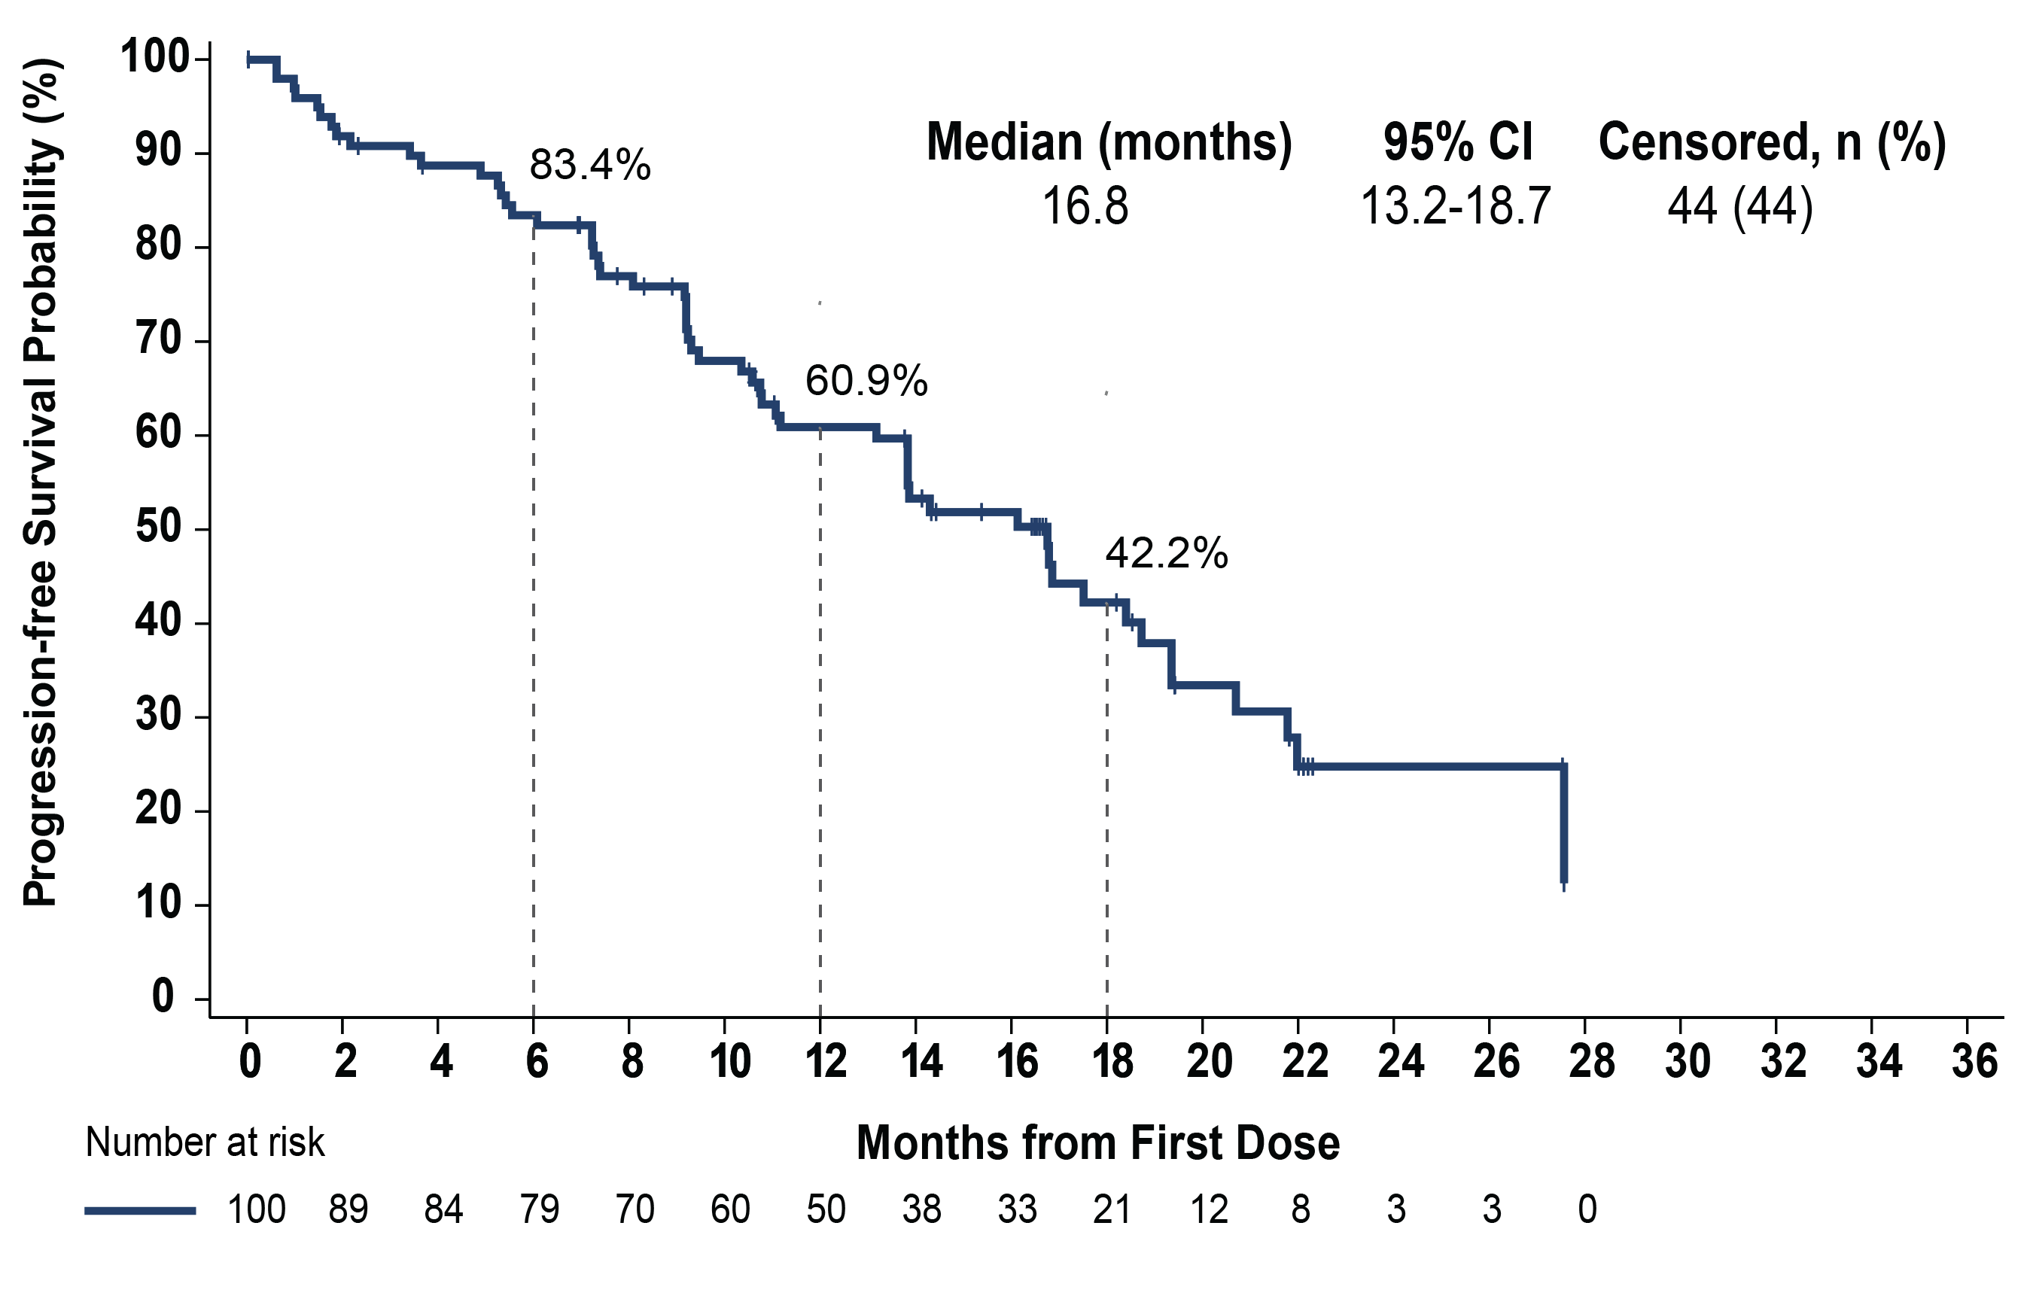
Phase 1/2 BRUIN Study: Progression-Free Survival in CLL/SLL Patients who Received Prior BTKi Treatment
All prior BTKi patients
Median prior lines = 3
Prior BTKi and BCL2i patients
Median prior lines = 5
Median follow-up of 19.4 months for patients who received prior BTKi
Median follow-up of 18.2 months for patients who received prior BTKi and BCL2i
Data cutoff date of 29 July 2022. Response status per iwCLL 2018 according to independent review committee assessment.
BCL-2i, B cell lymphoma-2 inhibitor; BTKi, Bruton’s tyrosine kinase inhibitor; CLL, chronic lymphocytic leukemia; iwCLL, International Workshop on Chronic Lymphocytic Leukemia; SLL, small lymphocytic lymphoma.
Mato AR et al. Blood (2022) 140 (Supplement 1): 2316–2320.
Notes:
Mato AR, Woyach JA, Brown JR, et al. Efficacy of pirtobrutinib in covalent BTK-inhibitor pre-treated relapsed / refractory CLL/SLL: Additional patients and extended follow-up from the phase 1/2 BRUIN study. Blood. 2022;140 (1)(suppl):2316-2320. doi:10.1182/blood-2022-159497

Slide 47
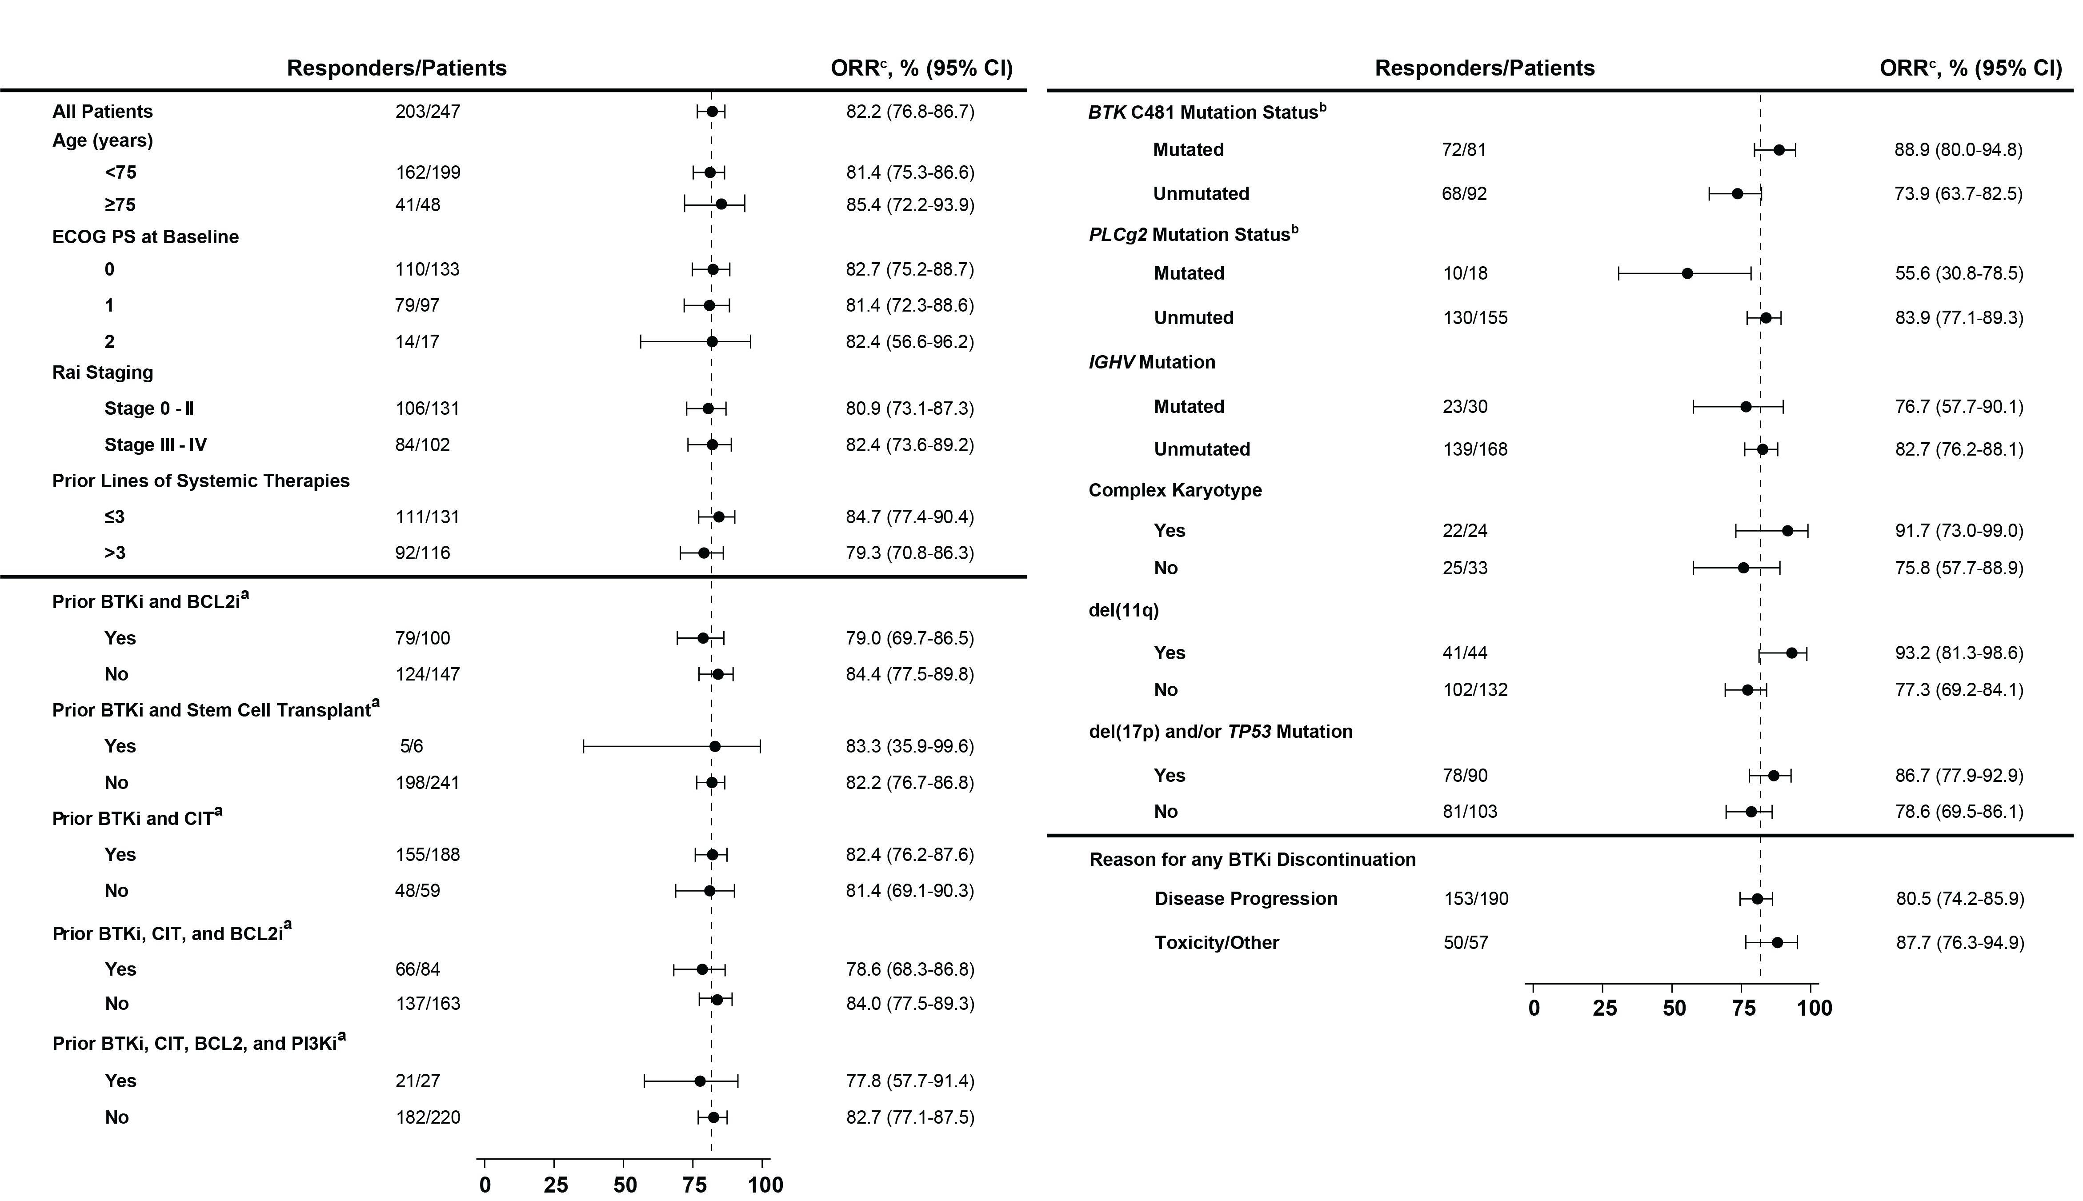
Phase 1/2 BRUIN Study: Overall Response Rate in CLL/SLL Subgroups
Data cutoff date of 29 July 2022. ªPrior therapy labels indicate that patients received at least the prior therapy, rows are not mutually exclusive. ^{b}Patients with available mutation data who progressed on any prior BTKi. ^{c}Response includes partial response with lymphocytosis. Response status per iwCLL 2018 according to independent review committee assessment.
BCL-2i, B cell lymphoma-2 inhibitor; BTKi, Bruton tyrosine kinase inhibitor; CIT, chemoimmunotherapy; CLL, chronic lymphocytic leukemia; del, deletion; ECOG PS, Eastern Cooperative Oncology Group performance status; IGHV, immunoglobulin heavy chain gene; iwCLL, International Workshop on Chronic Lymphocytic Leukemia; ORR, overall response rate; PI3Ki, phosphoinositide-3-kinase inhibitor; PLCG2, phospholipase C gamma 2; SLL, small lymphocytic lymphoma; TP53, tumor protein 53.
Mato AR et al. Blood (2022) 140 (Supplement 1): 2316–2320.
Notes:
Mato AR, Woyach JA, Brown JR, et al. Efficacy of pirtobrutinib in covalent BTK-inhibitor pre-treated relapsed / refractory CLL/SLL: Additional patients and extended follow-up from the phase 1/2 BRUIN study. Blood. 2022;140 (1)(suppl):2316-2320. doi:10.1182/blood-2022-159497

Slide 48
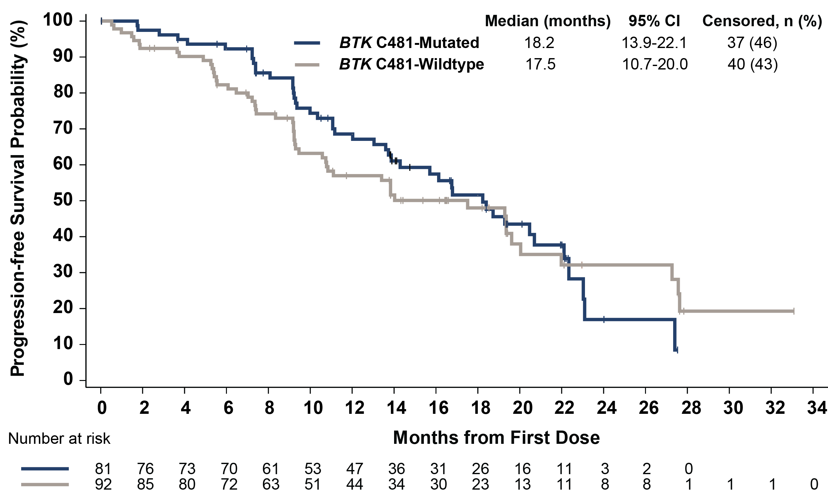
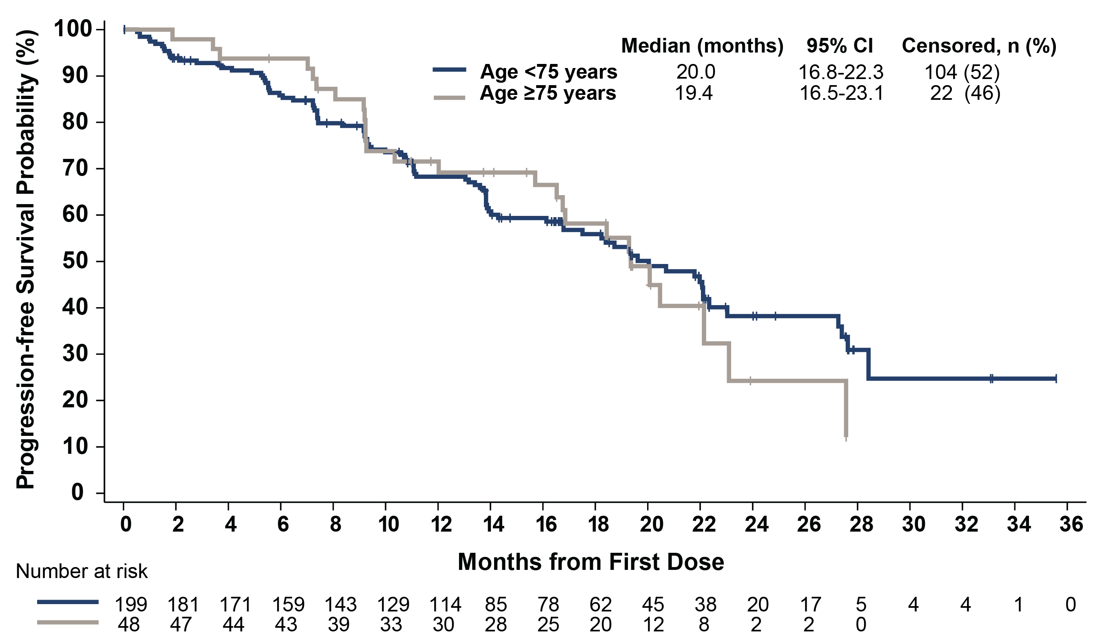
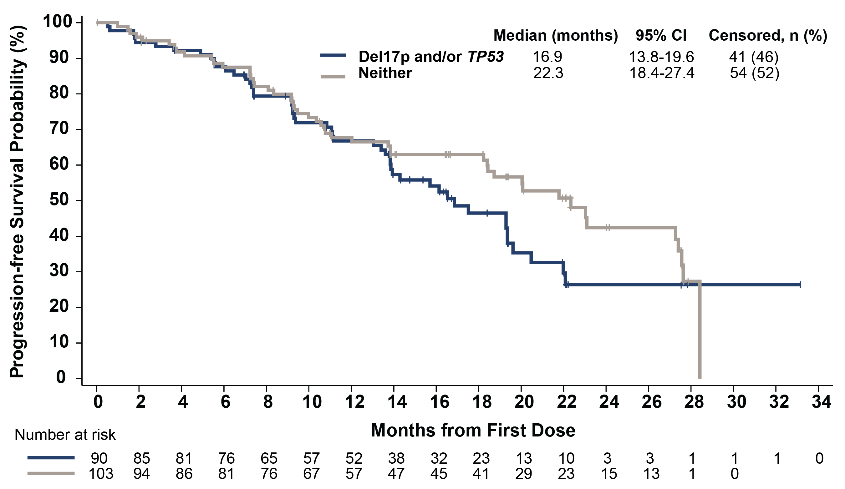
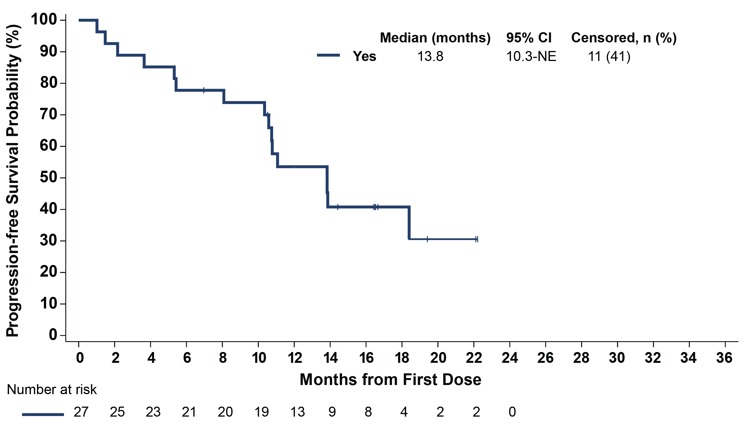
Phase 1/2 BRUIN Study: Progression-Free Survival in CLL/SLL Subgroups
BTK C481 mutation status^{a,b}
Age
del(17p) and/or TP53 mutationª
Prior BTKi, CIT, BCL2i, and PI3Ki therapy
Data cutoff date of 29 July 2022. Response status per iwCLL 2018 according to independent review committee assessment. ªBTK C481 mutation status, del(17p), and TP53 mutation status were centrally determined and based on pre-treatment samples. ^{b}Patients with available mutation data who progressed on any prior BTKi.
BCL-2i, B cell lymphoma-2 inhibitor; BTK, Bruton’s tyrosine kinase; BTKi, Bruton tyrosine kinase inhibitor; CIT, chemoimmunotherapy; CLL, chronic lymphocytic leukemia; del, deletion; PI3Ki, phosphoinositide-3-kinase inhibitor; SLL, small lymphocytic lymphoma; TP53, tumor protein 53.
Mato AR et al. Blood (2022) 140 (Supplement 1): 2316–2320.
Notes:
Mato AR, Woyach JA, Brown JR, et al. Efficacy of pirtobrutinib in covalent BTK-inhibitor pre-treated relapsed / refractory CLL/SLL: Additional patients and extended follow-up from the phase 1/2 BRUIN study. Blood. 2022;140 (1)(suppl):2316-2320. doi:10.1182/blood-2022-159497

Slide 49
Phase 1/2 BRUIN Study: Pirtobrutinib Safety Profile
 | All Doses and Patients (N=773)
 | Treatment-Emergent AEs, (≥15%), % |  | Treatment-Related AEs, %
Adverse Event (AEs) | Any Grade | Grade ≥ 3 | Any Grade | Grade ≥ 3
Fatigue | 28.7% | 2.1% | 9.3% | 0.8%
Diarrhea | 24.2% | 0.9% | 9.3% | 0.4%
Neutropeniaª | 24.2% | 20.4% | 14.7% | 11.5%
Contusion | 19.4% | 0.0% | 12.8% | 0.0%
Cough | 17.5% | 0.1% | 2.3% | 0.0%
Covid-19 | 16.7% | 2.7% | 1.3% | 0.0%
Nausea | 16.2% | 0.1% | 4.7% | 0.1%
Dyspnea | 15.5% | 1.0% | 3.0% | 0.1%
Anemia | 15.4% | 8.8% | 5.2% | 2.1%
AEs of Special Interest^{b} | Any Grade | Grade ≥ 3 | Any Grade | Grade ≥ 3
Bruising^{c} | 23.7% | 0.0% | 15.1% | 0.0%
Rash^{d} | 12.7% | 0.5% | 6.0% | 0.4%
Arthralgia | 14.4% | 0.6% | 3.5% | 0.0%
Hemorrhage/Hematoma^{e} | 11.4% | 1.8% | 4.0% | 0.6%
Hypertension | 9.2% | 2.3% | 3.4% | 0.6%
Atrial fibrillation/flutter^{f,g} | 2.8% | 1.2% | 0.8% | 0.1%
Median time on treatment for the overall safety population was 9.6 months
Discontinuations due to treatment-related AEs occurred in 2.6% (n=20) of all patients
Dose reductions due to treatment-related AEs occurred in 4.5% (n=35) of all patients
Overall and CLL/SLL safety profiles are consistent^{h}
Data cutoff date of 29 July 2022.. ªAggregate of neutropenia and neutrophil count decreased. ^{b}AEs of special interest are those that were previously associated with covalent BTK inhibitors. ^{c}Aggregate of contusion, petechiae, ecchymosis, and increased tendency to bruise. ^{d}Aggregate of all preferred terms including rash. ^{e}Aggregate of all preferred terms including hematoma or hemorrhage. ^{f}Aggregate of atrial fibrillation and atrial flutter. ^{g}Of the 22 total afib/aflutter TEAEs in the overall safety population, 7 occurred in patients with a prior medical history of atrial fibrillation. ^{h}CLL/SLL safety population data can be found via QR code.
AEs, adverse events; CLL, chronic lymphocytic leukemia; SLL, small lymphocytic lymphoma.
Mato AR et al. Blood (2022) 140 (Supplement 1): 2316–2320.
Notes:
Mato AR, Woyach JA, Brown JR, et al. Efficacy of pirtobrutinib in covalent BTK-inhibitor pre-treated relapsed / refractory CLL/SLL: Additional patients and extended follow-up from the phase 1/2 BRUIN study. Blood. 2022;140 (1)(suppl):2316-2320. doi:10.1182/blood-2022-159497

Slide 50
Ongoing Phase 3 Trials With Pirtobrutinib in CLL/SLL
Trial | Comparator | Setting/Population
BRUIN CLL-321 NCT04666038 | Pirtobrutinib vs. Investigator’s choice of: Idelalisib + rituximab Bendamustine + rituximab | BTK inhibitor pretreated CLL/SLL Prior treatment with a covalent BTK inhibitor Prior venetoclax is permitted
BRUIN CLL-322 NCT04965493 | Pirtobrutinib + venetoclax + rituximab vs. venetoclax + rituximab | Previously treated CLL/SLL Prior treatment may include a covalent BTKi No prior venetoclax permitted
BRUIN CLL-313 NCT05023980 | Pirtobrutinib vs. bendamustine + rituximab | Untreated Patients with CLL/SLL
BRUIN CLL-314 NCT05254743 | Pirtobrutinib vs. ibrutinib | Patients with CLL/SLL
BTK, Bruton’s tyrosine kinase; BTKi, Bruton tyrosine kinase inhibitor; CLL, chronic lymphocytic leukemia; SLL, small lymphocytic lymphoma.

Slide 51
BELLWAVE-001: Nemtabrutinib Demonstrated Robust and Durable Clinical Responses in Pretreated CLL^{1,2}
Nemtabrutinib: Reversible Inhibitor of Both WT and Ibrutinib-Resistant C481S-Mutated BTK
n (%) [95% CI] | CLL/SLL 65 mg QD n = 57 | CLL/SLL Cohort Aª n = 25 | CLL/SLL Cohort B^{b} n = 10
ORR | 30 (53) [39-66] | 15 (60) [39-79] | 4 (40) [12-74]
CR | 2 (4) [0.4-12] | 0 (0) [0-14] | 1 (10) [0.3-45]
PR | 15 (25) [15-40] | 5 (20) [7-41] | 2 (20) [3-56]
PR-L | 13 (23) [13-36] | 10 (40) [21-61] | 1 (10) [0.3-45]
SD | 17 (30) [18-43] | 8 (32) [15-54] | 3 (30) [7-65]
PD | 2 (4) [0.4-12] | 0 (0) [0-14] | 2 (20) [3-56]
No assessment | 8 (14) [6-26] | 2 (8) [1-26] | 1 (10) [0.3-45]
BTK, Bruton tyrosine kinase; CLL, chronic lymphocytic leukemia; CR, complete response; ORR, overall response rate; PR, partial response; PR-L, partial response with lymphocytosis; SD, stable disease; PD, progressive disease; QD, daily; SLL, small lymphocytic lymphoma; WT, wild type.
ª Cohort A comprises patients with mCLL/SLL who received ≥2 prior therapies, including covalent BTKi and who have C481S mutation. ^{b} Cohort B comprises patients with mCLL/SLL who received ≥2 prior therapies, are intolerant to BTKi, and who have no C481S mutation.
1. Woyach J et al. EHA 2022. Abstract P682. 2. A Study of Nemtabrutinib (MK-1026) (ARQ 531) in Participants With Selected Hematologic Malignancies. Clinical Trials Identifier: NCT03162536.
Notes:
Woyach J, et al. Nemtabrutinib (MK-1026), A non-covalent inhibitor of wild-type and C481S mutated Bruton tyrosine kinase for B-cell malignancies: efficacy and safety of the phase 2 dose-expansion BELLWAVE-001 study. Abstract presented at: Annual Meeting of the European Hematology Association; June 10, 2022. Abstract P682. https://library.ehaweb.org/eha/2022/eha2022-congress/357544/jennifer.woyach.nemtabrutinib.28mk-102629.a.non-covalent.inhibitor.of.wild-type.html?f=listing%3D3%2Abrowseby%3D8%2Asortby%3D1%2Amedia%3D1

Slide 52
BELLWAVE-001: Nemtabrutinib Demonstrated Robust and Durable Clinical Responses in Pretreated CLL¹
Cohort B
All CLL/SLL
Remaining in Response, %
Cohort A
 | N | Median (95% CI)
All CLL/SLL | 30 | NE (13.9-NE)
Cohort A | 15 | 13.9 (5.5-NE)
Cohort B | 4 | NE (NE-NE)
Time, mo
CLL, chronic lymphocytic leukemia; NE, not evaluable; SLL, small lymphocytic lymphoma.
1. Woyach J et al. EHA 2022. Abstract P682.
Notes:
Woyach J, et al. Nemtabrutinib (MK-1026), A non-covalent inhibitor of wild-type and C481S mutated Bruton tyrosine kinase for B-cell malignancies: efficacy and safety of the phase 2 dose-expansion BELLWAVE-001 study. Abstract presented at: Annual Meeting of the European Hematology Association; June 10, 2022. Abstract P682. https://library.ehaweb.org/eha/2022/eha2022-congress/357544/jennifer.woyach.nemtabrutinib.28mk-102629.a.non-covalent.inhibitor.of.wild-type.html?f=listing%3D3%2Abrowseby%3D8%2Asortby%3D1%2Amedia%3D1

Slide 53
BELLWAVE-001: Nemtabrutinib Is
Effective Against BTK Resistance Mutations¹
 | PFS Events, n/N, % | PFS Median (95% CI), mo
All CLL/SLL | 13/57 (23) | NE (10.6-NE)
Cohort A | 8/25 (32) | 15.7 (7.6-NE)
Cohort B | 3/10 (30) | NE (5.0-NE)
Cohort B
All CLL/SLL
Progression-Free Survival, %
Cohort A: patients with R/R CLL/SLL who received
≥2 prior therapies, including covalent BTKi, and who have a C481S mutation
Cohort A
Time, mo
No. at Risk
All | 57 | 28 | 19 | 14 | 7 | 2
Cohort A | 25 | 15 | 10 | 7 | 2 | 0
Cohort B | 10 | 4 | 2 | 2 | 1 | 0
BTK, Bruton tyrosine kinase; BTKi, Bruton’s tyrosine kinase inhibitor; CLL, chronic lymphocytic leukemia; NE, not evaluable; PFS, progression-free survival; R/R, relapsed/refractory; SLL, small lymphocytic lymphoma.
1. Woyach J et al. EHA 2022. Abstract P682.
Notes:
Woyach J, et al. Nemtabrutinib (MK-1026), A non-covalent inhibitor of wild-type and C481S mutated Bruton tyrosine kinase for B-cell malignancies: efficacy and safety of the phase 2 dose-expansion BELLWAVE-001 study. Abstract presented at: Annual Meeting of the European Hematology Association; June 10, 2022. Abstract P682. https://library.ehaweb.org/eha/2022/eha2022-congress/357544/jennifer.woyach.nemtabrutinib.28mk-102629.a.non-covalent.inhibitor.of.wild-type.html?f=listing%3D3%2Abrowseby%3D8%2Asortby%3D1%2Amedia%3D1

Slide 54
Updated Findings Continue to Show Efficacy of Nemtabrutinib in Pretreated CLL/SLL¹
Patients With CLL/SLL Treated With Nemtabrutinib 65 mg Once Daily (N = 57)
Nemtabrutinib
65 mg continued to show promising and durable anti-tumor activity with a manageable safety profile in a highly R/R population who had prior therapy with novel agents
ORR of 63% in C481S-mutated disease
 | CLL/SLL With Prior BTK and BCL-2 Inhibitors | C481S-Mutated BTK | del(17p) | IGHV Unmutated
n (%) | 24 (42) | 36 (63) | 19 (33) | 30 (53)
ORR, % (95% CI) | 58 (37-78) | 58 (41-75) | 53 (29-76) | 50 (31-69)
Objective response, n (%) CR PR PR with residual lymphocytosis | 14 (58) 0 6 (25) 8 (33) | 21 (58) 1 (3) 11 (31) 9 (25) | 10 (53) 1 (5) 2 (11) 7 (37) | 15 (50) 0 8 (27) 7 (23)
Median DOR, mo 95% CI | 8.5 2.7-NE | 24.4 8.8-NE | 11.2 5.7-NE | 24.4 8.5-NE
Median PFS, mo 95% CI | 10.1 7.4-15.9 | 26.3 10.1-NE | 10.1 4.6-NE | 15.9 7.4-NE
BCL-2, B cell lymphoma-2; BTK, Bruton tyrosine kinase; CLL, chronic lymphocytic leukemia; CR, complete response; del, deletion; DOR, duration of response; IGHV, immunoglobulin heavy chain gene; NE, not evaluable; ORR, overall response rate; PFS, progression-free survival; PR, partial response; SD, stable disease; PD, progressive disease; R/R, relapsed/refractory; SLL, small lymphocytic lymphoma.
1. Woyach J et al. ASH 2022. Abstract 3114.
Notes:
Woyach JA, Flinn IW, Awan FT, et al. Efficacy and safety of nemtabrutinib, a wild-type and C481S-mutated Bruton tyrosine kinase inhibitor for B-cell malignancies: Updated analysis of the open-label phase 1/2 dose-expansion Bellwave-001 Study. Abstract presented at: Annual Meeting of the American Society of Hematology; December 11, 2022; New Orleans, LA. Abstract 3114. https://ash.confex.com/ash/2022/webprogram/Paper163596.html

Slide 55
BELLWAVE-001: Nemtabrutinib Safety
Treatment-related Adverse Events, n (%) | All Patients at 65 mg QD N=112
 | All | Grade ≥3
Any treatment-related AEs | 82 (73) | 45 (40)
Treatment-related AEs ≥ 5%
Dysgeusia | 23 (21) | 0 (0)
Neutrophil count decreased | 22 (20) | 19 (17)
Fatigue | 14 (13) | 2 (2)
Platelet count decreased | 13 (12) | 5 (4)
Nausea | 13 (12) | 0 (0)
Hypertension | 11 (10) | 4 (4)
Diarrhea | 11 (10) | 2 (2)
Pyrexia | 9 (8) | 0 (0)
Constipation | 8 (7) | 0 (0)
Vomiting | 7 (6) | 0 (0)
Arthralgia | 6 (5) | 0 (0)
Dizziness | 6 (5) | 0 (0)
Rash maculopapular | 6 (5) | 3 (3)
QD, daily.
Woyach J et al. ASH 2022. Abstract 3114.
Notes:
Woyach JA, Flinn IW, Awan FT, et al. Efficacy and safety of nemtabrutinib, a wild-type and C481S-mutated Bruton tyrosine kinase inhibitor for B-cell malignancies: Updated analysis of the open-label phase 1/2 dose-expansion Bellwave-001 Study. Abstract presented at: Annual Meeting of the American Society of Hematology; December 11, 2022; New Orleans, LA. Abstract 3114. https://ash.confex.com/ash/2022/webprogram/Paper163596.html

Slide 56
Ongoing Phase 3 Trials With Nemtabrutinib in CLL/SLL
Trial | Comparator | Setting/Population
BELLWAVE-008 NCT05624554 | nemtabrutinib vs. chemoimmunotherapy (investigator's choice of fludarabine + cyclophosphamide + rituximab [FCR] or bendamustine + rituximab [BR]) | Previously untreated CLL/SLL without TP53 aberrations
CLL, chronic lymphocytic leukemia; SLL, small lymphocytic lymphoma; TP53, tumor protein 53.

Slide 57
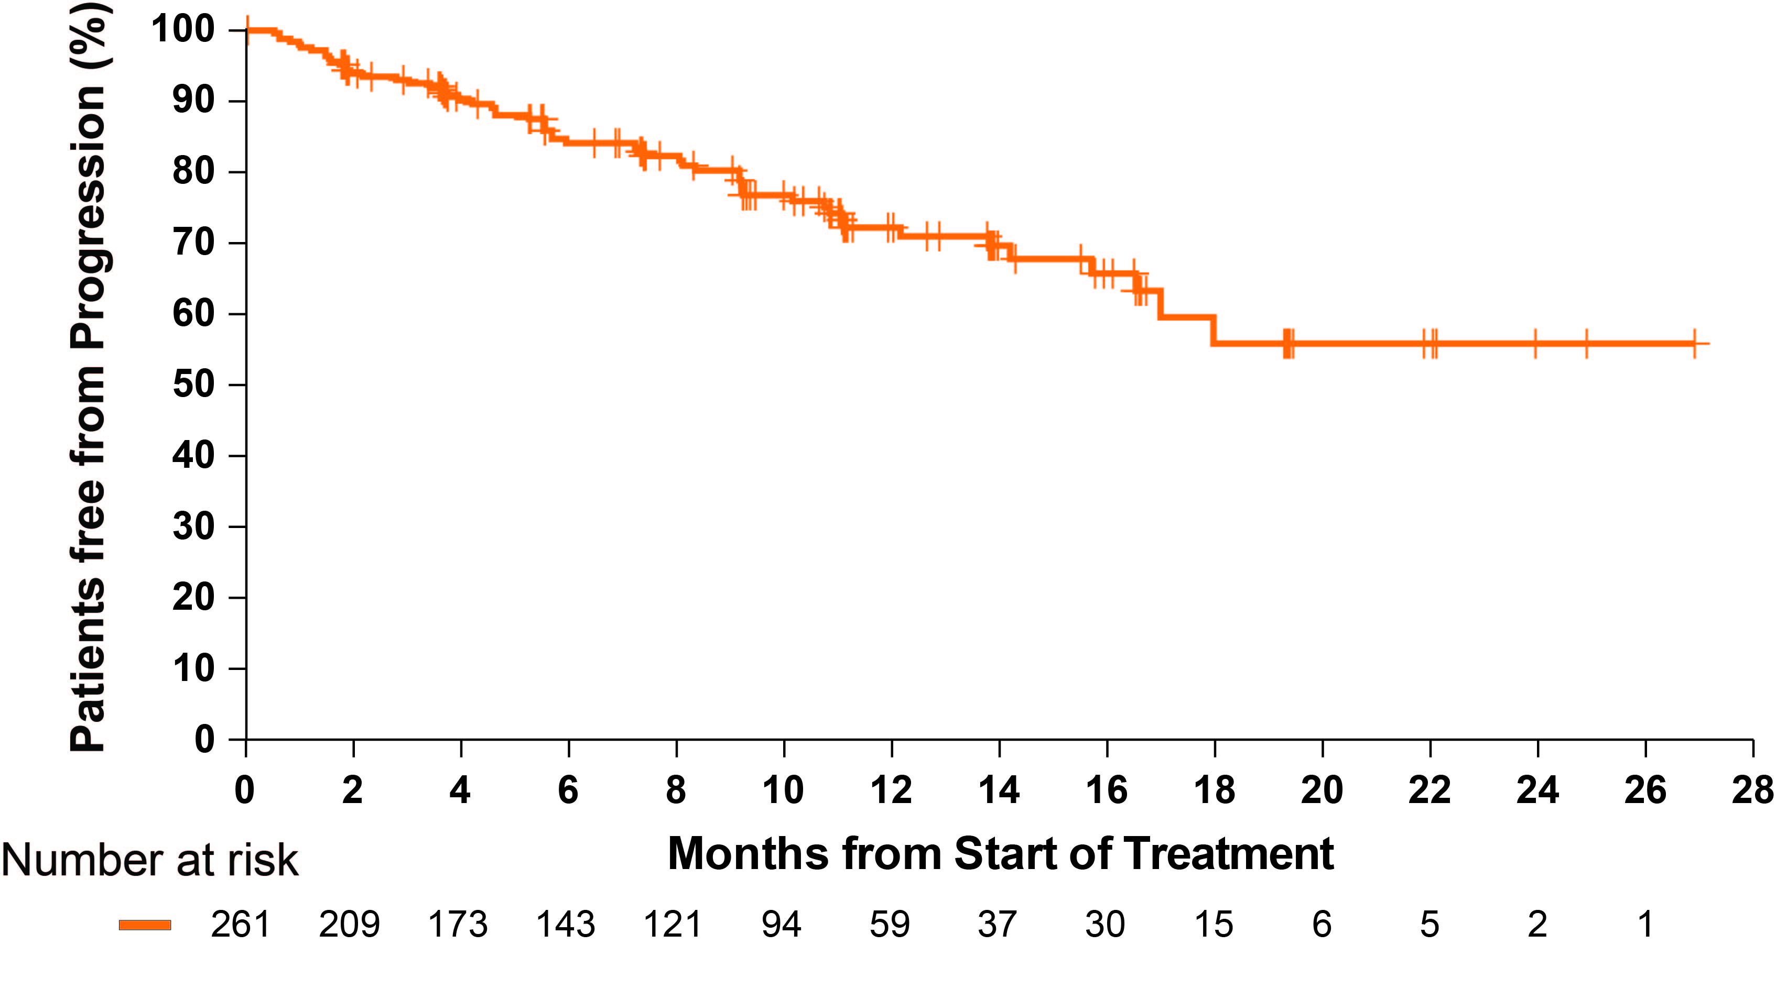
Progression of Disease on Pirtobrutinib
Progression on Pirtobrutinib: MSKCC Cohort
MSKCC, Memorial Sloan Kettering Cancer Center.
Mato A et al. ASH 2021. Abstract 391.
Notes:
Mato AR, Pagel JM, Coombs CC, et al. Pirtobrutinib, A next generation, highly selective, non-covalent BTK inhibitor in previously treated CLL/SLL: Updated results from the phase 1/2 BRUIN study. Blood. 2021;138 (1)(suppl):391. doi:10.1182/blood-2021-147599

Slide 58
Mechanisms of Resistance to Noncovalent BTKi

Slide 59
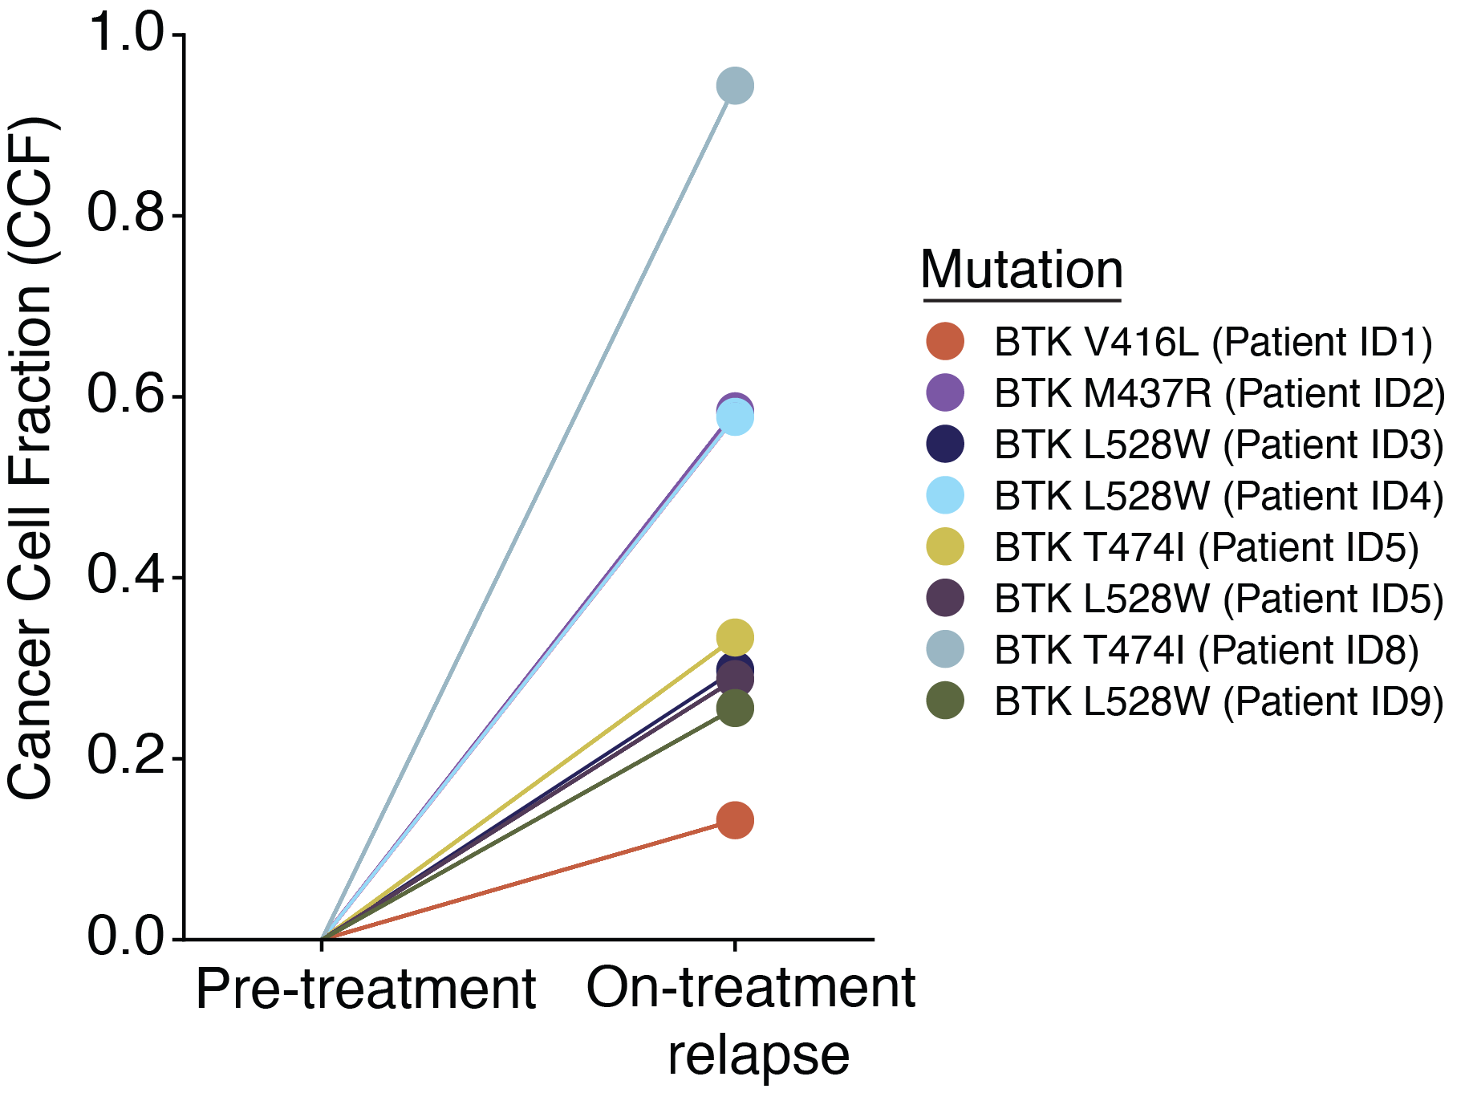
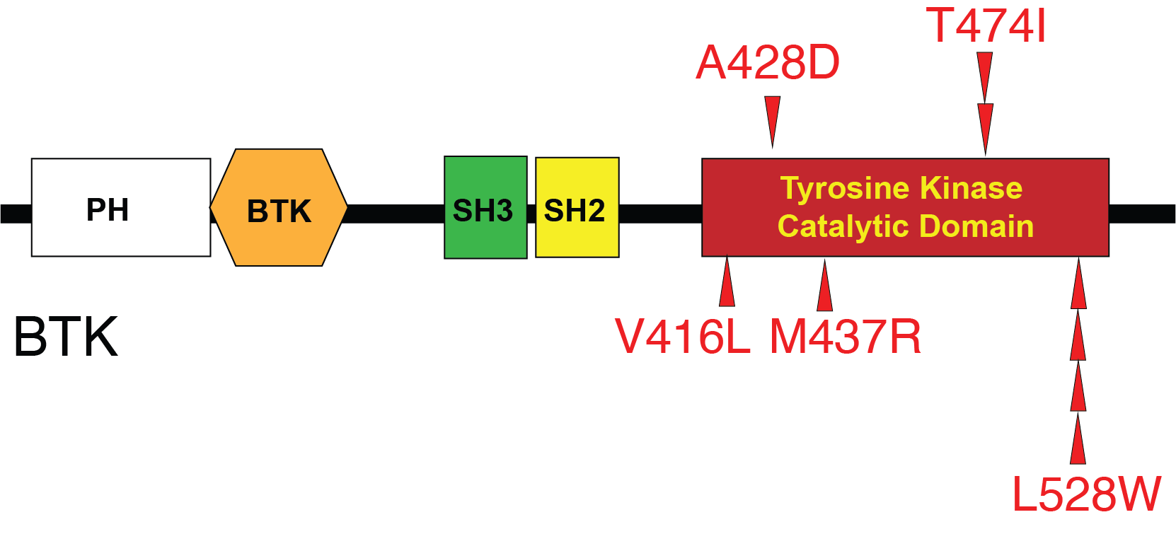
Acquired BTK Mutations on Pirtobrutinib
We identified novel acquired mutations in BTK at the time of disease progression including:
  BTK L528W
  BTK V416L
  BTK M437R
  BTK T474I
  BTK A428D
These mutations cluster around the tyrosine kinase catalytic domain of BTK
Additionally, several patients with progressive disease had pre-existing PLCG2 mutations
Structure of BTK
BTK, Bruton tyrosine kinase; PLCG2, phospholipase C gamma 2.
Wang E et al. N Engl J Med. 2022;386:735-743.
Notes:
Wang E, Mi X, Thompson MC, et al. Mechanisms of Resistance to Noncovalent Bruton's Tyrosine Kinase Inhibitors. N Engl J Med. 2022;386(8):735-743. doi:10.1056/NEJMoa2114110

Slide 60
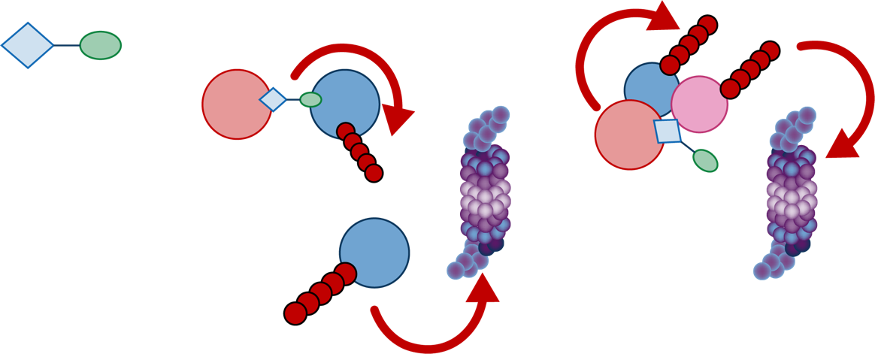
Can BTK Degraders Overcome Resistance?
NX-2127
BTK Degradation
Immunomodulatory Activity:
Degradation of Ikaros and Aiolos
CRBN ubiquitin ligase complex
Catalytic ubiquitination
Linker
Catalytic ubiquitination
Degradation
Harness
(CRBN binder)
Hook
(BTK binder)
Proteasome
Ikaros
Ikaros
CRBN
BTK
Aiolos
CRBN
BTK
Aiolos
CRBN
CRBN
NX-2127
CRBN ubiquitin ligase complex
Proteasome
BTK
BTK
BTK degradation
BTK, Bruton’s tyrosine kinase; CRBN, cereblon.
Nurix Therapeutics. https://ir.nurixtx.com/static-files/034274a1-db9c-4d76-8c9a-6e22c048656d

Slide 61
NX-2127-001, a first-in-human trial of NX-2127, a Bruton’s Tyrosine Kinase-targeted protein degrader, in patients with relapsed or refractory chronic lymphocytic leukemia and B-cell malignancies
Anthony Mato,¹ William G. Wierda,² Weiyun Ai,³ Ian Flinn,⁴ Michael Tees,⁵ Manish R. Patel,⁶ Krish Patel,⁷ Susan O’Brien,⁸ David Bond,⁹ Lindsey E. Roeker,¹ Tanya Siddiqi,¹⁰ Michael Wang,² Clare Sun,¹¹ Omar Abdel-Wahab,¹ Amanda Schwab,¹² May Tan,¹² Erin Meredith,¹² Melissa A. Gessner,¹² Adrian Wiestner,¹¹ Alexey Danilov¹⁰
¹Memorial Sloan Kettering Cancer Center, New York, NY, USA; ²MD Anderson Cancer Center, Houston, TX, USA; ³University of California San Francisco Medical Center, San Francisco CA, USA; ⁴Tennessee Oncology, Sarah Cannon Research Institute, Nashville, TN, USA; ⁵Colorado Blood Cancer Institute, Denver, CO, USA; ⁶Florida Cancer Specialists, Sarah Cannon Research Institute, Sarasota, FL, USA; ⁷Swedish Cancer Institute, Center for Blood Disorders and Cellular Therapy, Seattle, WA, USA; ⁸Chao Family Comprehensive Cancer Center, University of California, Irvine, Orange, CA, USA; ⁹The James Cancer Hospital at The Ohio State University, Columbus, OH, USA; ¹⁰City of Hope National Medical Center, Duarte, CA, USA; ¹¹National Heart, Lung, and Blood Institute, National Institutes of Health, Bethesda, MD, USA; ¹²Nurix Therapeutics, Inc., San Francisco, CA, USA
Mato A et al. ASH 2022. Abstract 965.
Notes:
Mato AR, Wierda WG, Ai WZ, et al. NX-2127-001, a first-in-human trial of NX-2127, a Bruton’s tyrosine kinase-targeted protein degrader, in patients with relapsed or refractory chronic lymphocytic leukemia and b-cell malignancies. Abstract presented at: Annual Meeting of the American Society of Hematology; December 12, 2022; New Orleans, LA. Abstract 965. https://ash.confex.com/ash/2022/webprogram/Paper164772.html

Slide 62
NX-2127 Has the Potential to Address Emerging BTK Mutations
NX-2127 degrades wild-type and mutant BTK, including the recently described kinase dead mutations
NX-2127 kills DLBCL tumor cells harboring wild-type BTK and mutant BTK
BTK degradation
Cell viability
NX-2127
NX-2127
Ibrutinib
Pirtobrutinib
BTK, Bruton tyrosine kinase; DLBCL, diffuse B-cell lymphoma; WT, wild type.
Montoya S et al. ASH 2022. Abstract 750.
Notes:
Montoya S, Bourcier J, Thrompson MC, et al. Kinase dead BTK mutations confer resistance to covalent and noncovalent BTK inhibitors but are susceptible to clinical stage BTK degraders. Annual Meeting of the American Society of Hematology; December 12, 2022; New Orleans, LA. Abstract 750. https://ash.confex.com/ash/2022/webprogram/Paper163268.html

Slide 63
NX-2127-001: Trial Design^{1,2}
Phase 1 trial in adults with relapsed/refractory B-cell malignancies
Dose escalation
Dose expansion options
CLL Phase 1b expansion cohort at 100 mg dose
  MTD not established
  100 mg dose chosen as expansion dose based on PD, clinical activity and safety profile
Phase 1a dose escalation is ongoing at 200 mg and 300 mg doses for patients with NHL (e.g. DLBCL, MCL, MZL, WM, FL)
Objectives:
Assess safety and tolerability
Identify MTD & biologically active dose
Evaluate PK/PD
CLL failed 2 or more prior treatments including a BTK inhibitor and regardless of baseline BTK
mutation status (up to 40)
– INITIATED –
Dose level 3
300 mg
Dose level 2
200 mg
DLBCL (up to 20)
Dose level 1
100 mg
MCL, MZL, WM (up to 20)
Dose level –1
50 mg
FL (up to 20)
Oral daily dosing
BTK, Bruton tyrosine kinase; CLL, chronic lymphocytic leukemia; DLBCL, diffuse large B-cell lymphoma; FL, follicular lymphoma; MCL, mantle cell lymphoma; MTD, maximum tolerated dose; MZL, marginal zone lymphoma; NHL, non-Hodgkin’s lymphoma; PD, pharmacodynamics; PK, pharmacokinetics; WM, Waldenstrom's macroglobulinemia.
1. Mato A et al. ASH 2022. Abstract 965. 2. https://clinicaltrials.gov/ct2/show/NCT04830137
Notes:
Mato AR, Wierda WG, Ai WZ, et al. NX-2127-001, a first-in-human trial of NX-2127, a Bruton’s tyrosine kinase-targeted protein degrader, in patients with relapsed or refractory chronic lymphocytic leukemia and b-cell malignancies. Abstract presented at: Annual Meeting of the American Society of Hematology; December 12, 2022; New Orleans, LA. Abstract 965. https://ash.confex.com/ash/2022/webprogram/Paper164772.html

Slide 64
Baseline Characteristics^{1,2}
Elderly population with multiple prior lines of targeted therapies and acquired mutations
Characteristics | CLL (n=23) | Overall population (N=36)
Median age, years (range) | 75 (61–90) | 75 (50–92)
Female, n (%) Male, n (%) | 9 (39.1) 14 (60.9) | 13 (36.1) 23 (63.9)
Lines of prior therapy, median (range) BTKi, n (%) Pirtobrutinib, n (%) BTKi and BCL2i, n (%) cBTKi, ncBTKi, and BCL2i, n (%) | 5 (2–11) 23 (100) 8 (34.8) 18 (78.3) 7 (30.4) | 4 (2–11) 31 (86.1) 11 (30.6) 19 (52.8) 7 (19.4)
BTK mutation presentª, n (%) C481 L528W T474 V416L | 10 (48) 5 (24) 4 (19) 3 (14) 1 (5) | 11 (35) 5 (16) 4 (13) 4 (13) 1 (3)
BCL2 mutation presentª, n (%) | 4 (19) | 4 (13)
PLCG2 mutation presentª, n (%) | 0 (0) | 1 (3.2)
Data cutoff: September 21, 2022
ªSpecific mutations are not additive as some patients have multiple BTK mutations
Mutations were tested by NGS centrally in those patients with available samples (n=31 in total population; n=21 in CLL population)
BCL-2i, B cell lymphoma-2 inhibitor; BTKi, Bruton tyrosine kinase inhibitor; cBTKi, covalent BTK inhibitor; CLL, chronic lymphocytic leukemia; ncBTKi, non-covalent BTK inhibitor; NGS, next-generation sequencing; PLCG2, phospholipase C gamma 2. 1. Mato A et al. ASH 2022. Abstract 965. 2. https://clinicaltrials.gov/ct2/show/NCT04830137
Notes:
Mato AR, Wierda WG, Ai WZ, et al. NX-2127-001, a first-in-human trial of NX-2127, a Bruton’s tyrosine kinase-targeted protein degrader, in patients with relapsed or refractory chronic lymphocytic leukemia and b-cell malignancies. Abstract presented at: Annual Meeting of the American Society of Hematology; December 12, 2022; New Orleans, LA. Abstract 965. https://ash.confex.com/ash/2022/webprogram/Paper164772.html

Slide 65
NX-2127 Safety Summary
(TEAEs >15% in all patients)^{1,2}
Treatment-emergent AEs occurring in >15% of total population, n (%) | Any grade (N=36) | Grade 3+ (N=36) | SAE (N=36)
Fatigue | 19 (52.8) | – | -
Neutropeniaª | 14 (38.9) | 13 (36.1) | -
Contusion^{b} | 10 (27.8) | – | 1 (2.8)
Thrombocytopenia^{c} | 9 (25) | 3 (8.3) | -
Anemia | 8 (22.2) | 4 (11.1) | 1 (2.8)
Hypertension | 9 (25.0) | 1 (2.8) | -
Constipation | 7 (19.4) | – | -
Dyspnea | 7 (19.4) | 1 (2.8) | -
Pruritis | 7 (19.4) | – | -
Atrial fibrillation/Atrial flutter^{d} | 6 (16.7) | 3 (8.3) | 2 (5.6)
Diarrhea | 6 (16.7) | – | -
Petechiae | 6 (16.7) | – | -
Rash | 6 (16.7) | – | -
1 DLT of cognitive disturbance was observed at 300 mg (CLL); MTD not reached
Data cutoff: September 21, 2022
ªAggregate of "neutropenia" and "neutrophil count decreased" ^{b}Contusion includes episodes of bruising and other similar terms ^{c}Aggregate of "thrombocytopenia" and "platelet count decreased" ^{d}Cases were confounded by risk factors such as: age >80 years (4 cases), history of hypertension (4 cases), male sex (3 cases), and history of prior AF on ibrutinib (2 cases)
AE, adverse event; AF, atrial flutter; DLT, dose-limiting toxicity; MTD, maximum tolerated dose; SAE, serious adverse event; TEAE, treatment-emergent adverse event.
1. Mato A et al. ASH 2022. Abstract 965. 2. https://clinicaltrials.gov/ct2/show/NCT04830137
Notes:
Mato AR, Wierda WG, Ai WZ, et al. NX-2127-001, a first-in-human trial of NX-2127, a Bruton’s tyrosine kinase-targeted protein degrader, in patients with relapsed or refractory chronic lymphocytic leukemia and b-cell malignancies. Abstract presented at: Annual Meeting of the American Society of Hematology; December 12, 2022; New Orleans, LA. Abstract 965. https://ash.confex.com/ash/2022/webprogram/Paper164772.html

Slide 66
NX-2127 Preliminary Efficacy (Patients With CLL)^{1,2}
Disease-evaluable patients | n=15
Objective response rate,ª % (95% CI) | 33 (12–62)
Best response, n (%)
CR | 0 (0)
PR | 5 (33.3)
SD | 5 (33.3)
PD | 2 (13.3)
NE^{b} | 3 (20)
Two or more prior treatments including:
BTKi
BTKi and BCL2i (‘Double exposed’)
*
BTK mutation at baseline
Treatment ongoing
*
*
*
*
*
*
*
*One patient, not shown above, with prior BTKi and BCL2i treatment and with a BTK mutation detected at baseline, had no nodal disease at baseline. Their treatment is ongoing with a PR
Data cutoff: September 21, 2022
ªObjective response rate includes CR + CRi + nPR + PR-L + PR
^{b}Patients who discontinued after a single assessment of SD are considered as NE
BCL2i, B-cell lymphoma-2 inhibitor; BTK, Bruton tyrosine kinase; BTKi, BTK inhibitor; CLL, chronic lymphocytic leukemia; CR, complete response; CRi, complete response with incomplete count recovery; NE, not evaluable; PD, progressive disease; PR, partial response; nPR, near partial response; PR-L, partial response with lymphocytosis; SD, stable disease.
1. Mato A et al. ASH 2022. Abstract 965. 2. https://clinicaltrials.gov/ct2/show/NCT04830137
Notes:
Mato AR, Wierda WG, Ai WZ, et al. NX-2127-001, a first-in-human trial of NX-2127, a Bruton’s tyrosine kinase-targeted protein degrader, in patients with relapsed or refractory chronic lymphocytic leukemia and b-cell malignancies. Abstract presented at: Annual Meeting of the American Society of Hematology; December 12, 2022; New Orleans, LA. Abstract 965. https://ash.confex.com/ash/2022/webprogram/Paper164772.html

Slide 67
Outcomes and Time On Therapy With NX-2127
(Patients With CLL) Responses seen in double and triple exposed patients
*
*
*
Two or more prior treatments including:
*
*
BTKi
BTKi & BCL2i (‘Double exposed’)
cBTKi, ncBTKi, & BCL2i (‘Triple exposed’)
Treatment ongoing
Patient
*
*
BTK mutation detected
*
°
BTK mutation status unknown
*
PR
PR-L
°
SD
*
PD
*
°
Median follow-up: 5.6 months (range: 0.3 to 15.7 months)
9 patients discontinued treatment due to: AEs (n=5); PD (n=2); >7 days of missed doses (n=1); patient choice (n=1)
0
1
2
3
4
5
6
7
8
9
10
11
12
13
14
15
16
17
18
Time (28d months)
Data cutoff: September 21, 2022
AE, adverse event; BCL2i, B-cell lymphoma-2 inhibitor; BTK, Bruton tyrosine kinase; BTKi, BTK inhibitor; cBTKi, covalent BTK inhibitor; CLL, chronic lymphocytic leukemia; ncBTKi, non-covalent BTK inhibitor; PD, progressive disease; PR, partial response; PR-L, partial response with lymphocytosis; SD, stable disease.
1. Mato A et al. ASH 2022. Abstract 965. 2. https://clinicaltrials.gov/ct2/show/NCT04830137
Notes:
Mato AR, Wierda WG, Ai WZ, et al. NX-2127-001, a first-in-human trial of NX-2127, a Bruton’s tyrosine kinase-targeted protein degrader, in patients with relapsed or refractory chronic lymphocytic leukemia and b-cell malignancies. Abstract presented at: Annual Meeting of the American Society of Hematology; December 12, 2022; New Orleans, LA. Abstract 965. https://ash.confex.com/ash/2022/webprogram/Paper164772.html

Slide 68
Addressing the Challenge of Double-Refractory CLL

Slide 69
Defining Double-Refractory Disease
BTKi ± anti-CD20 mAb (continuous)
Venetoclax + CD20 (time limited)
BTKi + venetoclax (time limited)
Progression
on therapy
Progression
on therapy
Progression
within 24 mo
of dx
Progression
on therapy
Venetoclax ± rituximab
BTKi
Venetoclax-based regimen or BTKi
Progression
within 24 mo
of dx
Progression
within 24 mo
of dx
Progression
within 12 mo
of ven tx
Primary or secondary resistance
to BTKi ±
ven retx
Progression
on therapy
Progression
on therapy
Double-refractory CLL patient
Dx, diagnosis; BTKi, Bruton’s tyrosine kinase inhibitor; CLL, chronic lymphocytic leukemia; mAB, monoclonal antibody; retx, retreatment; tx, treatment; ven, venetoclax.
1. Aronson JH et al. Am J Hematol. 2022;97(suppl 2):S19-S25.
Notes:
Aronson JH, Skånland SS, Roeker LE, Thompson MC, Mato AR. Approach to a patient with "double refractory" chronic lymphocytic leukemia: "Double, double toil and trouble" (Shakespeare). Am J Hematol. 2022;97 Suppl 2:S19-S25. doi:10.1002/ajh.26682

Slide 70
Real-World Data Show That Double-Refractory Disease Represents a Clear Unmet Medical Need in CLL/SLL
1.0
Among 382 patients who discontinued covalent BTKi/BCL-2i therapy, median time to discontinuation of the immediate subsequent line of therapy (post–BTKi/BCL-2i therapy) or death was 5.5 months¹
+
Median: 5.5 mo
95% CI, 4.3-6.0
+
+
+
+
+
+
+
+
+
+
+
+
Survival Probability
+
+
+
+
+
+
+
+
+
+
+
+
+
+
+
Censored
95% confidence limits
+
+
+
Patients previously treated with both a covalent BTKi and a BCL-2i experience poor outcomes with currently available post-covalent BTKi/BCL-2i therapy
+
+
+
+
+
+
+
+
+
+
+
+
+
+
+
+
+
+
+
+
+
+
+
+
+
Time From Dual Discontinuation to Subsequent Therapy Failure, mo
No. at Risk | 382 | 152 | 73 | 36 | 14 | 9 | 4 | 1 | 0
BCL-2i, B cell lymphoma-2 inhibitor; BTK, Bruton’s tyrosine kinase; BTKi, Bruton tyrosine kinase inhibitor; CLL, chronic lymphocytic leukemia; SLL, small lymphocytic lymphoma.
1. Mato A et al. ASH 2021. Abstract 3743.
Notes:
Mato A, et al. Outcomes for Patients with Chronic Lymphocytic Leukemia Previously Treated with a Covalent BTK Inhibitor and BCL2 Inhibitor in the United States: A Real-World Database Study. Abstract presented at: Annual Meeting of the American Society of Hematology; December 13, 2021; New Orleans, LA. Abstract 3743.

Slide 71
Where Do We Stand With Treatment for Double-Refractory Disease?
There are few good options; median time to discontinuation of the immediate subsequent LOT (post–BTKi/BCL-2i therapy) or death was 5.5 months¹
Novel BCL-2 mutations have been described in venetoclax-resistant, ibrutinib-resistant
CLL patients with BTK/
PLCG2 mutations²
What is being explored?
  Venetoclax retreatment
  Noncovalent BTKi
  CAR-T therapy
BCL-2, B cell lymphoma-2; BTK, Bruton’s tyrosine kinase; BTKi, Bruton tyrosine kinase inhibitor; CAR-T, chimeric antigen receptor-T-cell therapy; CLL, chronic lymphocytic leukemia;
LOT, line of treatment; PLCG2, phospholipase C gamma 2.
1. Mato A et al. ASH 2021. Abstract 3743. 2. Lucas F et al. Blood. 2020;135: 2192-2195.
Notes:
Mato A, et al. Outcomes for Patients with Chronic Lymphocytic Leukemia Previously Treated with a Covalent BTK Inhibitor and BCL2 Inhibitor in the United States: A Real-World Database Study. Abstract presented at: Annual Meeting of the American Society of Hematology; December 13, 2021; New Orleans, LA. Abstract 3743.
Lucas F, Larkin K, Gregory CT, et al. Novel BCL2 mutations in venetoclax-resistant, ibrutinib-resistant CLL patients with BTK/PLCG2 mutations. Blood. 2020;135(24):2192-2195. doi:10.1182/blood.2019003722

Slide 72
Is Venetoclax Retreatment an Option?¹
Retrospective study investigating outcomes and safety data for patients with CLL treated with a venetoclax-based regimen (Ven1) in any line of therapy and then re-treated with a second venetoclax-based regimen (Ven2) in a later line of therapy
Data sources included
  15 medical centers (n = 30)
  CLL Collaborative Study of Real-World Evidence database (n = 5)
  Patients from the MURANO trial dataset (n = 11)
Baseline Characteristics | Results | Patients With Available Data, n
Median age at CLL diagnosis, y (range) | 55.5 (24-75) | 46
Median age at Ven1 start, y (range) | 64 (31-75) | 46
Men | 73.9% | 46
Race | 83.3% White 9.5% Black 7.1% other | 42
Ven1 administered as part of a clinical trial | 56.5% | 46
Ven1 as monotherapy | 37% | 46
Ven1 as first-line treatment | 8.7% | 46
Median prior lines of therapy (range) | 2 (0-10) | 46
Prior BTKi | 40% | 45
del(17p) | 25% | 44
TP53 mutation | 15.6% | 32
Complex karyotype | 20.5% | 39
IGHV unmutated | 82.1% | 39
BTKi, Bruton’s tyrosine kinase inhibitor; CLL, chronic lymphocytic leukemia; del, deletion; IGHV, immunoglobulin heavy chain gene; TP53, tumor protein 53.
1. Thompson M et al. Blood Adv. 2022;6:4553-4557.
Notes:
Thompson MC, Harrup RA, Coombs CC, et al. Venetoclax retreatment of patients with chronic lymphocytic leukemia after a previous venetoclax-based regimen. Blood Adv. 2022;6(15):4553-4557. doi:10.1182/bloodadvances.2022007812

Slide 73
Retrospective Evidence Suggests Venetoclax
Can Be Effective, Including in Double-Exposed Patients¹
PFS for Ven2
1.0
Time, mo
ORR to Ven2 was 79.5
ORR of 56.3% in BTKi-exposed patients
No. at Risk
44 | 24 | 13 | 7 | 4 | 2
Although prospective studies are needed, the high ORR and durability of observed remissions support
venetoclax retreatment, and it appears to be highly active in “double-exposed” CLL
BTKi, Bruton’s tyrosine kinase inhibitor; CLL, chronic lymphocytic leukemia; CR, complete response; ORR, overall response rate; PFS, progression-free survival; PR, partial response; PD, progressive disease; SD, stable disease; Ven1; first treatment with a venetoclax-based regimen; Ven2; retreatment with a second venetoclax-based regimen
1. Thompson M et al. Blood Adv. 2022;6:4553-4557.
Notes:
Thompson MC, Harrup RA, Coombs CC, et al. Venetoclax retreatment of patients with chronic lymphocytic leukemia after a previous venetoclax-based regimen. Blood Adv. 2022;6(15):4553-4557. doi:10.1182/bloodadvances.2022007812

Slide 74
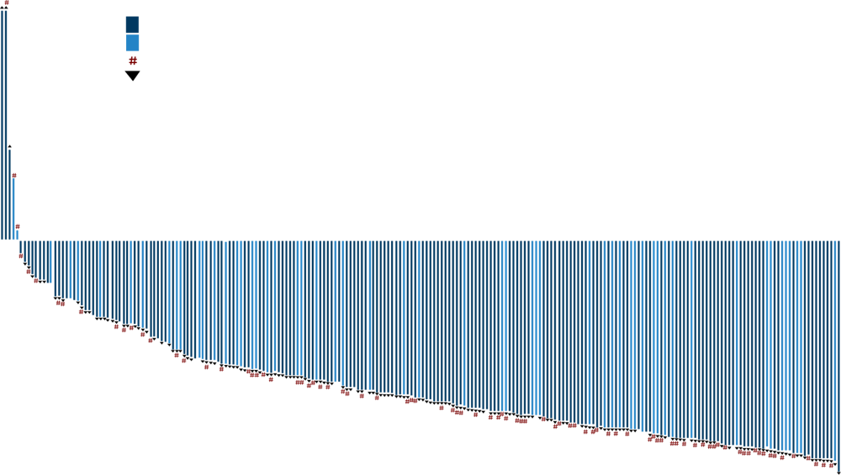
Pirtobrutinib (BRUIN Trial) in Patients With Prior Exposure to BCL-2 Inhibitor Therapy¹
Efficacy-Evaluable BTK-Pretreated CLL/SLL Patientsª | N = 252
Overall response rate, % (95% CI)^{b} | 68 (62-74)
Best response, n (%) CR PR PR-L SD | 2 (1) 137 (54) 32 (13) 62 (25)
BTK discontinuation for progression
BTK discontinuation for toxicity/other
Prior BCL-2 inhibitor
Ongoing
#
Maximum Change in SPD From Baseline, %
ª Efficacy-evaluable patients are those who had ≥1 postbaseline response assessment or had discontinued treatment prior to first postbaseline response assessment. ^{b} ORR includes patients with a best response of CR, PR, and PR-L. Response status per iwCLL 2018 according to investigator assessment. Total percentage may be different than the sum of the individual components because of rounding.
BCL-2, B cell lymphoma-2; BTK, Bruton’s tyrosine kinase; CLL, chronic lymphocytic leukemia; CR, complete response; ORR, overall response rate; PR, partial response; PR, partial response with lymphocytosis; SD, stable disease; SLL, small lymphocytic lymphoma; SPD, sum of the products of the greatest perpendicular diameters.
1. Mato A et al. EHA 2021. Abstract S147.
Notes:
Mato AR, et al. Pirtobrutinib, a highly selective, non-covalent (reversible) BTK inhibitor in previously treated CLL/SLL: updated results from the Phase 1/2 BRUIN Study. Abstract presented at: Annual Meeting of the European Hematology Association; June 12, 2021. S147. https://library.ehaweb.org/eha/2021/eha2021-virtual-congress/330170/peter.hillmen.first.interim.analysis.of.alpine.study.results.of.a.phase.3.html

Slide 75
BRUIN: Pirtobrutinib Is Active in CLL/SLL Patients Progressing After BTKi Therapy and Venetoclax¹
ORR, % (95% CI)
Median Lines of Prior Therapy, Median (Range) | Treated, n | Efficacy Evaluable,ª n
5 (1-11) | 108 | 102
5 (2-11) | 51 | 45
4 (2-11) | 200 | 192
5 (3-11) | 92 | 86
6 (3-11) | 33 | 27
Prior Therapy
BTK + BCL-2
BTK + PI3K
BTK + chemotherapy + CD20
BTK + chemotherapy + CD20 + BCL-2
BTK + chemotherapy + CD20 + BCL-2 + PI3K
0
25
50
75
100
ASH 2022: with longer follow-up, ORR of 74% in patients failing prior cBTKi and venetoclax²
ª Efficacy-evaluable patients are those who had ≥1 evaluable postbaseline assessment or had discontinued treatment prior to first postbaseline assessment.
ASH, American Society of Hematology; BCL-2, B cell lymphoma-2; BTK, Bruton’s tyrosine kinase; BTKi, Bruton tyrosine kinase inhibitor; cBTKi, covalent Bruton tyrosine kinase inhibitor; CLL, chronic lymphocytic leukemia; ORR, overall response rate; PI3K, phosphoinositide-3-kinase; SLL, small lymphocytic lymphoma.
1. Mato A et al. ASH 2021. Abstract 391. 2. Mato A et al. ASH 2022. Abstract 961.
Notes:
Mato AR, Pagel JM, Coombs CC, et al. Pirtobrutinib, A next generation, highly selective, non-covalent BTK inhibitor in previously treated CLL/SLL: Updated results from the phase 1/2 BRUIN study. Blood. 2021;138 (1)(suppl):391. doi:10.1182/blood-2021-147599
Mato AR, Woyach JA, Brown JR, et al. Efficacy of pirtobrutinib in covalent BTK-inhibitor pre-treated relapsed / refractory CLL/SLL: Additional patients and extended follow-up from the phase 1/2 BRUIN study. Annual Meeting of the American Society of Hematology; December 12, 2022; New Orleans, LA. Abstract 961. https://ash.confex.com/ash/2022/webprogram/Paper159497.html

Slide 76
TRANSCEND CLL 004: CAR-T Therapy Is Another Novel Option Being Explored in CLL¹
Enrollment and
leukapheresis
Measurable disease
reconfirmed
Screen
Bridging therapy
allowed
Lymphodepletion
FLU 30 mg/m² and
CY 300 mg/m² × 3 days
Liso-cel
2-7 days
after FLU/CY
Follow-up
On study: 24 months
Long-term: up to 15 years
after last liso-cel treatment
Liso-cel manufacturingª
96% success manufacturing rate
Key Eligibility
Relapsed/refractory CLL/SLL
Failed or ineligible for BTKi^{b}
High-risk disease^{c}: failed ≥2 prior therapies
Standard-risk disease: failed ≥3 prior therapies
ECOG PS of 0-1
        Dose Escalation: mTPI-2 Design^{d}
  28-day DLT period
        Primary objectives
  Safety
  Determine recommended dose
        Exploratory objectives
  Antitumor activity
  Pharmacokinetic profile
Dose Level | Dose | Evaluable (N = 23)
1 | 50 × 10⁶ CAR-T cells | 9
2 | 100 × 10⁶ CAR-T cells | 14
ClinicalTrials.gov identifier: NCT03331198.
ª One patient received nonconforming product. ^{b} Failure defined as SD or PD as best response, or PD after previous response, or discontinuation due to intolerance (unmanageable toxicity). Ineligibility defined as requirement for full-dose anticoagulation or history of arrhythmia. ^{c} Complex cytogenetic abnormalities, del(17p), TP53 mutation, or unmutated IGHV. ^{d} Guo W et al. Contemp Clin Trials. 2017;58:23-33.
1. Siddiqi T et al. ASH 2019. Abstract 503; Siddiqi T et al. Blood. 2022;139:1794-1806.
BTKi, Bruton’s tyrosine kinase inhibitor; CAR-T, chimeric antigen receptor-T-cell therapy; CLL, chronic lymphocytic leukemia; CY, cyclophosphamide; DLT, dose-limiting toxicity; ECOG PS, Eastern Cooperative Oncology Group performance status; FLU, fludarabine; liso-cel, lisocabtagene maraleucel; mTPI-2, modified toxicity probability interval-2 design.
Notes:
Siddiqi T, Soumerai JD, Dorritie KA, et al. Rapid undetectable MRD (uMRD) responses in patients with relapsed/refractory (R/R) chronic lymphocytic leukemia/small lymphocytic lymphoma (CLL/SLL) treated with lisocabtagene maraleucel (liso-cel), a CD19-directed CAR T cell product: updated results from Transcend CLL 004, a Phase 1/2 study including patients with high-risk disease previously treated with ibrutinib. Blood. 2019;134(1)(suppl):503. doi : 10.1182/blood-2019-127603
Siddiqi T, Soumerai JD, Dorritie KA, et al. Phase 1 TRANSCEND CLL 004 study of lisocabtagene maraleucel in patients with relapsed/refractory CLL or SLL. Blood. 2022;139(12):1794-1806. doi:10.1182/blood.2021011895

Slide 77
Additional Novel Agents in CLL
Potential Applications in Double-Exposed Patients
Novel BCL-2is
  Lisaftoclax (APG-2575)¹
  BGB-11417²
  LP-118 (dual BCL-2/BCL-XL inhibitor)³
  PZ18753b (BCL-2/BCL-XL PROTAC)⁴
PKCβ inhibitor – MS-553⁵
BTK degrader – NX-2127⁶
CD20 bispecifics – epcoritamab⁷
BCL-2, B cell lymphoma-2; BCL-2i, B cell lymphoma-2 inhibitor; B-cell lymphoma-extra large, BCL-XL, BTK, Bruton tyrosine kinase; CLL, chronic lymphocytic leukemia; PKCβ, protein kinase C beta.
1. Davids MS et al. ASH 2022. Abstract 964. 2. Cheah CY et al. ASH 2022. Abstract 962. 3. Ravikrishan J et al. ASH 2021. Abstract 679. 4. Rohena DD et al. ASH 2022. Abstract 206. 5. Blachly JS et al. ASH 2022. Abstract 963. 6. Mato A et al. ASH 2022. Abstract 965. 7. Kater AP et al. ASH 2022. Abstract 348.
Notes:
Davids MS, Chanan-Khan A, Mudenda B, et al. Lisaftoclax (APG-2575) safety and activity as monotherapy or combined with acalabrutinib or rituximab in patients (pts) with treatment-naïve, relapsed or refractory chronic lymphocytic leukemia/small lymphocytic lymphoma (R/R CLL/SLL): initial data from a phase 2 global study. Abstract presented at: Annual Meeting of the American Society of Hematology; December 12, 2022; New Orleans, LA. Abstract 964. https://ash.confex.com/ash/2022/webprogram/Paper160386.html
Cheah CY, Tam CS, Lasica M, et al. A phase 1 study with the novel B-cell lymphoma 2 (Bcl-2) inhibitor Bgb-11417 as monotherapy or in combination with zanubrutinib (ZANU) in Patients (Pts) with CLL/SLL: preliminary data. Abstract presented at: Annual Meeting of the American Society of Hematology; December 12, 2022; New Orleans, LA. Abstract 962. https://ash.confex.com/ash/2022/webprogram/Paper169662.html
Ravikrishnan J, Muhowski E, Lai TH, et al. Characterization of LP-118, a novel small molecule inhibitor of Bcl-2 and Bcl-Xl in chronic lymphocytic leukemia resistant to venetoclax. Blood. 2021;138(1)(suppl):679. doi:10.1182/blood-2021-151852
Rohena DD, Slawin B, Ravikrishnan J, et al. Targeting venetoclax resistant CLL using a protac-based BCL-2/BCL-XL degrader. Abstract presented at: Annual Meeting of the American Society of Hematology; December 10, 2022; New Orleans, LA. Abstract 206. https://ash.confex.com/ash/2022/webprogram/Paper168345.html
Blachly JS, Stephens DM, Ye JC, et al. Initial results from a phase 1/2 dose escalation and expansion study evaluating MS-553, a novel and selective PKCβ inhibitor, in patients with CLL/SLL. Abstract presented at: Annual Meeting of the American Society of Hematology; December 12, 2022; New Orleans, LA. Abstract 963. https://ash.confex.com/ash/2022/webprogram/Paper171203.html
Mato AR, Wierda WG, Ai WZ, et al. NX-2127-001, a first-in-human trial of NX-2127, a Bruton’s tyrosine kinase-targeted protein degrader, in patients with relapsed or refractory chronic lymphocytic leukemia and b-cell malignancies. Abstract presented at: Annual Meeting of the American Society of Hematology; December 12, 2022; New Orleans, LA. Abstract 965. https://ash.confex.com/ash/2022/webprogram/Paper164772.html
Kater AP, Ye JC, Sandoval-Sus J, et al. Subcutaneous epcoritamab in patients with Richter’s syndrome: early results from phase 1b/2 trial (EPCORE CLL-1). Abstract presented at: Annual Meeting of the American Society of Hematology; December 10, 2022; New Orleans, LA. Abstract 348. https://ash.confex.com/ash/2022/webprogram/Paper158298.html

Slide 78
Take-Home Messages
Double-refractory CLL represents a clear unmet medical need—one that is likely to increase as more patients are treated with BTKi and venetoclax
Retreatment with venetoclax is an intriguing approach that requires prospective validation
New options, including noncovalent BTKi and CAR-T therapy, have shown efficacy in double-refractory settings
BTKi, Bruton’s tyrosine kinase inhibitor; CAR-T, chimeric antigen receptor-T-cell therapy; CLL, chronic lymphocytic leukemia.

Slide 79
From Bench to Practice: Treatment Algorithms Which Include ncBTKis
(Should They Be Approved)
ncBTKis, non-covalent Bruton’s tyrosine kinase inhibitors.

Slide 80
From Bench to Practice: Treatment Algorithms Which Include ncBTKis (Should They Be Approved)
Venetoclax + CD20
cBTKi +/- Anti CD20 mAb
Progression on Therapy
Progression after therapy
Intolerance
Progression
Intolerance
Await clinical progression per iwCLL
Await clinical progression per iwCLL
cBTKi
cBTKi
Venetoclax Retreatment
cBTKi
Venetoclax +/- Rituximab
ncBTKi
Alternate
cBTKi or ncBTKi
Venetoclax +/- Rituximab
Venetoclax Retreatment
cBTKi
ncBTKi
ncBTKi
ncBTKi
Venetoclax +/- Rituximab
Venetoclax +/- Rituximab
Alternate
cBTKi or ncBTKi
ncBTKi
ncBTKi
Venetoclax Retreatment
Consider clinical trial. If none available, consider PI3Ki.
cBTKi, covalent Bruton’s tyrosine kinase inhibitor; iwCLL, International Workshop on Chronic Lymphocytic Leukemia; ncBTKi; noncovalent Bruton’s tyrosine kinase inhibitor; PI3Ki, phosphoinositide 3-kinase inhibitor.

Slide 81
Practical Application
Case Learning Lab
Notes:
AXIS will work with faculty to integrate appropriate case examples that highlight the potential future integration of non-covalent BTK inhibitors into treatment plans for relapsed/refractory CLL/SLL. The case studies will be designed to benchmark actions taken and measure simulated change in practice skills and performance within the practice setting, thus capturing data to support the impact of our educational activity.
The case studies will include a faculty facilitated discussion with the interprofessional clinical care team in attendance to foster individual and team-based reflection, peer-to-peer dialogue, and practical considerations regarding how emerging data with non-covalent BTK inhibitors may impact future clinical practice decision-making.

Slide 82
Sequencing of Targeted Therapies 1: Intolerance
75-year-old IGHV mutated, trisomy 12, CLL
  1st line therapy: BR 2016
  2nd line therapy: Ibrutinib 2019
    Discontinued 2019 in the setting of rash/arthralgias
  3rd line therapy 2023
How would you treat this patient?
  Alternate covalent BTK inhibitor
  Noncovalent BTK inhibitor
  PI3K inhibitor
  CIT retreatment
  Venetoclax based therapy
  Unsure
BR, bendamustine + rituximab; CIT, chemoimmunotherapy; CLL, chronic lymphocytic leukemia; IGHV, immunoglobulin heavy chain gene; PI3Ki, phosphoinositide 3-kinase inhibitor.

Slide 83
Sequencing of Targeted Therapies 1: Discussion
75-year-old IGHV mutated, trisomy 12, CLL
  1st line therapy: BR 2016
  2nd line therapy: Ibrutinib 2019
    Discontinued 2019 in the setting of rash/arthralgias
  3rd line therapy
Discuss role of alternate cBTKi in the setting of intolerance
Discuss role of alternate ncBTKi in the setting of intolerance
Discuss role of Pi3Ki in the setting of BTKi intolerance (if any)
Discuss role of CIT retreatment in 2023
Discuss role of venetoclax based therapy in this case
Discuss how real-world data has contributed to c and ncBTKi use in clinical setting
BR, bendamustine + rituximab; CIT, chemoimmunotherapy; CLL, chronic lymphocytic leukemia; cBTKi, covalent Bruton’s tyrosine kinase inhibitor; ncBTKi, noncovalent Bruton’s tyrosine kinase inhibitor; IGHV, immunoglobulin heavy chain gene; PI3Ki, phosphoinositide 3-kinase inhibitor.

Slide 84
Sequencing of Targeted Therapies 2: Progression
75-year-old IGHV mutated, trisomy 12, CLL
  1st line therapy: BR 2016
  2nd line therapy: Ibrutinib 2019
    Discontinued 2021 in the setting of clinical POD with bone marrow showing an acquired C481 mutation and del17p
  3rd line therapy
How would you treat this patient?
  Alternate covalent BTK inhibitor
  Noncovalent BTK inhibitor
  PI3K inhibitor
  CIT retreatment
  Venetoclax based therapy
  Unsure
BR, bendamustine + rituximab; CIT, chemoimmunotherapy; CLL, chronic lymphocytic leukemia; IGHV, immunoglobulin heavy chain gene; PI3Ki, phosphoinositide 3-kinase inhibitor; POD, progression of disease.

Slide 85
Sequencing of Targeted Therapies 2: Discussion
75-year-old IGHV mutated, trisomy 12, CLL
  1st line therapy: BR 2016
  2nd line therapy: Ibrutinib 2019
    Discontinued 2021 in the setting of clinical POD with bone marrow showing an acquired C481 mutation and del17p
  3rd line therapy
Discuss role of alternate covalent and noncovalent BTKi in the setting of clinical progression
Discuss role of venetoclax based therapy in this case
Discuss sequencing of ncBTKi and venetoclax in the R/R setting
BR, bendamustine + rituximab; CLL, chronic lymphocytic leukemia; IGHV, immunoglobulin heavy chain gene; ncBTKi, noncovalent Bruton’s tyrosine kinase inhibitor; POD, progression of disease; R/R, relapsed/refractory.

Slide 86
Sequencing of Targeted Therapies 3
75-year-old IGHV mutated, trisomy 12, CLL
  1st line therapy: BR 2016
  2nd line therapy: Ibrutinib 2019
    Discontinued 2021 in the setting of BTKi associated intolerance (atrial fibrillation)
  3rd line therapy 2017: Ven-R (24 months fixed duration)
  2023 = POD and need for CLL directed therapy
How would you treat this patient?
  Alternate covalent BTK inhibitor
  Noncovalent BTK inhibitor
  Venetoclax based re-treatment
  PI3K inhibitor
  Unsure
BR, bendamustine + rituximab; CLL, chronic lymphocytic leukemia; IGHV, immunoglobulin heavy chain gene; PI3K, phosphoinositide 3-kinase; POD, progression of disease; Ven-R, venetoclax + rituximab.

Slide 87
Sequencing of Targeted Therapies 3: Discussion
75-year-old IGHV mutated, trisomy 12, CLL
  1st line therapy: BR 2016
  2nd line therapy: Ibrutinib 2019
    Discontinued 2021 in the setting of BTKi associated intolerance (atrial fibrillation)
  3rd line therapy 2017: Patient treated with Ven-R (24 months fixed duration)
  2023 = POD and need for CLL directed therapy
Discuss role of alternate covalent and noncovalent BTKi in this setting
Discuss role of venetoclax based re-treatment (vs ncBTKi)
If this patient were age 55, what criteria would you use to refer for allo SCT or CAR-T (if available)?
Discuss sequencing of ncBTKi and venetoclax in the R/R setting
BR, bendamustine + rituximab; BTKi, Bruton’s tyrosine kinase inhibitor; CAR-T, chimeric antigen receptor T-cell therapy; CLL, chronic lymphocytic leukemia; IGHV, immunoglobulin heavy chain gene; POD, progression of disease; R/R, relapsed/refractory; SCT, stem cell transplant; Ven-R, venetoclax + rituximab.

Slide 88
Post-Assessment Question 1
Which of the following causes covalent Bruton’s tyrosine kinase (BTK) inhibitor resistance?
  Translocation of NF-kB
  Point mutation of C481
  Inhibition of downstream signaling of BCR pathway
  IGHV somatic hypermutations
  Unsure
Notes:
Correct answer: b) Point mutation of C481

Slide 89
Post-Assessment Question 2
Which of the following summarizes the main outcomes from the ELEVATE-RR trial in relapsed/refractory CLL?
  Acalabrutinib had noninferior PFS and fewer CV AEs
  No differences in PFS or CV AEs
  Ibrutinib had superior PFS, fewer CV AEs
  Acalabrutinib had worse PFS, fewer CV AEs
  Unsure
AEs, adverse events; CV, cardiovascular; PFS, progression-free survival.
Notes:
Correct answer: a) Acalabrutinib had noninferior PFS and fewer CV AEs

Slide 90
Post-Assessment Question 3
In the BRUIN trial, pirtobrutinib demonstrated favorable efficacy in heavily pretreated CLL/SLL in patients:
  With del (17p) and/or TP53 mutation only
  Without BTK C481 mutated disease
  With relapsed/refractory disease after prior BTKi only
  Who were double-refractory after a BTK and BCL2 inhibitor
  Unsure
BTKi, Bruton’s tyrosine kinase inhibitor.
Notes:
Correct answer: d) Who were double-refractory after a BTK and BCL2 inhibitor

Slide 91
Post-Assessment Question 4
A patient with CLL who had a good response to ibrutinib experienced painful arthralgias. What would you do next?
  This is a normal AE; urge patient to restart treatment
  Offer to switch to a PI3k inhibitor
  Sequence to a noncovalent BTKi or a clinical trial
  Restart ibrutinib at a reduced dose
  Unsure
AE, adverse event; BTKi, Bruton’s tyrosine kinase inhibitor.
Notes:
Correct answer: c) Sequence to a noncovalent BTKi or a clinical trial

Slide 92
Post-Assessment Question 5
A healthy 74-year-old man was diagnosed with symptomatic stage III CLL 5 years ago. He was treated with fludarabine, cyclophosphamide, and rituximab (FCR) and achieved a complete remission. In the past month, he has noticed progressive lymphadenopathy with early satiety. Scans identify an enlarged spleen, and lymph node biopsy is positive for CLL. He is treated with ibrutinib but develops severe headaches and an irregular heart rate with shortened QTc interval.
What would you do next?
  Stop ibrutinib and switch to chlorambucil + prednisone
  Hold ibrutinib until improvement; restart at reduced dose
  Stop ibrutinib and start acalabrutinib
  Enroll in a phase 3 trial of pirtobrutinib
  Recommend hospice care
Notes:
Correct answer: d) Enroll in a phase 3 trial of pirtobrutinib

Slide 93
Question-and-Answer Session

