Slide 1
AMYLOID-β TARGETING DMT role in aD pathology
GOAL: Target where amyloid β (Aβ) is the in the driver’s seat
investigational
Approved
Preclinical
(Asymptomatic AD)
Mild Cognitive Impairment (MCI)
Alzheimer’s Dementia
Mild, Moderate, Severe
Amyloid DMT
Aβ involvement
TAU involvement

Slide 2
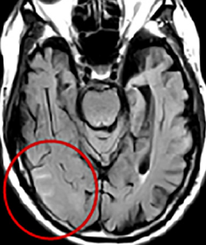
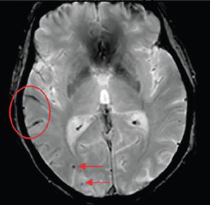
ARIA-E
ARIA-H
MRI changes suggestive of VASOGENIC EDEMA OR SULCAL EFFUSION
MRI changes suggestive of MICROHEMORRHAGES AND HEMOSIDEROSIS

Slide 3
PERCENT WITH ARIA-E AT HIGHEST DOSE
Number of APOE ε4 alleles
>4 baseline microhemorrhages
Older age
Cerebrovascular disease
 |  | Range across Agents
APOE ε4 carriers | Homozygotes | 33% - 64%
 | Heterozygotes | 11% - 35%
APOE ε4 non-carriers |  | 7% - 20%
TIMING OF ARIA
Likelihood of ARIA
Most ARIA events occur
in the early phases of Aβ targeted therapies
Exposure to DMT
Time

