Slide 1
Alternative Complement Pathway
Neutrophil-predominant vasculitis
AAV
C5a is key for neutrophil activation
C5a receptors (C5aR) prime therapeutic target
Selective C5a receptor antagonist
(avacopan)
Al-Hussain T, et al. Adv Anat Pathol. 2017;24(4):226-234.

Slide 2
ADVOCATE Trial Design
330 newly diagnosed or relapsing patients with GPA or MPA analyzed
Avacopan arm: 166 received:
Avacopan 30 mg bd
1.7 g prednisone*
RTX 375 mg/m² x4 (n = 107, 64.5%) or CYC/AZA (n = 59, 35.5%)
Active Control arm: 164 received:
3.8 g prednisone#
RTX 375 mg/m² x4 (n = 107, 65.2%) or CYC/AZA (n = 57, 34.8%)
Primary endpoint/Remission at 26 weeks (BVAS)
Avacopan: 120 out of 166 patients (72.3%)
Prednisone: 115 out of 164 patients (70.1%)
Primary endpoint/Sustained remission at 52 weeks (BVAS)
Avacopan: 109 out of 166 patients (65.7%)
Prednisone: 90 out of 164 patients (54.9%)
*mean total cumulative prednisone-equivalent dose from day 1 to end-of-treatment that included only non-study supplied glucocorticoids.
# mean total cumulative prednisone-equivalent dose from day 1 to end-of-treatment that included both study and non-study supplied glucocorticoids.
AZA, azathioprine; BVAS, Birmingham Vasculitis Activity Score; CYC, cyclophosphamide; RTX, rituximab.
Jayne DRW, et al. N Engl J Med. 2021;384(7):599-609.

Slide 3
ADVOCATE Trial
Jayne DRW, et al. N Engl J Med. 2021;384(7):599-609.

Slide 4
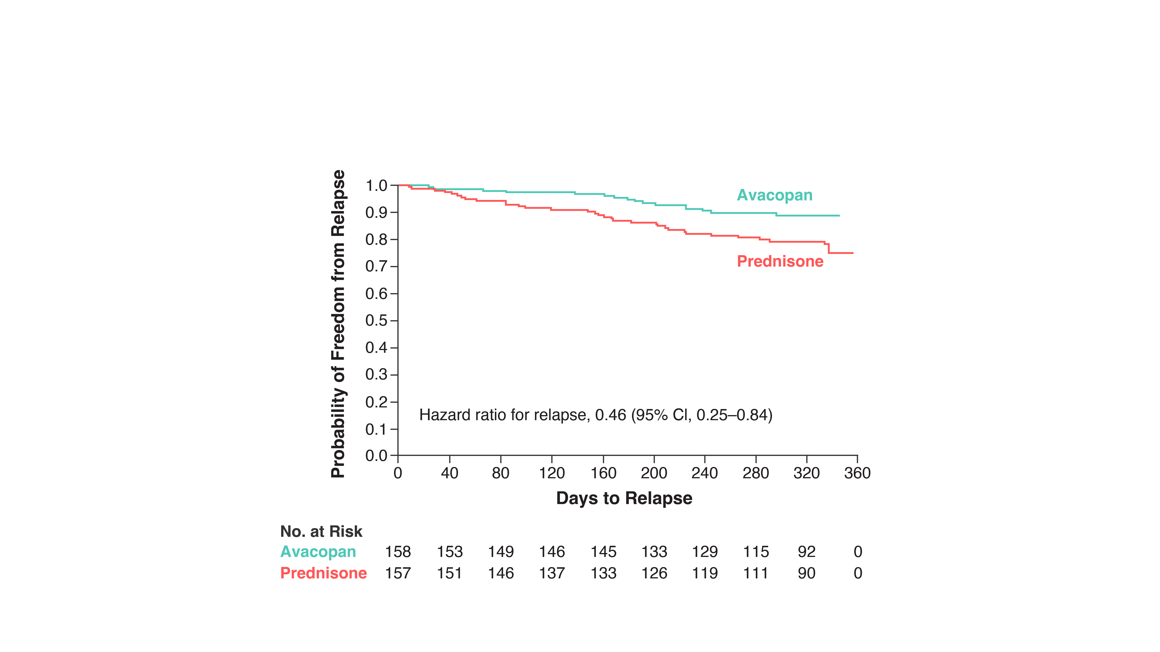
Avacopan-Based Regimen Resulted in Decreased Risk of Relapse
Jayne DRW, et al. N Engl J Med. 2021;384(7):599-609.

Slide 5
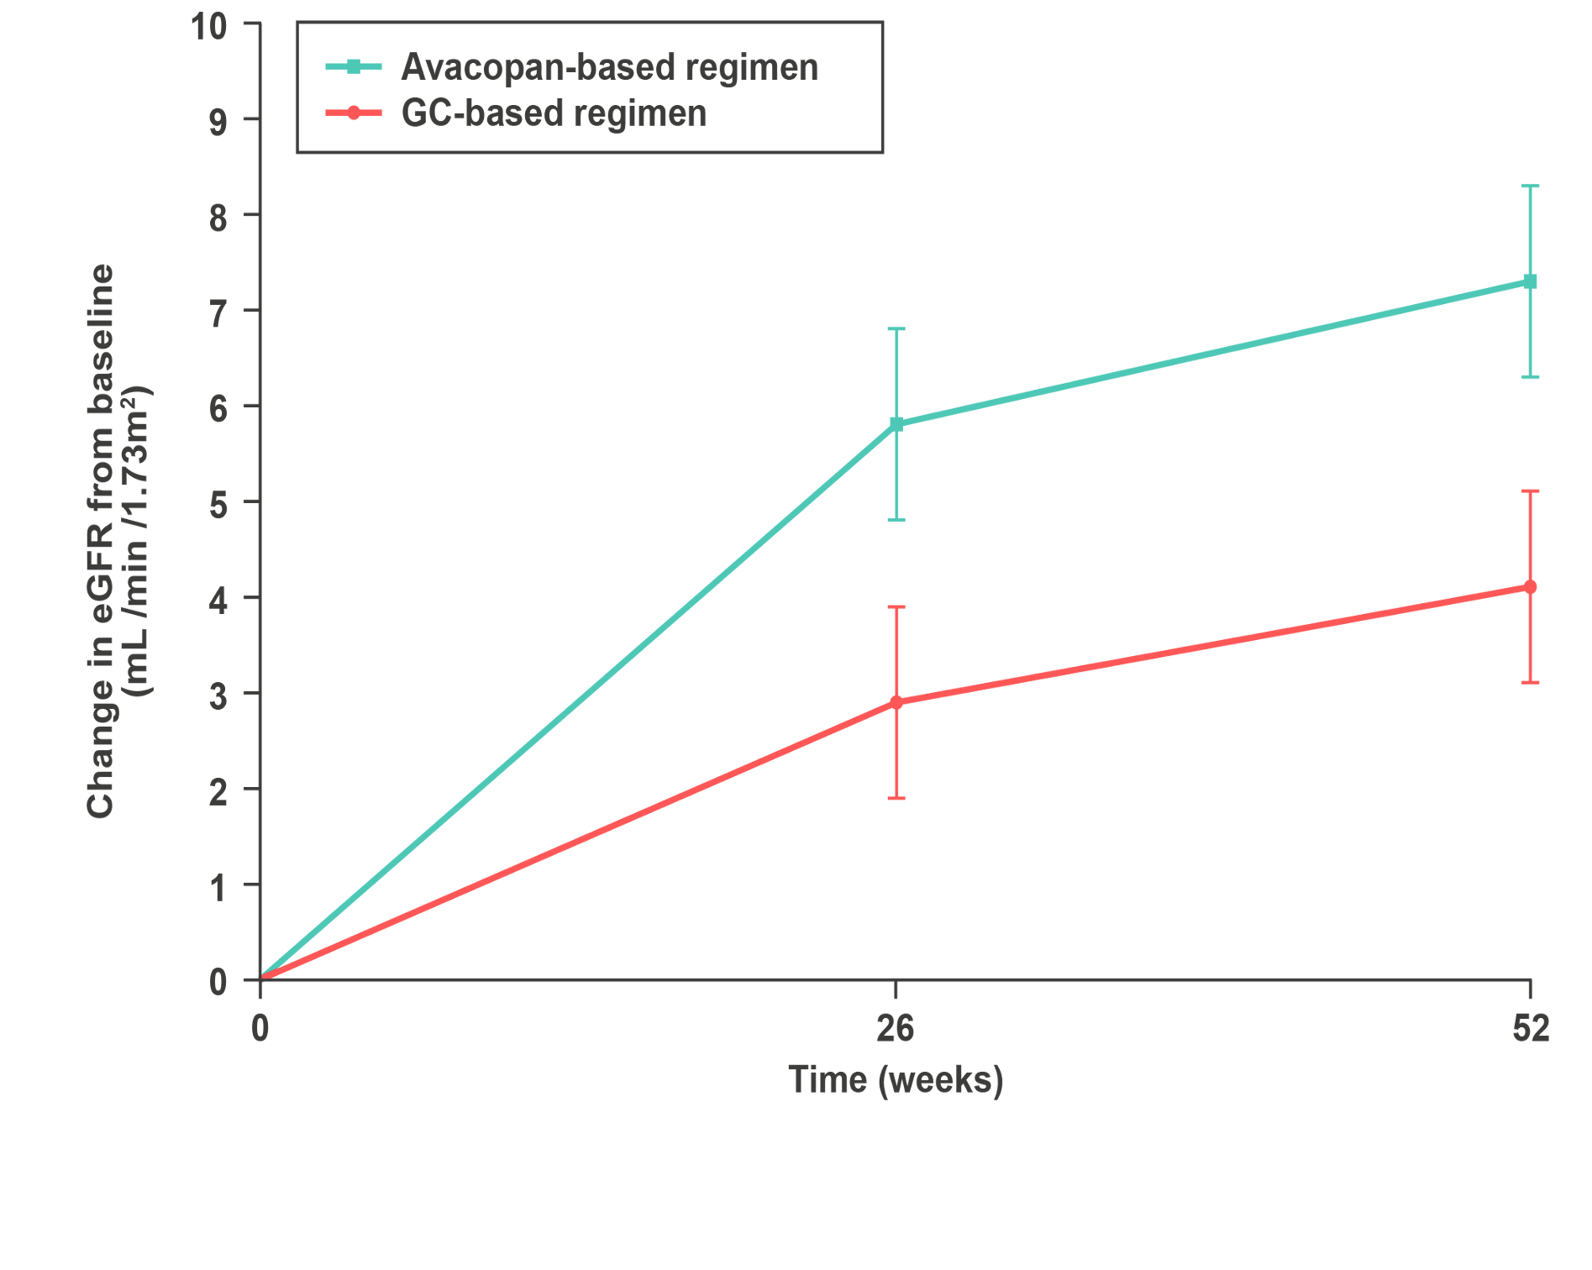
Avacopan-Based Regimen Resulted in Greater Improvements in Renal Function VS GC-Based Regimen
DECREASED UACR AT WEEK 4¹
IMPROVEMENTS IN eGFR TO WEEK 52¹
40% reduction
Avacopan-
based regimen (n = 121)
+7.3
mL /min /1.73m²
Avacopan-based regimen (n = 119*)
Treatment difference:
3.2 ml/min/1.73m²
(95% CI 0.3–6.1)¹
P = 0.029^{2,3}
VS
LSM ± SE change vs baseline in eGFR (mL/min/1.73m²)
+4.1
mL /min /1.73 m²
GC-based regimen (n = 125*)
GC-based regimen (n = 124)
No change
Baseline to Week 4 (P < 0.0001)
No difference in UACR was observed across the treatment groups at Week 52
Mean eGFR at baseline: 44.6 and 45.6 mL/min/1.73 m² in avacopan-based and GC-based regimen groups, respectively¹
*Patient numbers shown are for Week 52 only; patient numbers in avacopan-based and GC-based regimens at baseline were 131 and 134, respectively, and at Week 24 were 121 and 127, respectively. eGFR, estimated glomerular filtration rate; UACR, urine albumin-to-creatinine ratio. 1. Jayne D, et al. N Engl J Med. 2021;384(7):599-609. 2. Jayne D, et al. Nephrol Dial Transplant. 2020;35(Suppl 3):LB003. 3. Cortazar FB, et al. Kidney Int Rep. 2023;8(4):860-870.

Slide 6
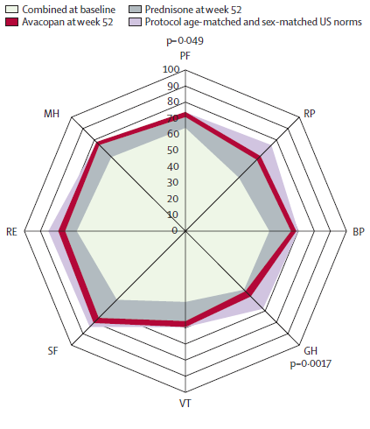
Avacopan-Based Regimen Resulted in Reduced Glucocorticoid Toxicity Scores and Improved Quality of Life VS GC-Based regimen
Patel NJ, et al. Lancet Rheumatol. 2023;5(3):e130-e138.
Jayne DRW, et al. N Engl J Med. 2021;384(7):599-609.

Slide 7
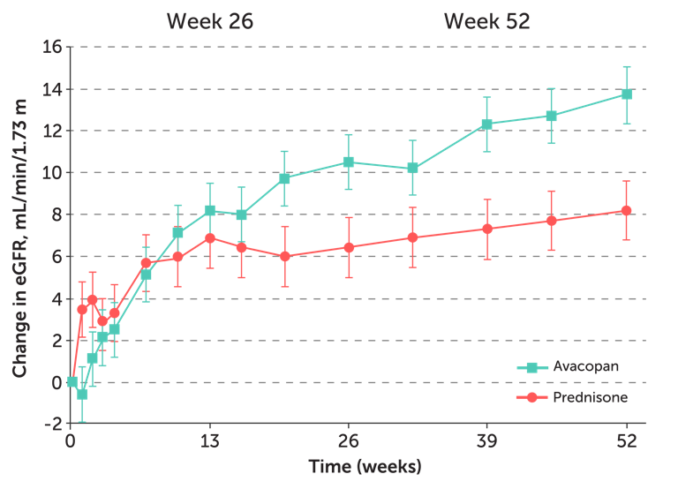
ADVOCATE Trial
265 patients with ANCA-associated glomerulonephritis
50 patients with an eGFR < 20 mL/min/1.73 m²
Improvements in eGFR
2
ANCA, antineutrophil cytoplasmic antibody; eGFR, estimated glomerular filtration rate.
Cortázar FB, et al. Kidney Int Rep. 2023;8(4):860-870. Jayne DRW, et al. N Engl J Med. 2021;384(7):599-609.

Slide 8
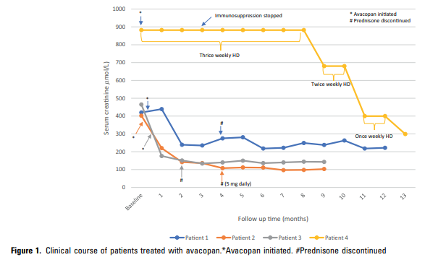
Use of Avacopan in Patients With Antineutrophil Cytoplasmic Antibody-Associated Vasculitis and Est. Glomerular Filtration Rate <15 mL/min per 1.73 m²

Slide 9
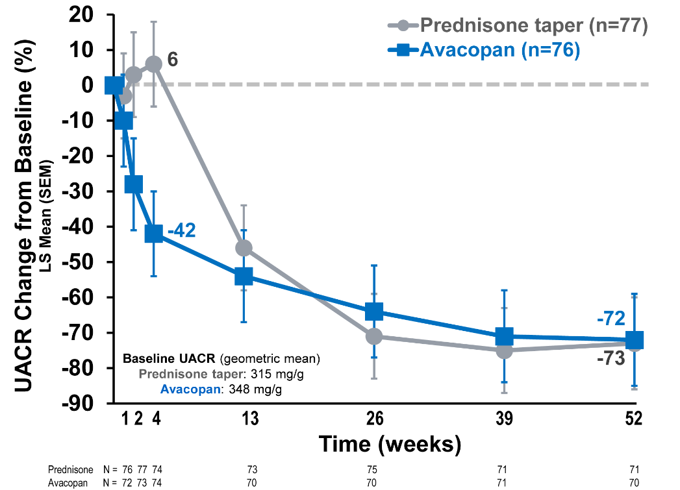
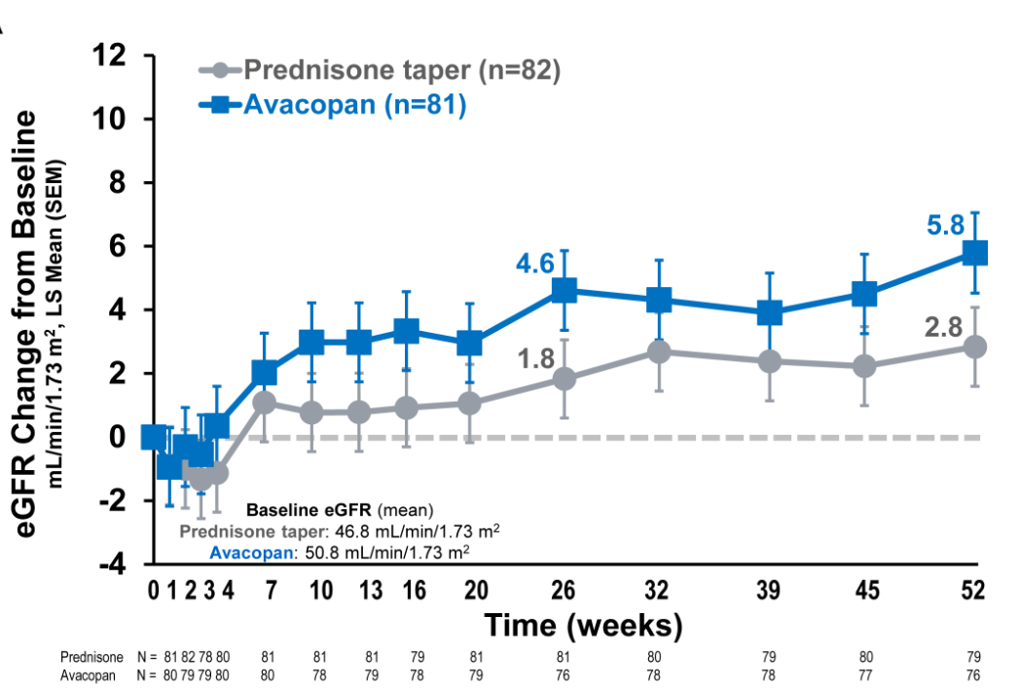
ADVOCATE Trial: Avacopan and Prednisone Taper

Slide 10
KDIGO: AAV Guidelines 2024
Diagnosis of AAV
Maintenance
Disease assessment
Induction of remission
Switch to azathioprine,
taper glucocorticoids
Continue rituximab
Rituximab + (glucocorticoid taper or avacopan)
OR
Cyclophosphamide + (glucocorticoid taper or avacopan)
OR
(Rituximab + cyclophosphamide) + (glucocorticoid taper)
Consider plasma exchange*
Taper azathioprine
Stop rituximab
Disease control “on drug” remission
“Off drug” remission
*Practice Point 9.3.1.9: Consider plasma exchange for patients with SCr >3.4 mg/dL (>300 mmol/L), patients requiring dialysis or with rapidly increasing SCr, or patients with diffuse alveolar hemorrhage who have hypoxemia. AAV, ANCA-associated vasculitis; ANCA, antineutrophil cytoplasmic antibody; SCr, serum creatinine. Floege J, et al. Kidney Int. 2024;105(3):447-449. KDIGO ANCA Vasculitis Work Group. Kidney Int. 2024;105(3S):S71-S116.

Slide 11
Using Avacopan First Line as an Alternative to GCs During Remission Induction
Starting avacopan 30 mg twice a day as early as possible in the treatment course
Using avacopan to rapidly reduce glucocorticoid exposure
Aiming to taper steroids within 1 to 2 weeks
Monitoring patients for signs of renal recovery, disease remission, or improvement in symptoms

Slide 12
Right Therapy for the Right Patient
Active glomerulonephritis + rapidly deteriorating kidney function who had better recovery with avacopan
Glucocorticoid-related
toxicity
No response
to a standard of care treatment
Glucocorticoid complications

Slide 13
ESKD Frequency Depends on eGFR!
644 (of 848) had ANCA-GN, median eGFR of 42.1 mL/min/1.73 m²
Patients with ESKD had a median baseline eGFR of 13.2 mL/min/1.73 m²
ANCA, antineutrophil cytoplasmic antibody; ANCA-GN, ANCA-associated glomerulonephritis; eGFR, estimated glomerular filtration rate; ESKD, end-stage kidney disease.
Alamo BS, et al. Nephrol Dial Transplant. Published online January 24, 2024. doi:10.1093/ndt/gfae018

Slide 14
Avacopan: ↓ Risk of Relapse
54% estimated relapse risk reduction in patients treated with avacopan compared to patients treated with standard regimen
Relapse rate in patients treated with standard regimen after 12 months was 20%
Relapse rate was cut in half to approximately 10% in patients treated with avacopan
Jayne DRW, et al. N Engl J Med. 2021;384(7):599-609.

Slide 15
Quote by Stephen McAdoo, MD
I think we can sometimes really underestimate the impact of that glucocorticoid toxicity in our patient population. So this is an exciting time to have a new option to glucocorticoids for the treatment of vasculitis.

