Slide 1
EFS by Pathologic Stage
Stage II | Patients, No. Chemo-IO | Patients, No. Chemotherapy | HR (95% CI)
Nivolumab (CheckMate 816)¹ | 65 | 62 | 0.87 (0.48-1.56)
Pembrolizumab (KEYNOTE-671)² | 118 | 121 | 0.59 (0.40-0.88)
Durvalumab (AEGEAN)³ | 104 | 110 | 0.76 (0.43-1.34)
Nivolumab (CheckMate 77T)⁴ | 81 | 81 | 0.81 (0.46-1.43)
Stage III
Nivolumab (CheckMate 816)¹ | 113 | 115 | 0.54 (0.37-0.80)
Pembrolizumab (KEYNOTE-671)² - IIIA | 217 | 224 | 0.57 (0.44-0.74)
Pembrolizumab (KEYNOTE-671)² - IIIB | 62 | 55 | 0.57 (0.36-0.90)
Durvalumab (AEGEAN)³ - IIIA | 173 | 165 | 0.57 (0.39-0.83)
Durvalumab (AEGEAN)³ - IIIB | 88 | 98 | 0.83 (0.53-1.32)
Nivolumab (CheckMate 77T)⁴ | 146 | 149 | 0.51 (0.36-0.72)

Slide 2
EFS With Perioperative Durvalumab by Nodal Status

Slide 3
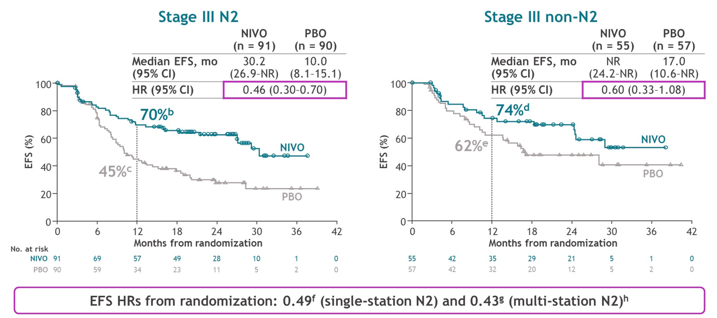
EFS With Perioperative Nivolumab by Nodal Status

Slide 4
EFS by PD-L1 Expression in Early-Stage NSCLC
 | PD-L1 < 1% HR (95% CI) | PD-L1 ≥ 1% HR (95% CI) | PD-L1 1%-49% HR (95% CI) | PD-L1 ≥ 50% HR (95% CI)
Nivolumab^{1,a} (816) | 0.85 (0.54-1.32) | 0.41 (0.24-0.70) | 0.58 (0.30-1.12) | 0.24 (0.10-0.61)
Pembrolizumab^{2,b} (671) | 0.75 (0.56-1.01) |  | 0.52 (0.36-0.73) | 0.48 (0.33-0.71)
Durvalumab^{3,c} (AEGEAN) | 0.76 (0.49-1.17) |  | 0.70 (0.46-1.05) | 0.60 (0.35-1.01)
Nivolumab^{4,a} (77T) | 0.73 (0.47-1.15) | 0.52 (0.35-0.78) | 0.76 (0.46-1.25) | 0.26 (0.12-0.55)
EFS, event-free survival; HR, hazard ratio; PD-L1, programmed death ligand 1.
ª ICH 28-8 pharmDx assay (Dako). ^{b} TPS by IHC 22C3 pharmDx assay. ^{c} VENTANA [SP263] IHC.

Slide 5
When we look at pathologic complete response and major pathological response rates according to stage or PD-L1 expression levels, we see…benefits favoring chemoimmunotherapy over chemotherapy.
Mark Awad, MD, PhD

