Slide 1
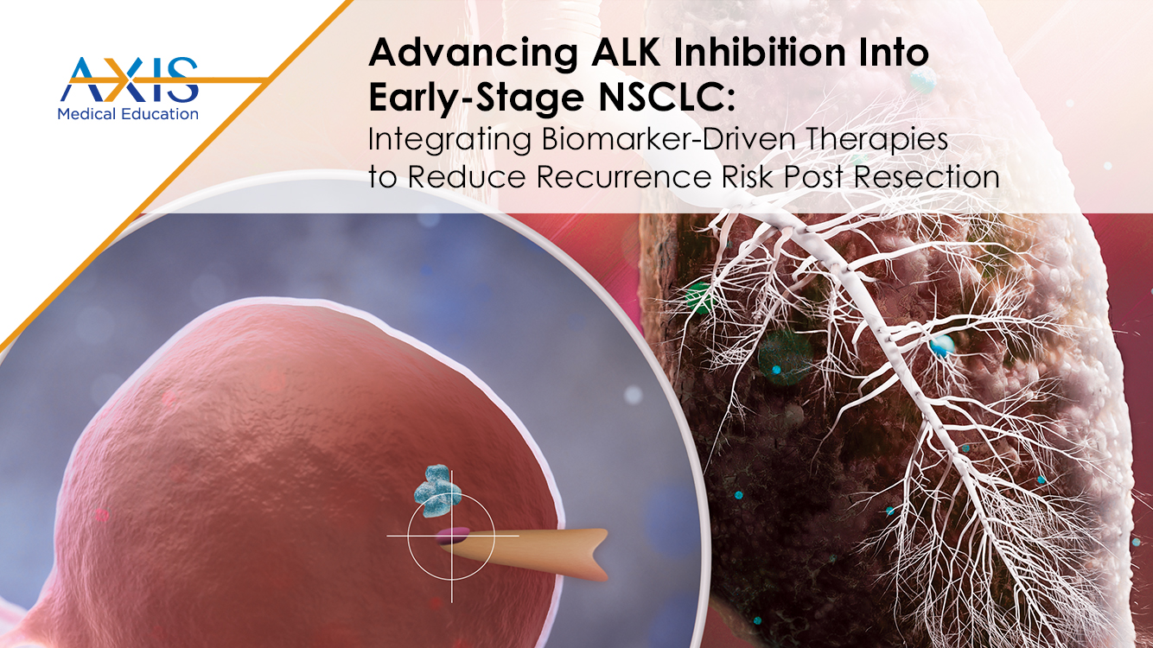

Slide 2
DISCLAIMER
This slide deck in its original and unaltered format is for educational purposes and is current as of December 2024. All materials contained herein reflect the views of the faculty, and not those of AXIS Medical Education, the CME provider, or the commercial supporter. Participants have an implied responsibility to use the newly acquired information to enhance patient outcomes and their own professional development. The information presented in this activity is not meant to serve as a guideline for patient management. Any procedures, medications, or other courses of diagnosis or treatment discussed or suggested in this activity should not be used by clinicians without evaluation of their patients’conditions and possible contraindications and/or dangers in use, review of any applicable manufacturer’s product information, and comparison with recommendations of other authorities.

Slide 3
DISCLOSURE OF UNLABELED USE
This activity may contain discussion of published and/or investigational uses of agents that are not indicated by the FDA. The planners of this activity do not recommend the use of any agent outside of the labeled indications.
The opinions expressed in the activity are those of the faculty and do not necessarily represent the views of the planners. Please refer to the official prescribing information for each product for discussion of approved indications, contraindications, and warnings.
USAGE RIGHTS
This slide deck is provided for educational purposes and individual slides may be
used for personal, non-commercial presentations only if the content and references
remain unchanged. No part of this slide deck may be published in print or
electronically as a promotional or certified educational activity without prior written
permission from AXIS. Additional terms may apply. See Terms of Service on
www.axismeded.com for details.

Slide 4
Learning Objectives
Upon completion of this activity, participants should be better able to:
Identify ALK-positive patients with early-stage NSCLC at high risk for recurrence post resection across the interprofessional care team
Incorporate therapeutic strategies for biomarker driven treatment of early-stage patients with ALK-positive NSCLC post resection
Develop clinical practice skills and team-based strategies to adopt use of targeted therapies in the adjuvant setting in patients with early-stage NSCLC
Recognize the clinical value of oncology-relevant endpoints beyond overall survival in patients with early-stage NSCLC post resection

Slide 5
Overview of Key Oncogenic
Drivers of NSCLC

Slide 6
Common Genomic Alterations in NSCLC
17%
EGFR Mutation
KRAS Mutation
25%
Point mutations in tyrosine kinase domain
Erlotinib, gefitinib, afatinib, dacomitinib, osimertinib
Activation of MAPK pathway
Negative prognostic marker
KRAS^{G12C} – sotorasib, adagrasib
Tyrosine kinase domain of EGFR gene
ALK Rearrangement
4-8%
EXON 18
EXON 19
EXON 20
EXON 21
Fusion between ALK and EML4
Constitutive ALK kinase activity
Crizotinib, ceritinib, alectinib, brigatinib, lorlatinib
ALK
EML4
G719X
Ex 19 deletion
T790M
L858R
Ex 20 Insertion
Unknown
EML4
Kinase domain
ALK-EML4 function oncogene
RET Rearrangement
2%
Fusion between RET tyrosine kinase domain and partner gene
Pralsetinib, selpercatinib
1%
ERBB2 (HER2) Mutation
Trastuzumab deruxtecan
Proliferation
survival
2%
ROS1 Rearrangement
2%
METex14 Skipping Mutation
MAPK, PI3K,
PLCy pathways
Crizotinib, entrectinib, repotrectinib
Capmatinib, tepotinib
RET proto
oncogene
xxx
2%
BRAF Mutation
CCDC6
xxx
CCDC6+
RET tyrosine
kinase domain
NTRK Rearrangement
1%
Dabrafenib + trametinib, encorafenib + binimetinib
Larotrectinib, entrectinib, repotrectinib
ALK, anaplastic lymphoma kinase; BRAF, B-Raf proto-oncogene, serine/threonine kinase; EGFR, epidermal growth factor receptor; EML4, echinoderm microtubule-associated protein-like 4; ERBB2, Erb-B2 receptor tyrosine kinase 2; HER2, human epidermal growth factor receptor 2; KRAS, KRAS proto-oncogene, GTPase; MAPK, mitogen-activated protein kinase; METex14, mesenchymal–epithelial transition exon 14; NSCLC, non-small cell lung cancer; NTRK, neurotrophic tyrosine receptor kinase; PI3K, phosphatidylinositol 3-kinase; PLC, phospholipase c; RET, rearranged during transfection; ROS1, ROS proto-oncogene 1, receptor tyrosine kinase.
Updated from Loh Z, et al. Intern Med J. 2019;49(12):1541-1545. Gupta R, et al. Am J Clin Oncol. 2019;42(4):337-344.
Notes:
Loh Z, Mitchell P, John T, Arulananda S. RET-rearranged non-small-cell lung cancer and therapeutic implications. Intern Med J. 2019;49(12):1541-1545.
Gupta R, Amanam I, Rahmanuddin S, et al. Anaplastic lymphoma kinase (ALK)-positive tumors: clinical, radiographic and molecular profiles, and uncommon sites of metastases in patients with lung adenocarcinoma. Am J Clin Oncol. 2019;42(4):337-344.
I'm showing on this slide the common genomic alterations in non-small cell, it’s become quite complex. We have 5 mutations and 4 fusions that are really part of the diagnosis. We're going to focus on ALK fusions or rearrangements highlighted in the box to the right. And you can see that depending upon what population of study that you might look at, the occurrence of this, or the incidence of this, can be anywhere from 4 to 8%. Of course, that will depend upon the population that you're testing.

Slide 7
EML4-ALK Is the Most Common
ALK-Fusion Protein
Summary of common variants
of the ALK-fusion protein^{1–4}
The most common rearrangement is between EML4 and ALK, which produces the
EML4-ALK-fusion protein^{1,2}
Frequency
in ALK+
NSCLC
Fusion protein
Variant
EML4
ALK
E13:A20
33%
The breakpoint within ALK occurs at
exon 20 (A20)^{1,2}
EML4
ALK
E6a/b:A20
29%
EML4
ALK
E20:A20
9%
EML4
ALK
E14:A20
3%
The breakpoint within EML4 can differ, thus generating different variants of the
fusion protein^{1,2}
EML4
ALK
E18:A20
2%
EML4
ALK
E15:A20
2%
EML4
ALK
E2:A20
2%
EML4
ALK
E17:A20
1%
Breakpoints within EML4^{1,2}
KIF5B
ALK
0.5%
Breakpoint at exon:
TFG
ALK
Unknown %
2
6
13
14
15
17
18
20
KLC1
ALK
PTPN3
ALK
EML4
STRN
ALK
Exon A20
Notes:
1. Gridelli C, Peters S, Sgambato A, Casaluce F, Adjei AA, Ciardiello F. ALK inhibitors in the treatment of advanced NSCLC. Cancer Treat Rev. 2014;40(2):300-306.
2. D'Arcangelo M, Wynes MW, Hirsch FR. The role of anaplastic lymphoma kinase inhibitors in the treatment of advanced nonsmall cell lung cancer. Curr Opin Oncol. 2013;25(2):121-129.
3. Hallberg B, Palmer RH. Mechanistic insight into ALK receptor tyrosine kinase in human cancer biology. Nat Rev Cancer. 2013;13(10):685-700.
4. Ou SH, Bartlett CH, Mino-Kenudson M, Cui J, Iafrate AJ. Crizotinib for the treatment of ALK-rearranged non-small cell lung cancer: a success story to usher in the second decade of molecular targeted therapy in oncology. Oncologist. 2012;17(11):1351-1375.
Anaplastic lymphoma kinase (ALK) gene rearrangements, most often consisting in a chromosome 2 inversion leading to a fusion with the echinoderm microtubule-associated protein like 4 (EML4) gene, results in the abnormal expression and activation of this tyrosine kinase in the cytoplasm of cancer cells.

Slide 8

EML4-ALK-Fusion Proteins Are Constitutively Active
EML4-ALK-fusion protein
In the EML4-ALK rearrangement, a region within chromosome 2 becomes inverted, resulting in the 5′ region of the EML4 gene becoming fused to the 3′ region of the
ALK gene^{1,2}
EML4-ALK-fusion proteins therefore consist of differing sections of the amino-terminal of EML4 fused to the protein-kinase domain of ALK^{1,2}
The EML4-ALK-fusion protein lacks the ALK transmembrane domain¹
EML4 promotes dimerization of the fusion protein resulting in constitutive activation of the ALK kinase domain¹
EML4 basic region
EML4 HELP domain
EML4 WD domain
ALK kinase domain
Notes:
Soda M, Choi YL, Enomoto M, et al. Identification of the transforming EML4-ALK fusion gene in non-small-cell lung cancer. Nature. 2007;448(7153):561-566.
Rikova K, Guo A, Zeng Q, et al. Global survey of phosphotyrosine signaling identifies oncogenic kinases in lung cancer. Cell. 2007;131(6):1190-1203.
A small inversion within chromosome 2p results in the formation of a fusion gene comprising portions of the echinoderm microtubule-associated protein-like 4 (EML4) gene and the anaplastic lymphoma kinase (ALK) gene in non-small-cell lung cancer (NSCLC) cells. Mouse 3T3 fibroblasts forced to express this human fusion tyrosine kinase generated transformed foci in culture and subcutaneous tumours in nude mice.

Slide 9
ALK Inhibitors in Clinical Use
ALK TKI |  | ADDITIONAL TARGETS | STATUS
1st generation | Crizotinib | MET, ROS1 | FDA / EMA approved, first line
2nd generation | Alectinib | RET, LTK | FDA / EMA approved, post crizotinib FDA / EMA approved, first line FDA / EMA approved, adjuvant setting
 | Brigatinib | EGFR, IGF-1R, ROS1 | FDA / EMA approved, post crizotinib FDA / EMA approved, first line
 | Ceritinib | IGF-1R, IR, ROS1 | FDA / EMA approved, post crizotinib FDA-approved, first line
 | Ensartinib | MET, ABL, AXL | FDA-approved, first line
 | Entrectinib | NTRKs, ROS1 | (FDA / EMA approved for ROS1 and NTRK, but not ALK)
3rd generation | Lorlatinib | ROS1 | FDA / EMA approved, in patients who have received 1 or more ALK inhibitors FDA / EMA approved, first line
↑ on-target potency, ↑ CNS penetration
Notes:
Awad MM, Shaw AT. ALK inhibitors in non-small cell lung cancer: crizotinib and beyond. Clin Adv Hematol Oncol. 2014;12(7):429-439.
Roskoski R Jr. Anaplastic lymphoma kinase (ALK) inhibitors in the treatment of ALK-driven lung cancers. Pharmacol Res. 2017;117:343-356.
Crizotinib was the first ALK inhibitor approved by the US Food and Drug Administration for the treatment of ALK-positive non-small cell lung cancer in 2011. The median time for the emergence of crizotinib drug resistance is 10.5 months after the initiation of therapy. Such resistance prompted the development of second-generation drugs including ceritinib, brigatinib, and alectinib, which are approved for the treatment of non-small cell lung cancer. Most recently, the third-generation ALK inhibitor lorlatinib is also approved for treating patients with ALK-positive disease.

Slide 10
Identifying ALK-Positive Patients at High Risk for Recurrence in the Community Setting

Slide 11
ALK: A Distinct Subset of NSCLC
Patients with ALK+ NSCLC tend to be…
Younger^{1–3}
Median age ~52 years versus
~70 years for other types of NSCLC
Never or light smokers^{2,4,5}
~70% patients with ALK+ NSCLC have
never smoked
Advanced disease at presentation^{6–8}
Pleural/pericardial effusion
Multiple lesions/sites
Symptomatic
CNS metastases
Notes:
1. Chia PL, Mitchell P, Dobrovic A, John T. Prevalence and natural history of ALK positive non-small-cell lung cancer and the clinical impact of targeted therapy with ALK inhibitors. Clin Epidemiol. 2014;6:423-432.
2. Camidge DR, Bang YJ, Kwak EL, et al. Activity and safety of crizotinib in patients with ALK-positive non-small-cell lung cancer: updated results from a phase 1 study. Lancet Oncol. 2012;13(10):1011-1019.
3. NIH. SEER. Cancer Stat Facts: Lung and Bronchus Cancer. https://seer.cancer.gov/statfacts/html/lungb.html
4. Tao H, Cai Y, Shi L, et al. Analysis of clinical characteristics and prognosis of patients with anaplastic lymphoma kinase-positive and surgically resected lung adenocarcinoma. Thorac Cancer. 2017;8(1):8-15.
5. Kayaniyil S, Hurry M, Wilson J, et al. Treatment patterns and survival in patients with ALK-positive non-small-cell lung cancer: a Canadian retrospective study. Curr Oncol. 2016;23(6):e589-e597.
6. Solomon BJ, Mok T, Kim DW, et al. First-line crizotinib versus chemotherapy in ALK-positive lung cancer. N Engl J Med. 2014;371(23):2167-2177.
7. Soria JC, Tan DSW, Chiari R, et al. First-line ceritinib versus platinum-based chemotherapy in advanced ALK-rearranged non-small-cell lung cancer (ASCEND-4): a randomised, open-label, phase 3 study. Lancet. 2017;389(10072):917-929.
8. Peters S, Camidge DR, Shaw AT, et al. Alectinib versus crizotinib in untreated ALK-positive non-small-cell lung cancer. N Engl J Med. 2017;377(9):829-838.
The median age of patients with ALK rearrangements is 52 years, which is younger than most NSCLC patients either with an EGFR mutation or an unselected NSCLC population. There is a male preponderance11 and most patients have a never or light (<10 pack years) smoking history. Most ALK+ patients have advanced disease at time if diagnosis, which may reflect the aggressiveness of these tumors and their predilection for cerebral and hepatic metastases in addition to pleural and pericardial effusions.

Slide 12
ALK Testing Is Recommended in Patients With Early-Stage NSCLC
Testing for PD-L1 status, EGFR mutations, and ALK rearrangements is recommended for patients with stages IB–IIIA, and IIIB (T3–4, N2) disease following surgical resection​
Molecular testing for ALK rearrangements should be performed when TKI therapy is a consideration for stage IB–IIIB disease​
The presence of an ALK rearrangement is associated with responsiveness to oral ALK TKIs​
Testing methods include FISH, IHC, NGS, and PCR assays​
ALK, anaplastic lymphoma kinase; EGFR, epidermal growth factor receptor; FISH, fluorescence in situ hybridization; IHC, immunohistochemistry; NGS, next-generation sequencing; NSCLC, non-small cell lung cancer; PCR, polymerase chain reaction; TKI, tyrosine kinase inhibitor.
NCCN Guidelines. Non-Small Cell Lung Cancer (Version 3.2025). NCCN.org.
Notes:
Riely GJ, Wood DE, Aisner DL, et al. NCCN Clinical Practice Guidelines in Oncology (NCCN Guidelines®) for Non-Small Cell Lung Cancer (Version 3.2025). © 2025 National Comprehensive Cancer Network. To view the most recent and complete version of the NCCN Guidelines®, go online to NCCN.org. ​
If we look at the NCCN guidelines for perioperative systemic therapy, and this really is the guidelines looking at systemic therapy following surgical resection, the NCCN guidelines call out testing for PD-L1, EGFR mutations, and ALK rearrangements in stage IB, through IIIA, up to IIIB, the T3, N2 category. And we'll talk a little bit about the rationale for this when we talk about the ALINA trial in a couple of slides.

Slide 13
How Should the Testing Be Done?
Notes:
Passaro A, Al Bakir M, Hamilton EG, et al. Cancer biomarkers: Emerging trends and clinical implications for personalized treatment. Cell. 2024;187(7):1617-1635.
Now, how should that testing be done? This is a table looking at the molecular methods for a biomarker testing. You can see there are a number of techniques shown to the left. I've highlighted what I think is the standard of care, and that's next-generation sequencing. The advantages here, this is high throughput. It has great sensitivity and specificity. It can cover all of these targets. We're focusing on ALK fusions today, but again, there are other mutations and other fusions that are important in the assessment of early-stage non-small as well as late stage non-small cell. So this is important. It does require a lot of bioinformatics support. It does have a bit longer turnaround time. It's really not an issue in the surgical population, because obviously these patients have to recover from surgery. Tissue issues are not as great in the early-stage population, because you have resected tissue or biopsies that are adequate for testing.

Slide 14
Role of Liquid Biopsy Across the Cancer Care Continuum
Notes:
IASLC. IASLC Atlas of Molecular Testing for Targeted Therapy in Lung Cancer. 2023. https://www.iaslc.org/iaslc-atlas-molecular-testing-targeted-therapy-lung-cancer
The clinical application of liquid biopsy in diagnostics and therapeutic decision-making for NSCLC continues to rapidly evolve. This figure displays the NSCLC continuum of care, from screening and early diagnosis to determination of minimal residual disease (MRD) in the postsurgical setting of early-stage disease, to genomic and immunodiagnostics of advanced-stage disease. It is notable that while tumor tissue profiling is applicable in patients with stage IV NSCLC, liquid biopsy is uniquely suited to have the potential to address screening of at-risk individuals, determination of MRD, and treatment response monitoring.

Slide 15
Rationale to Improve Disease Control in Resected ALK-Positive NSCLC

Slide 16
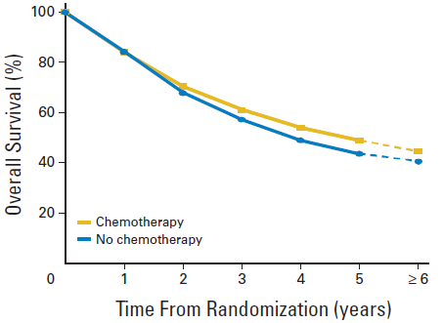
Meta-Analysis:
Lung Adjuvant Cisplatin Evaluation (LACE)
5 studies since 1995
  BLT, ALPI, IALT, JBR.10, ANITA
Pooled individual data
  4,585 patients
Chemotherapy
  ↓6.9% lung cancer death
  ↑1.4% non-cancer death
ALPI, Adjuvant Lung Project Italy; ANITA, Adjuvant Navelbine International Trialist Association; BLT, Big Lung Trial;
IALT, International Adjuvant Lung Cancer Trial; JBR.10, National Cancer Institute of Canada Clinical Trials Group JBR.10.
Pignon JP, et al. J Clin Oncol. 2008;26(21):3552-3559.
Notes:
Pignon JP, Tribodet H, Scagliotti GV, et al. Lung adjuvant cisplatin evaluation: a pooled analysis by the LACE Collaborative Group. J Clin Oncol. 2008;26(21):3552-3559.
With a median follow-up time of 5.2 years, the overall HR of death was 0.89 (95% CI, 0.82 to 0.96; P = .005), corresponding to a 5-year absolute benefit of 5.4% from chemotherapy. There was no heterogeneity of chemotherapy effect among trials. Chemotherapy effect was higher in patients with better performance status. There was no interaction between chemotherapy effect and sex, age, histology, type of surgery, planned radiotherapy, or planned total dose of cisplatin.

Slide 17
ALINA: A Global, Open-Label, Phase 3, Randomized Clinical Trial*
Resected Stage IB (≥4 cm)–IIIA
ALK+ NSCLC
per UICC/AJCC 7th edition
Other key eligibility criteria:
ECOG PS 0/1
Eligible to receive platinum-based
chemotherapy
Adequate end-organ function
No prior systemic cancer therapy
Stratification factors:
Stage: IB (≥4 cm) vs II vs IIIA
Race: Asian vs non-Asian
Alectinib 600 mg BID
2 years
Recurrence
Further treatments of investigator’s choice and survival follow-up
R
1:1
Platinum-based chemotherapy† Q3W; 4 cycles
Recurrence
N=257
Disease assessments (including brain MRI)§ were conducted at baseline,
every 12 weeks for years 1–2, every 24 weeks for years 3–5, and then annually
Primary endpoint
DFS per investigator,‡ tested hierarchically:
  Stage II–IIIA → ITT (Stage IB–IIIA)
Other endpoints
CNS disease-free survival
OS
Safety
Data cutoff: June 26, 2023. *Superiority trial. †Cisplatin + pemetrexed, cisplatin + vinorelbine, or cisplatin + gemcitabine; cisplatin could be switched to carboplatin in case of intolerability. ‡DFS defined as the time from randomization to the first documented recurrence of disease or new primary NSCLC as determined by the investigator or death from any cause, whichever occurs first. §Assessment by CT scan where MRI is not available.
ALK, anaplastic lymphoma kinase; BID, twice daily; CNS, central nervous system; DFS, disease-free survival; ECOG PS, Eastern Cooperative Oncology Group performance status; ITT, intention to treat; NSCLC, non-small cell lung cancer; OS, overall survival; Q3W, once every 3 weeks; UICC/AJCC, International Union Against Cancer/American Joint Committee on Cancer.
Wu YL, et al. N Engl J Med. 2024;390(14):1265-1276. ClinicalTrials.gov identifier: NCT03456076.
Notes:
Wu YL, Dziadziuszko R, Ahn JS, et al. Alectinib in resected ALK-positive non-small-cell lung cancer. N Engl J Med. 2024;390(14):1265-1276.
A study comparing adjuvant alectinib versus adjuvant platinum-based chemotherapy in patients with ALK positive non-small cell lung cancer. ClinicalTrials.gov identifier: NCT03456076. Updated August 26, 2024. https://www.clinicaltrials.gov/study/NCT03456076
And the reason we're testing is because the results of the ALINA trial shown here, this is a global, open-label, phase 3, randomized clinical trial. And this is using the 7th Edition. It included using stage IB; these were the larger stage 1B greater than 4 cm to IIIA, ALK-positive, non-small cell lung cancer. Other key eligibility criteria were good performance status. You were eligible to receive platinum-based therapy, you had good end-organ function, and had no prior therapy. The patients were stratified by stage as shown, as well as by race, Asian versus non-Asian.
The randomization was to platinum-based chemotherapy vs alectinib. Now, this is different than other trials, because this was a comparison of targeted therapy to our standard guideline-endorsed platinum-based chemotherapy for 4 cycles. The primary endpoint of this trial was disease-free survival by the investigator. There was a hierarchical testing method looking at the stage II to IIIA, so essentially the node-positive population, as well as the intent-to-treat population, which included the stage IB patients. Other endpoints included CNS disease-free survival, overall survival, and safety.
Now, it's important to note that disease assessments, including brain MRI, were conducted every 12 weeks for years 1 to 2, and every 24 weeks for years 3 to 5, and then annually.

Slide 18
Patient Demographics and Baseline Characteristics (ITT)
Characteristic | Alectinib (n=130) | Chemotherapy (n=127)
Median age <65/≥65 years, % | 54 years 79/21 | 57 years 73/27
Sex: female/male, % | 58/42 | 46/54
Smoking status: never/former/current, % | 65/32/4 | 55/43/2
Race: Asian/non-Asian, % | 55/45 | 56/44
ECOG PS: 0/1, % | 55/45 | 51/49
Stage at diagnosis*: IB/II/IIIA, % | 11/36/53 | 9/35/55
Nodal status: N0/N1/N2, % | 16/35/49 | 14/34/52
Histology: squamous/non-squamous, % | 5/95 | 2/98
Surgical procedure: Lobectomy/other, %† | 97/3 | 92/8
Notes:
Wu YL, Dziadziuszko R, Ahn JS, et al. Alectinib in resected ALK-positive non-small-cell lung cancer. N Engl J Med. 2024;390(14):1265-1276.
The demographic and clinical characteristics of the patients at baseline were generally well balanced between the treatment groups and were broadly similar to the available demographic data in patients with ALK-positive NSCLC; however, Black patients were underrepresented in the trial population. As compared with the chemotherapy group, the alectinib group had a higher percentage of female patients (57.7% vs. 46.5%) and patients who had never smoked (64.6% vs. 55.1%). No patients in the trial received neoadjuvant radiotherapy or postoperative radiotherapy.

Slide 19
Primary Endpoint: Disease-Free Survival, Stage II-IIIA*
100
93.8%
88.3%
Alectinib
 | Alectinib (n=116) | Chemotherapy (n=115)
Patients with event | 14 (12%) | 45 (39%)
Death | 0 | 1
Recurrence | 14 | 44
Median DFS, months (95% CI) | Not reached | 44.4 (27.8, NE)
DFS HR | 0.24 (0.13, 0.45)
(95% CI) | P<0.0001†
80
63.0%
60
53.3%
Disease-free survival (%)
Chemotherapy
40
20
0
24 30
Time (months)
0
6
12
18
36
42
48
54
No. at risk
Alectinib 116 | 111 | 111 | 107 | 67 | 49 | 35 | 21 | 10 | 3
Chemo 115 | 102 | 88 | 79 | 48 | 35 | 23 | 17 | 10 | 2
Nearly 50% have had
recurrence or death by year 3
Median survival follow-up: alectinib, 27.9 months; chemotherapy, 27.8 months
Notes:
Wu YL, Dziadziuszko R, Ahn JS, et al. Alectinib in resected ALK-positive non-small-cell lung cancer. N Engl J Med. 2024;390(14):1265-1276.
Now, looking at the primary endpoint of disease-free survival in the stage II to IIIA patients, you can clearly see that these curves separate early. The disease-free survival hazard ratio is 0.24, so a significant reduction in either the risk of recurrence or death. In looking at the 3-year time point, the difference is 53% for the chemotherapy control arm vs 88% for the alectinib arm on this trial.

Slide 20
Primary Endpoint: Disease-Free Survival, ITT (Stage IB-IIIA)*
100
93.6%
88.7%
 | Alectinib (n=130) | Chemotherapy (n=127)
Patients with event | 15 (12%) | 50 (39%)
Death | 0 | 1
Recurrence | 15 | 49
Median DFS, months (95% CI) | Not reached | 41.3 (28.5, NE)
DFS HR | 0.24 (0.13, 0.43)
(95% CI) | P<0.0001†
80
Alectinib
63.7%
60
54.0%
Disease-free survival (%)
Chemotherapy
40
20
0
24 30
Time (months)
0
6
12
18
36
42
48
54
At the data cutoff, OS data were immature, with only 6 (2.3%) OS events reported‡
No. at risk
Alectinib 130 | 123 | 123 | 118 | 74 | 55 | 39 | 22 | 10 | 3
Chemo 127 | 112 | 98 | 89 | 55 | 41 | 27 | 18 | 11 | 2
Median survival follow-up: alectinib, 27.8 months; chemotherapy, 28.4 months
Data cutoff: June 26, 2023; time from last patient in to data cutoff was ≈18 months.
*Per UICC/AJCC 7th edition. †Stratified log rank. ‡2 events in the alectinib arm, 4 events in the chemo arm; one additional patient in the chemo arm died but was censored due to incomplete date of death recorded. DFS was defined as the time from randomization to the first documented recurrence of disease or new primary NSCLC as determined by the investigator or death from any cause, whichever occurs first.
DFS, disease-free survival; HR, hazard ratio; ITT, intent to treat; NE, not established; NSCLC, non-small cell lung cancer; OS, overall survival; UICC/AJCC, International Union Against Cancer/American Joint Committee on Cancer.
Wu YL, et al. N Engl J Med. 2024;390(14):1265-1276.
Notes:
Wu YL, Dziadziuszko R, Ahn JS, et al. Alectinib in resected ALK-positive non-small-cell lung cancer. N Engl J Med. 2024;390(14):1265-1276.
When one adds in the stage IB, or this would be the intent-to-treat population, you can see that the hazard ratio remains stable at 0.24, highly statistically significant. It's very early in the follow-up. Obviously, the median follow-up for survival was just over 2 years in both arms of this particular trial. So at this data cutoff, there were only about 2% of overall survival events that had been reported. So we will have to stay tuned for the impact on overall survival in this setting.

Slide 21
Disease-Free Survival by Disease Stage
Stage IB
100
Alectinib
2-year DFS rate, % (95% CI) | Stage IB (n=26) | Stage II (n=92) | Stage IIIA (n=139)
Alectinib | 92.3 (77.8, 100.0) | 95.6 (89.5, 100.0) | 92.7 (86.4, 98.9)
Chemotherapy | 71.6 (44.2, 99.0) | 66.3 (51.7, 81.0) | 60.7 (47.9, 73.5)
HR† (95% CI) | 0.21 (0.02, 1.84) | 0.24 (0.09, 0.65) | 0.25 (0.12, 0.53)
80
60
40
Disease-free survival (%)
20
0
Chemotherapy
0
6
12
18
24 30
Time (months)
36
42
48
54
Stage II
100
Stage IIIA
100
80
Alectinib
80
Alectinib
60
60
Disease-free survival (%)
Chemotherapy
Disease-free survival (%)
40
40
Chemotherapy
20
20
0
0
0
6
12
18
24 30
Time (months)
36
42
48
54
0
6
12
18
24 30
Time (months)
36
42
48
54
Notes:
Wu YL, Dziadziuszko R, Ahn JS, et al. Alectinib in resected ALK-positive non-small-cell lung cancer. N Engl J Med. 2024;390(14):1265-1276.
The disease-free survival benefit from adjuvant alectinib as compared with chemotherapy was seen in subgroups defined according to disease stage.

Slide 22
Disease-Free Survival Subgroup Analysis (ITT)
Subgroup
No. of events / patients
DFS HR (95% CI)
All patients
65 / 257
0.24 (0.14–0.43)
Age
<65
≥65
43 / 196
22 / 61
0.26 (0.13–0.52)
0.24 (0.08–0.71)
Sex
Male
Female
35 / 123
30 / 134
0.26 (0.11–0.60)
0.22 (0.10–0.50)
Race
Asian
Non-Asian
31 / 143
34 / 114
0.36 (0.17–0.79)
0.16 (0.06–0.38)
ECOG PS at baseline
0
1
32 / 137
33 / 120
0.20 (0.09–0.46)
0.31 (0.14–0.69)
Tobacco use history
Never
Current
Previous
37 / 154
0 / 8
28 / 95
0.27 (0.13–0.55)
NE
0.22 (0.08–0.57)
Stage*
Stage IB
Stage II
Stage IIIA
6 / 26
22 / 92
37 / 139
0.21 (0.02–1.84)
0.24 (0.09–0.65)
0.25 (0.12–0.53)
Regional lymph node status
N0
N1
N2
11 / 39
20 / 88
34 / 130
0.19 (0.04–0.88)
0.34 (0.13–0.89)
0.21 (0.09–0.47)
0.1
0.3
1.0
3.0
Alectinib better
Chemotherapy better
Notes:
Wu YL, Dziadziuszko R, Ahn JS, et al. Alectinib in resected ALK-positive non-small-cell lung cancer. N Engl J Med. 2024;390(14):1265-1276.
The disease-free survival benefit from adjuvant alectinib as compared with chemotherapy was generally consistent across all subgroups.

Slide 23
CNS Disease-Free Survival in the ITT Population
100
98.4%
95.5%
Alectinib
80
85.8%
Chemotherapy
 | Alectinib (n=130) | Chemotherapy (n=127)
Patients with event | 5 | 18
Death | 1 | 4
Brain recurrence | 4 | 14
CNS-DFS HR* | 0.22
(95% CI) | (0.08, 0.58)
79.7%
60
CNS disease-free survival (%)
40
20
0
24 30
Time (months)
0
6
12
18
36
42
48
54
No. at risk
Alectinib 130
^{Chemo} 127
124
113
124
98
118
90
74
57
55
43
39
27
22
18
10
11
3
2
Median survival follow-up: alectinib, 27.8 months; chemotherapy, 28.4 months
Notes:
Wu YL, Dziadziuszko R, Ahn JS, et al. Alectinib in resected ALK-positive non-small-cell lung cancer. N Engl J Med. 2024;390(14):1265-1276.
Now, I mentioned in the design slide the frequent assessment of the CNS. This looks at the CNS disease-free survival. Again, in the intent-to-treat population, we see here a CNS disease-free survival hazard ratio of 0.22. Very significant in this particular setting. Again, chemotherapy at 3 years, about 80% of patients are free of CNS occurrence, whereas in the alectinib arm, which has very good CNS activity, about 95% in this setting.

Slide 24
Sites of Disease Recurrence (ITT)
No disease recurrence
(n=115)
No disease recurrence
(n=77)
Site(s) of distant recurrence* | Alectinib (n=130) | Chemotherapy (n=127)
Brain | 4 | 14
Bone | 1 | 8
Adrenal gland | 0 | 3
Lymph node | 0 | 2
Kidney | 0 | 1
Peritoneum | 0 | 1
Other | 1 | 0
Local/regional
+ distant (n=5)
New primary lung cancer (n=1)
Distant
(n=22)
Local/regional + distant (n=2)
Local/regional (n=22)
Local/regional (n=9)
Distant (n=3)
Alectinib
Chemotherapy†
Data cut-off: 26 June 2023.
*At disease assessment where first recurrence detected; patients may have multiple sites of disease recurrence counted. †One patient died without a recurrence event reported.
ITT, intent to treat.
Wu YL, et al. N Engl J Med. 2024;390(14):1265-1276.
Notes:
Wu YL, Dziadziuszko R, Ahn JS, et al. Alectinib in resected ALK-positive non-small-cell lung cancer. N Engl J Med. 2024;390(14):1265-1276.
Disease recurrence was observed in 15 patients (11.5%) in the alectinib group and 49 (38.6%) in the chemotherapy group. The most common site of recurrence was the brain, reported in 4 patients in the alectinib group and 14 in the chemotherapy group.

Slide 25
Safety Summary
 | Alectinib (n=128) | Chemotherapy (n=120)
Median treatment duration | 23.9 months | 2.1 months
Patients with any AEs, % | 98 | 93
Grade 3/4 AEs | 30 | 31
Grade 5 AEs | 0 | 0
Serious AEs | 13 | 8
Treatment-related serious AEs | 2 | 7
AEs leading to dose reduction | 26 | 10
AEs leading to dose interruption | 27 | 18
AEs leading to treatment withdrawal | 5 | 13
At data cutoff, 20.3% of patients in the alectinib arm were receiving ongoing treatment
Data cutoff: June 26, 2023.
Multiple occurrences of the same AE in one individual are counted only once in each category.
AE, adverse event.
Wu YL, et al. N Engl J Med. 2024;390(14):1265-1276.
Notes:
Wu YL, Dziadziuszko R, Ahn JS, et al. Alectinib in resected ALK-positive non-small-cell lung cancer. N Engl J Med. 2024;390(14):1265-1276.
The median duration of treatment for the safety-evaluable population was 23.9 months with alectinib and 2.1 months with chemotherapy. At least one adverse event was reported by 98.4% of the patients in the alectinib group and 93.3% of those in the chemotherapy group. The majority were grade 1 or 2 events. No grade 5 (fatal) adverse events were reported.
Serious adverse events were reported in 17 patients (13.3%) in the alectinib group and 10 patients (8.3%) in the chemotherapy group. Adverse events that led to dose reduction were reported in 25.8% of the patients in the alectinib group and 10.0% of those in the chemotherapy group, and adverse events that led to dose interruption were reported in 27.3% and 18.3%, respectively. Adverse events that led to dose discontinuation were reported in 5.5% of the patients in the alectinib group and 12.5% of those in the chemotherapy group.

Slide 26
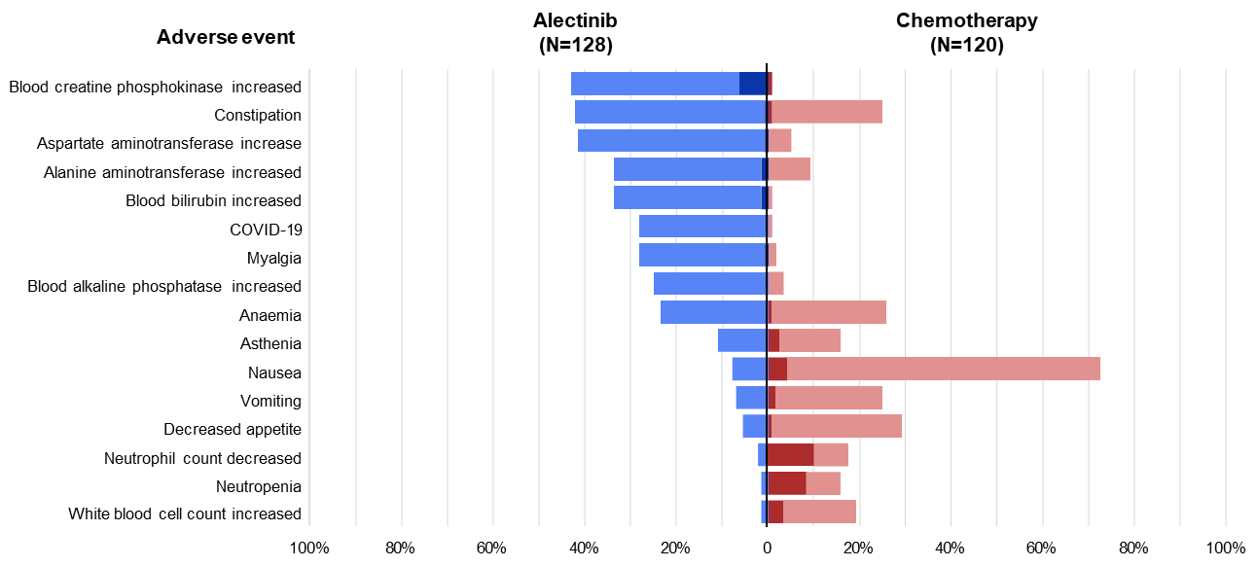

AEs Occurring in ≥15% of Patients
Data cutoff: June 26, 2023.
Median treatment duration was 23.9 months in the alectinib arm and 2.1 months in the chemotherapy arm. No grade 5 events were observed.
AE, adverse event.
Wu YL, et al. N Engl J Med. 2024;390(14):1265-1276.
Notes:
Wu YL, Dziadziuszko R, Ahn JS, et al. Alectinib in resected ALK-positive non-small-cell lung cancer. N Engl J Med. 2024;390(14):1265-1276.
The most commonly reported adverse events were increased creatine kinase levels (43.0%) and constipation (42.2%) in the alectinib group and nausea (72.5%) and decreased appetite (29.2%) in the chemotherapy group.

Slide 27
AEs Leading to Dose Interruption, Reduction, or Treatment Discontinuation in ≥3 Patients
Most AEs did not require any dose modification and had resolved by the data cut-off
Safety | Alectinib (n=128)
Median treatment duration | 23.9 months
Median dose intensity, % | 99.4
Any AE leading to dose interruption, n (%) | 35 (27.3)
in ≥3 patients
Blood CPK increased | 7 (5.5)
ALT increased | 7 (5.5)
AST increased | 6 (4.7)
COVID-19 | 6 (4.7)
Blood bilirubin increased* | 5 (3.9)
Myalgia | 3 (2.3)
Any AE leading to dose reduction, n (%) | 33 (25.8)
in ≥3 patients
Blood CPK increased | 8 (6.3)
Blood bilirubin increased* | 5 (3.9)
Any AE leading to treatment discontinuation, n (%) | 7 (5.5)
in ≥3 patients
Pneumonitis | 3 (2.3)
Notes:
Horinouchi H, Solomon BJ, Wu Y-L, et al. ALINA safety results: adjuvant alectinib vs chemotherapy in patients with resected ALK+ non-small cell lung cancer (NSCLC). Abstract presented at: World Conference on Lung Cancer; San Diego, California; September 7-10, 2024. Abstract OA13.04.
At data cut-off (June 26th, 2023), median safety follow-up was 24.8 months and 3.7 months in the alectinib and chemotherapy arms, respectively. The five most reported AEs in the alectinib arm were: blood creatine phosphokinase (CPK) increased (43.0%), constipation (42.2%), aspartate aminotransferase increased (41.4%), alanine aminotransferase increased (33.6%), and blood bilirubin increased (33.6%). Most of these AEs were of low grade, non-serious, and did not require any dose modification. Blood CPK increase led to dose reduction in 6.3% of patients and interruption in 5.5% of patients, and pneumonitis led to treatment withdrawal in 2.3% of patients.

Slide 28
Summary
ALINA is the first and only positive phase 3 trial of an ALK inhibitor in resected,
stage IB–IIIA NSCLC
Treatment with adjuvant alectinib resulted in a statistically significant and clinically meaningful improvement in DFS compared with chemotherapy (HR 0.24; 95% CI 0.13, 0.43; P < 0.0001)
  The DFS benefit was seen consistently across subgroups
An improvement in CNS-DFS was observed (HR 0.22; 95% CI 0.08, 0.58)
Adjuvant alectinib was tolerable and in line with the known safety profile of alectinib
Adjuvant alectinib represents an important new treatment strategy
for patients with resected, stage IB–IIIA, ALK+ NSCLC
ALK, anaplastic lymphoma kinase; CNS, central nervous system; DFS, disease-free survival; HR, hazard ratio; NSCLC, non-small cell lung cancer.
Wu YL, et al. N Engl J Med. 2024;390(14):1265-1276.
Notes:
Wu YL, Dziadziuszko R, Ahn JS, et al. Alectinib in resected ALK-positive non-small-cell lung cancer. N Engl J Med. 2024;390(14):1265-1276.
Adjuvant alectinib showed a significant benefit with respect to disease-free survival as compared with chemotherapy, as well as a mainly low-grade safety profile with few discontinuations due to adverse events. Adjuvant alectinib represents an important efficacious new treatment strategy for patients with resected ALK-positive NSCLC of stage IB, II, or IIIA.

Slide 29
Emerging Directions in Early Stage ALK+ NSCLC

Slide 30
ALNEO: Study Design
Resectable locally advanced stage III NSCLC
Candidate for surgical resection after multidisciplinary discussion
ALK positive (IHC/FISH/NGS)
No Previous treatment
ECOG PS 0-1
Neoadjuvant phase
Adjuvant phase
Alectinib 600mg bid for 2 months
Surgery
(non-PD)
Alectinib 600mg bid for 24 months
≤4 w
≤8 w
Primary endpoint: MPR by BICR
Secondary endpoints: pCR by BICR, OR, EFS, DFS, OS, AEs
According to the Simon’s two-stage mini-max design, the null hypothesis that the MPR is ≤20% will be tested against a one-sided alternative. In the first stage, 18 patients will be accrued. If there are 4 or fewer MPR in these 18 patients, the study will be stopped early for futility. Otherwise, 15 additional patients will be accrued for a total of 33. The null hypothesis will be rejected if 11 or more MPR are observed in 33 patients. This design yields a type I error rate of 0.05 and power of 0.80 when the true MPR is 40%
Notes:
Leonetti A, Boni L, Gnetti L, et al. Neoadjuvant alectinib in potentially resectable stage III ALK-positive NSCLC: interim analysis of ALNEO-GOIRC-01-2020 phase II trial. Abstract presented at: World Conference on Lung Cancer; San Diego, California; September 7-10, 2024. Abstract MA01.03.
ALNEO is a phase II, open-label, single-arm, multicenter study aimed at investigating the activity and safety of alectinib in potentially resectable locally advanced stage III ALK-positive NSCLC patients. Treatment-naïve patients with potentially resectable stage III ALK-positive NSCLC, ECOG PS≤1 were registered to receive neoadjuvant alectinib for 2 cycles (8 weeks) followed by surgery and adjuvant alectinib for 24 cycles (96 weeks). The primary endpoint was major pathological response (MPR). Secondary endpoints included pathological complete response (pCR), objective response (OR), event-free survival (EFS), disease-free survival (DFS), overall survival (OS), adverse events (AEs).

Slide 31
ALNEO: Study Population
Data cut-off date: January 31st, 2024
Baseline Characteristics |  | n=25
Median age, years (IQR) |  | 56 (49-67)
Gender, n (%) | Male | 8 (32)
 | Female | 17 (68)
Smoking, n (%) | Never | 14 (56)
 | Former | 11 (44)
ECOG PS, n (%) | 0 | 19 (76)
 | 1 | 6 (24)
Histology, n (%) | Adenocarcinoma | 25 (100)
Stage*, n (%) | IIIA | 14 (56)
 | IIIB | 11 (44)
N Stage*, n (%) | N0 | 2 (8)
 | N1 | 1 (4)
 | N2 | 22 (88)
Screened (n=30)
Registered (n=25)
18 (72%) included in the primary endpoint Interim Analysis
25 (100%) completed neoadjuvant phase
21 (84%)
underwent surgery
4 (16%) patients did not undergo surgery:
2 patient refusal
1 clinical decision
1 PD
20 (95%)
started adjuvant phase
Notes:
Leonetti A, Boni L, Gnetti L, et al. Neoadjuvant alectinib in potentially resectable stage III ALK-positive NSCLC: interim analysis of ALNEO-GOIRC-01-2020 phase II trial. Abstract presented at: World Conference on Lung Cancer; San Diego, California; September 7-10, 2024. Abstract MA01.03.
To date, the results are available in 25 patients registered in 20 Italian Oncology Centers from May 2021. Median age was 56 years (Interquartile Range [IQR], 49-67 years), 17 (68%) patients were female and 14 (56%) were never smokers. Clinical stage according to the 8th AJCC TNM was IIIA in 14 (56%) and IIIB in 11 (44%) patients. The most represented stage was T3N2 (n=6, 24%), followed by T1aN2 (n=4, 16%) and T4N2 (n=4, 16%). All the patients completed the neoadjuvant phase and 21 (84%) underwent surgery, which consisted of lobectomy in 17 (81%), pneumonectomy in 2 (9.5%) and other surgery in 2 (9.5%) patients.

Slide 32
ALNEO: MPR (Primary Endpoint)
Pathologic Response | n=18
MPR, n (%) | 7 (39)
pCR, n (%) | 3 (17)
No MPR, n (%) | 6 (33)
Not Assessed, n (%) | 5 (28)ª
 | n=25
Underwent Surgery, n (%) | 21 (84)
R0, n (% or surgery) | 18 (86)
Type of surgery, n (%)
Lobectomy | 17 (81)
Pneumonectomy | 2 (9.5)
Other Surgery | 2 (9.5)
Received adjuvant, n (% of surgery) | 20 (95)^{c}
Median interval from surgery, weeks (IQR) | 4.5 (2.7–6.0)
Median n of cycles, n (IQR) | 6 (1–20)
39%
(90% CI, 20–61)
Rate (%)
Objective Response^{b} | n=25
CR, n (%) | 7 (39)
PR, n (%) | 3 (17)
SD, n (%) | 6 (33)
PD, n (%) | 5 (28)ª
ORR, (%) | 20 (80)
n=7
Neoadjuvant treatment was well tolerated. G1-2 TEAEs were reported in 14 (56%) cases. No Grade ≥3 treatment-related AEs were observed
After a median follow-up of 10.8 months (IQR: 4.9–22.5), a total of 159 adjuvant courses were administered and the treatment appeared to be well tolerated
Notes:
Leonetti A, Boni L, Gnetti L, et al. Neoadjuvant alectinib in potentially resectable stage III ALK-positive NSCLC: interim analysis of ALNEO-GOIRC-01-2020 phase II trial. Abstract presented at: World Conference on Lung Cancer; San Diego, California; September 7-10, 2024. Abstract MA01.03.
Among patients who completed surgery, R0 was achieved in 18 (86%) patients. Overall, an OR was observed in 17 of 25 (68%) patients. In the interim analysis population, MPR was achieved in 7 (39%) patients and pCR in 3 (17%) patients. Presently, adjuvant treatment was started in 17 (68%) patients with a median interval from surgery of 5.1 weeks (IQR, 2.7-6.0 weeks). After a median follow-up of 10.8 months (IQR, 5.6-22.5 months), median EFS, DFS and OS were not reached. None of the patients experienced treatment-related Grade≥3 AEs during neoadjuvant phase.

Slide 33
ALNEO: Summary
Resectable stage IIIA/B
ALK+ NSCLC
Perioperative alectinib
600 mg BID
Primary endpoint: MPR 39% with pCR 17%
86% underwent surgery
(81% lobectomy);
R0 resection 86%
ORR: 80%
No grade ≥3 AEs during neoadjuvant alectinib
AE, adverse event; ALK, anaplastic lymphoma kinase; BID, twice daily; MPR, major pathologic response; NSCLC, non-small cell lung cancer; ORR, objective response rate; pCR, pathological complete response; R0, no residual tumor.
Leonetti A, et al. WCLC 2024. Abstract MA01.03.
Notes:
Leonetti A, Boni L, Gnetti L, et al. Neoadjuvant alectinib in potentially resectable stage III ALK-positive NSCLC: interim analysis of ALNEO-GOIRC-01-2020 phase II trial. Abstract presented at: World Conference on Lung Cancer; San Diego, California; September 7-10, 2024. Abstract MA01.03.
So we also recently had some information on a trial referred to as the ALNEO trial. This is perioperative alectinib in resectable stage III disease. There are about 25 patients in this presentation that we saw recently at the World Conference on Lung Cancer. Patients received perioperative alectinib at 600 mg BID. The primary endpoint is shown here with major pathologic response in 39% pathologic CR in 17%. The perioperative alectinib did not impact the percentage of patients undergoing surgery; 86% underwent surgery, R0 resection in all of those patients, and about 81% had a lobectomy. The overall response rate to preoperative portion of alectinib was 80%. And there were no grade 3 or greater adverse events during the neoadjuvant portion of the alectinib.

Slide 34
NAUTIKA1: Study Design
Neoadjuvant
Adjuvant
Key eligibility criteria
Resectable Stage IB, IIA, IIB, IIIA or select IIIB (T3N2) NSCLC
ALK+, ROS1+, NTRK+, RET+ or BRAF V600 mutation-positive, PD-L1 ≥1%, KRASG12c+
ECOG PS 0–1
No prior therapy for lung cancer within 2 years
NSCLC that is clinically T4 by virtue of mediastinal organ invasion or Stage IIIB by virtue of N3 disease are excluded
(N ≈ 125)
ALK+ cohort
Alectinib 600 mg BID x 2 Cycles (n≈25)
Surgery and pathological response assessment
4 Cycles of SOC chemotherapy* followed by up to 2 years of assigned TKI†
Survival follow-up
x 2 years
ROS1+ cohort
Entrectinib 600 mg QD x 2 Cycles (n≈20)
NTRK+ cohort
Entrectinib 600 mg QD x 2 Cycles (n≈20)
BRAF cohort (closed)
Vemurafenib 960 mg BID + cobimetinib 60 mg QD x 2 Cycles(n≈20)
RET+ cohort (closed)
Pralsetinib 400 mg QD x 2 Cycles (n≈20)
KRAS G12C+ cohort
Divarasib 400 mg QD (8 weeks)
Per PD-L1 status
PD-L1+ cohort
Atezolizumab x 4 Cycles + low-dose SBRT (8Gy x 3)‡
SOC treatment per investigator
Primary Endpoint
TKI cohorts: MPR (≤10% residual viable tumor cells)
CPI cohort: pCR
KRAS cohort: safety
Key Secondary Endpoints
MPR per central assessment
pCR
Investigator-assessed ORR, DFS, EFS, OS
Surgical outcomes
Safety
ctDNA clearance rate
Notes:
Lee JM, Toloza EM, Pass HI, et al. NAUTIKA1 study: preliminary efficacy and safety data with neoadjuvant alectinib in patients with stage IB-III ALK+ NSCLC. Abstract presented at: World Conference on Lung Cancer; Singapore; September 9-12, 2023. Abstract P2.01-06.
NAUTIKA1 (NCT04302025) is an ongoing, phase II, umbrella trial, evaluating the efficacy and safety of multiple therapies as neo(adjuvant) treatments in patients with resectable NSCLC that meet protocol-specified biomarker criteria. Tumor markers being investigated include ALK, ROS1, NTRK, BRAF V600, RET, KRAS G12C and PD-L1.
Eligible patients were ≥18 years old, had resectable stage IB, II, IIIA or select IIIB (T3N2 only; AJCC 8th edition) ALK+ NSCLC (by immunohistochemistry, fluorescence in situ hybridization, or tissue-/blood-based next-generation sequencing), and ECOG PS 0/1. Patients were treated with neoadjuvant alectinib 600mg twice daily (BID) for eight weeks, followed by surgery; they then received up to four cycles of platinum-based chemotherapy (unless chemotherapy was refused or contraindicated), followed by alectinib 600mg BID for two years. Primary endpoint: major pathological response (MPR; local assessment). Secondary endpoints included: pathological complete response (pCR); investigator-assessed objective response rate; downstaging.

Slide 35
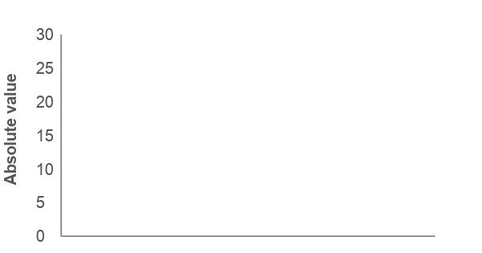
Response Outcomes
Median neoadjuvant alectinib treatment duration was 8 weeks (range: 7.9–8.7); all patients received ≥2 cycles of alectinib treatment.
One patient downstaged from stage IIIB to IIIA; one patient downstaged from stage IIIA to IIB after neoadjuvant treatment.
Response outcomes of patients from the ALK+ cohort
Weighted percentage viable tumour cells
(MPR and pCR)
Pathological response, n (%)* | ALK+ cohort (n=9)
Major pathological response† | 6 (66.7)
Pathological complete response‡ | 3 (33.3)
Radiographic response, n (%) | ALK+ cohort (n=9)
Complete response | 0
Partial response | 4 (44.4)
Stable disease | 5 (55.6)
Progressive disease | 0
Non-
MPR
Non-
MPR
MPR
(≤10%)
MPR
pCR
pCR
pCR
MPR
MPR
pCR (0%)
Patients (n=8§)
Notes:
Lee JM, Toloza EM, Pass HI, et al. NAUTIKA1 study: preliminary efficacy and safety data with neoadjuvant alectinib in patients with stage IB-III ALK+ NSCLC. Abstract presented at: World Conference on Lung Cancer; Singapore; September 9-12, 2023. Abstract P2.01-06.
Median treatment duration with neoadjuvant alectinib was 8 weeks. Nine eligible patients completed neoadjuvant alectinib treatment and were assessed for pathological response. Six patients achieved MPR, of whom three achieved pCR.

Slide 36
SAKULA: Neoadjuvant Ceritinib in ALK+ Locally Advanced NSCLC
7 patients: median age 50 years; 71% male; all stage IIIA
Three 28-day cycles of ceritinib at 750 mg QD
ORR: 100%
Six patients went to resection;
5 had R0 resection
Pathologic response: 2 pCR,
4 MPR
Most common AEs were
GI toxicities
Notes:
Zenke Y, Yoh K, Sakakibara-Konishi J, et al. Neoadjuvant ceritinib for locally advanced non-small cell lung cancer with ALK rearrangement: SAKULA trial. Abstract presented at: World Conference on Lung Cancer; Barcelona, Spain; September 7-9, 2019. Abstract P1.18-04.
Now, we do have data with other agents. This is a very small trial. Only 7 patients reported, but this was neoadjuvant ceritinib in the same population of ALK-positive locally advanced disease. I think the take-home message here is similar to what we saw in the ALNEO trial, again, small number of patients, the overall response rate was 100%, 6 of 7 patients went to resection, 5 had R0 resections. Pathologic response, 2 pathologic CRs and 4 major pathologic response. And again, the most common adverse events were related to GI toxicity, which we know are certainly there with ceritinib.

Slide 37
Ensartinib as Adjuvant Therapy in ALK+ Resected NSCLC: Double Blind, Placebo-Controlled, Multi-Center Phase 3 Trial
Resected Stage IB (≥4 cm)–IIIB (T3N2)
ALK+ NSCLC
Other key eligibility criteria:
ECOG PS 0/1
Eligible to receive platinum-based
chemotherapy
Adequate end-organ function
No prior systemic cancer therapy
Ensartinib
225 mg po QD
2 years
Recurrence
Further treatments of investigator’s choice and survival follow-up
R
1:1
Placebo
225 mg po QD
2 years
Recurrence
N=202
Chemotherapy optional and per investigator’s discretion
Primary endpoint
DFS
Other endpoints
DFS at 3 and 5 years
OS
Safety
Notes:
Ensartinib as adjuvant treatment in anaplastic lymphoma kinase (ALK) positive non-small cell lung cancer. ClinicalTrials.gov identifier: NCT05341583. Updated August 23, 2024. https://clinicaltrials.gov/study/NCT05341583
Now, other agents in this category of patients are being studied. This is the ensartinib trial. Again, this is a trial of adjuvant therapy in ALK-positive resected non-small cell patients. Again, double-blind, a placebo-controlled, phase 3 trial. This is a slightly different design, more like ADAURA, if you will. Again, this is in the stage IB greater than 4 centimeters up to IIIB ALK-positive patients. Again, good performance status, eligible to receive platinum-based chemotherapy. The chemotherapy was optional and was per the investigators discretion. If chemotherapy is given, or maybe the investigator will opt not to give chemotherapy, patients are randomized to ensartinib at the standard dose for 2 years vs placebo for 2 years. This is more similar to the ADAURA trial, very different than the ALINA trial design. The primary endpoint is disease-free survival, and the other endpoints are overall survival as well as safety.

Slide 38
Ensartinib: Other Ongoing Trials
A Phase 2 Study Comparing Ensartinib Versus Platinum-Based Chemotherapy as Adjuvant
Treatment for Stage II-IIIA
ALK-Positive Non-Small Cell Lung Cancer (NCT05186506)
Adjuvant Therapy of Ensartinib in Patients With Stage IB-IIIA
ALK-positive Non-Small Cell Lung Cancer: a Prospective, Multi-center, Single-arm Exploratory Study (NCT05241028)
A Study of Ensartinib as Neoadjuvant Therapy for Patients With ALK-Positive Resectable Non-Small Cell Lung Cancer (NCT05380024)
ALK, anaplastic lymphoma kinase.
ClinicalTrials.gov identifier: NCT05186506.
ClinicalTrials.gov identifier: NCT05241028.
ClinicalTrials.gov identifier: NCT05380024.
Notes:
A study comparing ensatinib versus platinum-based chemotherapy as adjuvant treatment for stage II-IIIA ALK-positive non-small cell lung cancer. ClinicalTrials.gov identifier: NCT05186506. Updated January 11, 2022. https://clinicaltrials.gov/study/NCT05186506
Adjuvant therapy of ensartinib in stage IB-IIIA ALK-positive non-small cell lung cancer. ClinicalTrials.gov identifier: NCT05241028. Updated October 10, 2024. https://clinicaltrials.gov/study/NCT05241028
A study of ensartinib as neoadjuvant therapy for patients with ALK positive resectable non-small cell lung cancer. ClinicalTrials.gov identifier: NCT05380024. Updated August 18, 2022. https://clinicaltrials.gov/study/NCT05380024
Several trials investigating ensartinib as (neo)adjuvant therapy in ALK+ resectable NSCLC are ongoing.

Slide 39
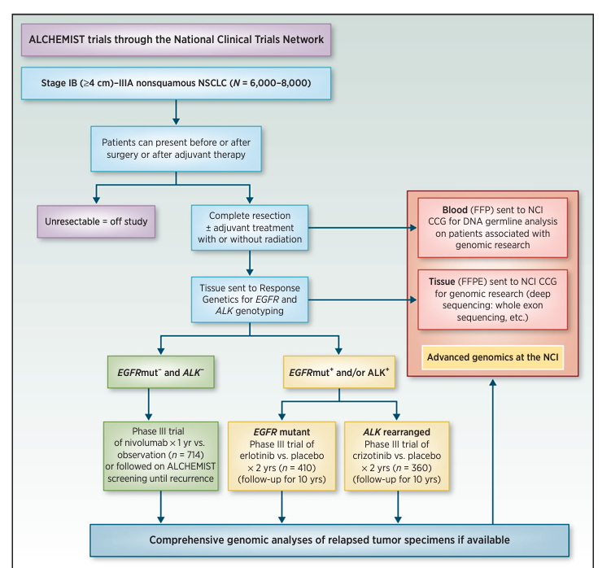
ALCHEMIST Trials: A Golden Opportunity to Transform Outcomes in Early-Stage Non-Small Cell Lung Cancer
Enrolled 166 of the
planned 160 – now
closed to accrual
1⁰ endpoint changed
from OS to DFS
Notes:
Govindan R, Mandrekar SJ, Gerber DE, et al. ALCHEMIST trials: a golden opportunity to transform outcomes in early-stage non-small cell lung cancer. Clin Cancer Res. 2015;21(24):5439-5444.
The Adjuvant Lung Cancer Enrichment Marker Identification and Sequencing Trial (ALCHEMIST) is an NCI-sponsored national clinical trials network (NCTN) initiative to address the needs to refine therapy for early-stage NSCLC. This program will screen several thousand patients with operable lung adenocarcinoma to determine whether their tumors contain specific molecular alterations [epidermal growth factor receptor mutation (EGFR) and anaplastic lymphoma kinase rearrangement (ALK)], making them eligible for treatment trials that target these alterations. Patients with EGFR mutation or ALK gene rearrangement in their tumor will be randomized to placebo versus erlotinib or crizotinib, respectively, after completion of their standard adjuvant therapy.

Slide 40
HORIZON-01 (Cohort A1): Alectinib vs Durvalumab Following cCRT or sCRT in Locally Advanced, Unresectable, Stage III ALK+ NSCLC
Locally advanced, unresectable,
stage III ALK+ NSCLC
Age ≥18 years old
Post SOC cCRT or sCRT
ECOG PS 0–2
Alectinib 600 mg PO BID
3 years
R
1:1
Durvalumab 1500 mg IV Q4W
1 year
N=120
Primary endpoint:
PFS
Key Secondary endpoints:
Time to CNS progression
ORR, DoR
OS
Safety
Notes:
A study evaluating the efficacy and safety of multiple therapies in cohorts of participants with locally advanced, unresectable, stage III non-small cell lung cancer (NSCLC). ClinicalTrials.gov identifier: NCT05170204. Updated October 24, 2024. https://clinicaltrials.gov/study/NCT05170204
This study will evaluate the efficacy and safety of multiple therapies in participants with locally advanced, unresectable, Stage III NSCLC with eligible biomarker status as determined by Version 8 of the American Joint Committee on Cancer/Union for International Cancer Control NSCLC staging system. Cohort A1 will enroll patients with ALK+ disease.

Slide 41
Skills and Interprofessional
Team-Based Strategies Needed to Adopt Adjuvant Targeted Therapies in the Community Setting

Slide 42

Clinically Relevant AEs in the ALINA Alectinib Arm
Bradycardia
All grades: 7.8%
Grade 3–4: 0%
Most clinically relevant AEs experienced with alectinib were low grade; higher-grade AEs could be well managed with dose interruption or reduction
The safety profile of alectinib in the ALINA trial was consistent with that observed in previous trials in patients with metastatic ALK+ NSCLC
Liver function abnormalities
All grades: 60.9%
Grade 3–4: 4.7%
Renal impairment
All grades: 15.6%
Grade 3–4: 0.8%
Rash
All grades: 14.1%
Grade 3–4: 0.8%
Constipation
All grades: 42.2%
Grade 3–4: 0.8%
Anemia
All grades: 23.4%
Grade 3–4: 0%
Myalgia
All grades: 28.1%
Grade 3–4: 0.8%
Blood CPK increased
All grades: 43.0%
Grade 3–4: 6.3%
Peripheral edema
All grades: 10.2%
Grade 3–4: 0%
Notes:
Horinouchi H, Solomon BJ, Wu Y-L, et al. ALINA safety results: adjuvant alectinib vs chemotherapy in patients with resected ALK+ non-small cell lung cancer (NSCLC). Abstract presented at: World Conference on Lung Cancer; San Diego, California; September 7-10, 2024. Abstract OA13.04.
Most clinically relevant AEs experienced with alectinib were low grade; higher-grade AEs could be well managed with dose interruption or reduction. The safety profile of alectinib in the ALINA trial was consistent with that observed in previous trials in patients with metastatic ALK+ NSCLC.

Slide 43
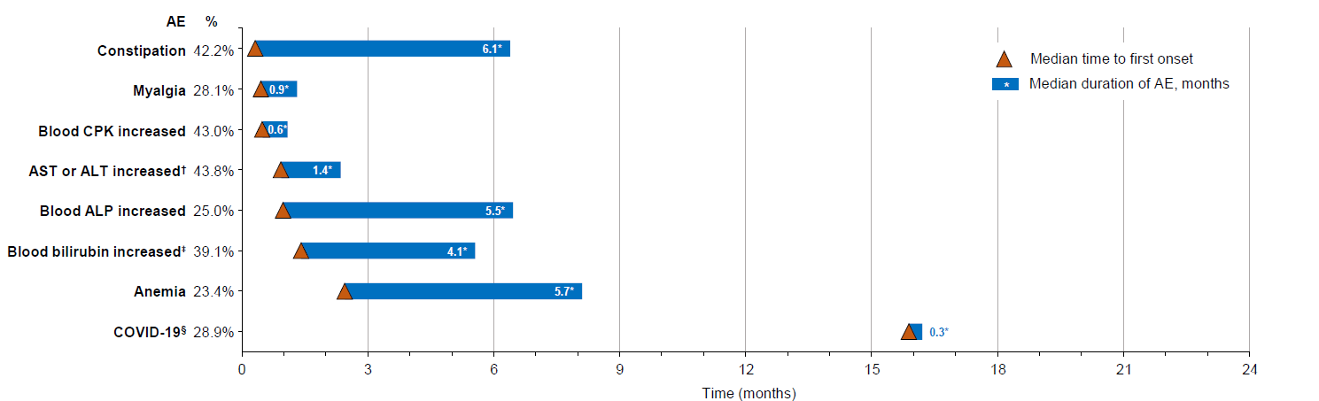
Time to Onset and Duration of Any AEs Occurring in ≥15% of Patients in the Alectinib Arm
For the most frequent AEs, the median time to onset occurred mostly during the first month of alectinib.
AEs of longer duration were mostly Grade 1–2 in severity, manageable and did not lead to treatment discontinuation
Notes:
Horinouchi H, Solomon BJ, Wu Y-L, et al. ALINA safety results: adjuvant alectinib vs chemotherapy in patients with resected ALK+ non-small cell lung cancer (NSCLC). Abstract presented at: World Conference on Lung Cancer; San Diego, California; September 7-10, 2024. Abstract OA13.04.
For the most frequent AEs, the median time to onset occurred mostly during the first month of alectinib. AEs of longer duration were mostly Grade 1–2 in severity, manageable and did not lead to treatment discontinuation.

Slide 44
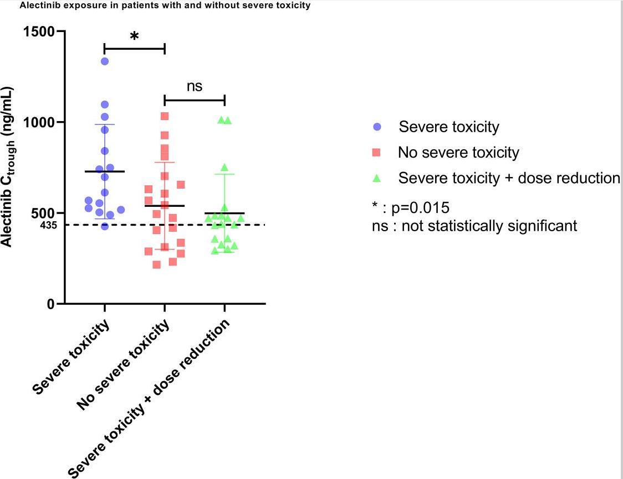

Cardiac Toxicity With Alectinib
Cardiac Toxicity With Alectinib
Alectinib exposure in patients with and without severe toxicity
Cardiac Follow-Up in Patients With ALK Positive
Lung Cancer Treated With Alectinib
53 patients with ALK positive NSCLC treated with alectinig
Prospective cardiac evaluation at cardio-oncology clinic
22 of 34 patients with echocardiograms while on
alectinib (median 24 months, range 7-38); no LV
systolic dysfunction
13 of 19 patients with echocardiograms prior to and 6 months after alectinib; no significant changes in LVEF
Adverse events data collection
Median heart rate decreased by 17 bpm
42% developed bradycardia; 17% required dose reduction
13% developed edema, 3.7% required dose reduction
Blood sampling for alectinib exposure
(N=47)
Higher mean plasma exposure in patients with
severe toxicity
Notes:
Pruis MA, Veerman GDM, Hassing HC, et al. Cardiac toxicity of alectinib in patients with ALK+ lung cancer: outcomes of cardio-oncology follow-up. JACC CardioOncol. 2023;5(1):102-113.
Here we see a slide from a recent publication looking at the cardiac toxicity with alectinib; most of this is centered around bradycardia. You can see this is a very nice study by a cardio-oncology group from the Netherlands, 53 patients with ALK-positive disease, treated with alectinib. They were followed with serial echocardiograms. They also looked at echocardiograms and showed no significant changes in left ventricular ejection fraction. You can see that the median heart rate decreased by about 17 beats per minute, 42% developed a bradycardia, 17% required dose reduction, 13% developed edema. This was, of course, edema not associated with a change in left ventricular ejection fraction. And you can see to the right that the higher mean plasma exposure in patients correlated with more severe toxicity. You can see that compared to patients without severe toxicity, that the mean alectinib trough concentrations were higher in those patients with severe toxicity. And no difference between patients with no severe toxicity or those with severe that had dose reduction.

Slide 45
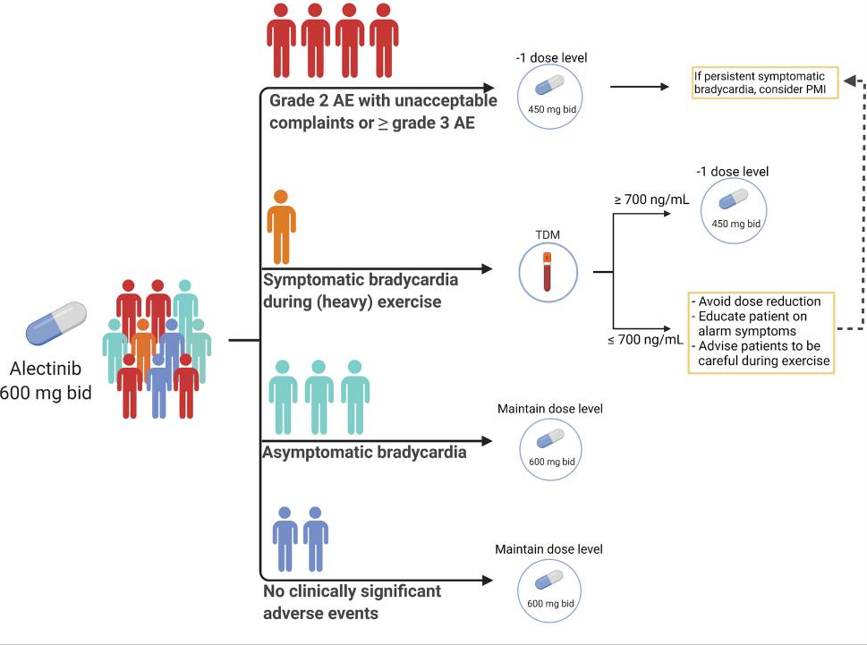
Managing Cardiac Toxicity With Alectinib
Notes:
Pruis MA, Veerman GDM, Hassing HC, et al. Cardiac toxicity of alectinib in patients with ALK+ lung cancer: outcomes of cardio-oncology follow-up. JACC CardioOncol. 2023;5(1):102-113.
They do offer a management strategy shown here. Obviously, in the bottom part of this, if you have no clinically significant adverse events or asymptomatic bradycardia, try to continue at the maintain dose level. If you get into the symptomatic areas, particularly if you have symptomatic bradycardia with exercise, they suggest a role for therapeutic drug monitoring. And that might lead to a dose reduction in these sorts of patients. And then certainly, if patients have grade 2 adverse events or have unacceptable complaints or higher-grade toxicity, obviously this would be a reason for dose reduction or other measures. Obviously, the cardiologist will need to be involved with these sorts of decisions.

Slide 46
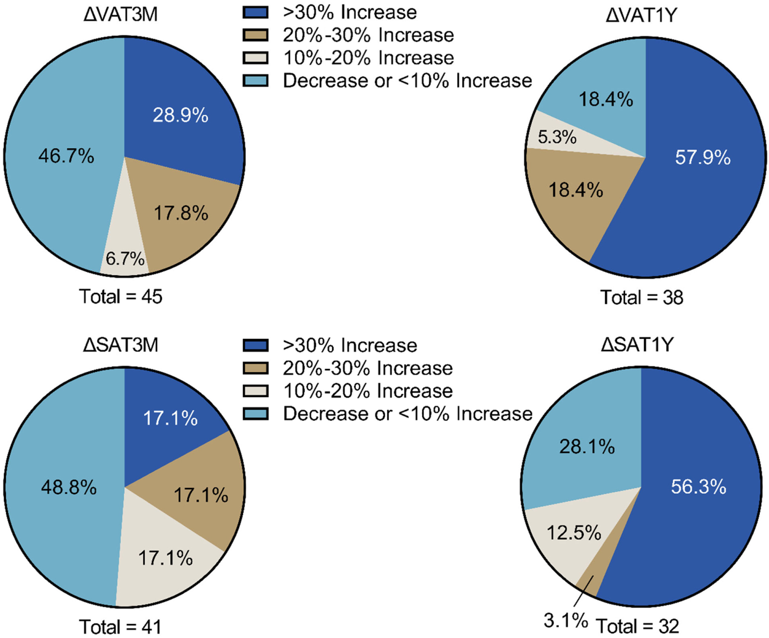
Weight Gain With Alectinib
Change is VAT and SAT at 3 mos and 1 yr
46 ALK+ patients
Waist circumference, VAT, SAT and skeletal muscle measured
Mean ↑ in waist circ – 9.7%
Incidence of sarcopenic obesity increased from 23.7% to 47.4% at 1 year
Notes:
de Leeuw SP, Pruis MA, Sikkema BJ, et al. Analysis of serious weight gain in patients using alectinib for ALK-positive lung cancer. J Thorac Oncol. 2023;18(8):1017-1030.
Alectinib may cause relevant increased sarcopenic abdominal obesity, with increases of both VAT and SAT, quickly after initiation. This may lead to many serious metabolic, physical, and mental disturbances in long-surviving patients.

Slide 47
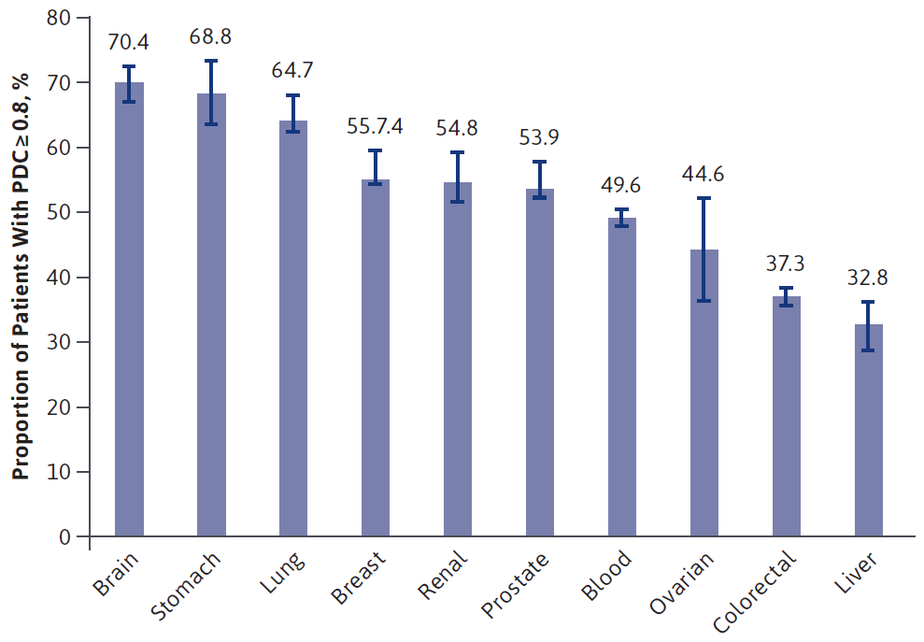
Defining the Magnitude of Poor Adherence to Oral Oncolytics
Retrospective cohort study
Optum Clinformatics Data Mart commercial claims database
2010-18
Adherence defined as proportion of days covered (PDC) > 0.8
37938 pts included
Adherence rate – 51.9%
Adherence worse with increased OOP costs, hospitalization and Medicare low-income subsidy
Notes:
Vyas A, Descoteaux A, Kogut S, et al. Predictors of adherence to oral anticancer medications: An analysis of 2010-2018 US nationwide claims. J Manag Care Spec Pharm. 2022;28(8):831-844.
Now, there is some literature in the field in the area of adherence. Obviously, it's important that patients adhere to treatment to get the effect. This is a retrospective cohort, sort of the Optum Clinformatics data, a commercial claims database, if you will. Almost 38,000 patients. You can see the overall adherence rate was about 52%. The adherence was worse with increased out-of-pocket cost, hospitalization in Medicare, low-income subsidy. They broke it down by tumor site, and you can see we've highlighted lung cancer here. So about 2/3 of patients that maintained a adherence of at least 80% or so in this particular dataset.

Slide 48
Adherence Barriers and Tools in Oncology
Adherence Barriers Include:
Adherence Tools Include:
Low health literacy
Limited patient knowledge
Complex administration schedules
Adverse effects
OOP costs
Pill diaries
Pill counts
Electronic medication monitors
Cellphone apps/alarms
Refill rates
Direct observation
Biological assays
Notes:
Mackler E, Segal EM, Muluneh B, Jeffers K, Carmichael J. 2018 Hematology/Oncology Pharmacist Association Best Practices for the Management of Oral Oncolytic Therapy: Pharmacy Practice Standard. J Oncol Pract. 2019;15(4):e346-e355.
Now, we know there are adherence barriers. These include low health literacy, limited patient knowledge, they have a complex administration schedule. Certainly, the two probably that drive most of it are adverse effects, as well as out-of-pocket costs. There are a number of tools that have been used over the years, pill diaries, pill counts, electronic monitors, cellphone apps, refill rates, obviously direct observation, as well as drug monitoring.

Slide 49
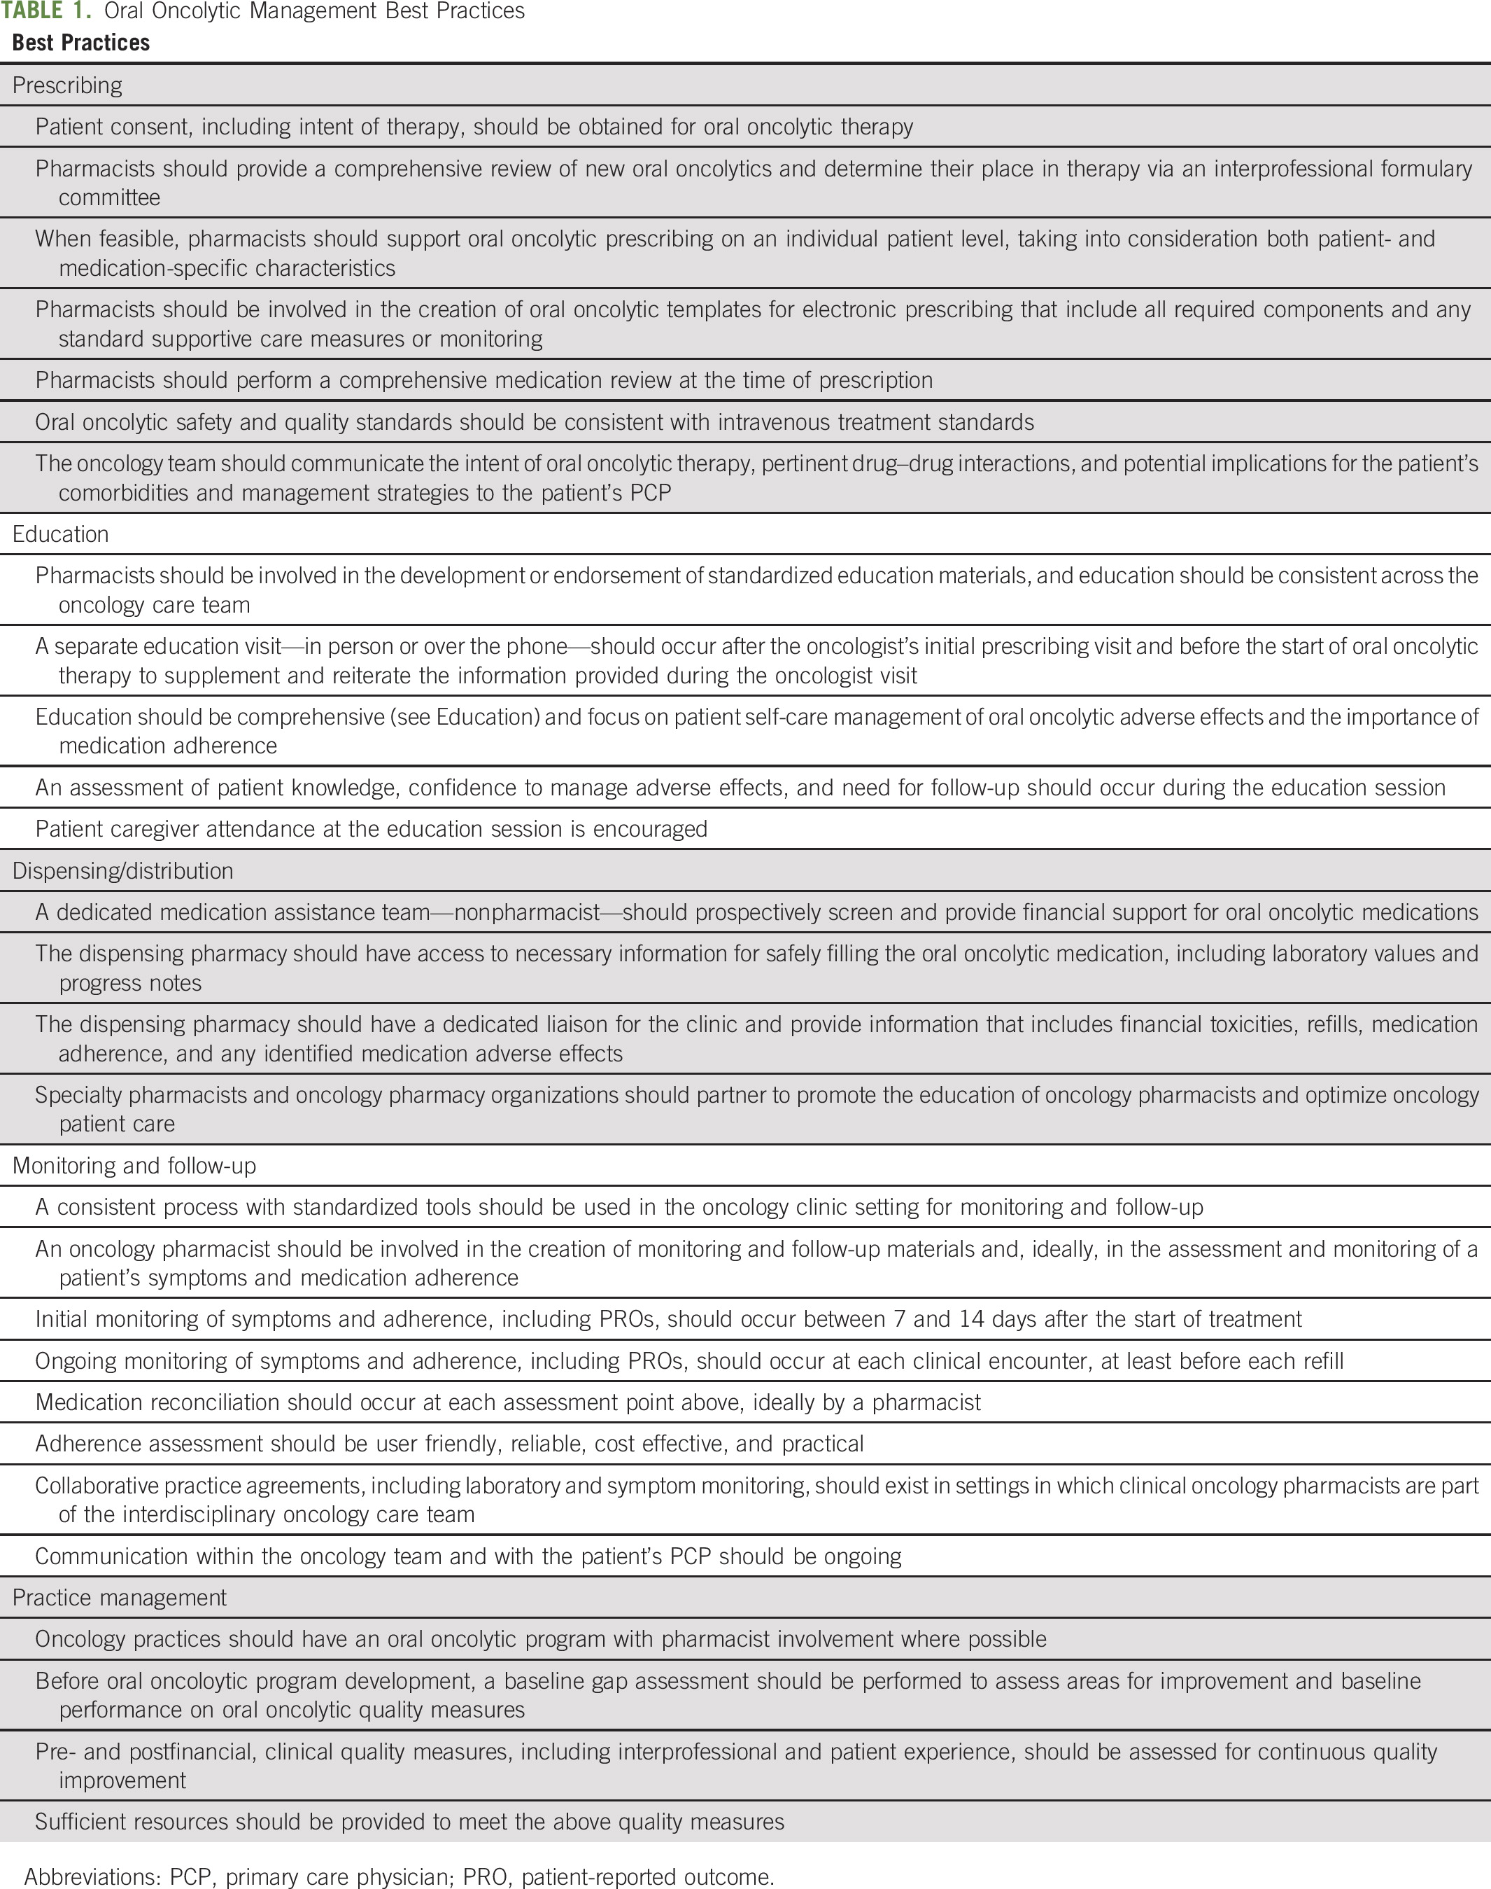
2018 HOPA Best Practices for Oral Oncolytics
Optimal adherence involves:
Prescribing
Education
Dispensing/distribution
Monitoring/follow-up
Practice management
Notes:
Mackler E, Segal EM, Muluneh B, Jeffers K, Carmichael J. 2018 Hematology/Oncology Pharmacist Association Best Practices for the Management of Oral Oncolytic Therapy: Pharmacy Practice Standard. J Oncol Pract. 2019;15(4):e346-e355.
Management of oral oncolytic therapy was divided into the following primary areas: prescribing, education, dispensing and distribution, and monitoring and follow-up.

Slide 50
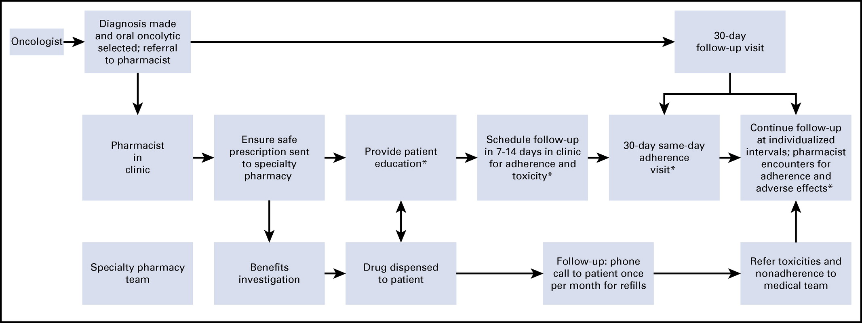
Oral Oncolytic Management – Optimal Workflow
Notes:
Mackler E, Segal EM, Muluneh B, Jeffers K, Carmichael J. 2018 Hematology/Oncology Pharmacist Association Best Practices for the Management of Oral Oncolytic Therapy: Pharmacy Practice Standard. J Oncol Pract. 2019;15(4):e346-e355.
Models that include pharmacists at the initiation of therapy allow for the verification of safe prescribing and proactive education on the importance of adherence and self-management of adverse effects. Addition of face-to-face encounters has also been found to contribute to enhanced pharmacist–patient relationships and provider satisfaction. Documentation of care in the patient’s medical record is critical to communicate findings and interventions to the interprofessional team.

Slide 51
Adherence to ALK Inhibitors* - RWE
Retrospective observational study – US commercial claims
July 2015 – December 2018
1st line – 1482 pts (445 alectinib, 1037 crizotinib)
2nd line – 880 pts (604 alectinib, 142 brigatinib, 134 ceritinib)
Adherence similar for all ALK inhibitors
1st line – median time to d/c – Alectinib 27.1 mos, crizotinib 8.8 mos
2nd line – d/c risk for Alectinib was 64% lower than ceritinib and 34% lower than brigatinib
*Data represents patients with stage IV disease.
ALK, anaplastic lymphoma kinase; d/c, discontinuation; RWE, real-world evidence.
Ganti AK, et al. J Manag Care Spec Pharm. 2022;28(3):305-314.
Notes:
Ganti AK, Lin CW, Yang E, Wong WB, Ogale S. Real-world adherence and persistence with anaplastic lymphoma kinase inhibitors in non-small cell lung cancer. J Manag Care Spec Pharm. 2022;28(3):305-314.
This study is the first to address a current research gap by assessing real-world adherence and persistence with ALK inhibitors among patients with ALK-positive NSCLC in real-world clinical practice. Alectinib was associated with longer real-world persistence than other ALK inhibitors, despite similar adherence. Further research with more patients and longer follow-up is needed to link persistence to real-world clinical outcomes

Slide 52
ASCO/FDA Action Plan to Improve Adherence to Oral Anticancer Agents
Action 1: Pharmaceutical companies and regulators should consider adherence early and throughout drug development
Action 2: Pharmaceutical companies and regulators should expand efforts to characterize toxicity and tolerability
Action 3: Pharmacists should assume a primary role in the care team in supporting oral anticancer agent adherence
Action 4: Cancer organizations should advocate for policies that ensure the affordability of oral anticancer drugs
Action 5: Research funders should support more studies on oral anticancer agent adherence
Notes:
Levit LA, Arora S, Kluetz PG, Magnuson A, Rahman A, Harvey RD. Call to action for improving oral anticancer agent adherence. J Clin Oncol. 2022;40(10):1036-1040.
Adherence to oral anticancer agents is an increasingly important consideration in cancer care because of the expanding number of FDA-approved oral agents, the improved effectiveness of these drugs leading to longer duration of treatment, and the negative consequences of poor adherence. This study explores challenges to adherence and presents an action plan for improvement. Although it is the ultimate responsibility of the patient to adhere to treatment, the drug development and care delivery system should be designed to optimize adherence. Action items to improve adherence include expanding strategies for dose optimization; recognizing the importance of persistent, low-grade toxicities in drug tolerability; incorporating patient-generated data such as PRO and wearable devices into clinical trials; leveraging pharmacists' expertise in clinical practice; ensuring the affordability of drugs; and funding more adherence research. The oncology community should follow this action plan to ensure that all patients with cancer benefit from promising oral treatments and the impact of nonadherence on outcomes is minimized.

Slide 53
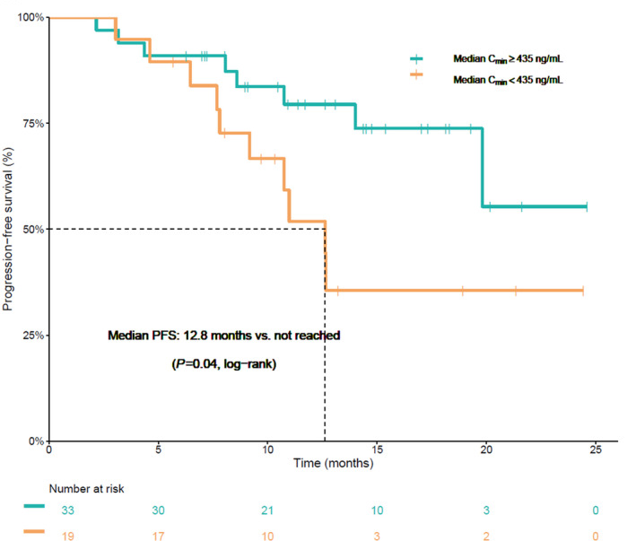
Exposure-Response Analysis With Alectinib
Observational study in 52 ALK+ patients with NSCLC receiving alectinib
Standard dose 600 mg bid
PFS is prolonged in patients with Cmin ≥435 ng/mL
Implication:
  Would monitoring levels make a difference in patients with minimal or no toxicity?
  Should therapeutic drug monitoring be part of routine clinical management?
Notes:
Groenland SL, Geel DR, Janssen JM, et al. Exposure-response analyses of anaplastic lymphoma kinase inhibitors crizotinib and alectinib in non-small cell lung cancer patients. Clin Pharmacol Ther. 2021;109(2):394-402.
There are some data with exposure response with alectinib. This is again in an observational study of about 52 patients, standard dose of 600 mg BID. Progression-free survival is prolonged in patients that have a higher median. Shown here to the right, you see the patients with a higher than 435 ng/mL concentration vs the lower. This is statistically significant. And so the implication here is, would monitoring levels make a difference in patients that really have no or minimal toxicity? And should that be part of routine clinical management in this particular setting?

Slide 54
Addressing the Absence of Mature OS Data for Targeted Therapies in the Adjuvant Setting

Slide 55
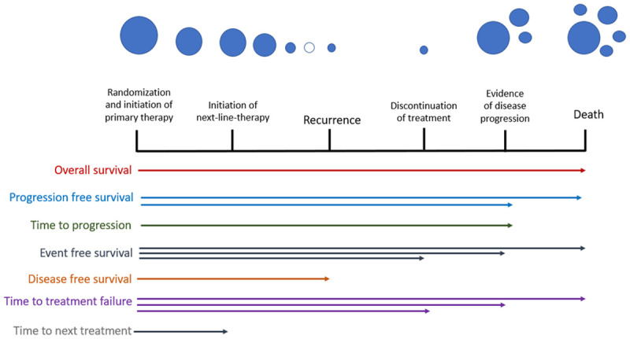
Endpoints Used in Oncology Clinical Trials
Notes:
Delgado A, Guddati AK. Clinical endpoints in oncology - a primer. Am J Cancer Res. 2021;11(4):1121-1131.
Clinical endpoints are essential for assessing the safety and efficacy of new cancer therapies. They are used by oncologists to help guide clinical decision making. While overall survival (OS) has frequently been regarded as the "gold standard" primary clinical endpoint, it's utility is constrained by several disadvantages. The time-consuming nature of trials using OS has led to a recent push to explore surrogate clinical endpoints and their potential to serve as primary clinical endpoints in lieu of OS. Additionally, it is becoming evident that other endpoints add valuable information about quality of life and treatment failure as their use is becoming increasingly prevalent in oncology clinical trials. Without a doubt, the use of clinical endpoints will continue to expand and evolve as new cancer therapies are developed and novel treatments, including immunotherapy, draw interest.

Slide 56
Issues with Endpoints in the Adjuvant Setting
Treatment is “blind” –
no visible tumor – only
micro-metastatic disease
Risk of micro-metastatic disease varies
Patients may be cured with surgery alone or recur
despite treatment
Potential utility of adjuvant therapy is only known at a distant time point
QoL can be difficult to assess versus a no treatment/
placebo control arm
Demonstrating an OS benefit takes a much longer time than in the metastatic setting
Notes:
Mittal A, Kim MS, Dunn S, et al. Frequently asked questions on surrogate endpoints in oncology-opportunities, pitfalls, and the way forward. eClinicalMedicine. 2024;76:102824.
Clinical trials in the adjuvant setting face unique challenges. First, any treatment in adjuvant setting is necessarily blind since response assessment is impossible in absence of visible tumor. Second, a majority of patients would have been cured without the need for adjuvant therapy and a percentage of patients would relapse despite the receipt of adjuvant therapy-the two groups who do not benefit but suffer harms from any adjuvant therapy. Third, any such potential utility of adjuvant therapy for the given patient can only be understood retrospectively at a distant time point in the future based on whether the cancer relapsed or not. Fourth, quality of life impact from adjuvant therapy can never be beneficial given the control arm would be not receiving this therapy and thus, not suffering the side effects of the therapy. Therefore, the goal of any adjuvant therapy should necessarily be to improve survival and clinical decision making relying on surrogates alone would be very challenging. However, in the adjuvant setting, demonstrating an OS benefit takes a much longer time than in the metastatic setting making trials powered for OS longer and more expensive to conduct.

Slide 57
Endpoints in Operable NSCLC
DFS – valid surrogate endpoint for OS in trials of adjuvant chemotherapy^{1,2}
DFS benefit in ADAURA translated to an OS benefit³
Other meaningful endpoints…….
  CNS DFS (brain mets common in ALK+ NSCLC)
  PROs (impact of toxicity)
  Adherence (long duration of therapy)
Notes:
Mauguen A, Pignon JP, Burdett S, et al. Surrogate endpoints for overall survival in chemotherapy and radiotherapy trials in operable and locally advanced lung cancer: a re-analysis of meta-analyses of individual patients' data. Lancet Oncol. 2013;14(7):619-626.
Fiteni F, Westeel V, Bonnetain F. Surrogate endpoints for overall survival in lung cancer trials: a review. Expert Rev Anticancer Ther. 2017;17(5):447-454.
Tsuboi M, Herbst RS, John T, et al. Overall survival with osimertinib in resected EGFR-mutated NSCLC. N Engl J Med. 2023;389(2):137-147.
Lastly, a few comments about endpoints in operable non-small cell lung cancer. Typically, as you've seen in the trials that I've mentioned, disease-free survival has been the primary endpoint. This has been demonstrated to be a valid surrogate endpoint for overall survival in trials of adjuvant chemotherapy. And we do have precedent in the ADAURA trial that that initial DFS benefit translated into an overall survival benefit. I think other clinically meaningful endpoints here include CNS disease-free survival. This is a very common problem in the ALK population to have brain metastases, so protection of the CNS is important. Patient-related outcomes, what is the impact of toxicity? As well as adherence, so you can get the long-term benefit from these treatments.

Slide 58
Will DFS Benefit Drive OS Benefit in ALINA?
ADAURA – DFS Benefit Translated to an OS Benefit
 | ADAURA^{1,2} | ALINA³
DFS HR | 0.17 | 0.24
OS HR | 0.49 (P < 0.001) | ?
CNS DFS HR | 0.18 | 0.22
Notes:
Wu YL, Tsuboi M, He J, et al. Osimertinib in Resected EGFR-Mutated Non-Small-Cell Lung Cancer. N Engl J Med. 2020;383(18):1711-1723.
Tsuboi M, Herbst RS, John T, et al. Overall survival with osimertinib in resected EGFR-mutated NSCLC. N Engl J Med. 2023;389(2):137-147.
Wu YL, Dziadziuszko R, Ahn JS, et al. Alectinib in resected ALK-positive non-small-cell lung cancer. N Engl J Med. 2024;390(14):1265-1276.
In the ADAURA trial, the DFS benefit with adjuvant osimertinib translated to an OS benefit. Whether this will be the case in ALINA is still unknown.

Slide 59
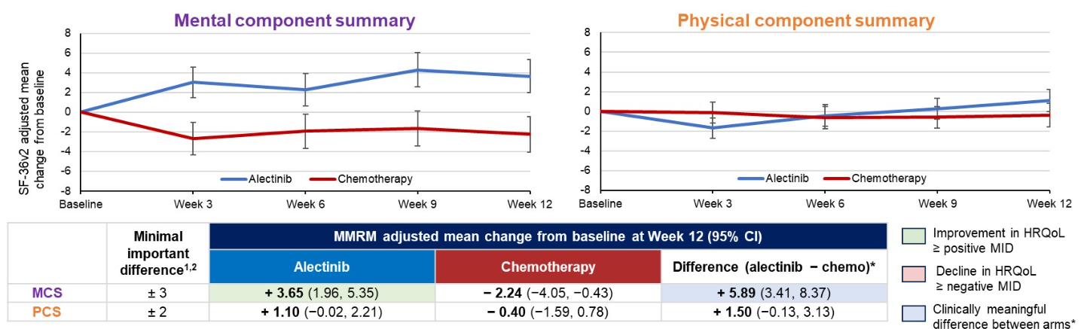
ALINA: HRQoL Results
Adjusted mean change from baseline in MCS and PCS to week 12
Within arms, change from baseline for MCS and PCS were compared with the respective MID:
  For MCS, a clinically meaningful improvement from baseline was seen with alectinib but not chemotherapy
  PCS scores remained stable
Clinically meaningful improvements from baseline in MCS were seen for alectinib versus chemotherapy
Notes:
Nishio M, Wu Y-L, Barlesi F, et al. Health-related quality of life (HRQoL) results for adjuvant alectinib vs chemotherapy in patients with resected ALK+ non-small cell lung cancer (NSCLC): Data from ALINA. Abstract presented at: American Society of Clinical Oncology Annual Meeting; Chicago, Illinois; May 31-June 4, 2024. Abstract 8006.
For MCS, a clinically meaningful improvement from baseline was seen with alectinib but not chemotherapy. In addition, clinically meaningful improvements from baseline in MCS were seen for alectinib versus chemotherapy.

Slide 60
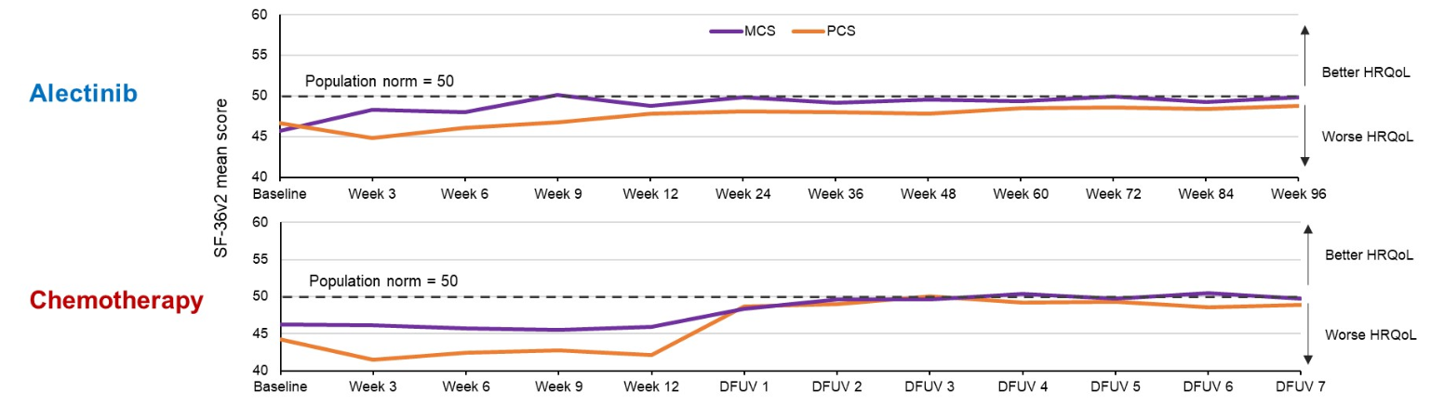
ALINA: Long-Term HRQoL Outcomes
During active treatment with alectinib, MCS and PCS generally improved through to week 96 and were similar to the general population
With chemotherapy, MCS and PCS improved after treatment was completed
Similar trends were observed across health domains
Notes:
Nishio M, Wu Y-L, Barlesi F, et al. Health-related quality of life (HRQoL) results for adjuvant alectinib vs chemotherapy in patients with resected ALK+ non-small cell lung cancer (NSCLC): Data from ALINA. Abstract presented at: American Society of Clinical Oncology Annual Meeting; Chicago, Illinois; May 31-June 4, 2024. Abstract 8006.
During active treatment with alectinib, MCS and PCS generally improved through to week 96 and were similar to the general population.

Slide 61
Case-Based Learning Lab

Slide 62
Case Study Description
Mr. Anderson, a 55-year-old male, never smoker, presented with a persistent cough
CXR – 4.5 cm RUL mass
Chest CT – 4.3 cm RUL mass –
no mediastinal adenopathy
PET – Hypermetabolism noted in RUL mass (SUV 15) – no evidence of hypermetabolic adenopathy –
no distant metastases
EBUS – negative R2, R4 and station 7 FNAs – RUL bx positive for adenocarcinoma
Brain MRI – negative
Robotic RUL lobectomy and
MLND – T2bN1 adenocarcinoma (1+ N1 node) – Stage IIB
NGS – EML4-ALK fusion
ALK, anaplastic lymphoma kinase; CT, computed tomography; CXR, chest x-ray; EBUS, endobronchial ultrasound; EML4, echinoderm microtubule-associated protein-like 4; FNA, fine needle aspiration; MLND, mediastinal lymph node dissection; MRI, magnetic resonance imaging; NGS, next-generation sequencing; PET, positron emission tomography; RUL, right upper lobe; SUV, standardized uptake value.

Slide 63
Case Study Audience Question
What would you recommend?
  Alectinib
  Brigatinib
  Lorlatinib
  Platinum + pemetrexed for 4 cycles
  Unsure
Notes:
Correct answer: a) Alectinib

Slide 64
Case Study Continuation
Mr. Anderson starts on adjuvant alectinib 4 weeks after his surgical resection
One month later he notes some mild constipation
Physical exam identified asymptomatic bradycardia
Routine laboratory studies show grade 1 AST/ALT elevations
CBC and other chemistries including bilirubin are normal

Slide 65
Case Study Audience Question
How would you manage his asymptomatic bradycardia?
  Continue alectinib with a reduced dose
  Continue alectinib with the same dose
  Withhold alectinib until bradycardia is resolved
  Permanently discontinue alectinib
  Unsure
Notes:
Correct answer: b) Continue alectinib with the same dose

Slide 66
Conclusion

Slide 67
Key Takeaways
Targeted therapies are now standard of care in molecularly defined subsets of early stage, resectable NSCLC
Molecular profiling, ideally NGS, should be performed in early-stage NSCLC
Adjuvant alectinib improves DFS and CNS DFS in stage IB-IIIA ALK-fusion positive resected NSCLC
  DFS is a valid surrogate endpoint for OS in the adjuvant setting of NSCLC
Strategies to ensure adherence should be prioritized
Side effect profile of alectinib in the post-surgical setting is manageable
Notes:
So our key takeaways here. Targeted therapies are now part of the standard of care in molecularly defined subsets of early-stage resectable non-small cell lung cancer. Molecular profiling is the standard of care. Ideally, it should be done by next-generation sequencing, and should be performed in all these patients with stage IB through IIIB disease.
Now in the ALINA trial, we saw the adjuvant alectinib improved disease-free survival, as well as CNS disease-free survival in stage IB through IIIA ALK fusion-positive resected non-small cell. Again, the disease-free survival has been a valid surrogate endpoint for OS, although we don't yet have OS in the adjuvant setting in this population of patients.
We should develop strategies that ensure adherence for patients. And certainly, what we've seen in data thus far is that the side effect profile of alectinib in the post-surgical setting appears to be manageable, just like it is in advanced-stage disease.

