Slide 1
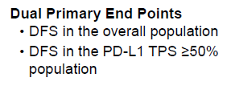
Adjuvant Immunotherapy Trials in Resectable NSCLC
IMpower010¹
PEARLS/KEYNOTE-091²

Slide 2
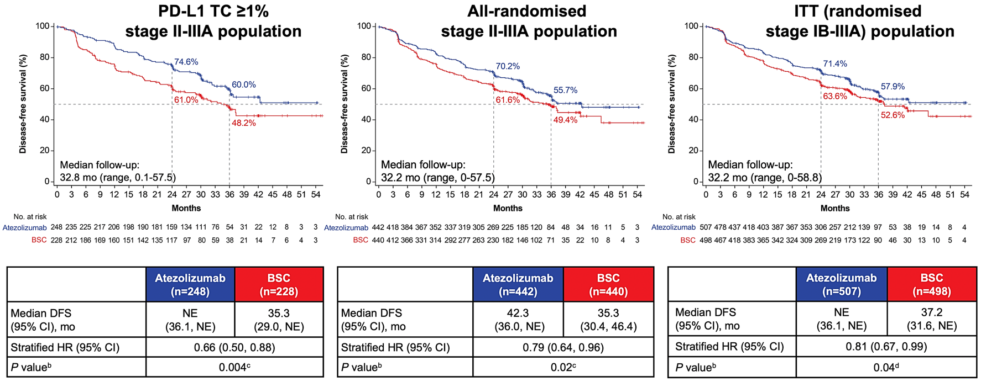
IMpower 010: DFS Curves by Subgroup

Slide 3
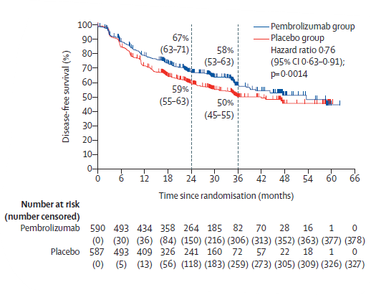
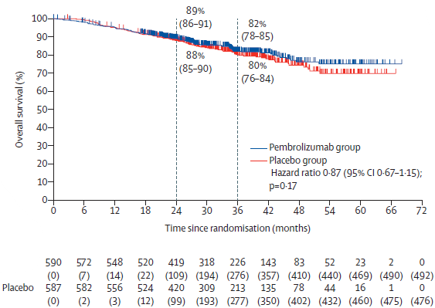
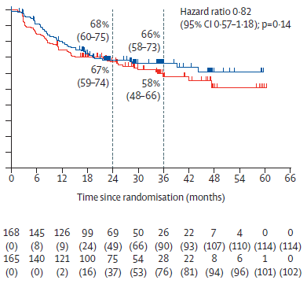
Survival: PEARLS/KEYNOTE-091
Overall
PD-L1 TPS ≥ 50%
Overall Survival

Slide 4
FDA-Approved Adjuvant Immunotherapy for NSCLC
 | PD-L1 < 1% |  | PD-L1 1% – 49% |  | PD-L1 > 50%
IB (>4cm) |  | Pembrolizumab |  | Pembrolizumab |  | Pembrolizumab
II |  | Pembrolizumab | Atezolizumab | Pembrolizumab | Atezolizumab | Pembrolizumab
IIIA |  | Pembrolizumab | Atezolizumab | Pembrolizumab | Atezolizumab | Pembrolizumab
Atezolizumab^{1,2}
DFS HR 0.66 (95% CI, 0.50-0.88) P = 0.0039
Stage II-IIIA, PD-L1 > 1%
Pembrolizumab^{3,4}
DFS HR 0.76 (95% CI, 0.63-0.91) P = 0.0014
Stage IB (>4cm)-IIIA, regardless of PD-L1

Slide 5
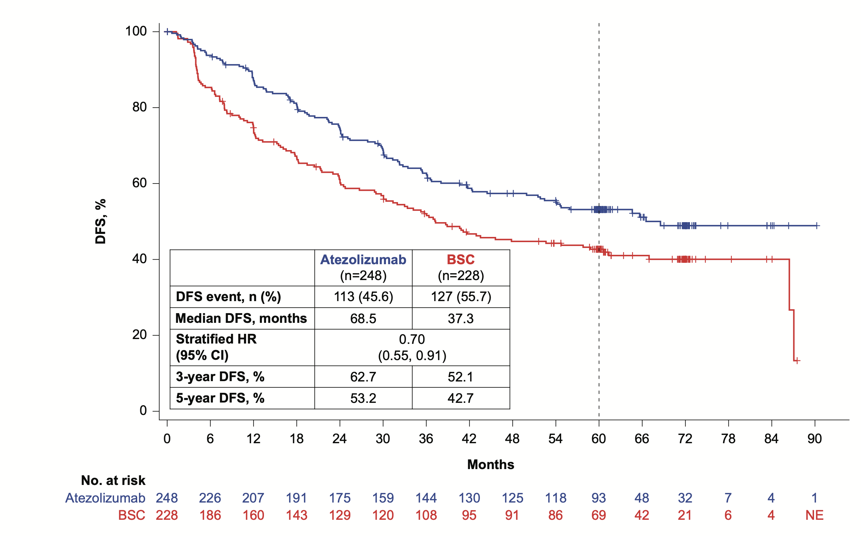
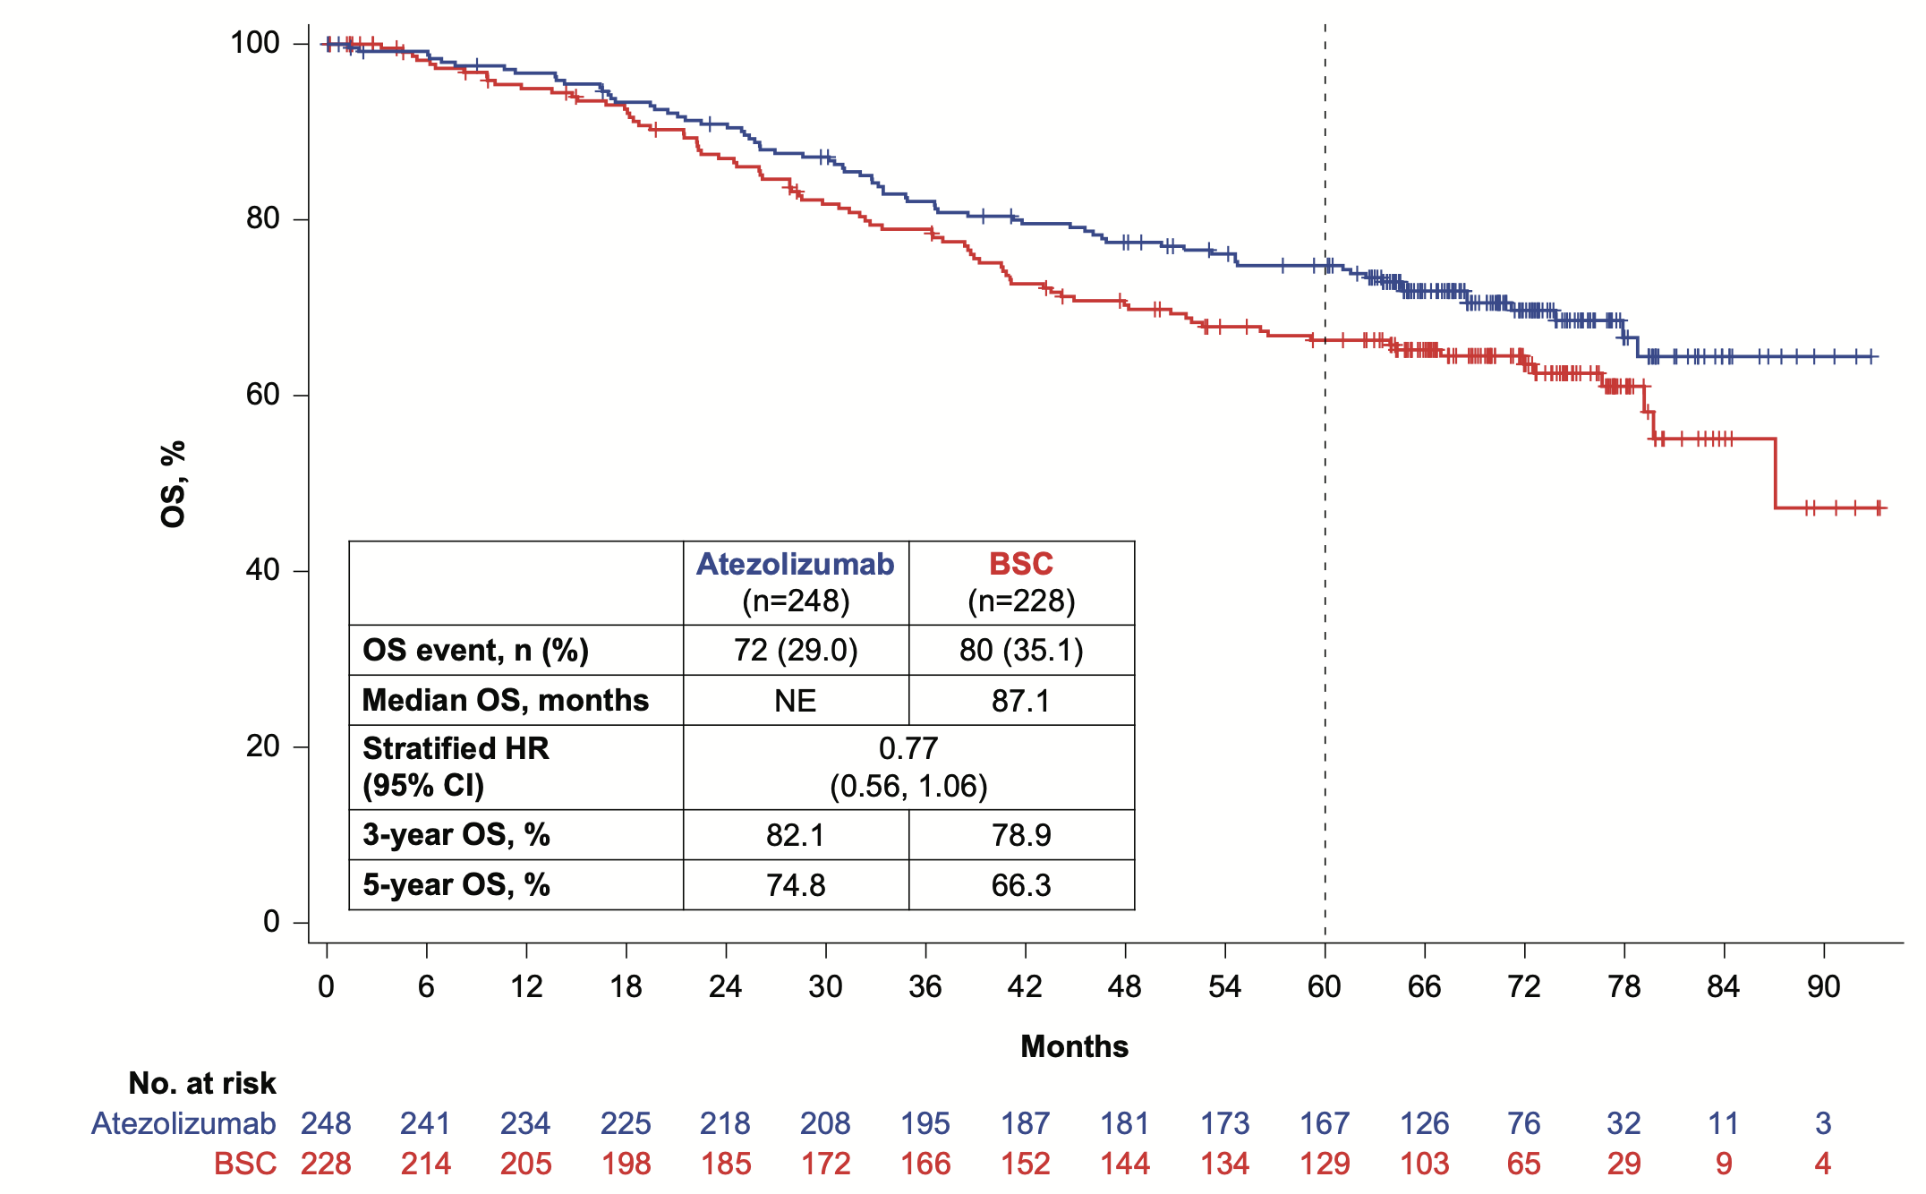
IMpower010: 5-Year Survival
DFS in the stage II-IIIA PD-L1 TC ≥1% population
OS in stage the II-IIIA PD-L1 TC ≥1% population
In stage II-IIIA PD-L1 TC ≥50% population without known EGFR or ALK mutations, DFS HR 0.49 (0.32-0.75) and OS HR 0.44 (0.26-0.74)

Slide 6
Where Does Adjuvant Immunotherapy Fit in the Perioperative Schema?
Home run for patients who did not see induction therapy and especially those with high PD-L1 expression
Perfect option for patients with stage I upstaged to stage II or IIIA and who are PD-L1 positive

