Slide 1

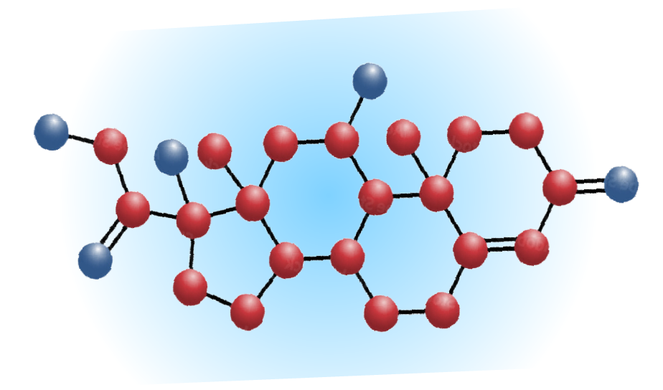
The Cortisol Reports
Episode 3 - Continuing the Search: New Data on Hypercortisolism Prevalence in Difficult-to-Control Metabolic Conditions

Slide 2
Learning Objectives
Assess the impact of new data related to hypercortisolism prevalence, burden of disease, lack or delays in treatment, and screening/diagnosis trends.
Review new clinical advances related to the identification and management of hypercortisolism.

Slide 3

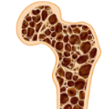



Excess Cortisol Linked to Cardiorenal Syndrome and More
Select Population
Prevalence of Hypercortisolismª
Adrenal incidentaloma
19% to 42.5%
Bone fragility
1.9% to 17.6%
Hypertension
Up to 8%
Diabetes mellitus
3.4%
Obesity
0.9% (pooled from 22 studies)
Previously thought prevalence of “hidden” hypercortisolism” was 0.2%-2% (up to 10% of the general population)
ªIncludes a range of disease severity and etiology.
Paschou SA, et al. Endocrine. 2016; Chiodini I, et al. Eur J Endocrinol. 2016; Anderson GH Jr, et al. J Hypertens. 1994; Omura M, et al. Hypertens Res. 2004; Martins LC, et al. J Hypertens. 2012;. Steffensen C, et al. Eur J Endocrinol. 2016; van Hulsteijn LT, et al. Eur J Endocrinol. 2020; Steffensen C, et al. Horm Metab Res. 2019; Pivonello R, et al. Lancet Diabetes Endocrinol. 2016; Aresta C, et al. Endocr Pract. 2021; Ceccato F, et al. Endocrinol Invest. 2025.
Notes:
Key takeaway: Screening the general population for hypercortisolism is not recommended. However, several studies have identified an enriched population in which hypercortisolism is quite common¹⁻⁸
This slide summarizes the prevalence of hypercortisolism in patients with adrenal incidentalomas, osteopenia/osteoporosis, hypertension, or diabetes mellitus, and in individuals who are obese
In patients with adrenal incidentalomas: 19% to 42.5%, based on a systematic review of 6 studies published between 2011 and 2014¹
In patients with osteopenia/osteoporosis: 4.8% to 10.8%, based on a report of 219 patients referred to outpatient clinics in Italy between January 2005 and December 2005 for the evaluation of osteoporosis²
In patients with hypertension: up to 8%, based on 3 studies published between 1994 and 2012³⁻⁵
In patients with diabetes: 5%, based on prospective study of 384 patients with type 2 diabetes and a systematic review of 14 studies published between 1996 and 2012^{6,7}
Finally, in obese individuals, a systematic review of 68 studies published between 1987 and 2018 reported an overall hypercortisolism prevalence of 0.9% (pooled from 22 studies)⁸
The high prevalence of hypercortisolism in some populations suggests that increased vigilance for this disorder may be justified^{2,6,9,10}
Details from studies are discussed in the Appendix
References:
Paschou SA, et al. Endocrine. 2016;51(2):225-235.
Chiodini I, et al. Ann Intern Med. 2007;147(8):541-548.
Anderson GH Jr, et al. J Hypertens. 1994;12(5):609-615.
Omura M, et al. Hypertens Res. 2004;27(3):193-202.
Martins LC, et al. J Hypertens. 2012;30(5):967-973.
Steffensen C, et al. Eur J Endocrinol. 2016;175(6):R247-R253.
Steffensen C, et al. Horm Metab Res. 2019;51(1):62-68.
van Hulsteijn LT, et al. Eur J Endocrinol. 2020;182(1):11-21.
Nieman LK, et al. J Clin Endocrinol Metab. 2008;93(5):1526-1540.
Chiodini I, et al. J Endocr Soc. 2019;3(5):1097-1109.

Slide 4
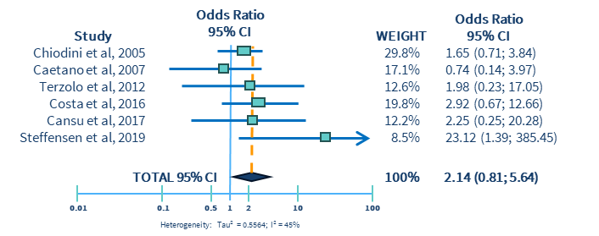
What we Know about Hypercortisolism and Hypertension
Association of cortisol excess and high blood pressure is well-known in patients with T2D
In hypertensive patients with hypercortisolism/Cushing Syndrome, conventional antihypertensive therapy may not effective until normal cortisol levels are restored, indicating a gap in care and significant need for new therapies
Aresta C, et al. Endocr Pract. 2021.

Slide 5
Resistant Hypertension According to 2017 AHA Guidelines
SBP ≥130 mmHg despite use of ≥3 BP medications from different classes at maximally tolerated doses, including a diuretic
SBP at any level with use of ≥4 BP medications from different classes
Plutzky J, et al. JACC Adv. 2026.

Slide 6
New Data: Prevalence of Hypercortisolism in Resistant HTN
Adults with resistant hypertension (~1000)
VISIT 1 – Any time of day
VISIT 2 ~8am
VISIT 3 ~8am
Eligibility, consent, history, exam, ªnonfasting labs, automated blood pressure
Post 1-mg overnight DST cortisol, fasting labsᵇ
ACTH cortisol, schedule noncontrast CT scan
Hypercortisolism
(post-DST cortisol > 1.8 μg/dL with dexamethasone ≥140 ng/dL)
Primary Endpoint: prevalence
MOMENTUM Trial
Primary Endpoint: Assess prevalence of endogenous hypercortisolism in patients with resistant hypertension
No hypercortisolism
(post-DST cortisol ≤ 1.8 μg/dL)
Plutzky J, et al. JACC Adv. 2026.
ªPlasma renin activity, aldosterone, dehydroepiandrosterone sulfate, N-terminal-pro-brain-natriuretic peptide, HbA1C, Fibrosis-4, aspartate aminotransferase-to-platelet-ratio index, uric acid, high-sensitivity C-reactive protein, complete blood count, comprehensive metabolic panel, eGFR and urine-albumin-to-creatine ratio.
ᵇACTH, fasting glucose, and fasting lipids

Slide 7
New Data: Prevalence of Hypercortisolism in Resistant HTN
27.3%
95% CI: (24.7%, 31.1%)
Post-DST cortisol >1.8 µg/dL
(hypercortisolism)
Post-DST cortisol ≤1.8 µg/dL
 | Mean (SD) | Diagnostic Threshold for Hypercortisolism
Post-DST cortisol | 4.2µg/dL (3.5 µg/dL ) | ≤1.8 µg/dL
Dexamethasone | 484.2 ng/dL (336.8 ng/dL) | >140 ng/dL
Bhatt DL, et al. ACC. 2026.
Notes:
Reference will be updated to JACC once ACC 2026 abstracts are published if appropriate

Slide 8
New Data: Prevalence of Adrenal Nodules (via CT Scan) in Patients with Hypercortisolism
24.3%
Adrenal Nodule
Post-DST cortisol >1.8 µg/dL
(hypercortisolism)
Post-DST cortisol ≤1.8 µg/dL
CT, computed tomography
Bhatt DL, et al. ACC. 2026.
Notes:
Reference will be updated to JACC once ACC 2026 abstracts are published if appropriate

Slide 9
Few differences in baseline characteristics
 | Post-DST cortisol
 | ≤1.8 µg/dL (n=789) | >1.8 µg/dL (hypercortisolism) (n=297) | P-value
Age, years, mean (SD) | 65.0 (10.9) | 66.2 (10.2) | NS
Female, % | 53.9% | 43.8% | 0.003
Body mass index, kg/m², mean (SD) | 33.5 (7.1) | 32.0 (6.9) | 0.002
Waist circumference, cm, mean (SD) | 109.3 (17.0) | 106.9 (18.0) | 0.048
Race, %
White | 57.0% | 57.2% | NS
Black or African American | 36.4% | 36.7%
Asian | 2.9% | 4.0%
Other | 3.7% | 2.0%
Ethnicity, %
Hispanic/Latino | 26.6% | 25.3% | NS
Non-Hispanic/Latino | 73.4% | 74.7%
SBP, mmHg, mean (SD) | 140.2 (17.5) | 141.3 (18.3) | NS
DBP, mmHg, mean (SD) | 83.9 (12.3) | 84.4 (13.1) | NS
HbA1c, %, mean (SD) | 6.4 (1.4) | 6.6 (1.6) | NS
Patients with hypercortisolism “look no different” than those without, except for lower body mass index and waist circumference
DBP, diastolic blood pressure; DST, dexamethasone suppression test; HbA1c, hemoglobin A1c; NS, not significant (P>0.05); SBP, systolic blood pressure; SD, standard deviation.
Bhatt DL, et al. ACC. 2026.

Slide 10
Limitations of MOMENTUM
US only
Of note: MOMENTUM prevalence (27.3%)¹ aligns with a prior, smaller Brazilian study (26.5%)² that used the same enrollment criteria
Diversity: low proportion of Asian patients; but substantial representation of women, Black, and Hispanic patients
Study did not differentiate between heart failure with or without reduced ejection fraction
No longitudinal follow-up to assess cardiovascular event rates
But other studies have shown higher rates of cardiovascular events in patients with hypercortisolism^{3,4}
Causation cannot be established in this study
1. Bhatt DL, et al. ACC. 2026; 2. Martins LC, et al. J Hypertens. 2012; 3. Di Dalmazi G, et al. J Clin Endocrinol Metab. 2020; 4. Petramala L, et al. Endocrine. 2020.

Slide 11

Recognizing the Need for Increased Screening
Consistent with the Endocrine Society Guidelines and now AACE Diabetes Guidelines, hypercortisolism screening is recommended as a secondary cause of (uncontrolled) cardiometabolic/endocrine disorders.
Patients with resistant hypertension
Patients with uncontrolled hypertension and difficult-to-control type 2 diabetes
>1/4 of people with SBP above goal on 3 antihypertensives (including a diuretic) or people on at least 4 antihypertensives will have hypercortisolism
~1/3 will have hypercortisolism
Patients with difficult-to-control type 2 diabetes
~25% will have hypercortisolism
Fleseriu M, et al. Lancet Diabetes Endocrinol. 2021; DeFronzo RA, et al. Diabetes Care. 2025; Buse JB, et al. Diabetes Care. 2025; Bhatt DL, et al. ACC. 2026; Sampson SL. Endocr Pract. 2026.

Slide 12
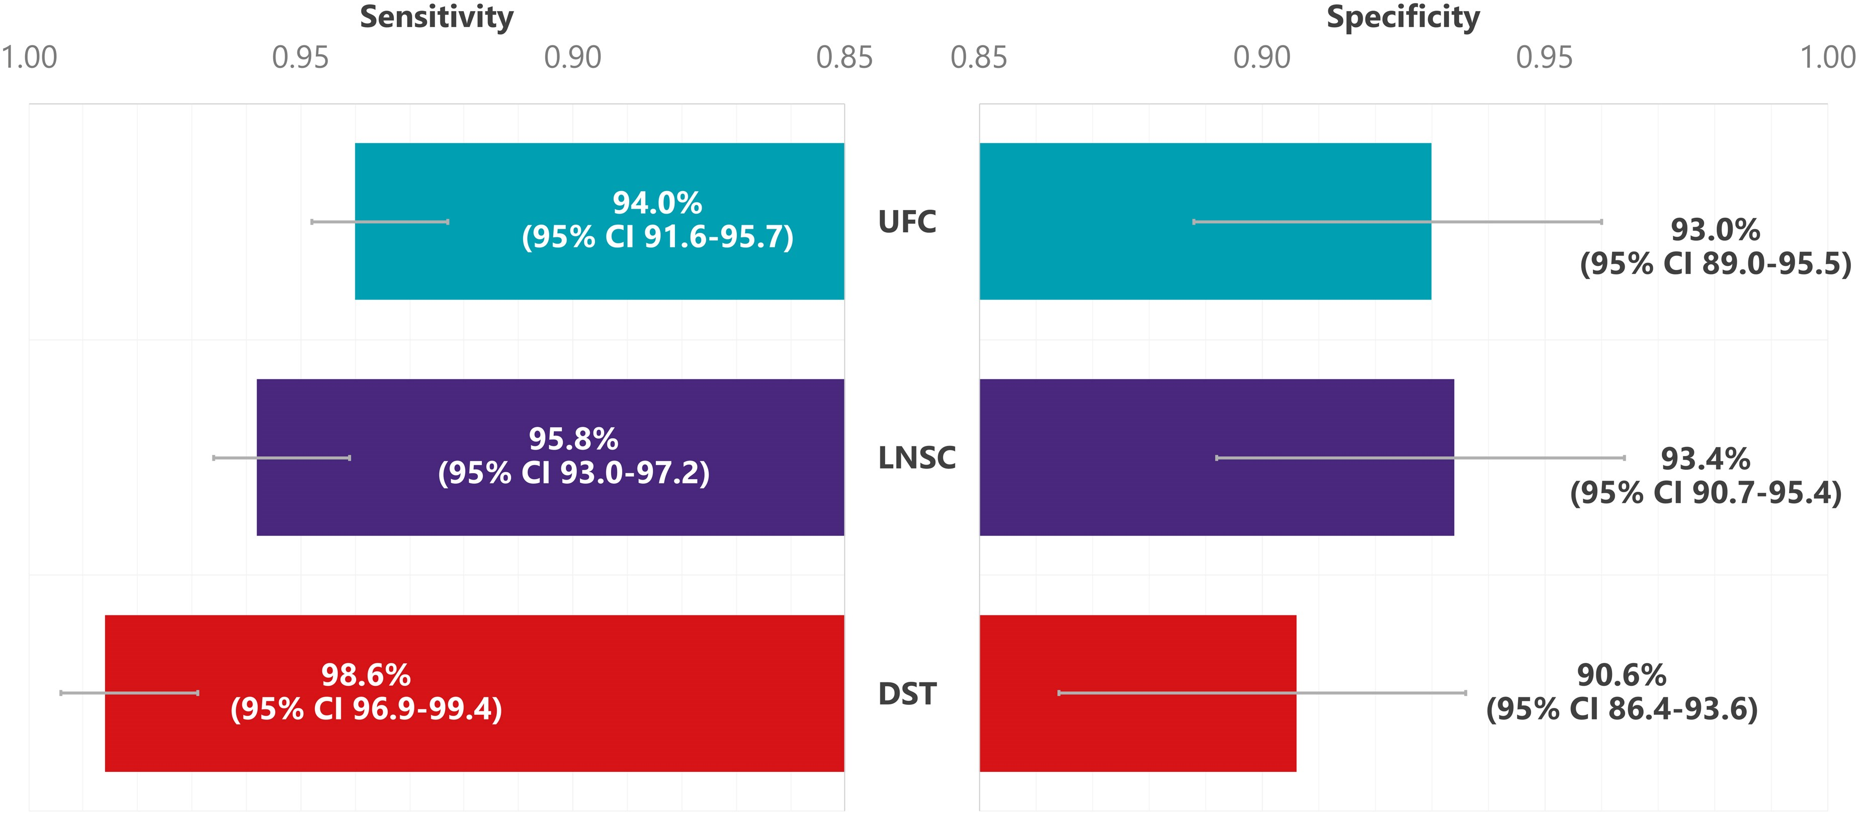
Screening Tests for Hypercortisolism
Test
UFC
LNSC
1 mg DST (≤1.8 µg/dL)
Caveat
Improper collection, high fluid intake (>5 liters), CKD
Improper collection, shift workers
CBG effect, Dex clearance
Sharma ST, et al. Clin Epidemiol. 2015; Hamidi O, et al. J Clin Endocrinol Metab. 2026; Fassnacht M, et al. Eur J Endocrinol. 2023.

Slide 13
Treatment of CS with Hypertension
LINC CARE Trial
A Double-blind, Randomised, 30-week Placebo-controlled Phase IV Study to Assess the Efficacy and Safety of Osilodrostat in Patients With Hypertension Caused by Hypercortisolaemia Due to Cushing's Syndrome
Demonstrating normalisation of hypercortisolaemia and in patients with hypertension and/or dysglycaemia clinically relevant and statistically significant reductions in blood pressure and glycaemia. This study aims at providing additional evidence on the safety, efficacy and appropriate dosing of osilodrostat in patients with CS, who have hypertension.
ClinicalTrials.gov. 2026.

