Slide 1
In the Range: Real Talk on Diabetes Monitoring Best Practices
Episode 2: Leveraging CGM to Its Full Potential in People with T2D
Presented by Cornerstone Medical Education and American Academy of CME.
Supported by an educational grant from Abbott Diabetes Care.

Slide 2
Why Don’t More Patients have CGM?
Approximately 90% of diabetes care in the US occurs in the primary care setting.
The American Diabetes Association (ADA) and the American Association of Clinical Endocrinology (AACE) recommend the use of CGM for many patients with diabetes.
CGM is associated with many benefits for patients with diabetes, including improved health behaviors, reductions in A1c, less hypoglycemia, decreases in body weight, reduced caloric intake, increased physical activity, improved treatment satisfaction, and adherence to a personal eating plan.

Slide 3
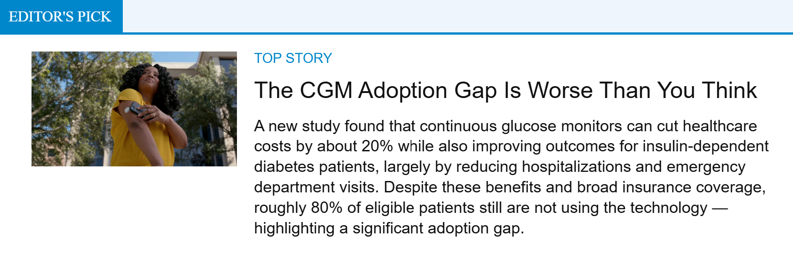
Why Don’t More Patients have CGM?
For clinicians, the benefits are also many: more informed treatment decisions, more engagement with the patient, greater insight into therapeutic impact – so much more information than the A1c provides.
Miller EM. Clin Diabetes. 2020; Adams K. MedCity News. 2025.

Slide 4
Benefits of CGM
A1C Reduction – Still Matters, But It’s Not the Whole Story
A1C remains a familiar, validated endpoint tied to long-term complication risk.
CGM consistently demonstrates modest but clinically meaningful A1C reductions across populations
  DIAMOND Trial (T1D & T2D on MDI) CGM users greater A1C reduction vs SMBG at 24 weeks
  GOLD Trial (T1D) CGM reduced A1C by ~0.4% compared with fingerstick monitoring
  MOBILE Study (T2D on basal insulin) CGM resulted in greater A1C reduction compared with SMBG, even without prandial insulin
Time in Range (TIR) – The Most Actionable Metric
ADA now emphasizes TIR as a key glycemic outcome, complementary to A1C
TIR reflects daily glucose stability, not just averages
Strongly associated with risk of microvascular complications
  GOLD Trial – Significant increases in TIR with CGM
  DIAMOND Trial – CGM users spent more time 70–180 mg/dL and less TAR
  Real-world registry studies show consistent TIR improvements across age groups and diabetes types.
Beck RW, et al. JAMA. 2017; Lind M, et al. JAMA. 2017; Martens T, et al. JAMA. 2021; Brown RE, et al. Diabet Med. 2022; Dowd R, et al. JMIR Diabetes. 2023; Gavin JR, et al. Diabetes Technol Ther. 2021.

Slide 5
ADA SOC Perspective on CGM
What’s changed in 2026 and why are we so excited for these changes?
CGM is now recommended from diagnosis and anytime thereafter for all people on insulin, on non-insulin therapies that can cause hypoglycemia, and any therapy where CGM helps management
It’s no longer optional for Type 1 or people with insulin-treated T2D; it’s standard of care
ADA. Diabetes Care. 2026.

Slide 6
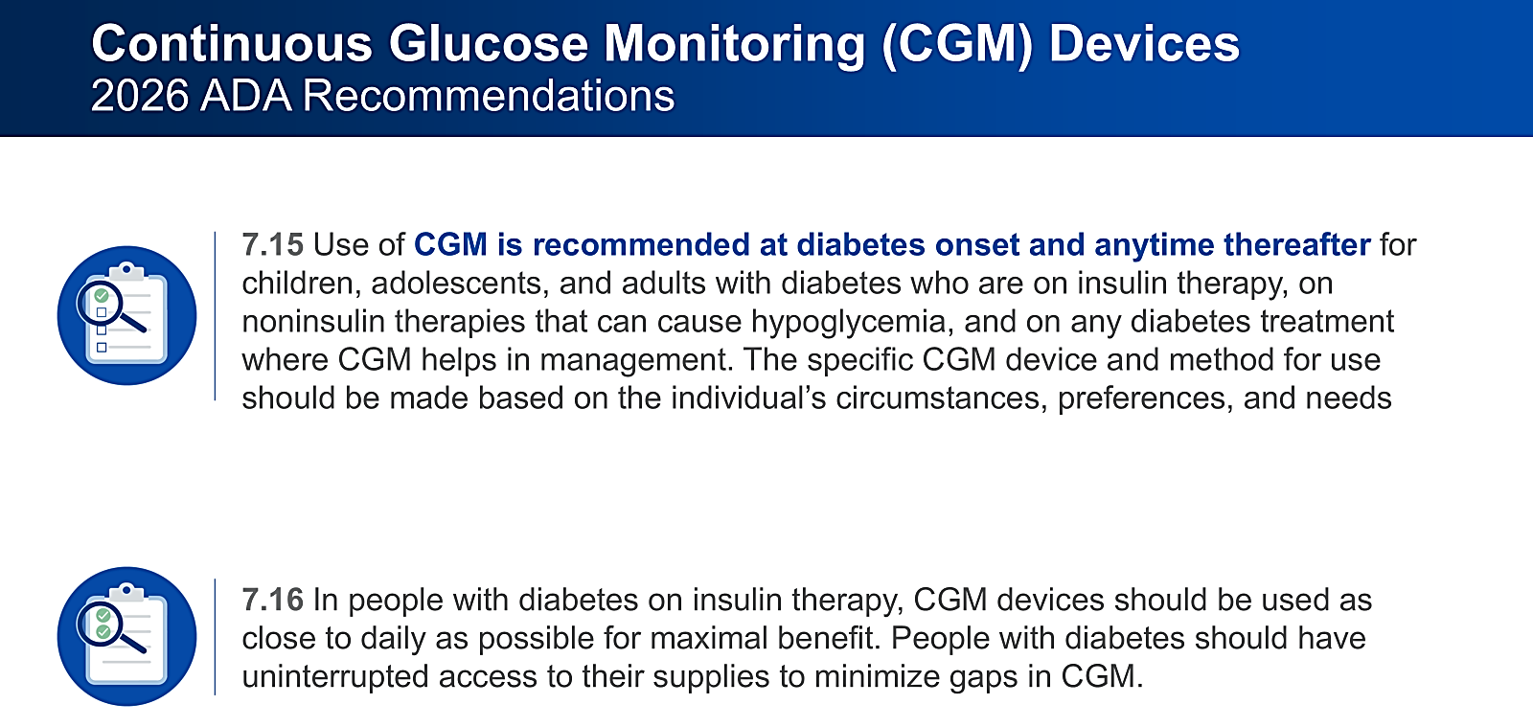
ADA SOC Perspective on CGM
ADA. Diabetes Care. 2026.

Slide 7
Hypoglycemia Reduction
The Most Persuasive Safety Argument…
Hypoglycemia is linked to falls, cognitive impairment, cardiovascular events, and mortality
Prevention is a core responsibility emphasized in ADA 2026 Standards
  IN CONTROL Trial (T1D with impaired awareness) CGM significantly reduced time spent <70 mg/dL compared with SMBG
  WISDM Study (Older adults with T1D) CGM reduced hypoglycemia and improved patient-reported outcomes.
  IMPACT Trial (Flash CGM)Significant reduction in hypoglycemia exposure without worsening A1C
  MOBILE Study (T2D on basal insulin)Reduced hypoglycemia alongside improved overall glycemia
van Beers CA, et al. Lancet Diabetes Endocrinol. 2016; Pratley RE, et al. JAMA. 2020; Oskarsson P, et al. Diabetologia. 2018; Martens T, et al. JAMA. 2021.

Slide 8
Why Patients (and Clinicians) Need CGM
Diabetes is continuous
The majority of diabetes care transpires between visits, outside of clinical encounters.
A1C
A1C alone may not be enough
Using A1C alone may not be very helpful to patients for understanding their diabetes.
BGM has notable limitations
It only measures blood glucose at a single point in time.
A1C, glycated hemoglobin or HbA1C; BGM, blood glucose monitoring.
Corathers SD, et al. Diabetes Spectr. 2020; Garber A, et al. Endocr Prac. 2020; Adolfsson P, et al. Eur Endocrinol. 2018.

Slide 9
CGM EARLY Can Support Glycemic Outcomes
People with T2D that achieve targets soon after diagnosis are more likely to keep glucose in target range.
Managing glucose levels early in diagnoses reduces chance of complications.
Reaching & sustaining A1C targets in the first year of treatment, showed long-term health improvements, even when control waned over time.
A1C, glycated hemoglobin or HbA1C; T2D, type 2 diabetes.
Laiteerapon N, et al. Diabetes Care. 2019.
Notes:
Tag: therapeutic inertia, CGM early
UKPDS showed:
Their observations indicate that intensive glucose control starting at the time of diagnosis is associated with a significantly decreased risk of myocardial infarction and death from any cause, in addition to the well-established reduction in the risk of microvascular disease. https://www.nejm.org/doi/full/10.1056/nejmoa0806470
With regard
to our hypothesis that the legacy effect begins the 1st year after diagnosis, we found that patients with HbA1c levels $6.5% ($48 mmol/mol) for the
0-to-1-year early exposure period had a
higher risk for microvascular and macrovascular
events than patients with HbA1c
levels ,6.5% (,48 mmol/mol) for the
same period (e.g., HbA1c 6.5% to ,7.0%
[48 to,53 mmol/mol]: HR 1.204 [95% CI
1.063–1.365]) (Table 2).
longer periods of exposure to HbA1c
levels $8.0% ($64 mmol/mol) were
associated with an increasing risk of
microvascular events. HbA1c levels
$9.0% ($75 mmol/mol) for early exposure
periods .0–4 years were associated
with an increasing risk of macrovascular
events.
Mortality
for the
same durations of exposure. Compared
with an HbA1c ,6.5% (,48 mmol/mol)
for the 0-to-1-year early exposure period,
HbA1c levels of 7.0% to ,8.0%
(53 to ,64 mmol/mol) and $9.0%
($75 mmol/mol) were associated
with a higher risk of mortality
Early Missing HbA1c
During the 1st year after diagnosis (0-to-
1-year early exposure period), patients
without an HbA1c value after the first
3 months after diagnosis had a higher
risk of microvascular (HR 1.354 [95% CI
1.218–1.505]) and macrovascular (1.112
[1.050–1.177]) events and mortality
In this large cohort study of patients with
newly diagnosed diabetes and at least
10 years of survival after diagnosis, we
found that diabetes control during the
1st year after diagnosis was strongly
associated with future risk for diabetic
complications and mortality, even after
adjusting for glycemic control after the
1st year.
The current study suggests that failure to
achieve an HbA1c ,6.5% (,48 mmol/mol)
within the 1st year after diabetes diagnosis
is sufficient to establish an irremediable
long-term future risk of
microvascular and macrovascular complications.
In addition, failure to achieve
an HbA1c,7.0% (,53 mmol/mol) within
the 1st year after diabetes diagnosis may
lead to an irreversible increased risk of
mortality.

Slide 10
A1C Values DO NOT EQUAL Time in Range (TIR)
Patient A
HbA1c 7%
Patient B
HbA1c 7%
Patient C
HbA1c 7%
A1C provides only an average
of a patient's glucose history.
TIR provides more actionable information than A1C alone
and should complement A1C.
Each 5% increase in TIR
is clinically beneficial.
In Target Range
(70-180 mg/dL)
Above Target Range
(> 180 mg/dL)
Below Target Range
(< 70 mg/dL)
Not actual patient data- for illustrative purposes only.
Battelino T, et al. Diabetes Care. 2019.
Notes:
Battelino T, Danne T, Bergenstal RM, Amiel SA, Beck R, Biester T, Bosi E, Buckingham BA, Cefalu WT, Close KL, Cobelli C, Dassau E, DeVries JH, Donaghue KC, Dovc K, Doyle FJ 3rd, Garg S, Grunberger G, Heller S, Heinemann L, Hirsch IB, Hovorka R, Jia W, Kordonouri O, Kovatchev B, Kowalski A, Laffel L, Levine B, Mayorov A, Mathieu C, Murphy HR, Nimri R, Nørgaard K, Parkin CG, Renard E, Rodbard D, Saboo B, Schatz D, Stoner K, Urakami T, Weinzimer SA, Phillip M. Clinical Targets for Continuous Glucose Monitoring Data Interpretation: Recommendations From the International Consensus on Time in Range. Diabetes Care. 2019 Aug;42(8):1593-1603. doi: 10.2337/dci19-0028. Epub 2019 Jun 8. PMID: 31177185; PMCID: PMC6973648.

Slide 11
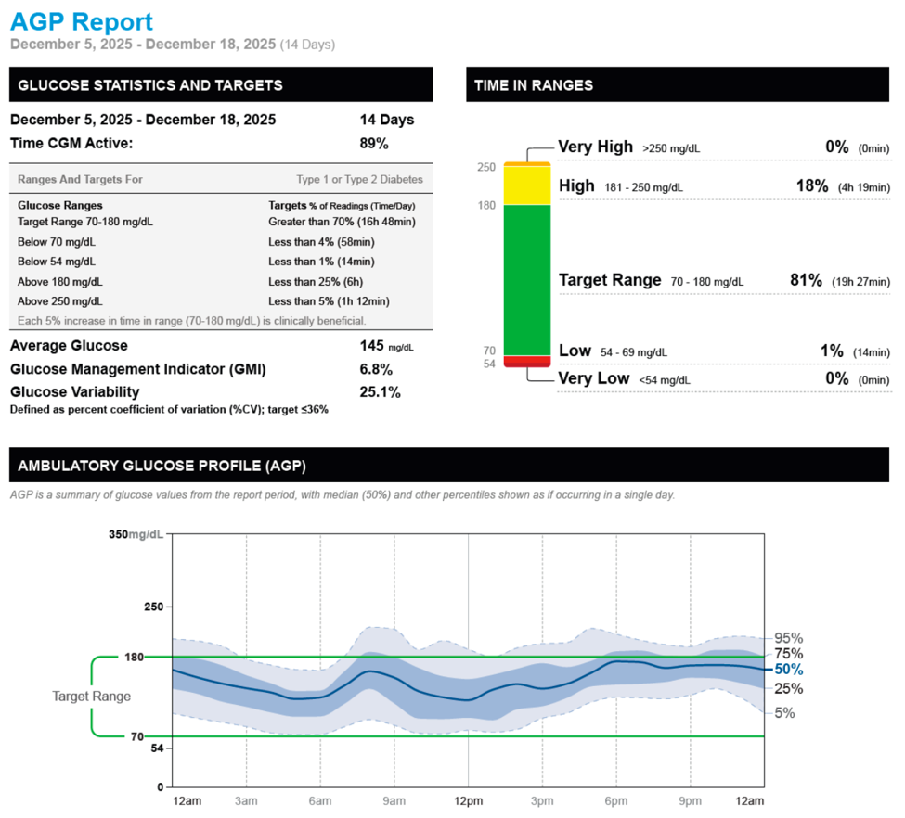
Metrics reported in the AGP:
Glucose Statistics & Targets:
Number of days the sensor is active:
  recommended minimum 14 consecutive days
Percentage of sensor data captured:
  recommended minimum is 70%
Glucose management indicator (GMI):
  assesses glycemic control for the time covered
  often used as an A1c comparison
Glucose variability:
  variance in glucose measurements
  Goal: less than or equal to 36%
Time above target glucose range (TAR) percentage of above a certain threshold
  (e.g., 180 mg/dL [High] or 250 mg/dL [Very high])
Time in range (TIR): percentage of time between 70 and 180 (goal: 70%)
Time below target glucose range (TBR):
  percentage of below a certain threshold
  (e.g., 70 mg/dL [Low] or 54 mg/dL [Very low])
Ambulatory Glucose Profile:
A summary of glucose value over the entire Report period, shown as though all values occurred in a single day.
Battelino T, et al. Diabetes Care. 2019.

Slide 12
Identifying Candidates for CGM
≥2 years of age who need or want more engagement with their diabetes
At risk for hypoglycemia
(e.g., patients of younger or older age, patients taking insulin)
Need modification of current treatment or are experiencing clinical inertia
Have poorly managed diabetes and would benefit from greater understanding of diet, activity, and medication on glycemic management
Want to actively participate in their diabetes care, including making lifestyle changes

Slide 13
Interprofessional Team Overview
Team-based approach is important for patient care
Limited time makes patient education challenging, even for specialists
Multiple resources are available
  Online and in-person
Education should cover both device use and interpreting data
Use available support systems to help patients
Goal is patient comfort with CGM and maximizing its benefit

Slide 14
Key Takeaways
CGM brings value to both clinicians and patients
With updates to standards of care and reimbursement, ALL patients should be offered CGM

