Slide 2
DISCLAIMER
This slide deck in its original and unaltered format is for educational purposes and is current as of June 2024. All materials contained herein reflect the views of the faculty, and not those of AXIS Medical Education, the CME provider, or the commercial supporter. Participants have an implied responsibility to use the newly acquired information to enhance patient outcomes and their own professional development. The information presented in this activity is not meant to serve as a guideline for patient management. Any procedures, medications, or other courses of diagnosis or treatment discussed or suggested in this activity should not be used by clinicians without evaluation of their patients’conditions and possible contraindications and/or dangers in use, review of any applicable manufacturer’s product information, and comparison with recommendations of other authorities.

Slide 3
DISCLOSURE OF UNLABELED USE
This activity may contain discussion of published and/or investigational uses of agents that are not indicated by the FDA. The planners of this activity do not recommend the use of any agent outside of the labeled indications.
The opinions expressed in the activity are those of the faculty and do not necessarily represent the views of the planners. Please refer to the official prescribing information for each product for discussion of approved indications, contraindications, and warnings.
USAGE RIGHTS
This slide deck is provided for educational purposes and individual slides may be
used for personal, non-commercial presentations only if the content and references
remain unchanged. No part of this slide deck may be published in print or
electronically as a promotional or certified educational activity without prior written
permission from AXIS. Additional terms may apply. See Terms of Service on
www.axismeded.com for details.

Slide 4
Learning Objectives
Upon completion of this activity, participants should be better able to:
Evaluate the novel MOA of CD20 X CD3 bispecific antibodies, how these agents are delivered, and the differences among and between these agents and CAR T-cell therapies for R/R DLBCL
Summarize updated clinical efficacy/safety data associated with the use of CD20 X CD3 bispecific antibodies for R/R DLBCL/LBCL
Develop team-based, multidisciplinary treatment plans that involve shared decision-making tactics for selected patients with R/R DLBCL/LBCL and include CD20 X CD3 bispecific antibodies based on clinical evidence, disease- and patient-related characteristics, and patient goals and preferences
Integrate team-based management and care coordination strategies for adverse events, including CRS and ICANS, related to the use of CD20 X CD3 bispecific antibodies for R/R LBCL/DLBCL

Slide 5
Rel/Ref LBCL: Where We’ve Come From

Slide 6
Poor Outcomes in Rel/Ref LBCL Post 1st Line
Scholar-1: Retrospective analysis of outcomes in patients with R/R DLBCL (N = 636)
Notes:
Crump M, Neelapu SS, Farooq U, et al. Outcomes in refractory diffuse large B-cell lymphoma: results from the international SCHOLAR-1 study. Blood. 2017;130(16):1800-1808.
SCHOLAR-1 is the first patient-level analysis of outcomes of refractory DLBCL from 2 large randomized trials and 2 academic databases. SCHOLAR-1 demonstrated poor outcomes in patients with refractory DLBCL, supporting a need for more effective therapies for these patients.
Diffuse large B-cell lymphoma (DLBCL) is the most common subtype of non-Hodgkin lymphoma. Although 5-year survival rates in the first-line setting range from 60% to 70%, up to 50% of patients become refractory to or relapse after treatment. Published analyses of large-scale outcome data from patients with refractory DLBCL are limited. SCHOLAR-1, an international, multicohort retrospective non-Hodgkin lymphoma research study, retrospectively evaluated outcomes in patients with refractory DLBCL which, for this study, was defined as progressive disease or stable disease as best response at any point during chemotherapy (>4 cycles of first-line or 2 cycles of later-line therapy) or relapsed at ≤12 months from autologous stem cell transplantation. SCHOLAR-1 pooled data from 2 phase 3 clinical trials (Lymphoma Academic Research Organization-CORAL and Canadian Cancer Trials Group LY.12) and 2 observational cohorts (MD Anderson Cancer Center and University of Iowa/Mayo Clinic Lymphoma Specialized Program of Research Excellence). Response rates and overall survival were estimated from the time of initiation of salvage therapy for refractory disease. Among 861 patients, 636 were included on the basis of refractory disease inclusion criteria. For patients with refractory DLBCL, the objective response rate was 26% (complete response rate, 7%) to the next line of therapy, and the median overall survival was 6.3 months. Twenty percent of patients were alive at 2 years. Outcomes were consistently poor across patient subgroups and study cohorts. SCHOLAR-1 is the largest patient-level pooled retrospective analysis to characterize response rates and survival for a population of patients with refractory DLBCL.

Slide 7
Timing Matters: Poor Outcomes in Rel/Ref LBCL Post 1st Line
Notes:
Maurer MJ, Jakobsen LH, Mwangi R, et al. Relapsed/Refractory International Prognostic Index (R/R-IPI): An international prognostic calculator for relapsed/refractory diffuse large B-cell lymphoma. Am J Hematol. 2021;96(5):599-605.
Kaplan Meier Curve of Overall Survival from First Progression by Time to Progression (Months) on Frontline Immunochemotherapy (IC) in SEAL Cohort. Model building was performed in patients from the SEAL consortium with disease progression after frontline immunochemotherapy. The primary endpoint was overall survival (OS) measured from date of progression. 1,234 of 5,112 patients treated with frontline immunochemotherapy in the SEAL consortium developed progressive disease. Time to progression on immunochemotherapy and age at progression were strongly associated with post-progression OS (both p<0.0001). Time to progression on frontline therapy is strongly associated with post-progression OS in DLBCL. We developed and validated a simple to apply clinical prognostic tool in the R/R setting. The useful prediction of expected outcomes in R/R DLBCL and can inform treatment decisions such as considerations for CART therapy as well as trial designs.

Slide 8
Rel/Ref LBCL: Chaos Driven By Clinical Trials
Notes:
Westin J, Sehn LH. CAR T cells as a second-line therapy for large B-cell lymphoma: a paradigm shift? Blood. 2022;139(18):2737-2746.
There's been a lot of chaos recently, and unfortunately that chaos has been driven by clinical trials in the relapsed/refractory diffuse large B-cell lymphoma space. As you can see here, the algorithm for second line therapy in large B-cell lymphoma has really been changed quite a bit. And what's changing it? Well, CAR T-cell therapy and a massive amount of new therapies in the large B-cell lymphoma space. We know that the majority of those patients who have large B-cell lymphoma, if they're going to relapse, that relapse will happen within the first year. I think now with ZUMA-7 and TRANSFORM data in the second-line, high-risk population of those patients who are primary refractory or who have relapsed within 1 year of therapy really drives the left side of this cartoon before the discussion of CAR T-cell eligibility. We know that a minority will relapse from large B-cell lymphoma and those relapses are going to occur greater than 1 year.

Slide 9
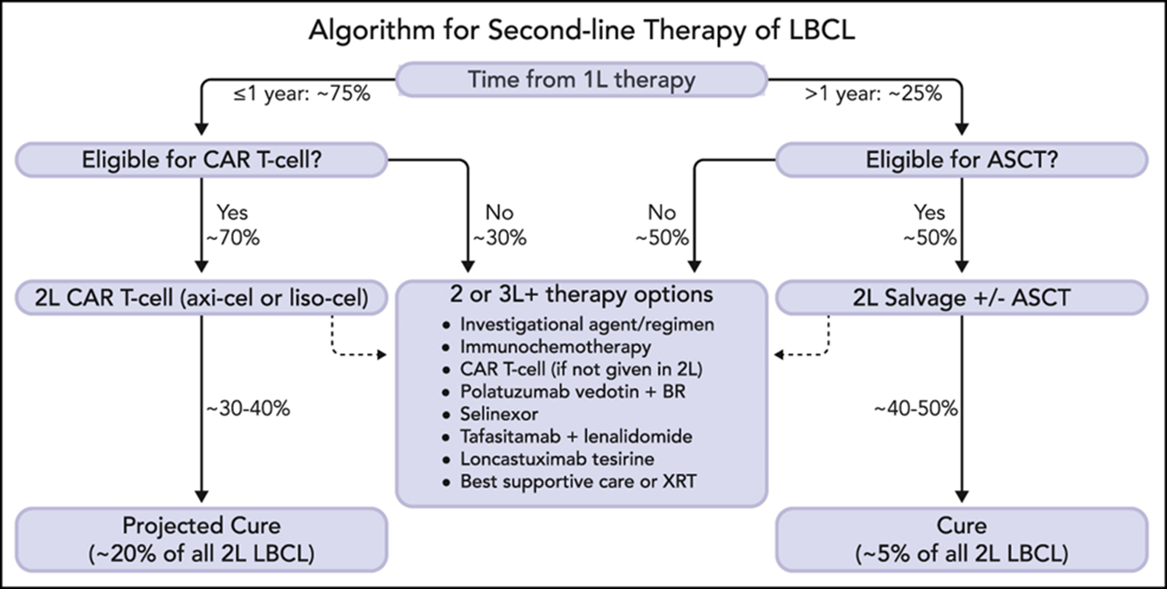
Rel/Ref LBCL: Chaos Driven By Clinical Trials
BISPECIFICS
Notes:
Westin J, Sehn LH. CAR T cells as a second-line therapy for large B-cell lymphoma: a paradigm shift? Blood. 2022;139(18):2737-2746.
And here’s where the classical auto transplant paradigm still is in play with second-line chemotherapy. If felt to be transplant eligible, and if a response is seen, then transplant can occur. But again, sometimes the middle of those therapies that you see here below but whether or not it is immunochemotherapy, CAR T-cell, polatuzumab + bendamustine and rituximab, tafasitamab plus lenalidomide, selinexor, loncastuximab tesirine, or even newly approved bispecifics. And that's what we're going to talk about today is our CD3 + CD20 bispecific antibodies.

Slide 10
Factors That Differentiate CD20 X CD3 Bispecific Antibodies

Slide 11
Patient Facing: Keep it Simple
Notes:
Falchi L, Vardhana SA, Salles GA. Bispecific antibodies for the treatment of B-cell lymphoma: promises, unknowns, and opportunities. Blood. 2023;141(5):467-480.
I often think that it should be kept very simple, and keep it patient-facing because it's very complex in how these are engineered. I like to use the analogy of spaghetti and the kiss of death. So, the antibodies are bringing the CD3 T-cell together with that CD20 antibody and then, that kiss of death does happen, you can see here through them coming together for cytotoxicity. But I also see this as a spaghetti noodle. And you can see the 2-fork analogy here, where you're winding them together, bringing them together before the lymphoma cell gets eaten.

Slide 12
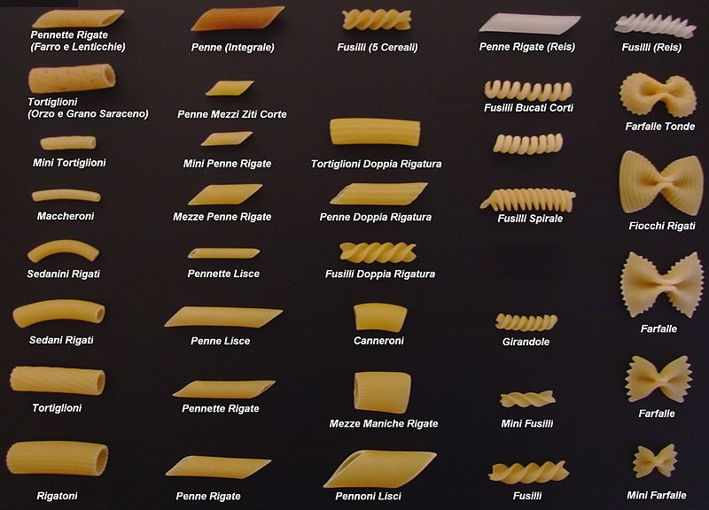
Provider Facing: Many Targets
Notes:
Tian Z, Liu M, Zhang Y, Wang X. Bispecific T cell engagers: an emerging therapy for management of hematologic malignancies. J Hematol Oncol. 2021;14(1):75.
There are many different types of spaghetti, just like there are many different types of bispecifics. And this technology is just blossoming to where there are multiple antigens that are being directed at these T-cells and you can see it not only in B-cell lymphomas, but also in other myeloid disorders and including solid tumors. And so really this space is just emerging in multiple different areas.
(Right) Targets of bispecific B cell-recruiting antibodies.
CD19 and CD20 are targets for treatment of NHL;
CD19 is the target for treatment of acute lymphocytic leukemia;
CD123, CD33, CLEC12A, WT1, and FLT3 are targets for treatment of acute myeloid leukemia;
BCMA, CD38, and GPRC5D are targets for treatment of multiple myeloma

Slide 13
Provider Facing: Way More Complex
Notes:
Minson A, Dickinson M. Glofitamab CD20-TCB bispecific antibody. Leuk Lymphoma. 2021;62(13):3098-3108.
But at the end, at this synapse of when you're bringing the malignant B-cell and the T-cell together, you can see here based on the cartoon of glofitamab, engaging a CD20 antigen and bringing it next to that CD3 TCR leading to perforin and granzyme B, release of the activated T-cell, which leads to hopeful apoptosis of the B-cell.
The structure and mechanism of Glofitamab. Glofitamab is a bispecific antibody with a special structure developed by Roche, which contains two domains that can bind to CD20 as well as one that binds to CD3.

Slide 14
History of Bispecific T-Cell Engagers
Notes:
Lussana F, Gritti G, Rambaldi A. Immunotherapy of acute lymphoblastic leukemia and lymphoma with T cell-redirected bispecific antibodies. J Clin Oncol. 2021;39(5):444-455.
Main T cell–redirecting bispecific antibodies in clinical development.
(A) Blinatumomab, the first bispecific T-cell engager (BiTE), is a tandem single-chain variable fragment (scFv).
(B) To increase the half-life, the CD3xCD20 BiTE it is linked to a silent fragment crystallizable region (constant; FC) portion to form the half-life extended (HLE)-BiTE.
(C, D) The knob-into-hole technology facilitates the correct pairing of FC portion of mosunetuzumab and glofitamab; this latter is characterized also by an asymmetric 2:1 format that incorporates bivalent binding to CD20 and monovalent binding to CD3 (CrossMAb).
(E) Design of odronextamab exploits differences in the affinities of the immunoglobulin isotypes for Protein A coupled with the use of common light chain, allowing efficient large-scale purification.
(F) In the Duo-Body, each parental antibody contains single matched point mutations in the constant region of the heavy chain 3 (CH3) domains, which allows the correct reassembly after in vitro separation (controlled fragment antigen-binding [Fab]-arm exchange).
(G) Plamotamab uses FC domain variants that spontaneously form stable, heterodimeric bispecific antibodies allowing the use of standard antibody production methods. Different from the other molecules, the FC domain is functional.

Slide 15
Bispecific T-Cell Engagers: Same But Different
Agent | Epcoritamab | Glofitamab | Mosunetuzumab |  | Odronextamab | Plamotamab
Configuration CD20:CD3 | 1:1 | 2:1 | 1:1 |  | 1:1 | 1:1
Administration | SC | IV | IV | SC* | IV | IV
Dosing | Step-up | Step-up | Step-up |  | Step-up | Step-up
CD20 Ab lead-in** | No | Yes | No |  | No | No
Fixed or Continuous | Cont | Fixed | Fixed | Cont | Cont
Post-dose Steroids | Yes | No | No | No | No
Inpatient Stay in Cycle 1*** | Yes | Yes | No | Unknown | Unknown
FDA Approval | Rel/ref DLBCL after ≥2 lines of therapy | Rel/ref DLBCL after ≥2 lines of therapy | Rel/ref FL after ≥2 lines of therapy | - | -
Notes:
And you also see this in the application of these bispecific T-cell engagers. You can see here the configuration may be different with glofitamab having a 2-arm to 1 ratio CD20 to CD3, whereas the other ones are a 1-to-1. Some of these may be subcutaneous dosing, like epcoritamab or mosunetuzumab, which is being developed with both IV and sub-q administration, versus others like glofitamab and odronextamab and plamotamab, which are primarily intravenous. All of these have step-up dosing to risk mitigate cytokine release syndrome and ICANS. The majority of them do not have a CD20 monoclonal antibody as part of their step-up dosing, whereas glofitamab uses obinutuzumab as a Cycle 1 Day 1 lead-in before the step-up dosing occurs at Cycle 1 Day 8. Also unique is whether or not it's a fixed duration or continuous duration. And you can see here epcoritamab, odronextamab and plamotamab were designed as a continuous dosing strategy, at least in the clinical trials, and glofitamab and mosunetuzumab has fixed duration. And we'll go through some of this data later in this talk. Also, kind of looking at how you're mitigating risk for CRS and ICANS with post-dose steroids, which is employed in epcoritamab, but not with the other agents. Some of them may require inpatient stays, both as part of the clinical trials and now with commercial availability with epcoritamab and glofitamab. And so, really, a lot of movement in the bispecific space. And this chaos really appreciates tables like this which help kind of differentiate these bispecifics, which have never been compared head-to-head in a clinical trial.

Slide 16
Advantages of Bispecific Antibodies
Readily available, "off-the-shelf” products | CAR T-cell therapy: treatment delay due to the time needed for leukapheresis and CAR T-cell manufacturing
 | BsAbs: do not require bridging therapy; administered SC or IV
Lower rates of severe side effects | CAR T-cell therapy: associated with severe CRS and neurological symptoms, which limits their use in older, more clinically vulnerable patients
 | BsAbs: lower rates of grade ≥3 CRS and neurotoxicity; can easily be discontinued in case of severe toxicity
Activity in a patient population that had previously rel/ref DLBCL after receiving CAR T-cell therapy | BsAbs are a promising choice, particularly for older patients and those with multiple prior lines of therapy BsAbs may be particularly important for patient who are not eligible for CAR T-cell therapies
Notes:
Hutchings M. The evolving therapy of DLBCL: Bispecific antibodies. Hematol Oncol. 2023;41(S1):107-111.
van de Donk NWCJ, Zweegman S. T-cell-engaging bispecific antibodies in cancer. The Lancet. 2023;402(10396):142-158.
So, what are some of the advantages of bispecifics? Well, I think one of those is that it's readily available. It's a quote, unquote off-the-shelf product. We know that CAR T-cell therapies don't grow on trees, and they can lead to treatment delays as there is time not only to get to a CAR T-cell center, but there is also time needed between leukapheresis to actual infusion. Bispecifics don't require bridging therapy, and as I alluded to on the prior slide, they can be administered as a subcutaneous dosing or intravenously.
CAR T-cell therapies have been associated with cytokine release syndrome and neurologic symptoms at different frequencies as well as severities, and there have been improvements over time in therapeutics based upon utilization of tocilizumab or prophylactic steroids, but this may limit their use in older or more advanced age individuals, including those who are more clinically vulnerable patient populations. With regards to bispecifics, the rates of Grade 3 or higher CRS and neurologic toxicities are lower and may be easily discontinued in the case of severe toxicity. Some of the attributes also of bispecifics is that they may be more available to patients, potentially with advanced age, or with those who have multiple prior lines of therapy, and those prior lines of therapy could include CAR T-cell. And in the upper bounds of some of the prospective trials getting all the way up to 11 prior lines of therapy before introduction of bispecifics. And there may be those individuals who logistically just may not be able to get to an authorized treatment center for CAR T-cells where this may be a particularly important option for those patients.

Slide 17
Bispecific T-Cell Engagers: Challenges
Logistics | Outpatient→Inpatient→Outpatient dosing Transition from academic to community Transition from community to academic
Dosing | Deliver treatment in the center, but supportive measures are only available in the hospital (next door or miles away) Tocilizumab availability (who buys & who stores)
Toxicity Management | Product-specific pre-medications and post-dose supportive measures Time-of-event specific Severity of event Location of patient
Notes:
But bispecifics do have their challenges. I think that there is some logistics still that can happen with bispecifics where you may start as an outpatient, need to go inpatient, and then go back out to outpatient dosing. There can be that transition to not having CAR T-cell availability and having to go to an academic institution from the community or starting in academia and then moving out to the community. And so those logistics need to be discussed, I think very early on. I think dosing, with the step-up dosing strategy, that can be something to get used to from that standpoint, as well as supportive measures, as I alluded to, may be different depending upon which bispecific you're using. And then also having tocilizumab, our IL-6 antagonist, available; but also, kind of going through who buys the tocilizumab and where is it stored? And then also thinking about toxicity management where each of them may be different. There may be different pre-medications and also post-dose supportive measures. And then also understanding what is the time of the specific event. Is it going to happen if it's intravenously at the time or near the time of administration versus subcutaneous, which may be delayed? And then what to expect and what are the signs, potentially, of severity of the event? And where is the patient going to be located? Are they close to the treatment center or are they going to be at a distance?
Need for multidisciplinary and interprofessional team-based management, care coordination and communication
The transition from inpatient to outpatient administration of BsAbs has been identified as a significant barrier to widespread adoption of these agents in the community setting (ACCC, 2022c).
As hospitalization is recommended for at least the first few days, followed by outpatient administration of the following doses, there is a need for detailed coordination among physicians, APPs, care coordinators, nurses, pharmacists, home infusion agencies, and insurance companies to ensure that the patient can safely receive the drug at home
Finding a home infusion company that has oncology nurses trained on infusing BsAbs can be difficult, highlighting a need for more training in this area
“There is an inpatient to outpatient transition that must be very meticulous, so as not to miss any days of treatment. And in that, it takes a village…because you need insurance approvals and coordination with the infusion agency, nurses, local pharmacy, and local facility that would be comfortable managing the patient’s side effects if something were to happen.” – Srinivas Devarakonda, MD (ACCC, 2022b)
A resource on best practices for transitioning from inpatient to outpatient administration of BsAbs has been published (ACCC, 2022a).
ACCC. Best practices in expanding access to bispecific antibodies and adverse event management. https://www.accc-cancer.org/docs/projects/bispecific-antibodies/bispecific-antibodies-brief.pdf
ACCC. Expanding access to bispecific antibodies in community cancer care. Updated August 3, 2022. https://www.accc-cancer.org/acccbuzz/blog-post-template/accc-buzz/2022/08/03/expanding-access-to-bispecific-antibodies-in-community-cancer-care
ACCC. Using bispefic antibodies in community practice. Challenges and opportunities. https://www.accc-cancer.org/docs/projects/bispecific-antibodies/using-bispecific-antibodies-in-community-practice.pdf

Slide 18
Clinical Efficacy/Safety Data of CD20 X CD3 Bispecific Antibodies

Slide 19
Epcoritamab

Slide 20
Bispecifics in 3rd line + LBCL: Epcoritamab
Key Eligibility:
DLBCL, HGBCL, transformed FL, PMBCL, FL3b
ECOG PS 0–2
≥2 prior therapies
Prior CAR-T allowed
Key Characteristics |  | Subjects (N=157)
Median age, y (range) |  | 64 (20–83)
NHL subtype, n (%) | DLBCL | 139 (89)
 | DeNovo | 97 (70)
 | tNHL | 40 (29)
 | Known DH/TL | 13/99 (13)
Median no. of prior lines (range), n |  | 3 (2–11)
Refractory to last prior therapy, n (%) |  | 130 (83)
Prior CAR-T, n (%) |  | 61 (39)
Refractory to prior CAR-T, n (%) |  | 46 (75)*
Treatment Duration
Continuous
SC administration
CRS mitigation
Steroid day of X 3 days post-dose for cycle (C) 1
No CD20 Ab lead-in
C1 step-up dosing (SUD)
Epcoritamab schedule
C1D1: 0.16 mg C1D8: 0.8 mg
C1D15 &D22: 48 mg (full dose)
---------------------------------------------
C 2 & 3 weekly: 48 mg
C 4-9 every 2 weeks: 48 mg
C10 and beyond monthly: 48 mg
Primary Endpoint: Overall response rate
Notes:
1. Thieblemont C, Phillips T, Ghesquieres H, et al. Epcoritamab, a novel, subcutaneous CD3xCD20 bispecific T-cell-engaging antibody, in relapsed or refractory large B-cell lymphoma: dose expansion in a phase I/II trial. J Clin Oncol. 2023;41(12):2238-2247. 2. Thieblemont C, Phillips T, Ghesquieres H, et al. Primary results of subcutaneous epcoritamab dose expansion in patients with relapsed or refractory large B-cell lymphoma: a phase 2 study. Abstract presented at: European Hematology Association Congress; Vienna, Austria; June 9-12, 2022. Abstract LB2364.
3. Jurczak W, Ghesquieres H, Karimi Y, et al. Longer follow-up from the pivotal EPCORE NHL-1 trial reaffirms subcutaneous epcoritamab induces deep, durable complete remissions in patients with relapsed/refractory large B-cell lymphoma. Abstract presented at: European Hematology Association Congress; Frankfurt, Germany; June 8-11, 2023. Abstract P1118.
Epcoritamab was approved on a Phase 2 single-agent trial of 157 subjects. The median age being 64, the upper-bound of being 83. The median prior lines of therapy was 3, again with the upper-bound of 11 prior lines of therapy. I think what is unique in this patient population is that a vast majority were refractory to their last therapy, and this is in large-cell lymphoma only, and it did include 39% of the population having had prior CAR T, with 75% of those refractory to their prior CAR T, and that means progressed within 6 months of their CAR T-cell. Epcoritamab is a continuous dosing strategy.

Slide 21
Bispecifics in 3rd line + LBCL: Epcoritamab
Efficacy | All patients (N = 157) | 3-year follow-up (Vose et al, 2024)
ORR | 63% | 59%
CR rate | 39% | 41% (an estimated 52% were still responding at 3 years)
Median Time to response | 1.4 months | -
Median Time to CR | 2.7 months | -
Median DOR | 12 months | 20.8 months
Median DoCR | Not Reached | 36.1 months
MRD negativity, as defined by ctDNA | - | 45.4%
Notes:
1. Thieblemont C, Phillips T, Ghesquieres H, et al. Epcoritamab, a novel, subcutaneous CD3xCD20 bispecific T-cell-engaging antibody, in relapsed or refractory large B-cell lymphoma: dose expansion in a phase I/II trial. J Clin Oncol. 2023;41(12):2238-2247. 2. Thieblemont C, Phillips T, Ghesquieres H, et al. Primary results of subcutaneous epcoritamab dose expansion in patients with relapsed or refractory large B-cell lymphoma: a phase 2 study. Abstract presented at: European Hematology Association Congress; Vienna, Austria; June 9-12, 2022. Abstract LB2364.
3. Jurczak W, Ghesquieres H, Karimi Y, et al. Longer follow-up from the pivotal EPCORE NHL-1 trial reaffirms subcutaneous epcoritamab induces deep, durable complete remissions in patients with relapsed/refractory large B-cell lymphoma. Abstract presented at: European Hematology Association Congress; Frankfurt, Germany; June 8-11, 2023. Abstract P1118.
4. Vose JM, Cheah CY, Clausen MR, et al. 3-Year Update from the Epcore NHL-1 trial: epcoritamab leads to deep and durable responses in relapsed or refractory large B-cell lymphoma. Abstract presented at: American Society of Hematology Annual Meeting; San Diego, California, December 7-10, 2024. Abstract 4480.
LBCL overall response and CR rates were 63.1% and 39.5%, respectively, and were consistent for DLBCL (61.9% and 39.6%). Median duration of CR was 20.8 mo. Median time to CR was 2.7 mo; 8 patients converted from partial response to CR at ≥36 wk. Additionally, median duration of response among patients with CR was 20.8 mo (95% CI, 17.3–NR), and an estimated 91.2%, 85.2%, and 79.0% of complete responders remained in response at 9, 12, and 15 mo, respectively.

Slide 22
Bispecifics in 3rd line + LBCL: Epcoritamab
Progression-Free Survival
Overall Survival
100
100
80
80
60
60
Probability
Probability
40
40
20
20
Median PFS = 4.4 months
Median OS = 18.5 months
0
0
0
3
6
9
12
15
18
21
24
24
0
3
6
9
12
15
18
21
24
27
Pts at risk
Time (months)
Pts at risk
Time (months)
155
92
47
35
29
18
13
1
NE
NE
155
121
97
58
49
33
20
5
1
NE
Notes:
1. Thieblemont C, Phillips T, Ghesquieres H, et al. Epcoritamab, a novel, subcutaneous CD3xCD20 bispecific T-cell-engaging antibody, in relapsed or refractory large B-cell lymphoma: dose expansion in a phase I/II trial. J Clin Oncol. 2023;41(12):2238-2247. 2. Thieblemont C, Phillips T, Ghesquieres H, et al. Primary results of subcutaneous epcoritamab dose expansion in patients with relapsed or refractory large B-cell lymphoma: a phase 2 study. Abstract presented at: European Hematology Association Congress; Vienna, Austria; June 9-12, 2022. Abstract LB2364.
3. Jurczak W, Ghesquieres H, Karimi Y, et al. Longer follow-up from the pivotal EPCORE NHL-1 trial reaffirms subcutaneous epcoritamab induces deep, durable complete remissions in patients with relapsed/refractory large B-cell lymphoma. Abstract presented at: European Hematology Association Congress; Frankfurt, Germany; June 8-11, 2023. Abstract P1118.
Median progression-free survival was NR (95% CI, 18.5–NR) among complete responders; an estimated 91.1%, 87.2%, and 81.3% of complete responders remained progression free at 9, 12, and 15 mo, respectively.
Median overall survival was 18.5 mo (95% CI, 11.7–not reached [NR]) for patients with LBCL and 19.4 mo (95% CI, 11.7–NR) for patients with DLBCL. Median overall survival was NR (95% CI, NR–NR) in patients who achieved CR; at 9, 12, and 15 mo, an estimated 98.3%, 95.0%, and 88.3% of complete responders were alive, respectively.

Slide 23
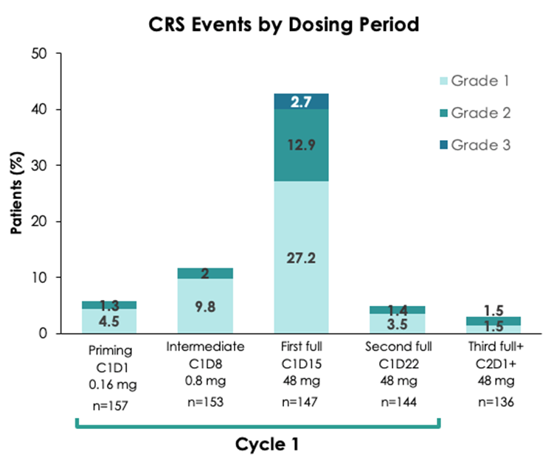
Bispecifics in 3rd line + LBCL: Epcoritamab
CRS Events by Dosing Period
Safety Summary | All patients (N=157)
All grade CRS | 50%
Grade 1 | 32%
Grade 2 | 14%
Grade 3 | 3%
Grade 4 | 0%
Grade 5 | 0%
Epcoritamab-related | 0%
Notes:
1. Thieblemont C, Phillips T, Ghesquieres H, et al. Epcoritamab, a novel, subcutaneous CD3xCD20 bispecific T-cell-engaging antibody, in relapsed or refractory large B-cell lymphoma: dose expansion in a phase I/II trial. J Clin Oncol. 2023;41(12):2238-2247. 2. Thieblemont C, Phillips T, Ghesquieres H, et al. Primary results of subcutaneous epcoritamab dose expansion in patients with relapsed or refractory large B-cell lymphoma: a phase 2 study. Abstract presented at: European Hematology Association Congress; Vienna, Austria; June 9-12, 2022. Abstract LB2364.
3. Jurczak W, Ghesquieres H, Karimi Y, et al. Longer follow-up from the pivotal EPCORE NHL-1 trial reaffirms subcutaneous epcoritamab induces deep, durable complete remissions in patients with relapsed/refractory large B-cell lymphoma. Abstract presented at: European Hematology Association Congress; Frankfurt, Germany; June 8-11, 2023. Abstract P1118.
Epcoritamab did have CRS occurring in 50% of the patients, with Grade 1 representing the majority of the patients at 32%. You can see to the right the CRS events were most commonly at Cycle 1 Day 15, or the first full dose at 48 milligrams, and then a substantial drop-off of CRS risk.

Slide 24
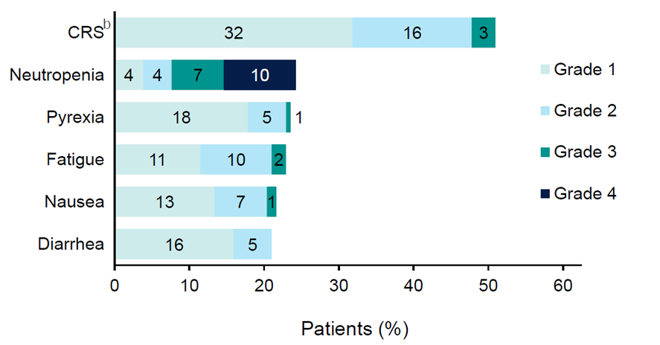
Epcoritamab: Beyond CRS
Notes:
Karimi Y, Ghesquieres H, Jurczak W, et al. Effect of follow-up time on the ability of subcutaneous epcoritamab to induce deep and durable complete remissions in patients with relapsed/refractory large B-cell lymphoma: Updated results from the pivotal EPCORE NHL-1 trial. Abstract presented at: American Society of Clinical Oncology Annual Meeting; Chicago, Illinois; June 2-6, 2023. Abstract 7525.
There can be adverse events beyond CRS, mainly hematologic in regards to neutropenia, but fatigue, nausea, and diarrhea can be seen, but most commonly at lower grades.

Slide 25
Epcoritamab: FDA Approval
May 2023: accelerated approval for relapsed or refractory DLBCL not otherwise specified, including DLBCL arising from indolent lymphoma, and high-grade B-cell lymphoma after two or more lines of systemic therapy
Based on results of EPCORE NHL-1 trial
Administered subcutaneously in 28-day cycles until disease progression or unacceptable toxicity
Recommended dose is step-up dosing in Cycle 1 followed by fixed dosing weekly dosing during Cycles 2 through 3, every other week during Cycle 4 through 9, and then every four weeks on Day 1 of subsequent cycles
Boxed Warning
Serious or life-threatening CRS
Life-threatening or fatal ICANS
Warnings and precautions
Infections and cytopenias
Should only be administered by a qualified healthcare professional with appropriate medical support to manage severe reactions such as CRS and ICANS
Because of the risk of CRS and ICANS, patients should be hospitalized for 24 hours after the Cycle 1 Day 15 dosage of 48 mg
Notes:
NCT03625037
FDA.gov. FDA grants accelerated approval to epcoritamab-bysp for relapsed or refractory diffuse large B-cell lymphoma and high-grade B-cell lymphoma. May 19, 2023. https://www.fda.gov/drugs/drug-approvals-and-databases/fda-grants-accelerated-approval-epcoritamab-bysp-relapsed-or-refractory-diffuse-large-b-cell
Epcoritamab is FDA approved as of May of 2023. You can see here that there are black box warnings with regard to serious or life-threatening CRS and life threatening or fatal ICANS. And in regard to the label, it should be the consideration of hospitalization for 24 hours after Cycle 1 Day 15, dosage of 48 milligram.

Slide 26
Arm 1 of EPCORE NHL-5: Epcoritamab + Lenalidomide in R/R DLBCL
Notes:
Gurion R, Mazza IR, Thieblemont C, et al. fixed-duration epcoritamab plus lenalidomide in patients with relapsed or refractory diffuse large B-cell lymphoma (DLBCL): updated results from arm 1 of the Epcore NHL-5 trial. Abstract presented at: American Society of Hematology Annual Meeting; San Diego, California, December 7-10, 2024. Abstract 3110.

Slide 27
Epcoritamab: Ongoing Trials
Trial | Phase | Treatment | Setting
EPCORE NHL-2 NCT04663347 | 1/2 | Epcoritamab in combination with other SOC agents Arm 1: epcoritamab + R-CHOP in untreated high-risk DLBCL with IPI scores of 3-5: ORR: 100%, CR 87% | B-NHL, 10 different treatment arms
EPCORE DLBCL-1 NCT04628494 | 3 | Epcoritamab vs investigator’s choice chemotherapy | R/R DLBCL who have failed or are ineligible for HDT-ASCT
EPCORE DLBCL-2 NCT05578976 | 3 | Epcoritamab in combination with R-CHOP vs R-CHOP | Newly diagnosed DLBCL
EPCORE DLBCL-3 NCT05660967 | 2 | Epcoritamab +/- lenalidomide | Newly diagnosed elderly patients with DLBCL who cannot tolerate anthracycline therapy
EPCORE DLBCL-4 NCT06508658 | 3 | Epcoritamab + lenalidomide vs rituximab + gemcitabine + oxaliplatin | R/R DLBCL
NCT05733650 | Expanded access program | Epcoritamab | R/R LBCL who have a high unmet medical need with no other treatment options
NCT05283720 | 2 | To evaluate adverse events and change in disease activity of subcutaneous epcoritamab in combination with anti-neoplastic agents | NHL
Notes:
Safety and efficacy trial of epcoritamab combinations in subjects with B-cell non-hodgkin lymphoma (B-NHL) (EPCORE™ NHL-2). ClinicalTrials.gov identifier: NCT04663347. Updated April 3, 2024. https://www.clinicaltrials.gov/study/NCT04663347
A phase 3 trial of epcoritamab vs investigator's choice chemotherapy in R/​R DLBCL (EPCORE DLBCL-1). ClinicalTrials.gov identifier: NCT04628494. Updated April 4, 2024. https://www.clinicaltrials.gov/study/NCT04628494
A study to evaluate change in disease activity of subcutaneous (SC) epcoritamab combined with intravenous and oral rituximab, cyclophosphamide, doxorubicin hydrochloride, vincristine, and prednisone (R-CHOP) or R-CHOP in adult participants with newly diagnosed diffuse large B-cell lymphoma (DLBCL) (EPCORE DLBCL-2). ClinicalTrials.gov identifier: NCT05578976. Updated April 9, 2024. https://www.clinicaltrials.gov/study/NCT05578976
Subcutaneous epcoritamab with or without lenalidomide as first line therapy for diffuse large B-cell lymphoma (EPCORE DLBCL-3). ClinicalTrials.gov identifier: NCT05660967. Updated April 3, 2024. https://www.clinicaltrials.gov/study/NCT05660967
Expanded access program for epcoritamab. ClinicalTrials.gov identifier: NCT05733650. Updated May 25, 2023. https://www.clinicaltrials.gov/study/NCT05733650
A study to evaluate adverse events and change in disease activity of subcutaneous (SC) epcoritamab in combination with oral and intravenous anti-neoplastic agents in adult participants with non-hodgkin lymphoma. ClinicalTrials.gov identifier: NCT05283720. Updated April 9, 2024. https://www.clinicaltrials.gov/study/NCT05283720
A study of subcutaneously injected epcoritamab plus oral lenalidomide tablets compared to intravenously (IV) infused rituximab plus IV infused gemcitabine and IV infused oxaliplatin in adult participants with relapsed or refractory diffuse large B-cell lymphoma (EPCORE DLBCL-4). ClinicalTrials.gov identifier:NCT06508658. Updated February 4, 2025. https://clinicaltrials.gov/study/NCT06508658

Slide 28
Glofitamab

Slide 29
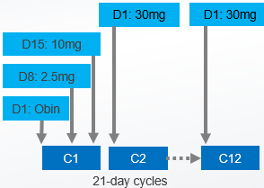
Bispecifics in 3rd line + LBCL: Glofitamab
Key Eligibility:
DLBCL-NOS, HGBCL, transformed FL, or PMBCL
ECOG PS 0–1
≥2 prior therapies
Prior CAR-T allowed
Key Characteristics |  | Subjects (N=154)
Median age, y (range) |  | 66 (21–90)
NHL subtype, n (%) | DLBCL | 110 (71)
 | tFL | 28 (18)
 | HGBCL | 10 (7)
 | PMBCL | 6 (4)
Median no. of prior lines (range), n |  | 3 (2–7)
Refractory to last prior therapy, n (%) |  | 131 (85)
Prior CAR-T, n (%) |  | 51 (33)
Refractory to prior CAR-T, n (%) |  | 46 (90)
Treatment Duration
Fixed up to 12 cycles
IV administration
CRS mitigation
Obinutuzumab (Obin)
C1D1 1000 mg IV
Cycle (C)1 step-up dosing (SUD)
Primary Endpoint: Complete response rate (best response) by PET/CT Lugano Criteria
Notes:
Hutchings M, Carlo-Stella C, Morschhauser F, et al. Glofitamab monotherapy in relapsed or refractory large B-cell lymphoma: extended follow-up from a pivotal phase II study and subgroup analyses in patients with prior chimeric antigen receptor T-cell therapy and by baseline total metabolic tumor volume. Abstract presented at: American Society of Hematology Annual Meeting; San Diego, California; December 9-12, 2023. Abstract 433.
Glofitamab was approved on a Phase 2 single-arm trial of 154 subjects. Median age was 66, but again the upper-bound was at 90 years old. Here, like the prior study, 85% of them were refractory to their last therapy. This did include prior CAR T-cell patients, representing about a third of the population with 90% of them being refractory to their prior CAR T. Unlike epcoritamab, obinutuzumab lead-in is required at Cycle 1 Day 1, and then the step-up dosing is given. This is IV, but this is fixed duration whereas epcoritamab is continuous duration.

Slide 30
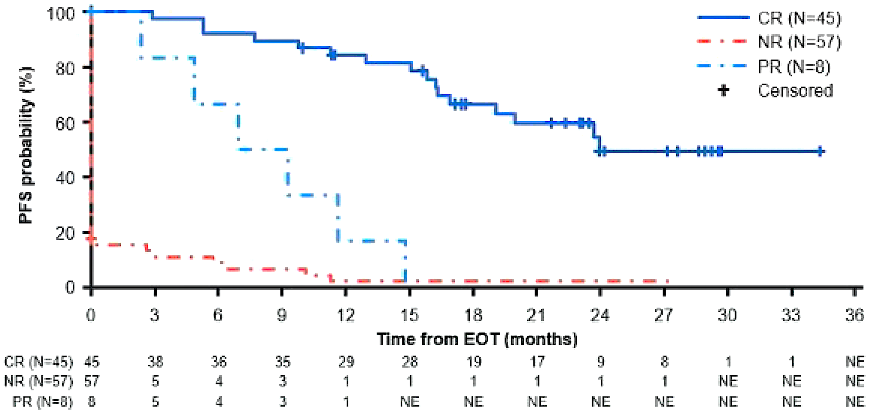
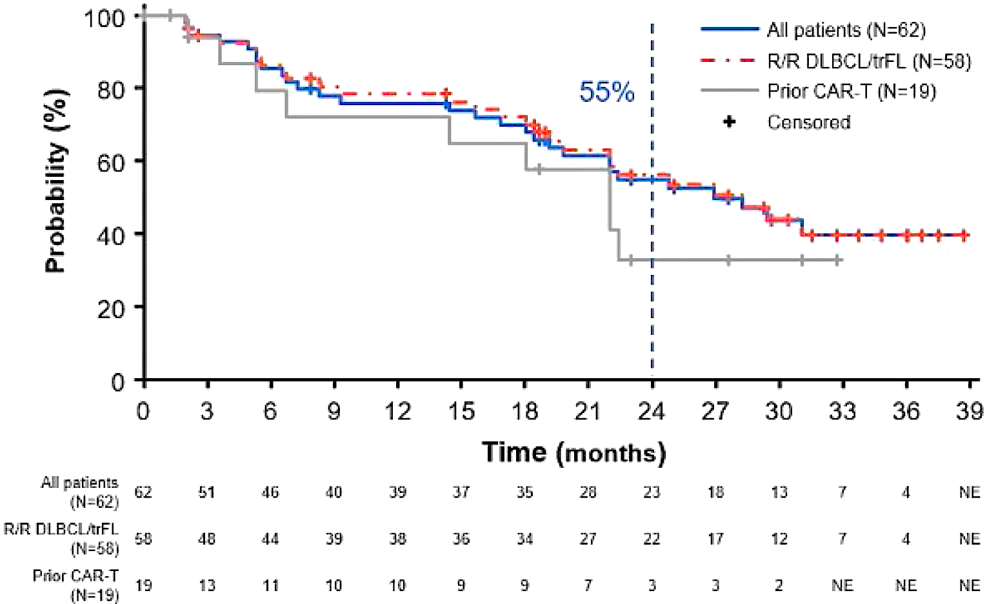
Bispecifics in 3rd line + LBCL: Glofitamab
Efficacy | All patients (N=155) | R/R DLBCL/tFL (N=132) | Prior CAR-T (N=51)
ORR | 52% | 56% | 50%
CR rate | 40% | 44% | 37%
Median CR f/u (range), months | 29.6 (0–39) | 29.6 (0–39) | 23.0 (0–33)
Median DoCR, months | 26.9 | 28.3 | 22.0
24-month DoCR | 55.0% | 56.2% | 33.1%
PFS at End of the Treatment
DoCR
Notes:
Hutchings M, Carlo-Stella C, Morschhauser F, et al. Glofitamab monotherapy in relapsed or refractory large B-cell lymphoma: extended follow-up from a pivotal phase II study and subgroup analyses in patients with prior chimeric antigen receptor T-cell therapy and by baseline total metabolic tumor volume. Abstract presented at: American Society of Hematology Annual Meeting; San Diego, California; December 9-12, 2023. Abstract 433.
This is broken down by those who had relapsed/refractory large-cell lymphoma or transformed follicular lymphoma, versus those with prior CAR T. In the total population the CR is around 40%, and the duration of CR was a little over 2 years for those who obtained a CR. You did see some mild differences in duration of CR at 24 months between the population who did not have prior CAR T, versus those who did have CAR T. What I did discuss is that glofitamab is a fixed-duration therapy, and so you can see at the PFS at the end of therapy, if you're on a CR, there can be the capability for durability, but if you had not achieved a CR by the end of therapy, the progression free survival was relatively short.

Slide 31
Bispecifics in 3rd line + LBCL: Glofitamab
Progression-Free Survival
Overall Survival
100
100
80
80
60
60
Probability
Probability
40
40
20
20
Median PFS = 4.9 months
Median OS = 11.5 months
0
0
0
3
6
9
12
15
18
21
24
24
0
3
6
9
12
15
18
21
24
27
Pts at risk
Time (months)
Pts at risk
Time (months)
155
92
47
35
29
18
13
1
NE
NE
155
121
97
58
49
33
20
5
1
NE
Notes:
Hutchings M, Carlo-Stella C, Morschhauser F, et al. Glofitamab monotherapy in relapsed or refractory large B-cell lymphoma: extended follow-up from a pivotal phase II study and subgroup analyses in patients with prior chimeric antigen receptor T-cell therapy and by baseline total metabolic tumor volume. Abstract presented at: American Society of Hematology Annual Meeting; San Diego, California; December 9-12, 2023. Abstract 433.
Glofitamab has a PFS of 4.9 months with an overall of median survival of 11.5 months.

Slide 32
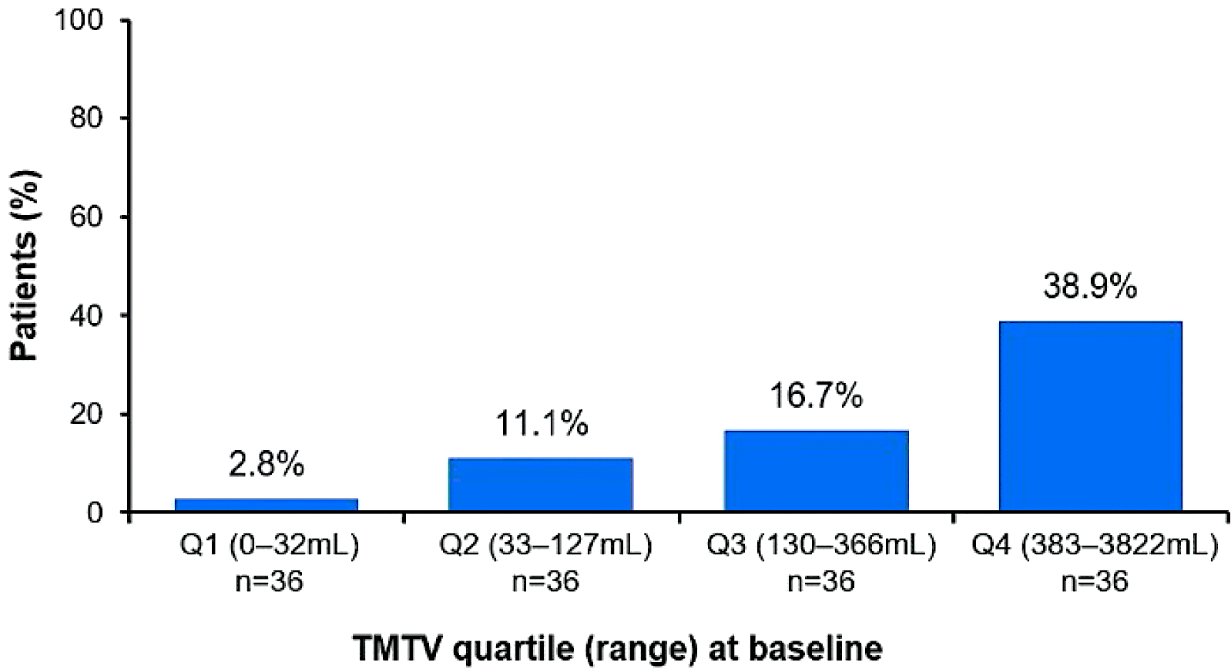
Bispecifics in 3rd line + LBCL: Glofitamab
Safety Summary | All patients (N=154)
All grade CRS | 64%
Grade 1 | 48%
Grade 2 | 12%
Grade 3 | 3%
Grade 4 | 1%
Grade 5 | 7%
Glofitamab-related | 0%
Grade ≥2 CRS
Most grade ≥2 CRS was seen with first dose of glofitamab (C1D8)
Higher baseline TMTV may be prognostic for increased risk of experiencing a grade ≥2 CRS event and lower PFS
Notes:
Hutchings M, Carlo-Stella C, Morschhauser F, et al. Glofitamab monotherapy in relapsed or refractory large B-cell lymphoma: extended follow-up from a pivotal phase II study and subgroup analyses in patients with prior chimeric antigen receptor T-cell therapy and by baseline total metabolic tumor volume. Abstract presented at: American Society of Hematology Annual Meeting; San Diego, California; December 9-12, 2023. Abstract 433.
Glofitamab also, all-grade CRS at 64% with the majority of the CRS events being Grade 1. You can see here that there may be, higher baseline total metabolic tumor volume may be prognostic for those at increased risk for experiencing Grade 2 or higher CRS events, as well as lower progression-free survival.

Slide 33
Glofitamab: Beyond CRS
Notes:
Dickinson M, Carlo-Stella C, Morschhauser F, et al. Glofitamab in patients with relapsed/refractory (R/R) diffuse large B-cell lymphoma (DLBCL) and ≥ 2 prior therapies: pivotal phase II expansion results. American Society of Clinical Oncology Annual Meeting; Chicago, Illinois; June 3-7, 2022. Abstract 7500.
Beyond CRS, there can be hematologic effects of neutropenia, anemia, and thrombocytopenia seen with glofitamab.

Slide 34
Glofitamab: FDA Approval
June 2023: accelerated approval for relapsed or refractory DLBCL-NOS or LBCL arising from follicular lymphoma, after two or more lines of systemic therapy
Based on results of NP30179 trial
Following a single 1,000 mg dose of obinutuzumab on Cycle 1 Day 1 to deplete circulating and lymphoid tissue B cells, glofitamab-gxbm is administered by IV infusion according to a step-up dosing schedule, then 30 mg on Day 1 of each subsequent cycle for a maximum of 12 cycles
Cycle length is 21 days
Refer to the prescribing information for complete dosing information
Boxed Warning
Serious or fatal CRS
Other Warnings and Precautions
Neurologic toxicity including ICANS, serious infections, and tumor flare
Should only be administered by a healthcare professional with appropriate medical support to manage severe reactions, including CRS
Because of the CRS risk, patients should be hospitalized during and for 24 hours after the first step up dose, and for the second step up dose if any grade CRS occurs
For subsequent doses, patients who experience Grade ≥2 CRS with their previous infusion should be hospitalized during and for 24 hours after the completion of the next infusion
Notes:
NCT03075696
FDA.gov. FDA grants accelerated approval to glofitamab-gxbm for selected relapsed or refractory large B-cell lymphomas. June 16, 2023. https://www.fda.gov/drugs/drug-approvals-and-databases/fda-grants-accelerated-approval-glofitamab-gxbm-selected-relapsed-or-refractory-large-b-cell
NOTE: Approval does not include HGBCL
Glofitamab was also approved in June of 2023, shortly thereafter the epcoritamab approval. This does have an obinutuzumab lead-in followed by glofitamab step-up dosing. And because of black box warnings, serious or fatal cytokine release syndrome, because of the CRS risks, patients should be hospitalized for 24-hours after the first step-up dose with caveats if CRS happens after that dosing.

Slide 35
STARGLO Phase 3 Study: Glofitamab + Gem-Ox vs R-Gem-Ox in 2L DLBCL
Notes:
Abramson J, Ku M, Hertzberg M, et al. Glofitamab plus gemcitabine and oxaliplatin (glofit-gemox) for relapsed/refractory (R/R) diffuse large B-cell lymphoma (DLBCL): results of a global randomized phase III trial (STARGLO). Abstract presented at: European Hematology Association Hybrid Congress; Madrid, Spain; June 13-16, 2024. Abstract LB3438.

Slide 36
Glofitamab: Ongoing Trials
Trial | Phase | Treatment | Setting
COALITION NCT04914741 | 1/2 | Glofitamab in addition to rituximab, cyclophosphamide, doxorubicin, vincristine, and prednisone (R-CHOP) or polatuzumab vedotin plus rituximab, cyclophosphamide, doxorubicin, and prednisone (RCHP) | Treatment-naïve younger patients with higher-risk DLBCL or high-grade B-cell lymphoma
NCT05364424 | 1 | Glofitamab (glofit) in combination with rituximab plus ifosfamide, carboplatin, and etoposide (R-ICE) | Relapsed/refractory transplant or CAR-T therapy eligible diffuse B-cell lymphoma
NCT03467373 | 1b | Glofitamab + rituximab (R) or obinutuzumab (G) plus cyclophosphamide, doxorubicin, vincristine, and prednisone (CHOP), or polatuzumab vedotin plus RCHP | R/R NHL or in participants with untreated DLBCL
SKYGLO NCT06047080 | 3 | Glofitamab + polatuzumab vedotin + rituximab, cyclophosphamide, doxorubicin, and prednisone (Pola-R-CHP) vs Pola-R-CHP | Previously untreated CD20-positive LBCL
Notes:
A multicentre, parallel arm, open-label trial of frontline R-CHOP/​Pola-RCHP and glofitamab in younger, higher risk patients with diffuse large B cell lymphoma (DLBCL) (COALITION). ClinicalTrials.gov identifier: NCT04914741. Updated August 23, 2023. https://www.clinicaltrials.gov/study/NCT04914741
A study evaluating the efficacy, safety, and pharmacokinetics of glofitamab in combination with rituximab plus ifosfamide, carboplatin etoposide phosphate in participants with relapsed/​refractory transplant or CAR-T therapy eligible diffuse B-cell lymphoma. ClinicalTrials.gov identifier: NCT05364424. Updated March 22, 2024. https://www.clinicaltrials.gov/study/NCT05364424
A study of glofitamab in combination with rituximab or obinutuzumab plus cyclophosphamide, doxorubicin, vincristine, and prednisone (CHOP), or polatuzumab vedotin plus rituximab, cyclophosphamide, doxorubicin, and prednisone (CHP) in participants with non-hodgkin lymphomas or with DLBCL. ClinicalTrials.gov identifier: NCT03467373. Updated February 1, 2024. https://www.clinicaltrials.gov/study/NCT03467373
A Phase III, Multicenter, Randomized, Open-Label Study Comparing the Efficacy and Safety of Glofitamab (RO7082859) in Combination With Polatuzumab Vedotin Plus Rituximab, Cyclophosphamide, Doxorubicin, and Prednisone (Pola-R-CHP) Versus Pola-R-CHP in Previously Untreated Patients With Large B-Cell Lymphoma. https://classic.clinicaltrials.gov/ct2/show/NCT06047080

Slide 37
Mosunetuzumab

Slide 38
Bispecifics in 3rd line + LBCL: Mosunetuzumab
Key Eligibility:
DLBCL-NOS, HGBCL, transformed FL
ECOG PS 0–1
≥2 prior therapies
Prior CAR-T allowed
Treatment Duration
Fixed
IV administration
CRS mitigation
Steroid with dose during C1
No CD20 Ab lead-in
C1 step-up dosing (SUD)
Key Characteristics |  | Subjects (N=88)
Median age, y (range) |  | 67 (24–96)
NHL subtype, n (%) | DLBCL | 65 (74)
 | tFL | 23 (26)
Median no. of prior lines (range), n |  | 3 (2–13)
Refractory to last prior therapy, n (%) |  | 70 (80)
Prior CAR-T, n (%) |  | 26 (30)
Refractory to prior CAR-T, n (%) |  | 18 (70)*
Primary Endpoint: Overall response rate
Notes:
Bartlett NL, Assouline S, Giri P, et al. Mosunetuzumab monotherapy is active and tolerable in patients with relapsed/refractory diffuse large B-cell lymphoma. Blood Advances. 2021;7(17):4926-4935.
Mosunetuzumab is approved in the follicular lymphoma space. Mosunetuzumab was studied in large B-cell lymphoma as a fixed-duration strategy. In this 88 subject study the median age was 67. Median prior lines of therapy was 3 with an upper-bound of 13.

Slide 39
Bispecifics in 3rd line + LBCL: Mosunetuzumab
Efficacy | All patients (N=88)
ORR | 42%
CR rate | 24%
Median CR f/u (range), months | 29.6 (0–39)
Median DoCR, months | 26.9
24-month DoCR | 55.0%
Notes:
Bartlett NL, Assouline S, Giri P, et al. Mosunetuzumab monotherapy is active and tolerable in patients with relapsed/refractory diffuse large B-cell lymphoma. Blood Advances. 2021;7(17):4926-4935.
In this study, the CR was slightly lower at 24%, with the median duration of CR at about 26 months. The median 24-month duration of CR was 55%.

Slide 40
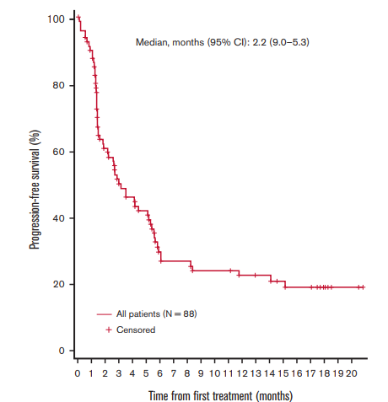
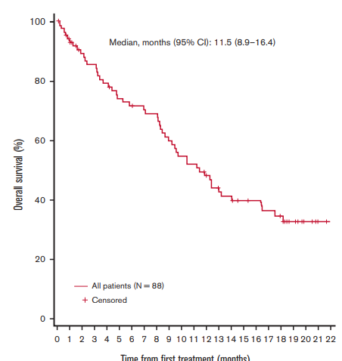
Bispecifics in 3rd line + LBCL: Mosunetuzumab
Progression-Free Survival
Overall Survival
Notes:
Bartlett NL, Assouline S, Giri P, et al. Mosunetuzumab monotherapy is active and tolerable in patients with relapsed/refractory diffuse large B-cell lymphoma. Blood Advances. 2021;7(17):4926-4935.
Mosunetuzumab had a median PFS of 2.2 months and a median overall survival at 11.5 months.

Slide 41
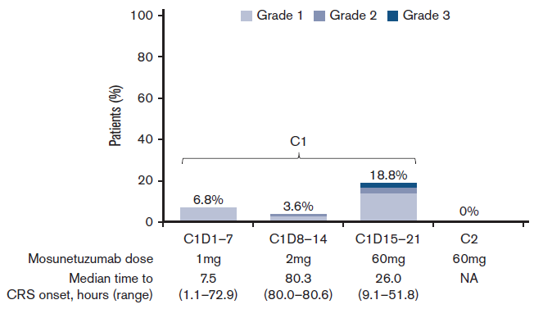
Bispecifics in 3rd line + LBCL: Mosunetuzumab
Patients (%) with CRS Events by Cycle and Grade
Safety Summary, n (%) | Subjects (N=88)
All grade CRS | 26%
Grade 1 | 21%
Grade 2 | 3%
Grade 3 | 2%
Grade 4 | 0%
Grade 5 | 0%
Mosun-related | 0%
Notes:
Bartlett NL, Assouline S, Giri P, et al. Mosunetuzumab monotherapy is active and tolerable in patients with relapsed/refractory diffuse large B-cell lymphoma. Blood Advances. 2021;7(17):4926-4935.
All-grade CRS was 26% with the majority, again, being Grade 1.

Slide 42
Mosunetuzumab: Beyond CRS
Notes:
Bartlett NL, Assouline S, Giri P, et al. Mosunetuzumab monotherapy is active and tolerable in patients with relapsed/refractory diffuse large B-cell lymphoma. Blood Advances. 2021;7(17):4926-4935.

Slide 43
Mosunetuzumab: FDA Approval
December 2022: accelerated approval for adult patients with relapsed or refractory follicular lymphoma (FL) after two or more lines of systemic therapy
Based on results of GO29781 trial
Recommended dose is 1 mg on Cycle 1 Day 1, 2 mg on Cycle 1 Day 8, 60 mg on Cycle 1 Day 15, 60 mg on Cycle 2 Day 1, and 30 mg on Day 1 in subsequent cycles
Treatment cycle is 21 days
Administered for 8 cycles unless patients experience unacceptable toxicity or disease progression
After 8 cycles, patients with a complete response should discontinue therapy
Patients with a partial response or stable disease should continue treatment up to 17 cycles unless they experience progressive disease or unacceptable toxicity
Boxed Warning
Serious or life-threatening CRS
Warnings and precautions
Neurologic toxicity, infections, cytopenias, and tumor flare
Notes:
NCT02500407
FDA.gov. FDA grants accelerated approval to mosunetuzumab-axgb for relapsed or refractory follicular lymphoma. December 23, 2022. https://www.fda.gov/drugs/resources-information-approved-drugs/fda-grants-accelerated-approval-mosunetuzumab-axgb-relapsed-or-refractory-follicular-lymphoma
Mosunetuzumab is not FDA approved in large B-cell lymphoma, but is approved in relapsed/refractory follicular lymphoma after 2 or more lines of systemic therapy.

Slide 44
Mosunetuzumab + Polatuzumab in R/R LBCL
Notes:
Chavez JC, Olszewski AJ, Bastos-Oreiro M, et al. A randomized phase II study of mosunetuzumab SC plus polatuzumab vedotin demonstrates improved outcomes versus rituximab plus polatuzumab vedotin in patients (Pts) with relapsed or refractory (R/R) large B-cell lymphoma (LBCL). Blood. 2024;144(Supplement 1):989.

Slide 45
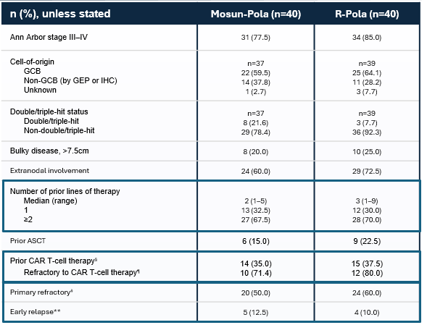
Mosunetuzumab + Polatuzumab in R/R LBCL
Notes:
Chavez JC, Olszewski AJ, Bastos-Oreiro M, et al. A randomized phase II study of mosunetuzumab SC plus polatuzumab vedotin demonstrates improved outcomes versus rituximab plus polatuzumab vedotin in patients (Pts) with relapsed or refractory (R/R) large B-cell lymphoma (LBCL). Blood. 2024;144(Supplement 1):989.

Slide 46
Mosunetuzumab + Polatuzumab in R/R LBCL
Notes:
Chavez JC, Olszewski AJ, Bastos-Oreiro M, et al. A randomized phase II study of mosunetuzumab SC plus polatuzumab vedotin demonstrates improved outcomes versus rituximab plus polatuzumab vedotin in patients (Pts) with relapsed or refractory (R/R) large B-cell lymphoma (LBCL). Blood. 2024;144(Supplement 1):989.

Slide 47
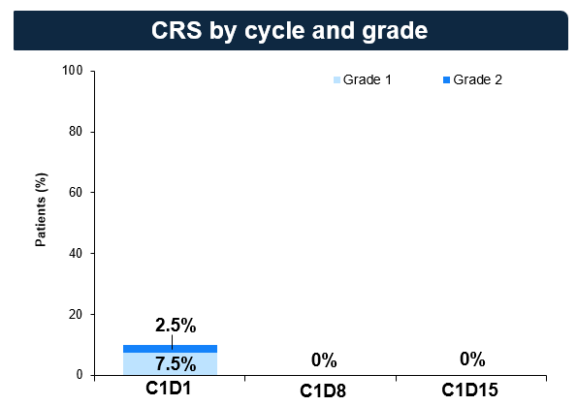
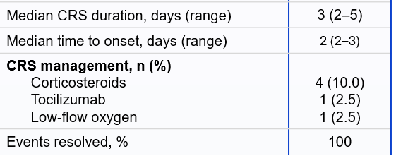
Mosunetuzumab + Polatuzumab in R/R LBCL
Notes:
Chavez JC, Olszewski AJ, Bastos-Oreiro M, et al. A randomized phase II study of mosunetuzumab SC plus polatuzumab vedotin demonstrates improved outcomes versus rituximab plus polatuzumab vedotin in patients (Pts) with relapsed or refractory (R/R) large B-cell lymphoma (LBCL). Blood. 2024;144(Supplement 1):989.

Slide 48
Odronextamab

Slide 49
Bispecifics in 3rd line + LBCL: Odronextamab
Key Eligibility:
DLBCL per WHO 2016
ECOG PS 0–1
≥2 prior therapies
Key Characteristics |  | Subjects (N=127)
Median age, y (range) |  | 66 (24–88)
NHL subtype, n (%) | DLBCL | 83 (65)
 | tNHL | 25 (20)
 | Known DH/TL | 19 (15)
Median no. of prior lines (range), n |  | 2 (2–8)
Refractory to last prior therapy, n (%) |  | 111 (87)
Cycle 1 (SUD)
D1/2, 8/9, 15/16
Treatment Duration
Continuous
CRS mitigation
Steroids/Benadryl premeds
O.7/4/20 mg
Cycles 2–4
D1, 8, 15
160 mg
Cycle 5+
Q2W → Q4W if durable CR (≥9 months)
320 mg
Primary Endpoint: Overall response rate by PET/CT Lugano Criteria
Notes:
Bannerji R, Arnason JE, Advani RH, et al. Odronextamab, a human CD20×CD3 bispecific antibody in patients with CD20-positive B-cell malignancies (ELM-1): results from the relapsed or refractory non-Hodgkin lymphoma cohort in a single-arm, multicentre, phase 1 trial. Lancet Haematol. 2022;9(5):e327-e339. Ayyappan S, Kim WS, Kim TM, et al. Final analysis of the phase 2 ELM-2 study: odronextamab in patients with relapsed/refractory (R/R) diffuse large B-cell lymphoma (DLBCL). Abstract presented at American Society of Hematology Annual Meeting; San Diego, CA; December 9-12, 2023. Abstract 436.
Odronextamab is not FDA-approved for large B-cell lymphoma, but does have single-arm Phase 2 data. This is given in a continuous dosing strategy based upon the trial of 127 subjects, with the median age of 66, the upper-bound in the upper 80s here, with a median of 2 prior lines of therapy.

Slide 50
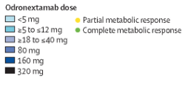
Odronextamab: ELM-1
Best percentage change from baseline in target lesions
LBCL Only
Subjects (80 mg or >) | ORR | CR
CAR-T Naïve (N=15) | 53% | 53%
CAR-T Exposed (N=30) | 33% | 23%
Notes:
Bannerji R, Arnason JE, Advani RH, et al. Odronextamab, a human CD20×CD3 bispecific antibody in patients with CD20-positive B-cell malignancies (ELM-1): results from the relapsed or refractory non-Hodgkin lymphoma cohort in a single-arm, multicentre, phase 1 trial. Lancet Haematol. 2022;9(5):e327-e339.
Data shown as best percentage change in activity in evaluable patients (ie, those attending assessment at week 12; all odronextamab doses) with diffuse large B-cell lymphoma without previous CAR T-cell therapy. The dotted line indicates 50% change.
There may have been some dose response. Here looking at CAR T-cell-naive patients treated at 80 mg or greater, the CR is 53%, and those who were CAR T exposed, the CR rate did lower to 23%.

Slide 51
Bispecifics in 3rd line + LBCL: Odronextamab
Safety Summary, n (%) | Subjects (N=127)
All grade CRS | 55%
Grade 1/2 | 98%
Grade 3 | 2%
Grade 4 | 0%
Grade 5 | 0%
Odronextamab-related | 0%
Notes:
Ayyappan S, Kim WS, Kim TM, et al. Final analysis of the phase 2 ELM-2 study: odronextamab in patients with relapsed/refractory (R/R) diffuse large B-cell lymphoma (DLBCL). Abstract presented at American Society of Hematology Annual Meeting; San Diego, CA; December 9-12, 2023. Abstract 436.
Odronextamab had 55% all-grade CRS with 98% of them being Grade 1 or Grade 2.

Slide 52
Odronextamab: Ongoing Trials
Trial | Phase | Treatment | Setting
ELM-1 NCT02290951 | 1 | Odronextamab | CD20+ B-cell malignancies previously treated with CD20-directed antibody therapy
ELM-2 NCT03888105 | 2 | Odronextamab | R/R B-cell NHL
ATHENA-1 NCT05685173 | 1 | Odronextamab + REGN5837 (Anti-CD22 x Anti-CD28) | Aggressive B-cell NHL
OLYMPIA-1 NCT06091254 | 3 | Odronextamab vs investigator’s choice | Previously untreated FL
OLYMPIA-2 NCT06097364 | 3 | Odronextamab + chemotherapy vs rituximab + chemotherapy | Previously untreated FL
OLYMPIA-3 NCT06091865 | 3 | Odronextamab + CHOP vs rituximab + CHOP | Previously untreated DLBCL
OLYMPIA-4 NCT06230224 | 3 | Odronextamab vs standard of care therapy | R/R aggressive B-cell NHL
OLYMPIA-5 NCT06149286 | 3 | Odronextamab + lenalidomide vs rituximab + lenalidomide | R/R FL and marginal zone lymphoma
Notes:
Study to investigate the safety and tolerability of odronextamab in patients with CD20+ B-cell malignancies (ELM-1). ClinicalTrials.gov identifier: NCT02290951. Updated September 7, 2023. https://www.clinicaltrials.gov/study/NCT02290951
A study to assess the anti-tumor activity and safety of odronextamab in patients with B-cell non-hodgkin lymphoma that have been previously treated (ELM-2). ClinicalTrials.gov identifier: NCT03888105. Updated April 8, 2024. https://www.clinicaltrials.gov/study/NCT03888105
A trial to study if REGN5837 in combination with odronextamab is safe for participants with aggressive B-cell non-hodgkin lymphomas (ATHENA-1). ClinicalTrials.gov identifier: NCT05685173. Updated December 21, 2023. https://www.clinicaltrials.gov/study/NCT05685173
A trial to learn if odronextamab is safe and well-tolerated and how well it works compared to rituximab combined with different types of chemotherapy for participants with follicular lymphoma (OLYMPIA-1). ClinicalTrials.gov identifier: NCT06091254. Updated April 9, 2024. https://www.clinicaltrials.gov/study/NCT06091254
A study to learn how well odronextamab combined with chemotherapy works and how safe it is compared to rituximab and chemotherapy in adult participants with previously untreated follicular lymphoma (OLYMPIA-2). ClinicalTrials.gov identifier: NCT06097364. Updated March 18, 2024. https://www.clinicaltrials.gov/study/NCT06097364
A study to compare how well odronextamab combined with chemotherapy works and how safe it is against rituximab combined with chemotherapy, in patients with previously untreated diffuse large B-cell lymphoma (OLYMPIA-3). ClinicalTrials.gov identifier: NCT06091865. Updated April 8, 2024. https://www.clinicaltrials.gov/study/NCT06091865
A trial to learn how effective and safe odronextamab is compared to standard of care for adult participants with previously treated aggressive B-cell non-hodgkin lymphoma (OLYMPIA-4). ClinicalTrials.gov identifier: NCT06230224. Updated April 5, 2024. https://www.clinicaltrials.gov/study/NCT06230224
A trial to learn if odronextamab combined with lenalidomide is safe and works better than rituximab combined with lenalidomide in participants with follicular lymphoma and marginal zone lymphoma (OLYMPIA-5). ClinicalTrials.gov identifier: NCT06149286. Updated April 10, 2024. https://www.clinicaltrials.gov/study/NCT06149286

Slide 53
Proposed Mechanisms of Resistance
Notes:
Falchi L, Vardhana SA, Salles GA. Bispecific antibodies for the treatment of B-cell lymphoma: promises, unknowns, and opportunities. Blood. 2023;141(5):467-480.
Mechanisms of resistance to BsAb within the lymphoma microenvironment.
Potential mechanisms of resistance to BsAb therapy include
(A) tumor cell–intrinsic mechanisms, such as antigen loss and activation of immune-evasive gene expression programs
(B) T-cell intrinsic mechanisms, including activation of regulatory T-cells, downregulation of the T-cell receptor, and development of T-cell exhaustion, and
(C) T-cell extrinsic mechanisms, including recruitment of immunosuppressive myeloid and/or stromal cells.

Slide 54
Patient Selection, Multidisciplinary Treatment Plans, and Sequencing Implications

Slide 55
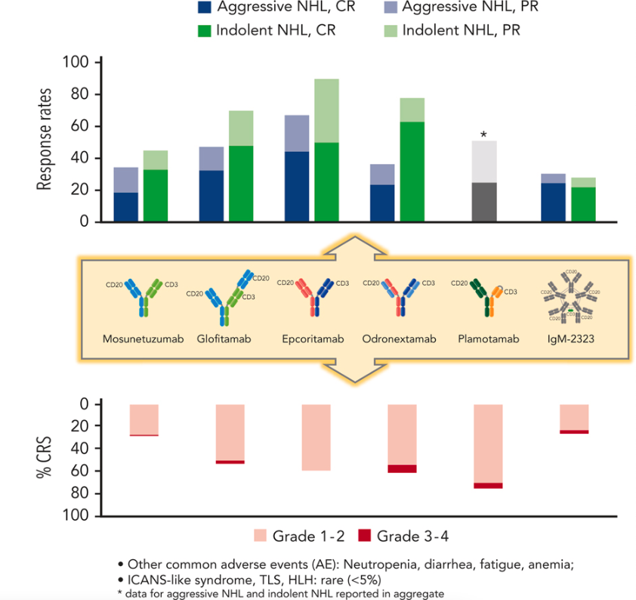
Bispecific Antibodies in B-cell Lymphoma: Response Rates and CRS
Notes:
Falchi L, Vardhana SA, Salles GA. Bispecific antibodies for the treatment of B-cell lymphoma: promises, unknowns, and opportunities. Blood. 2023;141(5):467-480.
Bispecific antibodies (BsAb) are a novel class of off-the-shelf T-cell redirecting drugs and are among the most promising immunotherapeutics for lymphoma today. BsAb may target various cell-surface antigens and exist in different formats. Anti-CD20xCD3 BsAb have demonstrated remarkable single-agent activity in patients with heavily pretreated B-NHL with a manageable toxicity profile dominated by T-cell overactivation syndromes.

Slide 56
When to Consider Bispecific: Patient Selection
NOT eligible for CAR-T
Comorbid conditions
Access constraints
Disease constraints
Post CAR-T
Super Refractory: Relapse within 100 days (non-trial population for epcoritamab/glofitamab)
Refractory: Relapsed within 6 months (trial population for epcoritamab/glofitamab)
Relapse: >6 months from CAR-T
Patient preference
Notes:
So, when trying to think about patient selection, I think what is important here is a multidisciplinary treatment team as well as, thinking about where you're going to sequence the patients. So, in regard to patient selection, who's not eligible for a CAR T-cell? I think it's becoming harder and harder to discern, but there may be comorbid conditions that may preclude CAR T-cell. There may be access constraints to having a caregiver or getting to an authorized treatment center. And then there may be the fast-paced disease, which is large B-cell lymphoma, which may constrain getting to a CAR T-cell center. And then, I think if you look in the post-CAR T-cell environment, I think you have to focus on there may be some super refractory patients, those that are relapsing within 100 days, where there is very little data in the clinical trial population being that these may have been excluded from clinical trials. There are those who are refractory or relapsed within 6 months of their CAR T-cell, and those patients were included in the epcoritamab and the glofitamab trial. And then, those who are relapsed greater than 6 months from CAR T, which represented a minority of the post-CAR T-cell population.

Slide 57
When to Consider Bispecific: Site Readiness
Management team
Patient
Bispecific Specific
Outpatient vs inpatient dosing
When to call
Facility Logistics
Communication with the hospital system
Supportive meds availability
Distance from tocilizumab
Patient-specific plan vs system plan
Caregiver
Nurse Champions
APP
Physician
Pharmacist
Administrator
Timing of monitoring
Monitoring of vitals
Laboratory evaluation
BP cuff, thermometer, Pulse Ox
30-60 minutes
Steroids, Tocilizumab, etc
ER, Inpatient Unit, On-call team, Pharmacy
Notes:
Switch from academia into the community setting—Raising the bar on care continuity
Community-based providers and their challenges
Establishment of clear referral pathways
Development of treatment algorithms for deep and durable remission
Strategies for interprofessional team-based care coordination
So, I think when considering bispecifics, it’s about site readiness. Not only do you have to have a team that's willing and able to manage the patients, and that can include caregivers, nurse champion, APPs, physicians, pharmacists and also speaking to your administrators because there can be some logistics about having appropriate timing and of administration, and having access to tocilizumab.
So, being bispecific specific, knowing when it can be delivered outpatient, when it is recommended to go inpatient. What is the timing of monitoring between IV and sub-Q? Educating the patient and their caregivers when to call. Is the time to call with a fever, and how are they going to have access to that? Whether or not there’s a thermometer at home, do they have blood pressure cuffs, as well as pulse oximetry accessibility? And then, how frequently are you going to follow laboratory evaluation?
And then, also, a facility logistics, thinking about those places and how you're going to communicate with the hospital, and who at your hospital to communicate with, whether that's ER, inpatient unit and your on-call team. And then, having supportive meds available, whether or not it’s take-home steroids, and having access to tocilizumab and at which distance. And so, really it is becoming a patient-specific plan as well as having a system plan.

Slide 58
When to Consider Bispecific: Treatment Sequencing
CD20 exposure only | Multi-chemo refractory ex: Pola-R-CHP; R-ICE
Early CAR-T (2nd Line) | Chemo to CAR-T ex: R-CHOP to Liso-cel/Axi-cel
Late CAR-T (3rd Line) | Multi-chemo relapsed ex: R-CHOP, R-ICE→HDT-ASCR; CAR-T
Novel NO CAR-T (4th Line) | ex: mini-R-CHOP; Tafa-Len; Lonca-T
Notes:
There are many different situations where you can consider, and what is the treatment sequencing? I'm starting to get into this population of where the disease is really bad, and I'm calling them a quad refractory large B-cell lymphoma, which is those who are CD79b antibody-drug conjugate like polatuzumab, rituximab, as well as anthracycline-refractory. And so those patients are progressing through a regimen like Pola-R-CHP [polatuzumab, rituximab, cyclophosphamide, doxorubicin, and prednisone] and then their disease is saying that they can't wait to get through a CAR T-cell, so then they're getting platinum-based therapy like R-ICE [rituximab plus ifosfamide, carboplatin, and etoposide]. So, you have platinum-refractory, anthracycline-refractory, rituximab or CD20-refractory, as well as CD79b refractory. Those patients can be very difficult to get to a CAR T-cell and have had 2 prior lines of therapy and may be available for bispecifics. Then you have the early CAR T who are getting Pola-R-CHP but can wait and get second-line lisocabtagene maraleucel or axicabtagene ciloleucel based upon the data from TRANSFORM and ZUMA-7, respectively. And then, those late relapses who get R-CHOP [rituximab plus cyclophosphamide, doxorubicin, vincristine, prednisone] and then get standard-of-care R-ICE and have a response amenable to transplant, but then relapse and go on to get CAR T-cell. Maybe those patients, if they relapse post-CAR T, may get epcoritamab. And then the novel no CAR T. So, you get mini-R-CHOP, followed by tafasitamab plus lenalidomide, followed by loncastuximab tesirine. Those can be situations where bispecifics may be able to insert themselves.

Slide 59
Coordinating Referrals/Transition and Follow-up Care
Establish Relationships and Referral Pathways | Establish strong relationships between clinicians at academic and community cancer programs Establishment of clear referral pathways and the transition from inpatient to outpatient administration; build on existing referral pathways (eg, for stem cell transplant or clinical trials) Ensure office staff are familiar with referral process
Patient Education | Create an online resource to help prepare patients to receive initial treatment at an academic medical center and follow-up care with a local oncologist Website can guide patients through the process and help them understand what to expect
 | Create a patient information sheet that clearly outlines team members and their roles and responsibilities across the different sites of care Community cancer program, local hospital, academic medical center, etc
 | Direct shared-decision making (SDM)
Use Telehealth | Use telehealth to provide follow-up care, remote vital sign monitoring, monitor for symptoms, and coordinate with local providers for patients who live further away from academic or tertiary care centers
Connect Patients | Connect patients with navigators who know how to coordinate logistics between community cancer programs and academic medical centers, if available Many community cancer programs have navigators for common cancers; may not have navigators for less common hematologic malignancies
Notes:
ACCC. Best practices in expanding access to bispecific antibodies and adverse event management. https://www.accc-cancer.org/docs/projects/bispecific-antibodies/bispecific-antibodies-brief.pdf
I think the biggest thing is to know when they need to be inpatient is therapy dependent and based upon whether or not they have CRS, and may need to be admitted a second time based upon if they do have CRS. Or outpatient can continue if they are tolerated. I think really the importance of coordinating referrals to academic or tertiary to community settings is planning ahead. I think if you're starting at academia, but know that they are going to want to get into the community, reaching out early. Or if you're in the community and you have a patient and you want to work with academia, really engaging them early to have that approach. A resource on best practices for transitioning from inpatient to outpatient administration of BsAbs has been published.

Slide 60
Team-Based Management Strategies for Adverse Events with CD20 X CD3 Bispecific Antibodies

Slide 61
When to Consider Bispecific: Plan is to Have a Plan
Notes:
Crombie JL, Graff T, Falchi L, et al. Consensus recommendations on the management of toxicity associated with CD3xCD20 bispecific antibody therapy. Blood. Published online January 22, 2024. doi:10.1182/blood.2023022432
I certainly think that it is a team-based management approach, and I think that this review by Dr. Crombie and colleagues really sums it up nicely, going through the patient selection, patient education, knowing which drug your administering. Really educating for self-monitoring but knowing when inpatient monitoring is appropriate. And then, what are truly the signs and assessment that you're going to have at the hand, not only of the patient and the caregivers, but of your team for CRS and ICAN assessment, and then knowing how you're going to manage CRS and neurotoxicity in this situation. With regard to CRS, I think that there are several supportive care management strategies of either steroids or tocilizumab that are product-specific and can also be institutionally specific.

Slide 62
Discussion: Considerations for Managing Adverse Events
Planning | Knowledge and planning for the anticipated treatment-related AEs
 | Step-up dosing
Challenges | Challenges of using new therapies
 | Tolerability profile of bispecific antibodies based on frequency and severity
Assessment and monitoring | CRS and neurotoxicity: onset, rates, and severity
 | Low blood cell counts
 | Team-based strategies for anticipating, monitoring, managing, and coordinating care for potential AEs
Quality of Life (QoL) | Patient-reported improvements of lymphoma-related symptoms
Experience | Nuances will occur with more experience in the management of bispecific antibodies

Slide 63
Addressing Adverse Events with Bispecific Antibodies
Premedication (e.g., prophylactic corticosteroids)
Step-up dosing
Hospitalization for administration
Slower infusion
Alternate routes of administration (e.g., subcutaneous)
Strategies to mitigate safety and tolerability concerns
Notes:
Falchi L, Vardhana SA, Salles GA. Bispecific antibodies for the treatment of B-cell lymphoma: promises, unknowns, and opportunities. Blood. 2023;141(5):467-480.

Slide 64
BsAbs Management Strategies: CRS
Occurs mostly within the first 24 hours following treatment initiation with continuous administration
CRS events are typically confined to the step-up doses or first full dose with intermittent administration
Typically occurs on the day of IV infusion and the day after SC administration
SC formulations may reduce the risk of severe CRS
Result in a more gradual increase in serum concentration and reduce the peak plasma levels of the antibodies
Supportive Care
Prompt administration of IL-6 receptor-blocking antibodies (tocilizumab) or steroids
Antipyretics (acetaminophen)
Intravenous fluid administration
Oxygen supplementation
Withhold drug or permanently discontinue
Strategies to Reduce Risk of CRS
Step-up dosing
Pre-medication strategies (including steroids)
Pretreatment with obinutuzumab for glofitamab
Co- and post-administration of prednisone for epcoritamab
Coordinate with local emergency departments and clinics and have on-call physicians
Develop a structured training program for staff including hospital nurses, ICU staff, and neurologists (and ER)
Develop a central repository of treatment protocols and algorithms, including toxicity management plans
Share with local community hospitals and those in the cancer program network to ensure a consistent approach
Educate patients and caregivers on the signs and symptoms of CRS; wallet card
Notes:
ACCC. Best practices in expanding access to bispecific antibodies and adverse event management. https://www.accc-cancer.org/docs/projects/bispecific-antibodies/bispecific-antibodies-brief.pdf
Hutchings M. The evolving therapy of DLBCL: Bispecific antibodies. Hematol Oncol. 2023;41(S1):107-111.
van de Donk NWCJ, Zweegman S. T-cell-engaging bispecific antibodies in cancer. The Lancet. 2023;402(10396):142-158.
Strategies to reduce the risk of CRS is really following the step-up dosing strategies, knowing the premedication strategies associated with each product, not leaving out the obinutuzumab if you're planning to give glofitamab. If you're getting epcoritamab, co- and post-administration of steroids is appropriate for Cycle 1. Coordinating with local facilities and having a central repository of treatment standard operating procedures and algorithms to help guide your team if after-hours communication is needed. And then, thoroughly educating patients and caregivers to the signs and symptoms of cytokine release syndrome, as well as neurotoxicity.

Slide 65
BsAbs Management Strategies: Neurotoxicity/ICANS
Higher incidence with CD19-directed agents (CAR-T)
Typically develops concurrently or shortly after CRS
Can also occur independently
Characterized by headaches, tremors, ataxia, aphasia, confusion, hallucinations, and seizures
Prevention
Step-up dosing and premedication
Monitor patients for neurological signs or symptoms during treatment
Supportive care
Tocilizumab if concurrent with CRS
Steroids (dexamethasone)
Anti-epileptic drugs
Withhold drug or permanently discontinue
Notes:
van de Donk NWCJ, Zweegman S. T-cell-engaging bispecific antibodies in cancer. The Lancet. 2023;402(10396):142-158.
ACTEMRA (tocilizumab). Prescribing information. Genentech; 2022.
And you can see here this may be higher with the incidence of CD19-directed agents, but it still can occur with our CD 20 agents. And knowing that steroids are the mainstay of treatment and tocilizumab could be used, or should be used, if concurrent with CRS and antiepileptic medications for prophylaxis could be utilized.

Slide 66
BsAbs Management Strategies
Infections
Cytopenias
Monitor complete blood counts throughout treatment
Consider prophylactic granulocyte colony-stimulating factor
Based on the severity of cytopenias, temporarily withhold or permanently discontinue treatment
Monitor patients for signs and symptoms of infection prior to and during treatment
Provide PJP prophylaxis prior to initiating treatment
Initiate antiviral prophylaxis against herpes virus prior to treatment
Withhold or consider permanent discontinuation of treatment based on severity

Slide 67
Improving Management of CRS in Patients Treated with BsAbs
Dosage and Administration | Step-up dosing
 | Interrupting therapy and providing supportive care
 | Pre-medication strategies (including steroids)
Training | Ensure ED staff and hospitalists are aware that an on-call physician is available to help manage any patient who may present with CRS
 | Develop a structured training program for staff
 | Include hospital nurses, ICU staff, and neurologists in conversations about CRS and neurotoxicity
Coordination | Develop a central repository of treatment protocols and algorithms, including toxicity management plans
 | Share with local community hospitals (and those in the cancer program network) to ensure that a consistent approach is delivered wherever the patient is treated
Patient Education | Remind patients and their caregivers about signs and symptoms of CRS
 | Caregivers may be the first ones who recognize symptoms and should be prepared to call the cancer care program for assistance
Notes:
ACCC. Best practices in expanding access to bispecific antibodies and adverse event management. https://www.accc-cancer.org/docs/projects/bispecific-antibodies/bispecific-antibodies-brief.pdf
A resource on best practices for transitioning from inpatient to outpatient administration of BsAbs has been published.

Slide 68
Practical Application: Case-Based Learning Lab

Slide 69
Case Study
Presentation
Medical History
78-year-old man presents with LBP and diffuse adenopathy on exam
Excisional bx: DLBCL-NOS
IHC based evaluation; non-GCB
FISH: Negative for MYC rearrangement
PET/CT demonstrates stage IV disease based on avid bone lesions
BM bx deferred (CBC normal)
LDH 250 (ULN: 192)
ECOG PS 1
IPI 3
PMH:
HTN
Medications:
HCTZ/lisinopril
Social History:
Retired lawyer
Works as a mower at local golf club
Cigars at the 19th hole
Bourbon 1-2 times per week
Notes:
This case that I'm going to present to you is a 78-year-old gentleman who presents with low back pain and diffuse adenopathy on exam. He has an excisional biopsy that shows large-cell lymphoma. By immunohistochemistry, it is felt to be a non-GCB subtype. Their FISH is negative for MYC rearrangement. Based upon PET/CT, they have Stage 4 disease based upon avid bone lesions. The bone marrow is deferred because the CBC is normal. They have an elevated LDH at 250, and the ECOG performance status is 1. This patient has an IPI score of 3 with limited comorbidities of hypertension.

Slide 70
Case Study Question #1
What would be your initial induction therapy?
R-CHOP
Mini-R-CHOP
Pola-R-CHP
DA-EPOCH-R
Unsure
Notes:
Correct answer: c) Pola-R-CHP

Slide 71
Rationale for Answer #1
PFS
ABC
GCB
Unclassified
Notes:
Tilly H, Morschhauser F, Sehn LH, et al. Polatuzumab vedotin in previously untreated diffuse large B-cell lymphoma. N Engl J Med. 2022;386(4):351-363.
Morschhauser F, Leung W, Raghavan V, et al. Deciphering the clinical benefit of Pola-R-CHP versus R-CHOP in different genetic subtypes beyond cell of origin in the POLARIX study. Abstract presented at: American Society of Hematology Annual Meeting; San Diego, California; December 9-12, 2023. Abstract 3000.
In my assessment, I would recommend Pola-R-CHP based upon the POLARIX trial. You can see this was a randomized double-blinded trial that was in favor of the primary endpoint of Pola-R-CHP versus R-CHOP at the 24-month mark of primary endpoint of PFS. What I think supports this even further is the subtype analysis showing that ABC did derive more of a benefit compared to R-CHOP who had an ABC subtype in the POLARIX trial.

Slide 72
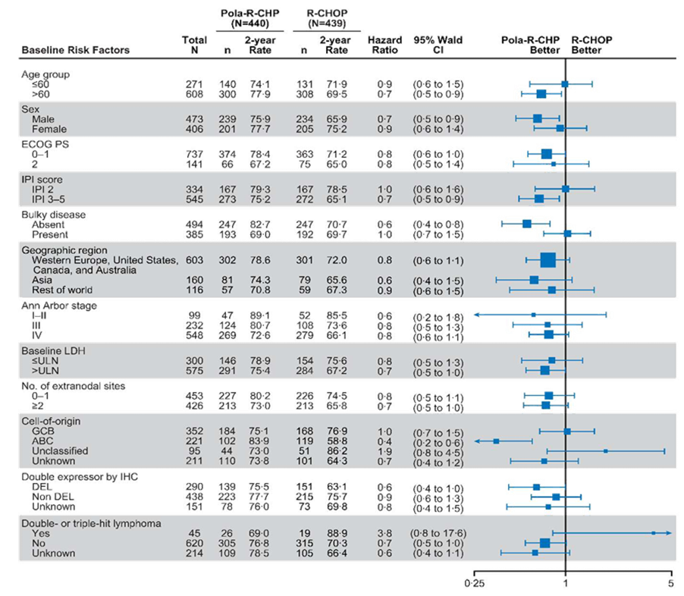
Rationale for Answer #1, Continued
Notes:
Tilly H, Morschhauser F, Sehn LH, et al. Polatuzumab vedotin in previously untreated diffuse large B-cell lymphoma. N Engl J Med. 2022;386(4):351-363.
Morschhauser F, Leung W, Raghavan V, et al. Deciphering the clinical benefit of Pola-R-CHP versus R-CHOP in different genetic subtypes beyond cell of origin in the POLARIX study. Abstract presented at: American Society of Hematology Annual Meeting; San Diego, California; December 9-12, 2023. Abstract 3000.
Other caveats that could be looked at here that go beyond the cell of origin could be advanced stage disease, as well as an IPI 3 to 5, of which our patient did. And the POLARIX trial did accrue those patients who had an IPI of 2 or greater.

Slide 73
Case Study Follow Up
Patient tolerates Pola-R-CHP X 6 with grade 1 peripheral neuropathy
EOT evaluation notes PET/CT negative but MRD positive
5 months post completion of Pola-R-CHP, he has recurrence of LBP with PET/CT findings consistent with relapse
Biopsy confirms DLBCL-NOS with involvement of marrow
LDH elevated
Mild anemia
CrCl is 50 ml/min, LVEF 50-55%, and O2 sats 95%
ECOG PS 1
Notes:
At our case follow-up, the patient tolerates Pola-R-CHP for 6 cycles and has resulting Grade 1 peripheral neuropathy. The end-of-treatment evaluation notes PET/CT is consistent with a metabolic complete response. But we do MRD assessment and the patient does have positive MRD. The patient’s monitored for 5 months but has recurrence of low back pain with PET/CT findings concerning for relapse. This is confirmed by biopsy. Creatinine clearance is less than 50, LVEF is 50 to 55%, and he has an oxygen saturation of 90% still with a good performance status.

Slide 74
Case Study Question #2
How would you manage this patient?
Tafasitamab + lenalidomide (25 mg)
Loncastuximab teserine
Liso-cel (CD19 CAR-T)
R-Gem-ox
Unsure
Notes:
Correct answer: c) Liso-cel (CD19 CAR-T)

Slide 75
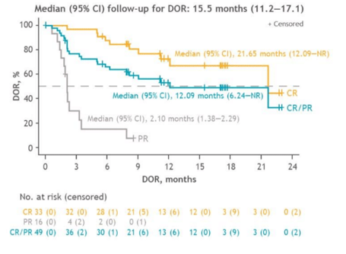
Rationale for Answer #2
PILOT Trial: liso-cel
Notes:
Sehgal A, Hoda D, Riedell PA, et al. Lisocabtagene maraleucel (liso-cel) as second-line (2L) therapy for R/R large B-cell lymphoma (LBCL) in patients (pt) not intended for hematopoietic stem cell transplantation (HSCT): primary analysis from the phase 2 PILOT study. Abstract presented at: American Society of Clinical Oncology Annual Meeting; Chicago, Illinois; June 3-7, 2022. Abstract 7062.
I would argue that giving lisocabtagene maraleucel, based upon the PILOT trial, not only the TRANSFORM or the ZUMA-7 trial, but this individual having some comorbid conditions, having some mild renal insufficiency. But otherwise, a good performance status, over the age of 70. The PILOT trial really looked at those individuals who had advanced age and comorbidities, as you can see here in the Venn diagram. And those patients that got lisocabtagene maraleucel could derive benefits, especially in those patients who obtained a CR. And so, while others like tafasitamab plus lenalidomide could be used in the second-line setting, I do think that CAR T-cell would be an opportunity for this patient.

Slide 76
Case Study Follow Up
Patient tolerates liso-cel with Grade 1 CRS without ICANS
Day +100 PET/CT with evidence of POD
Biopsy confirms DLBCL-NOS now CD19 negative by flow cytometry and IHC, but remains CD20 positive
ECOG PS 1
Notes:
This patient tolerates lisocabtagene maraleucel with Grade 1 CRS. Has no ICANS. However, at Day 100, the patient has evidence of progression of disease. Biopsy confirms diffuse large B-cell lymphoma, but now is CD19 negative by flow cytometry and IHC, but remains CD20-positive and has a maintained performance status.

Slide 77
Case Study Question #3
How would you manage this patient?
Tafasitamab + lenalidomide (25 mg)
Loncastuximab teserine
R-Gem-ox
Epcoritamab
Unsure
Notes:
Correct answer: d) Epcoritamab
Note: Glofitamab is also on indication for this patient and could be a correct answer.

Slide 78
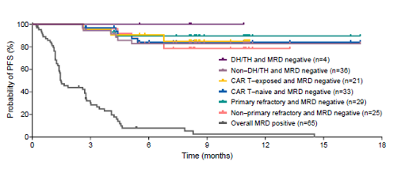
Rationale for Answer #3
EPCORE NHL-1 Trial: Epcoritamab
Notes:
Phillips T, Thieblemont C, Ghesquieres, et al. Epcoritamab monotherapy provides deep and durable responses including minimal residual disease (MRD) negativity: novel subgroup analyses in patients with relapsed/refractory (R/R) large B-cell lymphoma (LBCL). Abstract presented at: American Society of Clinical Oncology Annual Meeting; Chicago, Illinois; June 3-7, 2022. Abstract 4251.
So, tafasitamab plus lenalidomide yes, could be an option. But the CD19 negativity does concern me for tafasitamab plus lenalidomide. Loncastuximab could be an option. It has shown to have some ability for response at lower CD19 exposures. So, in this situation, I think epcoritamab following CAR T would be a reasonable option. I do think that, as alluded to here, that heavy pretreated populations were studied in the Phase 2. I would be concerned because of the relapse within 6 months. I'm not sure I would pull off and stop a bispecific if I could get them into a CR, just because of how relapsed they would be. I might consider that based upon the data shown here, that if I could achieve MRD negativity then maybe I would consider pulling away the bispecific from that standpoint. But again, epcoritamab is delivered as a continuous dosing strategy. Note: Glofitamab is also on indication for this patient and could be a correct answer.

Slide 79
Key Takeaways
LBCL remains a curable disease in the 1st line, 2nd line, and 3rd line setting but with diminishing odds
There are multiple targeted therapies, either single agents or in combination
Strategic considerations are necessary in the rel/ref LBCL space regarding the timing of CAR-T, CD19 engaging agents, and CD3XCD20 bispecific
Consideration of capabilities for local administration vs shared administration vs referral for the administration of CD3XCD20 bispecifics

