Slide 1
Advancing ADT in HSPC: Interprofessional Intensification Strategies Reshaping Care

Slide 2
DISCLAIMER
This slide deck in its original and unaltered format is for educational purposes and is current as of February 2026. All materials contained herein reflect the views of the faculty, and not those of AXIS Medical Education, the CME provider, or the commercial supporter. Participants have an implied responsibility to use the newly acquired information to enhance patient outcomes and their own professional development. The information presented in this activity is not meant to serve as a guideline for patient management. Any procedures, medications, or other courses of diagnosis or treatment discussed or suggested in this activity should not be used by clinicians without evaluation of their patients’conditions and possible contraindications and/or dangers in use, review of any applicable manufacturer’s product information, and comparison with recommendations of other authorities.

Slide 3
DISCLOSURE OF UNLABELED USE
This activity may contain discussion of published and/or investigational uses of agents that are not indicated by the FDA. The planners of this activity do not recommend the use of any agent outside of the labeled indications.
The opinions expressed in the activity are those of the faculty and do not necessarily represent the views of the planners. Please refer to the official prescribing information for each product for discussion of approved indications, contraindications, and warnings.
USAGE RIGHTS
This slide deck is provided for educational purposes and individual slides may be
used for personal, non-commercial presentations only if the content and references
remain unchanged. No part of this slide deck may be published in print or
electronically as a promotional or certified educational activity without prior written
permission from AXIS. Additional terms may apply. See Terms of Service on
www.axismeded.com for details.

Slide 4
Learning Objectives
Upon completion of this activity, participants should be better able to:
Integrate validated risk stratification tools and advanced imaging into clinical workflows to more accurately identify patients with HSPC most likely to benefit from ADT intensification
Critically review clinical trial data on ADT intensification across localized, biochemically recurrent, and metastatic HSPC to inform evidence-based treatment selection
Design team-based treatment strategies that align with current guidelines, integrate patient risk profiles, and minimize disease progression in HSPC
Proactively monitor, identify, and manage adverse events from ADT intensification in HSPC, ensuring patient safety and adherence via strong interprofessional coordination

Slide 5
Clinical Rationale for ADT Intensification in HSPC

Slide 6
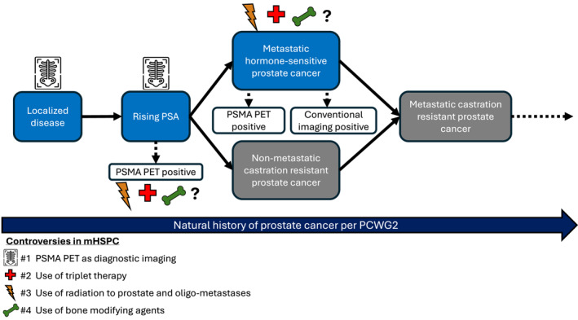
Natural History of Prostate Cancer

Slide 7
Risk Stratification for Clinically Localized Prostate Cancer: NCCN Guidelines
Low Risk
Has all of the following:
cT1–cT2a
Gleason Grade Group 1
PSA <10 ng/mL
Has all of the following:
No high-risk group features
No very-high-risk group features
Has one or more intermediate risk factors (IRFs):
cT2b–cT2c
Grade Group 2 or 3
PSA 10-20 ng/mL
Favorable intermediate
Has all of the following:
1 IRF
Gleason Grade Group 1 or 2
<50% biopsy cores positive (eg, <6 of 12 cores)
Unfavorable intermediate
Has one or more of the following:
2 or 3 IRFs
Gleason Grade Group 3
≥50% biopsy cores positive (eg, ≥6 of 12 cores)
Intermediate Risk
Has one or more high-risk features, but does not meet the criteria for very high risk:
cT3–cT4
Gleason Grade Group 4 or 5
PSA >20 ng/mL
High Risk
Has at least two of the following:
cT3–cT4
Gleason Grade Group 4 or 5
PSA >40 ng/mL
Very High Risk

Slide 8
Biochemical Recurrence After Local Therapy
Prostatectomy
Definition of recurrence: PSA >0.2
Staging: conventional imaging vs PSMA-PET
Treatment
Salvage RT ± ADT
Intermittent ADT?
Enzalutamide ± ADT
Primary Radiation +/- ADT
Definition of recurrence: PSA >2.0 from nadir with eugonadal testosterone
Staging: conventional imaging vs PSMA-PET
Some consideration of salvage RP or salvage RT (HDR brachytherapy)
Treatment
Intermittent ADT?
Enzalutamide ± ADT

Slide 9
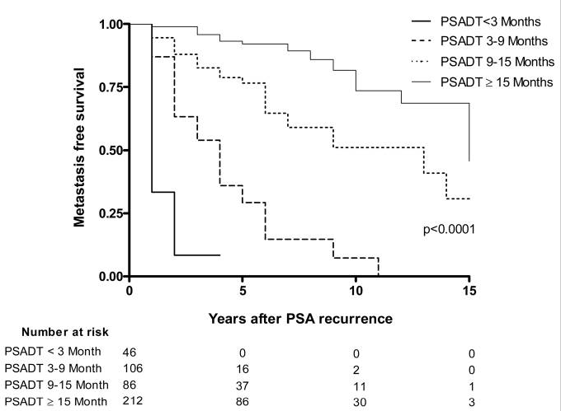
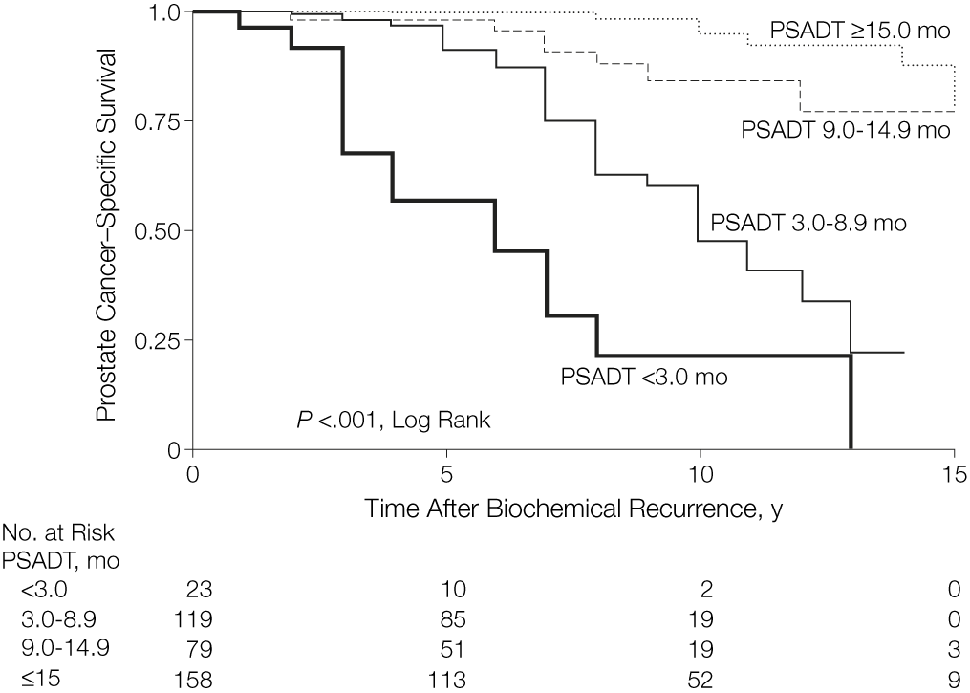
Significance of PSADT on the Risk of Metastatic Disease and Prostate Cancer-Specific Death After PSA Elevation

Slide 10
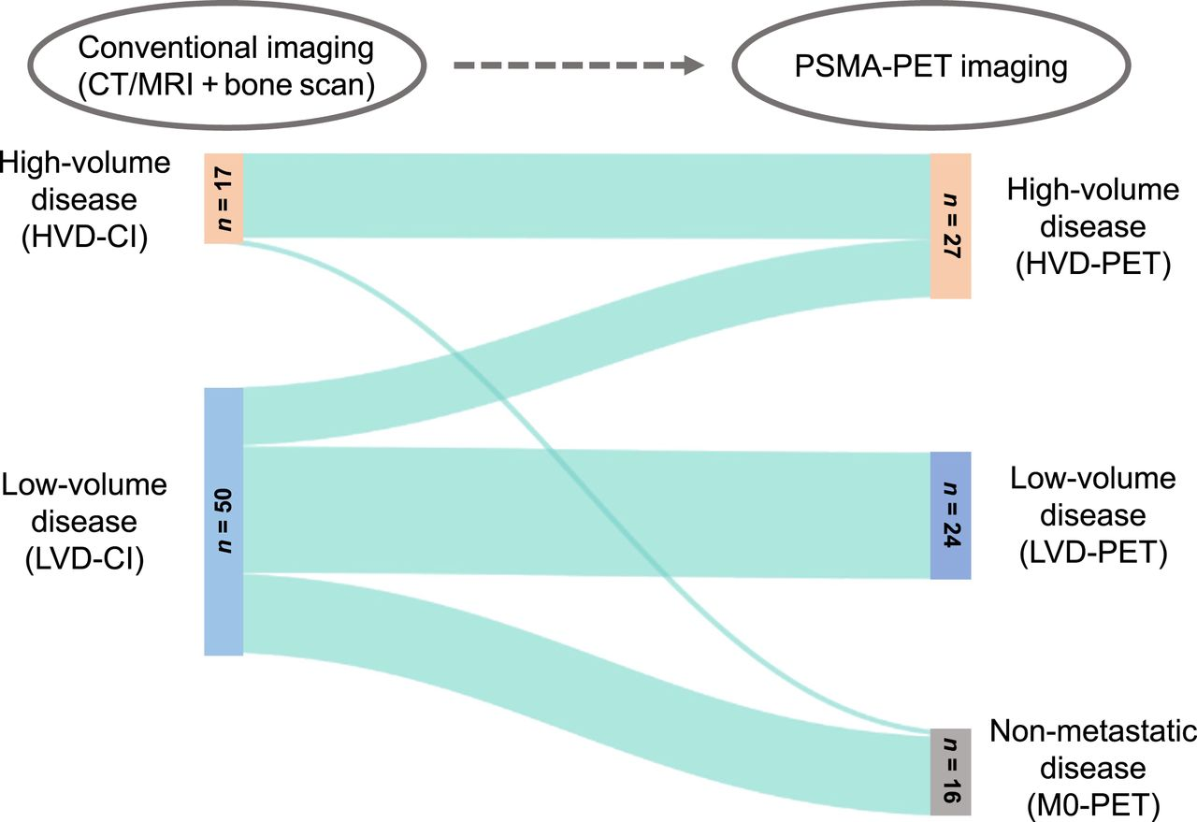
Conventional Imaging vs PSMA-PET Imaging
Compared with conventional imaging, addition of PSMA-PET leads to downstaging to M0 in every third patient and LVD to HVD upstaging in every fifth patient
Future HVD and LVD definitions based on PSMA-PET/CT should be adjusted based on patient outcome

Slide 11
Latest Clinical Evidence of Treatment Intensification in HSPC

Slide 12
ADT and Combinations
1
2
3
4
Testicular Androgen Suppression
“Old School” Adjuncts to Testicular Androgen Suppression
Androgen Receptor Pathway Inhibitors (ARPIs)
Emerging Strategies
LHRH agonists
LHRH antagonists
Orchiectomy
First generation AR antagonists
Flutamide
Bicalutamide
Nilutamide
Nonspecific CYP17 inhibitor
Ketoconazole
Steroids
Hydrocortisone
AR antagonists
Enzalutamide
Apalutamide
Darolutamide
CYP17 inhibitor
Abiraterone
AR degraders
AR N-terminal inhibitors
Novel CYP17 inhibitors
EZH2 inhibitors
PARP inhibitors
PI3K/AKT inhibitors
Radioligand therapy

Slide 13
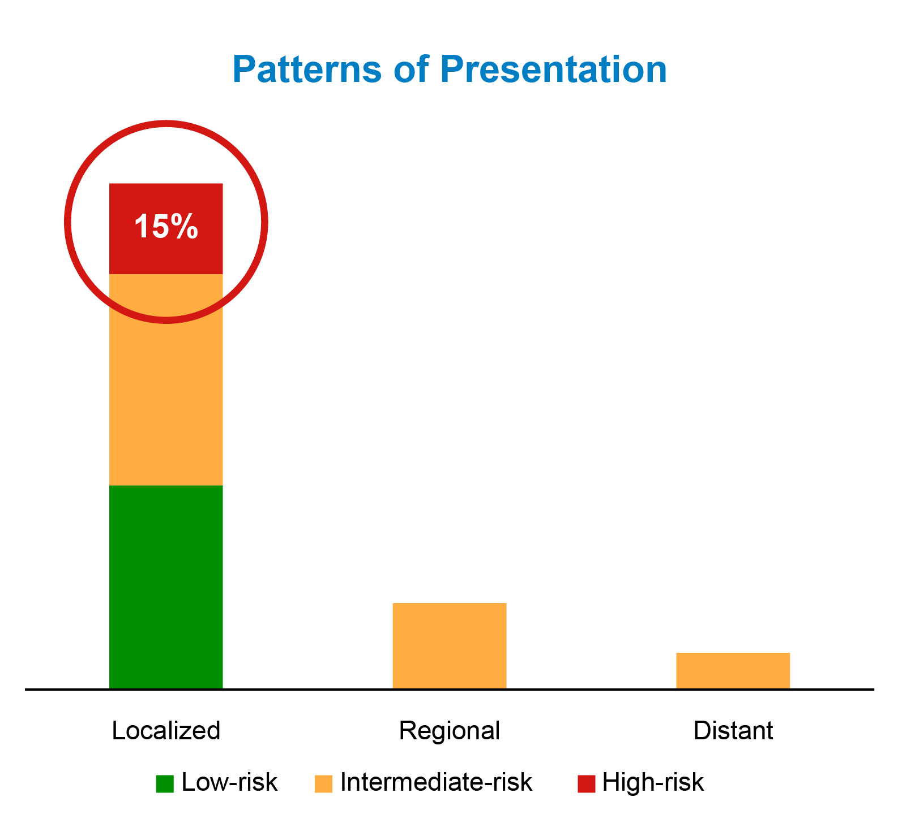
Localized High-Risk Prostate Cancer
Increased Mortality in High-Risk Prostate Cancer
High-Risk Feature | 15-Year PCSM
PSA > 20 ng/mL | 22%
Gleason 8-10 | 34%
cT3 | 38%
High-risk Disease* | 19%

Slide 14
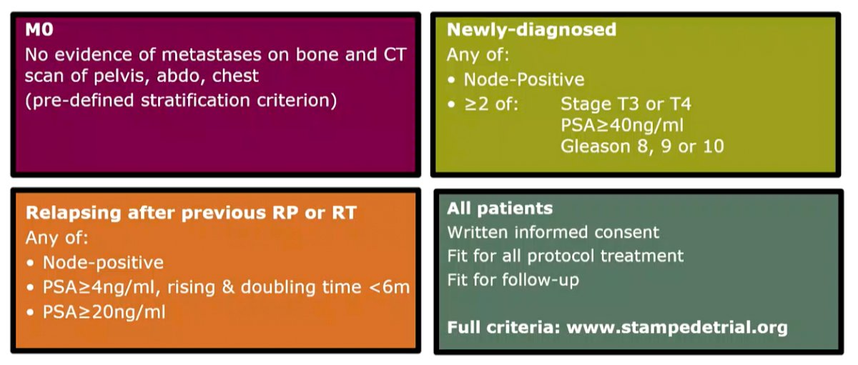
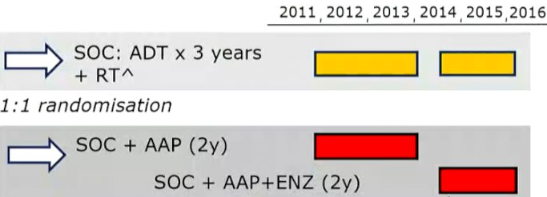
Meta-Analysis of Two Phase 3 Trials From STAMPEDE
Primary Endpoint: Metastasis-free survival
Secondary Endpoints: Overall survival, prostate cancer-specific survival, biochemical failure-free survival, progression-free survival, and safety

Slide 15
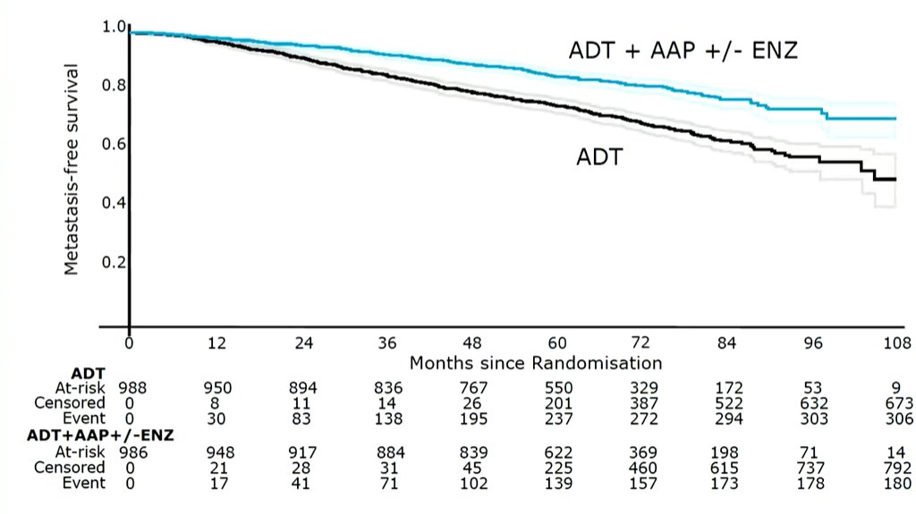
Meta-Analysis of STAMPEDE: MFS (Primary Endpoint)

Slide 16
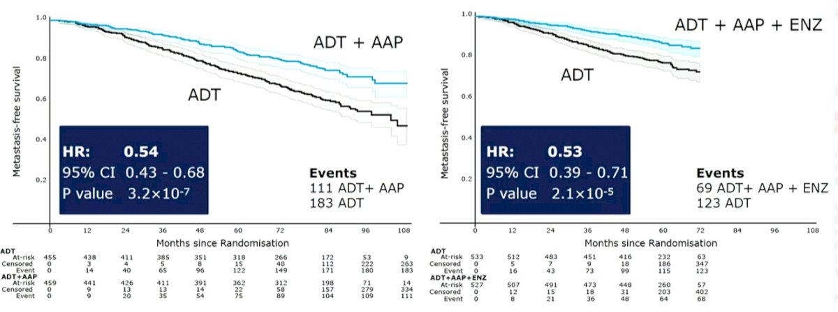
Meta-Analysis of STAMPEDE: MFS by Trials

Slide 17
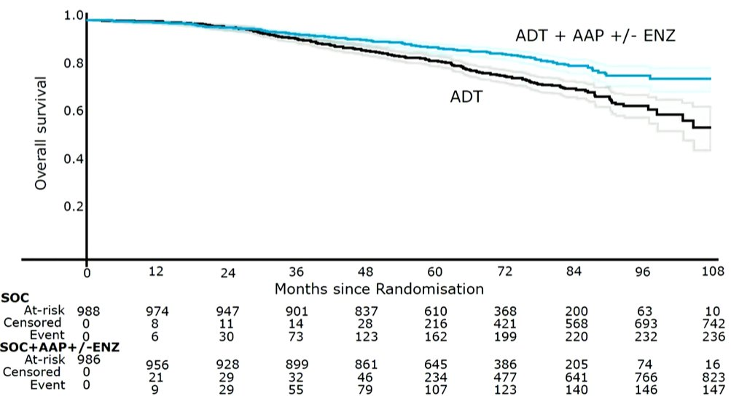
Meta-Analysis of STAMPEDE: OS

Slide 18
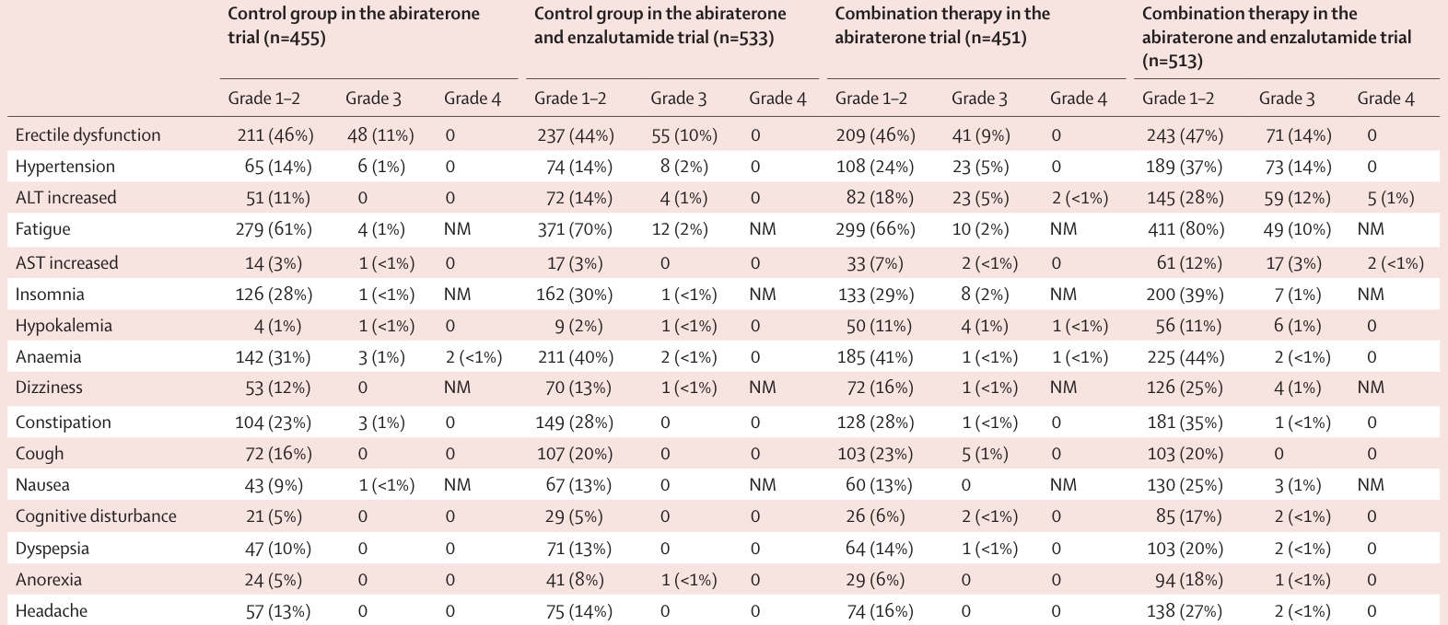
Meta-Analysis of STAMPEDE: Adverse Events

Slide 19
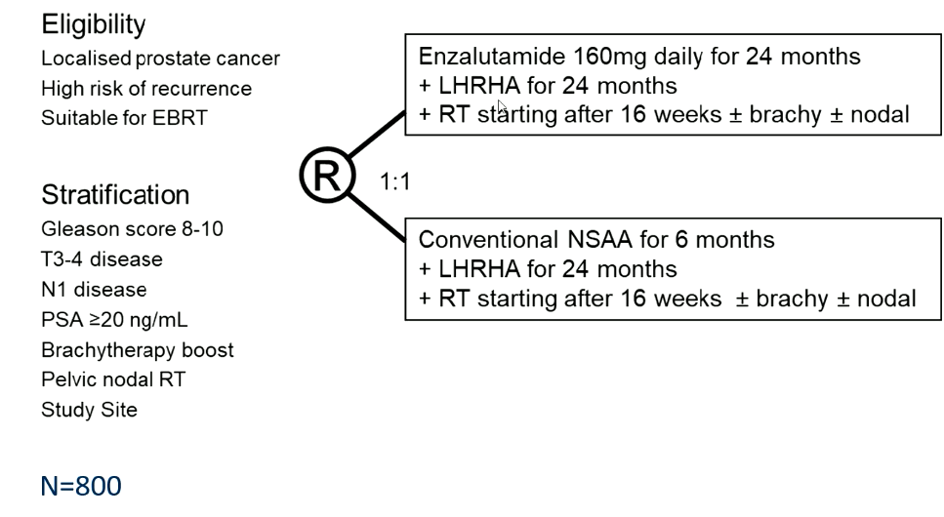
Phase 3 ENZARAD Trial: Study Design
Median follow-up: 8 years
Endpoints
Metastasis-free survival (primary)
OS
Cause-specific survival
PSA PFS
Clinical PFS
Castration-resistance
HRQoL
AEs
Incremental cost-effectiveness
Primary Endpoint:
MFS based on conventional imaging (CT or MRI or bone scan, per ICECAP)
Lesions on PSMA-PET alone insufficient
Event metastasis or death from any cause before metastasis

Slide 20
ENZARAD: Efficacy
Endpoint | ENZA (n = 401) | NSAA (n = 401)
MFS, % | 74 | 72
HR (95% CI) | 0.88 (0.67, 1.15)
PSA PFS, % | 67 | 62
HR (95% CI) | 0.78 (0.61, 0.99)
OS, % | 83 | 80
HR (95% CI) | 0.87 (0.63, 1.20)
PCSS, % | 97 | 96
HR (95% CI) | 0.90 (0.41, 1.97)
Nguyen PL, et al. ESMO 2025. Abstract LBA 86.

Slide 21
ENZARAD: Subgroup Analysis
Characteristic | MFS |  | OS
 | HR (CI) | P-value | HR (CI) | P-value
Regional lymph node involvement
N1 | 0.43 (0.20, 0.92) | .04 | 0.46 (0.17, 1.26) | .16
N0 | 0.97 (0.72, 1.30) |  | 0.94 (0.67. 1.33)
Pelvic field radiation
No | 1.25 (0.89, 1.76) | <.001 | 1.11 (0.75, 1.96) | .04
Yes | 0.47 (0.29, 0.76) |  | 0.53 (0.30, 0.96)
Very high risk
No | 1.04 (0.40, 2.71) | .74 | 1.60 (0.55, 4.65) | .16
Yes | 0.85 (0.64, 1.13) |  | 0.81 (0.57, 1.13)

Slide 22
ENZARAD: Safety
AE type, n | ENZA (n = 401) |  |  | NSAA (n = 401)
 | Gr 1-2 | Gr 3-4 | Gr 5 | Gr 1-2 | Gr 3-4 | Gr 5
Any | 210 | 182 | 3 | 206 | 181 | 4
Fatigue | 337 | 16 |  | 315 | 6
Hot flashes | 308 | 7 |  | 278 | 3
Psychiatric | 178 | 9 |  | 169 | 4
Nervous system | 177 | 25 |  | 122 | 15
Metabolic/Nutritional | 128 | 9 |  | 102 | 12
Respiratory | 99 | 6 |  | 78 | 9 | 1
Nausea | 97 | 0 |  | 57 | 0
Blood and lymphatic | 95 | 3 |  | 111 | 4
Hypertension | 71 | 43 |  | 76 | 25
Nguyen PL, et al. ESMO 2025. Abstract LBA 86.

Slide 23
Phase 3 ATLAS Trial: Study Design
Treatment phase: 28-day cycles ±2 days
Screening (≤35 days)
Neoadjuvant to RT (Cycles 1-2)
Concurrent with RT (Cycles 3-4)
Adjuvant to RT (Cycles 5-30)
HRLPC
ECOG PS 0/1
CCI ≤3
Candidates for primary RT
No distant metastasis, history of bilateral orchiectomy, pelvic radiation, or seizure
APA (240 mg QD) + bicalutamide-PBO + GnRHa
RT with APA (240 mg QD) + bicalutamide-PBO + GnRHa
APA (240 mg QD) + GnRHa
R
PBO + bicalutamide + GnRHa
RT with PBO + bicalutamide + GnRHa
PBO + GnRHa
1:1 (N=1503)
PSA and testosterone testing for BCF
Conventional and PET imaging initiated at BCF
Conventional imaging
Long-term follow-up
PSA and testosterone levels monitored every 3 months until distant metastasis by BICR
Conventional imaging every 6 months until distant metastasis by BICR or death
PET imaging every 6 months until distant metastasis on PET or conventional imaging by BICR or death

Slide 24
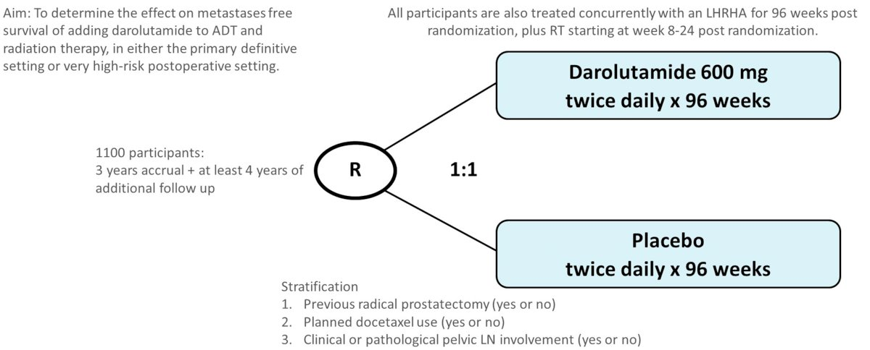
Phase 3 DASL-HiCaP Trial: Study Design
Patients planned for RT with very high-risk localized prostate cancer on conventional imaging or very high-risk features with PSA persistence or rise within 1 year following RP

Slide 25
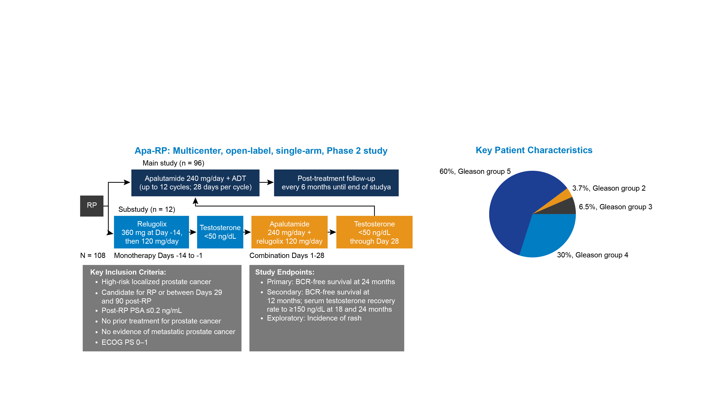
Phase 2 Apa-RP Trial: Study Design Apalutamide for High-Risk Localized Prostate Cancer Following Radical Prostatectomy (Post RP Adjuvant Rx)
The Apa-RP study provides proof of concept for treatment intensification with 12 cycles of apalutamide + ADT as an option for patients with high-risk localized prostate cancer who have undergone RP
The percentage of Black patients enrolled was representative of the US population (14%); White patients made up 82% of the study population

Slide 26
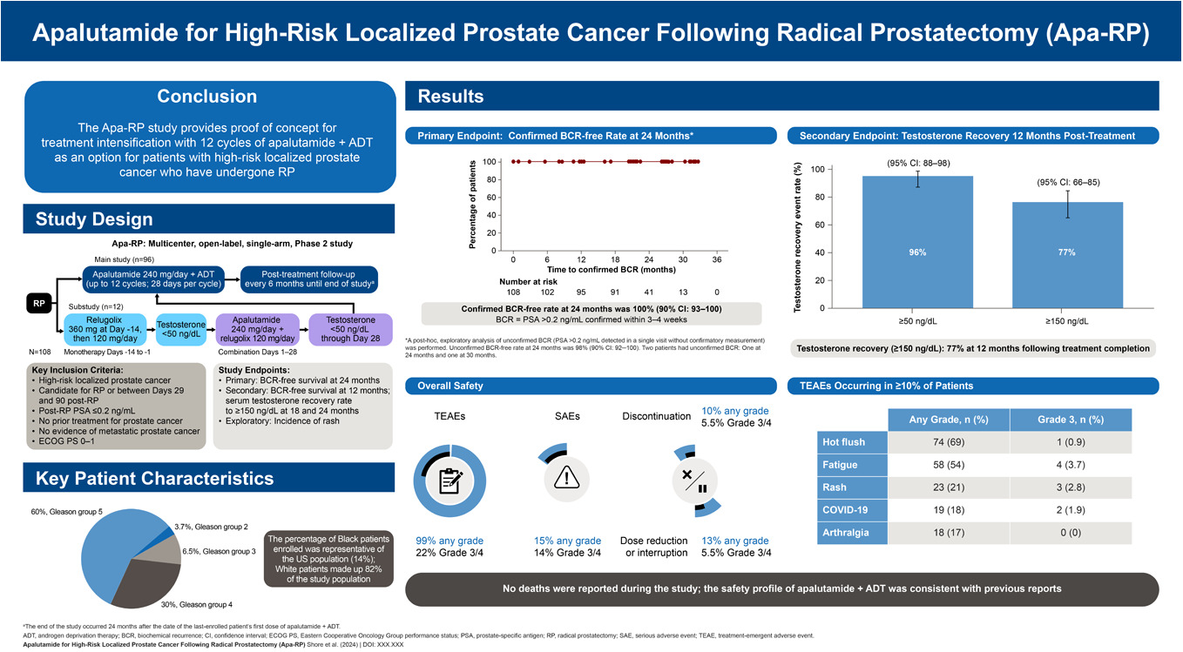
Apa-RP: BCR-Free Survival and Testosterone Recovery
Primary Endpoint:
Confirmed BCR-Free Rate at 24 Months*
Secondary Endpoint:
Testosterone Recovery 12 Months Post-Treatment
Confirmed BCR-free rate at 24 months:
100% (90% CI: 93-100)
BCR = 2 sequential PSA levels of >0.2 ng/mL measured within 3-4 weeks
Testosterone recovery (≥150 ng/dL):
77% at 12 months following treatment completion

Slide 27
Apa-RP: Safety
TEAEs Occurring in ≥10% of Patients
Overall Safety
 | Any Grade, n (%) | Grade 3, n (%)
Hot flush | 74 (69) | 1 (0.9)
Fatigue | 58 (54) | 4 (3.7)
Rash | 23 (21) | 3 (2.8)
COVID-19 | 19 (18) | 2 (1.9)
Arthralgia | 18 (17) | 0 (0)
No deaths were reported during the study;
the safety profile of apalutamide + ADT was consistent with previous reports

Slide 28
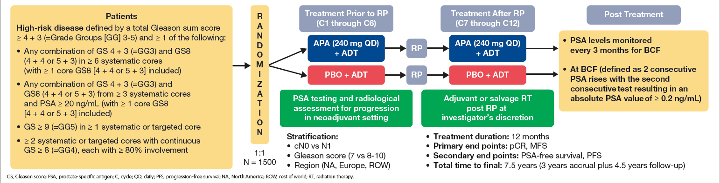
Phase 3 PROTEUS Trial: Study Design
Randomized, Double-Blind, Placebo-Controlled, Phase 3 Study of Apalutamide in Subjects with High-Risk, Localized or Locally Advanced Prostate Cancer Who Are Candidates for Radical Prostatectomy

Slide 29
Biochemically Recurrent (BCR) Prostate Cancer
Refers to a heterogeneous condition characterized by a rise in PSA levels after previous local therapy with conventional imaging methods such as CT, MRI, or bone scan showing no evidence of metastatic disease
Approximately one-third of patients with prostate cancer experience BCR following primary definitive treatment
BCR significantly elevates risk of distant metastasis and mortality, particularly in patients with unfavorable prognostic features

Slide 30
Phase 3 EMBARK Trial: Study Design
PSA recurrence after local Rx
PSADT ≤9 months
PSA ≥2.0 above nadir (RT) or ≥1.0 (RP)
Testosterone >150 ng/dL
No metastases on conventional imaging
Enzalutamide + leuprolide
37-week Rx
Rx stopped if PSA <0.2
Rx restarted at PSA 2.0 (RP) or PSA 5.0 (RT only)
Placebo + leuprolide
Enzalutamide – not blinded
Primary endpoint: MFS by BICR (enzalutamide/leuprolide vs leuprolide)
Key secondary endpoints: MFS by BICR (enzalutamide vs leuprolide), OS

Slide 31
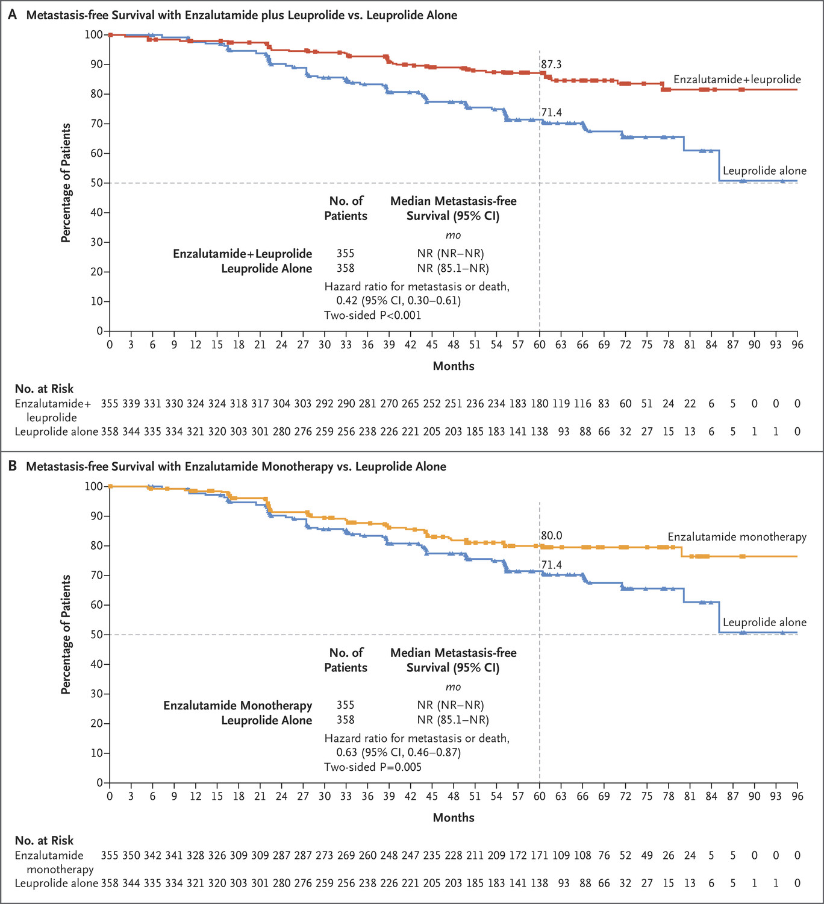
EMBARK: Metastasis-Free Survival
Enzalutamide + Leuprolide vs Leuprolide Alone
Enzalutamide Monotherapy vs Leuprolide Alone
HR 0.42
HR 0.63
Median follow-up: 5 years
Median PSADT: 4.9 months (at entry)
Median PSA: 5.2

Slide 32
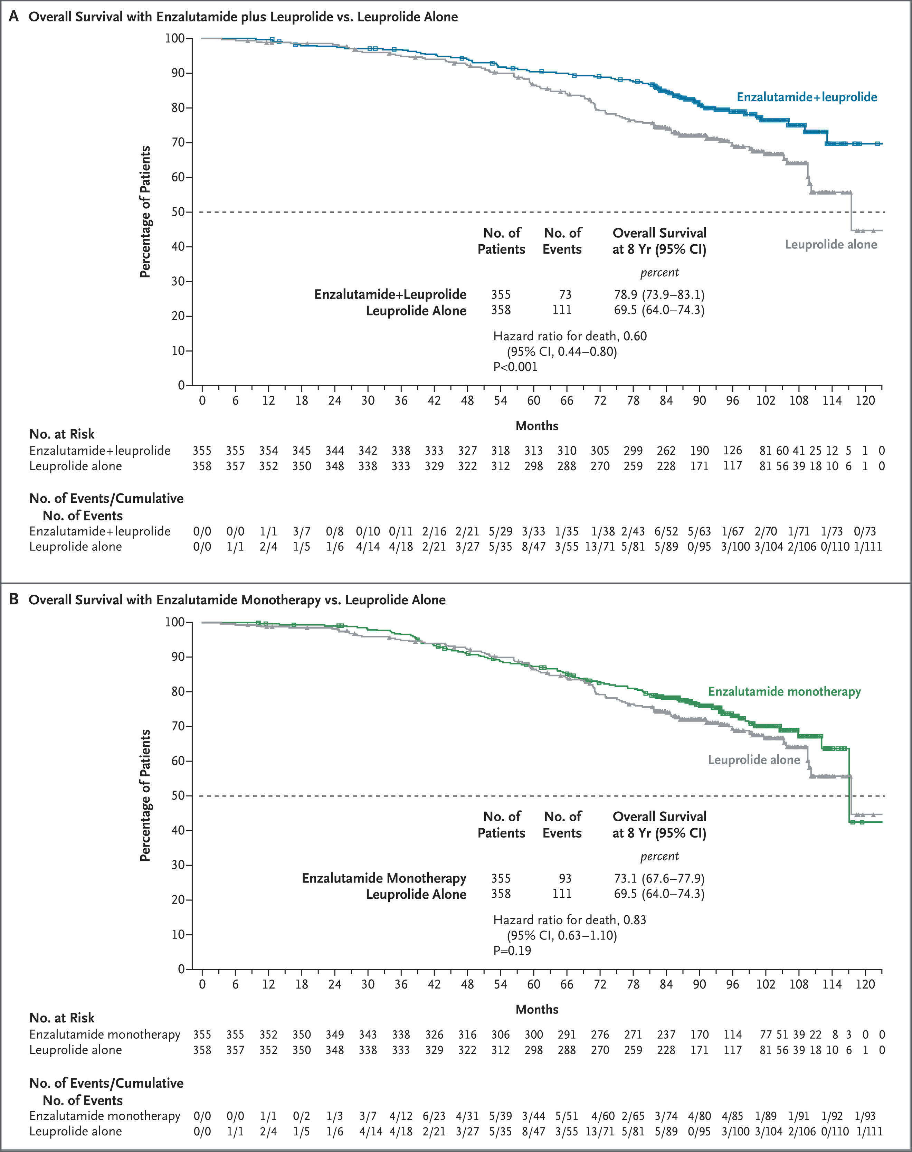
EMBARK: Overall Survival
Enzalutamide + Leuprolide vs Leuprolide Alone
Enzalutamide Monotherapy vs Leuprolide Alone
HR 0.60
HR 0.83

Slide 33
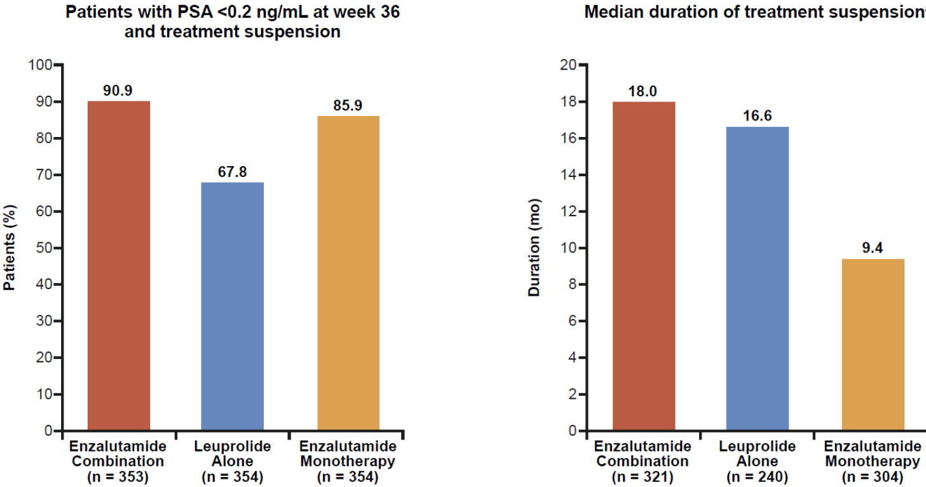
EMBARK: Treatment Suspension

Slide 34
EMBARK: Safety Summary
Event, n (%) | Enza combo (N=353) | Leuprolide alone (N=354) | Enza mono (N=354)
TEAE | 346 (98.0) | 347 (98.0) | 348 (98.3)
AE that was the primary reason for treatment discontinuation | 97 (27.5) | 45 (12.7) | 73 (20.6)
TEAE event leading to death | 10 (2.8) | 5 (1.4) | 12 (3.4)
Grade 3 or higher TEAE | 185 (52.4) | 175 (49.4) | 203 (57.3)
TEAE related to study drug | 307 (87.0) | 286 (80.8) | 316 (89.3)
Grade 3 or higher TEAE related to study drug | 68 (19.3) | 34 (9.6) | 72 (20.3)
Serious TEAE | 143 (40.5) | 133 (37.6) | 154 (43.5)
Serious TEAE related to study drug | 30 (8.5) | 9 (2.5) | 27 (7.6)

Slide 35
Phase 3 PRESTO Trial: Study Design
PSA recurrence after RP
PSADT ≤9 months
PSA >0.5 (RP)
Testosterone >150 ng/dL
No metastases on conventional imaging
N = 160
ADT alone
52 weeks RX
N = 163
ADT + apalutamide
N = 161
ADT + apalutamide + abiraterone + prednisone
Primary endpoint: PSA-PFS defined as PSA rise of at least 25% and 2 ng/mL above nadir, confirmed by repeat measurement
ADT compared separately to each experimental arm

Slide 36
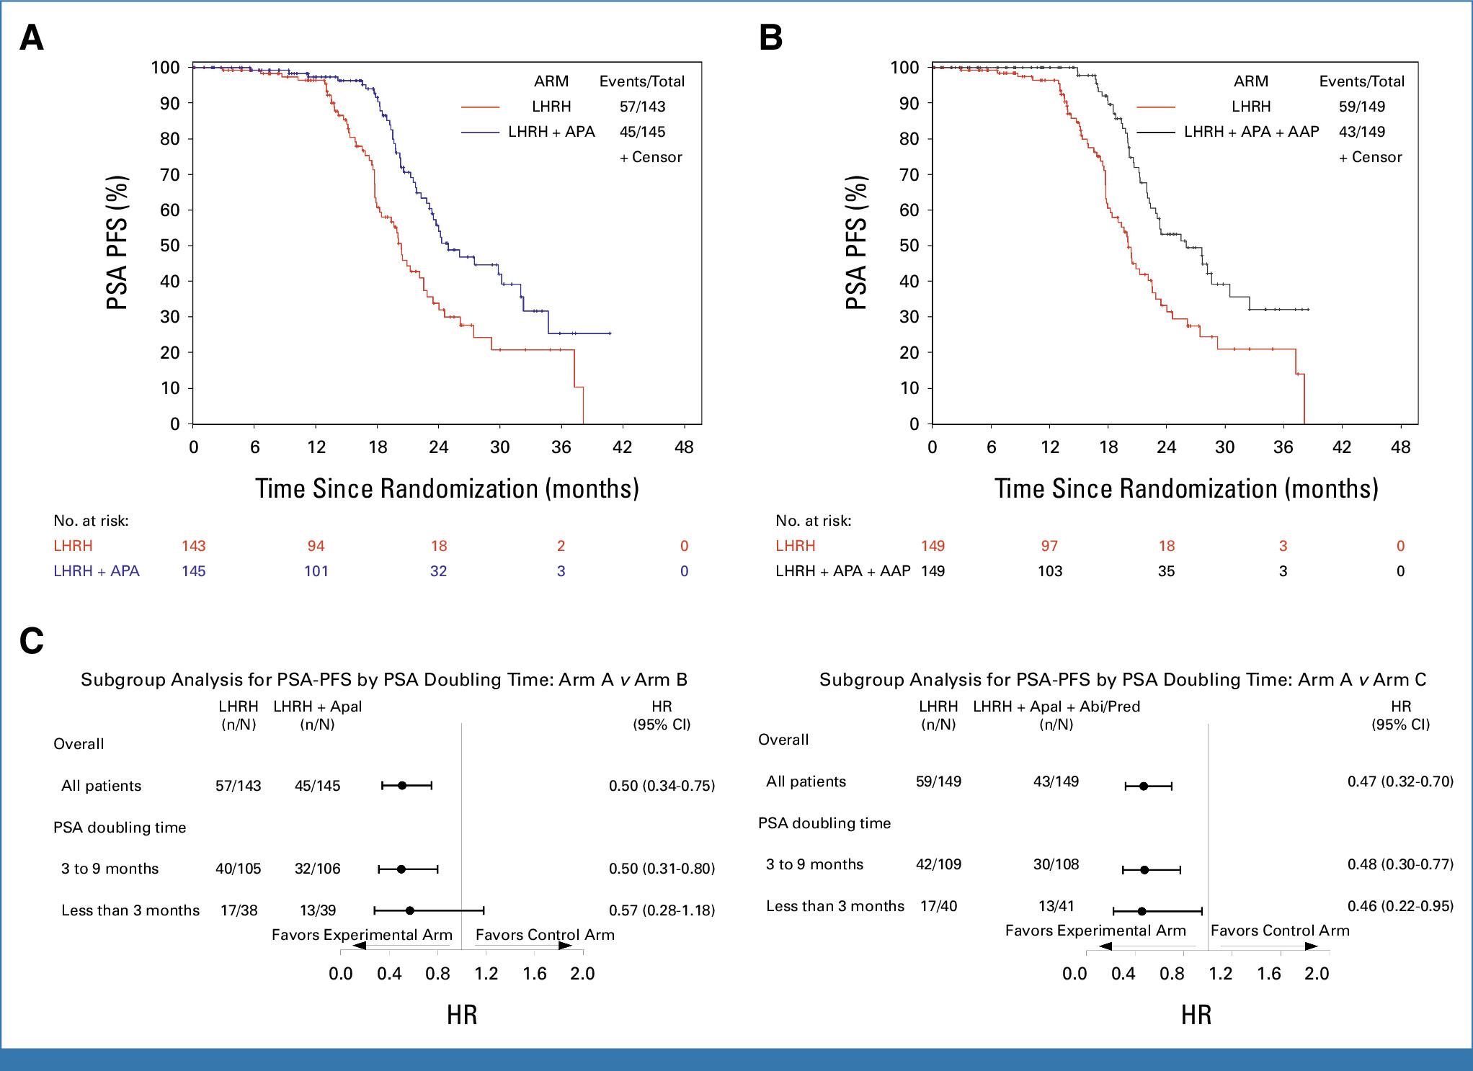
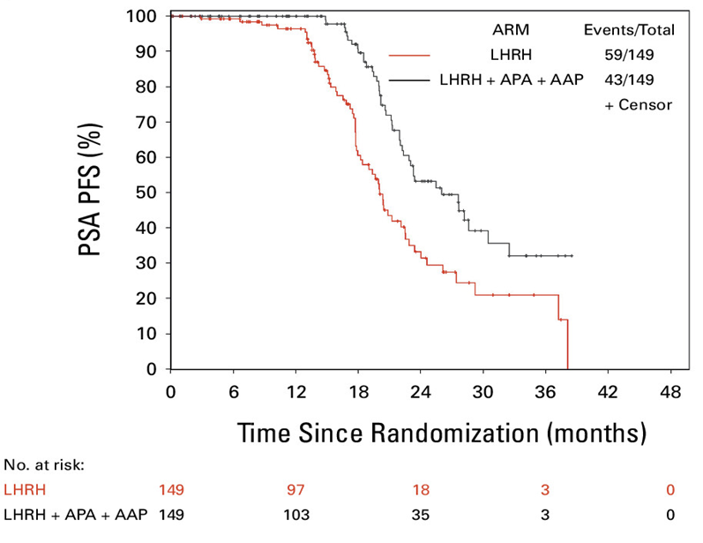
PRESTO: PSA-PFS (Primary Endpoint)
ADT + apalutamide vs ADT alone
ADT + apalutamide + abiraterone acetate + prednisone versus ADT alone

Slide 37
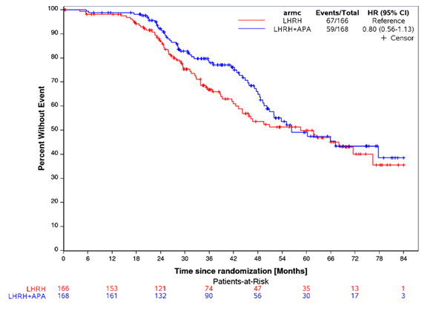
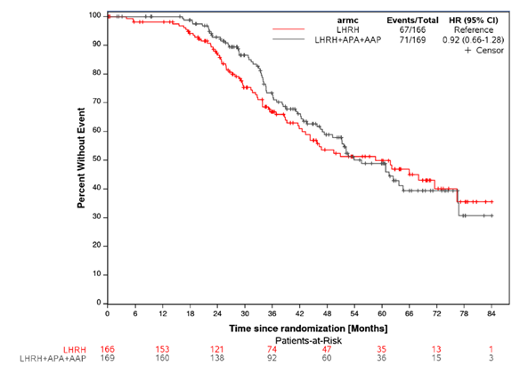
PRESTO: MFS
ADT + apalutamide + abiraterone acetate + prednisone versus ADT alone
ADT + apalutamide vs ADT alone
37

Slide 38
PRESTO: Safey Summary
 | Arm A ADT (n = 160) | Arm B ADT + Apalutamide (n = 167) | Arm C ADT + Apalutamide + abi/pred (n = 164)
Adverse Events (AE) | n (%) | n (%) | n (%)
Any AE | 153 (96) | 167 (100) | 163 (99)
Grade 3 or 4 AE | 35 (22) | 43 (26) | 67 (41)
AE leading to treatment discontinuation | 1 (0.6) | 2 (1) | 4 (2)

Slide 39
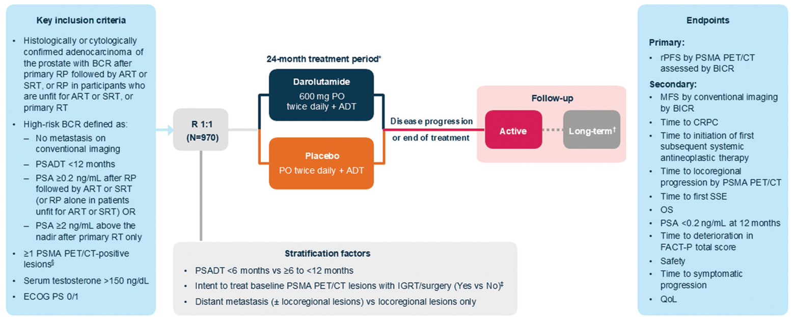
Phase 3 ARASTEP Trial: Study Design

Slide 40
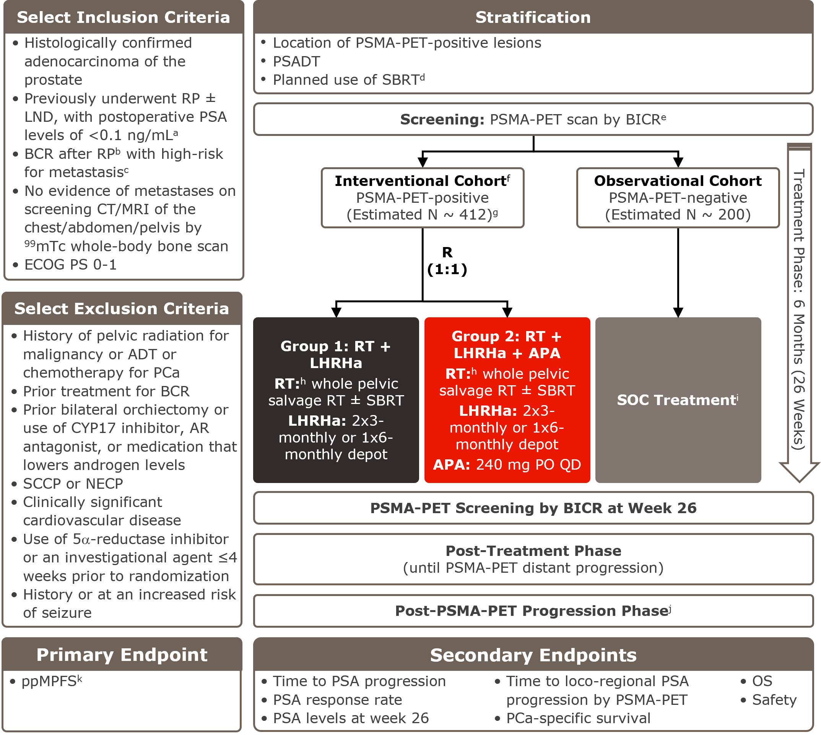
Phase 3 PRIMORDIUM Trial: Study Design

Slide 41
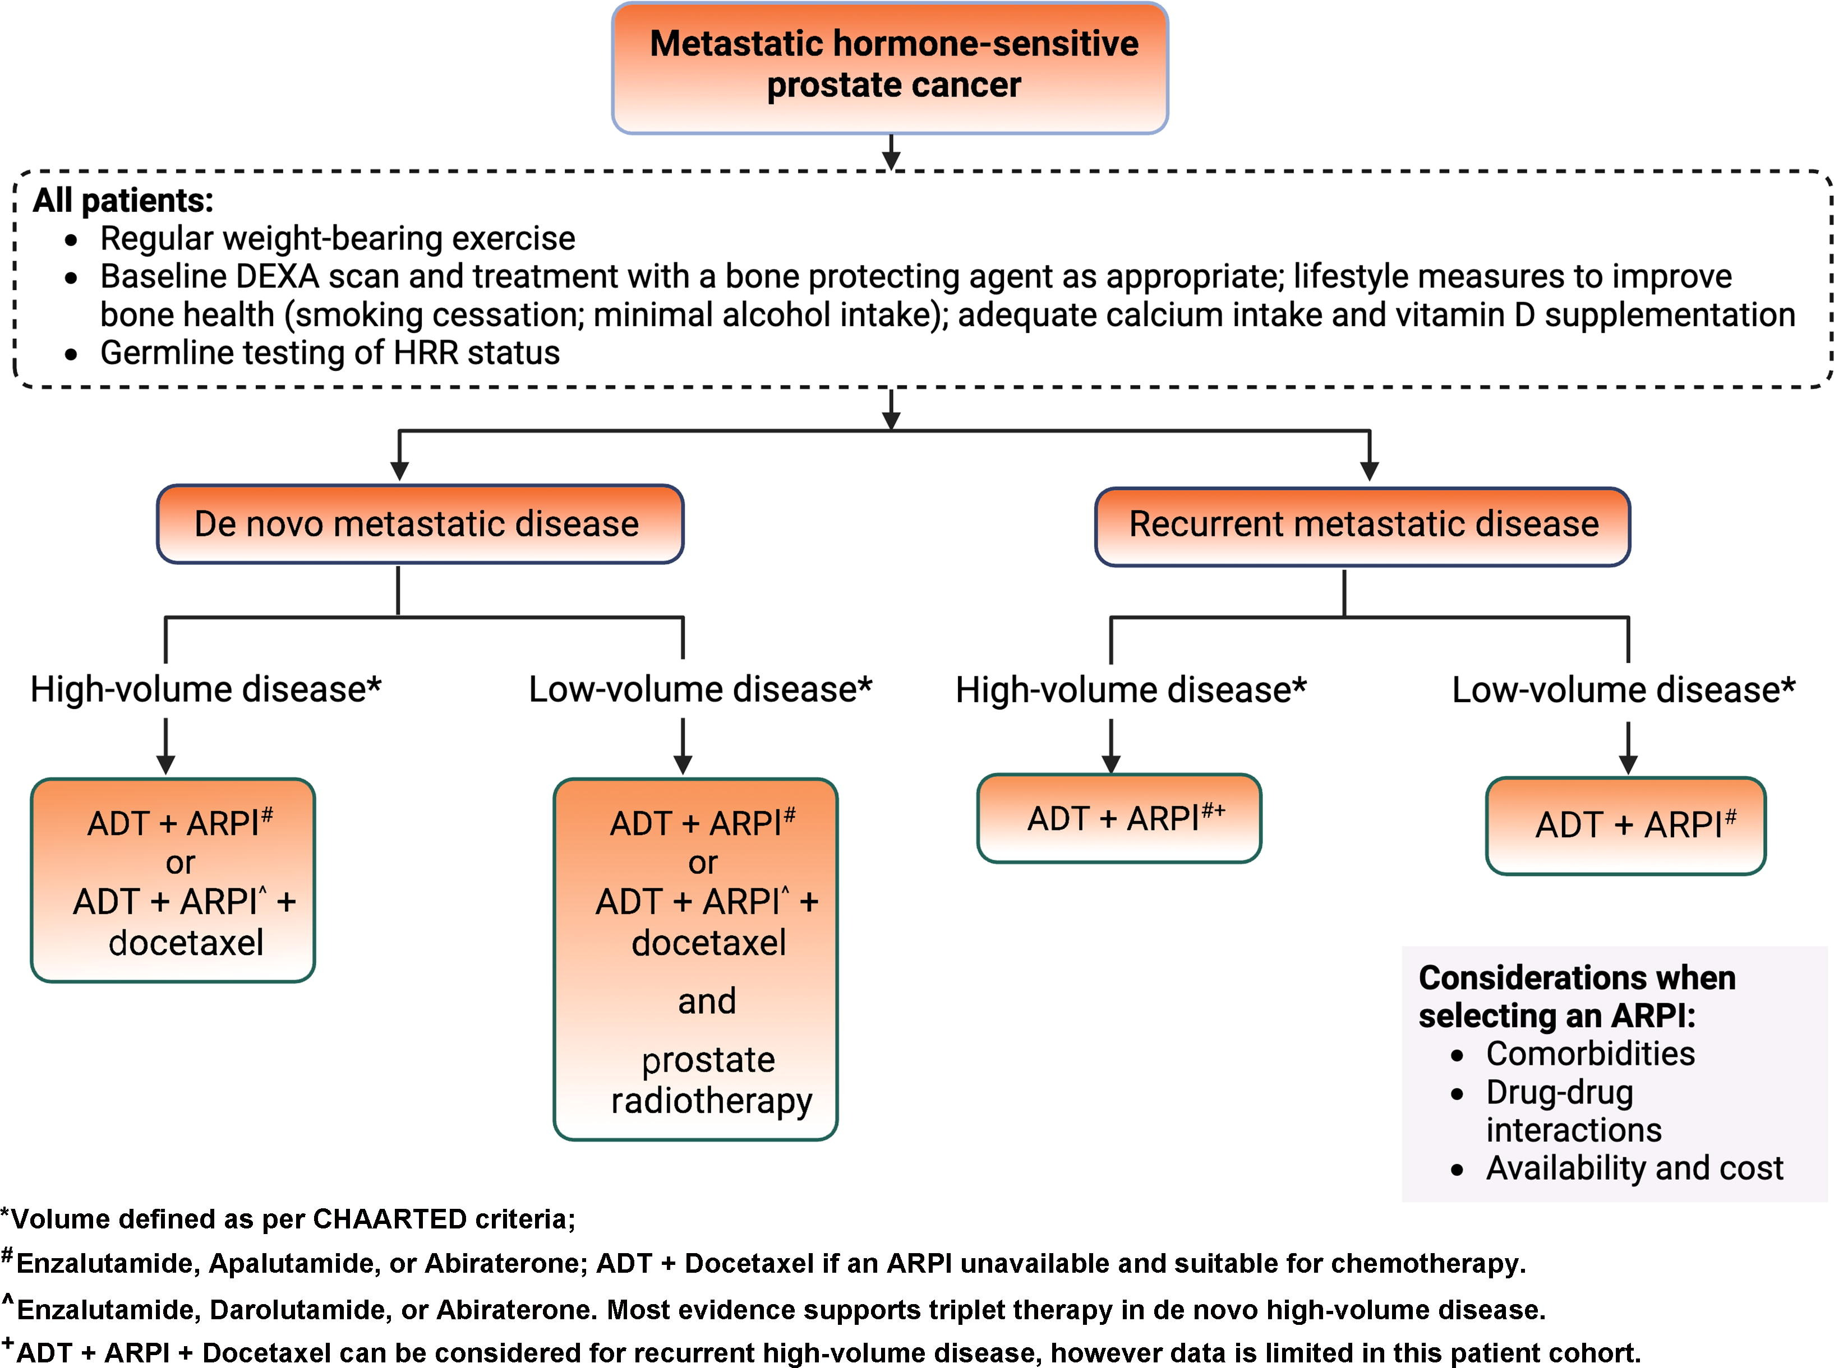
Treatment Intensification Strategies in mHSPC

Slide 42
Phase 3 Trials Evaluating Androgen Receptor Pathway Inhibitors in mHSPC
ARPI | Trial | Primary Endpoint(s) | Control Arm
Abiraterone | STAMPEDE | OS | ADT + placebo
 | LATITUDE | rPFS; OS | ADT + placebo
 | PEACE-1 | rPFS; OS | ADT + placebo
Enzalutamide | ENZAMET | OS | ADT + NSAA
 | ARCHES | rPFS | ADT + placebo
Apalutamide | TITAN | rPFS; OS | ADT + placebo
Darolutamide | ARASENS | OS | ADT + docetaxel
 | ARANOTE | rPFS | ADT + placebo

Slide 43
Summary of HR for OS in Phase 3 Trials Evaluating ARPIs in mHSPC
M1 HSPC | All M1 | High Volume | Low Volume | M0 at First Diagnosis - Metachronous M1
LATITUDE – Abiraterone (All de novo; N=1,199) | 0.66 (0.58-0.78) | 0.62 (0.52-0.74) | 0.72 (0.47-1.10) | N/A
STAMPEDE – Abiraterone (>90% de novo; N=999) | 0.60 (0.49-0.71) | 0.54 (0.43-0.69) | 0.55 (0.41-0.76) | N/A
PEACE-1 – Abiraterone (60% conc docetaxel; N=1,173) | 0.82 (0.69-0.98) | 0.72 (0.55-0.95) | 0.83 (0.50-1.39) | N/A
ENZAMET – Enzalutamide (45% conc docetaxel; N=1,125) | 0.67 (0.52-0.86) | 0.53 (0.42-1.09) | 0.39 (0.21-0.71) | 0.56 (0.29-1.06)
TITAN – Apalutamide (10% prior docetaxel; N=1,052) | 0.65 (0.53-0.79) | 0.70 (0.56-0.88) | 0.52 (0.35-0.79) | 0.39 (0.22-0.69)
ARCHES – Enzalutamide (18% prior docetaxel; N=1,150) | 0.66 (0.53-0.81) | 0.66 (0.52-0.88) | 0.66 (0.43-1.03) | N/A
ARASENS – Darolutamide + Docetaxel (77% high vol; N=1,305) | 0.68 (0.57-0.80) | 0.69 (0.57-0.82) | 0.68 (0.41-1.13) | N/A
ARANOTE – Darolutamide (72.5% de novo; N=669) | 0.81 (0.59-1.12) | 0.80 (0.57-1.13) | 0.90 (0.38-2.13) | N/A

Slide 44
All Grade Toxicities Across Phase 3 Trials in mHSPC
All grade, % | LATITUDE (abiraterone) vs placebo | ARCHES (enzalutamide) vs placebo | TITAN (apalutamide) vs placebo | ARANOTE (darolutamide) vs placebo
Fatigue | 22 vs 15 | 24 vs 20 | 19 vs 16 | 6 vs 8
HTN | 41 vs 24 | 9 vs 6 | 17 vs 15 | 9 vs 9
Rash | Not reported | 3 vs 2 | 27 vs 8 | 4 vs 4
Fall | Not reported | 4 vs 3 | 7 vs 7 | 1 vs 1
Fracture | 0 vs 0 | 6 vs 4 | 6 vs 4 | 4 vs 2
Cardiac | 16 vs 9 | 4 vs 3 | Not reported | 9 vs 7
Arthralgia | 17 vs 14 | 12 vs 11 | 17 vs 14 | 12 vs 11
LFT | 16 vs 11 | Not reported | Not reported | Not reported
Hypokalemia | 24 vs 4 | Not reported | Not reported | Not reported

Slide 45
Personalizing Treatment Intensification Strategies in HSPC

Slide 46
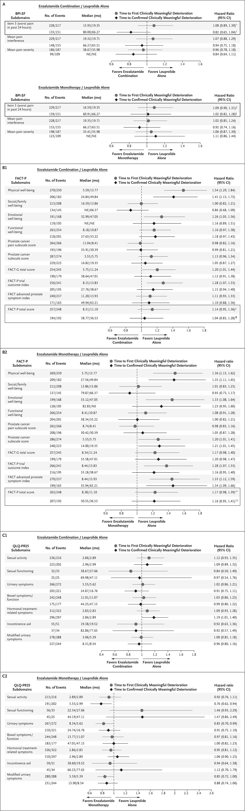
EMBARK: Enzalutamide Combination and Monotherapy Preserved High Health-Related QoL
FACT-P
enzalutamide combination vs. leuprolide alone
FACT-P
enzalutamide monotherapy vs. leuprolide alone

Slide 47
EMBARK: Enzalutamide Combination and Monotherapy Preserved High Health-Related QoL (Cont’d)
QLQ-PR 25
enzalutamide combination vs. leuprolide alone
QLQ-PR 25
enzalutamide monotherapy vs. leuprolide alone

Slide 48
Factors Impacting Time to Testosterone Recovery
Baseline testosterone
Patient age
Duration of ADT
Medical comorbidities
How often should we check baseline T level before initiating ADT? Once ADT is initiated, when should we check it again? Does it matter if T <50 vs <20 vs <10?

Slide 49
Variation in How Testosterone Recovery is Reported
HERO (9 mo Rx)
Testosterone >280 at 90 days off therapy (median age 72):
54% relugolix
3% leuprolide
PRESTO (12 mo Rx)
Testosterone >50 at median 3.8-4.7 months off therapy (median age 67)

Slide 50
Unfavorable PSA Nadir Is Prognostic
Overall Survival by PSA (ng/mL) Status at End of Induction

Slide 51
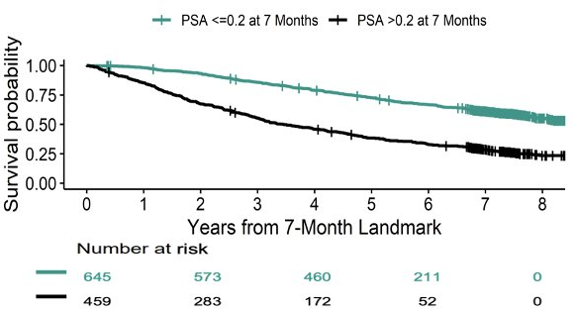
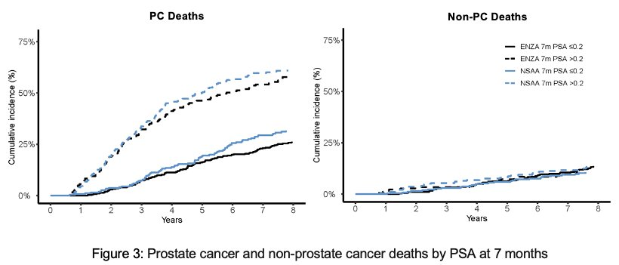
ENZAMET: PSA-Related Outcomes
Overall Survival
PC-Related Deaths

Slide 52
Clinical Considerations for Patients With mHSPC Not Achieving Optimal PSA Nadir
Is the ADT optimal?
Check testosterone level
If testosterone measurable, consider changing ADT agent and reassessing testosterone decline
If on orals, assess if patient taking as prescribed
If on oral AR-axis inhibitor and dose reduced, consider risk/benefit of full dose
If prostate RT hasn’t been administered, consider prostate RT if applicable
If patient was a candidate for SBRT to metastases and didn’t receive it, consider restaging and reconsideration
If patient was a candidate for triplet therapy (especially if synchronous, high volume) and received doublet therapy, consider adding the third therapy especially if <6 mo from initiation of therapy
If not performed, recommend germ-line testing to prepare for subsequent therapy
If not performed, consider somatic sequencing either on initial biopsy or liquid test

Slide 53
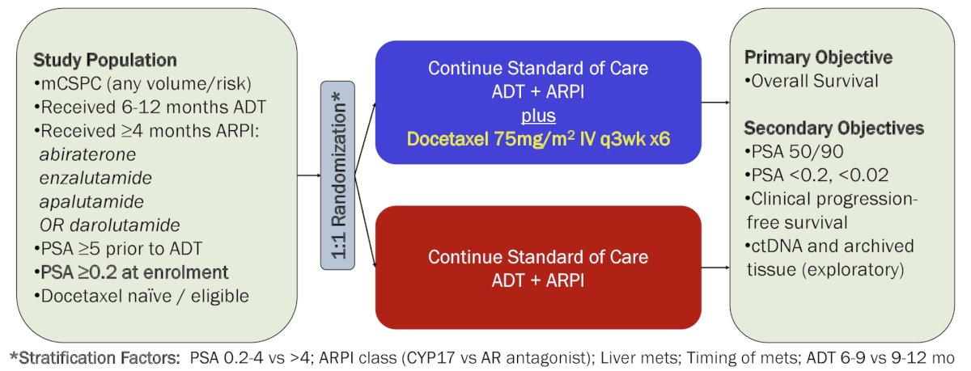
Phase 3 TRIPLE-SWITCH Trial: Study Design
N = 830

Slide 54
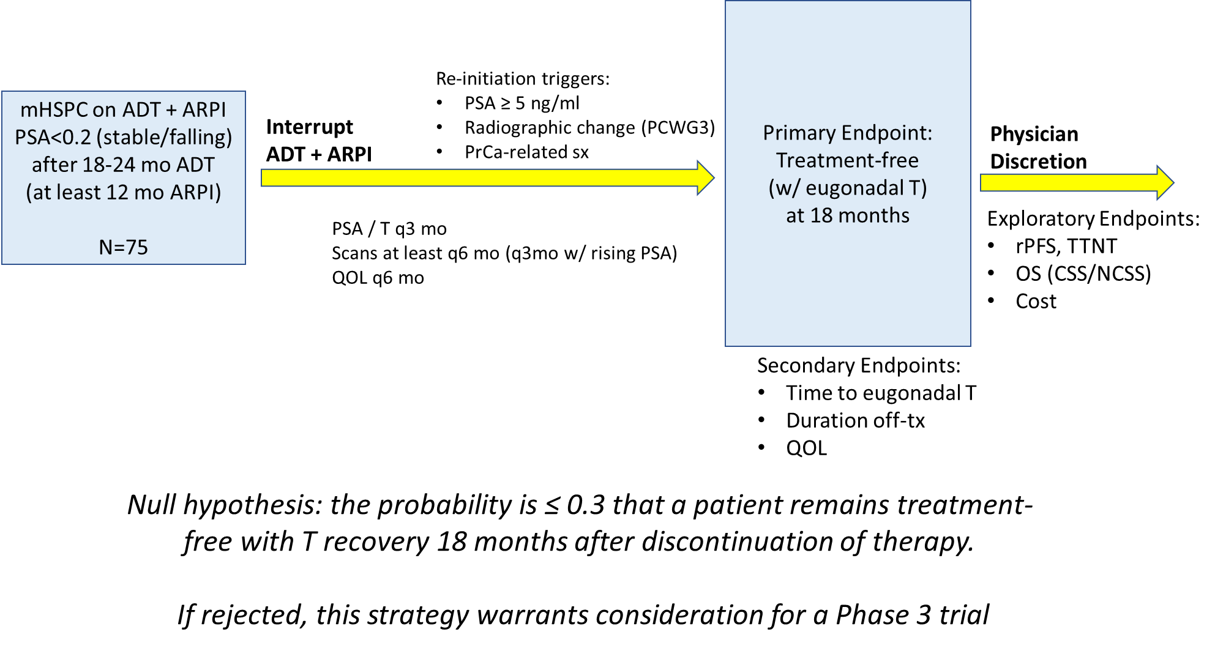
Is De-escalation Possible? A Dream Trial: ALLIANCE A032101/A-DREAM
Choudhury A (DFCI) PI

Slide 55
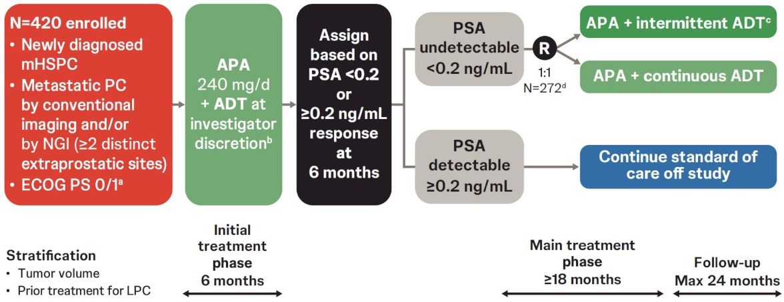
Phase 3 LIBERTAS Trial: Study Design

Slide 56
Enhancing Safety Through Multidisciplinary Collaboration

Slide 57

Multidisciplinary Teams Are Critical for Optimal Outcomes
Urologists
Radiation oncologists
Medical oncologists
Primary care providers
Medical specialist, cardiology, etc.
Pathologists
Radiologists
Basic researchers
Clinical trial staff
Advanced practice providers
Registered nurses
Pharmacists
Nutritionists
Psychologists, Social workers

Slide 58

Team Coordination
Establish best lines of communication
Introduce key team members
Assess language barriers
Review patient portals
Promote communication among caregivers
Define role of primary care provider

Slide 59
Adverse Event Management
Fatigue
Hot Flashes
Sleep hygiene
Alcohol moderation
Exercise
Psychologic health
ARPI dose modification or discontinuation if feasible
Medications
SSRI, megestrol, gabapentin, oxybutynin
Acupuncture
Wearable wrist bands

Slide 60
Adverse Event Management
Hypertension
Arthralgia
Weight management
Exercise
Alcohol moderation
Salt moderation
Medications
Cardiology referral
Concomitant meds (statins)
Assess, treat orthopedic issues
Stretching, PT
Massage
Acupuncture
Chiropractor
Medications

Slide 61
Adverse Event Management
Gastrointestinal
Dermatologic (rash)
Assessment: H&P
Dietary considerations
Communication with PCP
Concomitant medications
Psychologic contributors
GI consultation
Nutrition consultation
Concomitant medications
Exposure history
Hold medication if expected
Resume once rash resolved
Consider dose reduction
Treat rash
Topical steroids
Oral steroids
Consider dermatology consultation

Slide 62
Practical Application: Case-Based Learning Lab

Slide 63
Case 1 – Rising PSA After RP
65-YEAR-OLD MAN
Patient Presentation and History
Healthy with medical history of treated hypertension
Had RP 2 years ago for a Gleason 8, pT3a cancer
Post-RP PSA nadir was <0.02
However, 1 year after RP, PSA rose: 0.05, 0.08, 0.1, 0.13
Had salvage RT and ADT (leuprolide) x 6 months
PSA nadir was <0.02 at 9 months with recovered testosterone
PSA started to rise and was 1.2 with a PSADT of 5 months; conventional imaging was done and there were no metastases and PSMA-PET was also negative for metastases

Slide 64
Case 1 Audience Question
What would you recommend for this patient?
Surveillance
ADT monotherapy (agonist or antagonist)
ADT + enzalutamide
ADT + enzalutamide + docetaxel
Enzalutamide monotherapy
Unsure

Slide 65
Case 1 Discussion
Does this patient have any additional local therapy options?
What is the significance of the PSADT?
Is this a good time to consider germline or somatic sequencing?
Should any additional radiographic staging be done?
What treatment options does this patient have?

Slide 66
Case 1 – Outcome
65-YEAR-OLD MAN
Patient was treated per EMBARK trial with ADT + enzalutamide
PSA nadir was <0.02 at 9 months and treatment was stopped
Testosterone recovered to the normal range at 5 months
PSA started rising again at 9 months and PSA was followed to establish PSA doubling time
A PSMA-PET was obtained when PSA was 1.5 and 2 metastases were found (1 bone, 1 pelvic lymph node) and the patient was treated with SBRT to the metastases with ADT + ARPI

Slide 67
Case 2 – Synchronous mHSPC
65-YEAR-OLD MAN
Patient Presentation and History
Healthy with a medical history of treated hypertension
Had urinary urgency and frequency for 4 months and went to his PCP
DRE was abnormal and first PSA was 35, repeat 34
Bone scan and CT showed: large prostate, 3 bone mets in pelvis
Prostate biopsy: Gleason 8 cancer in 8/12 cores

Slide 68
Case 2 Study Audience Question
What treatment would you recommend for this patient?
ADT monotherapy (agonist or antagonist)
ADT + ARPI
ADT + ARPI + prostate radiation
ADT + ARPI + docetaxel + prostate radiation
Unsure

Slide 69
Case 2 Discussion
What is the role of prostate radiation in a patient with metastatic prostate cancer?
Once a patient has been diagnosed with metastatic prostate cancer with conventional imaging, what is the role of PSMA-PET imaging?
Should this patient have germline and/or somatic sequencing?
How should this patient be followed in the clinic?

Slide 70
Case 2 – Outcome
65-YEAR-OLD MAN
Patient was treated with ADT, apalutamide, and prostate radiation
Had germline testing and a pathogenic BRCA2 mutation was found
Had PSA nadir of 0.05 and was followed with PSA every 3 months and annual conventional imaging
After 4 years of therapy, PSA was rising, testosterone was confirmed castrate and conventional imaging showed 2 new bone metastasis: L2, L4
Treated with SBRT to L2, L4 and continued on apalutamide + ADT with PSA returning to nadir of 0.05

Slide 71
Key Takeaways

Slide 72
Key Takeaways
ADT intensification improves outcomes in high-risk localized prostate cancer, biochemically recurrent disease, and mHSPC
Risk stratification tools are important for identifying patients with HSPC who are most likely to benefit from ADT intensification
ADT intensification needs to be individualized based on patient and disease characteristics
Multidisciplinary team coordination and alignment can promote patient safety and adherence to treatment
Novel approaches including new agents and biomarkers are in development to further enhance outcomes in HSPC

Slide 73
Glossary
AAP, abiraterone acetate plus prednisone
ADT, androgen-deprivation therapy
APA, apalutamide
AR, androgen receptor
ARi, androgen-receptor inhibitor
ARPI, androgen-receptor pathway inhibitor
BCF, biochemical failure
BCR, biochemical recurrence
BFI, Brief Fatigue Inventory
BICR, blinded independent central review
BPI-SF, Brief Pain Inventory–Short Form
CCI, Charlson Comorbidity Index
CSS, cancer-specific survival
ECOG PS, Eastern Cooperative Oncology Group performance status
ENZA, enzalutamide
FACT-P, Functional Assessment of Cancer Therapy–Prostate
GnRHa, gonadotropin-releasing hormone agonist
GS, Gleason score
HDR, high dose-rate
HRLPC, high-risk localized prostate cancer
HRQoL, health-related quality of life
HTN, hypertension
LFT, liver function test
LHRH, luteinizing hormone-releasing hormone
M0, cancer has not spread to other areas of the body beyond nearby lymph nodes
M1, cancer has spread to distant parts of the body, including distant lymph nodes

Slide 74
Glossary
MFS, metastasis-free survival
mHSPC, metastatic hormone-sensitive prostate cancer
NCCN, National Comprehensive Cancer Network
NSAA, non-steroidal aromatase inhibitor
LHRH, luteinizing hormone-releasing hormone
NCSS, non-cancer-specific survival
PARP, poly (ADP-ribose) polymerase
pCR, pathological complete response
PCSM, prostate cancer–specific mortality
PCWG, Prostate Cancer Clinical Trials Working Group
PFS, progression-free survival
PSA, prostate-specific antigen
PSADT, PSA doubling time
PSMA-PET, prostate-specific membrane antigen positron emission tomography
QLQ-PR25, Quality of Life Questionnaire–Prostate 25
ROW, rest of world
RP, radical prostatectomy
rPFS, radiographic progression-free survival
RLT, radioligand therapy
RT, radiotherapy
SBRT, stereotactic body radiation therapy
TTNT, time to next treatment

