Slide 1


Slide 2
DISCLAIMER
This slide deck in its original and unaltered format is for educational purposes and is current as of March 2025. All materials contained herein reflect the views of the faculty, and not those of AXIS Medical Education, the CME provider, or the commercial supporter. Participants have an implied responsibility to use the newly acquired information to enhance patient outcomes and their own professional development. The information presented in this activity is not meant to serve as a guideline for patient management. Any procedures, medications, or other courses of diagnosis or treatment discussed or suggested in this activity should not be used by clinicians without evaluation of their patients’conditions and possible contraindications and/or dangers in use, review of any applicable manufacturer’s product information, and comparison with recommendations of other authorities.

Slide 3
DISCLOSURE OF UNLABELED USE
This activity may contain discussion of published and/or investigational uses of agents that are not indicated by the FDA. The planners of this activity do not recommend the use of any agent outside of the labeled indications.
The opinions expressed in the activity are those of the faculty and do not necessarily represent the views of the planners. Please refer to the official prescribing information for each product for discussion of approved indications, contraindications, and warnings.
USAGE RIGHTS
This slide deck is provided for educational purposes and individual slides may be
used for personal, non-commercial presentations only if the content and references
remain unchanged. No part of this slide deck may be published in print or
electronically as a promotional or certified educational activity without prior written
permission from AXIS. Additional terms may apply. See Terms of Service on
www.axismeded.com for details.

Slide 4
Learning Objectives
Upon completion of this activity, participants should be better able to:
Differentiate the mechanisms of action, delivery methods, and dosing protocols for approved and investigational CD3 X CD20 bispecific antibodies in patients with R/R FL
Incorporate evidence-based treatment with bispecific antibody therapies into coordinated care planning based on disease characteristics for patients with R/R FL
Develop interprofessional strategies for community-based clinicians in the administration, dosing, and management of bispecific antibody therapies in R/R FL
Integrate team-based management and care coordination tactics for AEs, including CRS and ICANS, associated with bispecific antibodies for R/R FL in the community setting

Slide 5
Expanding Bispecific Antibody Therapy Through Community-Based Care Teams

Slide 6
Frequency of NHL Subtypes in Adults
Mantle cell lymphoma (6%)
Peripheral T-cell (6%)
Follicular lymphoma (22%)
Other subtypes with a
frequency ≤2% (9%)
Small lymphocytic lymphoma (6%)
Composite
lymphomas (13%)
Marginal zone
B-cell lymphoma
MALT type (5%)
Marginal zone
B-cell lymphoma
nodal type (1%)
Diffuse large
B-cell (31%)
Lymphoplasmacytic lymphoma (1%)
MALT, mucosal associated lymphoid tissue; NHL, non-Hodgkin lymphoma.
Armitage JO, Weisenberger DD. J Clin Oncol. 1998;16(8):2780-2795.
Notes:
Armitage JO, Weisenburger DD. New approach to classifying non-Hodgkin's lymphomas: clinical features of the major histologic subtypes. Non-Hodgkin's Lymphoma Classification Project. J Clin Oncol. 1998;16(8):2780-2795.
Approximately 22% of NHLs are follicular lymphoma.

Slide 7
Background
Follicular lymphoma is the most common indolent lymphoma in the US and Western Europe, accounting for approximately 22% of all cases of Non-Hodgkin Lymphoma
Currently, the disease is incurable with variable patient disease courses and outcomes
There are several viable frontline options but currently no clear standard of care
Successive lines of therapy result in diminished returns, and outcomes are worse for patients who relapse within 24 months of chemoimmunotherapy
Novel agents have moved to the forefront of options in relapsed/refractory (R/R) disease

Slide 8
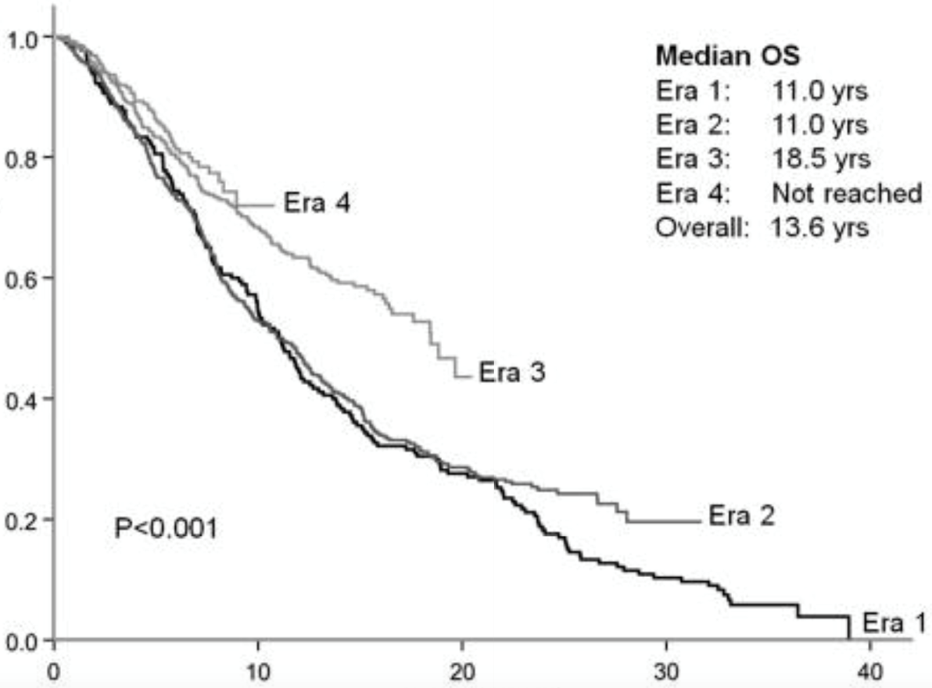
Treatment by Era and by Line of Therapy
Overall Survival
Era 1: Pre-Anthracycline (1960-1975) Era 2: Anthracycline (1976-1986)
Era 3: Aggressive Chemo/Purine Analogs (1987-1996) Era 4: Rituximab (1996-2003)
Chemo, chemotherapy; OS, overall survival.
Link BK, et al. Br J Haematol. 2019;184(4):660-663. Rivas-Delgado A, et al. J Haematol. 2019;184(5):753-759.
Notes:
Link BK, Day BM, Zhou X, et al. Second-line and subsequent therapy and outcomes for follicular lymphoma in the United States: data from the observational National LymphoCare Study. Br J Haematol. 2019;184(4):660-663.
Rivas-Delgado A, Magnano L, Moreno-Velázquez M, et al. Response duration and survival shorten after each relapse in patients with follicular lymphoma treated in the rituximab era. Br J Haematol. 2019;184(5):753-759.
Follicular lymphoma (FL) is an indolent disease characterized by long survival but frequent relapses. Before the introduction of rituximab, the clinical course of these patients showed a shorter response duration after each relapse. Patients with longer response duration after first-line showed significantly longer response duration after second-line therapy.

Slide 9
POD24/Transformation
Despite worsening outcomes with subsequent therapy, most patients with FL will live a considerable amount of time with disease
This does not appear to be the case with those who relapse early (within 24 months following first-line chemo-immunotherapy)
Patients who fall into the POD24 category tend to have worse outcomes with subsequent therapies and shortened overall survival, irrespective of the front-line therapy received
FL, follicular lymphoma; POD24, progression of disease within 2 years.

Slide 10
POD24/Transformation (Continued)
Data suggests that a portion of early relapsing patients have transformed DLBCL (tDLBCL)
Highlights the need to biopsy early relapsing patients to confirm/rule out transformation
Historically, patients with transformed disease have poor survival outcomes, although more contemporary data suggests outcomes are more promising¹⁻³
When transformation occurs, patients should be treated like they have de novo DLBCL
  Treatment should depend on what and how much chemotherapy has been given previously, including amount of anthracycline exposure
  Most clinicians advocate for consolidation ASCT if patients respond to chemotherapy
ASCT, autologous stem cell transplantation; DLBCL, diffuse large B cell lymphoma; POD24, progression of disease within 2 years.
1. Yuen AR, et al. J Clin Oncol. 1995;13(7):1726-1733.
2. Al-Tourah AJ, et al. J Clin Oncol. 2008;26(32):5165-5169.
3. Link BK, et al. J Clin Oncol. 2013;31(26):3272-3278.
Notes:
1. Yuen AR, Kamel OW, Halpern J, Horning SJ. Long-term survival after histologic transformation of low-grade follicular lymphoma. J Clin Oncol. 1995;13(7):1726-1733.
2. Al-Tourah AJ, Gill KK, Chhanabhai M, et al. Population-based analysis of incidence and outcome of transformed non-Hodgkin’s lymphoma. J Clin Oncol. 2008;26(32):5165-5169.
3. Link BK, Maurer MJ, Nowakowski GS, et al. Rates and outcomes of follicular lymphoma transformation in the immunochemotherapy era: a report from the University of Iowa/Mayo Clinic Specialized Program of Research Excellence Molecular Epidemiology Resource. J Clin Oncol. 2013;31(26):3272-3278.

Slide 11
Developing Evidence-Based Strategies for Patient Selection for Bispecific Antibody Therapy

Slide 12
Treatment Options in R/R Follicular Lymphoma
Only 2 currently approved agents/regimens for 2L R/R FL
3L R/R FL has several options
R2 (AUGMENT)
Chemotherapy/transplant?
Tazemetostat (NCT01897571; R/R FL patients with no other satisfactory options)
Tazemetostat (NCT01897571; with EZH2 mutation)
Obinutuzumab-Zanubrutinib (ROSEWOOD)
Bispecifics
  Mosunetuzumab (GO29781)
  Epcoritamab (EPCORE NHL-1)
CAR T
  Axi-cel (ZUMA-5)
  Tisa-cel (ELARA)
  Liso-cel (TRANSCEND FL)
Notes:
Currently, if we look at the treatment options for relapsed/refractory follicular lymphoma, there are only two currently approved regimens for second-line relapsed/refractory follicular lymphoma. These are lenalidomide/rituximab based on the AUGMENT study, and tazemetostat for relapsed/refractory follicular lymphoma patients who have no other satisfactory options. We do have chemotherapy and transplant, which has sort of fallen out of favor.
There are additional options in third-line+ follicular lymphoma. We have tazemetostat for patients with EZH2 mutations. We have Obinutuzumab/zanubrutinib based on the ROSEWOOD study with its pending confirmatory phase 3 trial, MAHOGANY. And then we have the bispecific antibodies; mosunetuzumab based on the clinical trial GO29781, and epcoritamab from the EPCORE NHL-1 study. Additionally, there are three approved CAR T-cell products in this space, axicabtagene autoleucel from the ZUMA-5 study, tisagenlecleucel from the ELARA study, and lisocabtagene maraleucel from the TRANSCEND FL trial.

Slide 13
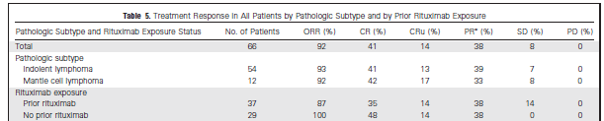
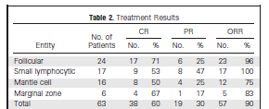
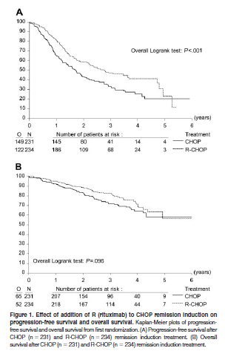
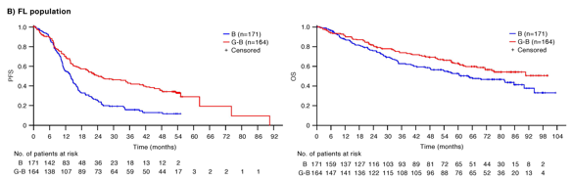
Chemotherapy/Transplant
No definitive studies evaluating the role of chemotherapy (BR, OB, R-CHOP, or O-CHOP) in this patient population
Would have to extrapolate from several small studies of treatments in R/R setting
Robinson et al. 2008
Rummel et al. 2005
Van Oers et al. 2006
Sehn et al. 2019
BR
OB
R-CHOP
B, bendamustine; BR, bendamustine and rituximab; CHOP, cyclophosphamide, doxorubicin, vincristine, prednisone; CR, complete response; CRu, complete response unconfirmed; G-B/OB, obinutuzumab and bendamustine; FL, follicular lymphoma; INV, investigator; ITT, intent-to-treat; OB, obinutuzumab plus bendamustine; O-CHOP, obinutuzumab + CHOP; ORR, overall response rate; OS, overall survival; PD, progressive disease; PFS, progression-free survival; PR partial response; R-CHOP, rituximab + CHOP; R/R, relapsed/refractory; SD, stable disease.
Sehn LH, et al. Blood. 2019;134(supplement_1):2822. van Oers MH, et al. Blood. 2006;108(10):3295-3301. Rummel MJ, et al. J Clin Oncol. 2005;23(15):3383-3389. Robinson KS, et al. J Clin Oncol. 2008;26(27):4473-4479.
Notes:
Sehn LH, Trněný M, Bouabdallah K, et al. Sustained overall survival benefit of obinutuzumab plus bendamustine followed by obinutuzumab maintenance compared with bendamustine alone in patients with rituximab-refractory indolent non-Hodgkin lymphoma: final results of the gadolin study. Blood. 2019;134(supplement_1):2822.
van Oers MH, Klasa R, Marcus RE, et al. Rituximab maintenance improves clinical outcome of relapsed/resistant follicular non-Hodgkin lymphoma in patients both with and without rituximab during induction: results of a prospective randomized phase 3 intergroup trial. Blood. 2006;108(10):3295-3301.
Rummel MJ, Al-Batran SE, Kim SZ, et al. Bendamustine plus rituximab is effective and has a favorable toxicity profile in the treatment of mantle cell and low-grade non-Hodgkin's lymphoma. J Clin Oncol. 2005;23(15):3383-3389.
Robinson KS, Williams ME, van der Jagt RH, et al. Phase II multicenter study of bendamustine plus rituximab in patients with relapsed indolent B-cell and mantle cell non-Hodgkin's lymphoma. J Clin Oncol. 2008;26(27):4473-4479.

Slide 14
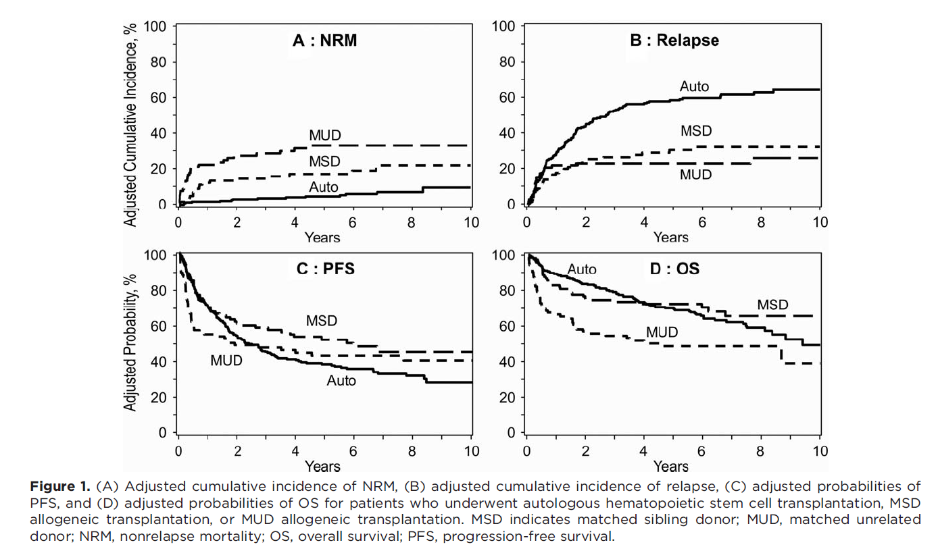
Transplant
So, what about transplant?
Data supports Auto, MSD vs. MUD
  This requires younger, more fit patients in addition to a donor for MSD
  Less relapses with MSD but more NRM
Benefit appears best in earlier lines of therapy
  3 or fewer prior lines
No data on transplant outcomes after R2 or other novel agents utilized in R/R FL
Auto, autologous; FL, follicular lymphoma; MSD, matched sibling donor; MUD, matched unrelated donor; NRM, nonrelapse mortality; OS, overall survival; PFS, progression-free survival; R/R, relapsed/refractory; R2, lenalidomide and rituximab.
Smith SM, et al. Cancer. 2018;124(12):2541-2551.
Notes:
Smith SM, Godfrey J, Ahn KW, et al. Autologous transplantation versus allogeneic transplantation in patients with follicular lymphoma experiencing early treatment failure. Cancer. 2018;124(12):2541-2551.

Slide 15
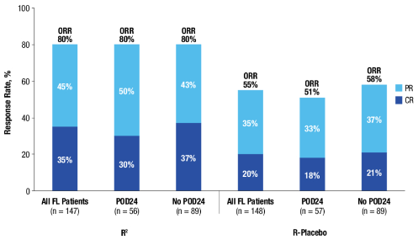
R2: AUGMENT
Randomized Phase 3 study of R2 vs. rituximab in R/R FL and MZL
Led to approval of R2 in 2L setting
Results suggest that treatment is mostly agnostic to POD24 status
Best responses (ORR and CR) were similar within each arm (R² or R-placebo) for all patients and those with or without POD24
Response in All FL Patients
and by POD24 Status (ITT)
Data cutoff June 22, 2018
2L, second-line; CR, complete response; FL, follicular lymphoma; ITT, intent-to-treat; MZL, marginal zone lymphoma; ORR, overall response rate; POD24, progression of disease within 2 years; PR, partial response; R, rituximab; R/R, relapsed/refractory; R2, lenalidomide and rituximab.
Leonard JP, et al. J Clin Oncol. 2019;37(14):1188-1199. Leonard JP, et al. EHA 2024. Abstract PF483.
Notes:
Leonard JP, Trneny M, Izutsu K, et al. AUGMENT: A phase III study of lenalidomide plus rituximab versus placebo plus rituximab in relapsed or refractory indolent lymphoma. J Clin Oncol. 2019;37(14):1188-1199.
Leonard JP, Trneny M, Izutzu K, et al. Efficacy was improved with lenalidomide/rituximab (R2) vs rituximab/placebo in patients with follicular lymphoma irrespective of POD24 status in the phase III augment study. Abstract presented at: European Hematology Association Hybrid Congress; Madrid, Spain; June 13-16, 2024. Abstract PF483.

Slide 16
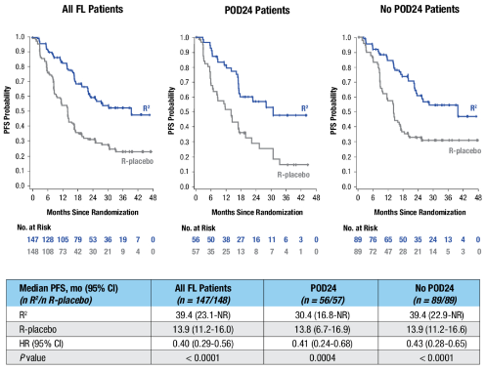
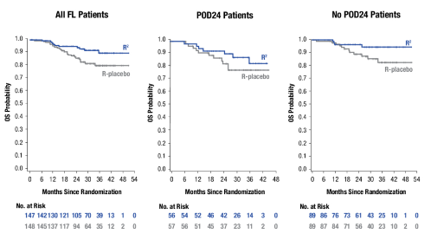
R2: AUGMENT
Progression-free Survival for All FL Patients
and by POD24 Status (ITT)
Overall Survival for All FL Patients
and by POD24 Status
At a median follow-up of 28.6 months, OS was not reached in all patients or according to POD24 status
Data cutoff June 22, 2018
FDA, Food and Drug Administration; FL, follicular lymphoma; HR, hazard ratio; ITT, intent-to-treat; OS, overall survival; PFS, progression-free survival; POD24, progression of disease within 2 years; R, rituximab; R/R, relapsed/refractory; R2, lenalidomide and rituximab.
Leonard JP, et al. J Clin Oncol. 2019;37(14):1188-1199.
Notes:
Leonard JP, Trneny M, Izutsu K, et al. AUGMENT: A phase III study of lenalidomide plus rituximab versus placebo plus rituximab in relapsed or refractory indolent lymphoma. J Clin Oncol. 2019;37(14):1188-1199.
Leonard JP, Trneny M, Izutzu K, et al. Efficacy was improved with lenalidomide/rituximab (R2) vs rituximab/placebo in patients with follicular lymphoma irrespective of POD24 status in the phase III augment study. Abstract presented at: European Hematology Association Hybrid Congress; Madrid, Spain; June 13-16, 2024. Abstract PF483.

Slide 17





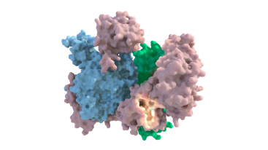

Follicular Lymphoma and EZH2
Germinal Center Reaction
EZH2 an epigenetic regulator of gene expression and cell fate decisions¹
EZH2 is required for normal B-cell biology and germinal center formation²
  Oncogenic mutations in EZH2 suppress exit from germinal state and “lock” B cells in this state, thereby transforming into a cancer²
EZH2 biology relevant in both mutant (MT) and wild-type (WT) EZH2 FL
  ~20% of patients with FL also have EZH2 gain of function mutations³
EZH2
EZH2
EZH2
Dark Zone Light Zone
Plasma cell
(makes antibodies)
Apoptosis
Naive B-cell
Oncogenic
Mutations in EZH2
Memory B-cell (remembers pathogens)
X
Tazemetostat
Germinal Center Derived Neoplasms
Tazemetostat, a first-in-class, selective oral inhibitor of EZH2 has shown antitumor activity in non-Hodgkin’s lymphoma patients with either MT or WT EZH2 ^{4,5}
17
FL, follicular lymphoma.
1. Gan L, et al. Biomark Res. 2018;6:10. 2. Béguelin W, et al. Cancer Cell. 2013;23(5):677-692. 3. Bödör C, et al. Blood. 2013;122(18):3165-3168. 4. Italiano A, et al. Lancet Oncol. 2018;19(5):649-659. 5. Morschhauser F, et al. Hematol Oncol. 2017;35(S2):24-25.
Notes:
1. Gan L, Yang Y, Li Q, Feng Y, Liu T, Guo W. Epigenetic regulation of cancer progression by EZH2: from biological insights to therapeutic potential. Biomark Res. 2018;6:10.
2. Béguelin W, Popovic R, Teater M, et al. EZH2 is required for germinal center formation and somatic EZH2 mutations promote lymphoid transformation. Cancer Cell. 2013;23(5):677-692.
3. Bödör C, Grossmann V, Popov N, et al. EZH2 mutations are frequent and represent an early event in follicular lymphoma. Blood. 2013;122(18):3165-3168.
4. Italiano A, Soria JC, Toulmonde M, et al. Tazemetostat, an EZH2 inhibitor, in relapsed or refractory B-cell non-Hodgkin lymphoma and advanced solid tumours: a first-in-human, open-label, phase 1 study. Lancet Oncol. 2018;19(5):649-659.
5. Morschhauser F, Salles G, McKay P, et al. Interim report from a phase 2 multicenter study of tazemetostat, an EZH2 inhibitor, in patients with relapsed or refractory B-cell non-Hodgkin lymphomas. Hematol Oncol. 2017;35(S2):24-25.

Slide 18
Tazemetostat: Oral EZH2 Inhibitor
All patients
  ORR higher in MT but PFS similar between MT or WT patients
Early relapsing patients
  Overall lower ORR compared to late relapsing pts
  PFS longer in those with EZH2 MT (13.8 months) vs. WT patients (5.8 months)
Parameter | EZH2 Mutant cohort (n=45) |  | EZH2 WT cohort (n=54)
 | Investigator | IRC | Investigator | IRC
ORR, n (%) | 35 (78) | 31 (69) | 18 (33) | 19 (35)
CR, n (%) | 4 (9) | 6 (13) | 3 (6) | 2 (4)
PR, n (%) | 31 (69) | 25 (56) | 15 (28) | 17 (31)
SD, n (%) | 10 (22) | 13 (29) | 16 (30) | 18 (33)
PD, n (%) | 0 | 1 (2)^{c} | 16 (30) | 12 (22)
DOR, months, median (95% CI) | 8.3 (5.5–13.8) | 10.9 (7.2–NE) | 14.7 (7.6–NE) | 13.0 (5.6–NE)
Endpoint by IRC Assessment | ITT Population
 | MT EZH2 (n=45) | WT EZH2 (n=54)
PFS, months, median (95% CI) | 13.8 (10.7–22.0) | 11.1 (3.7–14.6)
PFS at 12 months, median (95% CI) | 51.7 (34.4–66.6) | 47.1 (31.6–61.1)
PFS at 18 months, median (95% CI) | 38.8 (22.7–54.7) | 28.3 (14.8–43.4)
CR, complete response; DOR, duration of response; IRC, independent review committee; ITT, intent to treat; MT, mutant; NE, not established; ORR, overall response rate; PD, progressive disease; PFS, progression-free survival; PR, partial response; SD, stable disease; WT, wild-type.
Morschhauser F, et al. Lancet Oncol. 2020;21(11):1433-1442.
Notes:
Morschhauser F, Tilly H, Chaidos A, et al. Tazemetostat for patients with relapsed or refractory follicular lymphoma: an open-label, single-arm, multicentre, phase 2 trial. Lancet Oncol. 2020;21(11):1433-1442.
Indicated for the treatment of:
Adult patients with relapsed or refractory (R/R) follicular lymphoma (FL) whose tumors are positive for an EZH2 mutation as detected by an FDA-approved test and who have received at least 2 prior systemic therapies.​
Adult patients with relapsed or refractory follicular lymphoma who have no satisfactory alternative treatment options.
NCT01897571/Study E7438-G000-101

Slide 19
Obinutuzumab-Zanubrutinib: ROSEWOOD
Randomization (intent-to-treat analysis set) N=217
Arm A
Zanubrutinib + obinutuzumab
N=145
Arm B
Obinutuzumab
N=72
Not dosed
n=2
Treated
(safety analysis set)
n=143
Not dosed
n=1
Treated
(safety analysis set)
n=71
Off study treatment n=97
Disease progression: 53
Adverse event: 27
Investigator decision: 7
Patient withdrew consent: 5
Other: 7
Off study treatment n=65
Crossover to zanubrutinib + obinutuzumab: 35
Disease progression: 11
Adverse event: 9
Treatment completed: 4
Investigator decision: 3
Patient withdrew consent: 2
Other: 1
On-study treatment
n=46
On-study treatment
n=6
A total of 217 patients from 127 sites in 17 countries/regions were randomized between November 2017 and June 2021
Median follow-up for this analysis was 20.2 months
Notes:
Flowers C, Zinzani PL, Mayer J, et al. Zanubrutinib plus obinutuzumab versus obinutuzumab in patients with relapsed/refractory follicular lymphoma: Updated analysis of the ROSEWOOD study. Abstract presented at: American Society of Clinical Oncology Annual Meeting; Chicago, Illinois; June 2-6, 2023. Abstract 7545.
ROSEWOOD (NCT03332017) is a phase 2, randomized study designed to assess efficacy and safety of zanubrutinib plus Obinutuzumab (ZO) vs obinutuzumab (O) in pts with relapsed/refractory (R/R) FL. Pts with R/R FL (grade 1–3a) who received ≥2 lines of therapy including an anti-CD20 antibody and alkylating agent were randomized 2:1 to receive ZO or O. Zanubrutinib was given at 160 mg twice daily until progression or unacceptable toxicity. The primary endpoint was overall response rate (ORR) by independent central review. Secondary endpoints included duration of response (DOR), progression-free survival (PFS), time to next treatment (TTNT), overall survival (OS), and safety.

Slide 20
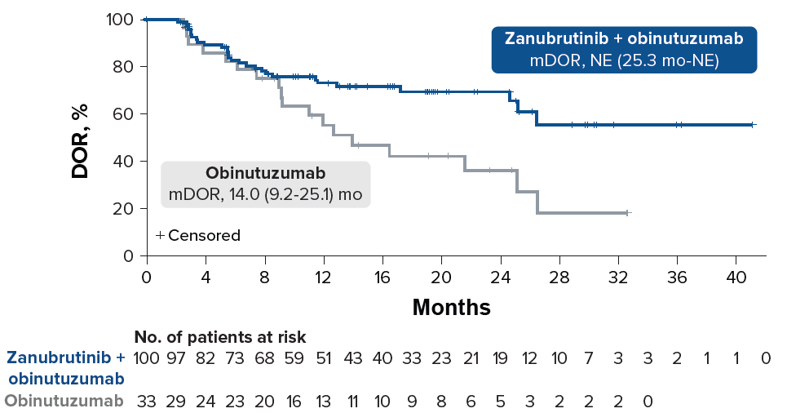
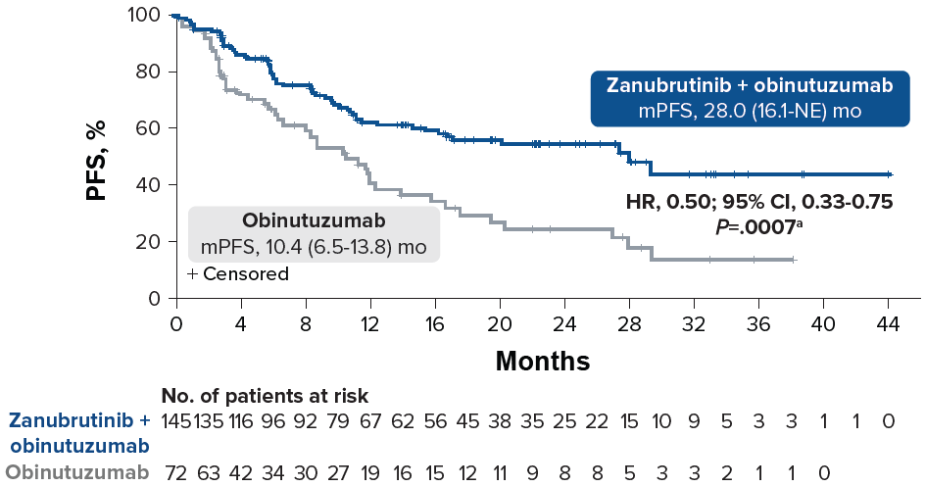
Obinutuzumab-Zanubrutinib: ROSEWOOD
Duration of Response
Progression-free Survival
Median duration of response by IRC was 14.0 months with obinutuzumab and was not reached in the zanubrutinib plus obinutuzumab arm
Median PFS was longer with zanubrutinib plus obinutuzumab vs obinutuzumab
DOR, duration of response; HR, hazard ratio; IRC, independent radiology committee; mDOR, median DOR; mPFS, median PFS; NE, not evaluable; PFS, progression-free survival.
Flowers C, et al. ASCO 2023. Abstract 7545.
Notes:
Flowers C, Zinzani PL, Mayer J, et al. Zanubrutinib plus obinutuzumab versus obinutuzumab in patients with relapsed/refractory follicular lymphoma: Updated analysis of the ROSEWOOD study. Abstract presented at: American Society of Clinical Oncology Annual Meeting; Chicago, Illinois; June 2-6, 2023. Abstract 7545.
ZO demonstrated meaningful activity and a manageable safety profile in pts with heavily pretreated R/R FL, representing a potential novel therapy. The median PFS was 28.0 mo (ZO) vs 10.4 mo (O) (hazard ratio [HR], 0.50 [95% CI: 0.33, 0.75]; P = 0.0007).

Slide 21
Bispecific Activity
Bispecific Antibody
CD20
receptor
CD3
receptor
Cytotoxic T cell
B cell
Notes:
EPKINLY™ (epcoritamab-bysp). Prescribing information. Genmab US; 2023.
Bispecific antibody that targets CD3/CD20
In vitro, epcoritamab activated T cells, caused the release of proinflammatory cytokines, and induced lysis of B cells

Slide 22
Bispecific Activity
Cytotoxic
granules
bispecific
CD20
receptor
CD3
receptor
Cytotoxic T cell
B cell
Notes:
EPKINLY™ (epcoritamab-bysp). Prescribing information. Genmab US; 2023.
Bispecific antibody that targets CD3/CD20
T-cell activation: In vitro, induces T-cell–mediated killing of CD20-expressing B cells.
Humanized IgG1-bispecific antibody: binds to the CD3 receptor expressed on the surface of T cells and CD20 expressed on the surface of B cells, including cancer cells.
CD20-expressing B cell: CD20 is expressed on the surface of lymphoma cells and healthy B‑lineage cells.

Slide 23
Bispecific Antibodies
Fab-arm, fragment antigen-binding region; Fc, fragment crystallizable; FcγR, Fc gamma receptor; Ig, immunoglobulin; mAb, monoclonal antibody; scFv, single-chain variable fragment.
1. Dufner V, et al. Blood Adv. 2019;3(16):2491-2498. 2. Goebeler ME, et al. J Clin Oncol. 2016;34(10):1104-1111. 3. Viardot A, et al. Blood. 2016;127(11):1410-1416. 4. Schuster SJ, et al. ASH 2019. Abstract 6. 5. Hutchings M, et al. ASH 2020. Abstract 403. 6. Bannerji R, et al. ASH 2020. Abstract 400. 7. Hutchings M, et al. ASH 2020. Abstract 402.
Notes:
1. Dufner V, Sayehli CM, Chatterjee M, et al. Long-term outcome of patients with relapsed/refractory B-cell non-Hodgkin lymphoma treated with blinatumomab. Blood Adv. 2019;3(16):2491-2498.
2. Goebeler ME, Knop S, Viardot A, et al. Bispecific T-cell engager (BiTE) antibody construct blinatumomab for the treatment of patients with relapsed/refractory non-Hodgkin lymphoma: final results from a phase I study. J Clin Oncol. 2016;34(10):1104-1111.
3. Viardot A, Goebeler ME, Hess G, et al. Phase 2 study of the bispecific T-cell engager (BiTE) antibody blinatumomab in relapsed/refractory diffuse large B-cell lymphoma. Blood. 2016;127(11):1410-1416.
4. Schuster SJ, Bartlett NL, Assouline S, et al. Mosunetuzumab induces complete remissions in poor prognosis non-Hodgkin lymphoma patients, including those who are resistant to or relapsing after chimeric antigen receptor T-cell (CAR-T) therapies, and is active in treatment through multiple lines. Abstract presented at: American Society of Hematology Annual Meeting; Orlando, Florida; December 7-10, 2019. Abstract 6.
5. Hutchings M, Carlo-Stella C, Bachyet E, et al. Glofitamab step-up dosing induces high response rates in patients with hard-to-treat refractory or relapsed non-Hodgkin lymphoma. Abstract presented at: American Society of Hematology Annual Meeting; December 5-8, 2020. Abstract 403.
6. Bannerji R, Allan JN, Arnason JE, et al. Odronextamab (REGN1979), a human CD20 x CD3 bispecific antibody, induces durable, complete responses in patients with highly refractory B-cell non-Hodgkin lymphoma, including patients refractory to CAR T therapy. Abstract presented at: American Society of Hematology Annual Meeting; December 5-8, 2020. Abstract 400.
7. Hutchings M, Mous R, Clausen MR, et al. Subcutaneous epcoritamab induces complete responses with an encouraging safety profile across relapsed/refractory B-cell non-Hodgkin lymphoma subtypes, including patients with prior CAR-T therapy: updated dose escalation data. Abstract presented at: American Society of Hematology Annual Meeting; December 5-8, 2020. Abstract 402.
Bispecific antibodies are modified immunoglobulin (Ig) molecules or their derivatives that can target not only a specific antigen of interest but also engage a host immune cell, such as T-cells (Radhakrishnan, 2024).
This dual targeting enables bispecific antibodies to trigger immune-mediated direct cell cytotoxicity or phagocytosis. By simultaneously binding to the target antigen on tumor cells and immune cells, bispecific antibodies facilitate the activation of the immune system, leading to cytotoxic effects against the targeted cells or their clearance through phagocytosis.
Immune cell engagement can occur both within and potentially outside the tumor. As a result of cytokine release in the local environment, an inflammatory milieu is triggered, which can have a bystander effect on the tumor microenvironment, in addition to inducing a systemic response.
This unique mechanism of action makes bispecific antibodies powerful tools in harnessing the immune response for targeted cancer therapy.
The manufacturing challenges and high cost of CAR T-cell therapy have made bispecific antibodies an attractive alternative, being more accessible as an off-the-shelf agent with clinically meaningful outcomes.
Several CD20 × CD3 bispecific antibodies that bind to CD20 of malignant cells have been developed for treating R/R FL, including epcoritamab, mosunetuzumab, glofitamab, and odronextamab (Abou Dalle, 2024).
Epcoritamab is a novel, subcutaneously administered, full-length, humanized IgG1 CD20 x CD3 bispecific antibody that redirects and activates T cells to kill CD20-expressing malignant cells.
The subcutaneous administration of epcoritamab provides a convenient alternative to intravenous therapies, making it an attractive option for long-term use.
Mosunetuzumab is an intravenously administered full-length, humanized, IgG1 bispecific antibody that targets CD20 on B-cells and CD3 on T-cells and was one of the first bispecific antibodies developed for R/R FL.
Glofitamab is an intravenously administered, full-length, humanized IgG CD20 x CD3 bispecific antibody that differs from other molecules in its structure, as it possesses two CD20 binding sites in a 2:1 format, which allows glofitumab to simultaneously engage two CD20 molecules on the tumor cell surface, resulting in an increased biological efficacy.
Odronextamab is an intravenously administered fully human bispecific antibody, unique in its IgG4 Fc portion, targeting CD20 and CD3 for the treatment of R/R FL.

Slide 24
Mosunetuzumab: GO29781
Mosunetuzumab:
CD20xCD3 bispecific antibody
Phase 2 multicenter trial of
SQ mosunetuzumab:
5 mg (C1D1),
45 mg (C1D8),
45 mg (C1D15),
45 mg D1 of subsequent 21-day cycles until EOT
C, cycle; D, day; EOT, end of trial; Fc, fragment crystallizable; CR, complete response; CRS, cytokine release syndrome; PR, partial response; Q3W, every 3 weeks;
SD, stable disease; SQ, subcutaneous.
Schuster SJ, et al. Blood. 2023;142(Supplement 1):603. Falchi L, et al. Blood. 2023;142(Supplement 1):604.
Notes:
Schuster SJ, Sehn LH, Bartlett NL, et al. Mosunetuzumab monotherapy continues to demonstrate durable responses in patients with relapsed and/or refractory follicular lymphoma after ≥2 prior therapies: 3-year follow-up from a pivotal phase II study. Blood. 2023;142(Supplement 1):603.
Falchi L, Okwali M, Ghione P, et al. Subcutaneous (SC) mosunetuzumab (mosun) as first-line therapy for patients (pts) with high tumor-burden follicular lymphoma (FL): first results of a multicenter phase 2 study. Blood. 2023;142(Supplement 1):604.
In a pivotal Phase II study (NCT02500407), mosunetuzumab demonstrated a high complete response (CR) rate with a manageable safety profile in patients with relapsed/refractory (R/R) follicular lymphoma (FL) and ≥2 prior lines of therapy (Budde et al. Lancet Oncol 2022). Mosunetuzumab is a fixed-duration treatment that can be administered in an outpatient setting. Here, we present updated data for patients with R/R FL and ≥2 prior lines of therapy, after 3 years of follow-up.
Eligible patients with R/R FL Grade (Gr) 1-3a and ≥2 prior therapies received intravenous mosunetuzumab in 21-day cycles with step-up dosing in Cycle (C) 1 (C1 Day [D] 1, 1mg; C1D8, 2mg; C1D15/C2D1, 60mg; C3D1 and onwards, 30mg). Hospitalization for treatment was not required. Patients achieving a CR by C8 completed treatment without additional cycles; patients with a partial response or stable disease received a total of 17 cycles. The primary endpoint was CR rate as determined by an Independent Review Committee (as best response; Cheson 2007 criteria).
Mosunetuzumab is also being studied as SQ to increase administration efficiency and convenience.

Slide 25
Mosunetuzumab
Patient disposition and exposure
 | N=90
Median time on study, months (range) | 28.3 (2-38)
Patients remaining in follow-up | 81%
Initial study treatment Completed Discontinued Due to progressive disease | 62% 38% 27%
Retreatment with mosunetuzumab | 4%
 | N=90
Number of cycles received <8 cycles 8 cycles >8 and <17 cycles 17 cycles | 23% 59% 6% 12%
Bartlett NL, et al. ASH 2022. Abstract 610.
Notes:
Bartlett NL, Sehn LH, Matasar MJ, et al. Mosunetuzumab monotherapy demonstrates durable efficacy with a manageable safety profile in patients with relapsed/refractory follicular lymphoma who received ≥2 prior therapies: updated results from a pivotal phase II study. Abstract presented at: American Society of Hematology Annual Meeting; New Orleans, Louisiana; December 10-13, 2022. Abstract 610.

Slide 26
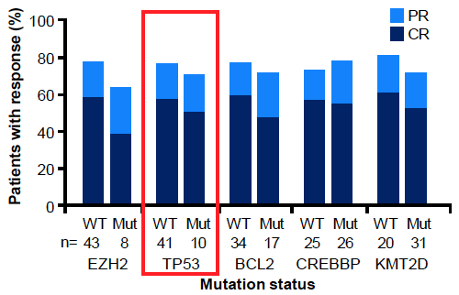
Mosunetuzumab Response
Response rates
Efficacy endpoint in the overall population by investigator assessment | N=90
ORR, % (95% CI) | 78% (68-86)
CR, % (95% CI) | 60% (49-70)
Median time to first response, months (range) | 1.4 months (1.0–11)
Median time to first CR, months (range) | 3.0 months (1.0–19)
High ORR and CR rate were consistent with published results¹
Response by mutation status
Notes:
Bartlett NL, Sehn LH, Matasar MJ, et al. Mosunetuzumab monotherapy demonstrates durable efficacy with a manageable safety profile in patients with relapsed/refractory follicular lymphoma who received ≥2 prior therapies: updated results from a pivotal phase II study. Abstract presented at: American Society of Hematology Annual Meeting; New Orleans, Louisiana; December 10-13, 2022. Abstract 610.
Budde LE, Sehn LH, Matasar M, et al. Safety and efficacy of mosunetuzumab, a bispecific antibody, in patients with relapsed or refractory follicular lymphoma: a single-arm, multicentre, phase 2 study. Lancet Oncol. 2022;23(8):1055-1065.
In all 90 pts, investigator (INV)-assessed objective response rate (ORR) and CR rate were 77.8% (95% CI: 67.8-85.9) and 60.0% (95% CI: 49.1-70.2), respectively. Compared with patients’ last prior therapy, mosunutuzumab demonstrated higher ORR and CR rates, with longer DOR, DOCR, PFS and time to next therapy.

Slide 27
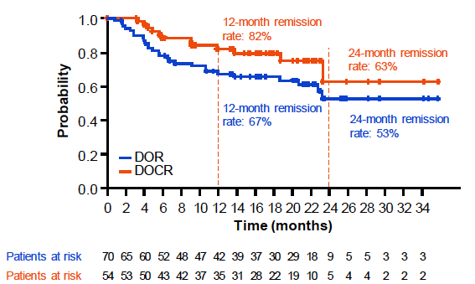
Mosunetuzumab Response
Durability of responses
Efficacy endpoint by investigator assessment | N=90
Median DOR, months (range), n=70 24-month DOR (95% CI) | NR (21-NR) 53% (38–68)
Median DOCR, months (range), n=54 24-month DOCR (95% CI) | NR (21-NR) 63% (38–88)
Median PFS, months (range) 24-month PFS (95% CI) | NR (21-NR) 48% (36–60)
Median TTNT, months (range) 24-month TTNT (95% CI) | NR (21-NR) 56% (45–67)
Median OS, months (range) 24-month OS (95% CI) | NR (21-NR) 87% (80–94)
DOR and DOCR
Durable responses: majority of patients in remission after 2 years
Notes:
Bartlett NL, Sehn LH, Matasar MJ, et al. Mosunetuzumab monotherapy demonstrates durable efficacy with a manageable safety profile in patients with relapsed/refractory follicular lymphoma who received ≥2 prior therapies: updated results from a pivotal phase II study. Abstract presented at: American Society of Hematology Annual Meeting; New Orleans, Louisiana; December 10-13, 2022. Abstract 610.
Median duration of response (DOR) and duration of CR (DOCR) were not reached (NR). Response rates, PFS, DOR, DOCR and time to next therapy or death were all improved with mosunutuzumab compared with last prior therapy.

Slide 28
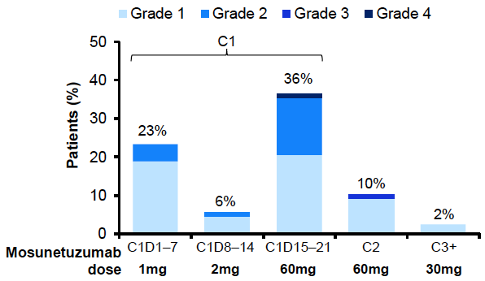
Mosunetuzumab Safety
Safety profile
CRS summary
Adverse events (AEs) | N=90
AE Mosunetuzumab related | 100% 92%
Grade 3/4 AE Mosunetuzumab related | 70% 51%
Serious AE Mosunetuzumab related | 47% 33%
Grade 5 (fatal) AE Mosunetuzumab related | 2% 0
AE leading to treatment discontinuation Mosunetuzumab related | 4% 2%
CRS by ASTCT criteria | N=90
CRS (any grade) Grade 1 Grade 2 Grade 3 Grade 4 | 44% 26% 17% 1% 1%
Median time to CRS onset, hours (range) C1D1 C1D15 | 5.2 (1.2–2.4) 27 (0.1–391)
Median CRS duration, days (range) | 3 (1–29)
Corticosteroids for CRS management | 11%
Tocilizumab for CRS management | 8%
Events resolved | 100%
CRS by cycle and grade
CRS was predominantly low grade and during Cycle 1 All CRS events resolved; no new events were reported with 10 months of additional follow-up
Notes:
Bartlett NL, Sehn LH, Matasar MJ, et al. Mosunetuzumab monotherapy demonstrates durable efficacy with a manageable safety profile in patients with relapsed/refractory follicular lymphoma who received ≥2 prior therapies: updated results from a pivotal phase II study. Abstract presented at: American Society of Hematology Annual Meeting; New Orleans, Louisiana; December 10-13, 2022. Abstract 610.
No new CRS events, or fatal, serious, or gr ≥3 adverse events (AEs) were reported since the previous analysis, and no evidence of chronic toxicity was observed. Overall, the rate of AEs leading to discontinuation was low (4.4%).

Slide 29
Mosunetuzumab FDA Approval
On December 22, 2022, the FDA granted accelerated approval to mosunetuzumab-axgb, a bispecific CD20-directed CD3 T-cell engager for adult patients with relapsed or refractory follicular lymphoma after 2 or more lines of systemic therapy
Mosunetuzumab-axgb was evaluated in GO29781, an open-label, multicenter, multi-cohort study
The efficacy population consisted of 90 patients with relapsed or refractory follicular lymphoma who had received at least 2 prior lines of systemic therapy, including an anti-CD20 monoclonal antibody and an alkylating agent
The prescribing information has a Boxed Warning for serious or life-threatening cytokine release syndrome
Warnings and precautions include neurologic toxicity, infections, cytopenias, and tumor flare
FDA, US Food and Drug Administration.
FDA.gov. https://www.fda.gov/drugs/resources-information-approved-drugs/fda-grants-accelerated-approval-mosunetuzumab-axgb-relapsed-or-refractory-follicular-lymphoma
Notes:
FDA.gov. FDA grants accelerated approval to mosunetuzumab-axgb for relapsed or refractory follicular lymphoma. Published December 22, 2022. https://www.fda.gov/drugs/resources-information-approved-drugs/fda-grants-accelerated-approval-mosunetuzumab-axgb-relapsed-or-refractory-follicular-lymphoma

Slide 30
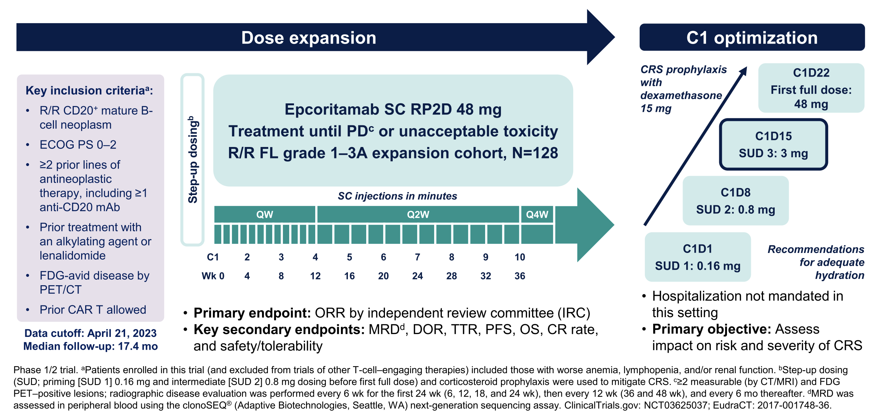
Epcoritamab: EPCORE NHL-1
C, cycle; CAR T, chimeric antigen receptor T cells; CR, complete response; CRS, cytokine release syndrome; CT, computed tomography; D, day; DOR, duration of response; ECOG PS, Eastern Cooperative Oncology Group performance status; FDG, fluorodeoxyglucose; FL, follicular lymphoma; mAb, monoclonal antibody; MRD, minimal residual disease; NHL, non-Hodgkin lymphoma; ORR, overall response rate; OS, overall survival; PET, positron emission tomography; PD, progressive disease; PFS, progression-free survival; QW, once weekly; Q2W, every 2 weeks; Q4W, every 4 weeks; R/R, relapsed/refractory; RP2D, recommended phase II dose; SC, subcutaneous; SUD, step-up dose; TTR, time to relapse; wk, week.
Linton KM, et al. Trans Cell Ther. 2024;30(2):S33-S34.
Notes:
Linton KM, Jurczak W, Lugtenburg PJ, et al. Deep and durable responses with epcoritamab sc monotherapy in patients with relapsed or refractory follicular lymphoma: data from the EPCORE NHL-1 follicular lymphoma dose-expansion cohort. Trans Cell Ther. 2024;30(2):S33-S34.
Pts with CD20+ R/R FL (grade [G] 1–3A) with ≥2 prior systemic tx lines received epcoritamab SC in 2 step-up doses in cycle (C) 1, followed by full 48-mg doses in 28-d Cs: QW, C1–3; Q2W, C4–9; and Q4W, C≥10 until disease progression or unacceptable toxicity. The primary endpoint was overall response rate (ORR) assessed per Lugano criteria by IRC.
The recommended regimen consists of epcoritamab-bysp administered subcutaneously in 28-day cycles until disease progression or unacceptable toxicity. The recommended dose is a 3 step-up dosage schedule in Cycle 1 (0.16 mg on Day 1, 0.8 mg on Day 8, 3 mg on Day 15, and 48 mg on Day 22), Cycle 2 and 3 (48 mg on Days 1, 8, 15, and 22), Cycles 4 to 9 (48 mg on Days 1 and 15), and Cycle 10 and beyond (48 mg on Day 1).

Slide 31
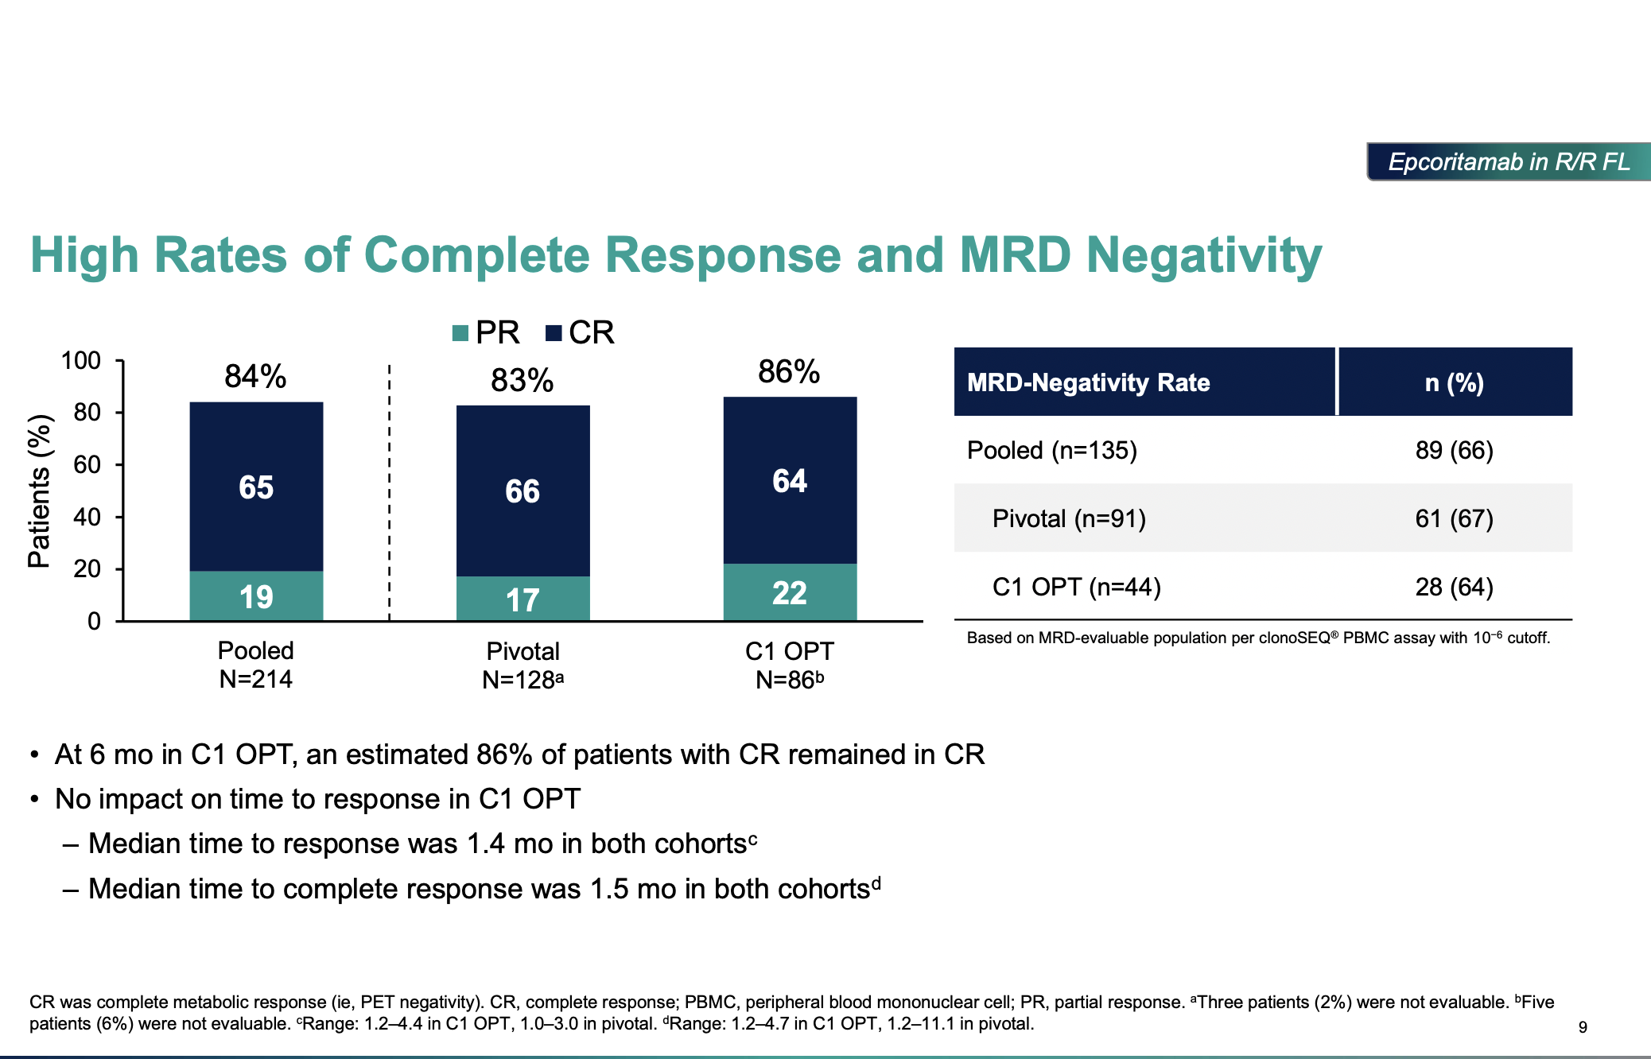
Epcoritamab Response
High Rates of Complete Response and MRD Negativity
At 6 months in C1 OPT, an estimated 86% of patients with CR remained in CR
No impact on time to response in C1 OPT
  Median time to response was 1.4 months in both cohorts^{c}
  Median time to complete response was 1.5 months in both cohorts^{d}
CR was complete metabolic response (ie, PET negativity).
ªThree patients (2%) were not evaluable. ^{b}Five patients (6%) were not evaluable. ^{c}Range: 1.2-4.4 in C1 OPTS, 1.0-3.0 in pivotal. ^{d}Range: 1.2-4.7 in C1 OPT, 1.2-11.1 in pivotal.
C, cycle; CR, complete response; MRD, minimal residual disease; OPT, optimization; PBMC, peripheral blood mononuclear cell; PR, partial response.
Linton K, et al. ASH 2023. Abstract 1655.
Notes:
Linton K, Jurczak W, Lugtenburg P, et al. Epcoritamab SC monotherapy leads to deep and durable responses in patients with relapsed or refractory follicular lymphoma: first data disclosure from the EPCORE NHL-1 follicular lymphoma dose-expansion cohort. Abstract presented at: American Society of Hematology Annual Meeting; San Diego, California; December 9-12, 2023. Abstract 1655.
In hard-to-treat, high-risk pts with R/R FL, epcoritamab SC monotherapy resulted in deep, durable responses with a manageable safety profile. Median time to response/CR was 1.4/1.5 mo. Median progression-free survival (PFS) was 15.4 mo; median duration of response, duration of CR, and overall survival were not reached.

Slide 32
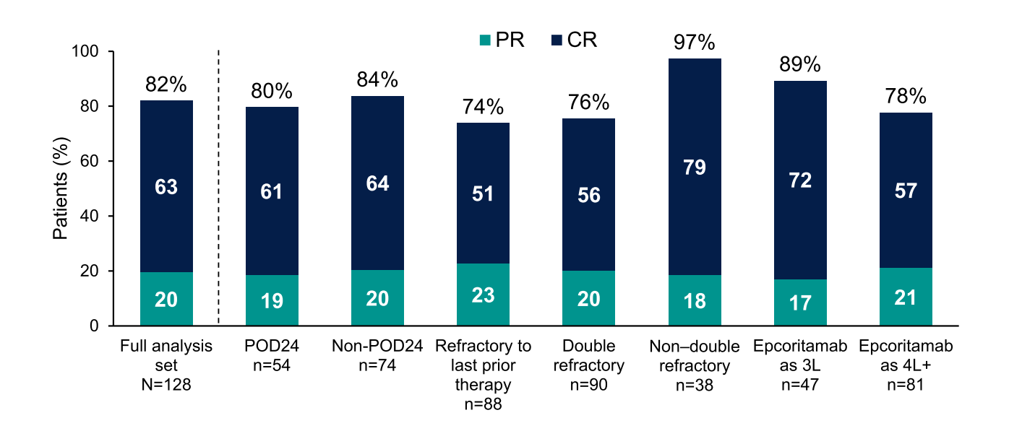
Epcoritamab Detailed Response
ORRs and CR Rates Were High Regardless of Subgroup
CR, complete response; ORR, overall response rate; POD24, progression of disease within 2 years; PR, partial response; 3L, third-line; 4L, fourth-line.
Linton K, et al. ASH 2023. Abstract 1655.
Notes:
Linton K, Jurczak W, Lugtenburg P, et al. Epcoritamab SC monotherapy leads to deep and durable responses in patients with relapsed or refractory follicular lymphoma: first data disclosure from the EPCORE NHL-1 follicular lymphoma dose-expansion cohort. Abstract presented at: American Society of Hematology Annual Meeting; San Diego, California; December 9-12, 2023. Abstract 1655.
ORRs/CR rates were consistently high across prespecified subgroups: double refractory, 76%/56%; refractory to last prior tx, 74%/51%; POD24, 80%/61%; progression within 2 y of initiating any 1L tx, 79%/64%.

Slide 33
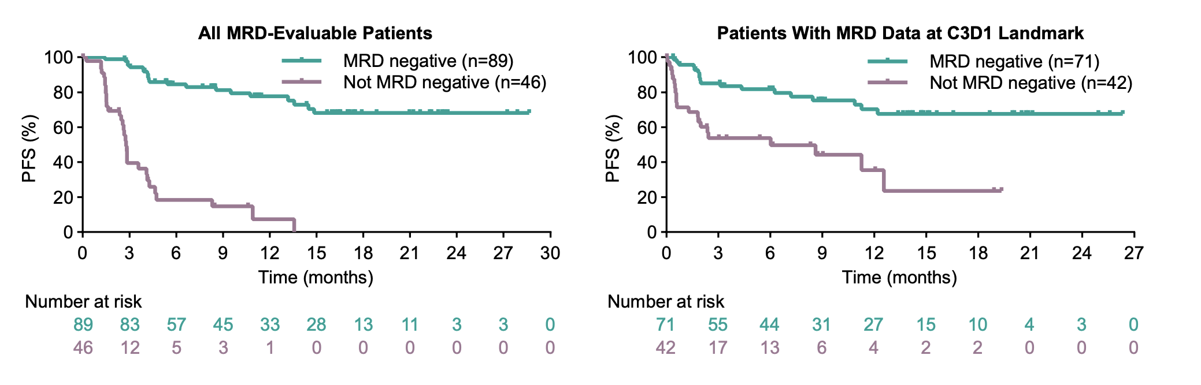
Epcoritamab Response
MRD Negativity (Overall and at C3D1) Associated With Favorable PFS
PFS assessed by investigator, MRD based on PBMC assay with 10⁻⁶ cutoff. MRD negative was defined as having MRD negativity at any time point.
C, cycle; D, day; MRD, minimal residual disease; PFS, progression-free survival.
Linton K, et al. ASH 2023. Abstract 1655.
Notes:
Linton K, Jurczak W, Lugtenburg P, et al. Epcoritamab SC monotherapy leads to deep and durable responses in patients with relapsed or refractory follicular lymphoma: first data disclosure from the EPCORE NHL-1 follicular lymphoma dose-expansion cohort. Abstract presented at: American Society of Hematology Annual Meeting; San Diego, California; December 9-12, 2023. Abstract 1655.
MRD negativity was correlated with improved PFS.

Slide 34
Epcoritamab Safety
C1 Optimization Reduced Risk and Severity of CRS
 | Pivotal Cohort N=128 | C1 Optimization Cohortª N=50
CRS, n (%)^{b} Grade 1 Grade 2 Grade 3 | 85 (66) 51 (40) 32 (25) 2 (2) | 24 (48) 20 (40) 4 (8) 0
Treated with tocilizumab, n/n (%) | 31/85 (36) | 6/24 (25)
Leading to epcoritamab discontinuation, n (%) | 0 | 0
CRS resolution, n/n (%) | 85/85 (100) | 24/24 (100)
Median time to resolution, d (range) | 2 (1–54) | 3 (1–14)
Patient baseline characteristics were consistent between cohorts
C1 optimization substantially reduced rate and severity of CRS
In both cohorts, CRS was mostly confined to C1
Similar response rates were observed in the C1 optimization cohort
There were no cases of ICANS in the C1 optimization cohort; 8 cases were observed in the pivotal cohort (all grade 1–2 and resolved; none led to discontinuation)
ªData cutoff: September 21, 2023. Median follow-up: 3.8 mo (range, 1.9-8.7). ^{b}Graded by Lee et al 2019 criteria.¹
C, cycle; CRS, cytokine release syndrome; D, day; ICANS, immune effector cell-associated neurotoxicity syndrome.
Linton K, et al. ASH 2023. Abstract 1655.
1. Lee DW, et al. Biol Blood Marrow Transplant. 2019;25:625-638.
Notes:
Linton K, Jurczak W, Lugtenburg P, et al. Epcoritamab SC monotherapy leads to deep and durable responses in patients with relapsed or refractory follicular lymphoma: first data disclosure from the EPCORE NHL-1 follicular lymphoma dose-expansion cohort. Abstract presented at: American Society of Hematology Annual Meeting; San Diego, California; December 9-12, 2023. Abstract 1655.
Lee DW, Santomasso BD, Locke FL, et al. ASTCT Consensus Grading for Cytokine Release Syndrome and Neurologic Toxicity Associated with Immune Effector Cells. Biol Blood Marrow Transplant. 2019;25(4):625-638.
The most common any-grade tx-emergent AEs (TEAEs) were CRS (66%), injection-site reaction (57%), COVID-19 (40%), and fatigue (30%). CRS was mostly low grade (40% G1, 25% G2, 2% G3), primarily occurred following the first full dose (median time to onset after first full dose, 15 h), and did not lead to tx discontinuation. There was clinically meaningful reduction in CRS incidence and severity in a separate R/R FL cohort evaluating an optimized SUD regimen in C1.

Slide 35
Epcoritamab FDA Approval
On June 26, 2024, the FDA granted accelerated approval to epcoritamab-bysp, a bispecific CD20-directed CD3 T-cell engager, for adult patients with relapsed or refractory follicular lymphoma (FL) after two or more lines of systemic therapy
Efficacy and safety were evaluated in EPCORE NHL-1, an open-label, multi-cohort, multicenter, single-arm trial that included 127 patients with relapsed or refractory FL after at least 2 lines of systemic therapy
The primary efficacy and safety were based on 127 patients who received a 2 step-up dosing regimen. A separate dose optimization cohort of 86 patients evaluated the recommended 3-step up dosage schedule for cytokine release syndrome (CRS) mitigation
The prescribing information includes a Boxed Warning for serious or fatal cytokine release syndrome (CRS) and immune effector cell-associated neurotoxicity (ICANS)
Warnings and Precautions include serious infections and cytopenias
FDA, US Food and Drug Administration.
FDA.gov. https://www.fda.gov/drugs/resources-information-approved-drugs/fda-grants-accelerated-approval-epcoritamab-bysp-relapsed-or-refractory-follicular-lymphoma
Notes:
FDA.gov. FDA grants accelerated approval to epcoritamab-bysp for relapsed or refractory follicular lymphoma. Published June 26, 2024. https://www.fda.gov/drugs/resources-information-approved-drugs/fda-grants-accelerated-approval-epcoritamab-bysp-relapsed-or-refractory-follicular-lymphoma

Slide 36
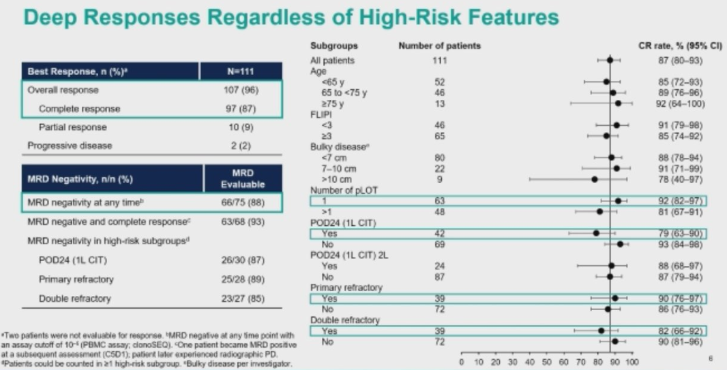
Epcoritamab: EPCORE NHL-2
Fixed-duration epcoritamab plus lenalidomide + rituximab (R2) in adult patients with R/R FL
Among 111 patients with a median follow-up of over two years, ORR was 96%, and CR rate was 87%
MRD analysis from blood samples showed that 88% of patients were MRD negative, indicating no detectable disease at 10-6 threshold
The FDA recently granted BTD for epcoritamab plus R2 for the treatment of adult patients with R/R FL who have received at least one prior line of therapy
Epcoritamab in combination with R2 vs R2 in R/R FL is being studied further in the ongoing, randomized, Phase 3 EPCORE FL-1 trial (NCT05409066)
Deep Responses Regardless of High-Risk Features
Notes:
Falchi L, Balari AS, Leppä S, et al. Fixed-duration epcoritamab + R² drives deep and durable responses in patients with relapsed or refractory follicular lymphoma: 2-year follow-up from arm 2 of the Epcore NHL-2 trial. Abstract presented at: American Society of Hematology Annual Meeting; San Diego, California; December 7-10, 2024. Abstract 342.
Soong D, Altıntaş I, Karavitis J, et al. Abstract 5071: Minimal residual disease (MRD) status by peripheral blood mononuclear cells (PBMCs) and circulating tumor DNA (ctDNA) demonstrates rapid, deep, and sustained response in patients (Pts) with relapsed/refractory follicular lymphoma (R/R FL) treated with subcutaneous (SC) epcoritamab monotherapy in the pivotal phase 1/2 EPCORE™ NHL-1 trial. Cancer Res. 2024;84(6_Supplement):5071.
Abbvie. Investigational Epcoritamab (DuoBody® CD3xCD20) Combination Therapy Shows High Response Rates in Clinical Trial of Patients With Relapsed or Refractory (R/R) Follicular Lymphoma (FL). Press release. December 7, 2024. https://news.abbvie.com/2024-12-07-Investigational-Epcoritamab-DuoBody-R-CD3xCD20-Combination-Therapy-Shows-High-Response-Rates-in-Clinical-Trial-of-Patients-With-Relapsed-or-Refractory-R-R-Follicular-Lymphoma-FL

Slide 37
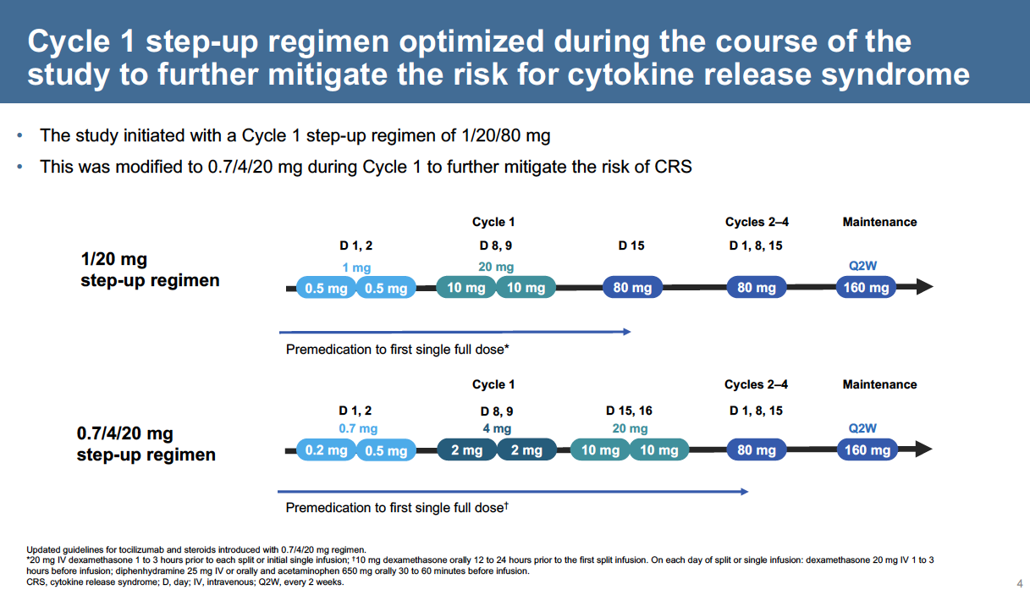
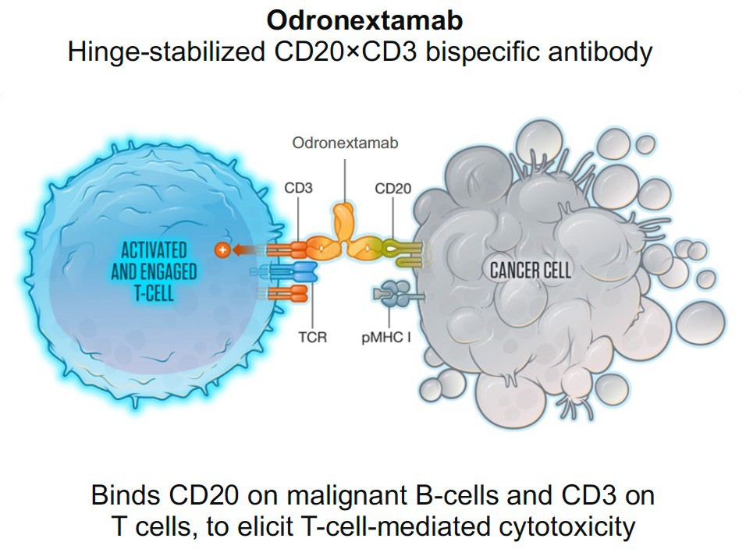
Odronextamab: ELM-2
Updated guidelines for tocilizumab and steroids introduced with 0.7/4/20 mg regimen.
*20 mg IV dexamethasone 1 to 3 hours prior to each split or initial single infusion; †10 mg dexamethasone orally 12 to 24 hours prior to the first split infusion. On each day of split or single infusion: dexamethasone 20 mg IV 1 to 3 hours before infusion; diphenhydramine 25 mg IV or orally and acetaminophen 650 mg orally 30 to 60 minutes before infusion.
CRS, cytokine release syndrome; D, day; FL, follicular lymphoma; IV, intravenous; pMHC-1, peptide major histocompatibility complex-1; Q2W, every 2 weeks; TCR, T-cell receptor.
Kim TM, et al. Blood. 2022;140(1):2280-2282. Kim TM, et al. Ann Oncol. 2024;35(11):1039-1047. Chong G, et al. Cancer Res. 2024;84(7_Suppl):CT243.
Notes:
Kim TM, Taszner M, Cho SG, et al. Odronextamab in patients with relapsed/refractory (R/R) follicular lymphoma (FL) grade 1-3a: results from a prespecified analysis of the pivotal phase II study ELM-2. Blood. 2022;140(1):2280-2282.
Kim TM, Taszner M, Novelli S, et al; ELM-2 Investigators. Safety and efficacy of odronextamab in patients with relapsed or refractory follicular lymphoma. Ann Oncol. 2024;35(11):1039-1047.
Chong G, Taszner M, Novelli S, et al. Abstract CT243: Primary analysis of the Phase 2 ELM-2 study: Odronextamab in patients (pts) with relapsed/refractory follicular lymphoma (R/R FL). Cancer Res. 2024;84(7_Suppl):CT243.
Analysis of odronextamab in R/R FL in the ELM-2 trial. IV odronextamab was administered in 21-day cycles (C) until disease progression/unacceptable toxicity. Steroid prophylaxis and step-up dosing (0.7/4/20 mg) were used in C1 to mitigate the risk of cytokine release syndrome (CRS), followed by 80 mg on Days (D) 1, 8, and 15 of C2-4. Maintenance dosing continued at 160 mg Q2W, or Q4W if complete response (CR) was durable for 9 months (mo). Primary endpoint was objective response rate (ORR) per Lugano criteria by independent central review (ICR).

Slide 38
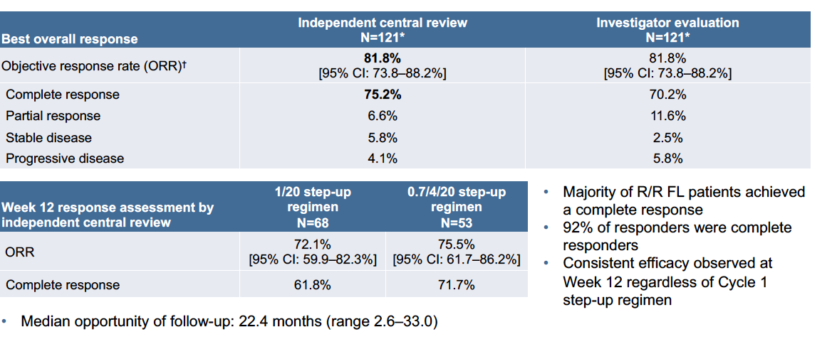
Odronextamab Response
FL, follicular lymphoma; R/R, relapsed/refractory.
Kim TM, et al. Blood. 2022;140(1):2280-2282.
Notes:
Kim TM, Taszner M, Cho SG, et al. Odronextamab in patients with relapsed/refractory (R/R) follicular lymphoma (FL) grade 1-3a: results from a prespecified analysis of the pivotal phase II study ELM-2. Blood. 2022;140(1):2280-2282.
ORR and CR rate by ICR were 81% (69/85) and 75% (64/85), respectively. ORR and CR rate were consistent across high-risk subgroups, including pts aged ≥65 y, POD24, FLIPI 3-5, and pts refractory to their last line of therapy; ORR and CR rate were also consistent for the subgroup of pts treated with the 0.7/4/20 step-up regimen.

Slide 39
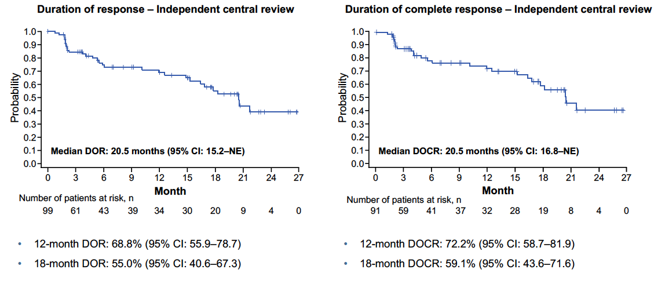
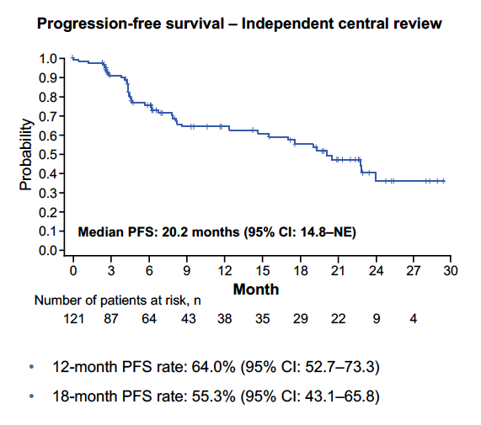
Odronextamab Response
Data cut-off date: Sep 15, 2022.
DOCR, duration of complete response; DOR, duration of response; NE, not evaluable; PFS, progression-free survival.
Kim TM, et al. Blood. 2022;140(1):2280-2282.
Notes:
Kim TM, Taszner M, Cho SG, et al. Odronextamab in patients with relapsed/refractory (R/R) follicular lymphoma (FL) grade 1-3a: results from a prespecified analysis of the pivotal phase II study ELM-2. Blood. 2022;140(1):2280-2282.
Responses were durable. Median PFS was 20.2 mos (95% CI 14.8-not estimable [NE]) and median OS was not reached (95% CI 23.0 mos-NE).

Slide 40
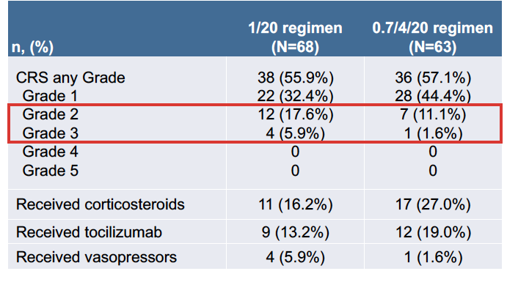
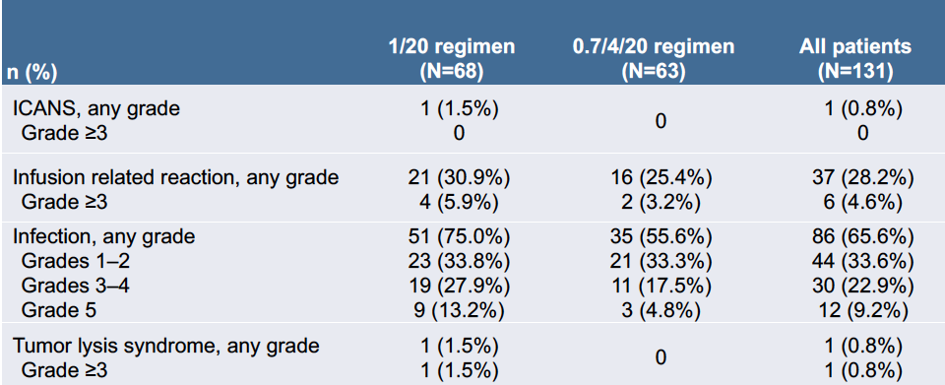
Odronextamab Safety
0.7/4/20 mg step-up regimen reduced the incidence of grade 2 and grade 3 CRS
Approximately half of patients with R/R FL had CRS, mostly grade 1
Only 1 case of grade 3 CRS with 0.7/4/20 mg step-up regimen and no grade 4 or higher CRS events
All CRS events resolved with a median time to resolution of 2 days (range 1–51)
No patients required mechanical ventilation or ICU admission for the management of CRS
Data cut-off date: Sep 15, 2022. CRS per Lee 2019.
CRS, cytokine release syndrome; FL, follicular lymphoma; ICANS, immune effector cell-associated neurotoxicity syndrome; ICU, intensive care unit; R/R, relapsed/refractory.
Kim TM, et al. Blood. 2022;140(1):2280-2282.
Notes:
Kim TM, Taszner M, Cho SG, et al. Odronextamab in patients with relapsed/refractory (R/R) follicular lymphoma (FL) grade 1-3a: results from a prespecified analysis of the pivotal phase II study ELM-2. Blood. 2022;140(1):2280-2282.
Following implementation of the 0.7/4/20 step-up regimen in C1, no Grade ≥2 CRS was observed; only Grade 1 CRS was reported in 39% of pts. All CRS events resolved and only 1 pt received tocilizumab for CRS management. No ICANS was reported in the 0.7/4/20 regimen compared with 3% in the 1/20 regimen. COVID-19 was reported (n=13,14%), including Grade ≥3 (n=5, 5%). Treatment-related Grade 5 AEs were reported for 2 pts; treatment-related AEs led to discontinuation in 6 pts.

Slide 41
Summary of Response FL
Drug | N | ORR | CR | PFS 36 m | OS 36 m | mOS
Mosunetuzumab | 90 | 78% | 60% | 43.2% | 82.4% | NR
Epcoritamab | 128 | 82% | 63% | 49.4%* | 70.2%* | N/A
Odronextamab | 121 | 81.8% | 75.2% | 55.3%* | 70.1%^{24m} | NR
Drug | DOR 12 m | DOCR 12 m | DOR 30 m | DOCR 30 m | mDOR | mDOCR
Mosunetuzumab | 67% | 82% | 56.6%* | 72.4% | 35.9 m | NR
Eporitamab | 58.4%* | 72.2% | N/A | N/A | NR | N/A
Odronextamab | 68.8% | 75% | 55%* | 59.1%* | 22.6 m† | 25.1 m†
*18 months
†20.1 months
CR, complete response; DOCR, duration of complete response; DOR, duration of response; FL, follicular lymphoma; m, months; mDOCR, median DOCR; mDOR, median DOR;
mOS, median OS; NR, not reached; ORR, overall response rate; OS, overall survival; PFS, progression-free survival.
1. Sehn LH,, et al. Blood. 2025;145(7):708-719. 2. Linton KM, et al. Lancet Haematol. 2024;11(8):e593-e605. 3. Kim TM, et al; ELM-2 Investigators. Ann Oncol. 2024;35(11):1039-1047.
Notes:
1. Sehn LH, Bartlett NL, Matasar MJ, et al. Long-term 3-year follow-up of mosunetuzumab in relapsed or refractory follicular lymphoma after ≥2 prior therapies. Blood. 2025;145(7):708-719.
2. Linton KM, Vitolo U, Jurczak W, et al. Epcoritamab monotherapy in patients with relapsed or refractory follicular lymphoma (EPCORE NHL-1): a phase 2 cohort of a single-arm, multicentre study. Lancet Haematol. 2024;11(8):e593-e605.
3. Kim TM, Taszner M, Novelli S, et al; ELM-2 Investigators. Safety and efficacy of odronextamab in patients with relapsed or refractory follicular lymphoma. Ann Oncol. 2024;35(11):1039-1047.
Summarizing what we have with follicular lymphoma, there is equivalency for the most part, with the overall response rate, complete response rate, and the progression-free survival of all three of these bispecific antibodies that targets CD3/CD20. Mosunetuzumab and epcoritamab are FDA-approved, and odronextamab is being evaluated for FDA approval, thus cementing the sort of efficacy of these bispecific antibodies in patients with relapsed/refractory follicular lymphoma, even as single agents.

Slide 42
Practical Considerations in the Application of Bispecific Antibody Therapy in R/R FL

Slide 43
Who is the Right Patient for a Bispecific Antibody?
Patient Selection, Multidisciplinary
Treatment Plans, and Sequencing Implications

Slide 44
When to Consider Bispecific Over Other Treatments: Patient Selection
Benefits
For now, limited to 3L+
Improved ORR, DOR, PFS vs. non-CAR T options
  Tazemetostat
  Obinutuzmab-zanubrutinib
Safety
  After completion of SUD, tolerability compares very favorably w/ other agents except for tazemetostat
Finite therapy
  Mosunetuzumab offers finite therapy which isn’t an option w/ non-CAR T options
Administration convenience
  Subcutaneous administration of epcoritamab provides a convenient alternative to intravenous therapies
  Subcutaneous administration of monsunetuzumab is being studied
3L, third line; CAR T, chimeric antigen receptor T cells; DOR, duration of response; ORR, overall response rate; PFS, progression-free survival; SUD, step-up dosing.
Notes:
For now, these drugs are limited to third-line and beyond. And so the benefits we have here, they have an improved overall response rate, duration of response, and progression-free survival versus non-CAR-T options, which include tazemetostat, and obinutuzumab-zanubrutinib. And specifically with mosunetuzumab, that is a finite treatment option, meaning that treatment will stop, as compared to these other options, which are given to progression or intolerance. Safety with these agents, after completion of step-up dosing, the tolerability of bispecific antibodies compares very favorably with other agents, except for possibly tazemetostat, which has a very safe and sort of patient-friendly patient profile. If we look at administrative convenience, we have subcutaneous options with epcoritamab and potentially in the future, mosunetuzumab, as well as the IV options with mosunetuzumab currently and if odronextamab gets an approval.

Slide 45
When to Consider Bispecific Over Other Treatments: Patient Selection
Limitations
Although risk of serious CRS/ICANS is low, some management structure is still required to address these side effects
  Champion to guide team
  SOP would be beneficial
  Tocilizumab needs to be on formulary
Risk of viral infections
Comfort
  Limited experience of some providers…learning curve
CRS, cytokine release syndrome; ICANS, immune effector cell-associated neurotoxicity syndrome; SOP, standard operating procedure.
Notes:
There are also some limitations. The risk of CRS and ICANS was low, but they still require some sort of structure to be in place to help manage those who might have this event. It's not a zero-sum situation, even with these optimizations that we've implemented. There needs to be some sort of plan in place when things do go bad. Typically, we'll have a champion to guide a team of support staff, whether that's a physician or nurse, to help sort of coordinate with the other team. A standard operating procedure would be beneficial for most academic centers or clinical facilities to help manage these patients. Tocilizumab needs to be sort of accessible in case patients do have grade 2 and beyond CRS, as you do a sort of mitigation of this will be very important to prevent any sort of severe adverse events. Outside of that, there's risk of viral infections with bispecific antibodies. So, monitoring IgG levels is important, and sometimes supplementation on IVIG is needed. And then as far as comfort, there is limited experience of some providers with bispecifics so there will be a learning curve not too dissimilar from what we saw with the introduction of monoclonal antibodies, and some of these other agents, such as venetoclax, into the community setting.

Slide 46
Considerations in Choosing Between Bispecifics and CAR T-Cells in FL
CAR T-cells | Mosunetuzumab/Epcoritamab
Excellent efficacy with longer follow up | Excellent efficacy, but with shorter follow up
Requires 3-4 weeks of manufacturing | Off-the-shelf
Logistically more complex | Logistically less complex
“One and done” for life at this time | 8-17 cycles (can be repeated [mosunetuzumab only])
Needs lymphodepleting chemotherapy | No lymphodepleting chemotherapy
Higher risk of CRS and neurotoxicity | Lower risk of CRS and neurotoxicity
Usually inpatient | Usually outpatient
They are not mutually exclusive, though we do not have data on optimal sequencing
Decision will be personalized for most patients between bispecifics and CAR T-cells
CAR T-cells for those with concern of tDLBCL
CAR, chimeric antigen receptor; CRS, cytokine release syndrome; FL, follicular lymphoma; tDLBCL, transformed diffuse large B-cell lymphoma.
Notes:
When comparing CAR T-cell therapy and a bispecific in this space, the agents are very similar. The benefits to bispecifics include excellent efficacy, shorter follow-up, they are off the shelf, logistically less complex than what we need with CAR T-cell therapy. With mosunetuzumab, you do have a one and done therapy. Epcoritamab, as of right now, as a treat to progression, but there are some studies evaluating limited therapy. You don't require lymphodepleting chemotherapy, lower risk of CRS and neurotoxicity, usually outpatient, and likely to be less cumbersome and burdensome to a hospital system due to less cost over time, especially for the finite treatment options.

Slide 47
Administration Considerations:
Bispecific Antibodies and CAR T-Cell Therapy
 | Form of Delivery | Dosing | Time to Initiation | Hospitalization Required
Bispecific Antibody
Mosunetuzumab | IV infusion | Step-up dosing, 21-day cycles for 8 cycles unless patients experience unacceptable toxicity or disease progression | Off-the-shelf | For administration: Should only be administered by a qualified healthcare professional with appropriate medical support to manage severe reactions such as CRS and ICANS
Epcoritamab | SC injection | Step-up dosing, 28-day cycles until disease progression or unacceptable toxicity
CAR T-cell Therapy
Axi-cel | IV infusion | 2×10⁶ CAR-positive viable T cells per kg body weight, with a maximum of 2×10⁸ CAR-positive viable T cells | Lymphodepleting chemotherapy T-cell Manufacturing: Collection (leukapheresis) Transportation Manufacturing Transportation Infusion | Yes: during administration and at least 7 days after infusion, then remain within proximity of a certified healthcare facility for at least 4 weeks
Tisa-cel | IV infusion | 0.6 to 6.0 x 10⁸ CAR-positive viable T cells
Liso-cel | IV infusion | 90 to 110×10⁶ CAR-positive viable T cells
Axi-cel, axicabtagene ciloleucel; CAR, chimeric antigen receptor; CRS, cytokine release syndrome; ICANS, immune effector cell-associated neurotoxicity syndrome; IV, intravenous; liso-cel, lisocabtagene maraleucel; SC, subcutaneous; tisa-cel, tisagenlecleucel.
Abou Dalle I, et al. Blood Cancer J. 2024;14(1):23.
Notes:
Abou Dalle I, Dulery R, Moukalled N, et al. Bi- and tri-specific antibodies in non-Hodgkin lymphoma: current data and perspectives. Blood Cancer J. 2024;14(1):23.
Bispecific antibodies are administered using a step-up dosing (SUD) process, which involves gradually increasing the dose to minimize potential adverse effects
Administer according to the step-up dosage schedule to reduce the incidence and severity of CRS
However, the treatment durations vary, with mosunetuzumab and glofitamab having fixed duration, while epcoritamab and odronextamab are administered until disease progression.
Mosunuetuzumab and the CAR T-cell options are given IV, while epcoritamab offers SC therapy.
Compared to CAR T-cell therapies, bispecific antibodies are off-the-shelf, with no time needed to lymphodepleting chemotherapy or T-cell manufacturing. Hospitalization is also not required.

Slide 48
When to Consider Bispecific: Treatment Sequencing
CD20 exposure only | Multi-chemo refractory ex: R-CHOP, BR, Rituximab…assuming CD20 is still expressed (important)
POD24 (3rd Line) | Multi-relapsed ex: R-CHOP/BR, R2
Late Relapse (3rd Line+) | ex: R-CHOP/BR, R2, Taz and/or Zanu-Obin
Frail Patients | ex: BR/R-CVP, Taz

Slide 49
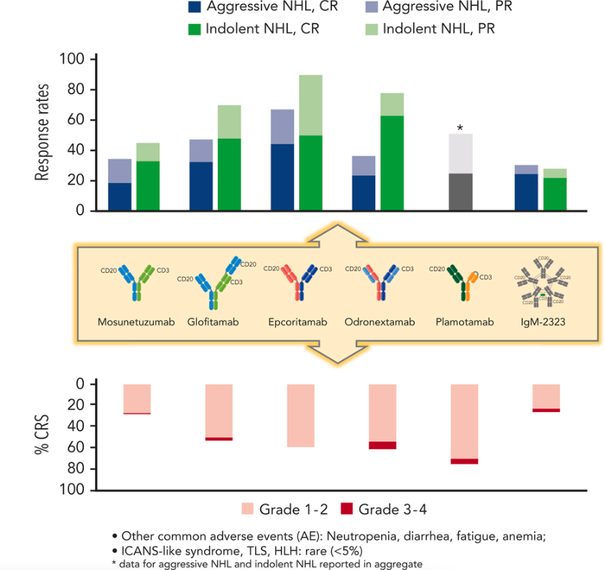
Bispecific Antibodies in B-Cell Lymphoma: Response Rates and CRS
Other common adverse events: Neutropenia, diarrhea, fatigue anemia
ICANS-like syndrome, TLS, HLH: rare (<5%)
Notes:
Falchi L, Vardhana SA, Salles GA. Bispecific antibodies for the treatment of B-cell lymphoma: promises, unknowns, and opportunities. Blood. 2023;141(5):467-480.

Slide 50
When to Consider Bispecific: Site Readiness
Management Team
Patient
Bispecific Specific
Outpatient vs inpatient dosing
When to call
Facility Logistics
Communication with the hospital system
Supportive meds availability
Distance from tocilizumab
Patient-specific plan vs system plan
Caregiver
Nurse Champions
APP
Physician
Pharmacist
Administrator
Timing of monitoring
Monitoring of vitals
Laboratory evaluation
BP cuff, thermometer, pulse oximeter
30-60 minutes
Steroids, tocilizumab, etc
ER, Inpatient Unit, On-call team, Pharmacy

Slide 51
Coordinating Referrals/Transition and Follow-Up Care
Establish Relationships and Referral Pathways | Establish strong relationships between clinicians at academic and community cancer programs Establishment of clear referral pathways and the transition from inpatient to outpatient administration; build on existing referral pathways (eg, for stem cell transplant or clinical trials) Ensure office staff are familiar with referral process
Patient Education | Create an online resource to help prepare patients to receive initial treatment at an academic medical center and follow-up care with a local oncologist Website can guide patients through the process and help them understand what to expect
 | Create a patient information sheet that clearly outlines team members and their roles and responsibilities across the different sites of care Community cancer program, local hospital, academic medical center, etc
 | Direct shared-decision making (SDM)
Use Telehealth | Use telehealth to provide follow-up care, remote vital sign monitoring, monitor for symptoms, and coordinate with local providers for patients who live further away from academic or tertiary care centers
Connect Patients | Connect patients with navigators who know how to coordinate logistics between community cancer programs and academic medical centers, if available Many community cancer programs have navigators for common cancers; may not have navigators for less common hematologic malignancies
Notes:
ACCC. Best practices in expanding access to bispecific antibodies and adverse event management. https://www.accc-cancer.org/docs/projects/bispecific-antibodies/bispecific-antibodies-brief.pdf
A resource on best practices for transitioning from inpatient to outpatient administration of BsAbs has been published.

Slide 52
Optimizing Safety via Interprofessional and
Team-Based Coordination
Team-Based Management Strategies for Adverse
Events with CD20 X CD3 Bispecific Antibodies

Slide 53
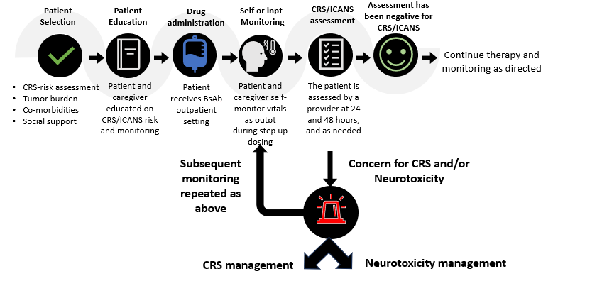
When to Consider Bispecific: Plan is to Have a Plan
Notes:
Crombie JL, Graff T, Falchi L, et al. Consensus recommendations on the management of toxicity associated with CD3×CD20 bispecific antibody therapy. Blood. 2024;143(16):1565-1575.
So plan to have a plan in place. Educating the patient is very important, as some of these events may happen outside of the time of an office being open, so patients should know what to do. Drug administration, in an outpatient setting, are you equipped to manage this in case of any adverse reactions happen. Self or inpatient monitoring, none of these bispecific antibodies in follicular lymphoma require in-hospital stay so education of the patient, having the patient make sure they have a thermometer, in some cases, a blood pressure cuff is important for monitoring and having a plan in place of what to happen when they have a fever, or if they have other events that may occur related to cytokine release syndrome. And continue therapy as directed if no issues occur. And a management plan in place in SOP for CRS management and neurotoxicity management in these patients.

Slide 54
Discussion: Considerations for
Managing Adverse Events
Planning | Knowledge and planning for the anticipated treatment-related AEs
 | Step-up dosing
Challenges | Challenges of using new therapies
 | Tolerability profile of bispecific antibodies based on frequency and severity
Assessment and monitoring | CRS and neurotoxicity: onset, rates, and severity
 | Low blood cell counts
 | Team-based strategies for anticipating, monitoring, managing, and coordinating care for potential AEs
Quality of Life (QoL) | Patient-reported improvements of lymphoma-related symptoms
Experience | Nuances will occur with more experience in the management of bispecific antibodies

Slide 55
Addressing Adverse Events with Bispecific Antibodies
Premedication (eg, prophylactic corticosteroids)
Step-up dosing
Hospitalization for administration
Slower infusion (Mosun only)
Alternate routes of administration (eg, subcutaneous)
Strategies to mitigate safety and tolerability concerns
Mosun, mosunetuzumab.
Falchi L, et al. Blood. 2023;141(5):467-480.
Notes:
Falchi L, Vardhana SA, Salles GA. Bispecific antibodies for the treatment of B-cell lymphoma: promises, unknowns, and opportunities. Blood. 2023;141(5):467-480.
Premedication with prophylactic corticosteroids is recommended. Epcoritamab does have a little bit longer duration of corticosteroid, usually Days 1 through 4, where mosunetuzumab is typically given at the time of the infusion. Step-up dosing has been implemented with all these agents based on our experience with blinatumomab. Hospitalization can be considered for some patients, but it's not required with any of these bispecific antibodies in follicular lymphoma. A slower infusion, so you can slow down the infusion rate with mosunetuzumab. That will eventually go away with the subcutaneous injection. But subcutaneous injections themselves typically have a longer sort of uptake. So you don't get as quick of a peak with a T-cell expansion in these patient populations with these bispecific antibodies, as we just mentioned on the last point.

Slide 56
BsAbs Management Strategies: CRS
Occurs mostly within the first 24 hours following treatment initiation with continuous administration
CRS events are typically confined to the step-up doses or first full dose with intermittent administration
Typically occurs on the day of IV infusion and the day after SC administration
SC formulations may reduce the risk of severe CRS
  More gradual increase in serum concentration and reduce the peak plasma levels of the antibodies
Prevention
Step-up dosing and premedication
Educate patients and caregivers on the signs and symptoms of CRS
Coordinate with local emergency departments and clinics
Supportive care
Prompt administration of IL-6 receptor-blocking antibodies (tocilizumab) or steroids
Antipyretics (acetaminophen)
Intravenous fluid administration
Oxygen supplementation
Withhold drug or permanently discontinue
BsAbs, bispecific antibodies; CRS, cytokine release syndrome; IL, interleukin; IV, intravenous; SC, subcutaneous.
Notes:
Looking at cytokine release syndrome, for the most part, these typically occur within the first 24 hours around the treatment initiation. The events are typically confined to step-up dosing, so once you get out of step-up dosing, the risk of this is generally very minimal, if at all. Subcutaneous formulations may reduce the risk of CRS, given a slow uptake, but it may also cause a delay at the occurrence of CRS, so you have to be aware that this may not occur within the first 24 hours, and something you should keep in mind through the first 48 to 96 hours. With supportive care, prompt administration of IL-6 receptor blocking antibodies such as tocilizumab; steroids, sometimes a pill in the pocket to send patients home with; antipyretics or anti-fever medications, acetaminophen; IV fluid administration; support of blood pressures; oxygen supplementation when needed. And then with severe cytokine release syndrome, then you would typically want to withhold the drug or permanently discontinue in this situation.

Slide 57
BsAbs Management Strategies: Neurotoxicity/ICANS
Lower incidence compared with CD19-directed agents (CAR T)
Typically develops concurrently or shortly after CRS
  Can also occur independently
Characterized by headaches, tremors, ataxia, aphasia, confusion, hallucinations, and seizures
Prevention
Step-up dosing and premedication
Monitor patients for neurological signs or symptoms during treatment
Supportive care
Tocilizumab if concurrent with CRS
Steroids (dexamethasone)
Anti-epileptic drugs
Withhold drug or permanently discontinue
BsAbs, bispecific antibodies; CAR T, chimeric antigen receptor T cells; CRS, cytokine release syndrome; ICANS, immune effector cell-associated neurotoxicity syndrome; IV, intravenous; SC, subcutaneous.
van de Donk NWCJ, Zweegman S. The Lancet. 2023;402(10396):142-158. ACTEMRA (tocilizumab). Prescribing information. Genentech; 2022.
Notes:
van de Donk NWCJ, Zweegman S. T-cell-engaging bispecific antibodies in cancer. The Lancet. 2023;402(10396):142-158.
ACTEMRA (tocilizumab). Prescribing information. Genentech; 2022.
Although neurotoxicity is a very low incidence in this patient population, it can occur. So some of the same mechanisms that actually prevent CRS are there, except that in neurological toxicity, the main agent to utilize to prevent this will be corticosteroids. So steroids are far more important for management of immune effector cell associated neurological syndrome than tocilizumab. And depending on the severity of ICANS or neurotoxicity, you would withhold or permanently discontinuity drug.

Slide 58
BsAbs Management Strategies
Infections
Cytopenias
Monitor patients for signs and symptoms of infection prior to and during treatment
Provide PJP prophylaxis prior to initiating treatment
Initiate antiviral prophylaxis against herpes virus prior to treatment
Withhold or consider permanent discontinuation of treatment based on severity
Monitor complete blood counts throughout treatment
Consider prophylactic granulocyte colony-stimulating factor
Based on the severity of cytopenias, temporarily withhold or permanently discontinue treatment
BsAbs, bispecific antibodies; PJP, Pneumocystis jirovecii pneumonia.
EPKINLY (epcoritamab-bysp). Prescribing information. Genmab; 2023.
COLUMVI (glofitamab-gxbm). Prescribing information. Genentech; 2023.
LUNSUMIO (mosunetuzumab-axgb). Prescribing information. Genentech; 2022.
Notes:
EPKINLY (epcoritamab-bysp). Prescribing information. Genmab; 2023.
COLUMVI (glofitamab-gxbm). Prescribing information. Genentech; 2023.
LUNSUMIO (mosunetuzumab-axgb). Prescribing information. Genentech; 2022.

Slide 59
Improving Management of CRS in Patients Treated with BsAbs
Dosage and Administration | Step-up dosing
 | Interrupting therapy and providing supportive care
 | Pre-medication strategies (including steroids)
Training | Ensure ED staff and hospitalists are aware that an on-call physician is available to help manage any patient who may present with CRS
 | Develop a structured training program for staff
 | Include hospital nurses, ICU staff, and neurologists in conversations about CRS and neurotoxicity
Coordination | Develop a central repository of treatment protocols and algorithms, including toxicity management plans
 | Share with local community hospitals (and those in the cancer program network) to ensure that a consistent approach is delivered wherever the patient is treated
Patient Education | Remind patients and their caregivers about signs and symptoms of CRS
 | Caregivers may be the first ones who recognize symptoms and should be prepared to call the cancer care program for assistance
Notes:
ACCC. Best practices in expanding access to bispecific antibodies and adverse event management. https://www.accc-cancer.org/docs/projects/bispecific-antibodies/bispecific-antibodies-brief.pdf
A resource on best practices for transitioning from inpatient to outpatient administration of BsAbs has been published.

Slide 60
Emerging Directions With Potential to Shape the Landscape

Slide 61
Bispecific Antibodies in Phase 3 Clinical Trials
Treatment | Trial | Phase | Setting
epcoritamab + R2 (rituximab + lenalidomide) Vs. R2 | EPCORE FL-1 NCT05409066 | 3 | R/R FL
epcoritamab + R2 Vs. chemoimmunotherapy | EPCORE FL-2 NCT06191744 | 3 | Previously untreated FL
odronextamab + lenalidomide Vs. R2 | OLYMPIA-5 NCT06149286 | 3 | R/R FL
odronextamab Vs. rituximab + chemotherapy | OLYMPIA-1 NCT06091254 | 3 | Previously untreated FL
odronextamab + chemotherapy Vs. rituximab + chemotherapy | OLYMPIA-2 NCT06097364 | 3 | Previously untreated FL
mosunetuzumab + lenalidomide vs. anti-CD20 monoclonal antibody + chemotherapy | MorningLyte NCT06284122 | 3 | Previously untreated FL FLIPI 2-5
mosunetuzumab + lenalidomide Vs. R2 | Celestimo NCT04712097 | 3 | R/R FL
FL, follicular lymphoma; FLIPI, The Follicular Lymphoma International Prognostic Index; R2, lenalidomide and rituximab; R/R, relapsed/refractory.
Falchi L, et al. Blood. 2023;142(Supplement 1):3053.
Notes:
Falchi L, Morschhauser F, Linton K, et al. EPCORE FL-1: Phase 3 trial of subcutaneous epcoritamab with rituximab and lenalidomide (R 2) versus R2 alone in patients with relapsed or refractory follicular lymphoma. Blood. 2023;142(Supplement 1):3053.
There are several phase 3 studies ongoing looking at bispecific antibodies in previously untreated and R/R FL.

Slide 62
Case-Based Learning Lab

Slide 63
Case Study Patient Presentation and History
Presentation
Medical History
56 y/o female with history of grade 1-2 FL diagnosed in 2015
Initially treated with watch and wait approach
Required treatment due to onset of fevers and night sweats in 2020
Achieved a complete response to bendamustine-rituximab (BR)
Did not receive maintenance
Relapsed in 2022
Treated w/ lenalidomide-rituximab (R2)
Had a partial response
Did not receive subsequent therapy due to low burden asymptomatic residual disease
Now with progression of disease approximately 1 year later
HTN: controlled w/ ACEi
DM: diet controlled
ACEi, angiotensin-converting enzyme inhibitors; DM, diabetes mellitus; FL, follicular lymphoma; HTN, hypertension.

Slide 64
Case Study Clinical Course
Initial treatments:
  First-line: bendamustine/rituximab
  Second-line: lenalidomide/rituximab (R2)
Heavily pre-treated patient refractory to both anti-CD20 therapy and an alkylating agent
  Timing of disease progression: POD24
Assessing response to prior therapy
Sequencing appropriate next line of therapy
Incorporating patient goals and impact of treatment on QoL
POD24, progression of disease within 2 years; QoL, quality of life.

Slide 65
Case Study Audience Question 1
What third-line therapy would you recommend for this patient?
Bispecific antibody therapy (epcoritamab, mosunetuzumab)
BTK inhibitor (zanubrutinib + obinutzuumab)
CAR T-cell therapy (axi-cel, tisa-cel, liso-cel)
EZH2 inhibitor (tazemetostat)
Unsure
Notes:
Correct answer: a) Bispecific antibody therapy (epcoritamab, mosunetuzumab)

Slide 66
Case Study Rationale for Best/Correct Answer
Patient chose treatment with bispecific antibody therapy
  Epcoritamab chosen due to:
    POD24
    Subcutaneous administration, off the shelf convenience, and time to therapy
    Lower rates of CRS and ICANS compared with CAR T-cell therapy
CAR, chimeric antigen receptor; CRS, cytokine release syndrome; ICANS, immune effector cell-associated neurotoxicity syndrome; POD24, progression of disease within 2 years.

Slide 67
Case Study Clinical Course
Patient has an initial response to epcoritamab based on palpable nodes
Despite step-up dosing and pre-/post-administration of dexamethasone, the patient experiences Grade 2 CRS in Cycle 2 after receipt of the 48 mg dose
  Temperature 101.1
  Hypotension not requiring vasopressors
  No oxygen required
Treatment-related adverse events:
  Team-based focus
  Spectrum of trAEs for which to prepare
CRS, cytokine release syndrome; trAE, treatment-related adverse event.

Slide 68
Case Study Audience Question 2
In addition to giving IV fluids, how would you manage this patient now?
  Admit to the hospital
  Monitor at home and have the patient come in if symptoms fail to resolve
  Administer tocilizumab
  Provide anti-pyretic in clinic and monitor
  Unsure
Notes:
Correct answer: c) Administer tocilizumab

Slide 69
Case Study Conclusion
Appropriate identification of CRS and grade
Appropriate management strategies to address AEs
Administer tocilizumab when appropriate
Appropriate utilization of corticosteroids and anti-pyretics to reduce hospital admissions when possible
When CRS symptoms are resolved, resume pre-medication with dexamethasone and epcoritamab at 48 mg dose
AE, adverse event; CRS, cytokine release syndrome.

