Slide 1
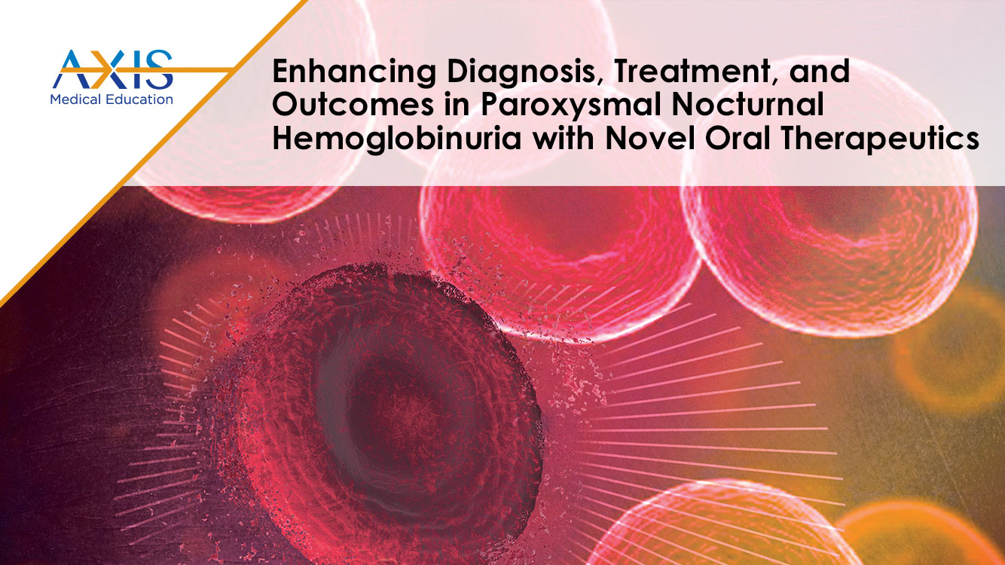

Slide 2
DISCLAIMER
This slide deck in its original and unaltered format is for educational purposes and is current as of May 2025. All materials contained herein reflect the views of the faculty, and not those of AXIS Medical Education, the CME provider, or the commercial supporter. Participants have an implied responsibility to use the newly acquired information to enhance patient outcomes and their own professional development. The information presented in this activity is not meant to serve as a guideline for patient management. Any procedures, medications, or other courses of diagnosis or treatment discussed or suggested in this activity should not be used by clinicians without evaluation of their patients’conditions and possible contraindications and/or dangers in use, review of any applicable manufacturer’s product information, and comparison with recommendations of other authorities.

Slide 3
DISCLOSURE OF UNLABELED USE
This activity may contain discussion of published and/or investigational uses of agents that are not indicated by the FDA. The planners of this activity do not recommend the use of any agent outside of the labeled indications.
The opinions expressed in the activity are those of the faculty and do not necessarily represent the views of the planners. Please refer to the official prescribing information for each product for discussion of approved indications, contraindications, and warnings.
USAGE RIGHTS
This slide deck is provided for educational purposes and individual slides may be
used for personal, non-commercial presentations only if the content and references
remain unchanged. No part of this slide deck may be published in print or
electronically as a promotional or certified educational activity without prior written
permission from AXIS. Additional terms may apply. See Terms of Service on
www.axismeded.com for details.

Slide 4
Learning Objectives
At the conclusion of this activity, participants should be better able to:
Describe the pathogenesis, clinical manifestations, and diagnostic criteria of paroxysmal nocturnal hemoglobinuria (PNH), focusing on strategies to overcome barriers to earlier diagnosis and treatment
Evaluate efficacy data from clinical trials and real-world evidence on current and emerging therapeutic agents in the treatment of PNH
Select the optimal therapeutic agent for a patient with PNH, addressing unmet needs through developing team-based treatment plans
Develop team-based strategies for the proper management of PNH treatment-related AEs to improve team-based care, safety, QoL, and adherence

Slide 5
Understanding PNH and wAIHA Through Pathogenesis, Clinical Manifestations, and Diagnostic Criteria

Slide 6
Paroxysmal Nocturnal Hemoglobinuria (PNH)
What is PNH?
Pathogenesis of PNH
Clinical aspects of PNH
Diagnosis & screening
Treatment of PNH
Notes:
Speaker Notes:
Today, we're going to be talking about PNH.

Slide 7
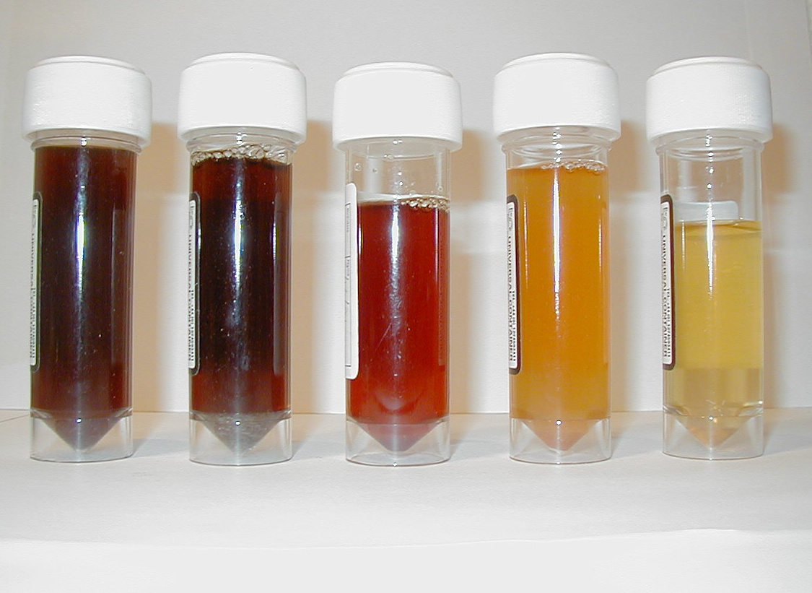
What is PNH?
Paroxysmal – sudden onset
Nocturnal – occurring at night (or early in morning upon awakening)
Hemoglobinuria
Despite the name, most patients do not present this way

Slide 8
What is PNH?
A rare (estimated incidence of 1-1.5 cases per million people) and unusual acquired hematologic disorder characterized by
  Intravascular hemolysis
  Bone marrow failure (cytopenias)
  Thrombosis
There is great clinical heterogeneity amongst patients with PNH
A disease that has
fascinated hematologists for
a long time…
Notes:
Speaker Notes:
It's estimated that about 1 to 1.5 cases per million people is the incidence rate. It's a very unusual disease. It is acquired; you're not born with this. And it's characterized by one of three different clinical pictures, either there's intravascular hemolysis, bone marrow failure with cytopenias, or thrombotic events, and it can be any or all three of these. There is incredible clinical heterogeneity amongst patients with PNH. Some are very asymptomatic. Others are just incredibly symptomatic. And it's fascinated hematologists for a long, long time.
Hill A, DeZern AE, Kinoshita T, Brodsky RA. Paroxysmal nocturnal haemoglobinuria. Nat Rev Dis Primers. 2017;3:17028.

Slide 9
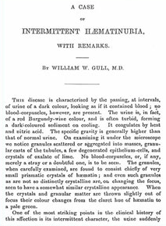
PNH – A Brief History
1st Published Case Report of PNH – 1866
Case Study
Notes:
Gull WW. A case of intermittent haematinuria, with remarks. Guy’s Hospital Reports. 1866;12:381-392.

Slide 10
What Causes PNH?
A mutation in the
PIG-A gene in
hematopoietic
stem cell
A condition that allows this mutant cell to become the dominant cell in the bone marrow (likely T-cell autoimmune attack)
AND
Notes:
Speaker Notes:
The reason PNH is so rare is that it takes two events to likely cause it. And they can occur in either order. The first event is there has to be a mutation in the what's called the PIGA gene, which is the first step in making your GPI anchor on hematopoietic stem cells and all their progeny. That is not an oncogenic mutation. Those cells have no growth advantage. So the second event has to be a condition that allows this mutant cell to become the dominant cell in the bone marrow. And we feel this is likely a T cell autoimmune attack, based on evidence both from aplastic anemia, to which this disease is highly related, and also some other research evidence.
Luzzatto L, Risitano AM. Advances in understanding the pathogenesis of acquired aplastic anaemia. Br J Haematol. 2018;182(6):758-776.

Slide 11

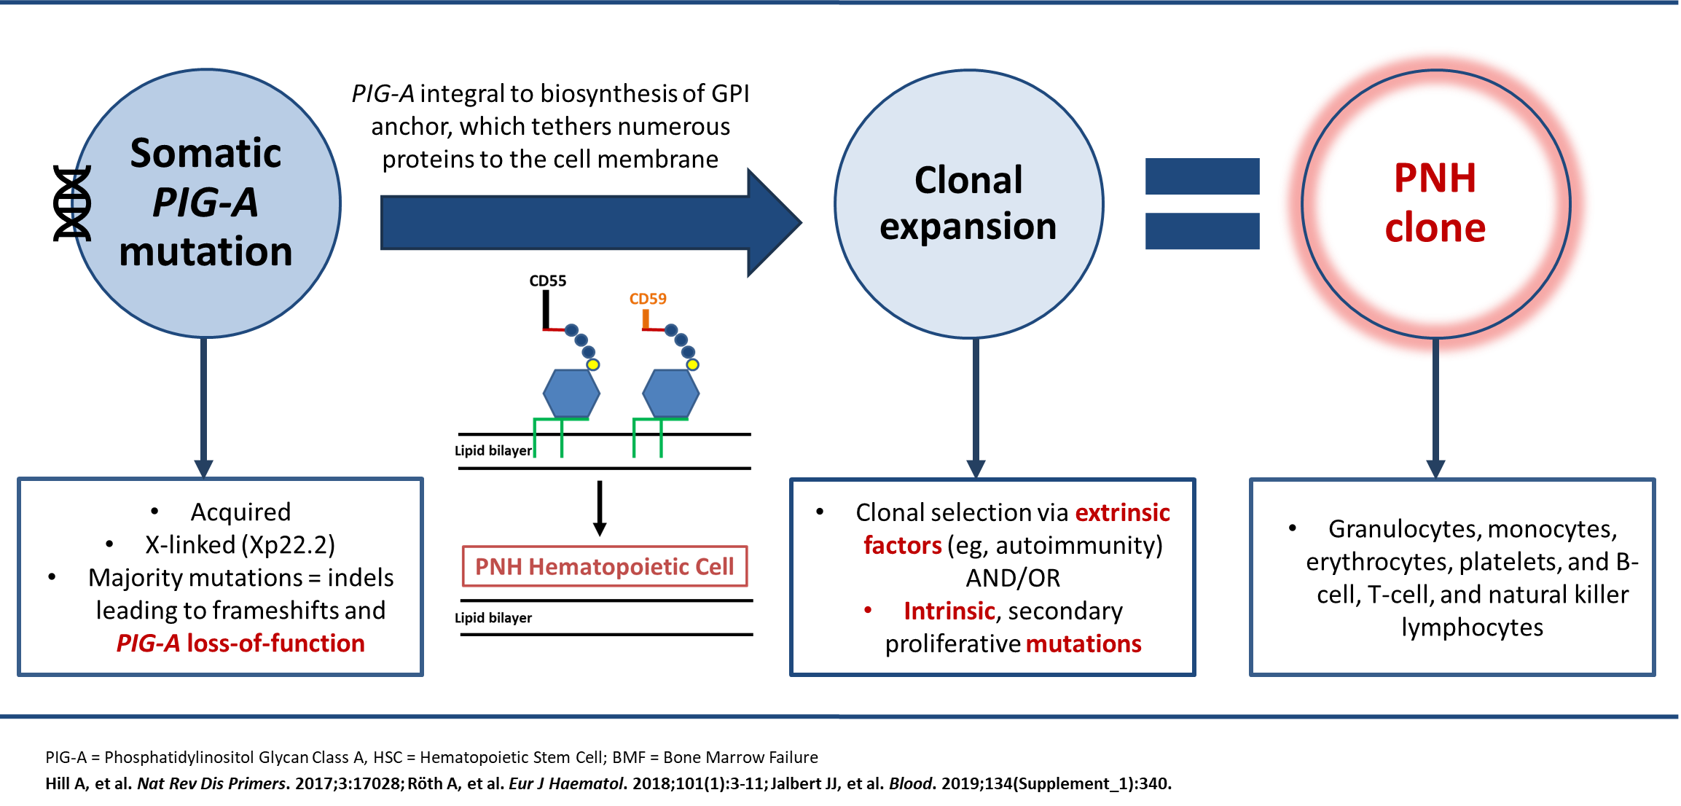
PNH: A Rare, Acquired Hematopoietic Stem Cell Disorder
PIG-A integral to biosynthesis of GPI anchor, which tethers numerous proteins to the cell membrane
Somatic PIG-A
mutation
Clonal expansion
PNH
clone
=
Acquired
X-linked (Xp22.2)
Majority mutations = indels leading to frameshifts and PIG-A loss-of-function
Clonal selection via extrinsic factors (eg, autoimmunity)
AND/OR
Intrinsic, secondary proliferative mutations
Granulocytes, monocytes, erythrocytes, platelets, and B-cell, T-cell, and natural killer lymphocytes
PNH Hematopoietic Cell
Notes:
Speaker Notes:
Again, the mutation is in the PIGA gene. It is acquired during normal hematopoiesis, when stem cells divide. The reason the PIGA gene is involved almost 99% of the time or higher, is that it is on the X chromosome, so it only takes one single hit to knock that gene either out completely or severely down. Females have lyonized one of their X chromosomes. Males only have one X chromosome. In the other cases of all the other genes, and there's at least 20 other genes involved in making the GPI anchor, they're all on somatic chromosomes, so it would take two hits to knock them out.
When you knock out that gene, you get a reduction in the GPI anchor and any proteins that are linked to the surface of the cells on that. There are a lot of different proteins, but the two that we know are the most important, at least in PNH, are CD55 and CD59 which protect the red cells from activated complement.
Hill A, DeZern AE, Kinoshita T, Brodsky RA. Paroxysmal nocturnal haemoglobinuria. Nat Rev Dis Primers. 2017;3:17028.
Röth A, Maciejewski J, Nishimura JI, Jain D, Weitz JI. Screening and diagnostic clinical algorithm for paroxysmal nocturnal hemoglobinuria: Expert consensus. Eur J Haematol. 2018;101(1):3-11.
Jalbert JJ, Chaudhari U, Zhang H, Weyne J, Shammo JM. Epidemiology of PNH and real-world treatment patterns following an incident PNH diagnosis in the US. Blood. 2019;134(Supplement_1):3407.

Slide 12
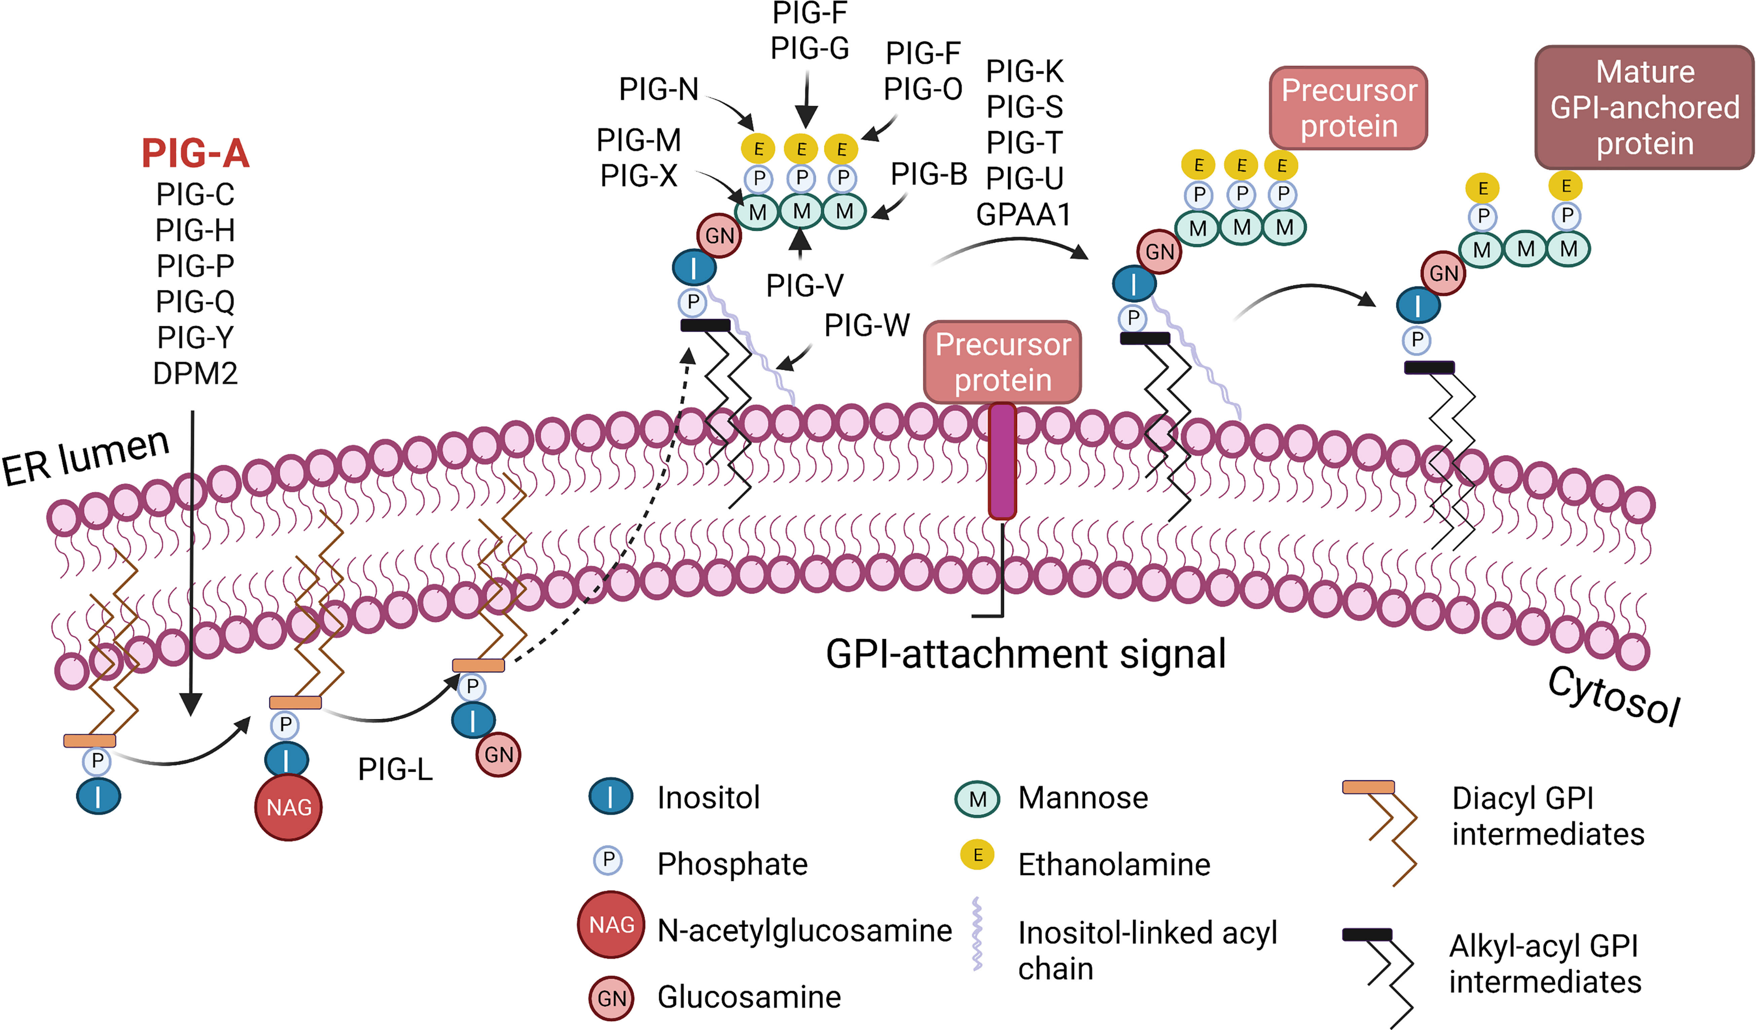
Biosynthesis of the GPI Anchor
Notes:
Speaker Notes:
Colden MA, Kumar S, Munkhbileg B, Babushok DV. Insights into the emergence of paroxysmal nocturnal hemoglobinuria. Front Immunol. 2022;12:830172.

Slide 13
The Defect in PNH
PROTEIN
A somatic mutation of the PIG-A gene in a hematopoietic stem cell results in a partial or complete absence of synthesis of the membrane GPI anchors
As a result, there is partial or complete loss of all GPI anchored proteins
Asp
C=O
NH
C₂H
GLYCAN CORE
C₂H
O²
O=P=O
O
PHOSPHATIDYL-
(1-6)
(1-2)
INOSITOL
(1-4)
ETHANOLAMINE
O
C₂H
N
O-P=O
O
O
C₂H
N²H
C₂H
C₂H
O-P-O
C₂H
C=O
O
O
O
C=O
MEMBRANE

Slide 14
The Missing Proteins in PNH: A Partial List
Complement defense proteins
  CD55 (decay accelerating
  factor, DAF)
  CD59 (membrane inhibitor of
  reactive lysis)
Enzymes
  Acetylcholinesterase
  Alkaline phosphatase
Immune system ligands
Adhesion molecules
  NCAM
  Fibronectin receptor
Growth factors and receptors
Differentiation antigens
  CD14 (monocytes)
  CD52 (T cells)
Anti-procoagulant proteins
  uPAR (CD87)

Slide 15
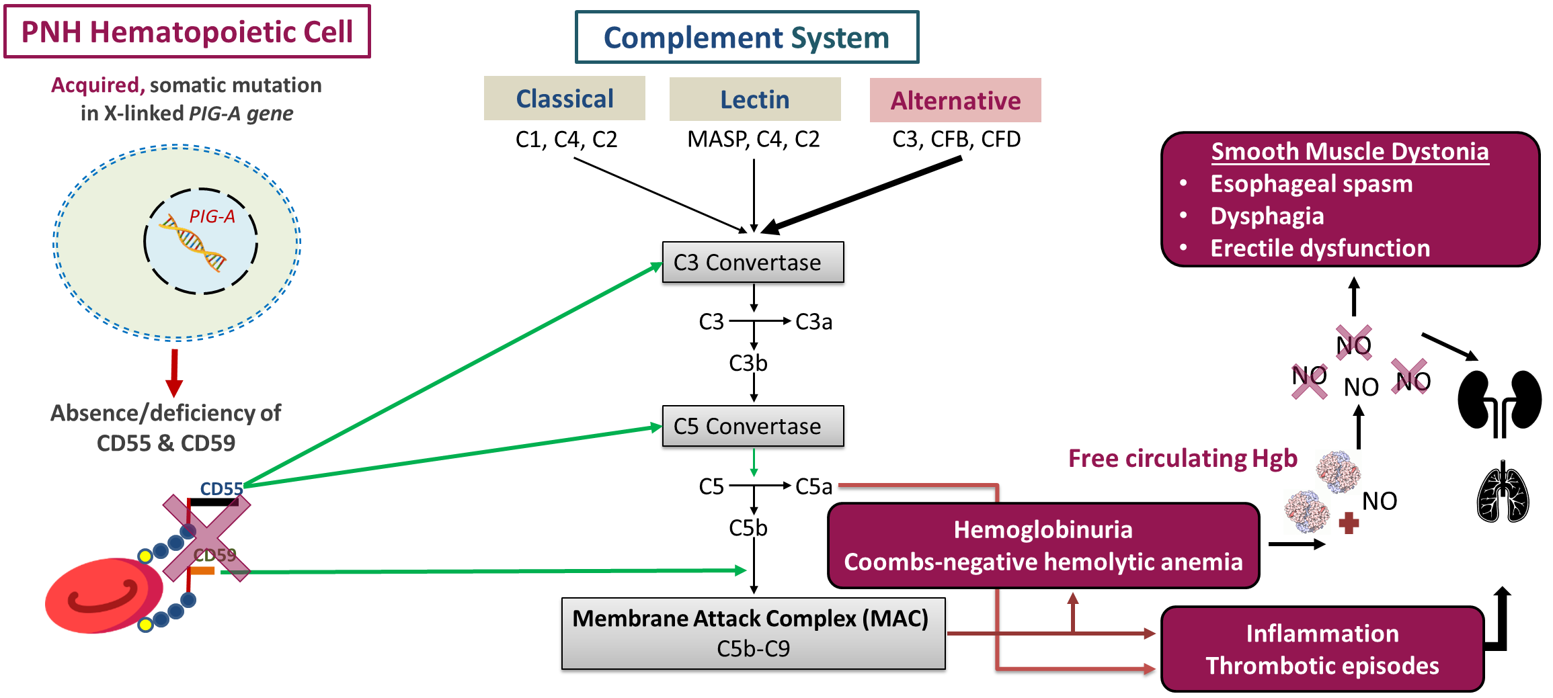
Complement Dysregulation as a Driver of PNH
Notes:
Speaker Notes:
As I mentioned, something has to allow the cell to mutate it to become clonally expanded. It can be either extrinsic factors, such as immune factors, and/or intrinsic factors. Some patients have secondary proliferative mutations, such as JAK2, that may drive clonal expansion.
So with the absence of CD55 and 59, whenever complement is activated, and realize it's always on to a low extent through a process called tick-over, the red cells can be lysed. And they will be lysed through the complement pathways, whether that's the alternative pathway or whether that's classical pathway. Most often it's the alternative pathway, unless they have an infection, that converges on the C3 convertase. C3 is cleaved, C3b goes on to cleave C5 into its active forms. And this forms what's called the membrane attack complex, or MAC, with C5 through C9. That forms a pore in the cell, usually the red cells, which leads to the lysis of the red cells. If it's risk enough, you will get hemoglobinuria, spilling of hemoglobin into the urine, not hematuria. the hemolytic anemia is Coombs negative. It's important to stress that. You can have inflammation from C5a, and likely the thrombotic episodes are related to that. The free hemoglobin that's released will cause smooth muscle dystonias, because it will squelch nitric oxide out of this blood system that leads to esophageal spasms. Can have severe chest pain. You feel like you can't swallow. In males, they'll get erectile dysfunction. Abdominal pain and chest pain are very common, as is fatigue.
Waheed A, Shammo J, Dingli D. Paroxysmal nocturnal hemoglobinuria: Review of the patient experience and treatment landscape. Blood Rev. 2024;64:101158.
Hill A, Kelly RJ, Hillmen P. Thrombosis in paroxysmal nocturnal hemoglobinuria. Blood. 2013;121(25):4985-4996.

Slide 16
Chronic Hemolysis is Central to the Morbidities and Mortality of PNH
Normal red blood cells are protected from complement attack by a shield of terminal complement inhibitors
Without this protective complement inhibitor shield, PNH red blood cells are destroyed
Thrombosis
Significant Impact on Survival
Renal Failure
Pulmonary Hypertension
Complement
Activation
Significant Impact on Quality of Life
Smooth Muscle Dystonias including Dysphagia,
Abdominal Pain,
and Male ED
Intact RBC
Reduced Red Cell Mass
Hemoglobin in
the Blood from Destroyed PNH RBCs
Hemoglobinuria
Anemia
Fatigue
Notes:
Speaker Notes:
So just in this cartoon, you see that normal red cells are protected from complement activation because of CD55 and CD59, whereas PNH red cells don't have that protection, and they will lyse whenever a complement is activated. That lysis will lead to anemia. And not only that, it will lead to hemoglobin which will squelch nitric oxide, leading to the smooth muscle dystonias we just mentioned, the hemoglobinuria, the fatigue. Long term, people can get pulmonary hypertension, renal failure, and we think that it, in part, plays a role in thrombotic events. All of these can have a significant impact on quality of life, and, more importantly, on survival.
Waheed A, Shammo J, Dingli D. Paroxysmal nocturnal hemoglobinuria: Review of the patient experience and treatment landscape. Blood Rev. 2024;64:101158.
Hill A, Kelly RJ, Hillmen P. Thrombosis in paroxysmal nocturnal hemoglobinuria. Blood. 2013;121(25):4985-4996.

Slide 17
PNH: Bone Marrow Failure Due to T-Cell
Mediated Attack
Two possible ways that T lymphocytes are involved in the pathogenesis of immune escape.
(A) CD1d presents GPI molecule as antigen to T lymphocytes and then activates them, these T lymphocytes kill the GPI⁺HSC; however, the GPI⁺HSC can escape from this attack.
(B) GPI-AP mediates the activation of T lymphocytes and promotes the release of its cytokines (eg, IL-2), then T lymphocytes kill HSCs expressing GPI-APs; however, HSCs that do not express GPI-APs escape from this effect. Figures were created in BioRender.com
Notes:
Speaker Notes:
I mentioned before that we think that there's a T cell-mediated attack as the second step that has to occur. That can occur before you even have a PNH mutation, that there is some attack on the bone marrow, mediated by the T lymphocytes, similar to what we see in aplastic anemia.
Li C, Dong X, Wang H, Shao Z. The role of T lymphocytes in the pathogenesis of paroxysmal nocturnal hemoglobinuria. Front Immunol. 2021;12:777649.

Slide 18
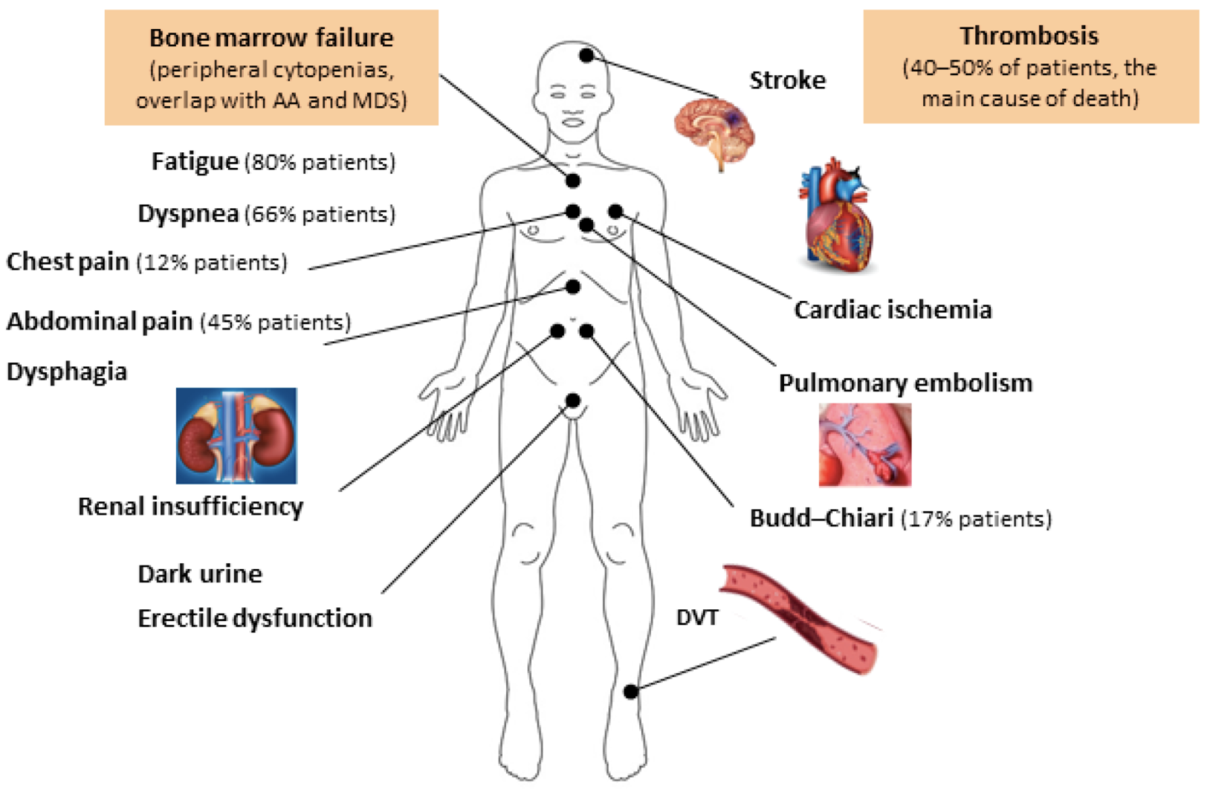
The Clinical Picture of PNH
Hemolysis due to complement activation
  Anemia and fatigue
  Hemoglobinuria, kidney damage
  Nitric oxide trapping >> Esophageal spasm, abdominal pain, pulmonary hypertension, impotence, fatigue?
Thrombosis – possibly due to complement activation
  Unusual sites of blood clots
Bone marrow failure
  Decreased blood counts (cytopenias)
Notes:
Speaker Notes:
So the clinical picture of PNH is as follows. You get hemolysis due to complement activation. From that, you get anemia and fatigue. You get hemoglobinuria. Acutely, you can have kidney damage if that hemoglobinuria is severe. Chronically, you can get kidney damage from the deposition of hemosiderin in the kidneys. The nitric oxide trapping or squelching leads to all sorts of symptoms. There can be thrombosis, usually in unusual sites, such as the liver, the spleen, the mesenteric vessels, or it can be typical DVTs or even arterial clots. And then you have the bone marrow failure with decreased blood counts or cytopenias, which is not too uncommon in PNH.

Slide 19
PNH – Presenting Symptoms Can Be Heterogenous
Clinical Signs or Symptoms | Incidence (%)
Thrombosis | 40
Anemia | 89
Bone marrow failure | 10-45
Fatigue, impaired QoL | 96
Hemoglobinuria | 26
Abdominal pain | 57
Dysphagia/Swallowing difficulty | 41
Erectile dysfunction | 47
Notes:
Speaker Notes:
Shown here are just the clinical signs and symptoms that we see with PNH. They can be very heterogeneous. Fatigue is probably the most common symptom we see, and that's a very subjective symptom, as you all are aware. Hemoglobinuria, at least in this one registry study was only in 26% of patients who presented. Now this was out of Asia, where there's – where bone marrow failure is more common. So hemoglobinuria, we estimate to be at least in 40% of patients when they present.

Slide 20
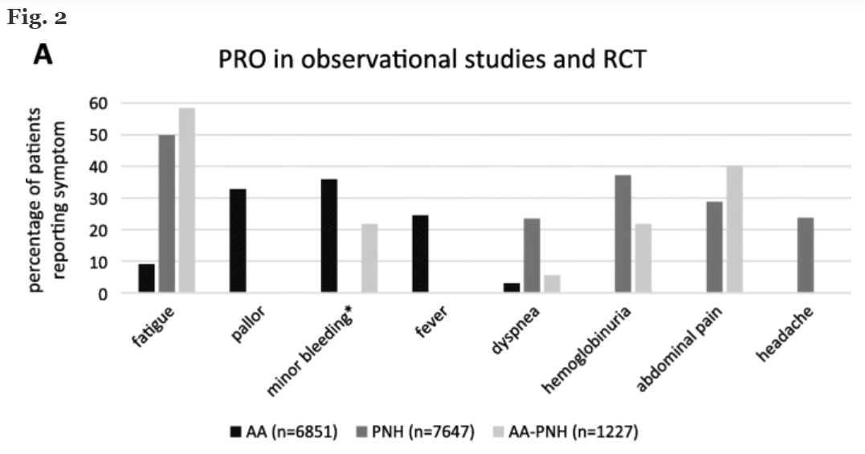
Impact of PNH
Quality of life
  Often suffer from fatigue, which reduces QoL even on treatment
  ~25% of patients on C5i have ongoing transfusion requirements
  Delayed diagnosis can further reduce QoL and affect the patient’s mental wellbeing
Economic considerations
  High costs of complement inhibitors remains an ongoing issue
  Newer agents and a recently approved biosimilar may help with this issue
  Global access to complement inhibitors remains a challenge
  Transfusion-dependent patients experiencing annualized all-cause hospitalization costs >$100,000
Larger clone size is associated with greater PNH disease burden
Notes:
Speaker Notes:
Weisshaar K, Ewald H, Halter J, et al. Development of a patient-reported outcome questionnaire for aplastic anemia and paroxysmal nocturnal hemoglobinuria (PRO-AA/PNH). Orphanet J Rare Dis. 2020;15(1):249.
Cheng WY, Sarda SP, Mody-Patel N, et al. Real-world healthcare resource utilization (HRU) and costs of patients with paroxysmal nocturnal hemoglobinuria (PNH) receiving eculizumab in a US population. Adv Ther. 2021;38(8):4461-4479.

Slide 21
Significant Mortality in PNH
Pre-Complement Inhibitor Therapy
100
5-year mortality: 35%
Diagnosed at all ages - median time from diagnosis to death: 10-15 yrs
80
Age- and Sex-Matched Controls
60
Patients Surviving (%)
40
20
Patients With PNH
0
0
5
10
15
20
25
Years After Diagnosis
Notes:
Speaker Notes:
And you can see here, PNH was not a good disease to have prior to our current treatments, with average survivals that ranged from 13 to 17 years, depending on which study you looked at. And since the median age of diagnosis is in the 30s, it was never a great disease to have when you tell a 30-year-old you may live on average 15 more years. The problem is the only curative therapy was a bone marrow transplant, which itself carries a 20% mortality risk, and it's hard to want to transplant somebody who may be asymptomatic and doing well and may live 13 or 15 years. So we always had difficulty with recommending transplant for these patients, and we don't do that anymore, now that we have complement therapy, as I'll show you.
Hillmen P, Lewis SM, Bessler M, Luzzatto L, Dacie JV. Natural history of paroxysmal nocturnal hemoglobinuria. N Engl J Med. 1995;333(19):1253-1258.

Slide 22
Diagnosis of PNH
PNH continues to be primarily a clinical diagnosis, which can be confirmed by laboratory analyses
Signs and symptoms are highly variable and may mirror other conditions
Most common symptoms at presentation are not unique to PNH
  Hemolytic anemia, often requiring transfusions
  Fatigue
  Dyspnea
  Abdominal pain or dysphagia
<40% of patients receive diagnosis within 12 months, 24% of all PNH diagnoses take 5 years or longer¹
Notes:
Speaker Notes:
The diagnosis of PNH was always tricky. Because it's such a rare disease, most doctors have never heard of it, or if they had a course in med school, they may have mentioned it. They don't remember that at all because they've never seen a case. Less than 40% of patients actually receive a diagnosis within 12 months of symptoms, and up to 24% take 5 years or longer from the time symptoms are occurring. It is primarily a clinical diagnosis, which is confirmed by a blood test. You send off at what's called a PNH screen, as we'll talk about later.
Bektas M, Copley-Merriman C, Khan S, Sarda SP, Shammo JM. Paroxysmal nocturnal hemoglobinuria: patient journey and burden of disease. J Manag Care Spec Pharm. 2020;26(12-b Suppl):S8-S14.
Dacie JV, Lewis SM. Paroxysmal nocturnal haemoglobinuria: clinical manifestations, haematology, and nature of the disease. Ser Haematol. 1972;5(3):3-23.

Slide 23
Clinical Indicators of Hemolysis
Elevated reticulocyte number
Elevated LDH
Reduced haptoglobin
Elevated bilirubin
Positive urine hemosiderin (intravascular hemolysis only)
Positive urine/serum free hemoglobin (intravascular hemolysis only)
Notes:
Speaker Notes:
The signs and symptoms are obviously highly variable and can mirror other conditions. Fatigue is incredibly common with so many things. fatigue in PNH is not the first thing that comes to mind. Clinical indications of hemolysis include an elevated reticulocyte count, elevated LDH levels, reduced haptoglobin levels, elevated bilirubin levels. If a urine hemosiderin test is done, it's positive in intravascular hemolysis. We can also do a urine – or a serum-free hemoglobin, and that's positive if it's intravascular also.

Slide 24
Types of Hemolytic Anemia
Intrinsic
  Membrane/cytoskeletal abnormalities – HS
  Enzyme defects – G6PD, PK
  Hemoglobin defects – thalassemia, sickle cell
  PNH
Extrinsic
  Non-immune
  Increased shear – artificial valves
  DIC, TTP, HUS/aHUS
  Immune – autoimmune hemolytic anemia (AIHA)
  Cold antibody – cold AIHA [cold agglutinin disease (CAD), cold agglutinin syndrome (CAS)]
  Warm antibody – warm AIHA (wAIHA)
  Mixed
Notes:
Speaker Notes:
Just to recall about the types of hemolytic anemia that occurs, there can be intrinsic defects to the red cells. This includes congenital diseases such as hereditary spherocytosis, where you have a membrane or cytoskeletal abnormality, enzyme defects such as G6PD deficiency or pyruvate kinase deficiency, hemoglobinopathy, such as thalassemia or sickle cell. And then the only one that is an acquired disease in this list is paroxysmal nocturnal hemoglobinuria, which we're talking about.
Extrinsic to the red cell, you can have both immune and non-immune causes. Non-immune causes include things such as DIC or TTP, artificial valves, especially when they're leaky, or immune causes, of which warm antibody immune hemolytic anemia is the most common form of hemolysis that we see, and those are patients who are Coombs positive or DAT positive.

Slide 25
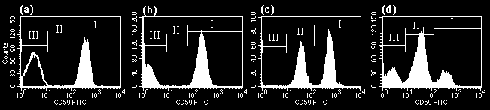
Flow Cytometry: Diagnostic Test for PNH
Perform on peripheral blood
Test both granulocytes and erythrocytes¹
  Erythrocytes alone are not sufficient due to hemolysis and the dilution effect of transfusions
Use monoclonal antibodies against GPI-anchored proteins, such as CD59 or CD55^{1,2}
PNH blood cells (PNH clone) are cells missing GPI-anchored proteins
Notes:
Speaker Notes:
The diagnostic test for PNH, as I mentioned, is a blood test. It should not be done on bone marrow because of nonspecific binding of antibodies. You test both white cells and red cells, in part because of the red cells are lysing rapidly, you may not detect the disease. We use monoclonal antibodies against GPI-anchored proteins such as CD59 or CD55. And what we're looking for are cells that are missing GPI-anchored proteins. And you see here in Panel A, that's a negative control antibody in that left-hand panel, where we see just this blank line. And here is a normal patient who has all of their red cells expressing CD59. Panel B shows a typical patient with PNH, where they have a population of cells that is completely missing CD59. And anything above 1% is considered PNH by diagnosis, whereas they have a normal population of red cells that are expressing CD59. Panel C shows a patient who has partial deficiency, what we call type II cells, in CD59. And then Panel D is a patient with a biclonal population of cells, one that is completely lacking type III and one that is partially lacking type II.
Hall SE, Rosse WF. The use of monoclonal antibodies and flow cytometry in the diagnosis of paroxysmal nocturnal hemoglobinuria. Blood. 1996;87(12):5332-5340.
Parker C, Omine M, Richards S, et al. Diagnosis and management of paroxysmal nocturnal hemoglobinuria. Blood. 2005;106(12):3699-3709.

Slide 26
Fluorescent AERolysin (FLAER)
FLAER binds to the GPI-anchor itself, rather than to
a single protein such as
CD55 or CD59
FLAER provides much greater signal noise and better accuracy than an antibody against a single target
α-CD59
CD59
GPI-
linked
protein
FLAER
FLAER
Notes:
Speaker Notes:
The FLAER test is another assay that's done using the same sort of flow cytometry panel. They have taken the aerolysin protein from the Aeromonas bacteria and labeled it with a fluorescein label, and it binds directly to the GPI anchor itself. So you're not looking for a specific antigen, you're going right for that GPI anchor. And because of that, you get a higher signal of the noise ratio and a higher sensitivity and specificity. But it can only be done on the white cells. The red cells have non-specific binding to this protein, so you can't use it there.
Brodsky RA, Mukhina GL, Li S, et al. Improved detection and characterization of paroxysmal nocturnal hemoglobinuria using fluorescent aerolysin. Am J Clin Pathol. 2000;114(3):459-466.

Slide 27
Significance of PNH Clone Size
~1/3 of patients with PNH clones have classical PNH with hemolysis and increased thrombotic risk
  Larger clone size (usually >50% PNH WBCs)
  Complement inhibitors improve outcomes in these patients
The other two-thirds have subclinical PNH or PNH overlapping with AA/BMF
  Patients typically with smaller clone sizes (<30%), no clinical hemolysis or symptoms
  Unlikely to benefit from complement inhibitors, treatment directed at BMF
  Some patients with moderate clone sizes, clinical hemolysis, and symptoms may benefit from complement inhibitors
  Continued screening (~annually of PNH clone size); classical PNH can evolve from AA and progressive BMF requiring treatment for AA can occur in classical PNH
PNH clones commonly occur in BM failure, typically smaller clones (<30%)
  Presence of a PNH clone can distinguish an acquired aplastic anemia from inherited bone marrow failure
Very small, polyclonal PNH populations can arise in normal individuals (2-4 per 100,000 cells)
Notes:
Speaker Notes:
Now, let me just deal with clone size briefly. About 1/3 to 40% of patients have classical PNH with clone sizes that are usually larger, usually greater than 50%. And that results in a lot of hemolysis and increased thrombotic episodes. And these are the patients that we need to treat with complement inhibitors. The rest of the patients have either PNH which overlaps with a bone marrow failure syndrome with cytopenias; they will not benefit from complement inhibitors, because that's a T cell-mediated process, and treatment should be directed using immunosuppressive therapy. These patients still can clot, and some of these patients may still have hemolysis, and if detected, they will benefit from complement inhibitors. They typically have smaller clone sizes, less than 30%, and there are some patients who have what's called subclinical PNH, where your clone size is less than 10%, and you really have no symptoms and no hemolysis, and they don't benefit from any treatment at all.
Babushok DV. When does a PNH clone have clinical significance?. Hematology Am Soc Hematol Educ Program. 2021;2021(1):143-152.
DeZern AE, Symons HJ, Resar LS, Borowitz MJ, Armanios MY, Brodsky RA. Detection of paroxysmal nocturnal hemoglobinuria clones to exclude inherited bone marrow failure syndromes. Eur J Haematol. 2014;92(6):467-470.
Shah YB, Priore SF, Li Y, et al. The predictive value of PNH clones, 6p CN-LOH, and clonal TCR gene rearrangement for aplastic anemia diagnosis. Blood Adv. 2021;5(16):3216-3226.

Slide 28
Who Should Be Screened For PNH?
Patients with “CATCH”
  Unexplained Cytopenias
  Aplastic anemia (or a history of)
  Unexplained Thrombosis
  Coomb’s negative hemolytic anemia
  Hemoglobinuria
Notes:
Speaker Notes:
Who should be screened for PNH? Patients who have the acronym, CATCH, which comes from my Canadian colleagues, with unexplained cytopenias; aplastic anemia or a history of aplastic anemia, and these patients need to be screened yearly; unexplained thrombosis, especially in a young person, and especially if it's in an unusual site; patient with Coombs-negative hemolytic anemia should be screened; and patients with hemoglobinuria should be screened.
Parker C, Omine M, Richards S, et al. Diagnosis and management of paroxysmal nocturnal hemoglobinuria. Blood. 2005;106(12):3699-3709.
Borowitz MJ, Craig FE, Digiuseppe JA, et al. Guidelines for the diagnosis and monitoring of paroxysmal nocturnal hemoglobinuria and related disorders by flow cytometry. Cytometry B Clin Cytom. 2010;78(4):211-230.
Canadian PNH Network. Accessed July 20, 2020. https://www.pnhnetwork.ca/en.html#patient-screening

Slide 29
The Efficacy of Current and Emerging Therapeutic Agents for Patients With PNH and wAIHA

Slide 30
PNH – Historical Treatments
Prior to complement inhibition, treatment was
primarily supportive in nature
For hemolysis
For bone
marrow failure
For thrombosis
  Transfusion support if needed
  Steroids (chronic therapy controversial)
  Immunosuppressive therapy
  Bone marrow transplant
  Anticoagulation
  Bone marrow transplant

Slide 31
PNH: Current and Emerging Therapies
Complement inhibition –
  FDA Approved
    Eculizumab
    Ravulizumab
    Crovalimab
    Pegcetacoplan
    Iptacopan
    Danicopan (+ C5 inhibitor)
In clinical trials
  Pozelimab + cemdisiran
  OMS906
  KP104
Supportive care remains important
Role of prophylactic anticoagulation very unclear
Allogeneic HCT has a very limited role
Treatment goals
  Correct anemia¹
  Reduce fatigue²
  Reduce risk of thrombosis, pulmonary hypertension, renal damage^{3,4}
Notes:
Speaker Notes:
We're going to move now to treatment, which is the most active area, as we now have six drugs that are FDA approved for complement inhibition in PNH, and they're listed there. There are more in clinical trials, which is hard to believe that we still need more drugs, but there is room for improvement in treating PNH.
Supportive care is always important in these patients. If they need a blood transfusion, you give them a blood transfusion. If they need iron, you give them iron, etc.
The role for prophylactic anticoagulation in PNH is very unclear. What we learned before complement inhibition is that anticoagulants really didn't work well in preventing clots, once you'd had a clot, so putting them on prophylaxis may just increase their bleeding risk without giving them any benefit.
Allogeneic stem cell, which is the only curative therapy for this disease, now has a very limited role, in part because the survivals have improved so dramatically with complement inhibition. Really allogeneic transplant is only used for patients with severe bone marrow failure that doesn't respond to immunosuppressive therapy.
The treatment goals now are to correct anemia, reduce fatigue and other symptoms, certainly reduce the risk of thrombosis and of all the long-term complications of PNH.
Martí-Carvajal AJ, Anand V, Cardona AF, Solà I. Eculizumab for treating patients with paroxysmal nocturnal hemoglobinuria. Cochrane Database Syst Rev. 2014;(10):CD010340.
Cançado RD, Araújo ADS, Sandes AF, et al. Consensus statement for diagnosis and treatment of paroxysmal nocturnal haemoglobinuria. Hematol Transfus Cell Ther. 2021;43(3):341-348.
Hill A, Sapsford RJ, Scally A, et al. Under-recognized complications in patients with paroxysmal nocturnal haemoglobinuria: raised pulmonary pressure and reduced right ventricular function. Br J Haematol. 2012;158(3):409-414.
Griffin M, Munir T. Management of thrombosis in paroxysmal nocturnal hemoglobinuria: a clinician's guide. Ther Adv Hematol. 2017;8(3):119-126.

Slide 32

First-Line C5 Complement Inhibitors for PNH
Classical
Lectin
Alternative
Terminal complement inhibitors target complement protein C5 preventing its cleavage, formation of the MAC, and MAC-mediated intravascular hemolysis
They also suppress C5a, which reduces inflammation and thrombosis
C1, C4, C2
MASP, C4, C2
C3, CFB, CFD
C3 Convertase
C3 Convertase
C3
C3a
 | Approval Year | Target | Administrationª | Half-life | Indication
Eculizumab | 2007 | C5 | Intravenous/2 weeks | ~12 days | Adults with PNH
Ravulizumab | 2018, 2021 (adults, pediatric) | C5 | Intravenous/4-8 weeks | ~49 days | Adult and pediatric PNH patients
Crovalimab^{b} | 2024 | C5 | SubQ / 4weeks | ~53 days | Adult and pediatric (≥13 years) PNH patients
C3b
C5 Convertase
C5 Convertase
C5
C5a
C5b
Membrane Attack Complex (MAC)
C6-C9
These agents are available through REMS
Notes:
Speaker Notes:
We can divide our complement inhibitors now into two groups. The first group is the distal or C5 inhibitors, which were started back in 2007 is when eculizumab was approved. It targets C5; it's a monoclonal antibody that's been humanized. It was given initially as a weekly loading dose for 4 weeks and then moved on to intravenously every 2 weeks. It was approved in 2007 for adults with PNH and made a dramatic, dramatic improvement in these patients, as I'll show you in the next slide. The other two drugs, ravulizumab, is a modified form of eculizumab with a longer half-life. It was approved in 2018. And then this last year, crovalimab, which binds to a separate epitope or a different epitope, was FDA approved, and it's given subcutaneously every 4 weeks.
Parker CJ. Update on the diagnosis and management of paroxysmal nocturnal hemoglobinuria. Hematology Am Soc Hematol Educ Program. 2016;2016(1):208-216.
Bektas M, Copley-Merriman C, Khan S, Sarda SP, Shammo JM. Paroxysmal nocturnal hemoglobinuria: role of the complement system, pathogenesis, and pathophysiology. J Manag Care Spec Pharm. 2020;26(12-b Suppl):S3-S8.
Waheed A, Shammo J, Dingli D. Paroxysmal nocturnal hemoglobinuria: Review of the patient experience and treatment landscape. Blood Rev. 2024;64:101158.
Röth A, Nishimura JI, Nagy Z, et al. The complement C5 inhibitor crovalimab in paroxysmal nocturnal hemoglobinuria. Blood. 2020;135(12):912-920.

Slide 33
Eculizumab: Humanized First-in-Class Anti-C5 Antibody
Human Framework Regions
CH1
Hinge
CL
Complementarity Determining Regions
(murine origin)
CH2
Human IgG₄ Heavy Chain
Constant Regions 2 and 3
Human IgG₂ Heavy Chain
Constant Region 1 and Hinge
CH3
Notes:
Speaker Notes:
Rother RP, Rollins SA, Mojcik CF, Brodsky RA, Bell L. Discovery and development of the complement inhibitor eculizumab for the treatment of paroxysmal nocturnal hemoglobinuria. Nat Biotechnol. 2007;25(11):1256-1264.

Slide 34
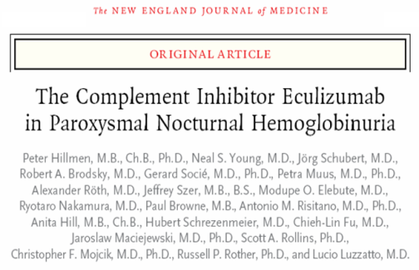

PNH Clinical Studies of Eculizumab
Pilot Study – NEJM 2004
N = 11
Long-Term Extension Trial
Evaluated long-term safety, efficacy and effect on thrombosis; Placebo patients switched to Eculizumab
N = 187
TRIUMPH – NEJM 2006
Pivotal Phase III, Double-Blind, Placebo-Controlled Trial, N = 87
SHEPHERD – Blood 2008
Broader patient population, including
those receiving minimal transfusions
or with thrombocytopenia, N = 97
Notes:
Speaker Notes:
The Pilot Study was a phase II, open-label study that included 11 patients and was 12 weeks long. TRIUMPH was a phase III double-blind, placebo-controlled randomized multicenter trial. To be eligible, patients had to have had a history of >4 transfusions / year and a platelet count > 100,000 /mm³. Patients received either eculizumab or placebo for 26 weeks. SHEPHERD was a phase III open-label, multicenter trial in a broader, more diverse patient population, including patients with lower transfusion requirements or thrombocytopenia (platelet count cut-off > 30,000 /mm³. Patients were treated with eculizumab for 12 months. TRIUMPH and SHEPHERD were designed to establish the efficacy and safety of SOLIRIS in patients with PNH and combined were the basis for the approval of eculizumab, All patients in the Pilot, TRIUMPH, and SHEPHERD trials were eligible to enroll into the extension trial (including placebo-treated patients in TRIUMPH who could now receive eculizumab).
Hillmen P, Hall C, Marsh JC, et al. Effect of eculizumab on hemolysis and transfusion requirements in patients with paroxysmal nocturnal hemoglobinuria. N Engl J Med. 2004;350(6):552-559.
Hillmen P, Young NS, Schubert J, et al. The complement inhibitor eculizumab in paroxysmal nocturnal hemoglobinuria. N Engl J Med. 2006;355(12):1233-1243.
Brodsky RA, Young NS, Antonioli E, et al. Multicenter phase 3 study of the complement inhibitor eculizumab for the treatment of patients with paroxysmal nocturnal hemoglobinuria. Blood. 2008;111(4):1840-1847.

Slide 35
Eculizumab Warning
Eculizumab increases the risk of meningococcal infections
  Vaccinate patients with a meningococcal vaccine at least 2 weeks prior to receiving the first dose of eculizumab
  Revaccinate according to current medical guidelines for vaccine use
  Monitor patients for early signs of meningococcal infections, evaluate immediately if infection is suspected, and treat with antibiotics if necessary
WARNING: SERIOUS MENINGOCOCCAL INFECTION
Notes:
Speaker Notes:
All these drugs, because they inhibit complement at C5, carry a black box warning that you need to vaccinate these patients against meningococcus, and we'll come back to vaccinations later on. The black box warning says you should vaccinate at least 2 weeks prior to receiving the first dose of eculizumab. You revaccinate according to current medical guidelines for vaccine use, which at least is every 5 years. And you'd educate these patients and give them a card to carry for warnings about meningococcal infections. So if they present to their ER, they can give it the doctor who may have never heard of PNH or this treatment, and can quickly start therapy with antibiotics.
In clinical studies, 2 (1%) out of 196 PNH patients developed serious meningococcal infections while receiving treatment with SOLIRIS; both had been vaccinated.
SOLIRIS (eculizumab). Prescribing information. Alexion Pharmaceuticals; 2007.

Slide 36
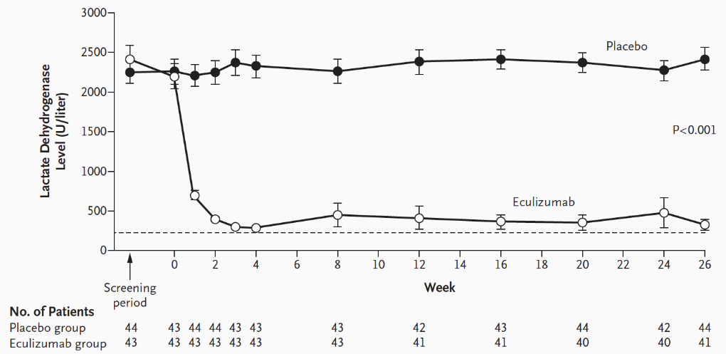
Eculizumab: Summary of Clinical Efficacy
Significantly reduced hemolysis, the underlying cause of morbidity and mortality in PNH
  86% reduction in hemolysis¹
  92% reduction in thrombotic events²
  73% reduction in need for transfusions¹
  Significant reduction in fatigue and improvement in QoL measures³
  AEs similar to placebo
Does not treat PNH-associated bone marrow failure
May not completely restore Hgb
Degree of Intravascular Hemolysis as Measured by Mean LDH Levels, Baseline to Week 26
(Phase 3 Trial)[a]
Degree of Intravascular Hemolysis as Measured by Mean LDH Levels, Baseline to Week 26 (Phase 3 Trial)¹
Notes:
Speaker Notes:
It, in many studies that were done, significantly reduced hemolysis within 2 weeks of giving the drug. LDH levels fell – fell dramatically, as shown in this diagram, to near, but not quite normal levels, and we'll come back to talk about that. So there was an 86% reduction in hemolysis, as measured by LDH levels, a 92% reduction in thrombotic events, which is very dramatic, not 100% but very close to it, a 73% reduction in need for transfusions, marked improvements in fatigue and quality of life measures, and the adverse events were very similar to placebos. This drug does not treat PNH-associated bone marrow failure and usually does not completely restore hemoglobin levels, as we'll show you.
Hillmen P, Young NS, Schubert J, et al. The complement inhibitor eculizumab in paroxysmal nocturnal hemoglobinuria. N Engl J Med. 2006;355(12):1233-1243.
Hillmen P, Muus P, Dührsen U, et al. Effect of the complement inhibitor eculizumab on thromboembolism in patients with paroxysmal nocturnal hemoglobinuria. Blood. 2007;110(12):4123-4128.
Brodsky RA, Young NS, Antonioli E, et al. Multicenter phase 3 study of the complement inhibitor eculizumab for the treatment of patients with paroxysmal nocturnal hemoglobinuria. Blood. 2008;111(4):1840-1847.

Slide 37
Eculizumab Has a Major Impact on Survival in PNH
100
100
80
Age- and Sex-Matched Controls
80
60
Patients Surviving (%)
60
40
Age- and sex-matched normal population
40
Eculizumab treated
20
Patients With PNH
20
0
0
0
5
10
15
20
25
0
1
2
3
4
5
6
7
8
9
Years After Diagnosis
Time (years)
Survival comparable to age and gender-matched control population out to 8 years
96% (76/79) patient survival
  No difference in mortality in patients on eculizumab vs healthy population (P = .46)
Notes:
Speaker Notes:
One thing we learned with the dramatic drop in thrombotic events, which used to be the number one cause of death in PNH patients, was the marked impact in survival in these patients to near normal levels, as shown in this study by Richard Kelly that was published in Blood in 2011. And several other subsequent studies have shown this same effect on survival.
Hillmen P, Lewis SM, Bessler M, Luzzatto L, Dacie JV. Natural history of paroxysmal nocturnal hemoglobinuria. N Engl J Med. 1995;333(19):1253-1258.
Kelly RJ, Hill A, Arnold LM, Brooksbank GL, et al. Long-term treatment with eculizumab in paroxysmal nocturnal hemoglobinuria: sustained efficacy and improved survival. Blood. 2011;117(25):6786-6792.

Slide 38
Clinical Trials and Observations
Key Points
Ravulizumab every 8 weeks is noninferior to eculizumab every 2 weeks across all efficacy end points in C5 inhibitor-naïve PNH patients
Ravulizumab provided immediate, complete, and sustained inhibition of C5 over the entire 8-week dose interval, unlike eculizumab
Notes:
Speaker Notes:
Lee JW, Sicre de Fontbrune F, Wong Lee Lee L, et al. Ravulizumab (ALXN1210) vs eculizumab in adult patients with PNH naive to complement inhibitors: the 301 study. Blood. 2019;133(6):530-539.
Kulasekararaj AG, Hill A, Rottinghaus ST, et al. Ravulizumab (ALXN1210) vs eculizumab in C5-inhibitor-experienced adult patients with PNH: the 302 study. Blood. 2019;133(6):540-549.

Slide 39
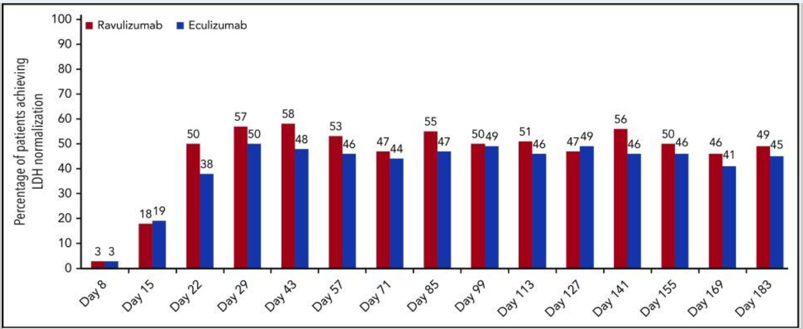
Terminal Complement Inhibitors – Ravulizumab
Modifications to the eculizumab monoclonal antibody led to ravulizumab which had a longer
half life.
Two studies (301 – complement inhibitor treatment naïve, and 302 – prior eculizumab treatment) compared ravulizumab to eculizumab. Both studies showed that ravulizumab was non-inferior to eculizumab across all end-points.
Ravulizumab provided immediate, complete, and sustained C5 inhibition over the 8 weeks period.
Still need to vaccination against Meningococcus.
Proportion of patients achieving LDH-N over time in the ravulizumab and eculizumab treatment groups
Notes:
Speaker Notes:
So modifications to the eculizumab monoclonal antibody led to ravulizumab, which has a longer half-life with more sustained high levels of C5 inhibition. There were two studies that were done on this drug, one in complement inhibitor- naive patients, and the other in patients who were on eculizumab. And that one compared to ravulizumab to eculizumab. Both of these studies were noninferiority studies, and both showed that ravulizumab was noninferior to eculizumab across all the endpoints that were studied. We can't claim it's superior, but we do know that is certainly much more convenient to give this drug every 8 weeks than every 2 weeks. And because it provides a higher level of C5 inhibition over that period, you probably get less breakthrough hemolysis events. You still need to vaccinate against meningoc – meningococcus with this antibody, and that's true for all the complement inhibitors.
Lee JW, Sicre de Fontbrune F, Wong Lee Lee L, et al. Ravulizumab (ALXN1210) vs eculizumab in adult patients with PNH naive to complement inhibitors: the 301 study. Blood. 2019;133(6):530-539.
Kulasekararaj AG, Hill A, Rottinghaus ST, et al. Ravulizumab (ALXN1210) vs eculizumab in C5-inhibitor-experienced adult patients with PNH: the 302 study. Blood. 2019;133(6):540-549.

Slide 40
Emerging Complement Inhibitors:
Terminal Inhibitors – Crovalimab
Novel anti-C5 monoclonal antibody engineered using Sequential Monoclonal Antibody Recycling Technology (SMART-Ig).
It is recycled within the circulation, enabling sustained complement inhibition through low-dose, subcutaneous administration every four weeks.
Notes:
Speaker Notes:
Finally, crovalimab is out there. It is a novel anti-C5 monoclonal antibody that was engineered using what was called smart technology so it bypasses the liver and has a long half-life, and you can use small volumes. Because of that, you can give it subcutaneously in smaller volumes. And the hope was that you could actually take this home and administer at home for patients. Three studies led to its FDA approval last year, COMMODORE 1, COMMODORE 2, and COMMODORE 3, which you can see where either in C5 treated or in C5 inhibitor-naive patients. This drug also was done in patients up to above the age of 13, or it is FDA approved for above the age of 13, so some pediatric patients.
Röth A, Fu R, He G, et al. Safety of crovalimab versus eculizumab in patients with paroxysmal nocturnal hemoglobinuria (PNH): pooled results from the phase III COMMODORE 1, COMMODORE 2, and COMMODORE 3 studies. Abstract presented at: American Society of Hematology Annual Meeting; San Diego, California; December 9-12, 2023. Abstract 575.

Slide 41



Crovalimab: Methods and Key Findings
Key findings from Phase III studies
COMMODORE 2¹
Non-inferiority of crovalimab vs eculizumab in hemolysis control and transfusion avoidance (co-primary endpoints)
Consistent safety profile between crovalimab and eculizumab
COMMODORE 3^{2,3}
Crovalimab met both co-primary efficacy endpoints
and was well tolerated
Disease control was maintained with no new safety signals after an additional 6 mo of crovalimab exposure
COMMODORE 1⁴
Crovalimab was well tolerated; some patients had transient immune complex reactions when switching between C5Is
Patients who switched to crovalimab maintained disease control
Crovalimabª
Loading
  Day 1: 1000 mg IV
  Days 2, 8, 15, and 22: 340 mg SC
Maintenance:
  From Day 29:
  Q4W 680 mg SC
Eculizumab
(only in COMMODORE
1 and 2)
Loading series per label
(COMMODORE 2 only)
Q2W 900 mg IV maintenance
All 3 studies had a 24-week primary treatment period and all patients continuing after Week 25 received crovalimab¹⁻⁴
Safety data from the 3 studies were pooled, and results from the total crovalimab and eculizumab populations are presented; total crovalimab population data are also presented by C5i-naïve vs.-switched status
Clinical cutoff for pooled analysis: November 16, 2022 (COMMODORE 2 and COMMODORE 1) and August 10, 2022 (COMMODORE 3)^{1,2,4}
Notes:
Speaker Notes:
Röth A, Fu R, He G, et al. Safety of crovalimab versus eculizumab in patients with paroxysmal nocturnal hemoglobinuria (PNH): pooled results from the phase III COMMODORE 1, COMMODORE 2, and COMMODORE 3 studies. Abstract presented at: American Society of Hematology Annual Meeting; San Diego, California; December 9-12, 2023. Abstract 575.
Röth A, He G, Tong H, et al. Phase 3 randomized COMMODORE 2 trial: Crovalimab versus eculizumab in patients with paroxysmal nocturnal hemoglobinuria naive to complement inhibition. Am J Hematol. 2024;99(9):1768-1777.
Liu H, Xia L, Weng J, et al. Efficacy and safety of the C5 inhibitor crovalimab in complement inhibitor-naive patients with PNH (COMMODORE 3): A multicenter, Phase 3, single-arm study. Am J Hematol. 2023;98(9):1407-1414.
Liu H, Xia L, Weng J, et al. Six-month crovalimab extension in the phase 3 COMMODORE 3 study: updated efficacy and safety results in complement inhibitor-naive patients (pts) with paroxysmal nocturnal hemoglobinuria (PNH). HemaSpher. 2023;7(S3):e1287903.
Scheinberg P, Clé DV, Kim JS, et al. Phase 3 randomized COMMODORE 1 trial: Crovalimab versus eculizumab in complement inhibitor-experienced patients with paroxysmal nocturnal hemoglobinuria. Am J Hematol. 2024;99(9):1757-1767.

Slide 42
Transient Immune Complex Reactions Resolved in Around 2 Weeks
In patients switching from other C5is to crovalimab, or from crovalimab to other C5is, transient immune complexes form between crovalimab, C5, and the other C5i. These complexes may lead to a one-time transient immune complex reaction in a fraction of switch patients
Across COMMODORE 1 and 2, transient immune complex reactions occurred in 33 of 185 patients (18%)
The median time to onset of the transient immune complex reaction was 1.6 weeks (range, 0.7–4.4) and the median duration of the resolved transient immune complex reactions was 1.9 weeks (0.4–34.1); some clinical symptoms were ongoing at clinical cutoff
Notes:
Speaker Notes:
One thing we learned when giving this there was an overlap when you had the C5 inhibitor still in your system and crovalimab. And because they bind to different epitopes, you could get these immune complexes that formed, which were very worrisome. Clinically, however, they just led to rash, which was limited to a few weeks, and outside of a little bit of itching, really did not cause any clinical problems, including no renal failure or other problems like that.
Röth A, Fu R, He G, et al. Safety of crovalimab versus eculizumab in patients with paroxysmal nocturnal hemoglobinuria (PNH): pooled results from the phase III COMMODORE 1, COMMODORE 2, and COMMODORE 3 studies. Abstract presented at: American Society of Hematology Annual Meeting; San Diego, California; December 9-12, 2023. Abstract 575.

Slide 43
Limits of C5-Targeting Therapy
Despite benefits of targeting C5, responses to eculizumab and ravulizumab are heterogeneous¹
  Most patients exhibit continuous low-level hemolysis
  25-35% still require RBC transfusions
Eculizumab prevents intravascular hemolysis, unmasks low-level extravascular hemolysis²
  Occurs through opsonization of PNH red cells by C3 fragments, leading to extravascular cell clearance
  This effect may contribute to low-level hemolysis and RBC transfusion requirements
Notes:
Speaker Notes:
Now, despite all of these C5 inhibitors being very, very good drugs, and its survival improving markedly, and symptoms improving, patients were still having suboptimal responses. Most patients continue to show a low level of hemolysis, 25 to 35% still required red cell transfusions. And what we learned is that eculizumab, though it blocks C5 and prevents its cleavage, C3 was still being cleaved and activated, and C3 fragments were coding these PNH red cells because they had no way of removing them, because of the lack of the GPI active proteins. And that would eventually lead to uptake in the spleen and liver and the reticuloendothelial cells, and extravascular hemolysis to various levels in patients. Some of these patients, it could be severe enough. And we estimated that 5 to 20% of patients on C5 inhibitors had a suboptimal response due to most often C3 coding of the red cells.
Subías Hidalgo M, Martin Merinero H, López A, et al. Extravascular hemolysis and complement consumption in paroxysmal nocturnal hemoglobinuria patients undergoing eculizumab treatment. Immunobiology. 2017;222(2):363-371.
Hill A, Rother RP, Arnold L, et al. Eculizumab prevents intravascular hemolysis in patients with paroxysmal nocturnal hemoglobinuria and unmasks low-level extravascular hemolysis occurring through C3 opsonization. Haematologica. 2010;95(4):567-573.

Slide 44
PNH – Treatment with Eculizumab
Suboptimal Responders
About 5-20% of PNH patients show a sub-optimal response (continued hemolysis and/ or transfusion need) to eculizumab
Potential etiologies
  Poor production (bone marrow failure)
  Dosing
  C5 polymorphism (Asian population)
  C3 coating of red cells
Notes:
Speaker Notes:
And that would eventually lead to uptake in the spleen and liver and the reticuloendothelial cells, and extravascular hemolysis to various levels in patients. Some of these patients, it could be severe enough. And we estimated that 5 to 20% of patients on C5 inhibitors had a suboptimal response due to most often C3 coding of the red cells.

Slide 45


Complement Activation: Current and Emerging Targets
Classical
Pathway
Lectin
Pathway
Danicopan + (C5)
Alternative
Pathway
Iptacopan
Pegcetacoplan
C3
CD55, CFH
C3_{H2O}
C3_{H20}
Tickover
C1qrs
CD55
Activated MBL
D + B
D + B
Proximal
Antibody
C4b2a
C3
C3bBb
C3b
C3_{H2O} Bb
C3
Ba
C3
CFI/MCP
Amplification
Weak Anaphylatoxin
Eculizumab Ravulizumab Crovalimab
Pozelimab
C3b
C3bi
CR3
Microbial Opsonization
Immune Complex Clearance
C3a
CFI, CFH
C5-convertase
Membrane Attack Complex formation leads to:
Prothrombotic & proinflammatory environment
Cell Lysis
Cell Activation
C5
Prothrombotic
Potent Anaphylatoxin
Chemotaxis
Cell Activation
Proinflammatory
Terminal
C5a
C5b
C6
C7
C8
C9
Terminal Complement Complex
CD59
Clinical consequences of chronic hemolysis
Notes:
Speaker Notes:
This led then to studies of the proximal pathway of C3 factor D and factor B inhibition, as shown in this slide.
Figueroa JE, Densen P. Infectious diseases associated with complement deficiencies. Clin Microbiol Rev. 1991;4:359-395.
Zipfel PF, Wiech T, Rudnick R, Afonso S, Person F, Skerka C. Complement inhibitors in clinical trials for glomerular diseases. Front Immunol. 2019;10:2166.
Ricklin D, Mastellos DC, Reis ES, Lambris JD. The renaissance of complement therapeutics. Nat Rev Nephrol. 2018;14(1):26-47.

Slide 46
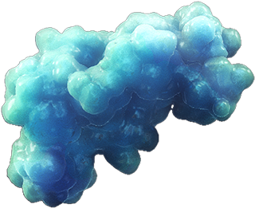
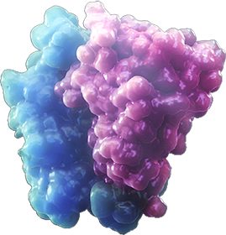
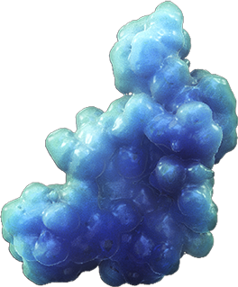

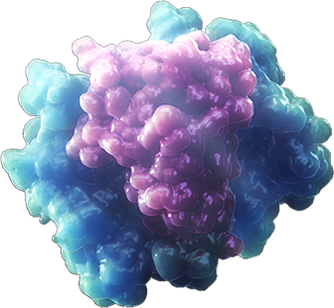
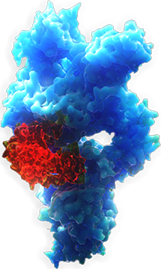

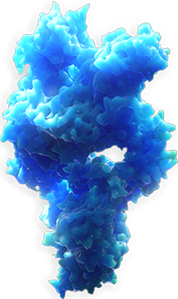
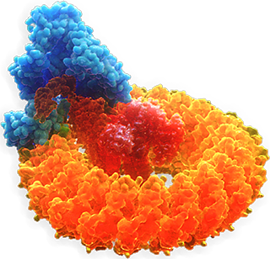
Proximal Complement Inhibitors
Alternative pathway
(Tick-over)
C3
Factor B
C3(H₂O)
Factor D
C3 convertase
Factor B
Factor D
C3
convertase
C3
C3b
C3a
Extravascular hemolysis via C3 opsonization and phagocytosis
C3b
Proximal pathways
C5
convertase
Terminal pathway
C5 inhibitors
C5
C6, C7,
C8, C9_{n}
C5a
C5b
MAC
Notes:
Speaker Notes:
This led then to studies of the proximal pathway of C3 factor D and factor B inhibition, as shown in this slide.

Slide 47
Proximal Complement Inhibitors
Agent | FDA Approval | MOA | Administration | Indication | REMS Program
Pegcetacoplan | May 2021 | Peglyated pentadecapeptide that targets C3 | Subcutaneous/ 2x weekly **on-body injector approved in October 2023 | Adult patients with PNH | Yes
Danicopan | May 2024 | Factor D inhibitor | Oral three times a day, with or without food With a C5 inhibitor | Adult patients with PNH | Yes
Iptacopan | December 2023 | Factor B inhibitor | Oral given BID with or without food | Adult patients with PNH | Yes
Notes:
Speaker Notes:
And we now have three FDA approved drugs that target those three factors. Pegcetacoplan was the first, which was FDA approved in May of 2021. It is given subcutaneously twice a week, for all adult patients with PNH. Danicopan is a factor D inhibitor that's given orally three times a day, and it has to be given with a C5 inhibitor, so you are not getting rid of your IV therapy with this. Iptacopan is an oral factor B inhibitor that is used as a monotherapy, and it's given twice a day.

Slide 48
Pegcetacoplan Versus Eculizumab in Paroxysmal Nocturnal Hemoglobinuria
Conclusions
Pegcetacoplan was superior to eculizumab in improving hemoglobin and clinical and hematologic outcomes in patients with PNH by providing broad hemolysis control, including control of intravascular and extravascular hemolysis
Notes:
Speaker Notes:
So let's talk first about pegcetacoplan.
Hillmen P, Szer J, Weitz I, et al. Pegcetacoplan versus eculizumab in paroxysmal nocturnal hemoglobinuria. N Engl J Med. 2021;384(11):1028-1037.

Slide 49
PEGASUS Trial
PEGASUS is a phase 3, randomized, multicenter trial comparing pegcetacoplan to eculizumab in PNH patients on eculizumab with an Hgb <10.5
Primary endpoint was the change in Hgb at week 16.
Pegcetacoplan was superior to eculizumab in improving Hgb levels and other clinical outcomes.
Adverse events include injection site reactions, diarrhea (mild), and breakthrough hemolysis
Notes:
Speaker Notes:
The PEGASUS was the phase 3 registry trial comparing pegcetacoplan to eculizumab in patients who were on eculizumab with a hemoglobin less than 10.5, a suboptimal responder, in a sense. During the first 4 weeks, all patients received both drugs together. So you see that rise in hemoglobin from 8.7 to 11.8-11.9 range. And then they were randomized to receiving either eculizumab alone or pegcetacoplan alone. And the primary endpoint of this was a change in the hemoglobin at week 16. And what you see here is that patients on eculizumab therapy fell right back to their baseline hemoglobin, whereas those in pegcetacoplan maintain this effect of staying in the close to normal range around 12.
Hillmen P, Szer J, Weitz I, et al. Pegcetacoplan versus eculizumab in paroxysmal nocturnal hemoglobinuria. N Engl J Med. 2021;384(11):1028-1037.

Slide 50
PEGASUS: Secondary Endpoints
Notes:
Speaker Notes:
Hillmen P, Szer J, Weitz I, et al. Pegcetacoplan versus eculizumab in paroxysmal nocturnal hemoglobinuria. N Engl J Med. 2021;384(11):1028-1037.

Slide 51
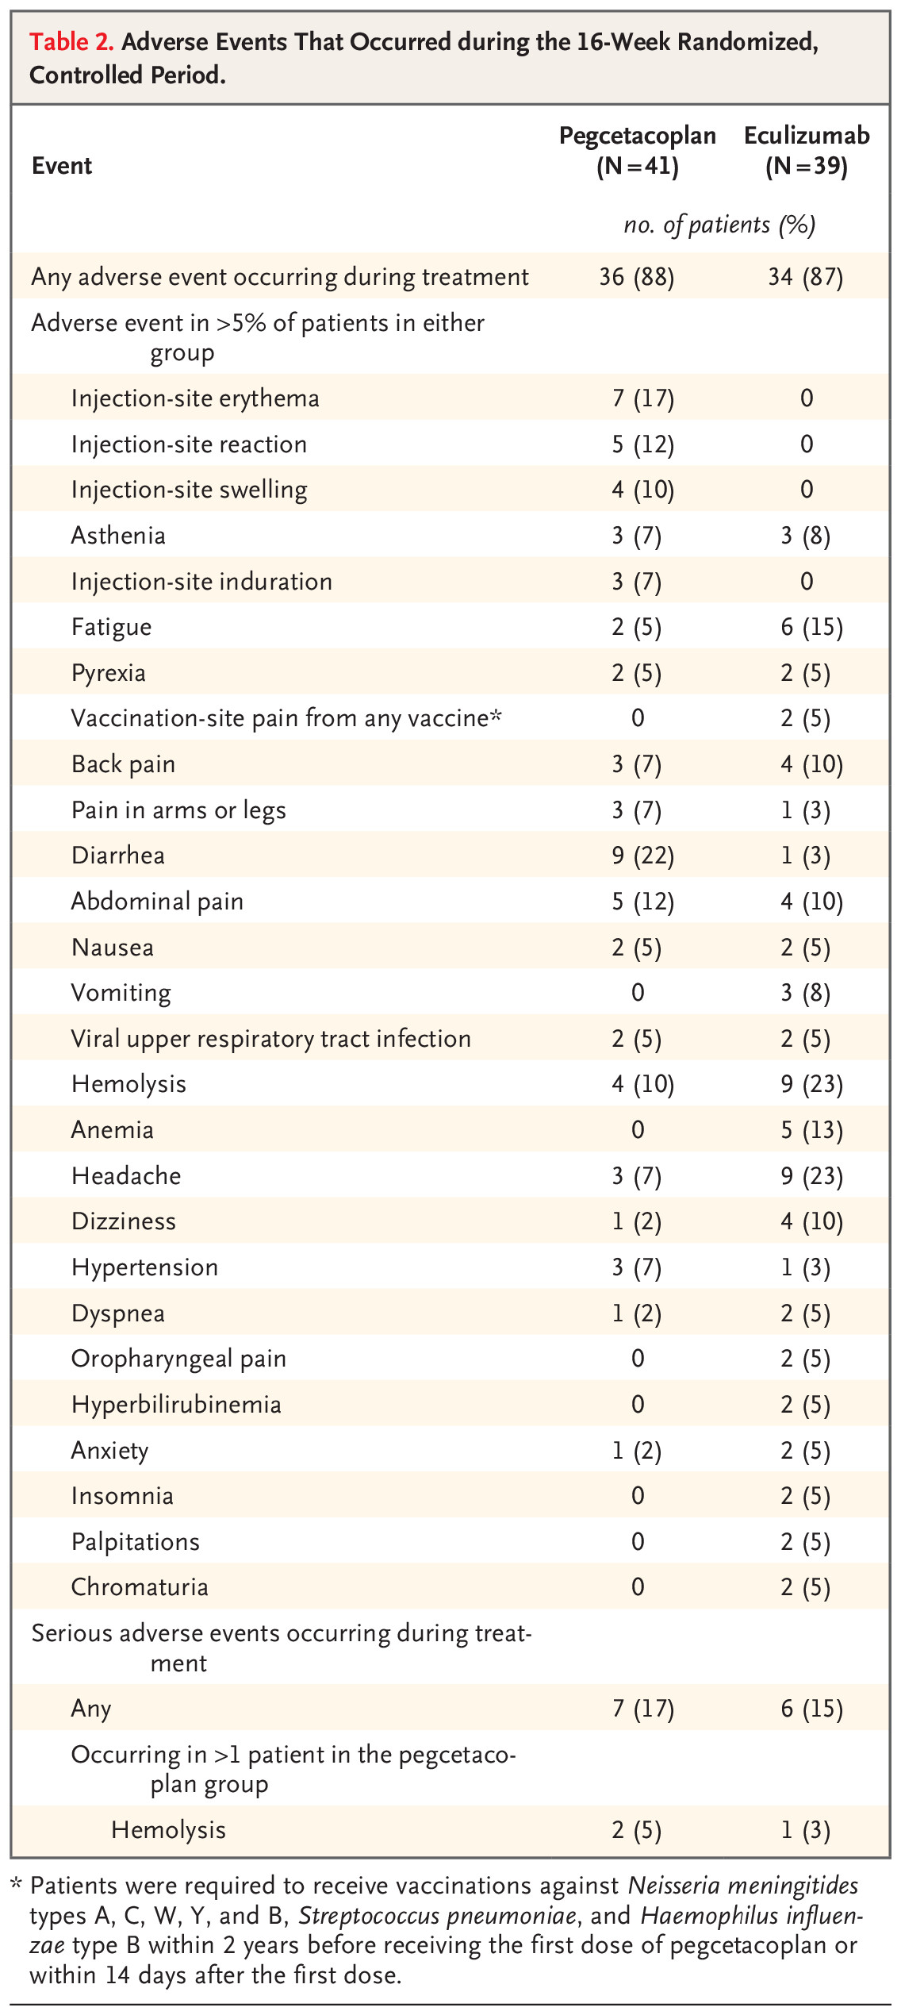
PEGASUS: Safety Outcomes
Breakthrough hemolysis reported in 13 patients (9 eculizumab, 4 pegcetacoplan)
3 patients in pegcetacoplan group discontinued due to TEAE of hemolysis
  Included 1 SAE
Injection site reactions: mostly mild
  None led to change in dose or study discontinuation
Diarrhea mostly mild (1 moderate)
  No dose changes due to diarrhea
Notes:
Speaker Notes:
There were a few adverse events, including injection site reaction, since it's a sub-q drug, diarrhea which was mild and self-limited, and some episodes of breakthrough hemolysis, although the number of breakthrough hemolysis events were actually higher in the eculizumab arm than in the pegcetacoplan arm. Again, safety outcomes are shown here. The breakthrough hemolysis occurred in 13 patients, 9 who were on the eculizumab arm, 4 on the pegceta – cetacoplan arm, 3 patients had to discontinue it because we didn't know what to do if they had hemolytic anemia. We put them back on the C5 inhibitor. We now have a study out there showing that if you give an extra dose of pegcetacoplan, you can abrogate that breakthrough hemolysis.
Hillmen P, Szer J, Weitz I, et al. Pegcetacoplan versus eculizumab in paroxysmal nocturnal hemoglobinuria. N Engl J Med. 2021;384(11):1028-1037.

Slide 52
PRINCE Trial: Pegcetacoplan Controls Hemolysis in Complement Inhibitor–Naive Patients With Paroxysmal Nocturnal Hemoglobinuria
Notes:
Speaker Notes:
PRINCE was a study done with the same drug in naive patients, complement inhibitor-naive patients. And you show here again that rise in hemoglobin to above 12 with a low LDH. And these patients’ reticulocyte counts fell. Everything looked very good for this drug. So it's now FDA approved and given primarily to patients with extravascular hemolysis or suboptimal response to C5 inhibitors, but it can be used up front in some patients.
Wong RSM, Navarro-Cabrera JR, Comia NS, et al. Pegcetacoplan controls hemolysis in complement inhibitor-naive patients with paroxysmal nocturnal hemoglobinuria. Blood Adv. 2023;7(11):2468-2478.

Slide 53
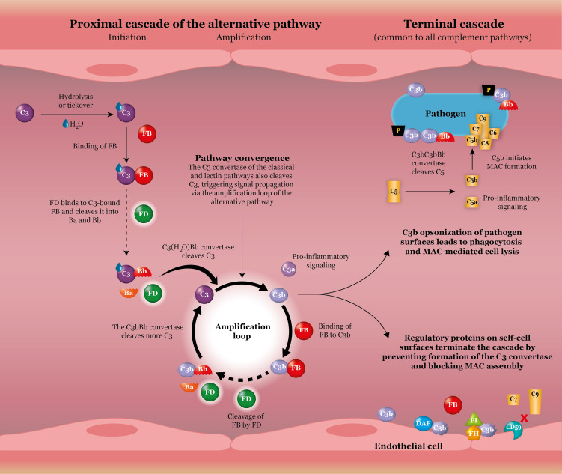
Factors B and D as Targets
Notes:
Speaker Notes:
Barratt J, Weitz I. Complement factor D as a strategic target for regulating the alternative complement pathway. Front Immunol. 2021;12:712572.

Slide 54
Proximal Complement Inhibitors: Danicopan
 | FDA Approval | MOA | Administration | Indication | REMS Program
Danicopan | May 2024 | Factor D inhibitor | Oral three times a day With a C5 inhibitor | Adult patients with PNH | Yes
Notes:
Speaker Notes:
Danicopan is the oral factor D inhibitor that was FDA approved in May of last year, given orally three times a day with a C5 inhibitor. They did not want to try it without that. In part, they were worried about breakthrough hemolysis on just a single agent.

Slide 55
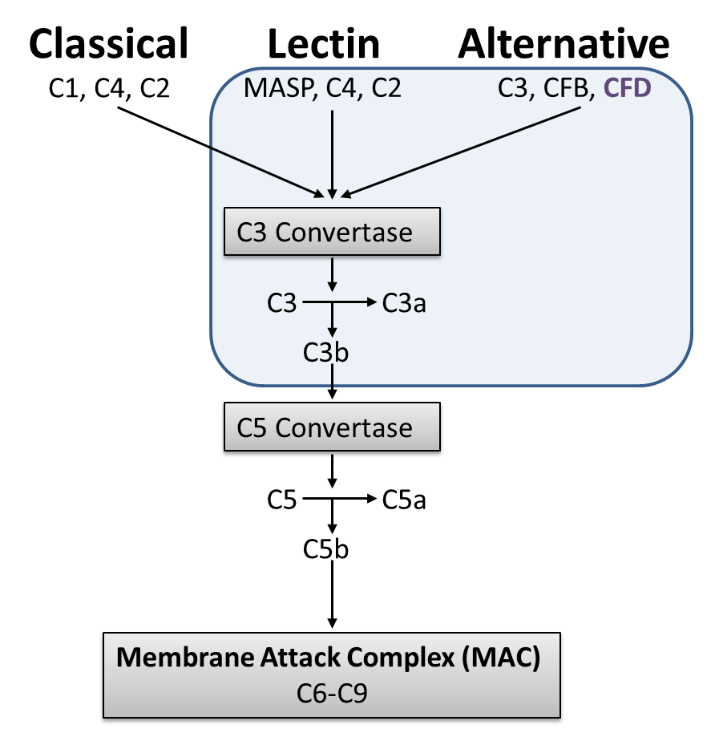
Proximal Complement Inhibitors – Danicopan
Indicated as add-on therapy to anti-C5 treatment for adult
patients with PNH experiencing EVH
Danicopan
Phase 3 ALPHA: Randomized, multiple-region, double-blind, placebo controlled
Efficacy and safety of danicopan as add-on to ravulizumab or eculizumab in adult PNH patients with clinically significant EVH
Orally administered
complement factor D inhibitor
Primary Endpoint
Change in Hb concentration from baseline to week 12
Patients could enroll in an additional 12-week open-label period and a two-year long-term extension, where those on placebo + anti-C5 switched to danicopan + anti-C5, while those on danicopan + anti-C5 continued the same regimen.
Danicopan + Anti-C5
Placebo
  2.94 g/dL
  0.5 g/dL
 | Danicopan-Danicopan |  | Placebo-Danicopan
 | 24 weeks | 48 weeks | 24 weeks | 48 weeks
Mean Hb (g/dL) | 10.78 | 10.36 | 10.46 | 10.51
P < 0.0001
Improvements in Hb continued at 24 weeks and were sustained through 48 weeks.
Notes:
Speaker Notes:
And you see here again, the primary endpoints were co-endpoints of either a hemoglobin rise of greater than 2 g/dL, or a hemoglobin rise to above 12. And you see that that did occur in the majority of patients treated with danicopan plus a C5 inhibitor as compared to placebo. Again, dramatically, on this graph, where you see patients treated - with danicopan plus the C5 inhibitor versus those just on the C5 inhibitor alone in the green line, that patients’ hemoglobin levels rose to above 10 when they were below 8 - in the baseline for these patients, and this was sustained out greater than 48 weeks. So it provides another option for treating patients.
Lee JW, Griffin M, Kim JS, et al. Addition of danicopan to ravulizumab or eculizumab in patients with paroxysmal nocturnal haemoglobinuria and clinically significant extravascular haemolysis (ALPHA): a double-blind, randomised, phase 3 trial. Lancet Haematol. 2023;10(12):e955-e965.
Kulasekararaj A, Griffin M, Piatek CI, et al. Danicopan as add-on therapy to ravulizumab or eculizumab versus placebo in patients with paroxysmal nocturnal hemoglobinuria and clinically significant extravascular hemolysis: phase 3 long-term data. Abstract presented at: American Society of Hematology Annual Meeting & Exposition; San Diego, California. December 9-12, 2023. Abstract 576.

Slide 56
Proximal Complement Inhibitors – Danicopan
Phase III ALPHA trial
Indicated as add-on therapy to anti-C5 treatment for adult patients with PNH experiencing EVH
Phase 3 ALPHA: Randomized, multiple-region, double-blind, placebo controlled
Efficacy and safety of danicopan as add-on to ravulizumab or eculizumab in adult PNH patients with clinically significant EVH
Key Takeaways
Danicopan as add-on to anti-C5 therapy significantly improved Hb levels and reduced the need for transfusion by addressing clinically significant EVH while maintaining control of IVH through 48 weeks of treatment
 | Danicopan-Danicopan |  | Placebo-Danicopan
 | Change or % at 12 weeks | Change or % at 24 weeks | Change or % at 12 weeks | Change or % at 24 weeks
LDH (U/L) | 2.94 | 3.17 | 0.50 | 2.26
ARC (x 10⁹/L) | -83.8 | -80.2 | 3.5 | -65.2
Hb increase ≥2 g/dL in absence of RBCT (%) | 59.5% | 46.3% | 0% | 35%
Transfusion avoidance (%) | 83.3% | 78% | 38.1% | 90%
C3 deposition on PNH RBCs (median, %) | 4.6 | 6.7 | 37.2 | 5.15
Secondary
Endpoints
Notes:
Speaker Notes:
Lee JW, Griffin M, Kim JS, et al. Addition of danicopan to ravulizumab or eculizumab in patients with paroxysmal nocturnal haemoglobinuria and clinically significant extravascular haemolysis (ALPHA): a double-blind, randomised, phase 3 trial. Lancet Haematol. 2023;10(12):e955-e965.
Kulasekararaj A, Griffin M, Piatek CI, et al. Danicopan as add-on therapy to ravulizumab or eculizumab versus placebo in patients with paroxysmal nocturnal hemoglobinuria and clinically significant extravascular hemolysis: phase 3 long-term data. Abstract presented at: American Society of Hematology Annual Meeting & Exposition; San Diego, California. December 9-12, 2023. Abstract 576.

Slide 57
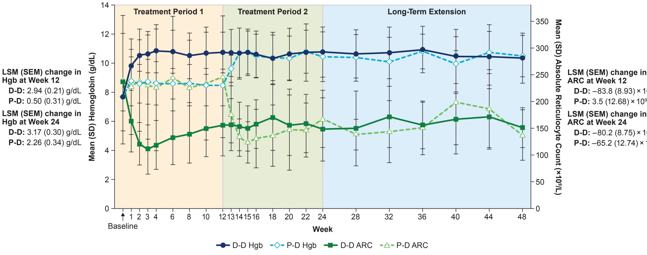
Change in Hemoglobin and Absolute Reticulocyte Count During 48 Weeks of Treatment
Notes:
Speaker Notes:
Again, dramatically, on this graph, where you see patients treated - with danicopan plus the C5 inhibitor versus those just on the C5 inhibitor alone in the green line, that patients’ hemoglobin levels rose to above 10 when they were below 8 - in the baseline for these patients, and this was sustained out greater than 48 weeks. So it provides another option for treating patients.
Lee JW, Griffin M, Kim JS, et al. Addition of danicopan to ravulizumab or eculizumab in patients with paroxysmal nocturnal haemoglobinuria and clinically significant extravascular haemolysis (ALPHA): a double-blind, randomised, phase 3 trial. Lancet Haematol. 2023;10(12):e955-e965.
Kulasekararaj A, Griffin M, Piatek CI, et al. Danicopan as add-on therapy to ravulizumab or eculizumab versus placebo in patients with paroxysmal nocturnal hemoglobinuria and clinically significant extravascular hemolysis: phase 3 long-term data. Abstract presented at: American Society of Hematology Annual Meeting & Exposition; San Diego, California. December 9-12, 2023. Abstract 576.

Slide 58
Proximal Complement Inhibitors: Iptacopan
 | FDA Approval | MOA | Administration | Indication | REMS Program
Iptacopan | December 2023 | Factor B inhibitor | Oral given BID with or without food | Adult patients with PNH | Yes
Notes:
Speaker Notes:
And finally, we have iptacopan, which is a factor B inhibitor, oral monotherapy given twice a day to adult patients with PNH.

Slide 59
Iptacopan: APPLY-PNH Clinical Trial
APPLY-PNH is an open-label, randomized, multicenter, phase III trial investigating iptacopan monotherapy in PNH patients with residual anemia despite SoC therapy
Two primary endpoints - Hematological response defined as an increase from baseline in Hb of ≥2 g/dL in the absence of RBC transfusions and hematological response defined as Hb ≥12 g/dL in the absence of RBC transfusions
Oral iptacopan monotherapy led to a significant majority of patients achieving clinically meaningful Hb increases and Hb ≥12 g/dL, associated with a higher rate of transfusion independence and reduced patient-reported fatigue, compared with SoC
15
14
13
12
12 g/dL
11
Mean Hb level, g/dL (SD)
10
9
8
7
BL
Wk1
Wk2
Wk4
Wk6
Wk8
Wk12
Wk16
Wk18
Wk20
Wk22
Wk24
Notes:
Speaker Notes:
APPLY is in treatment – C5 inhibitor-treated patients. APPOINT is in treatment-naive patients. Again, co-endpoints of a rise of greater than 2 or hemoglobin level greater than 12. And these were both met in the significant majority of patients compared to those that stayed on the C5 inhibitor alone. There was marked improvements in transfusion and independence, fatigue compared to standard of care.
de Latour RP, Röth A, Kulasekararaj AG, et al. Oral iptacopan monotherapy in paroxysmal nocturnal hemoglobinuria. N Engl J Med. 2024;390(11):994-1008.

Slide 60
Iptacopan: APPOINT-PNH Clinical Trial
APPOINT-PNH is a Phase 3, multinational, multicenter, open-label, single-arm study of Iptacopan in treatment-naïve PNH patients
92.2% achieved a 2.0 g/dL increase in Hgb levels from baseline without transfusion at week 24
62.8% achieved a Hgb level of > 12.0 g/dL
97.6% achieved transfusion independence by week 24
All secondary endpoints
all met
No episodes of BTH
12 g/dL
Mean Hb level at 24 weeks:
12.56 g/dL
(SD 1.49)
Notes:
Speaker Notes:
And this is just the APPOINT study showing the same thing, hemoglobin levels rising to near normal levels.
Risitano AM, Han B, Ueda Y, et al. Oral complement factor B inhibitor iptacopan monotherapy improves hemoglobin to normal/near-normal levels in paroxysmal nocturnal hemoglobinuria patients naïve to complement inhibitors: phase III APPOINT-PNH trial. Abstract presented at: 49th Annual Meeting of the European Society for Blood and Marrow Transplantation (EBMT); Paris, France; April 23-36, 2023. Abstract OS12-06.

Slide 61
Proximal Complement Inhibitors – Iptacopan 48-Week Data
Increases in Hb and
a mean normal/
near-normal Hb level were maintained in the iptacopan arm and rapidly achieved in the anti-C5-to-iptacopan arm upon treatment switch
15
Anti-C5 to iptacopan switch
14
13
12
12 g/dL
Mean Hb level, g/dL (SD)*
11
10
Mean Hb levels
at 48 weeks:
12.2 g/dL
(SD 1.6) and
12.1 g/dL
(SD 1.4)
9
8
7
BL
1
2
4
6
8
12
16
18
20
22
24
Patients with available data
25†
28
32
36
40
44
48
Study visit (week)
Iptacopan
62
61
59
60
59
59
60
59
59
59
57
61
–
56
59
59
57
57
59
Anti-C5 to iptacopan
35
29
27
32
32
31
33
28
34
32
32
34
27
28
32
31
29
30
30
 | Treatment arm | Adjusted mean change from baseline at Week 48 (95% CI) | Adjusted mean difference in change from baseline (95% CI): Week 48 vs Week 24
Change from baseline‡ in Hb level (g/dL)§ | Iptacopan | +3.35 (3.04,‖ 3.67‖) | −0.41 (−0.80, −0.01)
Female, n (%) | Anti-C5 to iptacopan | +3.36 (2.94,‖ 3.79) | +3.02 (2.49,‖ 3.56)
Notes:
Speaker Notes:
We have data out for the same drug for over 48 weeks, showing, again, a sustained response to the iptacopan given orally, it doesn't go away. And the side effects, again, have been very good with this drug. Everything looking good.

Slide 62


Proximal Complement Inhibitors – Iptacopan 48-Week Data Breakthrough Hemolysis (BTH)
Timeframe for assessment
Week 1 to
Week 24
Week 24 to
Week 48
Week 1 to
Week 24
Week 24 to
Week 48
Patients with clinical BTH*
2/62†
patients in the iptacopan arm
[2 events]
5/61†,‡
patients in the iptacopan arm
[5 events]
6/35
patients in the
anti-C5 arm
[11 events]
1/34§
patients who
switched from
anti-C5 to iptacopan
[1 event]
Patients with clinical BTH*
Patients with clinical BTH*
17.1%
8.2%
17.1%
2.9%
3.2%
8.2%
2.9%
3.2%
The overall adjusted annualized rate of clinical BTH* since initiation of iptacopan monotherapy, including
iptacopan-treated patients in both treatment arms, was 0.11 (95% CI 0.05, 0.23)
All clinical BTH events* reported during iptacopan monotherapy in APPLY-PNH were mild or moderate in severity and resolved without iptacopan discontinuation; one patient received a single dose of eculizumab per the decision of their investigator¹
Notes:
Speaker Notes:
The one thing I will say about iptacopan, and we'll have to wait with more time to see if this true, but the number of breakthrough hemolysis events, that is, you get a complement-activated event, like an infection, and you can get breakthrough hemolysis with all these drugs, but it seemed to be lower iptacopan. There is no head-to-head study to compare these, but historically, the number of breakthrough events with iptacopan seemed to be a little bit lower.
de Latour RP, Kulasekararaj A, Scheinberg P, et al. Clinical breakthrough hemolysis (BTH) during monotherapy with the oral factor B inhibitor iptacopan is generally not severe and managed without treatment discontinuation: 48-week data from the phase III APPLY-PNH and APPOINT-PNH trials in paroxysmal nocturnal hemoglobinuria (PNH). Blood. 2023;142(Supplement 1):1338.

Slide 63
Disease-Related and Treatment-Related Adverse Events (AEs)

Slide 64
Adverse Events and Management
Lipids¹
  Patients on proximal inhibitors should have lipid monitoring at least every 6 months
Vaccinations²
  All patients receiving complement inhibitors should receive Meningitis vaccines (both ACWY and B)
  Proximal inhibitor patients should receive pneumococcal vaccine, consider HiB vaccine
  Timing of vaccination (vaccines can activate complement)
Infections²
  All infections should receive immediate antibiotics
  Stopping complement inhibitor not recommended (despite FDA label)
Extravascular hemolysis^{3,4}
  Only seen in patients on C5 inhibitors
  Labs show elevated reticulocyte count, mildly elevated LDH, variable elevation in bilirubin, and may show weak DAT +
  If anemic or symptomatic, consider switching to a proximal inhibitor
Notes:
Speaker Notes:
With all these patients, we have to watch out for hyperlipidemia. It's not clear why they can get that. It's mild, and in most patients, it was managed easily with either diet modifications and/or with increasing their dose of statins. All patients have to be vaccinated against meningitis, as mentioned. In addition, if you're on a proximal inhibitor, you should receive the pneumococcal vaccine and possibly the Hemophilus influenza vaccine.
Vaccines can activate complements, so we have to be careful with that if you're not on a C5 inhibitor or a proximal inhibitor. And it's been recommended in some cases that we actually give prophylactic antibiotics, start the treatment with the complement inhibitor, and then vaccinate right away, so we can avoid that hemolysis. Infection should all receive immediate antibiotics. Stopping complement inhibitors is not recommended, even if you have an infection. The FDA label, for example, says, hey, if you get a serious infection, consider stopping it. But the reality is, if you do that, you're going to see a lot more hemolysis. And extravascular hemolysis is a complication that we just talked about, and in those cases, we should probably switch to a proximal inhibitor.
Peffault de Latour R, Röth A, Kulasekararaj AG, et al. Oral iptacopan monotherapy in paroxysmal nocturnal hemoglobinuria. N Engl J Med. 2024;390(11):994-1008.
Hill A, DeZern AE, Kinoshita T, Brodsky RA. Paroxysmal nocturnal haemoglobinuria. Nat Rev Dis Primers. 2017;3:17028.
Risitano AM, Notaro R, Marando L, et al. Complement fraction 3 binding on erythrocytes as additional mechanism of disease in paroxysmal nocturnal hemoglobinuria patients treated by eculizumab. Blood. 2009;113(17):4094-4100.
McKinley CE, Richards SJ, Munir T, et al. Extravascular hemolysis due to C3-loading in patients with PNH treated with eculizumab: defining the clinical syndrome. Blood. 2017;130(Suppl 1):3471.

Slide 65
Adverse Events and Management
Breakthrough hemolysis¹
  Usually related to a Complement Activating Event such as an infection (viral or bacterial)
  Except for pegcetacoplan,² there is no clinical data to support any recommendation
  Expert panel recommendations³
  My recommendations
    Continue current complement inhibitor and consider giving an
    extra dose
    Consider short course of steroids
Thrombosis¹
  Thrombotic episodes are now rare
  but can still happen
  Treat with thrombolytics and anticoagulants
  No data to know if switching to another complement inhibitor helps
Notes:
Speaker Notes:
Breakthrough hemolysis is usually related to complement-activating events such as infection or bacteria. Except for pegcetacoplan, we don't really have clinical guidelines to help do this. There is recommendations from an expert panel, although it is a little bit scattered all over the place in terms of what they recommend. I recommend continuing the current complement inhibitor they're on. You obviously treat the infection or whatever complement event there is – complement-activated event there is and consider giving an extra dose of whatever they're on, which is what we do with pegcetacoplan. Thrombotic events need to be treated with thrombolytics and anticoagulants as indicated. You have to be careful for bleeding. There is no data if you are on a complement inhibitor, if switching to another component inhibitor will help prevent another clot.
Hill A, DeZern AE, Kinoshita T, Brodsky RA. Paroxysmal nocturnal haemoglobinuria. Nat Rev Dis Primers. 2017;3:17028.
Griffin M, Kelly RJ, Panse J, et al. Management of acute breakthrough hemolysis with intensive pegcetacoplan dosing in patients with PNH. Blood Adv. 2024;8(7):1776-1786.
Dingli D, De Castro Iii C, Koprivnikar J, et al. Expert consensus on the management of pharmacodynamic breakthrough-hemolysis in treated paroxysmal nocturnal hemoglobinuria. Hematology. 2024;29(1):2329030.

Slide 66
Conclusion

Slide 67
Complement Inhibition for PNH:
Which One Should We Use?
Now have 6 FDA approved complement inhibitors for PNH, more may be on the way
Some target terminal pathway, others the proximal pathway
Two are oral, others given IV or subQ at various intervals
All are very well tolerated with few side effects
Patients need to be alert for infections, especially meningococcal infections
Some may be better at achieving a higher hemoglobin level
Breakthrough hemolysis is still an issue for all drugs
Other considerations: side effects, rate of thrombosis, cost and insurance coverage, compliance
Choosing the right therapy may take consultation with a center that specializes in PNH
Notes:
Speaker Notes:
How to choose which one to use is not easy. It takes somebody who knows all the drugs well to discuss with the patient, asking the patients what they would prefer is one method. But obviously there are side effects to all these drugs, and you need to know which one is best for the patient. We have to consider side effects, rate of thromboses, the cost of these drugs, they're all very expensive, whether insurance will cover them, and we have to make sure the patients can be compliant, especially if they're on an oral drug, because if you stop or miss a dose, you can quickly go into a hemolytic flare. All these drugs are well tolerated, with few side effects. And choosing the right therapy might take consultation with a center that specializes in PNH.

Slide 68
Case-Based Learning Lab

Slide 69
Case 1
Patient C is a 41-year-old woman
She initially presented 20 years ago with shortness of breath and heavy menstrual periods. She was found to be markedly pancytopenic
W/U including a bone marrow biopsy showed aplastic anemia. She was treated with ATG and cyclosporine with complete count recovery. A bone marrow biopsy one year later was normocellular.

Slide 70
Case 1 Continued
She did well until 8 years ago when she noticed fatigue
Labs 8/22/16 showed WBC 3.4, Hgb 5.7, HCT 17.5, platelets 142K
Referred to her local hematologist. BM biopsy showed 40-45% cellular marrow with erythroid hyperplasia. Normal FISH, normal cytogenetics.
Peripheral blood flow cytometry was + for PNH
She was started on eculizumab on 9/12/2016

Slide 71
Case 1 Continued
CBC 1/13/2017 showed WBC 3.8, Hgb 9.4, HCT 28, platelets 188K, LDH 268
Evaluated for a bone marrow transplant, not felt to be a candidate
Still didn’t feel great, required transfusions q 3 months despite increasing dose of eculizumab to 1200 mg q 2 weeks
Switched to ravulizumab in
Dec 2020
Referred to Duke in June 2021
WBC 5.8, Hgb 7.6, HCT 23, platelets 247K, LDH 263, T bili 7.1, normal transaminases, Retic 20.60%

Slide 72
Case 1 Continued
Felt to be sub-optimal responder, likely due to C3 coating of her red cells and extravascular hemolysis
Started on Iptacopan January 2024
Patient C was last seen in clinic on 10/20/2024
Absolutely no complaints
WBC 6.0, Hgb 14.8, HCT 45, platelets 183K, LDH 145, T bili 1.2, Retic 1.12%
Still feels well with stable blood counts

Slide 73
For PNH patients on a C5 inhibitor, extravascular hemolysis can be recognized by:
High reticulocyte count, very high LDH, low bilirubin, and low haptoglobin
Low reticulocyte count, very high LDH, low bilirubin, and low haptoglobin
High reticulocyte count, slightly elevated LDH, high bilirubin, low haptoglobin
DAT (Coombs’ test) that becomes positive for IgG

Slide 74
Answer: C
Extravascular hemolysis is usually recognized by a high reticulocyte count indicating hemolysis. The LDH is usually mildly elevated (whereas it is very highly elevated in intravascular hemolysis). The bilirubin level is elevated to a variable degree. The haptoglobin is low. The DAT (Coombs test) may be weakly positive for C3 complement (not IgG).
Notes:
McKinley CE, Richards SJ, Munir T, et al. Extravascular hemolysis due to C3-loading in patients with PNH treated with eculizumab: defining the clinical syndrome. Blood. 2017;130(Suppl 1):3471.
Hill A, DeZern AE, Kinoshita T, Brodsky RA. Paroxysmal nocturnal haemoglobinuria. Nat Rev Dis Primers. 2017;3:17028.

Slide 75
Case 2
Ms L is a 41-year-old woman referred to Duke in May 2024 for PNH
In April 2022, 2 months after having a COVID infection, she developed severe headache with CT brain and MRI showing a right posterior cortical vein thrombus. Treated with apixaban. Thrombophilia work up negative (PNH screen not performed). Reports having some esophageal spasms to cold beverages then.
Referred to hematologist in April 2024 for cytopenias. WBC 2.0, ANC 1.1, Hgb 10.5, MCV 104, reticulocyte 119 (3.78%), platelets 90K, LDH 608, total bilirubin 1.2.
Bone marrow biopsy 5/13/2024 - slightly hypocellular marrow, trilineage hematopoiesis, and no morphologic evidence of leukemia, lymphoma, or dysplasia; however, flow cytometry showed granulocytes without CD16 expression and monocytes without CD14 expression, suggestive but not diagnostic of PNH
PNH panel sent 5/22/2024 showed PNH with granulocyte clone size of 99.78%

Slide 76
Case 2 Continued
Seen on 5/22/2024 – Discussed her disease, prognosis, risk of thrombotic events, and treatment options. Hgb has been drifting down to 9.7, feels some fatigue. She has not needed a transfusion. The patient had already done some research. She travels extensively in her job, and requested treatment with oral Iptacopan. Vaccinations against meningitis and pneumococcus were given.
Started on oral Iptacopan on 6/6/2024
Had some mild headaches during first week of treatment, otherwise tolerated it quite well

Slide 77
Case 2 Continued
LDH
Hgb

Slide 78
Which of the following statements is true regarding thrombosis in PNH?
Blood clots are never serious in PNH due to a lack of complement regulation
Anticoagulants are effective at preventing recurrent thrombotic events in PNH
All complement inhibitors have demonstrated a marked decrease in the incidence of thrombosis in PNH
Eculizumab is the preferred treatment for a PNH patient presenting with a thrombotic episode

Slide 79
Answer: C
Blood clots are very serious in PNH and historically were the major cause of death prior to the development of death in PNH. Anticoagulation is recommended for a thrombotic event, but without complement inhibitors, patients tended to have recurrent thrombotic episodes despite anti-coagulation. While eculizumab can be used for effective treatment, all complement inhibitors reduce the incidence of thrombotic events dramatically and about to the same incidence rate.
Notes:
Hill A, DeZern AE, Kinoshita T, Brodsky RA. Paroxysmal nocturnal haemoglobinuria. Nat Rev Dis Primers. 2017;3:17028.
Hillmen P, Muus P, Dührsen U, et al. Effect of the complement inhibitor eculizumab on thromboembolism in patients with paroxysmal nocturnal hemoglobinuria. Blood. 2007;110(12):4123-4128.

Slide 80
Thank You!

