Slide 1


Slide 2
DISCLAIMER
This slide deck in its original and unaltered format is for educational purposes and is current as of April 2025. All materials contained herein reflect the views of the faculty, and not those of AXIS Medical Education, the CME provider, or the commercial supporter. Participants have an implied responsibility to use the newly acquired information to enhance patient outcomes and their own professional development. The information presented in this activity is not meant to serve as a guideline for patient management. Any procedures, medications, or other courses of diagnosis or treatment discussed or suggested in this activity should not be used by clinicians without evaluation of their patients’conditions and possible contraindications and/or dangers in use, review of any applicable manufacturer’s product information, and comparison with recommendations of other authorities.

Slide 3



Welcome and Introductions
Chair
Faculty
Theresa Wicklin Gillespie,
PhD, MA, RN, FAAN
Looney Family Professor of Cancer Research
Dept of Hematology and Medical Oncology and Dept of Surgery
Emory University School of Medicine
Winship Cancer Institute
Atlanta, GA
Kristi K. Orbaugh, MSN, NP, AOCNP
Adult Nurse Practitioner
Community Hospital Oncology Physicians
Indianapolis, IN
Kimberly Podsada, MSN, NP-C, CNS
Oncology Nurse Practitioner
University of California-San Diego
Comprehensive Breast Health Cancer
La Jolla, CA

Slide 4
Disclosures
Theresa Wicklin Gillespie, PhD, MA, RN, FAAN, reported a financial interest/relationship or affiliation in the form of: Research grant: National Institutes of Health
Kristi K. Orbaugh, MSN, NP, AOCNP, reported a financial interest/relationship or affiliation in the form of: Serve(d) as a speaker or a member of a speakers bureau for: AstraZeneca Pharmaceuticals LP, Daiichi-Sankyo, Inc., Exelixis, Inc., Gilead, Lilly USA, Pfizer, Inc., Sobi, Stemline
Kimberly Podsada, MSN, NP-C, CNS, reported a financial interest/relationship or affiliation in the form of: Serve(d) as a speaker or a member of a speakers bureau for: Daiichi Sankyo/AstraZeneca, Novartis Pharmaceuticals Corporation, Pfizer, Inc.

Slide 5
Learning Objectives
After participating in this educational activity, participants should be better able to:
Explain the importance of risk assessment in treatment decision-making for patients with early-stage HR+/HER- breast cancer
Recognize factors elevating risk of relapse in patients with early-stage HR+/HER2- breast cancer to guide treatment selection
Describe how CDK4/6 inhibitors are beneficial for use in the adjuvant setting in HR+/HER2- early breast cancers based on the key clinical research findings
Select appropriate treatments for patients with early-stage HR+/HER- breast cancer based on individualized assessment of recurrence risk
Develop strategies to mitigate and manage adverse events associated with CDK4/6 inhibitors to reduce or prevent treatment-related toxicities, treatment delays, nonadherence, and discontinuation of therapy
Integrate nursing strategies to facilitate shared decision-making in educating patients about the risks and benefits of adjuvant CDK4/6 inhibitor therapies for HR+/HER2- early breast cancer, aiming to enhance treatment adherence and persistence

Slide 6
Importance of Assessing Risk of Relapse in Early-Stage ER+/HER2- Breast Cancer
Kimberly Podsada, MSN, NP-C, CNS

Slide 7
Patient Case/Polling Question 1
A 40 yo premenopausal female presented with a palpable left breast mass. Imaging and biopsy of breast and lymph node revealed clinical T2N1, grade 2, ER/PR 90%, HER2 0 by IHC, and FISH negative invasive ductal carcinoma. She enrolled in a clinical trial and was not eligible due to low MammaPrint®. Staging scans without metastasis.
What test would you consider ordering next?
Oncotype DX
Genetic testing
NGS/Molecular testing
Breast Cancer Index (BCI)

Slide 8
Patient Case
A 40 yo premenopausal female presented with a palpable left breast mass. Imaging and biopsy of breast and lymph node revealed clinical T2N1, grade 2, ER/PR 90%, HER2 0 by IHC, and FISH negative invasive ductal carcinoma. She enrolled in a clinical trial and was not eligible due to low MammaPrint®. Staging scans without metastasis.
What test would you
consider ordering next?
Oncotype DX
Genetic testing
NGS/Molecular testing
Breast Cancer Index (BCI)
Correct answer is Genetic testing. Oncotype is based on pathological stage, not clinical (although this is not always practiced). NGS testing would be appropriate for mBC.
BCI is appropriate after 5 years of endocrine therapy.

Slide 9
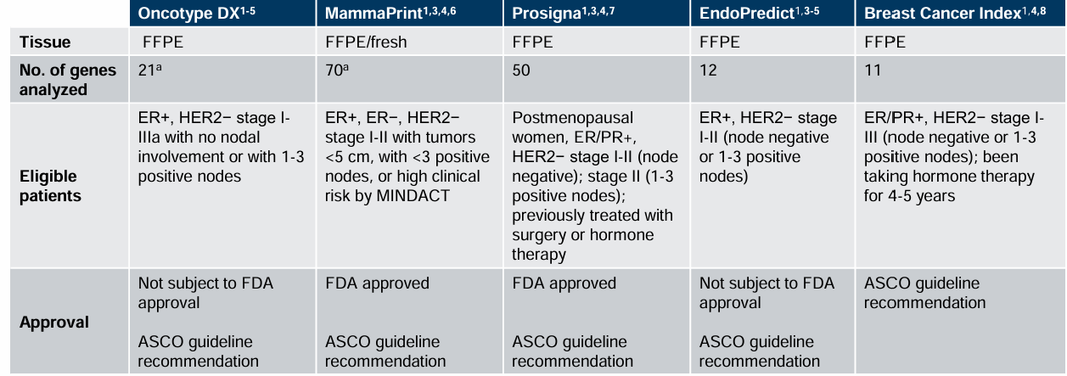
Early Breast Cancer Genomic Testing
ASCO, American Society of Clinical Oncology; ER, estrogen receptor; FDA, US Food and Drug Administration; FFPE, formalin-fixed paraffin-embedded; HER2, human epidermal growth factor receptor 2; MINDACT, Microarray in Node-negative Disease may Avoid ChemoTherapy; PR, progesterone receptor.
ªNo overlap between gene profiles of MammaPrint and Oncotype DX.
1. Andre F, et al. J Clin Oncol. 2022;40(16):1816-1837. 2. DePolo J. https://www.breastcancer.org/screening-testing/oncotype-dx#recurrence. 3. Cognetti F, et al. Oncotarget. 2021;12(9):936-947.
4. Čelešnik H, et al. Cancers (Basel). 2023;15(4):1087. 5. Medicaid.gov. https://medicaid.ncdhhs.gov/1s-7-gene-expression-profiling-breast-cancer/download?attachment#:~:text-to%20be%20recommended.-,1.1.4%20Endopredict%C2%AEEPClin%20Score,to%20FDA%20approval%20or%20clearance. 6. Breastcancer.org. https://www.breastcancer.org/screening-testing/mammaprint-test. 7. Breastcancer.org. https://www.breastcancer.org/screening-testing/prosigna-assay. 8. Breastcancer.org. https://www.breastcancer.org/screening-testing/breast-cancer-index-test
Notes:
1. Andre F, Ismaila N, Allison KH, et al. Biomarkers for adjuvant endocrine and chemotherapy in early-stage breast cancer: ASCO guideline update. J Clin Oncol. 2022;40(16):1816-1837.
2. Breastcancer.org. Oncotype DX Tests. Accessed September 6, 2024. https://www.breastcancer.org/screening-testing/oncotype-dx#recurrence
3. Cognetti F, Biganzoli L, De Placido S, et al. Multigene tests for breast cancer: the physician's perspective. Oncotarget. 2021;12(9):936-947.
4. Čelešnik H, Potočnik U. Blood-based mRNA tests as emerging diagnostic tools for personalised medicine in breast cancer. Cancers (Basel). 2023;15(4):1087.
5. Medicaid.gov. NC Medicaid Gene Expression Profiling for Breast Cancer. Accessed September 6, 2024. https://medicaid.ncdhhs.gov/1s-7-gene-expression-profiling-breast-cancer/download?attachment#:~:text-to%20be%20recommended.-,1.1.4%20Endopredict%C2%AEEPClin%20Score,to%20FDA%20approval%20or%20clearance
6. Breastcancer.org. MammaPrint Test. Accessed September 6, 2024. https://www.breastcancer.org/screening-testing/mammaprint-test
7. Breastcancer.org. Prosigna Breast Cancer Prognostic Gene Signature Assay. Accessed September 6, 2024. https://www.breastcancer.org/screening-testing/prosigna-assay
8. Breastcancer.org. Breast Cancer Index Test. Accessed September 6, 2024. https://www.breastcancer.org/screening-testing/breast-cancer-index-test

Slide 10
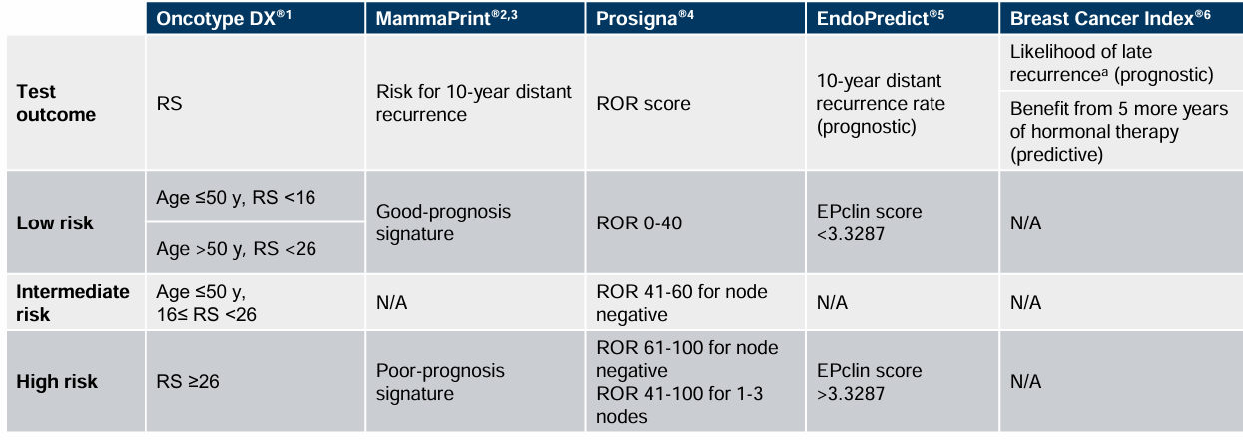
Early Breast Cancer Genomic Testing and
Cancer Recurrence Risk
The brand names mentioned in this document are the property of their respective trademark owners.
EP, EndoPredict; RS, recurrence score; N/A, not applicable; ROR, risk of recurrence.
ª 5 to 10 years after diagnostic.
1. Breastcancer.org. https://www.breastcancer.org/screening-testing/oncotype-dx#recurrence. 2. Haan JC, et al. Genes Chromosomes Cancer. 2022;61(3):148-160. 3. Van De Vijver MJ, et al. N Engl J Med. 2002;347(25):1999-2009. 4. Breastcancer.org. https://www.breastcancer.org/screening-testing/prosigna-assay. 5. Breastcancer.org. https://www.breastcancer.org/screening-testing/endopredict-test. 6. Breastcancer.org. https://www.breastcancer.org/screening-testing/breast-cancer-index-test.
Notes:
1. Breastcancer.org. Oncotype DX Tests. Accessed September 6, 2024. https://www.breastcancer.org/screening-testing/oncotype-dx#recurrence
2. Haan JC, Bhaskaran R, Ellappalayam A, et al. MammaPrint and BluePrint comprehensively capture the cancer hallmarks in early-stage breast cancer patients. Genes Chromosomes Cancer. 2022;61(3):148-160.
3. van de Vijver MJ, He YD, van't Veer LJ, et al. A gene-expression signature as a predictor of survival in breast cancer. N Engl J Med. 2002;347(25):1999-2009.
4. Breastcancer.org. Prosigna Breast Cancer Prognostic Gene Signature Assay. Accessed September 6, 2024. https://www.breastcancer.org/screening-testing/prosigna-assay
5. Breastcancer.org. EndoPredict Test. Accessed September 6, 2024. https://www.breastcancer.org/screening-testing/endopredict-test
6. Breastcancer.org. Breast Cancer Index Test. Accessed September 6, 2024. https://www.breastcancer.org/screening-testing/breast-cancer-index-test

Slide 11





Factors Associated With Increased Incidence of Breast Cancer
Incidence of breast cancer is influenced by factors such as lifestyle,
life expectancy, and breast cancer screening and awareness¹⁻³
Gender
Women are at a ~100-fold greater risk than men⁴⁻⁶
Lifestyle
Obesity after menopause, alcohol consumption, and lack of physical activity⁸
Genetics
Hereditary and genetic factors (eg, family/personal history, BRCA1 or BRCA2 mutations) account for 5-10% of breast cancer cases³
Hormones
Increased/abnormal estrogen and progesterone levels and postmenopausal hormone replacement therapy^{9,10}
Family history
About 15-20% of women with breast cancer have a family history⁷
Reproductive
Early menarche, late menopause, fewer number of children, giving birth at an older age¹
1. Sung H, et al. CA Cancer J Clin. 2021;71(3):209-249. 2. Lima SM, et al. EClinicalMedicine. 2021;38:100985. 3. Bray F, et al. CA Cancer J Clin. 2018;68(6):394-424. 4. Breastcancer.org. https://www.breastcancer.org/symptoms/understand_bc/statistics. 5. American Cancer Society. https://www.cancer.org/cancer/breast-cancer-in-men/about/key-statistics.html. 6. Cancer Research UK. https://www.cancerresearchuk.org/about-cancer/breast-cancer/risks-causes/risk-factors. 7. Haber G, et al. Am J Public Health. 2012;102(12):2322-2329. 8. Centers for Disease Control and Prevention. https://www.cdc.gov/cancer/breast/basic_info/risk_factors.htm. 9. National Cancer Institute. https://www.cancer.gov/about-cancer/causes-prevention/risk/hormones. 10. Breastcancer.org. https://www.breastcancer.org/risk/factors/hrt.
Notes:
Key Points:
Breast cancer is ~100 and 70 times less common among white and black men than among white and black women
Women are 140 times more likely to develop breast cancer than men in the United Kingdom
BRCA1 leads to an increased risk of 85% likelihood of developing breast cancer over a lifetime and smaller increase in ovarian cancer
References:
1. Sung H, Ferlay J, Siegel RL, et al. Global cancer statistics 2020: GLOBOCAN estimates of incidence and mortality worldwide for 36 cancers in 185 countries. CA Cancer J Clin. 2021;71(3):209-249.
2. Lima SM, Kehm RD, Terry MB. Global breast cancer incidence and mortality trends by region, age-groups, and fertility patterns. EClinicalMedicine. 2021;38:100985.
3. Bray F, Ferlay J, Soerjomataram I, Siegel RL, Torre LA, Jemal A. Global cancer statistics 2018: GLOBOCAN estimates of incidence and mortality worldwide for 36 cancers in 185 countries. CA Cancer J Clin. 2018;68(6):394-424.
4. Breastcancer.org. U.S. breast cancer statistics. Accessed August 5, 2021. https://www.breastcancer.org/symptoms/understand_bc/statistics
5. American Cancer Society. Key statistics for breast cancer in men. Accessed August 5, 2021. https://www.cancer.org/cancer/breast-cancer-in-men/about/key-statistics.html
6. Cancer Research UK. Risk factors. Accessed August 5, 2021. https://www.cancerresearchuk.org/about-cancer/breast-cancer/risks-causes/risk-factors
7. Haber G, Ahmed NU, Pekovic V. Family history of cancer and its association with breast cancer risk perception and repeat mammography. Am J Public Health. 2012;102(12):2322-2329.
8. Centers for Disease Control and Prevention. What are the risk factors for breast cancer? Accessed August 4, 2021. https://www.cdc.gov/cancer/breast/basic_info/risk_factors.htm
9. National Cancer Institute. Hormones. Accessed August 4, 2021. https://www.cancer.gov/about-cancer/causes-prevention/risk/hormones.
10. Breastcancer.org. Using HRT (hormone replacement therapy). Accessed August 4, 2021. https://www.breastcancer.org/risk/factors/hrt

Slide 12
Patient Risk Factors
Mother with breast cancer at age 30
Menarche 12 yo
G3 P3- 22 yo with first delivery
Hysterectomy 37 yo due to menorrhagia, ovaries in place
Breast cancer diagnosis at
40 yo
No previous history of breast biopsies
History of smoking,
quit 7 years ago
Occasional alcohol use
No Jewish heritage
BMI 44.02 kg/m²
No current exercise routine with sedentary lifestyle
There may be additional risk factors after pathology is available

Slide 13
Patient Case (Cont.)
19 gene panel completed with
no actionable mutations, BRCA normal
She proceeded with bilateral mastectomy/left ALND with immediate DIEP reconstruction
Pathology revealed pT2N3b (5/26 lymph nodes) mixed invasive lobular (90%) and ductal (10%) carcinoma, HR+ HER2-, extensive LVI and dermal lymphatic involvement
Adjuvant chemotherapy with dd Adriamycin/Cytoxan followed by dd Taxol was completed and she proceeded with goserelin and anastrozole during radiation
During this time, adjuvant abemaciclib was approved by FDA and she agreed to start 150 mg BID daily x 2 years

Slide 14
Risk of Breast Cancer Recurrence
Approximately 30% of patients with high-risk EBCª experience recurrence
by 5 years’ follow-up.^{1,2}
Factors that affect risk of recurrence in people with EBC²⁻⁶:
  Young age at diagnosis
  Axillary node involvement
  Tumor morphology (ductal versus lobular)
  Negative ER or overexpressed tumor HER2 status
  Larger tumor size
  Positive or close margins
  Higher tumor grade
  PR negativity
  Symptomatic presentation
  High proliferation rate (eg, high Ki-67)
  Presence of lymphovascular invasion
  Metaplastic carcinoma (vs non-metaplastic)
ªHR+, HER2- EBC.
EBC, early breast cancer; HER2, human epidermal growth factor receptor 2; HR, hormone receptor.
1. Sheffield KM, et al. Future Oncol. 2022;18(21):2667-2682. 2. Győrffy B, et al. Breast Cancer Res. 2015;17(1):11. 3. Dang CM, Giuliano AE. Oncology. 2011;25(10):895-896, 899. 4. Stuart-Harris R, et al. Breast. 2019;44:153-159. 5. Li LT, et al. Mol Med Rep. 2015;11(3):1566-1572. 6. Reddy TP, et al. Breast Cancer Res. 2020;22:121.
Notes:
References:
1. Sheffield KM, Peachey JR, Method M, et al. A real-world US study of recurrence risks using combined clinicopathological features in HR-positive, HER2-negative early breast cancer. Future Oncol. 2022;18(21):2667-2682.
2. Győrffy B, Hatzis C, Sanft T, Hofstatter E, Aktas B, Pusztai L. Multigene prognostic tests in breast cancer: past, present, future. Breast Cancer Res. 2015;17(1):11.
3. Dang CM, Giuliano AE. Local recurrence risk factors in women treated with BCT for early-stage breast cancer. Oncology (Williston Park). 2011;25(10):895-6, 899.
4. Stuart-Harris R, Dahlstrom JE, Gupta R, Zhang Y, Craft P, Shadbolt B. Recurrence in early breast cancer: analysis of data from 3,765 Australian women treated between 1997 and 2015. Breast. 2019;44:153-159.
5. Li LT, Jiang G, Chen Q, Zheng JN. Ki67 is a promising molecular target in the diagnosis of cancer (review). Mol Med Rep. 2015;11(3):1566-1572.
6. Reddy TP, Rosato RR, Li X, Moulder S, Piwnica-Worms H, Chang JC. A comprehensive overview of metaplastic breast cancer: clinical features and molecular aberrations. Breast Cancer Res. 2020;22:121.

Slide 15
Unmet Needs and Gaps in Current Treatment Strategy for HR+/HER2- Early Breast Cancer (EBC)
Primary endocrine therapy (ET) resistance in EBC develops within the first 2 years of adjuvant therapy which may result in local and regional (breast and axillary) recurrence, or incurable distant site recurrence/MBC¹⁻⁴
  A total of 11.9% of high-risk patients with HR+/HER2- EBC experience recurrence within 2 years of follow-up¹
  High-risk patients are 3 times at risk of recurrence/death as compared to non-high–risk patients¹
Thus, it is imperative to identify patients with primary endocrine-resistant HR+ EBC and administer additional therapy to prevent, or delay, recurrence or progressive disease²⁻⁴
CDK 4/6-inhibitors have demonstrated success in reducing the risk of recurrence in HR+/HER2- EBC, when administered in combination with ET²
Notes:
1. Sheffield KM, Peachey JR, Method M, et al. A real-world US study of recurrence risks using combined clinicopathological features in HR-positive, HER2-negative early breast cancer. Future Oncol. 2022;18(21):2667-2682.
2. Johnston SRD, Harbeck N, Hegg R, et al. Abemaciclib combined with endocrine therapy for the adjuvant treatment of HR+, HER2-, node-positive, high-risk, early breast cancer (monarchE). J Clin Oncol. 2020;38(34):3987-3998.
3. Richman J, Dowsett M. Beyond 5 years: enduring risk of recurrence in oestrogen receptor-positive breast cancer. Nat Rev Clin Oncol. 2019;16(5):296-311.
4. Cardoso F, Paluch-Shimon S, Senkus E, et al. 5th ESO-ESMO international consensus guidelines for advanced breast cancer (ABC 5). Ann Oncol. 2020;31(12):1623-1649.

Slide 16
Disease Characteristics of EBC Associated
With a Worse Outcome
Characteristic | Results | Reference
High tumor grade | Patients with lower grade tumors show up to 41% longer survival than those with higher grade tumors | Saadatmand et al, 2015¹
Negative PR status | Lack of PR expression was associated with a 60% higher risk of recurrence and 86% worsening of overall survival | Ethier et al, 2018²
Lymph node involvement | Increased lymph node involvement was associated with 11-31% decreased survival | Narod et al, 2012³
Large tumor size | Increase in tumor size was associated with 13-33% decreased survival | Narod et al, 2012³
Lymphovascular invasion | LVI is associated with 21% reduction in survival rates | Woo et al, 2002⁴
High Ki-67 level | Higher Ki-67 levels are associated with worse 5-year disease free survival rates than lower Ki-67 levels (77% vs. 90%) | Fasching et al, 2019⁵
Luminal subtype | Relative 5-year survival was greatest for luminal A tumors (94%) compared with that for luminal B, HER2-enriched, and TN tumors (91%, 84%, and 77%, respectively) | Fallahpour et al, 2017;⁶ NCI: Female Breast Cancer Statistics⁷
Notes:
References:
Saadatmand S, Bretveld R, Siesling S, Tilanus-Linthorst MMA. Influence of tumour stage at breast cancer detection on survival in modern times: population based study in 173,797 patients. BMJ. 2015;351:h4901.
Ethier JL, Ocaña A, Rodríguez Lescure A, et al. Outcomes of single versus double hormone receptor-positive breast cancer. A GEICAM/9906 sub-study. Eur J Cancer. 2018;94:199-205.
Narod SA. Tumour size predicts long-term survival among women with lymph node-positive breast cancer. Curr Oncol. 2012;19(5):249-253.
Woo CS, Silberman H, Nakamura SK, et al. Lymph node status combined with lymphovascular invasion creates a more powerful tool for predicting outcome in patients with invasive breast cancer. Am J Surg. 2002;184(4):337-340.
Fasching PA, Gass P, Häberle L, et al. Prognostic effect of Ki-67 in common clinical subgroups of patients with HER2-negative, hormone receptor-positive early breast cancer. Breast Cancer Res Treat. 2019;175(3):617-625.
Fallahpour S, Navaneelan T, De P, Borgo A. Breast cancer survival by molecular subtype: a population-based analysis of cancer registry data. CMAJ Open. 2017;5(3):E734-E739.
National Cancer Institute. Cancer stat facts: female breast cancer subtypes. Accessed August 09, 2021. https://seer.cancer.gov/statfacts/html/breast-subtypes.html

Slide 17
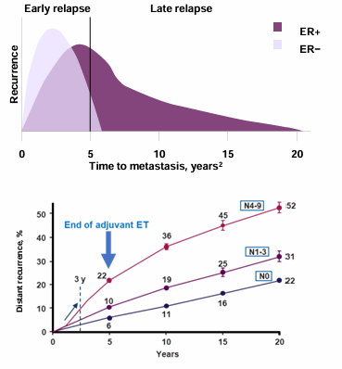
Patients with HR+ EBC are at Risk of Both Early and Late Recurrence
~50% of the recurrence occur early, within 1-5 years of diagnosis^{1,2}
Rick of recurrence remains beyond 20 years³
Risk of recurrence remains, irrespective of nodal status⁴
The majority of these invasive disease events are distant recurrences (metastasis), for which no cure currently exists⁵⁻⁸
Notes:
1. Foldi J, O'Meara T, Marczyk M, Sanft T, Silber A, Pusztai L. Defining risk of late recurrence in early-stage estrogen receptor-positive breast cancer: clinical versus molecular tools. J Clin Oncol. 2019;37(16):1365-1369.
2. Gomis RR, Gawrzak S. Tumor cell dormancy. Mol Oncol. 2017;11(1):62-78.
3. Pedersen RN, Esen BÖ, Mellemkjær L, et al. The incidence of breast cancer recurrence 10-32 years after primary diagnosis. J Natl Cancer Inst. 2022;114(3):391-399.
4. Pan H, Gray R, Braybrooke J, et al. 20-year risks of breast-cancer recurrence after stopping endocrine therapy at 5 years. N Engl J Med. 2017;377(19):1836-1846.
5. Johnston SRD, Toi M, O'Shaughnessy J, et al. Abemaciclib plus endocrine therapy for hormone receptor-positive, HER2-negative, node-positive, high-risk early breast cancer (monarchE): results from a preplanned interim analysis of a randomised, open-label, phase 3 trial. Lancet Oncol. 2023;24(1):77-90.
6. Gnant M, Dueck AC, Frantal S, et al. Adjuvant palbociclib for early breast cancer: the PALLAS trial results (ABCSG-42/AFT-05/BIG-14-03). J Clin Oncol. 2022;40(3):282-293.
7. Slamon D, Lipatov O, Nowecki Z, et al. Ribociclib plus endocrine therapy in early breast cancer. N Engl J Med. 2024;390(12):1080-1091.
8. Early Breast Cancer Trialists' Collaborative Group (EBCTCG). Aromatase inhibitors versus tamoxifen in early breast cancer: patient-level meta-analysis of the randomised trials. Lancet. 2015;386(10001):1341-1352.

Slide 18
Early Recurrences Are an Urgent Concern, Regardless of Nodal Status
Recent data from control arms of phase 3 trials of adjuvant CDK4/6 inhibitors in patients with HR+/HER2− stages II and III EBC show that the risk remains regardless of nodal status, with…
  Up to 11% of patients with N0 disease
  Up to 13% of patients with N1 disease
  Up to 24% of patients with N2-3 disease
…experiencing an invasive disease event within 3 years of starting standard-of-care adjuvant endocrine therapy¹⁻⁴
1 in 8 women treated with ET alone are expected to have an invasive disease event by 3 years in the NATALEE trial¹
Notes:
1. Hortobagyi GN, Stroyakovskiy D, Yardley DA, et al. Ribociclib + nonsteroidal aromatase inhibitor as adjuvant treatment in patients with HR+/HER2- early breast cancer: final invasive disease-free survival analysis from the NATALEE trial. Abstract presented at: San Antonio Breast Cancer Symposium; San Antonio, Texas; December 5-9, 2023. Abstract GS03-03.
2. Mayer EL, Dueck AC, Martin M, et al. Palbociclib with adjuvant endocrine therapy in early breast cancer (PALLAS): interim analysis of a multicentre, open-label, randomised, phase 3 study. Lancet Oncol. 2021;22(2):212-222.
3. Bardia A, Hortobagyi GN, Lipatov O, et al. Invasive disease–free survival (iDFS) across key subgroups from the phase III NATALEE study of ribociclib (RIB) + a nonsteroidal aromatase inhibitor (NSAI) in patients (pts) with HR+/HER2- early breast cancer (EBC). Abstract presented at: European Society of Medical Oncology Congress; Madrid, Spain; October 20-24, 2023. Abstract LBA23.
4. Johnston SRD, Toi M, O'Shaughnessy J, et al. Abemaciclib plus endocrine therapy for hormone receptor-positive, HER2-negative, node-positive, high-risk early breast cancer (monarchE): results from a preplanned interim analysis of a randomised, open-label, phase 3 trial. Lancet Oncol. 2023;24(1):77-90.

Slide 19
Managing CDK4/6 Inhibitors in the Adjuvant Setting for Patients with High-Risk EBC
The ultimate goal is to reduce risk of early or late recurrence while balancing medication symptom set
Review medication common and rare, but serious side effects, dosing schedule, monitoring, and management strategies
Consider abemaciclib dose escalation, with intention to reach maximum dose or dose reduce if full dose is started
Consider riboclibib dose reduction or hold as indicated
Address obstacles to adherence and create individualized, tailored plan to ensure compliance; include rationale regarding adjuvant therapy and reducing risk of cancer recurrence

Slide 20
Recent Current and Emerging Evidence Supporting CDK4/6 Inhibitors in Adjuvant Therapy for HR+/HER2- Early BC
Theresa Wicklin Gillespie, PhD, MA, RN, FAAN

Slide 21
Polling Question 4
The study population enrolled in the monarchE trial was eligible
if they:
Were postmenopausal women only
Had HR+, N+, HER2- tumors
Were diagnosed with advanced stage breast cancer
Were considered to be at very low risk of recurrence
Had received no prior chemotherapy
Notes:
Correct answer: B. Had HR+, N+, HER2- tumors

Slide 22
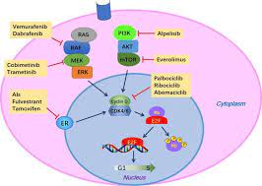
Brief Background on CDK4/6 Inhibitors:
How is MOA for These Agents Different From Other Breast Therapies? Why Is This Class of Drugs Important?
3 approved agents in this class of drugs: palbociclib, ribociclib, and abemaciclib
Initial FDA approval 10 yr ago (palbociclib, 2015) for HR+ breast cancer
Mechanism of action: Work by inhibiting phosphorylation of Rb (retinoblastoma) protein, which deactivates tumor suppressor protein, thus preventing cell proliferation¹
Cell cycle regulated by numerous factors, including cyclins, cyclin-dependent kinases (CDK), and CDK inhibitors
Checkpoint often over-expressed in HR+ breast cancer cells, so represents key target
Initial FDA approvals for CDK4/6 inhibitors + ET (aromatase inhibitor or fulvestrant), for first- or second-line treatment of HR+, HER2-negative, advanced or metastatic breast cancer^{2,3}
Wu et al, 2020³
1. Pavlovic D, et al. Ther Adv Med Oncol. 2023;15:17588359231205848.
2. FDA.gov. https://www.fda.gov/drugs/science-and-research-drugs/use-cyclin-dependent-kinase-46-inhibitor-hormonal-therapy-metastatic-breast-cancer-efficacy patient#:~:text=CDK%204/6%20inhibitors%20in,advanced%20or%20metastatic%20breast%20cancer
3. Wu Y, et al. Cancer Manag Res. 2020;12:3477-3487.

Slide 23
Pooled Analysis of All CDK4/6 Inhibitors by Clinical & Demographic Subgroups for HR+, HER2-, Advanced or Metastatic Breast Cancer
Pooled analysis of 7 trials, N = 4,200, all randomized to AI or fulvestrant + CDK4/6 inhibitor vs placebo, approved before 2019
PFS increased whether ET was AI or fulvestrant
Increase in median PFS observed in all clinicopathological subgroups
Increase in PFS for pre- and post-menopausal, and across ethnicity subgroups
Results reported limited to White and Asian subgroups are because only small number of pts of other races or ethnicities enrolled in 7 trials analyzed¹

Slide 24
Recent Data for CDK4/6 Inhibitor Use in Early-Stage Breast Cancer

Slide 25
PALLAS Trial – Prospective, Randomized Ph III
Eligibility: HR+, HER2-, early-stage breast cancer
Randomization: 2 yr palbociclib (125 mg po qd D1-21 of 28 d cycle) + adjuvant ET vs ET alone (for at least 5 yr)
Primary end point = invasive disease-free survival (iDFS)
Secondary end points = invasive breast cancer–free survival, distant recurrence-free survival, locoregional cancer-free survival, & overall survival (OS)
N = 5,796 patients enrolled; 5,761 included in ITT population
At median follow-up 31 mos, iDFS occurred in 253/2884 (8.8%) pts who received palbociclib + ET vs 263/2877 (9.1%) pts who received ET alone
At 4 yrs analysis, similar results between 2 treatments groups: iDFS = 84.2% vs 84.5%; HR = 0.96 (CI 0.81-1.14; P = 5.65)
No significant differences observed for secondary time-to-event endpoints
Subgroup analyses did not show any differences by subgroup
No new safety signals
Conclusion: addition of adjuvant palbociclib to standard ET did not improve outcomes vs ET alone in pts with HR+ , HER2- early breast cancer

Slide 26
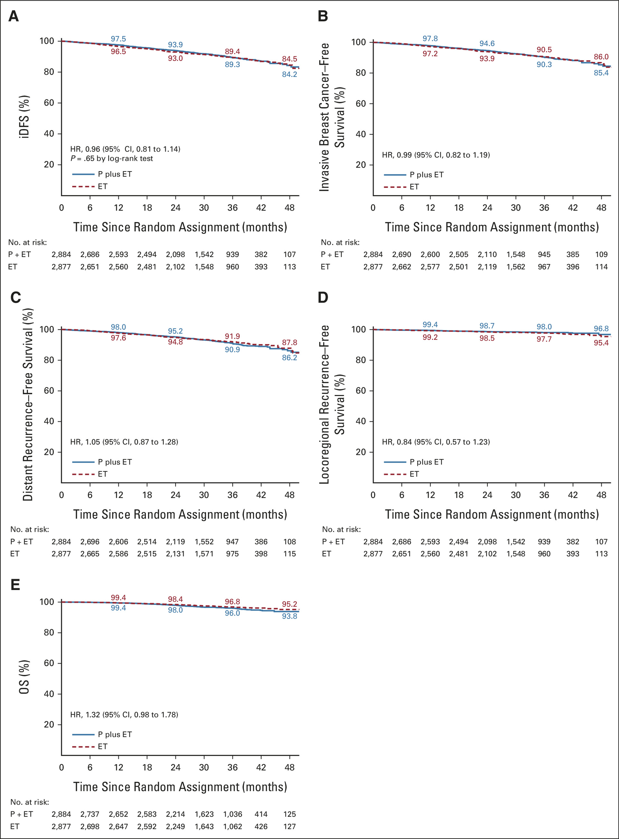
PALLAS Trial Results
PALLAS Results – iDFS at 48 months
PALLAS Results – OS at 48 months

Slide 27
PENELOPE-B Trial (NCT01864746): Double-Blind,
Placebo-Controlled, Ph III as Adjuvant Therapy for
Residual High-Risk, Invasive Breast Cancer
Eligibility: Pts with HR+, HER2- breast cancer with residual invasive disease after neoadjuvant chemotherapy (NACT) & at high risk for relapse
Trial design: Adjuvant ET + palbociclib (PAL) or placebo x 13 cycles (28 d)
Primary outcome = iDFS; N = 1250 randomized; median age = 49 yrs
Median follow-up 42.9 mos, 308 events observed
No significant improvement in iDFS with addition of PAL: HR = 0.93 (CI 0.74-1.17; P = 5.25)
No difference among subgroups
Conclusion: Palbociclib for 1 year + ET did not improve iDFS in women with residual invasive disease after NACT

Slide 28
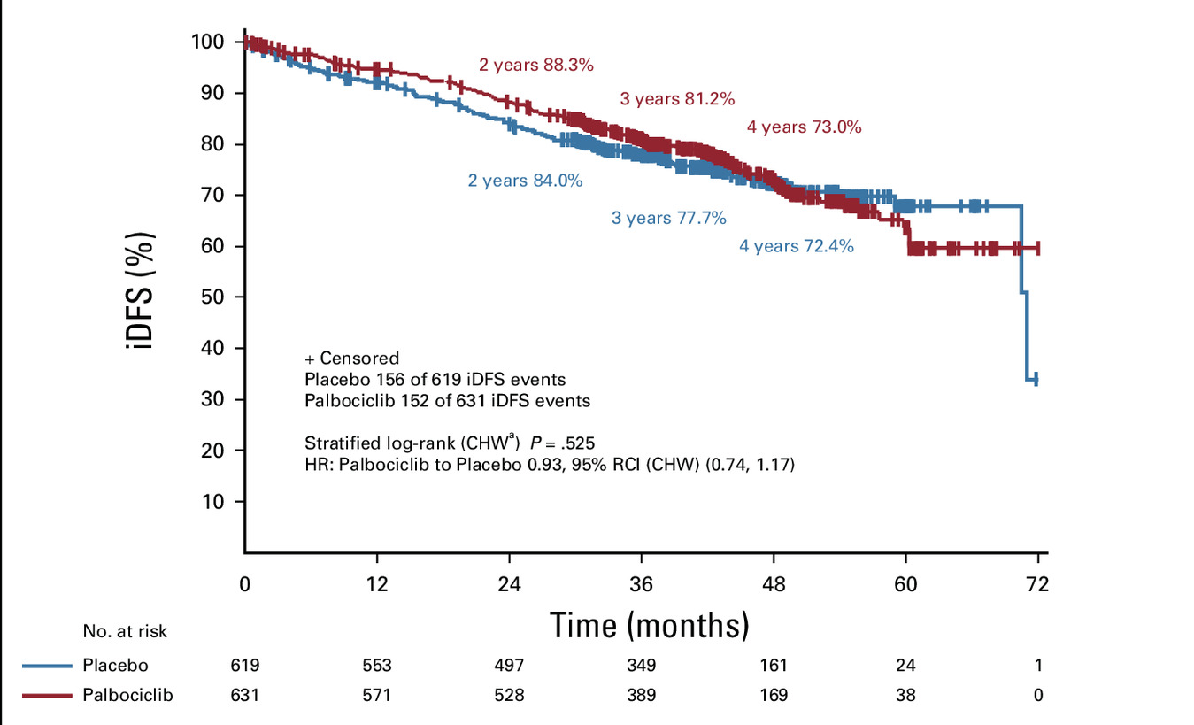
PENELOPE B Results: iDFS, Kaplan Meier

Slide 29
monarchE Trial (NCT03155997): Abemaciclib for Adjuvant Therapy in Early-Stage Breast Cancer
monarchE Study Design:
RCT(1:1), open-label, multicenter trial
Randomized to 2 yr abemaciclib + doctor’s choice ET vs ET alone
Primary efficacy outcome = invasive disease-free survival (iDFS)
Eligibility
  Women & men with HR+, HER2-, N+, resected, early breast cancer
  Clinical & pathological characteristics indicating high risk of recurrence

Slide 30
monarchE Trial – Abemaciclib for Adjuvant Therapy in Early-Stage Breast Cancer: Results
N = 2003 (sample size)
In pts with high risk of recurrence & Ki-67 score ≥20% results showed statistically significant improvement in iDFS (HR 0.626; 95% CI: 0.488, 0.803; P = 0.0042).
IDFS at 36 months was 86.1% (95% CI: 82.8, 88.8) for pts receiving abemaciclib + ET vs 79.0% (95% CI: 75.3, 82.3) for pts receiving ET alone
Continued association with improved iDFS & distant relapse-free survival over longer follow-up
OS showed no significant benefit with addition of adjuvant abemaciclib + ET in this population
Results supported 10/2021 approval of abemaciclib + ET in adjuvant setting & March 2023 expanded indication, removing Ki67 score requirement for high-risk

Slide 31
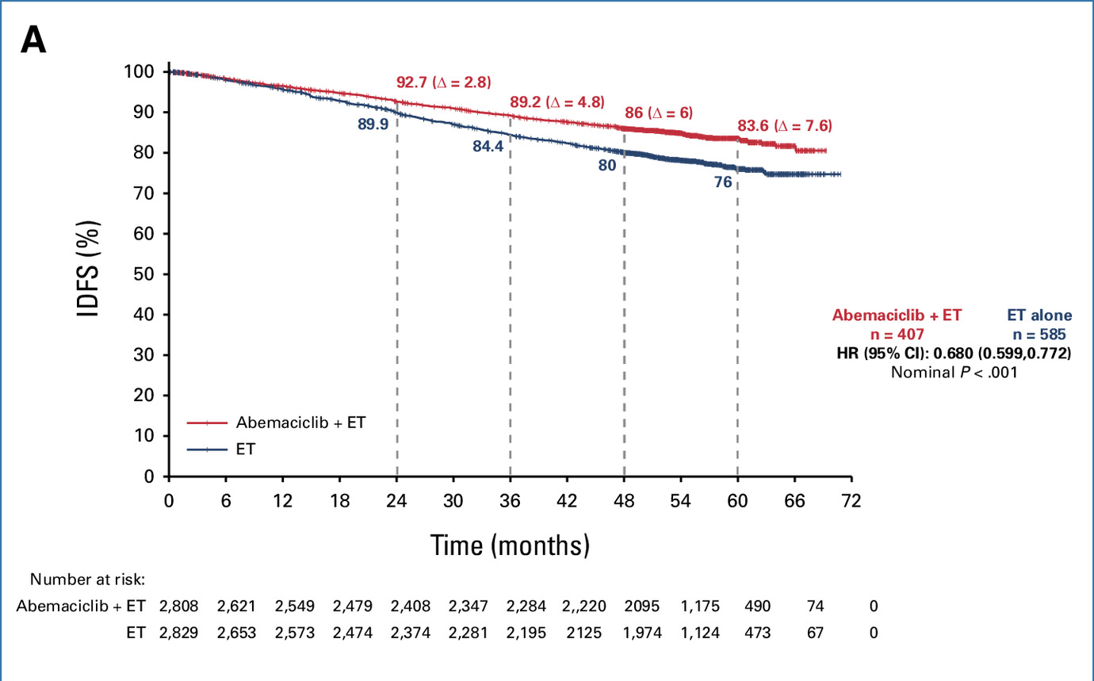
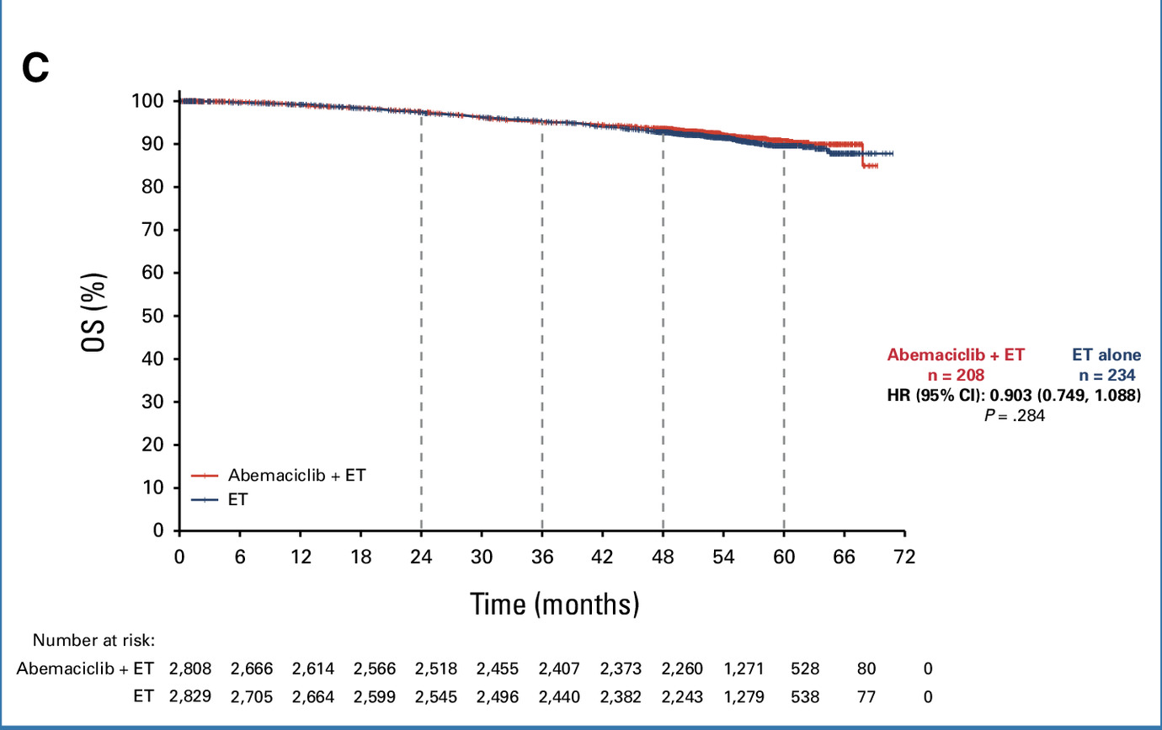
monarchE Trial Results: iDFS & OS
monarchE Trial Results – iDFS at 72 months
monarchE Trial Results – OS at 72 months

Slide 32
Subgroups Analysis of Older Patients in monarchE
Subgroups analysis of monarchE by age conducted to help guide management of older patients receiving adjuvant abemaciclib
At median follow-up of 42 months, a numerically favorable IDFS effect was observed in both the < 65
and ≥ 65 age groups
Similar findings were observed in DRFS
IDFS, events | Patients aged < 65 years (n = 4787) | Patients aged ≥ 65 years (n = 850)
Abemaciclib + ET | 270 | 66
ET alone | 414 | 85
HR (95% CI) | HR 0.646 95% CI: 0.554, 0.753 | HR 0.767 95% CI: 0.556, 1.059

Slide 33
Ribociclib – NATALEE Trial (NCT03701334):
RCT, Ph III, Early Stage Breast Cancer
Eligibility: HR+, HER2-, Stage II-III breast cancer; could have received prior adj or neoadj Tx for up to 12 mos previously
Study Design: Ribociclib (400 mg/d x 3 wk then 1 wk off x 3 yr) + nonsteroidal AI (letrozole (2.5mg/d) or anastrozole (1 mg/d) x 5 yr) or NSAI alone; premenopausal also received goserelin q 28 d
Primary Endpoint: iDFS; N=5101
Analysis at 3 years: iDFS 90.4% with ribociclib + NSAI vs 87.1% with NSAI alone (HR = 0.75; 95% CI 0.62 to 0.91; P = 0.003).
Secondary end points — distant disease–free survival and recurrence-free survival — also demonstrated advantage of ribociclib + NSAI.
3-year regimen ribociclib 400-mg starting dose + NSAI was not associated with any new safety concerns
Conclusions: Ribociclib + NSAI significantly improved iDFS in pts with HR+, HER2- stage II or III early breast cancer

Slide 34
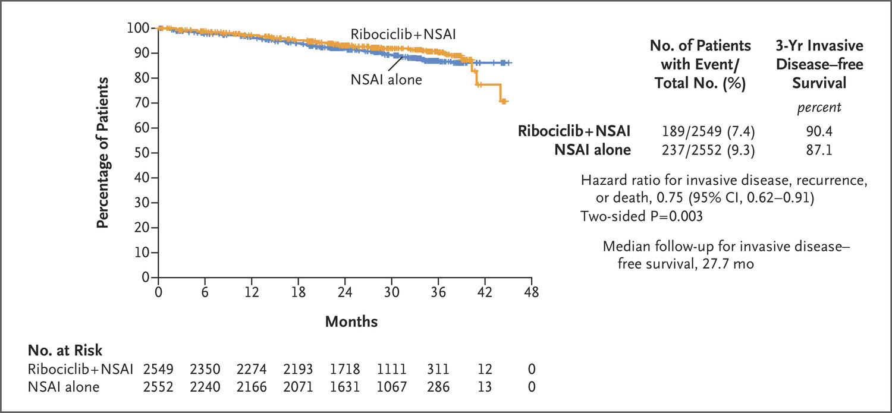
NATALEE Results: 3 yr iDFS – Ribociclib + NSAI (90%) vs NSAI alone (87.1%)

Slide 35
NATALEE Subgroup Analysis by Prior Systemic Treatment
Prior tx, n (%) | RIB + NSAI n = 2549 | NSAI alone n = 2552 | HR (95% CI)
No prior CT | 300 (12) | 307 (12) | 0. (0.47-1.44)
Prior CT | 2249 (88) | 2245 (88) | 0.74 (0.62-0.89)
Prior neoadjuvant CTª | 1085 (43) | 1095 (43) | 0.82 (0.64-1.03)
Prior adjuvant CTª | 1223 (48) | 1220 (48) | 0.69 (0.52-0.92)
No prior ET | 793 (31) | 812 (32) | 0.77 (0.57-1.03)
Prior ET^{b} | 1756 (69) | 1740 (68) | 0.74 (0.60-0.92)
ET <12 wks^{b} | 744 (29) | 717 (28) | 0.75 (0.54-1.06)
ET ≥12 to <26 wks^{b} | 650 (26) | 663 (26) | 0.73 (0.51-1.04)
ET ≥26 wks^{b} | 358 (14) | 353 (14) | 0.74 (0.45-1.22)
iDFS benefit with RIB + NSAI was shown regardless of duration of prior ET as well as prior (neo)adjuvant CT vs no CT, underlying potential role of CDK4/6 inhibitors in therapeutic de-escalation of CT in EBC
A majority of pts with N0 disease at diagnosis had received prior (neo)adjuvant CT, highlighting that these pts had a risk of recurrence that was considered high enough to warrant CT

Slide 36
Summary of Recent CDK4/6 Inhibitor Trials as Adjuvant Therapy; in Early-Stage Breast Cancer
PALLAS – Addition of adjuvant palbociclib to standard ET did not improve outcomes vs ET alone in pts with HR+, HER2- early breast cancer
PENEPOLE-B – Palbociclib for 1 year + ET did not improve iDFS in women with residual invasive disease after neoadjuvant therapy & at high risk for relapse
monarchE - Improved iDFS & distant relapse-free survival over longer follow-up for abemaciclib + ET in adjuvant setting; no difference for OS
NATALEE - Ribociclib + NSAI significantly improved iDFS in pts with HR+, HER2- stage II or III early breast cancer; OS results pending

Slide 37
References
FDA.gov. FDA approves abemaciclib with endocrine therapy for early breast cancer . Press release. October 13, 2021. https://www.fda.gov/drugs/resources-information-approved-drugs/fda-approves-abemaciclib-endocrine-therapy-early-breast-cancer
FDA.gov. Use of Cyclin-Dependent Kinase 4/6 Inhibitor with Hormonal Therapy in Metastatic Breast Cancer—Efficacy in Patient Subgroups. Updated November 16, 2020. https://www.fda.gov/drugs/science-and-research-drugs/use-cyclin-dependent-kinase-46-inhibitor-hormonal-therapy-metastatic-breast-cancer-efficacy-patient#:~:text=CDK%204/6%20inhibitors%20in,
advanced%20or%20metastatic%20breast%20cancer
Gnant M, Dueck AC, Frantal S, et al; PALLAS groups and investigators. Adjuvant palbociclib for early breast cancer: the PALLAS trial results (ABCSG-42/AFT-05/BIG-14-03). J Clin Oncol. 2022;40(3):282-293.
Klocker EV, Egle D, Bartsch R, Rinnerthaler G, Gnant M. Efficacy and safety of CDK4/6 inhibitors: a focus on HR+/HER2- early breast cancer. Drugs. 2025;85(2):149-169.
Loibl S, Marmé F, Martin M, et al. Palbociclib for residual high-risk invasive HR-positive and HER2-negative early breast cancer-The Penelope-B Trial. J Clin Oncol. 2021;39(14):1518-1530.
Pavlovic D, Niciforovic D, Papic D, et al. CDK4/6 inhibitors: basics, pros, and major cons in breast cancer treatment with specific regard to cardiotoxicity - a narrative review. Ther Adv Med Oncol. 2023;15:17588359231205848.
Rastogi P, O'Shaughnessy J, Martin M, et al. Adjuvant abemaciclib plus endocrine therapy for hormone receptor-positive, human epidermal growth factor receptor 2-negative, high-risk early breast cancer: results from a preplanned monarche overall survival interim analysis, including 5-year efficacy outcomes. J Clin Oncol. 2024;42(9):987-993.
Slamon DJ, Fasching PA, Hurvitz S, et al. Rationale and trial design of NATALEE: a Phase III trial of adjuvant ribociclib + endocrine therapy versus endocrine therapy alone in patients with HR+/HER2- early breast cancer. Ther Adv Med Oncol. 2023;15:1758835923117
8125.
Slamon D, Lipatov O, Nowecki Z, et al. Ribociclib plus endocrine therapy in early breast cancer. N Engl J Med. 2024;390(12):1080-1091.
Wu Y, Zhang Y, Pi H, Sheng Y. Current therapeutic progress of CDK4/6 inhibitors in breast cancer. Cancer Manag Res. 2020;12:
3477-3487.

Slide 38
Managing Adverse Events of CDK4/6 Inhibitors: Strategies for Prevention and Mitigation
Kristi K. Orbaugh, MSN, NP, AOCNP
Notes:
Managing Adverse Events of CDK4/6 Inhibitors: Strategies for Prevention and Mitigation (Addresses LO 5)
Should begin with a brief case regarding the management of a TEAE related to CDK4/6 therapy; include 1 polling question
Key discussion points:
CDK4/6 inhibitor safety data from pivotal trials and real-world evidence
Monitoring and management strategies for select AEs
Diarrhea
Hepatoxicity
Neutropenia
VTE
ILD/pneumonitis

Slide 39
Key Toxicities of CDK4/6 Inhibitors in
Early Breast Cancer
Diarrhea
QT prolongation
Neutropenia
ILD/pneumonitis
Hepatoxicity
VTE

Slide 40
Let’s Meet Darcie
Darcie started on abemaciclib, a GnRh agonist, and an aromatase inhibitor for her high-risk early-stage breast cancer
Three weeks after starting abemaciclib the patient develops a grade 2 diarrhea
How would this patient be handled in your clinic?

Slide 41
Polling Question 6
Darcie has developed grade 2 diarrhea. How should her toxicity be managed?
2 loperamide after the first loose stool and then maximize the dosing for the next 24 hours
Hold her abemaciclib if no improvement in 24 hours
Consider dose reduction if diarrhea recurs
All of the above
Notes:
The risk of recurrence for patients with node-positive, HR+, EBC is up to 30% at 5 years despite combined chemotherapy, endocrine therapy, and radiotherapy
–monarchE was designed to evaluate the addition of 2 years of adjuvant abemaciclib 150mg BID daily, to endocrine therapy (ET) in HR+, HER2-, node-positive, high-risk EBC
Dose reductions are commonly used to manage treatment related toxicity with the goal of maximizing treatment adherence. The impact of dose reductions on drug efficacy is important to both patients and providers.
Based on multiple analyses, the efficacy of adjuvant abemaciclib in monarchE was not compromised by dose reductions
It has been demonstrated that dose reductions of abemaciclib do not compromise efficacy, suggesting lower doses and a dose escalation strategy may be equally as effective as standard dosing
Initiating at lower doses may allow for greater tolerance and less incidence of diarrhea and thus reducing the discontinuation rate

Slide 42
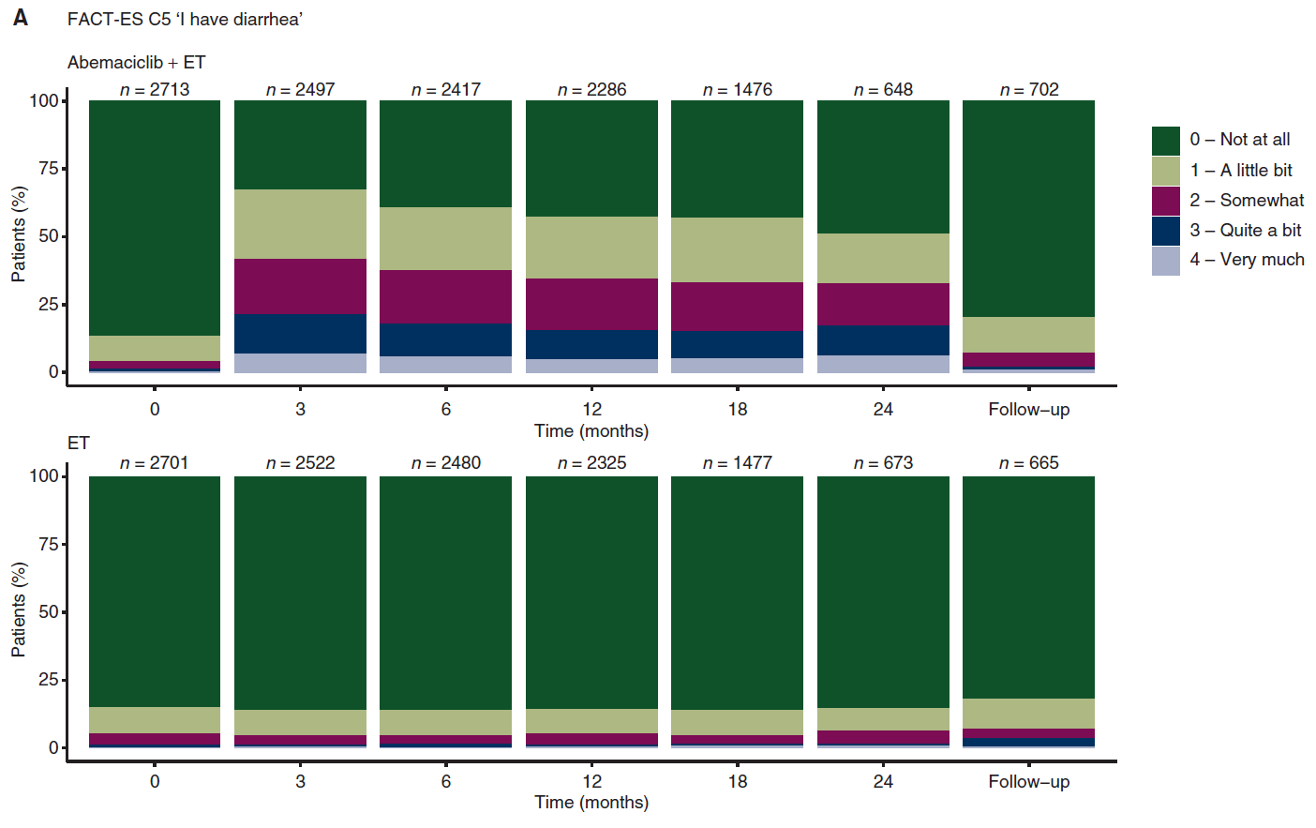
Diarrhea
19-35% patients on ribociclib will develop diarrhea
81-90% of patients on abemaciclib will develop diarrhea
  Diarrhea tends to be worse in the first 8 weeks
  Diarrhea was more frequently reported in earlier PRO assessments (months 3 and 6) in monarchE
  Vital to support patient during that time

Slide 43
Diarrhea Management: Give the Patient a Plan
Know the patient’s baseline bowel habits
  Number of stools over baseline
Medication management
  Maximize loperamide dosing
  Consider alternative medications (such as Lomotil, colestipol, bulk-forming agents)
Dietary management
  Minimize offending foods during the first few weeks of treatment
Monitor electrolytes
Monitor hydration status
Consider dose reduction

Slide 44
Management of Diarrhea by Grade
The first sign of loose stools
Start antidiarrheal agents (e.g., loperamide) and increase intake of oral fluids
Grade 1
(increase of <4 stools
per day over baseline)
Grade 2
(increase of 4-6 stools
per day over baseline)
Grade 3
(increase of ≥7 stools
per day over baseline)
Grade 4
(Life-threatening consequences/
Urgent intervention indicated)
Not resolved to
Grade ≤1
within 24 hours
Persistent
or
Recurrent
No dose modification required
Suspend dose until toxicity resolves to Grade ≤1
Suspend dose until toxicity resolves to Grade ≤1
Dose must be reduced in case of persistent or recurrent Grade 2
Dose must be reduced

Slide 45
QT Interval Prolongation
QT prolongation was noted with ribociclib in patients with eBC (NATALEE) who received 400 mg plus NSAI
  8 out of 2494 patients (0.3%) had > 500 ms post-baseline QTcF interval value
  50 out of 2494 patients (2%) had > 60 ms QTcF increase from baseline
QTcF prolongation was reversible with dose interruption
  The majority of QTcF prolongation occurred within the first 4 weeks of ribociclib
  There were no reported cases of torsades de pointes
Ribociclib has been shown to prolong the QT interval in a concentration-dependent manner
Avoid ribociclib in patients who are at significant risk of developing torsades de pointes (TdP), including patients:
  With uncontrolled or significant cardiac disease, recent myocardial infarction, heart failure, unstable angina, bradyarrhythmias, uncontrolled hypertension, high degree atrioventricular block, severe aortic stenosis, or uncontrolled hypothyroidism
  With congenital long QT syndrome
  With electrolyte abnormalities
  Taking drugs known to prolong QT interval and/or strong CYP3A inhibitors as this may lead to prolongation of the QTcF interval

Slide 46
Management of QT Interval Prolongation
ECG assessment should be completed at baseline, on Day 14 of Cycle 1 and as clinically indicated
Initiate treatment only in patients with QTcF <450 msec
Correct electrolyte abnormalities prior to ribociclib treatment initiation
Review the patient’s complete medication list to assess for other meds that could cause QT prolongation
Correct uncontrolled hypertension and uncontrolled hypothyroidism prior to starting ribociclib
Assess patient for cardiac issues
Increased QT prolongation with concomitant use of tamoxifen; ribociclib is not indicated for concomitant use with tamoxifen

Slide 47
Dose Modification and Management for
QT Prolongation
QTcF* prolongation | Early breast cancer | Advanced or metastatic breast cancer
>480 ms and ≤500 ms | Interrupt ribociclib treatment and wait until QTcF resolved to ≤480 ms
 | Resume at the same dose | Reduce to the next lower dose level
 | If QTcF >480 ms recurs, interrupt ribociclib treatment and wait until QTcF resolves to ≤480 ms, then resume at next lower dose level.
>500 ms | Interrupt ribociclib treatment and wait until QTcF resolves to ≤480 ms, then resume at next lower dose level. If QTcF >500 ms recurs, discontinue ribociclib.
Permanently discontinue ribociclib if QTcF interval prolongation is either >500 ms or >60 ms change from baseline AND associated with any of the following: Torsades de Pointes, polymorphic ventricular tachycardia, syncope, or signs/symptoms of serious arrhythmia.
Note: If dose reduction below 200 mg/day is required, discontinue ribociclib. Electrocardiograms (ECGs) should be assessed prior to initiation of treatment in all patients. Repeat ECGs at approximately Day 14 of the first cycle, and as clinically indicated. In case of QTcF prolongation at any given time during treatment, monitor ECG more frequently, and as clinically indicated

Slide 48
Neutropenia
Abemaciclib¹
Ribociclib²
Neutropenia occurred in 37% to 46% of patients in the monarchE study
Monitor CBC prior to the start of therapy, every 2 weeks for the first 2 months, monthly for the next 2 months and then as clinically indicated
Dose interruption, dose reduction, or delay in treatment can be considered for patients who develop grade 3 or 4 neutropenia
In patients with eBC who received ribociclib + NSAI, 94% developed neutropenia; 45% of those patients had grade 3 or 4 neutropenia and 0.3% had febrile neutropenia
Monitor CBC prior to start of therapy, every 2 weeks for the first 2 months, monthly for the next 4 months and then as clinically indicated
Dose interruption, dose reduction, or delay in treatment can be considered for patients who develop grade 3 or 4 neutropenia

Slide 49
Neutropenia Management Strategies
For abemaciclib:
Before the start of each cycle, hematologic toxicity must resolve to grade ≤2
CBC should be monitored prior to the start of therapy, every 2 weeks for the first 2 months, monthly for the next 2 months, and as clinically indicated
For ribociclib:
CBC should be monitored prior to the start of therapy, every 2 weeks for the first 2 months, monthly for the next 4 months, and then as clinically indicated
Neutropenia
Grade 1–2
Grade 3
Recurrent Grade 3
or Grade 4
No dose
modification
required
Suspend dose until
AE resolves to
Grade ≤2
Suspend dose until
AE resolves to
Grade ≤2
No dose
reduction required
Reduce to the
next lower dose

Slide 50
ILD/Pneumonitis
Severe, life-threating, or fatal interstitial lung disease (ILD) and/or pneumonitis can occur with all the CDK 4/6 inhibitors¹
Imperative to do pulmonary baseline assessment prior to starting any CDK 4/6 inhibitors^{2,3}
  Monitor patients while on active treatment with CDK 4/6 inhibitors
In monarchE, 3% of patients on abemaciclib developed ILD or pneumonitis; 1.4% were
grade 3 or 4⁴
In NATALEE, 1.5% of patients on ribociclib had ILD/pneumonitis (grade1/2)²

Slide 51
Management of ILD
Interstitial Lung Disease/Pneumonitis
Grade 1–2
Persistent or recurrent Grade 2 toxicityª
Grade 3 or Grade 4
No dose
modification required
Suspend dose until
resolves to baseline
or Grade ≤1
Discontinue therapy
Reduce to the next lower dose

Slide 52
Hepatotoxicity
Grade 3/4 increases in ALT (2 to 6%) and AST (2 to 3%) were reported in patients receiving abemaciclib¹
  Monitor liver function tests (LFTs) prior to the start of therapy, every 2 weeks for the first 2 months, monthly for the next 2 cycles, and as clinically indicated
  Consider dose interruption, dose reduction or discontinuation
  With severe hepatic impairment, reduce the abemaciclib dosing schedule to once daily
Grade 3/4 increases in ALT (8%) and AST (4.7%) in patients on ribociclib²
  Monitor liver function tests (LFTs) prior to the start of therapy, every 2 weeks for the first 2 months, monthly for the next 4 cycles, and as clinically indicated
  Consider dose interruption, dose reduction or discontinuation

Slide 53
Venous Thromboembolism (VTE)
VTE was reported in 2-5% of patients across 3 clinical trials with abemaciclib
  Dose interruption is recommended for eBC with any grade of VTE and for MBC patients with grade 3 or 4 VTE
  Abemaciclib has not been studied in patients with eBC who had a history of VTE
All CDK 4/6 inhibitors when combined with endocrine therapy are associated with a two to threefold higher risk of VTE when compared to ET alone in patients with advanced breast cancer
The risks of arterial events are still to be defined

Slide 54
Conclusions
The use of abemaciclib and ribociclib in eBC has shown reduction in recurrent disease.
Both of the drugs have specific toxicity profiles that can be well managed.
  Patient education and symptom management should be included in the patient’s plan of care.
TEAEs can have a negative effect on patient’s QoL. The patient should be well educated on potential toxicities and have a clearly defined plan to mitigate the TEAEs.
Oncology nurses need to be vigilant in monitoring for TEAEs and be prepared to manage the TEAEs to allow patient to remain adherent and stay on their prescribed treatment plan.

Slide 55
References
Abemaciclib. Prescribing information. Eli Lilly and Company; 2025.
Boley C, Timotea L, LaRose L, Rocha A. Cancer Treatment. In: Baldwin C, Coleman C, Saria MG, eds. Advanced Oncology Nursing Certification Review and Resource Manual. Oncology Nursing Society; 2023:443-475.
Data on file. Lilly USA, LLC. DOF-AL-US-0109.
FDA.gov. FDA approves abemaciclib with endocrine therapy for early breast cancer . Press release. October 13, 2021. https://www.fda.gov/drugs/resources-information-approved-drugs/fda-approves-abemaciclib-endocrine-therapy-early-breast-cancer
FDA.gov. Use of Cyclin-Dependent Kinase 4/6 Inhibitor with Hormonal Therapy in Metastatic Breast Cancer—Efficacy in Patient Subgroups. Updated November 16, 2020. https://www.fda.gov/drugs/science-and-research-drugs/use-cyclin-dependent-kinase-46-inhibitor-hormonal-therapy-metastatic-breast-cancer-efficacy-patient#:~:text=CDK%204/6%20inhibitors%20in,advanced%20or%20metastatic%20breast%20cancer
Hortobagyi GN, Stroyakovskiy D, Yardley DA, et al. Ribociclib + nonsteroidal aromatase inhibitor as adjuvant treatment in patients with HR+/HER2- early breast cancer: final invasive disease-free survival analysis from the NATALEE trial. Abstract presented at: San Antonio Breast Cancer Symposium; San Antonio, Texas; December 5-9, 2023. Abstract GS03-03.
Johnston SRD, Harbeck N, Hegg R, et al; monarchE Committee Members and Investigators. Abemaciclib combined with endocrine therapy for the adjuvant treatment of HR+, HER2-, node-positive, high-risk, early breast cancer (monarchE). J Clin Oncol. 2020;38(34):‌3‌9‌8‌7-‌3‌9‌9‌8.
Johnston SRD, Toi M, O’Shaughnessy J, et al; on behalf of monarchE Committee Members. Abemaciclib plus endocrine therapy for hormone receptor-positive, HER2-negative, node-positive, high-risk early breast cancer (monarchE): results from a preplanned interim analysis of a randomised, open-label, phase 3 trial. Lancet Oncol. 2023;24(1):77-90.
Klocker EV, Egle D, Bartsch R, Rinnerthaler G, Gnant M. Efficacy and safety of CDK4/6 inhibitors: a focus on HR+/HER2- early breast cancer. Drugs. 2025;85(2):149-169.
Pavlovic D, Niciforovic D, Papic D, et al. CDK4/6 inhibitors: basics, pros, and major cons in breast cancer treatment with specific regard to cardiotoxicity - a narrative review. Ther Adv Med Oncol. 2023;15:17588359231205848.
Rastogi P, O'Shaughnessy J, Martin M, et al. Adjuvant abemaciclib plus endocrine therapy for hormone receptor-positive, human epidermal growth factor receptor 2-negative, high-risk early breast cancer: results from a preplanned monarche overall survival interim analysis, including 5-year efficacy outcomes. J Clin Oncol. 2024;42(9):987-993.
Slamon DJ, Fasching PA, Hurvitz S, et al. Rationale and trial design of NATALEE: a Phase III trial of adjuvant ribociclib + endocrine therapy versus endocrine therapy alone in patients with HR+/HER2- early breast cancer. Ther Adv Med Oncol. 2023;15:17588359231178125. ​
Slamon D, Lipatov O, Nowecki Z, et al. Ribociclib plus endocrine therapy in early breast cancer. N Engl J Med. 2024;390(12):1080-1091.​
Wu Y, Zhang Y, Pi H, Sheng Y. Current therapeutic progress of CDK4/6 inhibitors in breast cancer. Cancer Manag Res. 2020;12:3477-3487.

Slide 56
Unlocking Best Practices for CDK4/6 Inhibitor Patient Management to Boost Adherence and Persistence
Kimberly Podsada, MSN, NP-C, CNS

Slide 57
Patient Case
Patient experienced significant joint and muscle aches with menopause-associated mood changes and fatigue. Anastrozole was discontinued and exemestane was prescribed as was bupropion 150 mg daily. Once abemaciclib started, she reported diarrhea and increased heartburn.

Slide 58




Factors Influencing Adherence
According to the WHO, adherence is a multidimensional phenomenon and is influenced by various factors.¹⁻³
Patient-Related
Therapy-Related
Disease-Related
Healthcare System-Related
Social and Economic
Perceptions of necessity, benefit, and quality of life
Forgetting and self-efficacy
Preference for alternative
Routinization
Depression or anxiety
Side effects
Modifications and complexity of regimen
Duration and variations of therapy
Pill burden
Comorbidities
Unknown tumor size
Node-positive disease
Shorter duration of follow-up visits
Prescribing errors
Different physicians responsible for follow-up
Relationship with HCPs
Lack of patient involvement in decision making
Younger or older age
Higher out-of-pocket cost
Lower income and education level
Unmarried
Patients and physicians report similar determinants of noncompliance and nonpersistence to ET.³
Notes:
Key Points:
Patient-related factors:
Perceptions of need for medication are influenced by concerns about symptoms (addiction, tolerance, and long-term adverse events), expectations of results, experiences, and illness cognitions
Self-efficacy depends on the patient’s degree of confidence in being able to follow prescribed treatment
Non-adherence can be attributed to disruption of lifestyle, difficulty in establishing a routine, and struggle in re-filling and self-monitoring prescriptions
Therapy-related factors
Variations in treatment include approach (surgical vs. non-surgical, types of drugs) and timing of therapy (eg, before/after meals)
Healthcare system-related factors:
Follow-up by a primary physician rather than an oncologist correlates with medication nonpersistence
Receiving conflicting information about consequences and too much/too less support from HCPs are associated with non-adherence
Being uninformed about side effects can also lead to nonpersistance in patients
References:
1. World Health Organization. Adherence to long-term therapies: evidence for action. Accessed May 24, 2021. https://iris.who.int/bitstream/10665/42682/1/9241545992.pdf
2. Verbrugghe M, Verhaeghe S, Lauwaert K, Beeckman D, Van Hecke A. Determinants and associated factors influencing medication adherence and persistence to oral anticancer drugs: a systematic review. Cancer Treat Rev. 2013;39(6):610-621.
3. Paranjpe R, John G, Trivedi M, Abugosh S. Identifying adherence barriers to oral endocrine therapy among breast cancer survivors. Breast Cancer Res Treat. 2019;174(2):297-305.

Slide 59
Interventions to Improve Adherence
There is no single intervention strategy that is effective to improve adherence across all patients, conditions, and settings. Hence, patient-tailored interventions and multidisciplinary approach toward adherence are needed
  Devising a multidisciplinary approach requires coordinated action from health professionals, researchers, health planners, and policy makers
Therapy-Related Interventions¹
Patient-Related Interventions¹
  Simplification of regimens
  Education on the use of medications
  Providing clear instructions
  Patient-tailored prescriptions
  Continuous monitoring and reassessment of treatment
  Assessment and management of side effects
  Interventions to redress misconceptions about treatment and encourage dialogue between patient and oncologist
  Assessment of psychological needs
  Use of conventional (brochures) and digital (web-based) tools to educate on the use of medications
  Behavioral motivational intervention
  Good patient-provider relationship
  Self-management of disease, treatment, and side effects
There are various methods to predict the risk of medication nonadherence and measure rates of adherence.²
Notes:
Key Point:
There are various ways to assess and measure medication adherence. The Morisky Medication Adherence Scale (MMAS), Adherence Estimator, Adherence Starts With Knowledge (ASK®)-12, and Brief Adherence Rating Scale (BARS) are some of the tools that may be useful at predicting the risk of medication non-adherence and measuring rates of adherence
References:
1. World Health Organization. Adherence to long-term therapies: evidence for action. Accessed May 24, 2021. https://iris.who.int/bitstream/10665/42682/1/9241545992.pdf
2. Spoelstra SL, Rittenberg CN. Assessment and measurement of medication adherence: oral agents for cancer. Clin J Oncol Nurs. 2015;19(Suppl. 3):47-52.

Slide 60
Impact of Dose Reductions on Efficacy of Adjuvant Abemaciclib For High-Risk Patients With EBC
The risk of recurrence for patients with node-positive, HR+, EBC is up to 30% at 5 years despite combined chemotherapy, endocrine therapy, and radiotherapy
monarchE was designed to evaluate the addition of 2 years of adjuvant abemaciclib 150 mg BID to endocrine therapy in HR+, HER2-, node-positive, high-risk EBC
Dose reductions are commonly used to manage treatment related toxicity with the goal of maximizing treatment adherence; the impact of dose reductions on drug efficacy is important to both patients and providers.
Based on multiple analyses, the efficacy of adjuvant abemaciclib in monarchE was not compromised by dose reductions
It has been demonstrated that dose reductions of abemaciclib do not compromise efficacy, suggesting lower doses and a dose escalation strategy may be equally as effective as standard dosing
Initiating at lower doses may allow for greater tolerance and less incidence of diarrhea, thus reducing the discontinuation rate
Notes:
Sheffield KM, Peachey JR, Method M, et al. A real-world US study of recurrence risks using combined clinicopathological features in HR-positive, HER2-negative early breast cancer. Future Oncol. 2022;18(21):2667-2682.
Goetz MP, Cicin I, Testa L, et al. Impact of dose reductions on adjuvant abemaciclib efficacy for patients with high-risk early breast cancer: analyses from the monarchE study. NPJ Breast Cancer. 2024;10(1):34.
Moore H, Erner E, Dent S, et al. Impact of abemaciclib dose escalation on compliance and safety in hormone receptor positive (HR+), human epidermal growth factor receptor 2 negative (HER2-) breast cancer. Abstract presented at: San Antonio Breast Cancer Symposium; San Antonio, Texas; December 10-13, 2024. Poster P1-02-04.

Slide 61
Features of NATALEE Study Design
Patients could receive any ET for ≤12 months prior to starting ribociclib and NSAI
Patients with stage II-III HR+/HER2- EBC, including those with no nodal involvement, are at risk of recurrence for decades after initial diagnosis
Ribociclib was dosed at 400 mg daily, 3 weeks on and 1 week off x 3 years, the metastatic approved dose is 600 mg, to improve tolerability while maintain efficacy
Extended treatment duration may be important to prolong cell cycle arrest and drive more tumor cells into irreversible senescence
Notes:
Slamon DJ, Fasching PA, Hurvitz S, et al. Rationale and trial design of NATALEE: a Phase III trial of adjuvant ribociclib + endocrine therapy versus endocrine therapy alone in patients with HR+/HER2- early breast cancer. Ther Adv Med Oncol. 2023;15:17588359231178125.
Slamon D, Lipatov O, Nowecki Z, et al. Ribociclib plus Endocrine Therapy in Early Breast Cancer. N Engl J Med. 2024;390(12):1080-1091.

Slide 62
References
Bardia A, Hortobagyi GN, Lipatov O, et al. Invasive disease–free survival (iDFS) across key subgroups from the phase III NATALEE study of ribociclib (RIB) + a nonsteroidal aromatase inhibitor (NSAI) in patients (pts) with HR+/HER2- early breast cancer (EBC). Abstract presented at: European Society of Medical Oncology Congress; Madrid, Spain; October 20-24, 2023. Abstract LBA23.
Cardoso F, Paluch-Shimon S, Senkus E, et al. 5th ESO-ESMO international consensus guidelines for advanced breast cancer (ABC 5). Ann Oncol. 2020;31(12):1623-1649.
Early Breast Cancer Trialists' Collaborative Group (EBCTCG). Aromatase inhibitors versus tamoxifen in early breast cancer: patient-level meta-analysis of the randomised trials. Lancet. 2015;386(10001):1341-1352.
Ethier JL, Ocaña A, Rodríguez Lescure A, et al. Outcomes of single versus double hormone receptor-positive breast cancer. A GEICAM/9906 sub-study. Eur J Cancer. 2018;94:199-205.
Fallahpour S, Navaneelan T, De P, Borgo A. Breast cancer survival by molecular subtype: a population-based analysis of cancer registry data. CMAJ Open. 2017;5(3):E734-E739.
Fasching PA, Gass P, Häberle L, et al. Prognostic effect of Ki-67 in common clinical subgroups of patients with HER2-negative, hormone receptor-positive early breast cancer. Breast Cancer Res Treat. 2019;175(3):617-625.
Foldi J, O'Meara T, Marczyk M, Sanft T, Silber A, Pusztai L. Defining risk of late recurrence in early-stage estrogen receptor-positive breast cancer: clinical versus molecular tools. J Clin Oncol. 2019;37(16):1365-1369.
Gnant M, Dueck AC, Frantal S, et al. Adjuvant palbociclib for early breast cancer: the PALLAS trial results (ABCSG-42/AFT-05/BIG-14-03). J Clin Oncol. 2022;40(3):282-293.
Slamon D, Lipatov O, Nowecki Z, et al. Ribociclib plus endocrine therapy in early breast cancer. N Engl J Med. 2024;390(12):1080-1091.
Goetz MP, Cicin I, Testa L, et al. Impact of dose reductions on adjuvant abemaciclib efficacy for patients with high-risk early breast cancer: analyses from the monarchE study. NPJ Breast Cancer. 2024;10(1):34.
Gomis RR, Gawrzak S. Tumor cell dormancy. Mol Oncol. 2017;11(1):62-78.
Hortobagyi GN, Stroyakovskiy D, Yardley DA, et al. Ribociclib + nonsteroidal aromatase inhibitor as adjuvant treatment in patients with HR+/HER2- early breast cancer: final invasive disease-free survival analysis from the NATALEE trial. Abstract presented at: San Antonio Breast Cancer Symposium; San Antonio, Texas; December 5-9, 2023. Abstract GS03-03.
Johnston SRD, Harbeck N, Hegg R, et al. Abemaciclib combined with endocrine therapy for the adjuvant treatment of HR+, HER2-, node-positive, high-risk, early breast cancer (monarchE). J Clin Oncol. 2020;38(34):3987-3998.
Johnston SRD, Toi M, O'Shaughnessy J, et al. Abemaciclib plus endocrine therapy for hormone receptor-positive, HER2-negative, node-positive, high-risk early breast cancer (monarchE): results from a preplanned interim analysis of a randomised, open-label, phase 3 trial. Lancet Oncol. 2023;24(1):77-90.
Mayer EL, Dueck AC, Martin M, et al. Palbociclib with adjuvant endocrine therapy in early breast cancer (PALLAS): interim analysis of a multicentre, open-label, randomised, phase 3 study. Lancet Oncol. 2021;22(2):212-222.

Slide 63
References
Moore H, Erner E, Dent S, et al. Impact of abemaciclib dose escalation on compliance and safety in hormone receptor positive (HR+), human epidermal growth factor receptor 2 negative (HER2-) breast cancer. Abstract presented at: San Antonio Breast Cancer Symposium; San Antonio, Texas; December 10-13, 2024. Poster P1-02-04.
Narod SA. Tumour size predicts long-term survival among women with lymph node-positive breast cancer. Curr Oncol. 2012;19(5):249-253.
National Cancer Institute. Cancer stat facts: female breast cancer subtypes. Accessed August 09, 2021. https://seer.cancer.gov/statfacts/html/breast-subtypes.html
Pan H, Gray R, Braybrooke J, et al. 20-year risks of breast-cancer recurrence after stopping endocrine therapy at 5 years. N Engl J Med. 2017;377(19):1836-1846.
Paranjpe R, John G, Trivedi M, Abugosh S. Identifying adherence barriers to oral endocrine therapy among breast cancer survivors. Breast Cancer Res Treat. 2019;174(2):297-305.
Pedersen RN, Esen BÖ, Mellemkjær L, et al. The incidence of breast cancer recurrence 10-32 years after primary diagnosis. J Natl Cancer Inst. 2022;114(3):391-399.
Reddy TP, Rosato RR, Li X, Moulder S, Piwnica-Worms H, Chang JC. A comprehensive overview of metaplastic breast cancer: clinical features and molecular aberrations. Breast Cancer Res. 2020;22:121.
Richman J, Dowsett M. Beyond 5 years: enduring risk of recurrence in oestrogen receptor-positive breast cancer. Nat Rev Clin Oncol. 2019;16(5):296-311.
Saadatmand S, Bretveld R, Siesling S, Tilanus-Linthorst MMA. Influence of tumour stage at breast cancer detection on survival in modern times: population based study in 173,797 patients. BMJ. 2015;351:h4901.
Sheffield KM, Peachey JR, Method M, et al. A real-world US study of recurrence risks using combined clinicopathological features in HR-positive, HER2-negative early breast cancer. Future Oncol. 2022;18(21):2667-2682.
Slamon D, Lipatov O, Nowecki Z, et al. Ribociclib plus Endocrine Therapy in Early Breast Cancer. N Engl J Med. 2024;390(12):1080-1091.
Slamon DJ, Fasching PA, Hurvitz S, et al. Rationale and trial design of NATALEE: a Phase III trial of adjuvant ribociclib + endocrine therapy versus endocrine therapy alone in patients with HR+/HER2- early breast cancer. Ther Adv Med Oncol. 2023;15:17588359231178125.
Spoelstra SL, Rittenberg CN. Assessment and measurement of medication adherence: oral agents for cancer. Clin J Oncol Nurs. 2015;19(Suppl. 3):47-52.
Verbrugghe M, Verhaeghe S, Lauwaert K, Beeckman D, Van Hecke A. Determinants and associated factors influencing medication adherence and persistence to oral anticancer drugs: a systematic review. Cancer Treat Rev. 2013;39(6):610-621.
Woo CS, Silberman H, Nakamura SK, et al. Lymph node status combined with lymphovascular invasion creates a more powerful tool for predicting outcome in patients with invasive breast cancer. Am J Surg. 2002;184(4):337-340.
World Health Organization. Adherence to long-term therapies: evidence for action. Accessed May 24, 2021. https://iris.who.int/bitstream/10665/42682/1/9241545992.pdf

Slide 64
Let’s Talk Real Life Toxicities
Kristi K. Orbaugh, MSN, NP, AOCNP

Slide 65
Darcie’s Treatment Journey
40 yo premenopausal sp chemo, lumpectomy and XRT (pT3pN2M0)
Darcie is started on abemaciclib, a GnRh agonist, and an aromatase inhibitor for her high-risk early-stage breast cancer
She is married, works part time and cares for her 2 young children
She has become very active on a social media breast cancer support group; several group members regularly use supplements, herbs and vitamins
Darcie shares with her health care team that she is preparing to start several things that were recommended to her

Slide 66
Toxicity Management
At her routine follow-up, assessment demonstrates the following toxicities:
  Diarrhea
    Grade 2 at the outset but after appropriate management has resolved to a grade 1
  Fatigue
    Grade 2; Darcie shares that her fatigue is starting to affect her quality of life
  Hot Flashes
    Patient describes as annoying
  Interested in taking various supplements and herbs
Notes:
1Sheffield KM et al. 2022 Future Oncol;18(21):2667-2682 NPJ Breast Cancer NPJ Breast Cancer. 2024 Apr 26;10(1):34. doi: 10.1038/s41523-024-00639-1
Erner E, et al. Poster Presented at: SABCS 2024. Poster P1-02-04.
Verzenio (abemaciclib). Prescribing information. Lilly USA, LLC.
¹Pavlovic D, Niciforovic D, Papic D, et al. CDK4/6 inhibitors: basics, pros, and major cons in breast cancer treatment with specific regard to cardiotoxicity - a narrative review. Ther Adv Med Oncol. 2023 Oct 11;15:17588359231205848. doi: 10.1177/17588359231205848.
²https://www.fda.gov/drugs/science-and-research-drugs/use-cyclin-dependent-kinase-46-inhibitor-hormonal-therapy-metastatic-breast-cancer-efficacy-patient#:~:text=CDK%204/6%20inhibitors%20in,advanced%20or%20metastatic%20breast%20cancer.
³Wu Y, Zhang Y, Pi H, Sheng Y. Current Therapeutic Progress of CDK4/6 Inhibitors in Breast Cancer. Cancer Manag Res. 2020 May 15;12:3477-3487. doi: 10.2147/CMAR.S250632. PMID: 32523378; PMCID: PMC7237121.
⁴Klocker EV, Egle D, Bartsch R, Rinnerthaler G, Gnant M. Efficacy and Safety of CDK4/6 Inhibitors: A Focus on HR+/HER2- Early Breast Cancer. Drugs. 2025 Feb;85(2):149-169. doi: 10.1007/s40265-024-02144-y. Epub 2025 Jan 17. PMID: 39820840; PMCID: PMC11802638.
⁵Gnant M, Dueck AC, Frantal S, Martin M, Burstein HJ, Greil R, Fox P, Wolff AC, Chan A, Winer EP, Pfeiler G, Miller KD, Colleoni M, Suga JM, Rubovsky G, Bliss JM, Mayer IA, Singer CF, Nowecki Z, Hahn O, Thomson J, Wolmark N, Amillano K, Rugo HS, Steger GG, Hernando Fernández de Aránguiz B, Haddad TC, Perelló A, Bellet M, Fohler H, Metzger Filho O, Jallitsch-Halper A, Solomon K, Schurmans C, Theall KP, Lu DR, Tenner K, Fesl C, DeMichele A, Mayer EL; PALLAS groups and investigators. Adjuvant Palbociclib for Early Breast Cancer: The PALLAS Trial Results (ABCSG-42/AFT-05/BIG-14-03). J Clin Oncol. 2022 Jan 20;40(3):282-293. doi: 10.1200/JCO.21.02554.
⁶Loibl S, Marmé F, Martin M, Untch M, Bonnefoi H, Kim SB, Bear H, McCarthy N, Melé Olivé M, Gelmon K, García-Sáenz J, Kelly CM, Reimer T, Toi M, Rugo HS, Denkert C, Gnant M, Makris A, Koehler M, Huang-Bartelett C, Lechuga Frean MJ, Colleoni M, Werutsky G, Seiler S, Burchardi N, Nekljudova V, von Minckwitz G. Palbociclib for Residual High-Risk Invasive HR-Positive and HER2-Negative Early Breast Cancer-The Penelope-B Trial. J Clin Oncol. 2021 May 10;39(14):1518-1530. doi: 10.1200/JCO.20.03639.
⁷FDA, 10//13/2021 https://www.fda.gov/drugs/resources-information-approved-drugs/fda-approves-abemaciclib-endocrine-therapy-early-breast-cancer

Slide 67
CYP3A Pathway
Abemaciclib and ribociclib are both metabolized via the CYP3A pathway
Strong and moderate CYP3A inhibitors can increase the exposure to abemaciclib and ribociclb plus their active metabolites to a clinically meaningful extent and may lead to increased toxicity
Avoid concomitant use of strong or moderate CYP3A inducers and consider alternative agents; coadministration of strong or moderate CYP3A inducers decreases the plasma concentrations of abemaciclib and ribociclib plus the active metabolites and may lead to reduced activity
Avoid grapefruit products
with both agents

Slide 68
Polling Question 9
Darcie is finding it difficult to to keep up with her daily activities due to the fatigue she is experiencing. What suggestions would you recommend?
The patient should not “push” herself during this time
The patient should continue her routine activities including regular exercise
If fatigue persists, consider dose reductions
All of the above
B and C
Notes:
⁸Rastogi P, O'Shaughnessy J, Martin M, Boyle F, Cortes J, Rugo HS, Goetz MP, Hamilton EP, Huang CS, Senkus E, Tryakin A, Cicin I, Testa L, Neven P, Huober J, Shao Z, Wei R, André V, Munoz M, San Antonio B, Shahir A, Harbeck N, Johnston S. Adjuvant Abemaciclib Plus Endocrine Therapy for Hormone Receptor-Positive, Human Epidermal Growth Factor Receptor 2-Negative, High-Risk Early Breast Cancer: Results From a Preplanned monarchE Overall Survival Interim Analysis, Including 5-Year Efficacy Outcomes. J Clin Oncol. 2024 Mar 20;42(9):987-993. doi: 10.1200/JCO.23.01994. Epub 2024 Jan 9. Erratum in: J Clin Oncol. 2024 Jun 10;42(17):2111. doi: 10.1200/JCO.24.00711. Erratum in: J Clin Oncol. 2025 Jan;43(1):113. doi: 10.1200/JCO-24-02469.
⁹Slamon DJ, Fasching PA, Hurvitz S, et al. Rationale and trial design of NATALEE: a Phase III trial of adjuvant ribociclib + endocrine therapy versus endocrine therapy alone in patients with HR+/HER2- early breast cancer. Ther Adv Med Oncol. 2023 May 29;15:17588359231178125. doi: 10.1177/17588359231178125.
¹⁰Slamon D, Lipatov O, Nowecki Z, McAndrew N, Kukielka-Budny B, Stroyakovskiy D, Yardley DA, Huang CS, Fasching PA, Crown J, Bardia A, Chia S, Im SA, Ruiz-Borrego M, Loi S, Xu B, Hurvitz S, Barrios C, Untch M, Moroose R, Visco F, Afenjar K, Fresco R, Severin I, Ji Y, Ghaznawi F, Li Z, Zarate JP, Chakravartty A, Taran T, Hortobagyi G. Ribociclib plus Endocrine Therapy in Early Breast Cancer. N Engl J Med. 2024 Mar 21;390(12):1080-1091. doi: 10.1056/NEJMoa2305488. PMID: 38507751.

Slide 69
Con’t…
How do we best address her desire to start complimentary or alternative medications?

Slide 70
Conclusion

