Slide 1
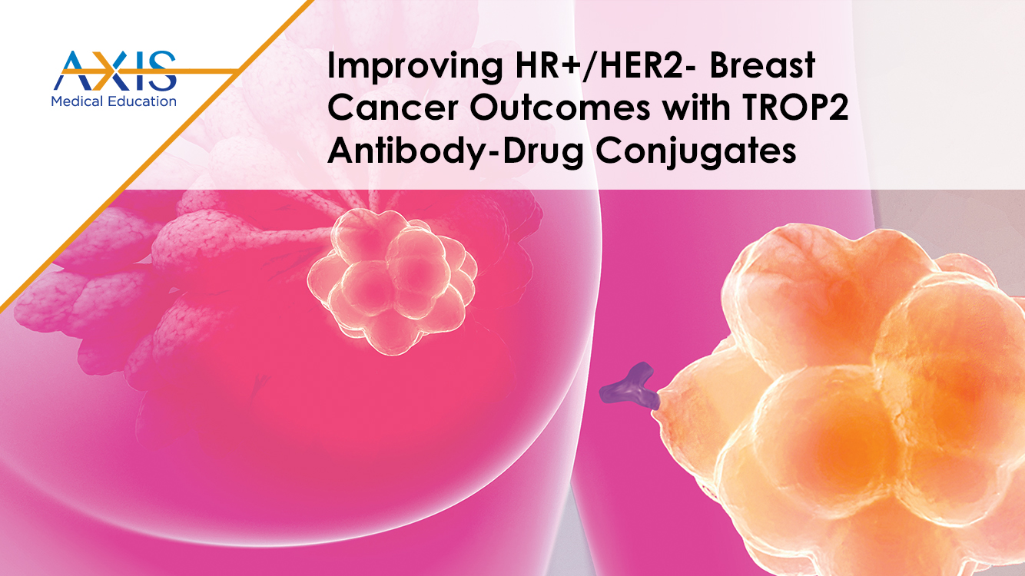

Slide 2
DISCLAIMER
This slide deck in its original and unaltered format is for educational purposes and is current as of April 2025. All materials contained herein reflect the views of the faculty, and not those of AXIS Medical Education, the CME provider, or the commercial supporter. Participants have an implied responsibility to use the newly acquired information to enhance patient outcomes and their own professional development. The information presented in this activity is not meant to serve as a guideline for patient management. Any procedures, medications, or other courses of diagnosis or treatment discussed or suggested in this activity should not be used by clinicians without evaluation of their patients’conditions and possible contraindications and/or dangers in use, review of any applicable manufacturer’s product information, and comparison with recommendations of other authorities.

Slide 3
DISCLOSURE OF UNLABELED USE
This activity may contain discussion of published and/or investigational uses of agents that are not indicated by the FDA. The planners of this activity do not recommend the use of any agent outside of the labeled indications.
The opinions expressed in the activity are those of the faculty and do not necessarily represent the views of the planners. Please refer to the official prescribing information for each product for discussion of approved indications, contraindications, and warnings.
USAGE RIGHTS
This slide deck is provided for educational purposes and individual slides may be
used for personal, non-commercial presentations only if the content and references
remain unchanged. No part of this slide deck may be published in print or
electronically as a promotional or certified educational activity without prior written
permission from AXIS. Additional terms may apply. See Terms of Service on
www.axismeded.com for details.

Slide 4
Learning Objectives
Upon completion of this activity, participants should be better able to:
Summarize the current unmet needs that exist as a result of current treatment guidelines for endocrine resistant HR+/HER2- metastatic breast cancer
Differentiate TROP2-directed ADCs in the treatment of endocrine resistant HR+/HER2- metastatic breast cancer based on construct, along with pharmacokinetic and pharmacodynamic properties
Assess pivotal trial data, evidence, and results regarding TROP2-directed ADCs in endocrine resistant HR+/HER2- metastatic breast cancer
Apply a team-based shared decision-making approach to effectively guide and facilitate treatment selection for individuals diagnosed with endocrine resistant HR+/HER2- metastatic breast cancer
Develop team-based surveillance and management strategies to overcome treatment-related adverse effects in patients receiving TROP2-directed ADCs for endocrine resistant HR+/HER2- metastatic breast cancer to enhance supportive care and improve quality of life

Slide 5
Case: 55-Year-Old Woman With HR+ MBC
55F with metastatic HR+ MBC (HER2, IHC = 0 with no detectable membrane staining). Disease progression on various endocrine-based therapies, and recently capecitabine. PS = 1. No organ dysfunction. Known history of inflammatory bowel disease. gBRCA = negative. PIK3CA and ESR1 WT. What therapy would you consider next?
Eribulin
Navelbine
Sacituzumab Govitecan (SG)
Trastuzumab Deruxtecan (T-DXd)
Datopotamab Deruxtecan (Dato-DXd)
Notes:
Slide Notes:
We will begin our program with a common scenario we see in clinic, a 55-year-old female with metastatic hormone receptor-positive HER2 IHC 0 metastatic breast cancer, who has had disease progression on various endocrine-based regimens. She also received one line of chemotherapy with capecitabine, good performance status. She has no actionable genomic alterations, germline BRCA is negative. She has a history of inflammatory bowel disease. And the question is, after capecitabine, what would you consider for this patient? eribulin, navelbine, sacituzumab govitecan, or trastuzumab deruxtecan, or datopotamab deruxtecan.
So it's a common scenario we are faced with the clinic. We have all these drugs that are FDA approved now, so I'll review how to select these agents and how to sequence these agents.

Slide 6
Unmet Treatment Need in HR+, HER2-Negative (HER2−) mBC
Current treatment landscape and outcomes – mPFS
1L
ET + CDK4/6i
No prior
CDK4/6i
24.8–28.2 mo^{1–3}
2L+
ET + targeted therapies
Prior
CDK4/6i
2.8–5.5 mo^{4,5}
ET monotherapy
Prior
CDK4/6i
1.9–2.6 mo^{4,5}
3L+
Single-agent CT
Mostly CT
naïve (mBC)
6.2–7.1 mo^{6–8}
T-DXd
(HER2-low)
Prior ET
and CT
13.2 mo⁹
Chemotherapy is utilized widely for management of endocrine-resistant HR+/HER2– MBC, but can be associated with low response rate, poor prognosis, and significant toxicity including myelosuppression and peripheral neuropathy, highlighting need for better therapies in this setting.
CDK4/6i, cyclin-dependent kinase 4/6 inhibitor; CT, chemotherapy; ET, endocrine therapy; HER2, human epidermal growth factor receptor 2; HR+, hormone receptor–positive; mBC, metastatic breast cancer; mo, months; mPFS, median progression-free survival; T-DXd, trastuzumab deruxtecan.
Curigliano G, et al. J Clin Oncol. 2024;42(17_suppl):LBA1000.
1. Finn RS, et al. N Engl J Med. 2016;375;1925-1936. 2. Hortobagyi GN, et al. Ann Oncol. 2018;29:1541-1547. 3. Johnston S, et al. NPJ Breast Cancer. 2019;5:5​. 4. Turner NC, et al; CAPItello-291 Study Group. N Engl J Med. 2023;388:2058-2070. 5. Bidard FC, et al. J Clin Oncol. 2022;40:3246-3256. 6. O’Shaughnessy J, et al. JAMA Netw Open. 2021;4:e214103. 7. O’Shaughnessy J, et al. Cancer Res. 2021;81(4_suppl):GS4-01. 8. Robert NJ, et al. J Clin Oncol. 2011;29:1252-1260. 9. Curligiano G, et al. J Clin Oncol. 2024;42(17): LBA1000.
Notes:
Slide Notes:
Curigliano G, Hu X, Dent RA, et al. Trastuzumab deruxtecan (T-DXd) vs physician’s choice of chemotherapy (TPC) in patients (pts) with hormone receptor-positive (HR+), human epidermal growth factor receptor 2 (HER2)-low or HER2-ultralow metastatic breast cancer (mBC) with prior endocrine therapy (ET): Primary results from DESTINY-Breast06 (DB-06). J Clin Oncol. 2024;42(17_suppl):LBA1000.
Finn RS, Martin M, Rugo HS, et al. Palbociclib and letrozole in advanced breast cancer. N Engl J Med. 2016;375;1925-1936.
Hortobagyi GN, Stemmer SM, Burris HA, et al. Updated results from MONALEESA-2, a phase III trial of first-line ribociclib plus letrozole versus placebo plus letrozole in hormone receptor-positive, HER2-negative advanced breast cancer. Ann Oncol. 2018;29:1541-1547.
Johnston S, Martin M, Di Leo A, et al. MONARCH 3 final PFS: a randomized study of abemaciclib as initial therapy for advanced breast cancer. NPJ Breast Cancer. 2019;5:5.
Turner NC, Oliveria M, Howell SJ, et al; CAPItello-291 Study Group. Capivasertib in hormone receptor–positive advanced breast cancer. N Engl J Med. 2023;388:2058-2070.
Bidard F-C, Kaklamani VG, Neven P, et al. Elacestrant (oral selective estrogen receptor degrader) versus standard endocrine therapy for estrogen receptor-positive, human epidermal growth factor receptor 2-negative advanced breast cancer: results from the randomized phase III EMERALD trial. J Clin Oncol. 2022;40:3246-3256.
O’Shaughnessy J, McIntyre K, Wilks S, et al. Efficacy and safety of weekly paclitaxel with or without oral alisertib in patients with metastatic breast cancer. JAMA Netw Open. 2021;4:e214103.
O’Shaughnessy J, Schwartzberg L, Piccart M, et al. Results from CONTESSA: A phase 3 study of tesetaxel plus a reduced dose of capecitabine versus capecitabine alone in patients with HER2-, hormone receptor + (HR+) metastatic breast cancer (MBC) who have previously received a taxane. Cancer Res. 2021;81(4_suppl):GS4-01.
Robert NJ, Diéras V, Glasy J, et al. RIBBON-1: randomized, double-blind, placebo-controlled, phase III trial of chemotherapy with or without bevacizumab for first-line treatment of human epidermal growth factor receptor 2-negative, locally recurrent or metastatic breast cancer. J Clin Oncol. 2011;29:1252-1260.
Modi S, Jacot W, Yamashita T, et al, for the DESTINY-Breast04 Trial Investigators. Trastuzumab deruxtecan in previously treated HER2-low advanced breast cancer. N Engl J Med. 2022;387:9-20.

Slide 7
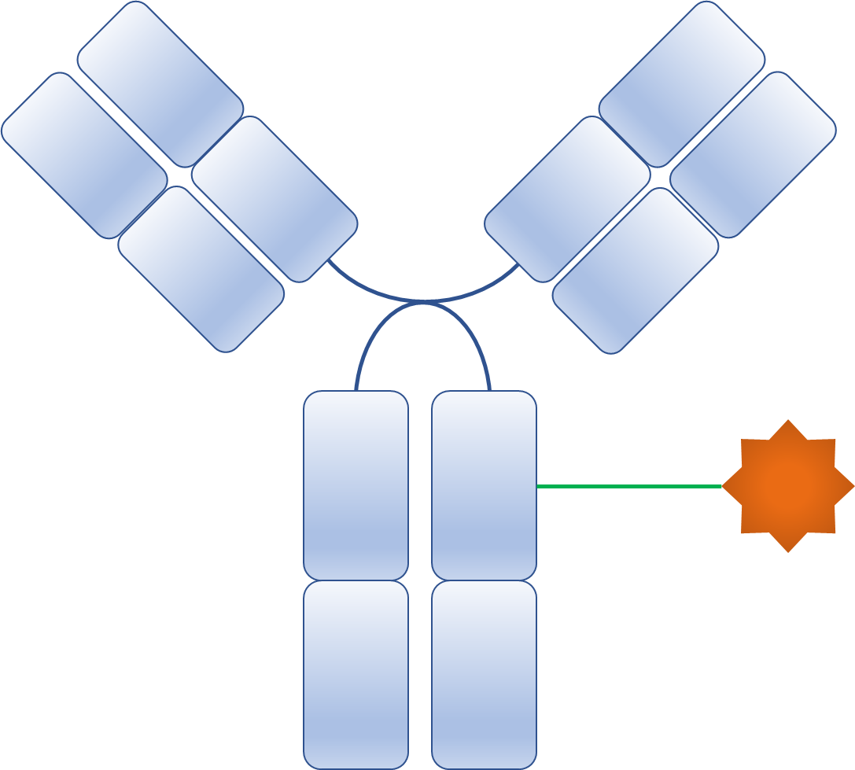

Selective Delivery of Toxic Payload
6. Bystander Effect
1. Binding of an ADC to antigen
2. Internalization to the early endosome
Trop-2
Trop-2
Clathrin
5. Apoptosis of the cancer cell
H⁺
Lysosomes
H⁺
3. Degradation of ADCs in the lysosome
4. Release and action of payload
ADC, antibody-drug conjugate.
Nagayama A, et al. Target Oncol. 2017;12(6):719-739.
Notes:
Slide Notes:
The idea of antibody drug conjugate is that once an ADC molecule recognizes tumor antigen, it binds to the transmembrane antigen and becomes internalized via receptor-mediated endocytosis. It is trafficked to the lysosome, get degraded and releases the payload.
Nagayama A, Ellisen LW, Chabner B, Bardia S. Antibody-drug conjugates for the treatment of solid tumors: clinical experience and latest developments. Target Oncol. 2017;12(6):719-739.

Slide 8
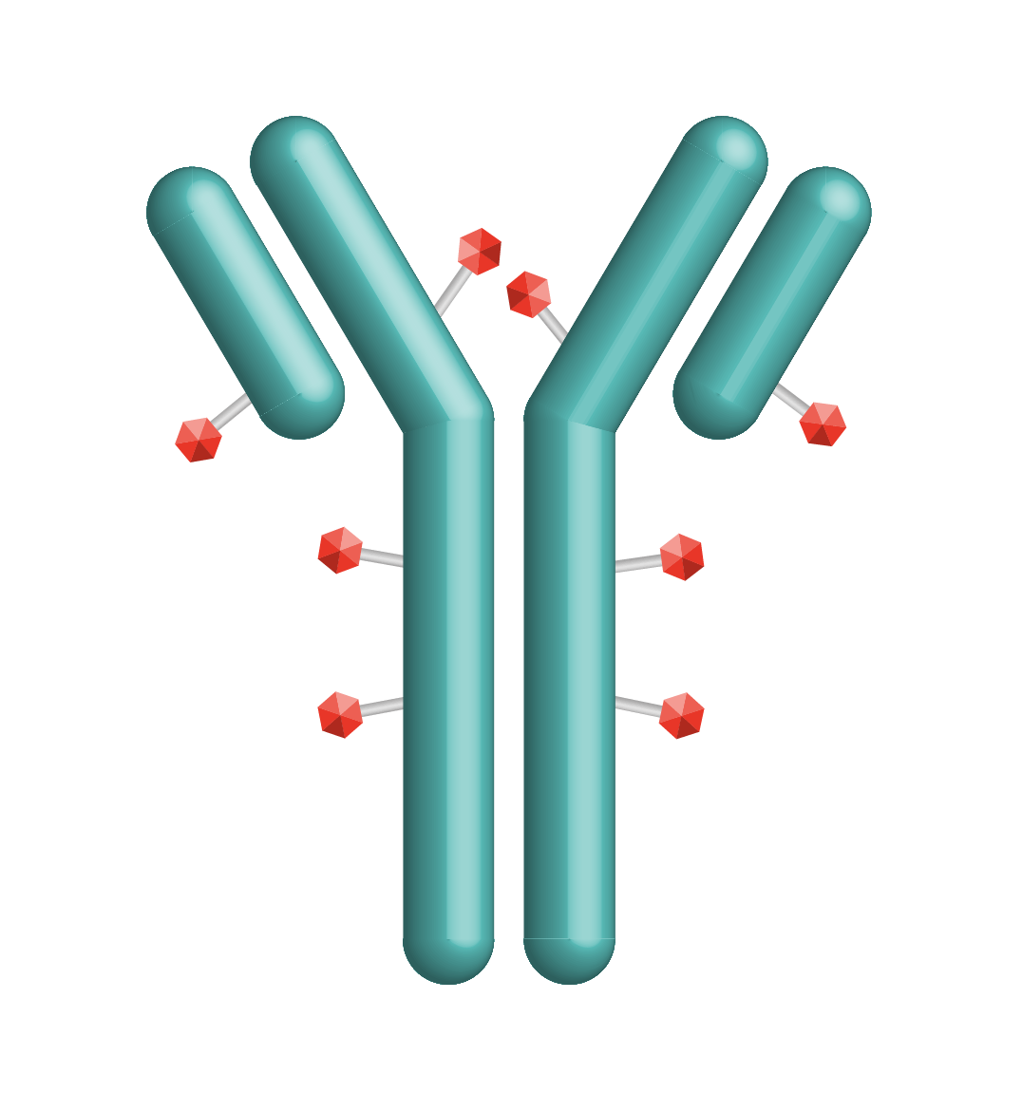
Sacituzumab Govitecan: First-in-Class TROP2 ADC
Linker for SN-38
Hydrolyzable linker for payload release
Humanized anti‒TROP2 antibody
SG is distinct from other ADCs
Antibody highly specific for Trop-2
High drug-to-antibody ratio (7.6:1)
Internalization and enzymatic cleavage by tumor cell not required for the liberation of SN-38 from the antibody
Hydrolysis of the linker also releases the SN-38 cytotoxic extracellularly in the tumor microenvironment, providing a bystander effect
SN-38 payload
SN-38 more potent than parent compound, irinotecan
ADC, antibody-drug conjugate; SG, sacituzumab govitecan; TROP2, trophoblast cell-surface antigen 2.
Nagayama A, et al. Ther Adv Med Oncol. 2020;12:1758835920915980.
Cardillo TM, et al. Bioconjugate Chem. 2015;26(5):919-931.
Notes:
Slide Notes:
Let's start with sacituzumab govitecan. It was the first in class TROP2-directed ADC. It targets TROP2. It has SN38, the active metabolite of irinotecan as the payload, also has a bystander effect, so it can even impact cells with low or no expression of TROP2.
Nagayama A, Vidula N, Ellisen L, Bardia A. Novel antibody-drug conjugates for triple negative breast cancer. Ther Adv Med Oncol. 2020;12:1758835920915980.
Cardillo TM, Govindan SV, Sharkey RM, et al. Sacituzumab govitecan (IMMU-132), an anti-Trop-2/SN-38 antibody-drug conjugate: characterization and efficacy in pancreatic, gastric, and other cancers. Bioconjugate Chem. 2015;26(5):919-931.

Slide 9
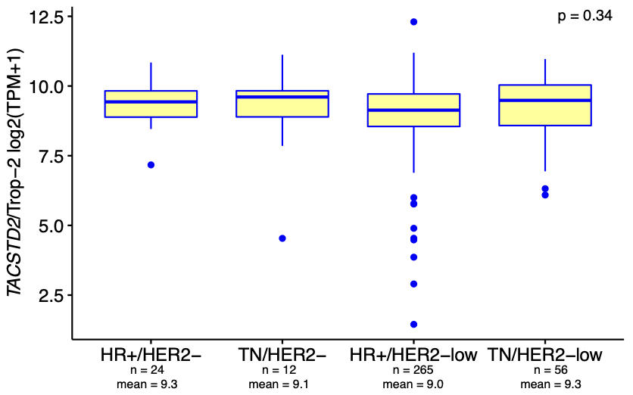
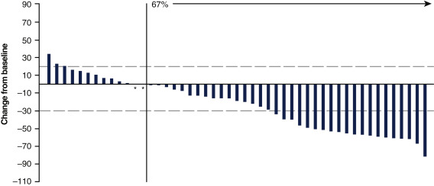
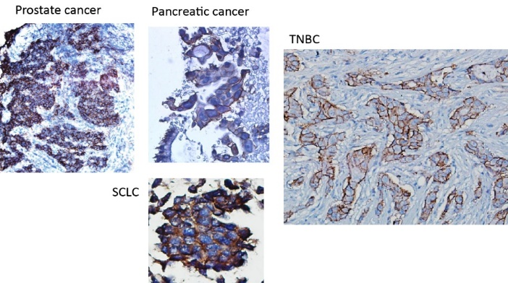
Rationale for TROP2 ADC: HR+ MBC
Best Percent Change From Baseline in the Sum of the Diameters of the Target Lesions With SG in HR+ MBC
HR+ Breast Cancer
Confirmed
ORR = 31.5%
ADC, antibody-drug conjugate; HER2, human epidermal growth factor receptor 2; HR, hormone receptor; MBC, metastatic breast cancer; ORR, overall response rate; TACSTD2, tumor associated calcium signal transducer 2; TN, triple-negative; TROP2, trophoblast cell-surface antigen 2.
Kalinsky K, et al. Ann Oncol. 2020;3(12):1709-1718.
Notes:
Kalinsky K, Diamond JR, Vahdat LT, et al. Sacituzumab govitecan in previously treated hormone receptor-positive/HER2-negative metastatic breast cancer: final results from a phase I/II, single-arm, basket trial. Ann Oncol. 2020;3(12):1709-1718.
Medford A, Spring LM, Moy B, Bardia A. Antibody drug conjugates for patients with breast cancer. Curr Probl Cancer. 2021;45(5):100795.

Slide 10
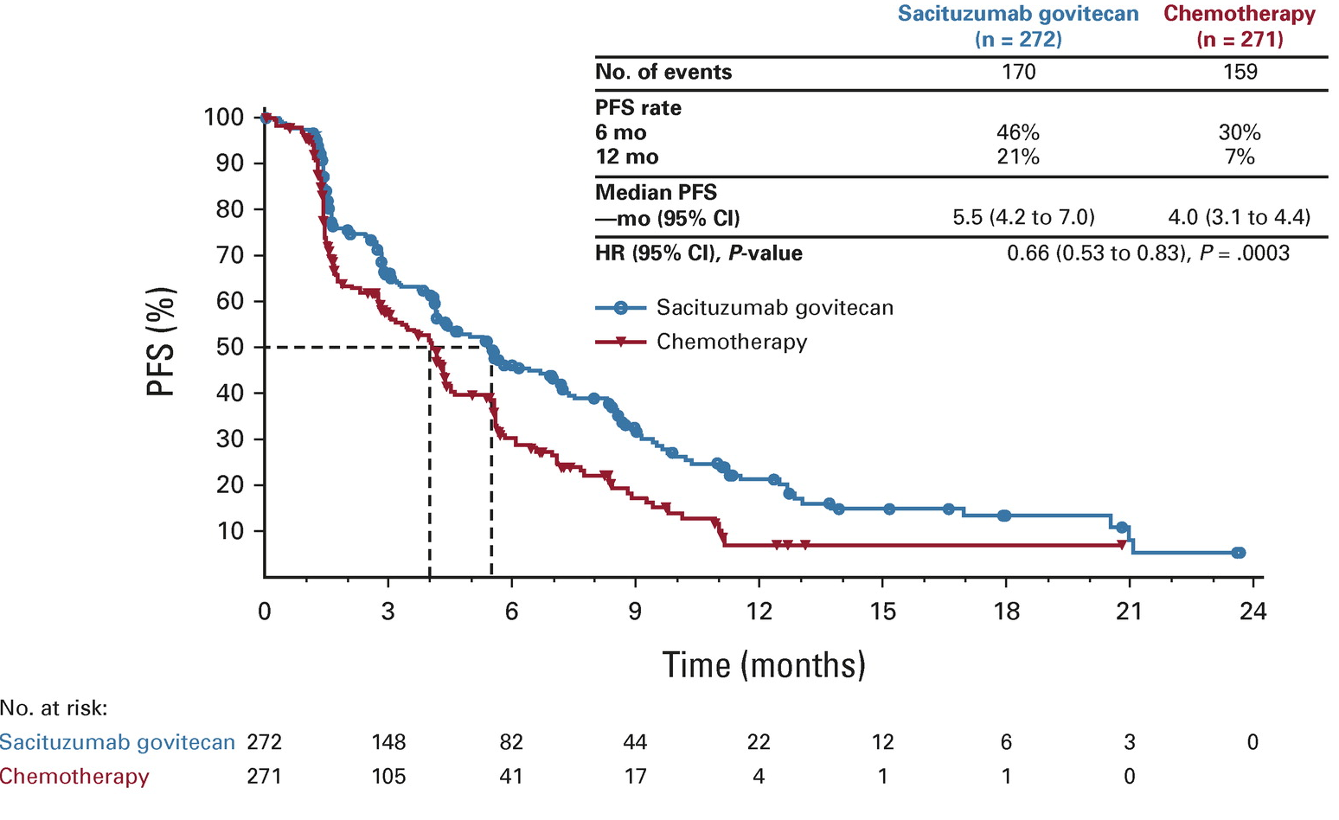
TROPiCs-02: Sacituzumab Govitecan vs TPC: PFS (HR+ MBC)
HR, hazard ratio; HR+, hormone receptor–positive; MBC, metastatic breast cancer; mo, month; PFS, progression-free survival; TPC, treatment of physician's choice.
Rugo HS, et al. J Clin Oncol. 2022;40(20):3365-3376.
Notes:
Slide Notes:
This was evaluated in the TROPiCS-02 study, a pivotal phase 3 trial that demonstrated that sacituzumab govitecan was superior to standard chemotherapy for patients with hormone receptor-positive, HER2-negative breast cancer, so that was both HER2-low as well as HER2 IHC 0 metastatic breast cancer. There was improvement in progression-free survival.
Rugo HS, Bardia A, Marmé F, et al. Sacituzumab govitecan in hormone receptor-positive/human epidermal growth factor receptor 2-negative metastatic breast cancer. J Clin Oncol. 2022;40(20):3365-3376.

Slide 11
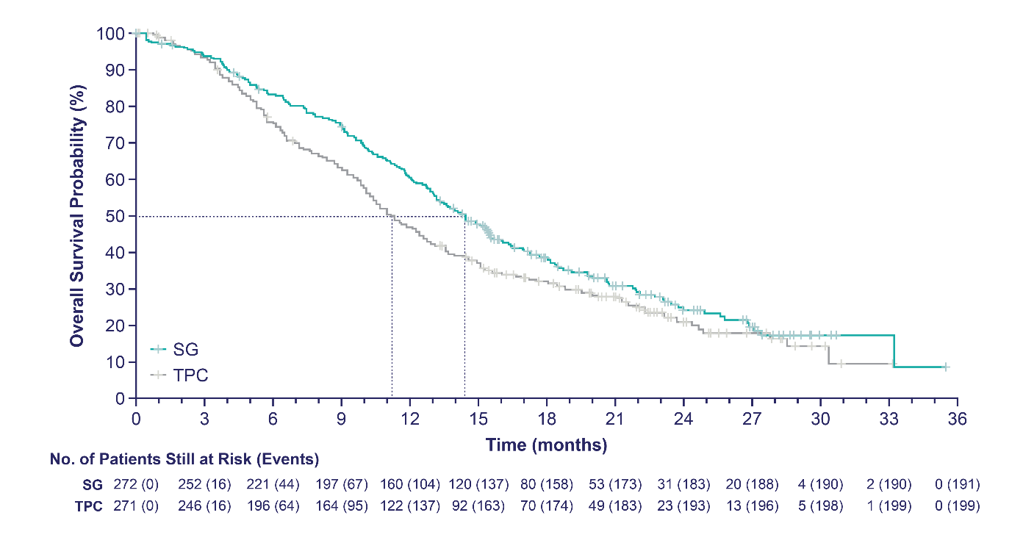
Sacituzumab Govitecan vs TPC: OS (HR+ MBC)
12 months
SG demonstrated a statistically significant improvement in OS vs TPC with 21% reduction in the risk of death; having met statistical significance, no further formal statistical testing of OS will occur
Patients who received SG survived a median of 3.2 months longer than those who received TPC
 | SG (n=272) | TPC (n=271)
Number of events | 191 | 199
Median OS, mo (95% CI) | 14.4 (13.0–15.7) | 11.2 (10.1–12.7)
Stratified HR (95% CI) | 0.79 (0.65–0.96)
Stratified Log Rank P value | P=0.020
12-month OS rate, % (95% CI) | 61 (55–66) | 47 (41–53)
Median follow-up was 12.5 months.
HR, hazard ratio; HR+, hormone receptor–positive; MBC, metastatic breast cancer; OS, overall survival; SG, sacituzumab govitecan; TPC, treatment of physician’s choice.
Rugo HS, et al. ESMO 2022. Abstract 15530.
Notes:
Slide Notes:
There was also improvement in overall survival as well. The median overall survival was 14.5 months with sacituzumab govitecan versus 11 months or so with standard chemotherapy. This led to the FDA approval for sacituzumab govitecan. And as per label, it was for patients who've received at least two prior lines of systemic therapy in this setting.
Rugo HS, Schmid P, Tolaney SM, et al. Health-related quality of life (HRQoL) in the phase III TROPiCS-02 trial of sacituzumab govitecan (SG) vs chemotherapy in HR+/HER2- metastatic breast cancer (MBC). Abstract presented at: European Society of Medical Oncology Congress; Paris, France; September 9-13, 2022. Abstract 15530.

Slide 12
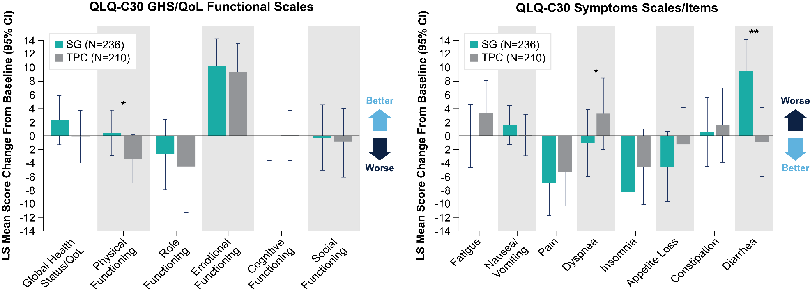
Change From Baseline in HRQoL Status, Functioning, and Symptoms
Overall, the SG arm showed a trend in improvement for most assessments when compared with TPC
*P < 0.05. **P < 0.001.
EORTC QLQ-C30, European Organization for the Research and Treatment of Cancer Core Quality of Life questionnaire; GHS, global health status; HRQoL, health-related quality of life; LS, least squares; SG, sacituzumab govitecan; TPC, treatment of physician’s choice.
Rugo HS, et al. ESMO 2022. Abstract 15530.
Notes:
Slide Notes:
As seen in this slide, an improvement was measured by a positive change in the functional scale or a negative change in the symptom scale. Patients in the SG arm showed a trend for improvement in most HRQoL domains. For QLQ-C30 functions and symptoms, statistically significant improvements in physical functioning and dyspnea were observed for patients receiving SG versus TPC. It is worth noticing the direction of change for the scales shown here. For example, while physical functioning was slightly improved with SG, it was deteriorating in the TPC arm. Same results are seen with global health status/QoL, dyspnea, but the opposite for diarrhea favoring TPC. No statistically significant differences between SG and TPC were observed for the other domains.
Rugo HS, Schmid P, Tolaney SM, et al. Health-related quality of life (HRQoL) in the phase III TROPiCS-02 trial of sacituzumab govitecan (SG) vs chemotherapy in HR+/HER2- metastatic breast cancer (MBC). Abstract presented at: European Society of Medical Oncology Congress; Paris, France; September 9-13, 2022. Abstract 15530.

Slide 13

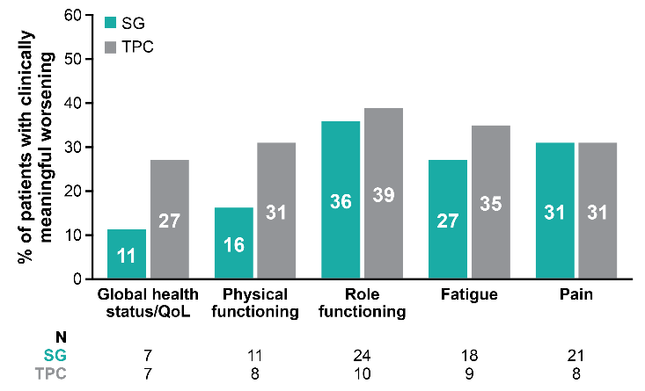
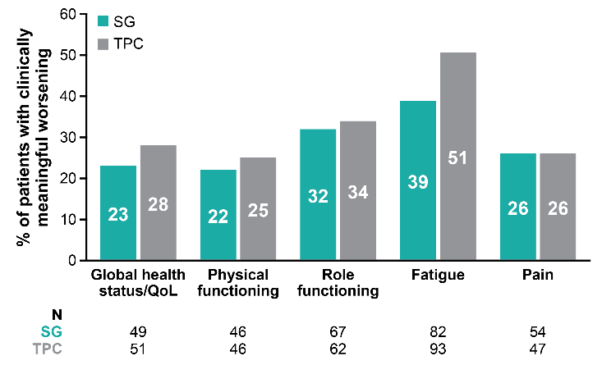
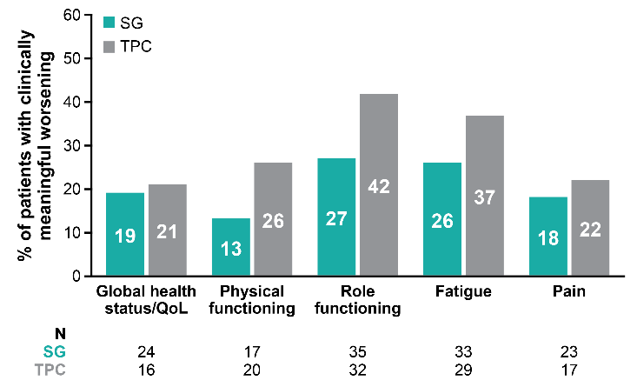

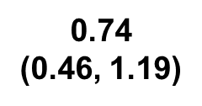
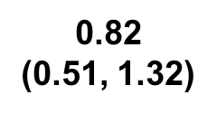
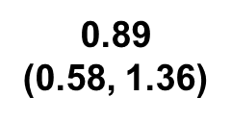
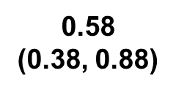
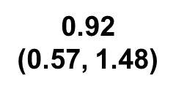
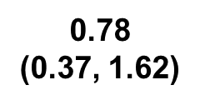
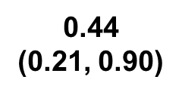
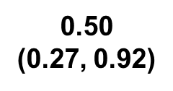
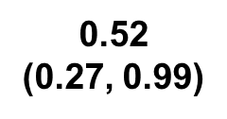
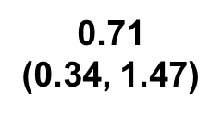
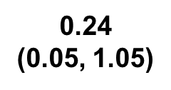
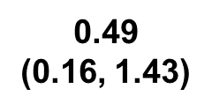
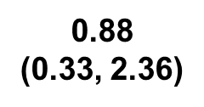
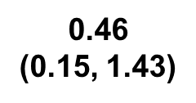
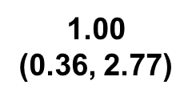
Proportion of Patients with Clinically Meaningful Worsening of QoL
Cycle 2
Cycle 6
Cycle 11
Over time, a greater proportion of patients receiving TPC experienced clinically meaningful worsening of QoL vs those who received SG
*P < 0.05.
OR, odds ratio; QoL, quality of life; SG, sacituzumab govitecan; TPC, treatment of physician’s choice.
Rugo HS, et al. ESMO 2022. Abstract 15530.
Notes:
Slide Notes:
In these figures, each bar represents the proportion of patients with clinically meaningful worsening for each primary-focused HRQoL domain. As you can see, the proportions of patients with clinically meaningful worsening were higher in the TPC arm than in the SG arm across most timepoints. For example, over time, the proportion of patients with clinically meaningful worsening of HRQoL outcomes for TPC increased from 25% to 26% to 31%, while the proportion of patients with clinically meaningful worsening of HRQoL outcomes for SG decreased from 22% to 13% to 16%. For fatigue, the proportion of patients with clinically meaningful worsening of HRQoL outcomes for SG also decreased from 39% to 26% to 27% while the proportion for TPC decreased from 51% to 37% to 35%.
Rugo HS, Schmid P, Tolaney SM, et al. Health-related quality of life (HRQoL) in the phase III TROPiCS-02 trial of sacituzumab govitecan (SG) vs chemotherapy in HR+/HER2- metastatic breast cancer (MBC). Abstract presented at: European Society of Medical Oncology Congress; Paris, France; September 9-13, 2022. Abstract 15530.

Slide 14
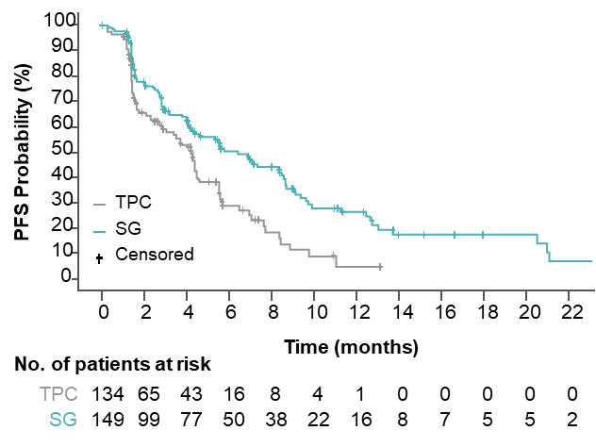
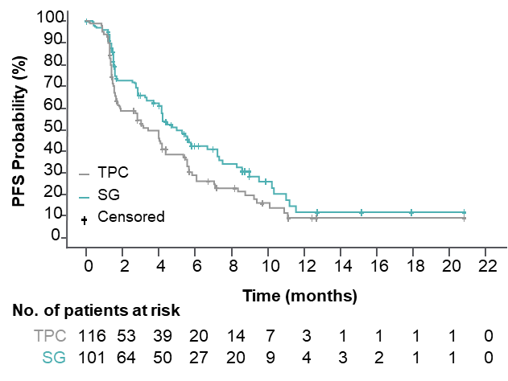
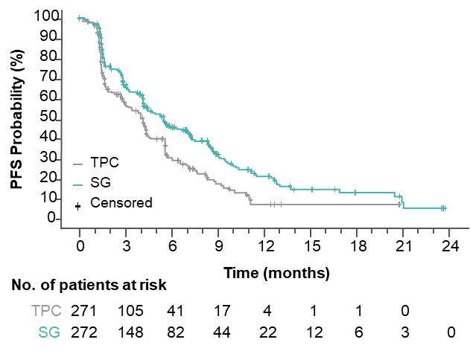
Sacituzumab Govitecan vs TPC:
Efficacy by HER2 Status (Tropics-02)
HER2-Lowª
HER2 IHC0
ITT¹
 | SG (n=149) | TPC (n=134)
Median PFS, mo | 6.4 | 4.2
HR (95% CI) | 0.58 (0.42–0.79), P<0.001
 | SG (n=101) | TPC (n=116)
Median PFS, mo | 5.0 | 3.4
HR (95% CI) | 0.72 (0.51–1.00), P=0.05
 | SG (n=272) | TPC (n=271)
Median PFS, mo (95% CI) | 5.5 (4.2–7.0) | 4.0 (3.1–4.4)
HR (95% CI) | 0.66 (0.53–0.83), P=0.0003
Within the HER2-low population, median PFS with SG vs TPC for the IHC1+ and IHC2+ subgroups was 7.0 vs 4.3 (HR, 0.57) and 5.6 vs 4.0 (HR, 0.58) months, respectively
The hazard ratio for median PFS in a sensitivity analysis of the HER2-low subgroup (excluding ISH-unverified) was similar (HR, 0.53)
ªHER2-low defined as IHC1+, or IHC2+ and ISH-negative/unverified. ^{b}39 patients with HER2 IHC2+ did not have ISH data documentation available for verification and were presumed to be HER2-low, consistent with the trial eligibility criteria to enroll HER2-negative patients.
HER2, human epidermal growth factor receptor 2; HR, hazard ratio; IHC, immunohistochemistry; ISH, in situ hybridization; ITT, intent to treat; PFS, progression-free survival; SG, sacituzumab govitecan; TPC, treatment of physician’s choice.
1. Rugo HS, et al. J Clin Oncol. 2022;40(20):3365-3376.
Schmid P, et al. ESMO 2022. Abstract 214MO.
Notes:
Slide Notes:
SG significantly improved PFS vs TPC in both HER2-negative subgroups with a hazard ratio of 0.58 in patients with HER2-Low disease and 0.72 in the HER2 IHC-0 group. These results were consistent with that of the intent-to-treat population with a hazard ratio of 0.66.
Schmid P, Cortés J, Marmé F, et al. Sacituzumab govitecan (SG) efficacy in hormone receptor-positive/human epidermal growth factor receptor 2-negative (HR+/HER2–) metastatic breast cancer (MBC) by HER2 immunohistochemistry (IHC) status in the phase III TROPiCS-02 study. Abstract presented at: European Society of Medical Oncology Congress; Paris, France; September 9-13, 2022. Abstract 214MO.
Rugo HS, Bardia A, Marmé F, et al. Sacituzumab govitecan in hormone receptor-positive/human epidermal growth factor receptor 2-negative metastatic breast cancer. J Clin Oncol. 2022;40(20):3365-3376.

Slide 15
Efficacy by TROP2 Expression in the TROPiCS-02 Study of Patients With HR+/HER2– Metastatic Breast Cancer
No impact of TROP2 expression on efficacy
<100 Subgroup
≥100 Subgroup
100
100
80
 | SG (n = 96) | TPC (n = 96)
Median PFS, mo (95% CI) | 5.3 (4.1–6.0) | 4.0 (2.8–5.6)
HR (95% CI) | 0.77 (0.54–1.09)
80
 | SG (n = 142) | TPC (n = 128)
Median PFS, mo (95% CI) | 6.4 (4.0–8.3) | 4.1 (2.1–4.5)
HR (95% CI) | 0.60 (0.44–0.81)
60
60
PFS probability (%)
PFS probability (%)
40
40
20
TPC
SG
20
TPC
SG
0
0
3
6
9
12
15
18
21
0
0
3
6
9
12
15
18
21
24
Number
Time (months)
Time (months)
SG
a
t risk (
e
v
e
n
ts)
Number
a
t risk (
e
v
e
n
ts)
TPC
96 (0)
53 (27)
24 (47)
13 (54)
5 (59)
0 (62)
SG
142(0)
77 (46)
50 (62)
25 (76)
15 (83)
10 (85)
4 (86)
2 (87)
0 (88)
96 (0)
39 (36)
19 (49)
10 (56)
2 (60)
0 (60)
TPC
128(0)
52 (48)
18 (72)
6 (78)
2 (81)
1 (81)
1 (81)
0 (81)
100
<100 Subgroup
100
≥100 Subgroup
 | SG (n = 96) | TPC (n = 96)
Median OS, mo (95% CI) | 14.6 (12.7–18.1) | 11.3 (10.0–13.3)
HR (95% CI) | 0.75 (0.54–1.04)
80
80
 | SG (n = 142) | TPC (n = 128)
Median OS, mo (95% CI) | 14.4 (12.7–16.4) | 4.1 (9.9–12.9)
HR (95% CI) | 0.83 (0.62–1.11)
60
60
OS probability (%)
OS probability (%)
40
40
20
TPC
SG
20
TPC
SG
0
0
3
6
9
12
15
18
21
24
27
30
33
0
0
3
6
9
12
15
18
21
24
27
30
33
36
Time (months)
Time (months)
a
t risk (
e
v
e
n
ts)
a
t risk (
e
v
e
n
ts)
Number
Number
SG
96 (0)
90 (3)
79 (13)
72 (20)
57 (35)
43 (53)
28 (53)
18 (60)
9 (64)
5 (66)
1 (66)
1 (66)
SG
142(0)
132(9)
116(24)
102(37)
86(53)
61(73)
42(83)
28(90)
16(96)
10(98)
2 (99)
1 (99)
0 (99)
TPC
96 (0)
91 (5)
75 (21)
61 (34)
47 (48)
32 (62)
23 (68)
16 (72)
9 (74)
6 (75)
3 (76)
1 (76)
TPC
128(0)
117(8)
89(34)
78(45)
55(68)
41(79)
32(80)
22(83)
9(86)
4 (87)
1 (87)
0 (88)
HER2, human epidermal growth factor receptor 2; HR, hazard ratio; HR+, hormone receptor–positive; mo, month; OS, overall survival; PFS, progression-free survival; SG, sacituzumab govitecan; TPC, treatment of physician’s choice; TROP2, trophoblast cell-surface antigen 2.
Rugo HS, et al. Lancet. 2023;402(10411):1423-1433.
Notes:
Slide Notes:
What about biomarkers? Should we look for TROP2, the drug targets TROP2? Should we measure for TROP2? And the answer in clinic is no. We do not look at TROP2 expression for selection of sacituzumab govitecan at this time based on the FDA label. In TROPiCS-02, as well as other trials like the ASCENT, the team looked at the correlation between TROP2 and outcomes, and even in patients with low expression of TROP2, the benefit with SG was maintained, so the outcomes were better with SG as compared to standard chemotherapy. So measurement of TROP2 does not influence clinical decision-making, and that's why we don't use it in clinic at this time.
Rugo HS, Bardia A, Marmé F, et al. Overall survival with sacituzumab govitecan in hormone receptor-positive and human epidermal growth factor receptor 2-negative metastatic breast cancer (TROPiCS-02): a randomised, open-label, multicentre, phase 3 trial. Lancet. 2023;402(10411):1423-1433.

Slide 16
Treatment Related Adverse Effects:
Sacituzumab Govitecan (vs TPC)
 |  |  | SG (n=258) |  |  | TPC (n=224)
TRAE |  |  | All grade % | Grade 3, % | Grade 4, % | All grade, % | Grade 3, % | Grade 4, %
Hematologic | Neutropenia | Neutropenia Febrile neutropenia Anemia Leukopenia | 63 | 46 | 17 | 43 | 27 | 13
 | Anemia |  | 34 | 8 | 0 | 24 | 5 | 0
 | Leukopenia |  | 16 | 10 | 1 | 11 | 5 | 1
 | Febrile neutropenia |  | 6 | 5 | 1 | 2 | 2 | <1
Gastrointestinal | Diarrhea |  | 59 | 10 | 0 | 12 | <1 | 0
 | Nausea |  | 57 | 2 | <1 | 26 | <1 | 0
 | Vomiting |  | 29 | 1 | <1 | 10 | <1 | 0
Other | Fatigue | Fatigue Alopecia Decreased appetite Hyperglycemia Hypomagnesemia Hypophosphatemia | 45 | 3 | 0 | 30 | 5 | 0
 | Alopecia |  | 46 | 0 | 0 | 16 | 0 | 0
Key grade ≥3 TRAEs (SG vs TPC): neutropenia (51% vs 33%), diarrhea (10% vs <1%), leukopenia (10% vs 5%), anemia (8% vs 5%), and febrile neutropenia (6% vs 2%)
No severe cardiovascular toxicity, no grade >2 neuropathy or grade >3 interstitial lung disease with SG
SG, sacituzumab govitecan; TPC, treatment of physician’s choice; TRAE, treatment-related adverse event.
Bardia A, et al; ASCENT Clinical Trial Investigators. N Engl J Med. 2021;384(16):1529-1541.
Notes:
Slide Notes:
How about AEs? Three common AEs seen with sacituzumab govitecan; the first one is neutropenia, close to 50% so 1 in 2 patients will have grade 3 or grade 4 neutropenia. Generally recommend secondary prophylaxis, although for certain patients, such as elderly, you could consider primary prophylaxis as well. The second side effect is diarrhea, generally grade 1/grade 2, although you can see grade 3/4 diarrhea as well. Generally recommend prophylactic antidiarrheal, secondary prophylaxis with the use of loperamide. And the third side effect is alopecia. The drug uniformly causes alopecia, so it's important to counsel patients regarding this side effect.
The AEs we do not see with sacituzumab govitecan include cardiovascular toxicity, neuropathy, or interstitial lung disease. And this becomes important as we have multiple agents in this setting. And how do we select between the different agents? The AE profile can be an important factor to consider when selecting the ADC.
The other point to note is sacituzumab govitecan is given Day 1, Day 8, every 21 days in terms of schedule.
Bardia A, Hurvitz SA, Tolaney SM, et al; ASCENT Clinical Trial Investigators. Sacituzumab govitecan in metastatic triple-negative breast cancer. N Engl J Med. 2021;384(16):1529-1541.

Slide 17
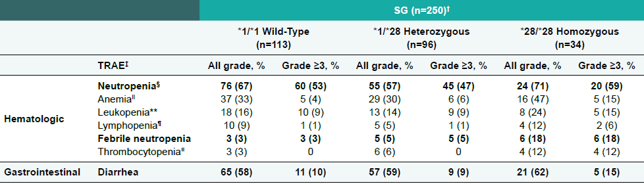
UGT1a1 Status and Association With Toxicity
UGT1A1 polymorphisms may modulate incidence of adverse events
Routine testing is not recommended except in certain circumstances (eg, black patients have a higher rate of this genotype; patients who have significant neutropenia with other agents)
SG, sacituzumab govitecan; TRAE, treatment-related adverse event.
Rugo HS, et al. SABCS 2020. Poster PD2-07.
Notes:
Slide Notes:
Uridine diphosphate glucuronosyltransferase 1A1 (UGT1A1) haplotype status is illustrated in 146 patients who received IMMU-132 along with the incidence of neutropenia or diarrhea based on haplotype. The top pie diagram shows the distribution of each of the 3 haplotypes (*1*1, *1*28, and *28*28), and the diagrams below indicate the proportion of patients in these sets that had grade 3 or greater (Gr 31) neutropenia or various grades of diarrhea.
Rugo HS, Lerebours F, Juric D, et al. Alpelisib + letrozole in patients with PIK3CA-mutated, hormone-receptor positive (HR+), human epidermal growth factor receptor-2-negative (HER2-) advanced breast cancer (ABC) previously treated with a cyclin-dependent kinase 4/6 inhibitor (CDK4/6i) + fulvestrant: BYLieve study results. Abstract presented at: San Antonio Breast Cancer Symposium; Virtual; December 8-11, 2020. Poster PD2-07.

Slide 18
Datopotamab Deruxtecan
Patients with relapsed/refractory advanced or metastatic TNBC have poor clinical outcomes¹
Dato-DXd is a differentiated TROP2-directed ADC designed with 3 components^{2,3}:
  A humanized anti-TROP2 IgG1 mAb
  A topoisomerase I inhibitor payload
  (exatecan derivative, DXd)
  A tetrapeptide-based cleavable linker
Dato-DXd has demonstrated highly encouraging antitumor activity and manageable AEs in the NSCLC cohort⁴
  6 mg/kg has been selected as the dose for expansion into other advanced tumor types
  Humanized
  Anti-TROP2 IgG1 mAb
Deruxtecan^{5,a}
Cleavable Tetrapeptide-Based Linker
Topoisomerase I Inhibitor
Payload (DXd)
ªActual drug positions may vary.
ADC, antibody drug conjugate; AE, adverse event; IgG1, immunoglobulin G1; mAB, monoclonal antibody; NSCLC, non-small cell lung cancer; TNBC, triple-negative breast cancer; TROP2, trophoblast cell-surface antigen 2.
1. Bardia A, et al; ASCENT Clinical Trial Investigators. N Engl J Med. 2021;384(16):1529-1541. 2. Okajima D, et al. AACR-NCI-EORTC 2019. Abstract C026. 3. Nakada T, et al. Chem Pharm Bull (Tokyo). 2019;67(3):173-185. 4. Spira A, et al. WCLC 2020. Abstract 3407. 5. Krop I, et al. SABCS 2019. Abstract GS1-03.
Notes:
Bardia A, Hurvitz SA, Tolaney SM, et al; ASCENT Clinical Trial Investigators. Sacituzumab govitecan in metastatic triple-negative breast cancer. N Engl J Med. 2021;384(16):1529-1541.
Okajima D, Yamaguchi J, Kitamura M, et al. DS-1062a, a novel TROP2-targeting antibody-drug conjugate with a novel DNA topoisomerase I inhibitor DXd, demonstrates potent antitumor activity in preclinical models. Abstract presented at: AACR-NCI-EORTC International Conference; Boston, Massachusetts; October 26-30, 2019. Abstract C026.
3. Nakada T, Sugihara K, Jikoh T, Abe Y, Agatsuma T. The latest research and development into the antibody-drug conjugate, [fam-] trastuzumab deruxtecan (DS-8201a), for HER2 cancer therapy. Chem Pharm Bull (Tokyo). 2019;67(3):173-185.
4. Spira A, Lisberg A, Sands J, et al. Datopotamab deruxtecan (Dato-DXd; DS-1062), a TROP2 ADC, in patients with advanced NSCLC: updated results of TROPION-PanTumor01 phase 1 study. Abstract presented at: World Conference on Lung Cancer; Virtual; January 28-31, 2021. Abstract 3407.
5. Krop I, Saura C, Yamashita T, et al. [Fam-] trastuzumab deruxtecan (T-DXd; DS-8201a) in subjects with HER2-positive metastatic breast cancer previously treated with T-DM1: A phase 2, multicenter, open-label study (DESTINY-Breast01. Abstract presented at: San Antonio Breast Cancer Symposium; San Antonio, Texas; December 10-14, 2019. Abstract GS1-03.

Slide 19
TROPION-Breast01 Study Design
Randomized, phase 3, open-label, global study (NCT05104866)
Key inclusion criteria:
Patients with HR+/HER2– breast cancer* (HER2‒ defined as IHC 0/1+/2+; ISH negative)
Previously treated with 1–2 lines of chemotherapy (inoperable/metastatic setting)
Experienced progression on ET and for whom ET was unsuitable
ECOG PS 0 or 1
Dato-DXd
6 mg/kg IV Day 1 Q3W
(n=365)
Endpoints:
Dual primary: PFS by BICR per RECIST v1.1, and OS
Secondary endpoints included: ORR,
PFS (investigator assessed), TFST,
safety, PROs
1:1
Investigator’s choice of chemotherapy (ICC)
as per protocol directions†
(eribulin mesylate D1,8 Q3W; vinorelbine D1,8 Q3W;
gemcitabine D1,8 Q3W; capecitabine D1–14 Q3W)
(n=367)
Randomization stratified by:
Lines of chemotherapy in unresectable/metastatic setting (1 vs 2)
Geographic location (US/Canada/Europe vs ROW)
Previous CDK4/6 inhibitor (yes vs no)
Treatment continued until PD, unacceptable tolerability, or other discontinuation criteria
Detailed description of the statistical methods published previously.¹
*Per American Society of Clinical Oncology/College of American Pathologists (ASCO/CAP) guidelines. †ICC was administered as follows: eribulin mesylate, 1.4 mg/m² IV on Days 1 and 8, Q3W; vinorelbine, 25 mg/m² IV on Days 1 and 8, Q3W; or gemcitabine, 1000 mg/m² IV on Days 1 and 8, Q3W; capecitabine, 1000 or 1250 mg/m² orally twice daily on Days 1 to 14, Q3W (dose per standard institutional practice).
BICR, blinded independent central review; CDK4/6, cyclin-dependent kinase 4/6; D, day; ECOG PS, Eastern Cooperative Oncology Group performance status; ET, endocrine therapy; HER2, human epidermal growth factor receptor 2; HR+, hormone receptor–positive; IHC, immunohistochemistry; ISH, in-situ hybridization; IV, intravenous; ORR, overall response rate; OS, overall survival; PD, progressive disease; PFS, progression-free survival; PROs, patient-reported outcomes; Q3W, every 3 weeks; RECIST, Response Evaluation Criteria in Solid Tumors; ROW, rest of world; TFST, time to first subsequent therapy.
1. Bardia A, et al. Future Oncol. 2024;20(8):423-436.
Notes:
1. Bardia A, Jhaveri K, Kalinsky, K. et al. TROPION-Breast01: Datopotamab deruxtecan vs chemotherapy in pre-treated inoperable or metastatic HR+/HER2- breast cancer. Future Oncol. 2024;20(8):423-436.

Slide 20
Dato-DXd in HR+ MBC (TROPION-Breast01)
PFS by BICR: primary endpoint
1.0
0.9
0.8
0.7
0.6
0.5
0.4
0.3
0.2
0.1
0
Probability of PFS
 | Dato-DXd | ICC
Median PFS, months (95% CI) | 6.9 (5.7–7.4) | 4.9 (4.2–5.5)
HR (95% CI) | 0.63 (0.52–0.76)
P-value | <0.0001
53.3%
37.5%
38.5%
25.5%
Dato-DXd (n=365)
18.7%
14.6%
ICC (n=367)
0
3
6 9
Time from randomization (months)
12
15
Number at risk
Dato-DXd 365
ICC 367
249
205
158
93
66
26
15
8
4
1
PFS by investigator assessment: Median 6.9 vs 4.5 months; HR 0.64 (95% CI 0.53‒0.76)
PFS by BICR was consistent across subgroups
BICR, blinded independent central review; Dato-DXd, datopotamab deruxtecan; HR, hazard ratio; HR+, hormone receptor–positive; ICC, investigator's choice of chemotherapy; MBC, metastatic breast cancer; PFS, progression-free survival.
Bardia A, et al. ESMO 2023. Abstract LBA11.
Notes:
Slide Notes:
The second ADC, that's now FDA approved, is datopotamab deruxtecan, which targets TROP2. It's a different antibody than sacituzumab govitecan. It's datopotamab. It's a different payload as well, deruxtecan as opposed to SN38 which is much more potent in terms of TOP1 inhibition. And the linker is different as well. It's a tetrapeptide-based cleavable linker. The drug is given every 3 weeks, so it has a different schedule as well, as compared to sacituzumab govitecan.
In terms of efficacy, this was evaluated in the phase 3 TROPION-Breast01 study, where there was improvement in progression-free survival, median PFS of about 7 months with Dato-DXd versus about 5 months with standard chemotherapy. Hazard ratio of 0.63. So improvement in progression-free survival was seen with this agent. Statistically significant, clinically meaningful as well.
Bardia A, Jhaveri K, Im S, et al. Datopotamab deruxtecan (Dato-DXd) vs chemotherapy in previously-treated inoperable or metastatic hormone receptor-positive, HER2-negative (HR+/HER2–) breast cancer (BC): Primary results from the randomised phase III TROPION-Breast01 trial. Abstract presented at: European Society of Medical Oncology Congress; Madrid, Spain; October 20-24, 2023. Abstract LBA11.

Slide 21
Time to First Subsequent Therapy
1.0
0.8
 | Dato-DXd | ICC
Median TFST, months (95% CI) | 8.2 (7.4–8.9) | 5.0 (4.6–5.7)
HR (95% CI) | 0.53 (0.45–0.64)
Probability of no first
subsequent therapy
0.6
0.4
0.2
Dato-DXd (n=365)
ICC (n=367)
0.0
0
3
6
9
12
15
18
Time from randomization (months)
Number at risk
Dato-DXd
365
304
231
110
36
7
0
ICC
367
256
147
65
13
4
0
Dato-DXd, datopotamab deruxtecan; HR, hazard ratio; ICC, investigator's choice of chemotherapy; TFST, time to first subsequent therapy.
Bardia A, et al. ESMO 2023. Abstract LBA11.
Notes:
Bardia A, Jhaveri K, Im S, et al. Datopotamab deruxtecan (Dato-DXd) vs chemotherapy in previously-treated inoperable or metastatic hormone receptor-positive, HER2-negative (HR+/HER2–) breast cancer (BC): Primary results from the randomised phase III TROPION-Breast01 trial. Abstract presented at: European Society of Medical Oncology Congress; Madrid, Spain; October 20-24, 2023. Abstract LBA11.

Slide 22
PFS by BICR in Subgroups
Prior CDK 4/6 Inhibitor
Prior duration of CDK4/6 inhibitor: ≤12 months
Prior duration of CDK4/6 inhibitor: >12 months
1.0
 | Dato-DXd | ICC
Median PFS, months (95% CI) | 6.9 (5.5–8.1) | 4.2 (4.0–5.5)
HR (95% CI) | 0.61 (0.45–0.81)
1.0
 | Dato-DXd | ICC
Median PFS, months (95% CI) | 7.1 (5.6–8.5) | 5.0 (4.1–5.7)
HR (95% CI) | 0.61 (0.45–0.82)
0.8
0.8
0.6
0.6
Probability of PFS
Probability of PFS
0.4
0.4
0.2
0.2
Dato-DXd (n=151)
Dato-DXd (n=153)
0.0
ICC (n=136)
0.0
ICC (n=164)
0
3
6
9
12
15
18
0
3
6
9
12
15
18
Time from randomization (months)
Time from randomization (months)
No. at risk
No. at risk
Dato-DXd
151
106
63
26
8
2
0
Dato-DXd
153
102
70
28
6
1
0
ICC
136
74
35
7
0
0
0
ICC
164
90
40
13
7
1
0
BICR, blinded independent central review; CDK, cyclin-dependent kinase; CI, confidence interval; Dato-DXd, datopotamab deruxtecan; HR, hazard ratio; ICC, investigator's choice of chemotherapy; PFS, progression-free survival.
Bardia A, et al. ESMO 2023. Abstract LBA11.
Notes:
Bardia A, Jhaveri K, Im S, et al. Datopotamab deruxtecan (Dato-DXd) vs chemotherapy in previously-treated inoperable or metastatic hormone receptor-positive, HER2-negative (HR+/HER2–) breast cancer (BC): Primary results from the randomised phase III TROPION-Breast01 trial. Abstract presented at: European Society of Medical Oncology Congress; Madrid, Spain; October 20-24, 2023. Abstract LBA11.

Slide 23
Dato-DXd in HR+ MBC: Overall Survival (Tropion-B01)
1.0
 | Dato-DXd | ICC
OS events, n (%) | 223 (61) | 213 (58)
Median OS, months (95% CI) | 18.6 (17.3–20.1) | 18.3 (17.3–20.5)
HR (95% CI) | 1.01 (0.83–1.22)
Maturity: 59.6%
Median follow-up: 22.8 months
Protocol prespecified OS sensitivity analysis based on the stratification factors according to the eCRF*:
HR 0.99 (95% CI: 0.82–1.20)
0.9
0.8
0.7
0.6
Probability of OS
0.5
0.4
0.3
0.2
Dato-DXd (n=365)
0.1
ICC (n=367)
0
0
3
6
9
12
15
18
21
24
27
30
33
36
Number at risk
Time from randomisation (months)
Dato-DXd
365
349
331
299
259
227
180
118
49
12
1
ICC
367
335
309
283
249
213
175
123
51
9
1
Data cutoff: July 24, 2024. Pre-specified P-value boundary for OS analysis: ⍺=0.0427.
*Mis-stratification between interactive response technology (where data entered could not be changed by the site) and eCRF (where data could be corrected by sites) was <5%.
Dato-DXd, datopotamab deruxtecan; eCRF, electronic case report form; HR, hazard ratio; HR+, hormone receptor–positive; ICC, investigator's choice of chemotherapy; MBC, metastatic breast cancer; OS, overall survival.
Pistilli B, et al. ESMO Virtual Plenary 2025. Abstract VP1-2025.
Notes:
Slide Notes:
In terms of overall survival, the team did not see an improvement in overall survival in this clinical trial with a hazard ratio of 1.
Pistilli B, Jhaveri K, Im S-A, et al. Datopotamab deruxtecan (Dato-DXd) vs chemotherapy (CT) in previously-treated inoperable or metastatic hormone receptor-positive, HER2-negative (HR+/HER2–) breast cancer (BC): Final overall survival (OS) from the phase III TROPION-Breast01 trial. ]

Slide 24
Overall Survival Adjusted for Subsequent ADC Therapy
Post-hoc Sensitivity Analysis Using IPCW Method
1.0
 | Dato-DXd | ICC
OS events, n (%) | 195 (53) | 177 (48)
Median OS, months | 19.1 | 17.5
HR (95% CI) | 0.86 (0.70–1.06)
0.9
0.8
0.7
0.6
Probability of OS
0.5
0.4
0.3
0.2
Dato-DXd (n=365)
0.1
ICC (n=367)
0
0
3
6
9
12
15
18
21
24
27
30
33
Number at risk
Time from randomization (months)
Dato-DXd
365
348
327
290
245
212
163
105
43
12
2
ICC
367
329
285
243
196
158
120
79
29
8
2
Data cutoff: July 24, 2024.
ADC, antibody-drug conjugate; Dato-DXd, datopotamab deruxtecan; HR, hazard ratio; ICC, investigator's choice of chemotherapy; IPCW, inverse probability censoring weighting; OS, overall survival.
Pistilli B, et al. ESMO Virtual Plenary 2025. Abstract VP1-2025.
1. Robins JM. American Statistical Association; 1993:24-33.
2. Robins JM, Finkelstein DM. Biometrics. 2000;56(3):779-788.
3. Sherry AD, et al. BMJ Oncology. 2024;3:e000322.
Notes:
Slide Notes:
However, this study was done in an era where trastuzumab deruxtecan was also approved, and so the team did additional sensitivity analysis, adjusting for the use of T-DXd, or balancing the use of T-DXd in both the arms so there was no imbalance. And then you could see a trend towards improvement in overall survival with Dato-DXd, a hazard ratio 0.86, 19 months of median OS with Dato-DXd was a 17.5 with investigator’s choice of chemotherapy. So it appears that at least some of the difference in OS was because of imbalance in the use of subsequent ADC like T-DXd. And also speaks to the challenge in interpreting overall survival in the current era, when there are multiple effective agents.
Pistilli B, Jhaveri K, Im S-A, et al. Datopotamab deruxtecan (Dato-DXd) vs chemotherapy (CT) in previously-treated inoperable or metastatic hormone receptor-positive, HER2-negative (HR+/HER2–) breast cancer (BC): Final overall survival (OS) from the phase III TROPION-Breast01 trial. Abstract presented at: ESMO Virtual Plenary; February 12, 2025. Abstract VP1-2025.
Robins JM. Information recovery and bias adjustment in proportional hazards regression analysis of randomized trials using surrogate markers. In: Proceedings of the Biopharmaceutical Section, American Statistical Association. American Statistical Association; 1993:24-33.
Robins JM, Finkelstein DM. Correcting for noncompliance and dependent censoring in an AIDS Clinical Trial with inverse probability of censoring weighted (IPCW) log-rank tests. Biometrics. 2000;56(3):779-788.
Sherry AD, Msaouel P, Lin TA, et al. Postprogression therapy and confounding for the estimated treatment effect on overall survival in phase III oncology trials. BMJ Oncology. 2024;3:e000322.

Slide 25
TTD in Global Health Status/Quality of Life
1.0
TTD* in GHS/QoL (confirmed)
0.8
0.6
Probability of
no deterioration
0.4
0.2
Dato-DXd (n=365)
ICC (n=367)
0.0
0
3
6
9
12
15
18
No. at risk
Time from randomization (months)
Dato-DXd
365
145
90
37
6
1
0
ICC
367
101
54
19
3
1
0
TTD* | Median TTD, months (first instance) |  | HR (95% CI) | Median TTD, months (confirmed) |  | HR (95% CI)
 | Dato-DXd | ICC |  | Dato-DXd | ICC
GHS/QoL | 3.4 | 2.1 | 0.85 (0.68–1.06) | 9.0 | 4.8 | 0.76 (0.58–0.98)
*TTD in pain, physical functioning and GHS/QoL are secondary endpoints. The primary analysis was based on time to first deterioration, defined as the time from date of randomization to date of first deterioration. Sensitivity analysis was based on time to confirmed deterioration, which required deterioration to be confirmed at a subsequent timepoint. Deterioration was defined as change from baseline that reached a clinically meaningful deterioration threshold (16.6 for GHS/QoL and pain, 13.3 for physical functioning).
Dato-DXd, datopotamab deruxtecan; GHS/QoL, global health status/quality of life; HR, hazard ratio; ICC, investigator's choice of chemotherapy; TTD, time to deterioration.
Bardia A, et al. ESMO 2023. Abstract LBA11.
Notes:
Bardia A, Jhaveri K, Im S, et al. Datopotamab deruxtecan (Dato-DXd) vs chemotherapy in previously-treated inoperable or metastatic hormone receptor-positive, HER2-negative (HR+/HER2–) breast cancer (BC): Primary results from the randomised phase III TROPION-Breast01 trial. Abstract presented at: European Society of Medical Oncology Congress; Madrid, Spain; October 20-24, 2023. Abstract LBA11.

Slide 26
Overall Safety Summary
TRAEs, n (%)¹ | Dato-DXd (n=360) | ICC (n=351)
All grades | 337 (94) | 303 (86)
Grade ≥3 | 75 (21) | 157 (45)
Associated with dose reduction | 75 (21) | 106 (30)
Associated with dose interruption | 43 (12) | 86 (25)
Associated with discontinuation | 9 (3) | 9 (3)
Associated with death | 0 | 1 (0.3)
Serious TRAEs | 21 (6) | 32 (9)
Grade ≥3 | 17 (5) | 31 (8)
Most common TRAEs leading to dose interruption:
  Dato-DXd: fatigue*, infusion-related reaction, ILD, stomatitis (each 1%)
  ICC: neutropenia† (17%), leukopenia‡ (3%)
No TRAEs led to discontinuation in ≥1% of patients in either arm
One treatment-related death in the ICC arm due to febrile neutropenia
*Fatigue includes the preferred terms of fatigue, asthenia, and malaise. †Neutropenia includes the preferred terms neutropenia and neutrophil count decreased. ‡Leukopenia includes the preferred terms of white blood cell count decreased and leukopenia.
Dato-DXd, datopotamab deruxtecan; ICC, investigator's choice of chemotherapy; ILD, interstitial lung disease; TRAE, treatment-related adverse event.
Bardia A, et al. ESMO 2023. Abstract LBA11.
Notes:
Slide Notes:
In terms of side effects, the side effect of Dato-DXd, while it targets TROP2, is different from sacituzumab govitecan. In the clinical trial, the incidence of grade 3/grade 4 AEs were actually lower with Dato-DXd as compared to standard chemotherapy. So overall, it's well tolerated. The percentage of dose reduction interruptions were lower with Dato-DXd as compared to standard chemo.
Bardia A, Jhaveri K, Im S, et al. Datopotamab deruxtecan (Dato-DXd) vs chemotherapy in previously-treated inoperable or metastatic hormone receptor-positive, HER2-negative (HR+/HER2–) breast cancer (BC): Primary results from the randomised phase III TROPION-Breast01 trial. Abstract presented at: European Society of Medical Oncology Congress; Madrid, Spain; October 20-24, 2023. Abstract LBA11.

Slide 27
Adverse Events of Clinical Interest
Neutropenia* | Dato-DXd (n=360) | ICC (n=351)
Treatment-related neutropenia*, n (%)
Any grade | 39 (11) | 149 (42)
Grade ≥3 | 4 (1) | 108 (31)
Leading to dose interruption | 0 | 60 (17)
Leading to dose reduction | 1 (0.3) | 45 (13)
Leading to dose discontinuation | 0 | 1 (0.3)
G-CSF usage, n (%)
On treatment | 10 (3) | 81 (22)
Post-treatment† | 1 (0.3) | 30 (8)
Stomatitis‡ | Dato-DXd (n=360) | ICC (n=351)
Treatment-related stomatitis‡, n (%)
Any grade | 180 (50) | 46 (13)
Grade 3 | 23 (6) | 9 (3)
Leading to dose interruption | 5 (1) | 3 (1)
Leading to dose reduction | 44 (12) | 5 (1)
Leading to dose discontinuation | 1 (0.3) | 0
*Neutropenia includes the preferred terms neutropenia and neutrophil count decreased. Treatment-related febrile neutropenia occurred in 0 patients in the Dato-DXd arm and 8 patients (2.3%; all grade ≥3) in the ICC arm. †Administered after discontinuation of study treatment. ‡As part of the Oral Care Protocol specified in the study protocol, daily use of prophylaxis with a steroid-containing mouthwash (e.g., dexamethasone oral solution or a similar mouthwash regimen using an alternative steroid advocated by institutional/local guidelines) was highly recommended.
Dato-DXd, datopotamab deruxtecan; G-CSF, granulocyte colony stimulating factor; ICC, investigator's choice of chemotherapy.
Bardia A, et al. ESMO 2023. Abstract LBA11.
Notes:
Slide Notes:
Generally does not cause much neutropenia, unlike sacituzumab govitecan. And the rate of neutropenia with Dato-DXd is lower as compared to standard chemo as well.
Bardia A, Jhaveri K, Im S, et al. Datopotamab deruxtecan (Dato-DXd) vs chemotherapy in previously-treated inoperable or metastatic hormone receptor-positive, HER2-negative (HR+/HER2–) breast cancer (BC): Primary results from the randomised phase III TROPION-Breast01 trial. Abstract presented at: European Society of Medical Oncology Congress; Madrid, Spain; October 20-24, 2023. Abstract LBA11.

Slide 28
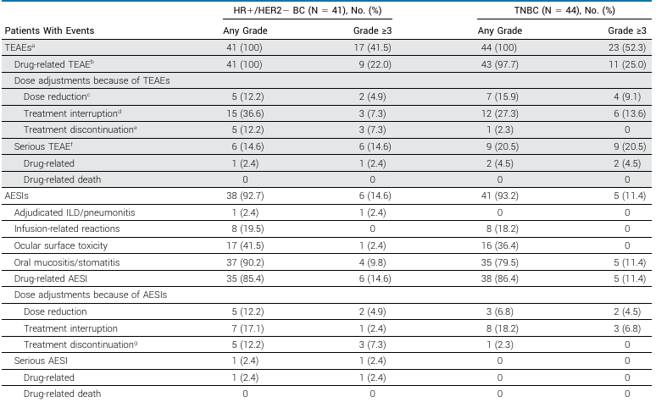
Adverse Events of Special Interest With
Datopotamab Deruxtecan
AESI, adverse event of special interest; BC, breast cancer; HER2, human epidermal growth factor receptor 2; HR, hormone receptor; ILD, interstitial lung disease; TEAE, treatment-emergent adverse event; TNBC, triple-negative breast cancer.
Bardia A, et al. J Clin Oncol. 2024;42(19):2281-2294.
Notes:
Slide Notes:
But the drug does have side effects. Two important side effects to note; one is stomatitis, or mucositis, which can be seen with Dato-DXd, usually grade 1/grade 2, recommend primary prophylaxis with the use of a steroid mouthwash, and usually with that, you can manage the mucositis. The second side effect is pneumonitis, not to the degree as seen with T-DXd, but it is a side effect that can be seen with Dato-DXd, so it does require monitoring as well.
Bardia A, Krop IE, Kogawa T, et al. Datopotamab deruxtecan in advanced or metastatic HR1/ HER2– and triple-negative breast cancer: results from the phase I TROPION-PanTumor01 Study. J Clin Oncol. 2024;42(19):2281-2294.

Slide 29
Management of AESIs with Datopotamab Deruxtecan
Ocular surface toxicity
Median time to onset: 2.1 months
Recommend primary prophylaxis with preservative-free lubricant eye drops several times daily; avoid use of contact lenses if possible
Ophthalmology visit for baseline ophthalmic exam at treatment initiation, annually while on treatment, at end of treatment, and as clinically indicated
Monitor for ocular adverse events during treatment and prompt referral to ophthalmologist for any new or worsening ocular adverse reactions
AESI, adverse event of special interest.
DATROWAY (datopotamab deruxtecan-dlnk). Prescribing information. Daiichi Sankyo, Inc.; 2025.
Notes:
Slide Notes:
How do you manage these side effects? Let's talk about ocular toxicity. The median onset of ocular toxicity is about 2 months from the start of Dato-DXd, generally recommend primary prophylaxis with a preservative-free lubricant eye drop and ophthalmology visit as well. If it's severe, you can hold the drug. In very severe cases, discontinue Dato-DXd.
DATROWAY (datopotamab deruxtecan-dlnk). Prescribing information. Daiichi Sankyo, Inc.; 2025.

Slide 30
Management of AESIs with Datopotamab Deruxtecan
Mucositis/Stomatitis
Median time to onset: 0.7 months
Recommend corticosteroid containing mouth wash 3-4 times/day, both for primary prophylaxis as well as treatment
Ice-chips or ice-water during infusion could be considered
Monitor for signs and symptoms of stomatitis; if stomatitis increases, consider increasing frequency of mouthwash, adding other topical treatment, and/or withholding Dato-DXd treatment to help reduce severity
AESI, adverse event of special interest.
DATROWAY (datopotamab deruxtecan-dlnk). Prescribing information. Daiichi Sankyo, Inc.; 2025.
Notes:
Slide Notes:
In terms of mucositis, as I mentioned, this is a side effect seen with Dato-DXd. Usually the first cycle, you'll see the side effect. Recommend steroid mouthwash three to four times a day, ice chips or ice water during infusion can also be considered. Again if it becomes severe, grade 3/grade 4, hold Dato-DXd, which would then allow this AE to recover, and then you can resume generally at a lower dose.
DATROWAY (datopotamab deruxtecan-dlnk). Prescribing information. Daiichi Sankyo, Inc.; 2025.

Slide 31
FDA Approval
On Jan 17th 2025, the FDA approved datopotamab deruxtecan (Dato-DXd) for patients with unresectable/metastatic
HR+/HER2- breast cancer, who have received at least one
prior line of chemotherapy
FDA.gov. https://www.fda.gov/drugs/resources-information-approved-drugs/fda-approves-
datopotamab-deruxtecan-dlnk-unresectable-or-metastatic-hr-positive-her2-negative-breast
Notes:
FDA.gov. FDA approves datopotamab deruxtecan-dlnk for unresectable or metastatic, HR-positive, HER2-negative breast cancer. Press release. Published January 17, 2025. Accessed February 14, 2025. https://www.fda.gov/drugs/resources-information-approved-drugs/fda-approves-datopotamab-deruxtecan-dlnk-unresectable-or-metastatic-hr-positive-her2-negative-breast

Slide 32
Ongoing Clinical Trials with SG and Dato-DXd in Breast Cancer
Clinical Trial | Setting | Intervention
ASCENT-03/04 | 1st line metastatic TNBC | SG vs TPC (± IO)
ASCENT-05 | Residual disease after NACT for localized TNBC | SG + Pembro vs Pembro/Cape
ASCENT-07 | 1st line metastatic HR+ MBC (endocrine-resistant setting) | SG vs TPC
TROPION-Breast 02 | 1st line metastatic TNBC (PD-L1 negative) | Dato-DXd vs TPC
TROPION-Breast 03 | Residual disease after NACT for localized TNBC | Dato-DXd ± Durvalumab vs ICT
TROPION-Breast 04 | Neoadjuvant therapy for TNBC | Dato-DXd + Durva vs TPC + IO
TROPION-Breast 05 | 1st line metastatic TNBC (PD-L1 positive) | Dato-DXd + IO vs TPC + IO
Cape, capecitabine; Dato-DXd, datopotamab deruxtecan; HR, hormone receptor; ICT, investigator’s choice of treatment; IO, immuno-oncology; MBC, metastatic breast cancer; NACT, neoadjuvant chemotherapy; PD-L1, programmed death ligand 1; pembro, pembrolizumab; SG, sacituzumab govitecan; TNBC, triple-negative breast cancer; TPC, treatment of physician’s choice.

Slide 33
How About Other ADCs?

Slide 34
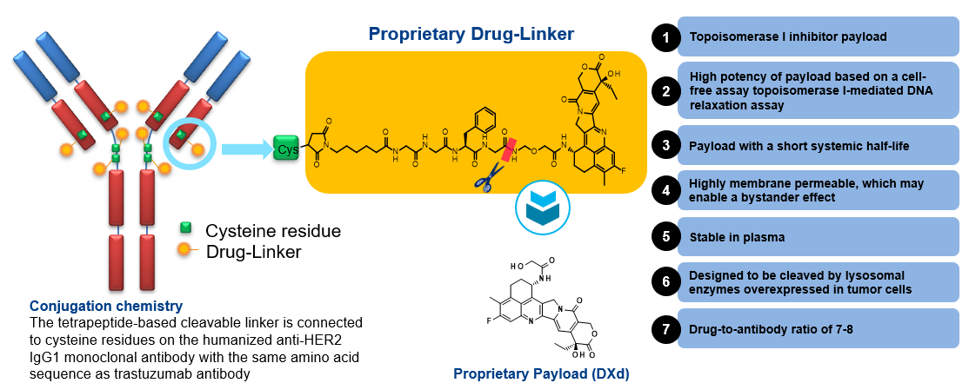
Trastuzumab Deruxtecan (T-DXd): HER2 ADC
With Bystander Effect
Trastuzumab Deruxtecan is a HER2 targeted ADC with 7 key attributes
Exatecan derivative
Courtesy: Sponsor (AZ).
ADC, antibody-drug conjugate; HER2 human epidermal growth factor receptor 2; IgG1, immunoglobulin G1.
Notes:
Slide Notes:
Now, besides this, there are other drugs that are in development or even approved. For example, T-DXd is another drug that's approved for HER2-low and ultralow metastatic breast cancer that's hormone receptor-positive. There are other drugs in development, like sacituzumab tirumotecan, patritumab deruxtecan. So multiple ADCs in development.

Slide 35
Targeting ‘Low’ and ‘Ultralow’ HER2-Expressing Tumors in mBC
HER2 IHC categories within HR+, HER2− mBC (per ASCO/CAP guidelines¹)
DESTINY-Breast06
patient population:
~85% of HR+, HER2− mBC
HER2-low
~60–65%^{2,3}
HER2-ultralow
~20–25%^{2,3}
IHC 2+/ISH−
IHC 1+
IHC 0
Weak-to-moderate complete
membrane staining
in >10% tumor cells
Faint, incomplete
membrane staining
in >10% tumor cells
Faint, incomplete membrane staining in ≤10% tumor cells
Absent / no observable
membrane staining
ASCO/CAP, American Society of Clinical Oncology/College of American Pathologists; HER2, human epidermal growth factor receptor 2; HR, hormone receptor; IHC, immunohistochemistry; ISH, in situ hybridization; mBC, metastatic breast cancer; T-DXd, trastuzumab deruxtecan.
Images adapted from Venetis K, et al. Front Mol Biosci. 2022;9:834651.
1. Wolff AC, et al. J Clin Oncol. 2023;41(22):3867-3872. 2. Denkert C, et al. Lancet Oncol. 2021;22(8):1151-1161. 3. Chen Z, et al. Breast Cancer Res Treat. 2023;202(2):313-323.
Notes:
Venetis K, Crimini E, Sajjadi E, et al. HER2 Low, ultra-low, and novel complementary biomarkers: expanding the spectrum of HER2 positivity in breast cancer. Front Mol Biosci. 2022;9:834651.
1. Wolff AC, Somerfeld MR, Dowsett M, et al. Human epidermal growth factor receptor 2 testing in breast cancer: ASCO–College of American Pathologists Guideline Update. J Clin Oncol. 2023;41(22):3867-3872.
2. Denkert C, Seither F, Schneeweiss A, et al. Clinical and molecular characteristics of HER2-low-positive breast cancer: pooled analysis of individual patient data from four prospective, neoadjuvant clinical trials. Lancet Oncol. 2021;22(8):1151-1161.
3. Chen Z, Jia H, Zhang H, et al. Is HER2 ultra-low breast cancer different from HER2 null or HER2 low breast cancer? A study of 1363 patients. Breast Cancer Res Treat. 2023;202(2):313-323.

Slide 36
DESTINY-Breast06 Study Design
Phase 3, randomized, multicenter, open-label study (NCT04494425)
PATIENT POPULATION
HR+ mBC
HER2-low (IHC 1+ or IHC 2+/ISH−) or HER2-ultralow (IHC 0 with membrane staining)*
Chemotherapy naïve in the mBC setting
Prior lines of therapy
≥2 lines of ET ± targeted therapy for mBC
OR
1 line for mBC AND
Progression ≤6 months of starting first-line ET + CDK4/6i
OR
Recurrence ≤24 months of starting adjuvant ET
T-DXd
5.4 mg/kg Q3W
(n=436)
ENDPOINTS
Primary
PFS (BICR) in HER2-low
Key secondary
PFS (BICR) in ITT (HER2-low + ultralow)
OS in HER2-low
OS in ITT (HER2-low + ultralow)
R
1:1
HER2-low = 713
HER2-ultralow = 153†
TPC
(n=430)
Other secondary
PFS (INV) in HER2-low
ORR (BICR/INV) and DOR (BICR/INV) in HER2-low and ITT (HER2-low + ultralow)
Safety and tolerability
Patient-reported outcomes‡
Options:
capecitabine,
nab-paclitaxel,
paclitaxel
Stratification factors
Prior CDK4/6i use (yes vs no)
HER2 expression (IHC 1+ vs IHC 2+/ISH− vs IHC 0 with membrane staining)
Prior taxane in the non-metastatic setting (yes vs no)
*Determined based on the most recent evaluable HER2 IHC sample prior to randomization; HER2-ultralow defined as faint, partial staining of the membrane in ≤10% of the cancer cells (also known as IHC >0<1+). †As determined by IRT (note: efficacy analyses in the HER2-ultralow subgroup were based on n=152 by central laboratory testing). ‡To be presented separately.
BICR, blinded independent central review; CDK4/6i, cyclin-dependent kinase 4/6 inhibitor; DOR, duration of response; ET, endocrine therapy; HER2, human epidermal growth factor receptor 2; HR, hormone receptor; IHC, immunohistochemistry; INV, investigator assessed; IRT, interactive response technology; ISH, in situ hybridization; ITT, intent-to-treat; mBC, metastatic breast cancer; ORR, objective response rate; OS, overall survival; PD, progressive disease; PFS, progression-free survival; Q3W, every 3 weeks; R, randomization; T-DXd, trastuzumab deruxtecan; TPC, chemotherapy treatment of physician’s choice.
ClinicalTrials.gov identifier: NCT04494425.
Notes:
Study of trastuzumab deruxtecan (T-DXd) vs investigator's choice chemotherapy in HER2-low, hormone receptor positive, metastatic breast cancer (DB-06). ClinicalTrials.gov identifier: NCT04494425. Updated January 15, 2025. https://clinicaltrials.gov/study/NCT04494425

Slide 37
PFS (BICR) in HER2-Low: Primary Endpoint
1.0
Hazard ratio 0.62
95% CI 0.51–0.74
P<0.0001*
0.8
T-DXd
mPFS: 13.2 mo
0.6
Δ 5.1 mo
Probability of PFS
0.4
TPC
mPFS: 8.1 mo
0.2
0
0
No. at risk
3
6
9
12
15
18
21
24
27
30
33
36
39
T-DXd
359
310
265
213
163
131
72
49
28
17
10
6
1
0
354
254
192
118
85
65
37
19
10
6
2
1
1
TPC
0
T-DXd demonstrated a statistically significant and clinically meaningful improvement
in PFS compared with standard-of-care chemotherapy in HER2-low
*P-value of <0.05 required for statistical significance.
BICR, blinded independent central review; HER2, human epidermal growth factor receptor 2; mo, months; (m)PFS, (median) progression-free survival; T-DXd, trastuzumab deruxtecan; TPC, chemotherapy treatment of physician’s choice.
Curigliano G, et al. J Clin Oncol. 2024;42(17_suppl):LBA1000.
Notes:
Curigliano G, Hu X, Dent RA, et al. Trastuzumab deruxtecan (T-DXd) vs physician’s choice of chemotherapy (TPC) in patients (pts) with hormone receptor-positive (HR+), human epidermal growth factor receptor 2 (HER2)-low or HER2-ultralow metastatic breast cancer (mBC) with prior endocrine therapy (ET): Primary results from DESTINY-Breast06 (DB-06). J Clin Oncol. 2024;42(17_suppl):LBA1000.

Slide 38
PFS (BICR) in HER2-Low: Subgroup Analysis
 | No. of events / no. of patients |  | mPFS (95% CI), months |  | Hazard ratio (95% CI)
 | T-DXd | TPC | T-DXd | TPC
Age
<65 years | 158/252 | 157/244 | 13.2 (11.2–15.2) | 7.8 (6.9–8.6) |  | 0.59 (0.47–0.74)
≥65 years | 67/107 | 75/110 | 13.2 (9.7–17.0) | 8.5 (6.9–11.5) |  | 0.68 (0.49–0.95)
HER2 status*
IHC 1+ | 157/238 | 150/234 | 12.9 (11.0–15.2) | 8.2 (7.1–9.8) |  | 0.74 (0.59–0.93)
IHC 2+/ISH− | 65/117 | 80/118 | 15.2 (12.2–21.4) | 7.0 (6.2–8.4) |  | 0.43 (0.31–0.60)
Prior CDK4/6i
Yes | 206/324 | 212/320 | 13.1 (11.2–15.2) | 7.9 (6.9–8.6) |  | 0.61 (0.51–0.74)
No | 19/35 | 20/34 | 16.1 (9.7–NE) | 11.1 (6.9–20.6) |  | 0.64 (0.34–1.21)
Prior taxane use (adjuvant/neoadjuvant setting)
Yes | 94/151 | 101/151 | 12.9 (9.7–14.0) | 7.4 (6.3–9.3) |  | 0.64 (0.48–0.85)
No | 131/208 | 131/203 | 15.0 (11.3–16.5) | 8.3 (7.0–9.7) |  | 0.59 (0.46–0.76)
Number of prior lines of ET (metastatic setting)
1 | 27/54 | 45/67 | 15.2 (9.7–19.1) | 8.0 (5.7–8.5) |  | 0.45 (0.27–0.72)
2 | 158/242 | 153/236 | 13.1 (11.2–15.2) | 8.3 (6.9–10.0) |  | 0.69 (0.55–0.86)
≥3 | 39/62 | 33/49 | 12.3 (8.3–18.5) | 8.1 (5.4–9.7) |  | 0.53 (0.33–0.86)
Endocrine resistance
Primary | 66/105 | 83/116 | 13.1 (10.0–15.2) | 6.8 (5.3–8.1) |  | 0.56 (0.40–0.78)
Secondary | 159/254 | 148/236 | 13.2 (11.3–15.5) | 9.0 (7.5–11.1) |  | 0.65 (0.52–0.82)
Chemotherapy used in control arm†
Capecitabine | 131/220 | 134/208 | 13.5 (11.4–15.4) | 8.5 (7.0–11.4) |  | 0.62 (0.49–0.79)
Nab-paclitaxel | 56/80 | 55/90 | 12.4 (8.3–15.2) | 8.3 (7.1–11.2) |  | 0.82 (0.56–1.20)
Paclitaxel | 38/59 | 43/56 | 14.5 (9.6–19.1) | 6.3 (5.0–6.9) |  | 0.37 (0.23–0.58)
Liver metastases
Yes | 163/243 | 166/232 | 11.4 (9.8–13.2) | 7.0 (6.4–8.1) |  | 0.58 (0.46–0.72)
No | 62/116 | 66/122 | 17.0 (15.0–19.4) | 11.3 (8.2–14.8) |  | 0.66 (0.46–0.93)
0.25
0.5
1
2
Favors T-DXd
Favors TPC
*Based on central laboratory data (ie the HER2 result from the most recent evaluable sample prior to randomization). †specified by the investigator prior to randomization.
BICR, blinded independent central review; CDK4/6i, cyclin-dependent kinase 4/6 inhibitor; ET, endocrine therapy; HER2, human epidermal growth factor receptor 2; IHC, immunohistochemistry; ISH, in situ hybridization; (m)PFS, (median) progression-free survival; NE, not evaluable; T-DXd, trastuzumab deruxtecan; TPC, chemotherapy treatment of physician’s choice.
Curigliano G, et al. J Clin Oncol. 2024;42(17_suppl):LBA1000.
Notes:
Curigliano G, Hu X, Dent RA, et al. Trastuzumab deruxtecan (T-DXd) vs physician’s choice of chemotherapy (TPC) in patients (pts) with hormone receptor-positive (HR+), human epidermal growth factor receptor 2 (HER2)-low or HER2-ultralow metastatic breast cancer (mBC) with prior endocrine therapy (ET): Primary results from DESTINY-Breast06 (DB-06). J Clin Oncol. 2024;42(17_suppl):LBA1000.

Slide 39


Antitumor Activity
120
T-DXd
120
TPC
100
100
80
80
60
60
40
40
20
20
Best percentage change in sum
of diameters from baseline
Best percentage change in sum
of diameters from baseline
0
0
−20
−20
−40
−40
−60
HER2-low
−60
HER2-low
−80
HER2-ultralow
−80
HER2-ultralow
−100
−100
 | HER2-low* |  | ITT |  |  | HER2-ultralow*
 | T-DXd (n=359) | TPC (n=354) | T-DXd (n=436) | TPC (n=430) |  | T-DXd (n=76) | TPC (n=76)
Confirmed ORR, n (%) | 203 (56.5) | 114 (32.2) | 250 (57.3) | 134 (31.2) |  | 47 (61.8) | 20 (26.3)
Best overall response, n (%)
Complete response | 9 (2.5) | 0 | 13 (3.0) | 0 |  | 4 (5.3) | 0
Partial response | 194 (54.0) | 114 (32.2) | 237 (54.4) | 134 (31.2) |  | 43 (56.6) | 20 (26.3)
Stable disease | 125 (34.8) | 170 (48.0) | 148 (33.9) | 212 (49.3) |  | 22 (28.9) | 42 (55.3)
Clinical benefit rate, n (%)† | 275 (76.6) | 190 (53.7) | 334 (76.6) | 223 (51.9) |  | 58 (76.3) | 33 (43.4)
Duration of response, median, mo | 14.1 | 8.6 | 14.3 | 8.6 |  | 14.3 | 14.1
ORR based on RECIST v1.1; response required confirmation after 4 weeks.
*HER2-low status determined per IRT data, and HER2-ultralow status determined per central laboratory data; †defined as complete response + partial response + stable disease at Week 24, by blinded independent central review.
HER2, human epidermal growth factor receptor 2; IHC, immunohistochemistry; ITT, intent-to-treat; mo, months; ORR, objective response rate; RECIST, Response Evaluation Criteria in Solid Tumours; T-DXd, trastuzumab deruxtecan; TPC, chemotherapy treatment of physician’s choice.
Curigliano G, et al. J Clin Oncol. 2024;42(17_suppl):LBA1000.
Notes:
Curigliano G, Hu X, Dent RA, et al. Trastuzumab deruxtecan (T-DXd) vs physician’s choice of chemotherapy (TPC) in patients (pts) with hormone receptor-positive (HR+), human epidermal growth factor receptor 2 (HER2)-low or HER2-ultralow metastatic breast cancer (mBC) with prior endocrine therapy (ET): Primary results from DESTINY-Breast06 (DB-06). J Clin Oncol. 2024;42(17_suppl):LBA1000.

Slide 40
Drug-Related TEAEs in ≥20% of Patients
(Either Treatment Group)
Nausea
Fatigue*
Alopecia
Neutropenia†
Transaminases increased‡
Anemia§
Vomiting
Diarrhea
Decreased appetite
Leukopenia¶
PPE
T-DXd, Any grade
T-DXd, Grade ≥3
TPC, Any grade
TPC, Grade ≥3
80
60
40
20
0
20
40
60
80
Patients experiencing drug-related TEAEs (%)
*Includes the preferred terms fatigue, asthenia, malaise and lethargy. †Includes the preferred terms neutrophil count decreased and neutropenia. ‡Includes the preferred terms transaminases increased, aspartate aminotransferase increased, alanine aminotransferase increased, gamma-glutamyltransferase increased, liver function test abnormal, hepatic function abnormal, and liver function test increased. §Includes the preferred terms hemoglobin decreased, red blood cell count decreased, anemia, and hematocrit decreased. ¶Includes the preferred terms white blood cell count decreased and leukopenia.
PPE, palmar-plantar erythrodysesthesia syndrome; TEAE, treatment-emergent adverse event; T-DXd, trastuzumab deruxtecan; TPC, chemotherapy treatment of physician’s choice.
Curigliano G, et al. J Clin Oncol. 2024;42(17_suppl):LBA1000.
Notes:
Curigliano G, Hu X, Dent RA, et al. Trastuzumab deruxtecan (T-DXd) vs physician’s choice of chemotherapy (TPC) in patients (pts) with hormone receptor-positive (HR+), human epidermal growth factor receptor 2 (HER2)-low or HER2-ultralow metastatic breast cancer (mBC) with prior endocrine therapy (ET): Primary results from DESTINY-Breast06 (DB-06). J Clin Oncol. 2024;42(17_suppl):LBA1000.

Slide 41
Adverse Events of Special Interest
Adjudicated as drug-related interstitial lung disease / pneumonitis*
n (%) | Grade 1 | Grade 2 | Grade 3 | Grade 4 | Grade 5 | Any grade
T-DXd (n=434) | 7 (1.6) | 36 (8.3) | 3 (0.7) | 0 | 3 (0.7) | 49 (11.3)
TPC (n=417) | 0 | 1 (0.2) | 0 | 0 | 0 | 1 (0.2)
Left ventricular dysfunction
n (%) | Grade 1 | Grade 2 | Grade 3 | Grade 4 | Grade 5 | Any grade
Ejection fraction decreased†
T-DXd (n=434) | 1 (0.2) | 31 (7.1) | 3 (0.7) | 0 | 0 | 35 (8.1)
TPC (n=417) | 0 | 11 (2.6) | 1 (0.2) | 0 | 0 | 12 (2.9)
Cardiac failure†
T-DXd (n=434) | 0 | 0 | 0 | 0 | 0 | 0
TPC (n=417) | 0 | 1 (0.2) | 1 (0.2) | 1 (0.2) | 0 | 3 (0.7)
*Grouped term. Median time to first onset of interstitial lung disease / pneumonitis for patients with T-DXd was 141 days (range 37–835). No pending cases of drug-related interstitial lung disease / pneumonitis to be adjudicated. One interstitial lung disease–related death per investigator assessment was upheld by the adjudication committee. An additional two deaths were adjudicated as interstitial lung disease–related by the adjudication committee;.†Preferred term.
T-DXd, trastuzumab deruxtecan; TPC, chemotherapy treatment of physician’s choice.
Curigliano G, et al. J Clin Oncol. 2024;42(17_suppl):LBA1000.
Notes:
Curigliano G, Hu X, Dent RA, et al. Trastuzumab deruxtecan (T-DXd) vs physician’s choice of chemotherapy (TPC) in patients (pts) with hormone receptor-positive (HR+), human epidermal growth factor receptor 2 (HER2)-low or HER2-ultralow metastatic breast cancer (mBC) with prior endocrine therapy (ET): Primary results from DESTINY-Breast06 (DB-06). J Clin Oncol. 2024;42(17_suppl):LBA1000.

Slide 42
PFS by Time to Progression on 1L ET + CDK4/6i and Endocrine Resistance
6–12-mo 1L TTP*
>12-mo 1L TTP*
<6-mo 1L TTP*
1.0
Hazard ratio 0.69†
95% CI 0.43, 1.12
1.0
Hazard ratio 0.67†
95% CI 0.51, 0.88
1.0
Hazard ratio 0.38†
95% CI 0.25, 0.59
0.8
0.8
0.8
0.6
T-DXd (n=60)
mPFS: 13.2 mo
0.6
T-DXd (n=168)
mPFS: 12.9 mo
0.6
T-DXd (n=65)
mPFS: 14.0 mo
Probability of PFS
Probability of PFS
Probability of PFS
Δ 7.5 mo
0.4
0.4
0.4
0.2
Δ 6.3 mo
0.2
Δ 4.7 mo
0.2
TPC (n=59)
mPFS: 6.5 mo
TPC (n=52)
mPFS: 6.9 mo
TPC (n=166)
mPFS: 8.2 mo
0.0
39
0.0
0
3
6
9
12
15
18
21
24
27
30
33
36
39
0.0
0
3
6
9
12
15
18
21
24
27
30
33
36
39
0
3
6
9
12
15
18
21
24
27
30
33
36
Time from randomization (mo)
Time from randomization (mo)
Time from randomization (mo)
Number at risk
Number at risk
Number at risk
T-DXd
TPC
60
52
50
34
38
21
31
11
28
8
20
7
9
6
6
3
3
1
1
0
1
0
0
0
T-DXd
TPC
168
166
146
114
125
86
94
62
74
44
59
33
28
14
17
8
11
6
6
2
2
0
1
0
0
0
T-DXd
TPC
65
59
61
38
53
30
47
14
32
12
25
9
12
4
8
4
3
0
3
0
0
0
 | Primary endocrine resistance‡ |  | Secondary endocrine resistance‡
 | T-DXd (n=128) | TPC (n=140) | T-DXd (n=308) | TPC (n=288)
mPFS, mo (95% CI) | 12.4 (10.3, 15.2) | 6.6 (5.4, 7.4) | 13.2 (12.0, 15.5) | 9.5 (8.0, 11.1)
PFS hazard ratio (95% CI) | 0.57 (0.42, 0.77)† |  | 0.68 (0.55, 0.84)†
T-DXd improved PFS vs TPC regardless of time to progression on
1L ET + CDK4/6i or type of endocrine resistance
*TTP analysis included 570 patients with PD on prior 1L ET + CDK4/6i (65.8% of the ITT population). †The hazard ratio and its CI were estimated from an unstratified Cox proportional hazards model. ‡Endocrine resistance assessed by investigators per 5th ESO-ESMO advanced breast cancer guidelines. Primary endocrine resistance was defined as relapse in the first 2 years of adjuvant ET, or PD <6 mo of 1L ET for mBC. Secondary (acquired) endocrine resistance was defined as relapse after the first 2 years on adjuvant ET, or relapse within 12 mo of completing adjuvant ET, or PD >6 mo after initiating ET for mBC1.
1L, first line; CDK4/6i, cyclin-dependent kinase 4/6 inhibitor; ESO-ESMO, European School of Oncology-European Society for Medical Oncology; ET, endocrine therapy; ITT, intent-to-treat; mBC, metastatic breast cancer; mo, months; (m)PFS, (median) progression-free survival; PD, progressive disease; T‑DXd, trastuzumab deruxtecan; TPC, physician’s choice of chemotherapy; TTP, time to progression.
1. Cardoso F, et al. Ann Oncol. 2020;31:1623-1649.
Notes:
Cardoso F, Paluch-Shimon S, Senkus E, et al. 5th ESO-ESMO international consensus guidelines for advanced breast cancer (ABC 5). Ann Oncol. 2020;31:1623-1649.

Slide 43
Pneumonitis/ILD Management: Initial Work-Up
Early recognition and treatment are critical to improving outcomes:
Condition may be asymptomatic (Gr1) which only changes on radiographic imaging or is accompanied by symptoms including cough, shortness of breath, fever
Evaluate for alternative etiology (infection, disease progression, other medications)
In the absence of clear alternative etiology, all events should be considered to be related to T-DXd
Management of all toxicities should be per toxicity–related guidelines until toxicity resolves, unless or until proved to be due to alternate etiology
Consider high-resolution CT scan of chest, and pulmonology or infectious disease consultation
CT, computed tomography; ILD, interstitial lung disease; T-DXd, trastuzumab deruxtecan.
Bardia A, et al. Oncologist. 2022;27(8):637-645.
Notes:
Bardia A, Harnden K, Mauro L, et al. Clinical practices and institutional protocols on prophylaxis, monitoring, and management of selected adverse events associated with trastuzumab deruxtecan. Oncologist. 2022;27(8):637-645.

Slide 44
Pneumonitis/ILD Management
Pneumonitis
Grade 1 (asymptomatic: clinical or diagnostic observations only)
Grade 2 (Symptomatic; medical intervention indicated; limiting instrumental ADL)
Grade 3 or 4 (Severe symptoms, O2 indicated, life-threatening respiratory compromise)
Monitor closely (weekly if indicated)
Consider starting systemic steroids
If no improvement or there is evidence of worsening radiologic, oximetric or PFT markers consider treating as G2 event
If event resolves, re-start T-DXd
Hospitalization required
Promptly start methylprednisolone pulse therapy (500 – 1000mg/day) x 3 days followed by 1mg/kg/day of prednisone (or equivalent) for ≥ 14 days or until clinical resolution of clinical and Chest CT findings, followed by gradual taper over at least 4 weeks
If no improvement within 3-5 days, re-evaluate with additional work-up for alternative causes. Consider other immunosuppressants
DISCONTINUE T-DXd
Monitor symptoms closely
Promptly start systemic steroids
(≥ 1 mg/kg/day of prednisone or equivalent) for ≥14 days or until complete resolution of clinical and Chest CT findings, followed by gradual taper over at least 4 weeks
If no clinical improvement within 5 days of initial steroid therapy, re-evaluate for other causes, and/or switch to IV steroids such as methylprednisolone 2mg/kg/day
DISCONTINUE T-DXd
ADL, activities of daily living; CT, computed tomography; G, grade; ILD, interstitial lung disease; IV, intravenous; O2, oxygen; PFT, pulmonary function test; T-DXd, trastuzumab deruxtecan.
Bardia A, et al. Oncologist. 2022;27(8):637-645.
Notes:
Bardia A, Harnden K, Mauro L, et al. Clinical practices and institutional protocols on prophylaxis, monitoring, and management of selected adverse events associated with trastuzumab deruxtecan. Oncologist. 2022;27(8):637-645.

Slide 45
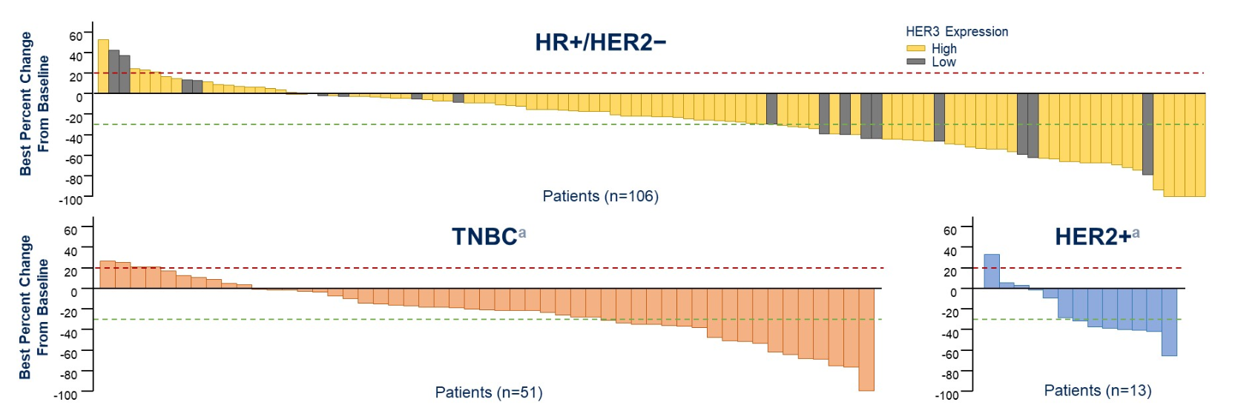
Patritumab Deruxtecan (U3-1402): ADC Targeting HER3
Critical DXd ADC design features
High potency payload with a different MOA and short half-life
Bystander effect
Stable linker-payload
Tumor-selective cleavable linker
High drug-to-antibody ratio
HER3-DXd induced a clinically meaningful decrease in tumor size by BICR in most patients across BC subtypes.^{b}
ªPatients with TNBC and HER2+ were all HER3-high. ^{b}Best percentage change from baseline in sum of diameters based on BICR for all target lesions identified is represented by patient. If any lesion measurement is missing at a post baseline tumor assessment visit, that visit is not taken into consideration for best percent change from baseline in sum of diameters.
ADC, antibody-drug conjugate; BC, breast cancer; BICR, blinded independent central review; HER3-DXd, patritumab deruxtecan; HER2/3, human epidermal growth factor receptor 2/3; HR, hormone receptor; TNBC, triple-negative breast cancer.
Krop I, et al. ASCO 2022. Abstract 1002.
Notes:
Krop I, Masuda N, Mukohara T, et al. Results from the phase 1/2 study of patritumab deruxtecan, a HER3-directed antibody-drug conjugate (ADC), in patients with HER3-expressing metastatic breast cancer (MBC). Abstract presented at: American Society of Clinical Oncology Annual Meeting; Chicago, Illinois; June 3-7, 2022. Abstract 1002.

Slide 46
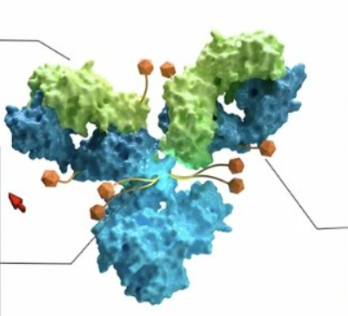
Sacituzumab Tirumotecan (Sac-TMT)
TROP2 ADC developed with a proprietary Kthiol (pyrimidine-thiol) linker conjugated to a novel topoisomerase I inhibitor at DAR 7.4
Antibody
hRS7, a recombinant humanized anti-TROP2 antibody with high affinity
Linker
Kthiol conjugation: irreversible coupling to improve stability of ADC
Payload release: intracellular cleavage and extracellular hydrolysis in TME
Balanced stability: balance between efficacy and safety to expand therapeutic window
Payload
Novel topo I inhibitor (a belotecan derivative), highly active
Average DAR: 7.4 (range: 7-8)
Bystander effect
Methylsulfonyl derivatization enhances linker stability and toxin permeability
ADC, antibody-drug conjugate; DAR, drug-to-antibody ratio; TME, tumor microenvironment; topo, topoisomerase; TROP2, trophoblast cell-surface antigen 2.
Fang W, et al. J Clin Oncol. 2024;42(16_suppl):8502.
Notes:
Fang W, Wang Q, Cheng Y, et al. Sacituzumab tirumotecan (SKB264/MK-2870) in combination with KL-A167 (anti-PD-L1) as first-line treatment for patients with advanced NSCLC from the phase II OptiTROP-Lung01 study. J Clin Oncol. 2024;42(16_suppl):8502.

Slide 47
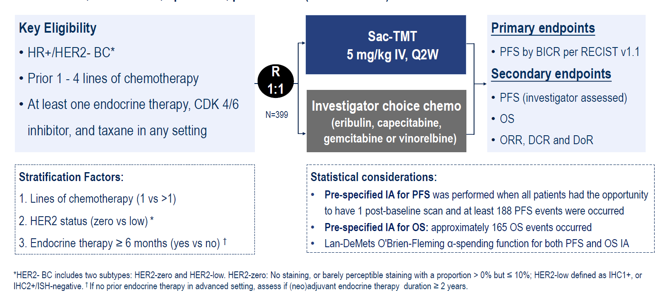
Phase 3 OptiTROP-Breast02 Study Design
Li M, et al. ESMO 2025. Abstract LBA23.
Notes:
Li M, Fan Y, Li H, et al. Sacituzumab tirumotecan (sac-TMT) vs investigator's choice of chemotherapy (ICC) in previously treated locally advanced or metastatic hormone receptor-positive, HER2-negative (HR+/HER2-) breast cancer (BC): Results from the randomized, multi-center phase III OptiTROP-Breast02 study. Abstract presented at: European Society for Medical Oncology Congress; Berlin, Germany; October 17-21, 2025. Abstract LBA23.

Slide 48
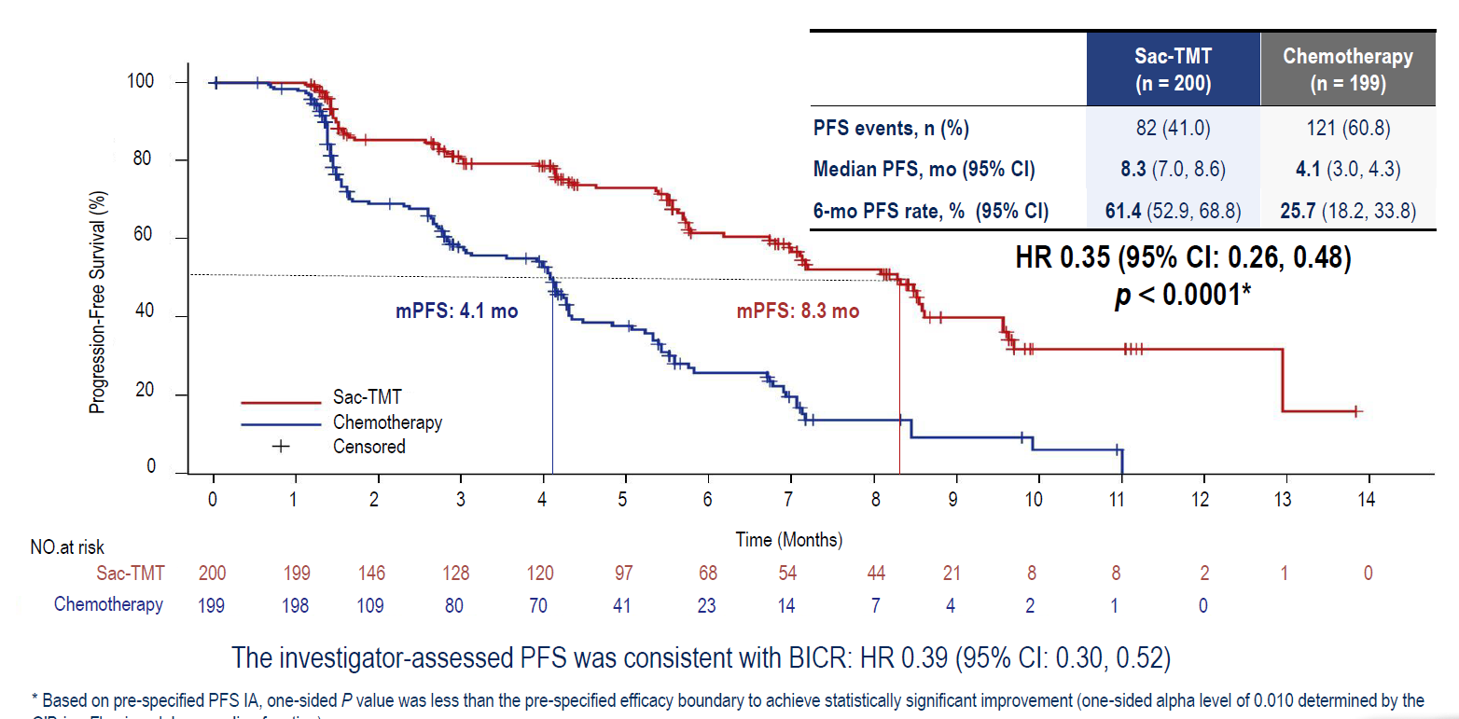
OptiTROP-Breast02: PFS
Li M, et al. ESMO 2025. Abstract LBA23.
Notes:
Li M, Fan Y, Li H, et al. Sacituzumab tirumotecan (sac-TMT) vs investigator's choice of chemotherapy (ICC) in previously treated locally advanced or metastatic hormone receptor-positive, HER2-negative (HR+/HER2-) breast cancer (BC): Results from the randomized, multi-center phase III OptiTROP-Breast02 study. Abstract presented at: European Society for Medical Oncology Congress; Berlin, Germany; October 17-21, 2025. Abstract LBA23.

Slide 49
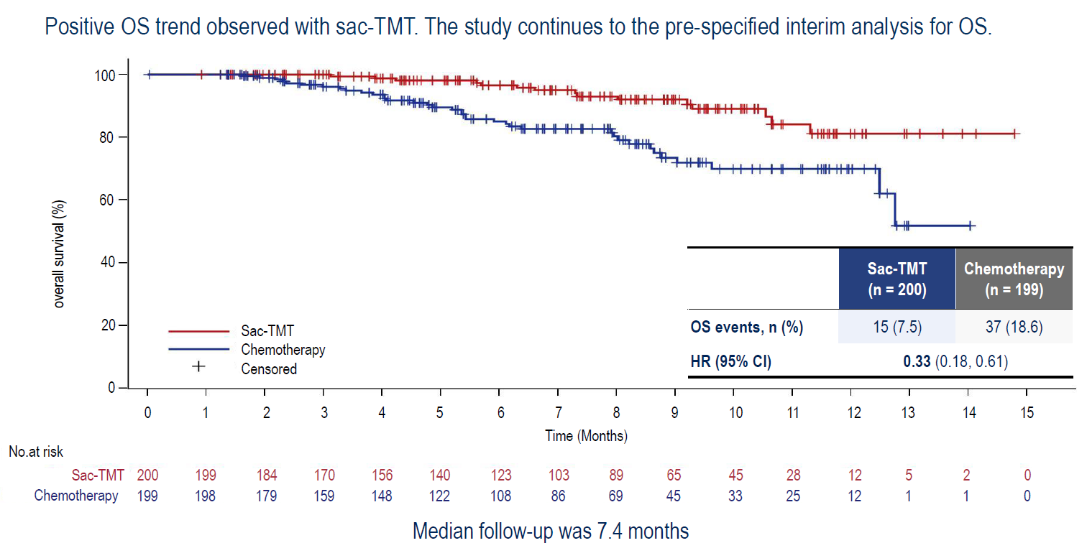
OptiTROP-Breast02: OS
Li M, et al. ESMO 2025. Abstract LBA23.
Notes:
Li M, Fan Y, Li H, et al. Sacituzumab tirumotecan (sac-TMT) vs investigator's choice of chemotherapy (ICC) in previously treated locally advanced or metastatic hormone receptor-positive, HER2-negative (HR+/HER2-) breast cancer (BC): Results from the randomized, multi-center phase III OptiTROP-Breast02 study. Abstract presented at: European Society for Medical Oncology Congress; Berlin, Germany; October 17-21, 2025. Abstract LBA23.

Slide 50
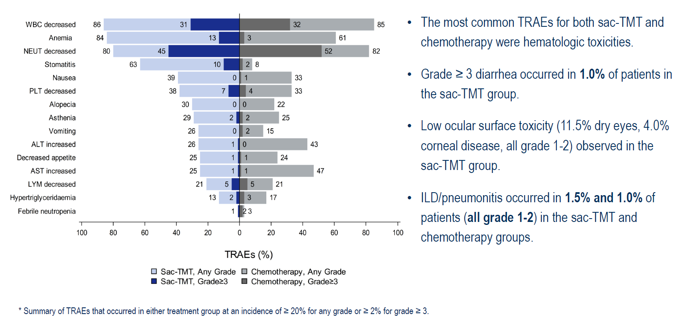
OptiTROP-Breast02: Common TRAEs*
Li M, et al. ESMO 2025. Abstract LBA23.
Notes:
Li M, Fan Y, Li H, et al. Sacituzumab tirumotecan (sac-TMT) vs investigator's choice of chemotherapy (ICC) in previously treated locally advanced or metastatic hormone receptor-positive, HER2-negative (HR+/HER2-) breast cancer (BC): Results from the randomized, multi-center phase III OptiTROP-Breast02 study. Abstract presented at: European Society for Medical Oncology Congress; Berlin, Germany; October 17-21, 2025. Abstract LBA23.

Slide 51
TROP2-Directed ADCs in TNBC: Phase 3 Data

Slide 52
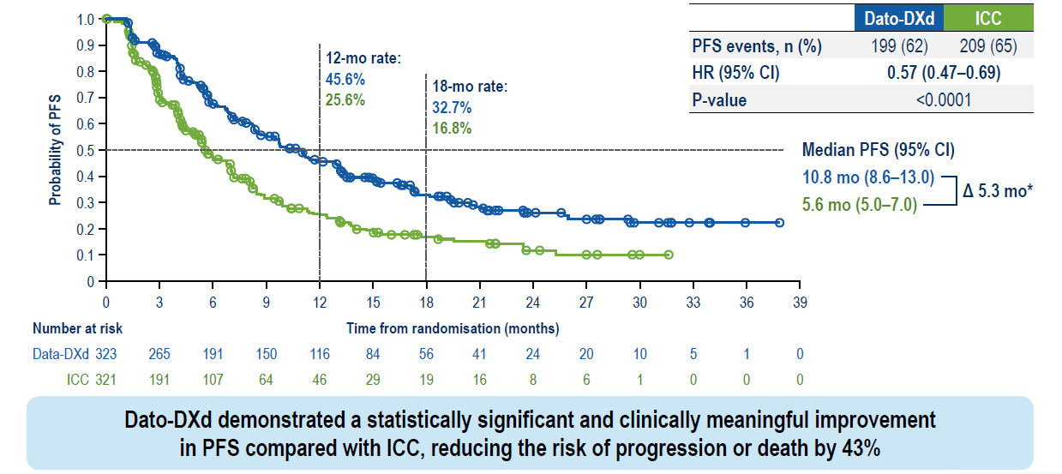
TROPION-Breast02: First-Line Dato-DXd in Locally Recurrent or Metastatic TNBC – PFS
Dent R, et al ESMO 2025. Abstract LBA21.
Notes:
Dent R, Shao Z, Schmid P, et al. First-line datopotamab deruxtecan (Dato-DXd) vs chemotherapy in patients with locally advanced recurrent inoperable or metastatic triple-negative breast cancer (TNBC) for whom immunotherapy was not an option: primary results from the randomized, phase 3 TROPION-Breast02 trial. Abstract presented at: European Society for Medical Oncology Congress; Berlin, Germany; October 17-21, 2025. Abstract LBA21.

Slide 53
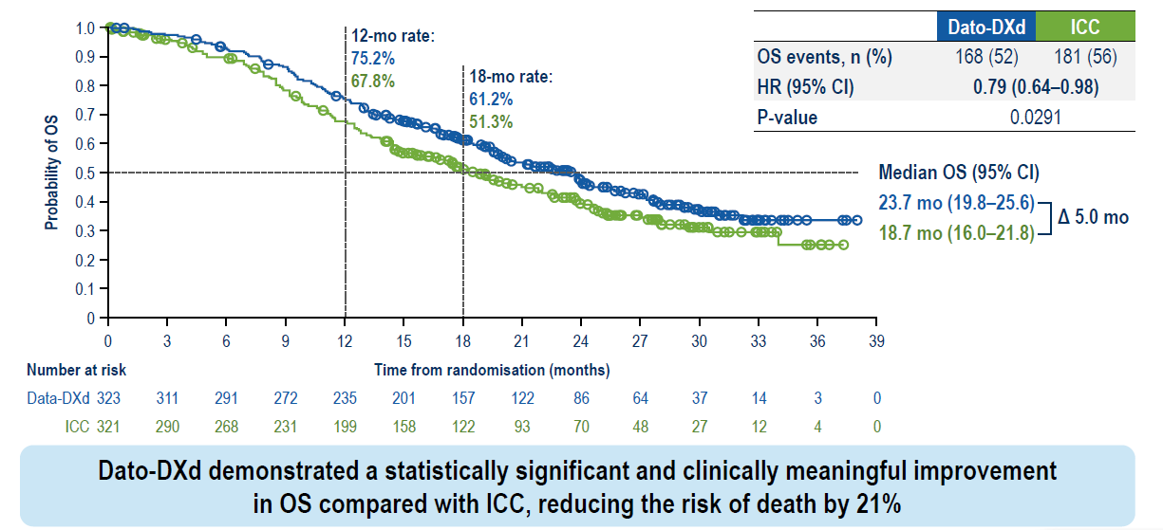
TROPION-Breast02: OS
Dent R, et al ESMO 2025. Abstract LBA21.
Notes:
Dent R, Shao Z, Schmid P, et al. First-line datopotamab deruxtecan (Dato-DXd) vs chemotherapy in patients with locally advanced recurrent inoperable or metastatic triple-negative breast cancer (TNBC) for whom immunotherapy was not an option: primary results from the randomized, phase 3 TROPION-Breast02 trial. Abstract presented at: European Society for Medical Oncology Congress; Berlin, Germany; October 17-21, 2025. Abstract LBA21.

Slide 54
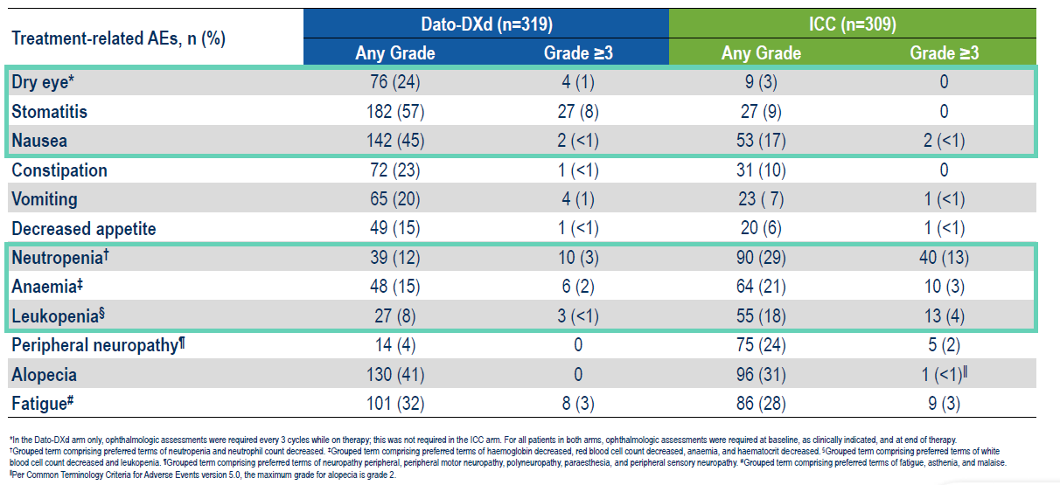
Most Common TRAEs (≥15% of Patients)
Dent R, et al ESMO 2025. Abstract LBA21.
Notes:
Dent R, Shao Z, Schmid P, et al. First-line datopotamab deruxtecan (Dato-DXd) vs chemotherapy in patients with locally advanced recurrent inoperable or metastatic triple-negative breast cancer (TNBC) for whom immunotherapy was not an option: primary results from the randomized, phase 3 TROPION-Breast02 trial. Abstract presented at: European Society for Medical Oncology Congress; Berlin, Germany; October 17-21, 2025. Abstract LBA21.

Slide 55
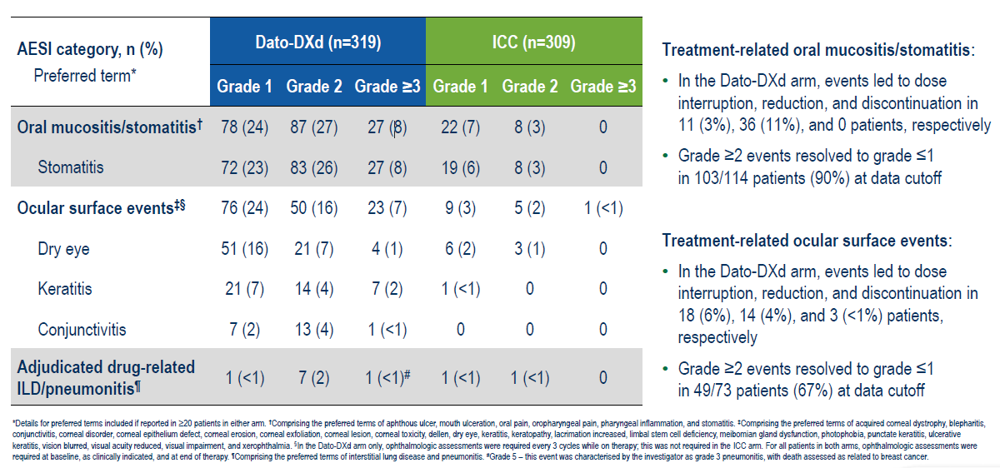
TRAEs for Dato-DXd
Dent R, et al ESMO 2025. Abstract LBA21.
Notes:
Dent R, Shao Z, Schmid P, et al. First-line datopotamab deruxtecan (Dato-DXd) vs chemotherapy in patients with locally advanced recurrent inoperable or metastatic triple-negative breast cancer (TNBC) for whom immunotherapy was not an option: primary results from the randomized, phase 3 TROPION-Breast02 trial. Abstract presented at: European Society for Medical Oncology Congress; Berlin, Germany; October 17-21, 2025. Abstract LBA21.

Slide 56
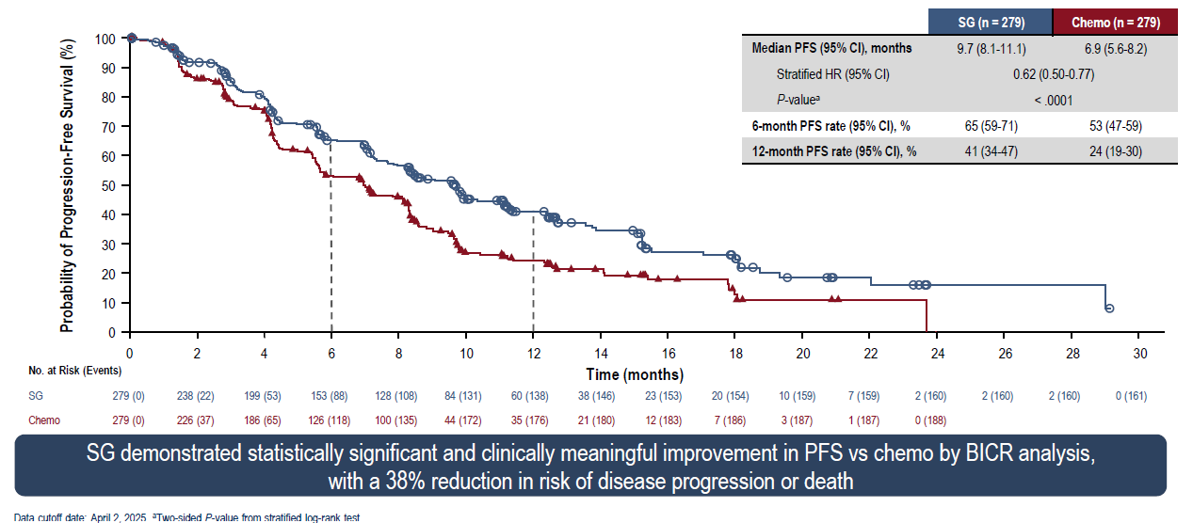
ASCENT-03: Sacituzumab Govitecan vs Chemotherapy Previously Untreated Metastatic TNBC – PFS
Cortes J, et al. ESMO 2025. Abstract LBA20.
Notes:
Cortes J, Bardia A, Punie K, et al. Primary results from ASCENT-03: a randomized phase 3 study of sacituzumab govetican vs chemotherapy in patients with previously untreated metastatic triple-negative breast cancer who are unable to received PD-L1 inhibitors. Abstract presented at: European Society for Medical Oncology Congress; Berlin, Germany; October 17-21, 2025. Abstract LBA20.

Slide 57
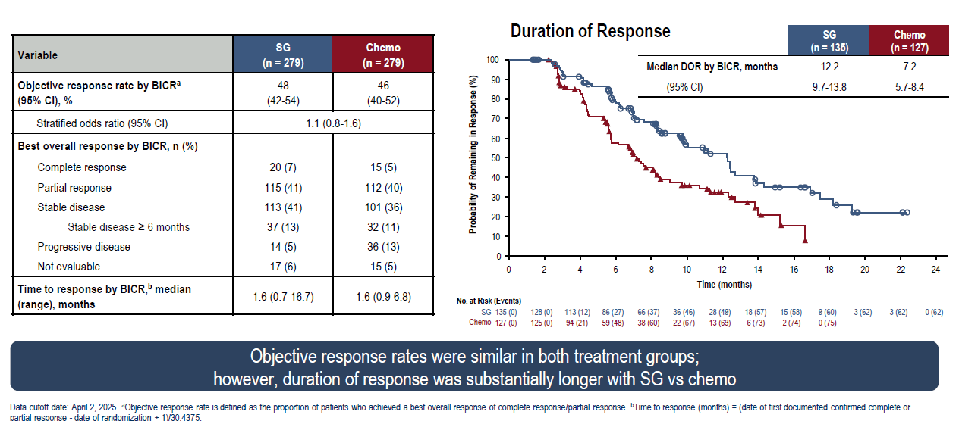
ASCENT-03: Tumor Response
Cortes J, et al. ESMO 2025. Abstract LBA20.
Notes:
Cortes J, Bardia A, Punie K, et al. Primary results from ASCENT-03: a randomized phase 3 study of sacituzumab govetican vs chemotherapy in patients with previously untreated metastatic triple-negative breast cancer who are unable to received PD-L1 inhibitors. Abstract presented at: European Society for Medical Oncology Congress; Berlin, Germany; October 17-21, 2025. Abstract LBA20.

Slide 58
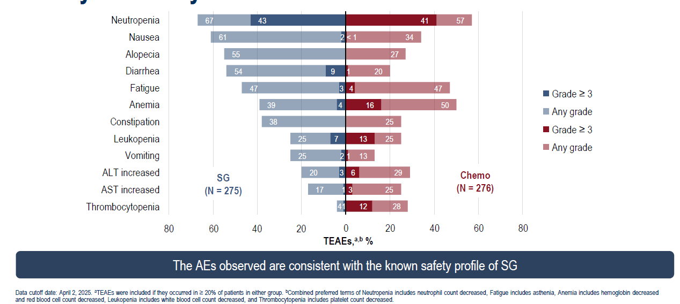
Safety Summary: Most Common AEs
Cortes J, et al. ESMO 2025. Abstract LBA20.
Notes:
Cortes J, Bardia A, Punie K, et al. Primary results from ASCENT-03: a randomized phase 3 study of sacituzumab govetican vs chemotherapy in patients with previously untreated metastatic triple-negative breast cancer who are unable to received PD-L1 inhibitors. Abstract presented at: European Society for Medical Oncology Congress; Berlin, Germany; October 17-21, 2025. Abstract LBA20.

Slide 59
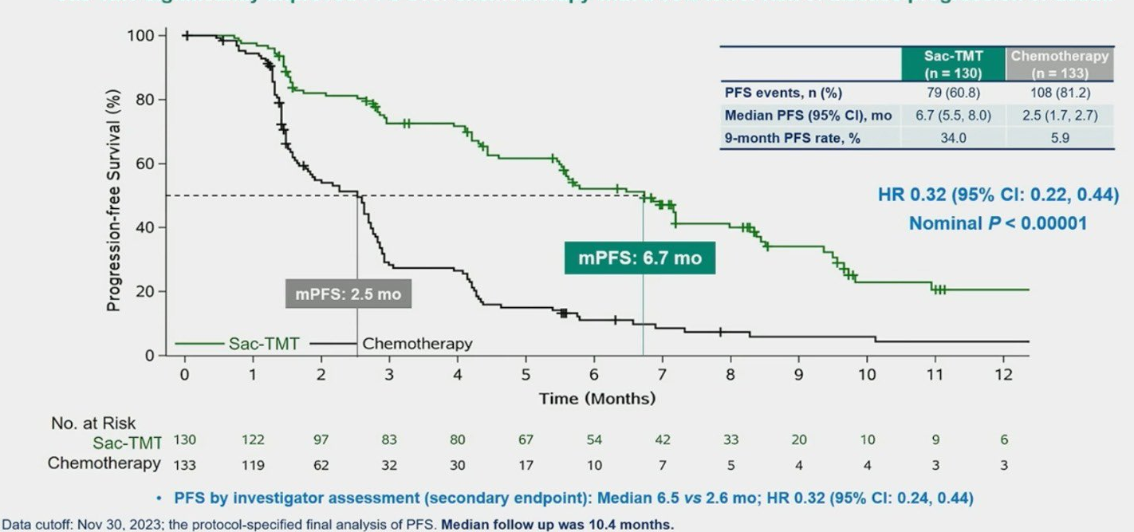
Phase 3 OptiTROP-Breast01: Sac-TMT in Previously Treated Locally Recurrent or Metastatic TNBC
PFS by BICR (Final Analysis)
BICR, blinded independent central review; CI , confidence interval; HR, hazard ratio; mo, month; PFS, progression-free survival; sac-TMT, sacituzumab tirumotecan; TNBC, triple-negative breast cancer.
Xu B, et al. J Clin Oncol. 2024;42(16_suppl):104.
Notes:
Xu B, Yin Y, Fan Y, et al. Sacituzumab tirumotecan (SKB264/MK-2870) in patients (pts) with previously treated locally recurrent or metastatic triple-negative breast cancer (TNBC): Results from the phase III OptiTROP-Breast01 study. J Clin Oncol. 2024;42(16_suppl):104.

Slide 60
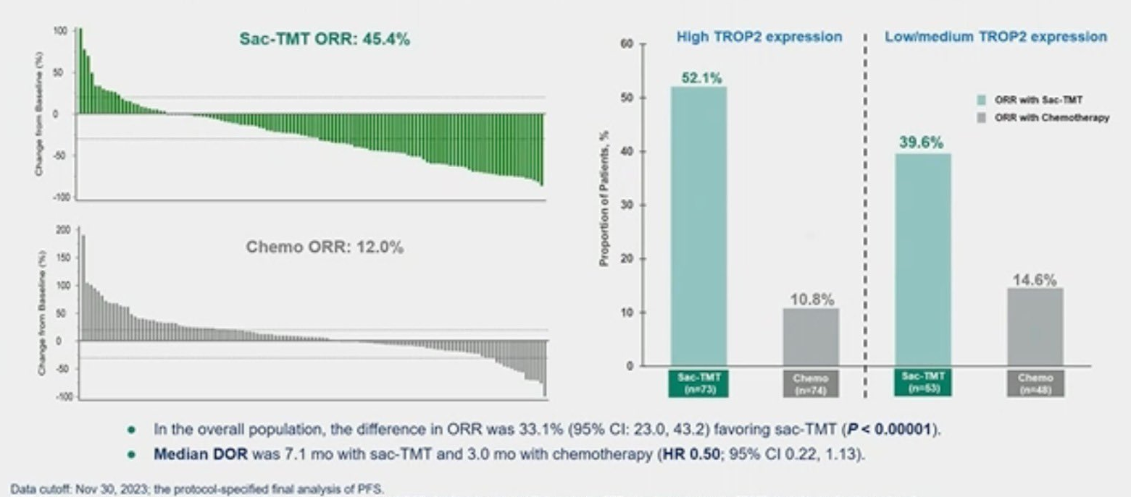
Tumor Response and Best Change in Target Lesions by BICR
BICR, blinded independent central review; DOR, duration of response; ORR, overall response rate; sac-TMT, sacituzumab tirumotecan; TROP2, trophoblast cell-surface antigen 2.
Xu B, et al. J Clin Oncol. 2024;42(16_suppl):104.
Notes:
Xu B, Yin Y, Fan Y, et al. Sacituzumab tirumotecan (SKB264/MK-2870) in patients (pts) with previously treated locally recurrent or metastatic triple-negative breast cancer (TNBC): Results from the phase III OptiTROP-Breast01 study. J Clin Oncol. 2024;42(16_suppl):104.

Slide 61
ADCs to Target MBC: Multiple Agents in Development
Antibody-Drug Conjugate | Target | Payload
Trastuzumab deruxtecan (DS-8201a) | HER2 | Topo-1 inhibitor
Sacituzumab govitecan (IMMU-132) | TROP2 | Topo-1 inhibitor
Datopotamab deruxtecan (DS-1062) | TROP2 | Topo-1 inhibitor
Sacituzumab Tirumotecan | TROP2 | Topo-1 inhibitor
Patritumab deruxtecan (U3-1402) | HER3 | Topo-1 inhibitor
NBE-002 | ROR1 | Topo-2 inhibitor
Praluzatamab ravtansine | CD166 | Microtubule inhibitor
ADC, antibody-drug conjugate; CD166, activated leukocyte cell adhesion molecule; HER2/3, human epidermal growth factor receptor 2/3; MBC, metastatic breast cancer; ROR1, receptor tyrosine kinase–like orphan receptor 1; topo, topoisomerase;TROP2, trophoblast cell-surface antigen 2.

Slide 62
How to Sequence the Different ADCs?

Slide 63
Mechanism Governing Resistance:
Antibody vs Payload
TACSTD2, tumor associated calcium signal transducer 2; TOP1, topoisomerase I; TROP2, trophoblast cell-surface antigen 2.
Coates JT, et al. Cancer Discov. 2021;11(10):2436-2445.
Notes:
Slide Notes:
And a question for the field is, how do we sequence the different ADCs? At this time, we don't have any biomarkers to guide sequencing of ADCs, but conceptually it'll be based on resistance.
Coates JT, Sun S, Leshchiner I, et al. Parallel genomic alterations of antigen and payload targets mediate polyclonal acquired clinical resistance to sacituzumab govitecan in triple-negative breast cancer. Cancer Discov. 2021;11(10):2436-2445.

Slide 64
Implications of Resistance Mechanisms for ADC Sequencing
TROP2-targeted
ADC
No Response
TROP2 mutation
Non-TROP2-
targeted ADC
Response
TOP1i payload
ADC
No Response
TOP1 mutation
Non-TOP1i-
payload ADC
Response
ADC, antibody-drug conjugate; TACSTD2, tumor associated calcium signal transducer 2; TOP1i, topoisomerase I inhibitor; TROP2, trophoblast cell-surface antigen 2.
Coates JT, et al. Cancer Discov. 2021;11(10):2436-2445.
Notes:
Slide Notes:
So for example, we know that some tumors develop mutations in TOP1, which is the target of the payload, both sacituzumab govitecan and datopotamab deruxtecan. And if you have emergence of TOP1 mutation, that'll cross resistance between SG and Dato-DXd and even T-DXd. All these three ADCs that are FDA approved have TOP1 payload, so there's TOP1 mutation that could result in cross resistance. On the other hand, if the resistance is more because of the antigen, then you can use T-DXd and then Dato-DXd. Because one targets HER2, the other targets TROP2.
So better understanding of resistance could help with sequencing. It's not ready for prime time yet because we need the clinical assays, but conceptually as a field, that's where we are going.
Coates JT, Sun S, Leshchiner I, et al. Parallel genomic alterations of antigen and payload targets mediate polyclonal acquired clinical resistance to sacituzumab govitecan in triple-negative breast cancer. Cancer Discov. 2021;11(10):2436-2445.

Slide 65
Management of HR+/HER2- MBC: General Guideline
First line therapy
ET + CDK4/6i
ET+ CDK 4/6i
Genotyping (plasma preferred)
ESR1m
PIK3CAm
AKT Pathway
gBRCAm
WT
2nd line (plus) therapy
Elacestrant
Ful +
Alpelisib
Ful + Capivasertib
PARP
Inh
Fulvestrant +/-
CDK4/6i, mTORi
After ET options
T-DXd *
(HER2 low and ultralow)
Chemotherapy
Sacituzumab Govitecan
Datopotamab Deruxtecan
*For some patients, chemotherapy (cape) might be preferred before T-DXd; utilize patient-centered discussion.
AKT, protein kinase B; cape, capecitabine; CDK4/6i, cyclin-dependent kinase 4/6 inhibitor; ESR1m, estrogen receptor 1 gene mutation; ET, endocrine therapy; ful, fulvestrant; gBRCAm, germline BRCA-mutated; HER2, human epidermal growth factor receptor 2; HR, hormone receptor; PARP, poly(ADP-ribose) polymerase; MBC, metastatic breast cancer; mTORi, mammalian target of rapamycin inhibitor; PIK3CAm, phosphatidylinositol-4,5-bisphosphate 3-kinase catalytic subunit alpha gene mutation; T-DXd, trastuzumab deruxtecan; WT, wild type.
Notes:
Slide Notes:
So what's the current guideline? This is my recommendation for management of hormone receptor-positive HER2-negative metastatic breast cancer. In the first-line setting, I would recommend endocrine therapy, plus a CDK4/6 inhibitor, ribociclib, palbociclib, abemaciclib, those are the three ones that are FDA approved. In the second-line setting, strongly recommend genotyping, because it's actionable. If a patient has ESR1-mutant breast cancer or detection of ESR1 mutations, generally by a blood-based assay, elacestrant is the drug that's approved for a patient who has PIK3CA mutation, fulvestrant plus alpelisib, or fulvestrant plus capivasertib would be an option for a patient who has detectable alterations in the AKT pathway. So that's PIK3CA mutation, or PTEN mutation, or AKT mutation, then you can use fulvestrant plus capivasertib as well. For patients with germline BRCA mutations, PARP inhibitors, olaparib and talazoparib would be options to consider. If a patient does not have any actionable genomic alteration that's detectable, you can use fulvestrant with/without switching the CDK4/6 inhibitor. So if in the first-line setting, ribo was used; in the second-line setting, you could consider abemaciclib or consider the use of everolimus. The approval of everolimus is not linked to any genomic alteration. So certainly something you can use in this setting. In the second-line, third-line setting, usually we sequence these endocrine-based options. So if you’ve started with fulvestrant/capi, then after that, you could consider everolimus or abemaciclib. Or if a patient has both ESR1/PIK3CA mutation, you could consider elacestrant as well. So generally, we use endocrine-based options.
Once endocrine-based options have been exhausted, that's when we go to ADCs and chemo. Based on DESTINY-Breast06, T-DXd, or trastuzumab deruxtecan, is an option to consider in this setting for both HER2-low or ultralow metastatic breast cancer. For some patients, capecitabine could be an option before T-DXd, it's an oral drug. If you use T-DXd first, then you can use capecitabine after that. If you use capecitabine first, then you can use T-DXd after that. Generally, that's the preferred regimen to consider for a patient with HER2-low or ultralow disease. And then after that, we consider sacituzumab govitecan. And now we have datopotamab deruxtecan as well. For a patient who has HER2 IHC 0 disease, two or three biopsies, all HER2 IHC 0, 00, not even ultralow, then as per label, the option would be sacituzumab govitecan or datopotamab deruxtecan. You cannot use T-DXd as per the label.
So that's my algorithm. I generally sequence these ADCs. I prioritize ADCs over chemo based on what we've seen from the clinical trials. If there's a good clinical trial option available, that's always something to consider.

Slide 66
Shared Decision-Making (SDM)
SDM is a fundamental method of care that is central to individualizing treatment¹
It involves an MDT approach to ensure optimal care for and communication with the patient and their family¹
The initial step involves promoting productive dialogues that encourage active patient-clinician collaboration, facilitating the process of care plan development, and supporting the cocreation of a comprehensive care plan¹
Person-centered decision-making (PCDM)²
  A person-centered orientation throughout the care continuum is fundamental to PCDM
  The patient and the clinician share values and preferences, comprehensively discuss options, and then arrive collaboratively at treatment decisions that are preference-aligned
MDT, multi-disciplinary team; SDM, shared decision-making.
1. Shickh S, et al. Am Soc Clin Oncol Educ Book. 2023;43:e389516. 2. Rocque GB, et al. J Natl Compr Cancer Netw. 2024;22(1):e237113.
Notes:
Slide Notes:
It's good to do shared decision-making with the patient based on their priorities based on the comorbid conditions they have. Sometimes it requires multidisciplinary management as well. So if a patient has history of pneumonitis with T-DXd, involving a pulmonologist. Or like the case we reviewed a patient with inflammatory bowel disease, working with a GI specialist. So more of a patient-centered, person-centered decision-making, is critical when there are multiple options.
Schedule. SG is Day 1, Day 8 every 21 days, while Dato-DXd is every 3 weeks.
Shickh S, Leventakos K, Lewis MA, et al. Shared decision making in the care of patients with cancer. Am Soc Clin Oncol Educ Book. 2023;43:e389516.
Rocque GB, Patel MI, Wallner LP, et al. Patient-centered decision-making in metastatic breast cancer care delivery: a call to action. J Natl Compr Canc Netw. 2024;22(1):e237113.

Slide 67
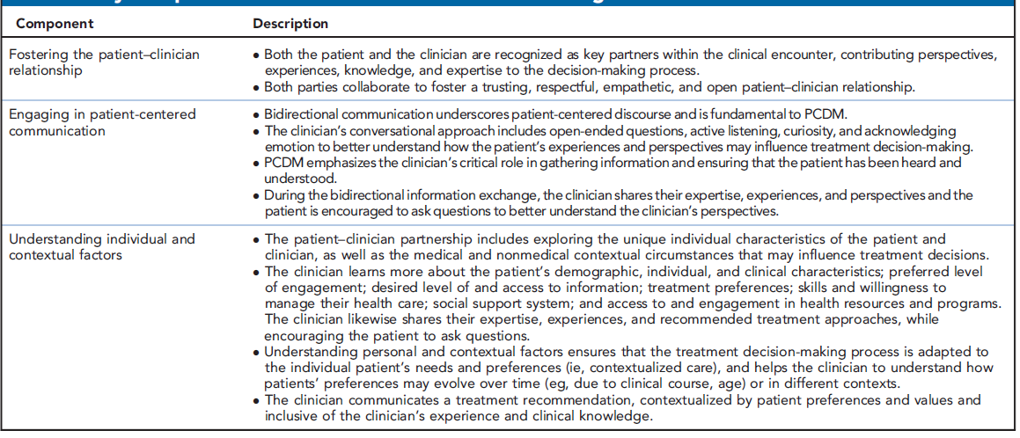
Key Components of Person-Centered
Decision-Making
PCDM, person-centered decision-making .
Rocque GB, et al. J Natl Compr Cancer Netw. 2024;22(1):e237113.
Notes:
Slide Notes:
So all of those factors come into picture in terms of looking at these drugs. And the key components are to foster the patient-clinician relationship, ensuring that we are engaged in a patient-centered communication, understanding their preferences, understanding the different comorbid conditions, and providing the right drug.
Rocque GB, Patel MI, Wallner LP, et al. Patient-centered decision-making in metastatic breast cancer care delivery: a call to action. J Natl Compr Canc Netw. 2024;22(1):e237113.

Slide 68
Practical Application:
Case-Based Learning Lab

Slide 69
Case 1: 55-Year-Old Woman With HR+ MBC
55F with metastatic HR+ MBC (HER2 IHC = 1+). Disease progression on various endocrine based therapy, and recently capecitabine. PS = 1. No organ dysfunction. Known history of inflammatory bowel disease. gBRCA = negative. PIK3CA and ESR1 WT.
What therapy would you consider next?
  Eribulin
  Navelbine
  Sacituzumab govitecan (SG)
  Trastuzumab deruxtecan (T-DXd)

Slide 70
Case 1: 55-Year-Old Woman With HR+ MBC
Pt started T-DXd. 4 months after treatment developed symptomatic drug-related pneumonitis (grade 2). T-DXd was discontinued.
What therapy would you consider next?
  Eribulin
  Navelbine
  Sacituzumab govitecan (SG)
  Datopotamab deruxtecan (Dato-DXd)

Slide 71
Case 1: 55-Year-Old Woman With HR+ MBC
Pt started SG. On C2D1 presents with ANC = 800.
What would you recommend next?
  Continue SG
  Give G-CSF and continue SG
  Hold SG, give G-CSF, and consider resuming SG once ANC recovers to grade 1 or less
  Permanently discontinue SG

Slide 72
Case 2: 65-Year-Old Woman With HR+ MBC
55F with metastatic HR+ MBC (HER2-ultralow IHC 0+). Disease progression on various endocrine based therapy, and recently capecitabine. PS = 1. No organ dysfunction. gBRCA = negative. PIK3CA and ESR1 WT. Pt has history of inflammatory-bowel disease with periodic exacerbations of diarrhea.
What therapy would you consider next?
  Eribulin
  Navelbine
  Sacituzumab govitecan (SG)
  Trastuzumab deruxtecan (T-DXd)
  Datopotamab deruxtecan (Dato-DXd)

Slide 73
Case 2: 65-Year-Old Woman With HR+ MBC
Pt started Dato-DXd. 2 months into treatment developed grade 2 mucositis.
What would you recommend next?
  Continue Dato-DXd
  Recommend steroid mouthwash and continue Dato-DXd
  Hold Dato-DXd, give steroid mouthwash, and consider resuming Dato-DXd once mucositis improves to grade 1 or less
  Permanently discontinue Dato-DXd

Slide 74
Summary
TROP2 ADCs have revolutionized care of patients with HR+ MBC
  Datopotamab deruxtecan: currently approved for HR+/HER2- MBC
  after 1 prior line of chemotherapy.
  Sacituzumab govitecan:
  approved for metastatic HR+
  breast cancer after 2 prior lines
  of systemic therapy.
  Sacituzumab tirumotecan:
  in advanced stages of clinical development in phase 3
  clinical trials.
There are multiple other ADCs in development to target antigens overexpressed in MBC.
Additional studies evaluating efficacy of ADCs alone and in combination as well as other indications in breast cancer could redefine the receptor classification of breast cancer.
ADC, antibody-drug conjugate; HER2, human epidermal growth factor receptor 2; HR, hormone receptor; MBC, metastatic breast cancer; TROP2, trophoblast cell-surface antigen 2.
Notes:
Slide Notes:
So to summarize, TROP2 ADCs have revolutionized the care for patients with hormone receptor-positive metastatic breast cancer. Datopotamab deruxtecan is now approved for hormone receptor-positive HER2-negative metastatic breast cancer after one prior line of chemo, as per label. Sacituzumab govitecan also approved for hormone receptor-positive breast cancer after two prior lines of systemic therapy. And sacituzumab tirumotecan, not approve yet, is being evaluated in phase 3 clinical trials. Besides this, there are other drugs and development as well. So for the field, the question is going to be, how do we sequence these agents? How do we move them to earlier lines? As well as, how do we build with combinations that are ADC based?

