Slide 1
Optimizing Perioperative Therapy in Early-Stage NSCLC:
A Multidisciplinary Approach

Slide 2
DISCLAIMER
This slide deck in its original and unaltered format is for educational purposes and is current as of July 2025. All materials contained herein reflect the views of the faculty, and not those of AXIS Medical Education, the CME provider, or the commercial supporter. Participants have an implied responsibility to use the newly acquired information to enhance patient outcomes and their own professional development. The information presented in this activity is not meant to serve as a guideline for patient management. Any procedures, medications, or other courses of diagnosis or treatment discussed or suggested in this activity should not be used by clinicians without evaluation of their patients’conditions and possible contraindications and/or dangers in use, review of any applicable manufacturer’s product information, and comparison with recommendations of other authorities.

Slide 3
DISCLOSURE OF UNLABELED USE
This activity may contain discussion of published and/or investigational uses of agents that are not indicated by the FDA. The planners of this activity do not recommend the use of any agent outside of the labeled indications.
The opinions expressed in the activity are those of the faculty and do not necessarily represent the views of the planners. Please refer to the official prescribing information for each product for discussion of approved indications, contraindications, and warnings.
USAGE RIGHTS
This slide deck is provided for educational purposes and individual slides may be
used for personal, non-commercial presentations only if the content and references
remain unchanged. No part of this slide deck may be published in print or
electronically as a promotional or certified educational activity without prior written
permission from AXIS. Additional terms may apply. See Terms of Service on
www.axismeded.com for details.

Slide 4
Learning Objectives
At the conclusion of this activity, participants should be better able to:
Identify the clinico-pathologic rationale for perioperative immunotherapy in early-stage, resectable NSCLC
Apply multidisciplinary biomarker- and evidence-based decision-making strategies to select patients with stage II-IIIB NSCLC for perioperative therapy
Incorporate case-based and expert-derived perioperative immunotherapy principles into early-stage NSCLC patient management in an interprofessional, community-based care setting
Develop interprofessional strategies for early detection and management of immune-related adverse events in patients with NSCLC receiving perioperative immunotherapy

Slide 5
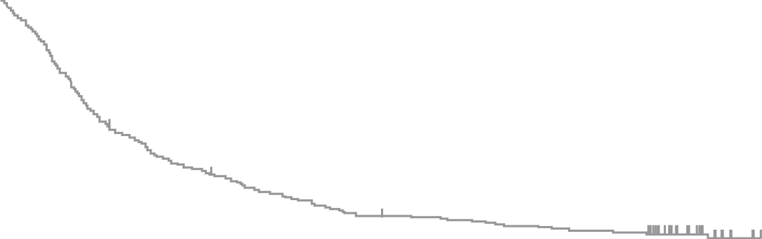
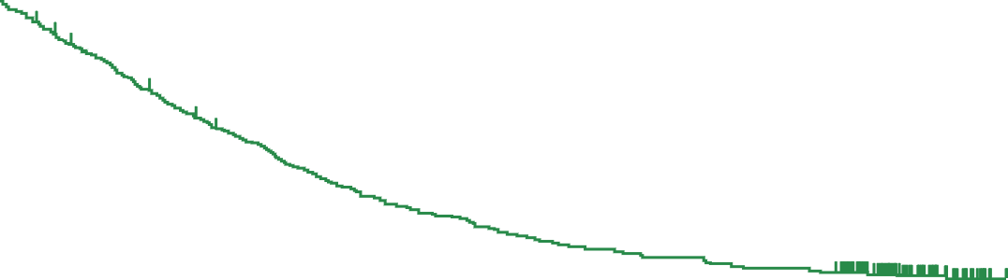
IO+ Chemo: Cure in Metastatic? KEYNOTE-189: 5-year Efficacy Update in Non-Sq NSCLC
 | Pembro + chemo | Placebo + chemo
Events, n (%) | 329 (80.2) | 183 (88.8)
Median , months (95% CI) | 22.0 (19.5, 24.5) | 10.6 (8.7, 13.6)
HR (95% CI) | 0.60 (0.50, 0.72)
PFS (ITT population)
OS (ITT population)
 | Pembro + chemo | Placebo + chemo
Events, n (%) | 369 (90.0) | 201 (97.6)
Median , months (95% CI) | 9.0 (8.1, 10.4) | 4.9 (4.7, 5.5)
HR (95% CI) | 0.50 (0.42, 0.60)
100
100
80
69.8%
48.0%
60
39.8%
17.7%
80
40
23.1%
4.3%
13.1%
1.9%
5-y PFS
7.5%
0.6%
OS (%)
5-y OS
19.4%
11.3%
10.2%
1.3%
60
45.7%
27.3%
20
40
31.3%
17.4%
23.6%
13.8%
PFS (%)
0
0
12
24
36
48
60
72
No. at risk
Time, months
20
Pembro + chemo
410
158
91
49
37
21
0
Placebo + chemo
208
35
8
3
2
1
0
0
0
12
24
36
48
60
72
 | PD-L1 TPS ≥50% | Arm C | PD-L1 TPS 1% - 49% | HR & CI (Arm B : Arm C | PD-L1 TPS <1%
 | Pembro + chemo (n=132) | Placebo + chemo (n=70) | Pembro + chemo (n=128) | Placebo + chemo (n=58) | Pembro + chemo (n=127) | Placebo + chemo (n=63)
PFS HR (95% CI) | 0.35 (0.25, 0.49) | 11/24 17/20 | 0.57 (0.41, 0.80) |  | 0.67 (0.49, 0.92)
5-y PFS rate^{b}, % | 12.8 | 0 | 6.5 | 1.9 | 2.4 | 0
No. at risk
Time, months
Pembro + chemo
410
283
184
126
95
77
0
Placebo + chemo
206
96
55
34
27
22
0
 | PD-L1 TPS ≥50% | Arm C | PD-L1 TPS 1% - 49% | HR & CI (Arm B : Arm C | PD-L1 TPS <1%
 | Pembro + chemo (n=132) | Placebo + chemo (n=70) | Pembro + chemo (n=128) | Placebo + chemo (n=58) | Pembro + chemo (n=127) | Placebo + chemo (n=63)
OS HR (95% CI) | 0.68 (0.49, 0.96) | 11/24 17/20 | 0.65 (0.46, 0.90) |  | 0.55 (0.39, 0.76)
5-y OS rate, % | 29.6 | 21.4 | 19.8 | 7.7 | 9.6 | 5.3
5-Yr OS 10-30%
Notes:
Novello S, Kowalski DM, Luft A, et al. 5‑year update from KEYNOTE‑407: pembrolizumab plus chemotherapy in squamous non–small‑cell lung cancer (NSCLC). Ann Oncol. 2022;33(suppl 7):S993-S994.

Slide 6
Neoadjuvant ICI
Adjuvant ICI
Perioperative ICI
What Do the Approaches Add
to Each Other?
What Variables Matter?
Notes:
Slide Notes
We’ll first talk about neoadjuvant immune checkpoint inhibitors, or ICI, adjuvant ICI, and then perioperative. We’ll also consider what these approaches add to each other and what variables are important.

Slide 7
ICI Treatment Paradigms in Early-Stage NSCLC
ICI
Adjuvant
ICI
neoadjuvant
ICI
perioperative
ICI
monotherapy
IMpower010, KN091,
BR31, ANVIL
CM159, LCMC3, IFCT1601
ICI+chemo Combination
KEYNOTE-671,
CheckMate 77T, AEGEAN,
RATIONALE 315, Neotorch,
IMpower 030..
NADIM/2
CM816
ICI+novel Combination
NeoCOAST,
NEO predict-Lung, NeoPromise /BGB-LC-202
NeoCOAST 2, SKYSCRAPER-05
Phase II
Phase III

Slide 8
Neoadjuvant Treatment:
Neoadjuvant Alone
Notes:
Speaker Notes
We’ll look first at neoadjuvant treatment. There is only one major g trial that looked at just neoadjuvant therapy.

Slide 9
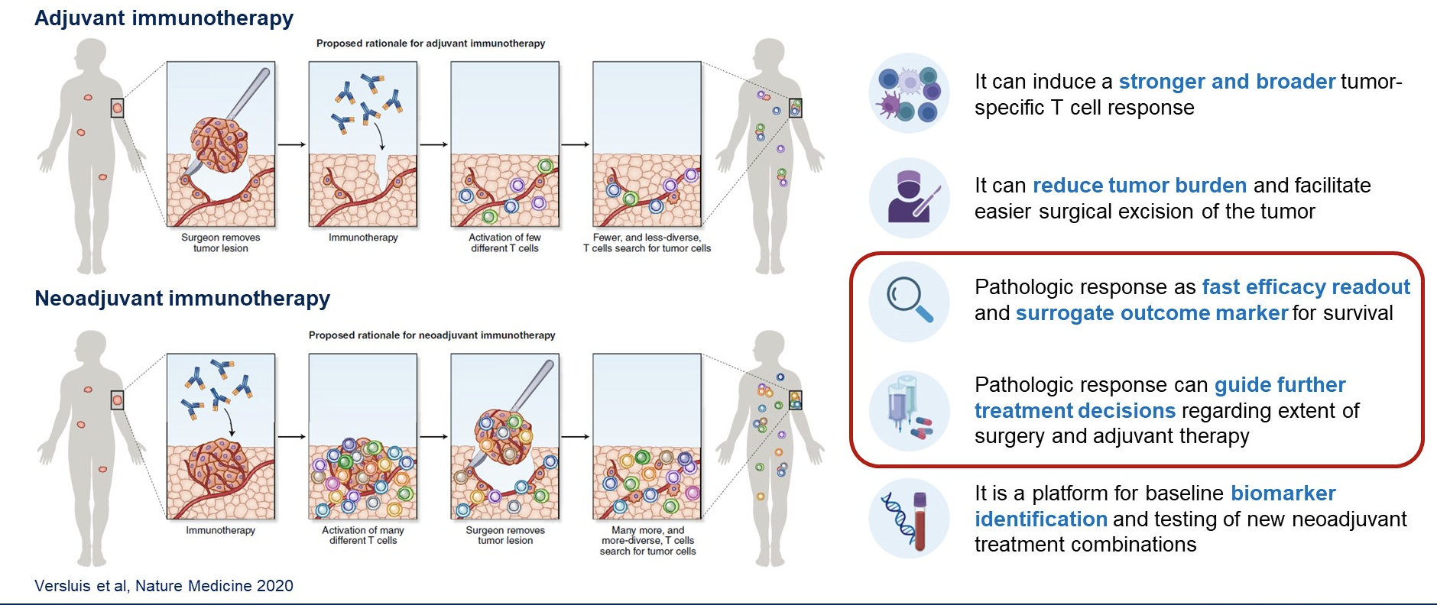
Theoretical Benefits of Neoadjuvant
Notes:
Slide Notes
We’ll start our session with a discussion on the theoretical benefits of neoadjuvant. The key point is that if you give the immune checkpoint inhibitor while the tumor is still there, there is a lot more opportunity to find the right new antigens to go after. You're going to get that stronger response because there's more tumor to see and attack.
Versluis JM, Klinghammer K, Saupe F, et al. Neoadjuvant immunotherapy in resectable non-small cell lung cancer: feasibility and safety results from the NEOSTAR study. Nat Med. 2020;25(4):475-484.​

Slide 10
First Phase III: CheckMate816
37% stage IB/II; 63% Stage IIIA
50% PD-L1 >1%
No EGFR/ALK
Key eligibility criteria
Newly diagnosed, resectable, stage IB (≥ 4 cm)–IIIA NSCLC
(per TNM 7th edition)
ECOG PS 0–1
No known sensitizing EGFR mutations or ALK alterations
Stratified by
stage (IB/II vs IIIA),
PD-L1^{b} (≥ 1% vs < 1%), and sex
NIVO 360 mg Q3W
+
chemo Q3W (3 cycles)
Surgery
(within 6 weeks
post-treatment)
Optional adjuvant chemo ± RT
N = 358
R
1:1
Radiologic
restaging
Follow-up
Chemo Q3W (3 cycles)
Notes:
Slide Notes
CheckMate 816 enrolled patients who had theoretically resectable stage 1B, 2, and 3A non–small cell lung cancer. Most patients had stage 3A (two-thirds). About half the patients had some PD-L1 expression on their tumor. Patients with a known EGFR mutation or ALK translocation were excluded. Patients were randomized to get chemotherapy alone for 3 cycles or that same chemotherapy regimen with the addition of nivolumab. Surgery was performed within 6 weeks, and then patients had the option of receiving additional chemotherapy/radiation, but immune therapy afterwards.
Spicer J, Wang C, Tanaka F, et al. Surgical outcomes from the phase 3 CheckMate 816 trial: nivolumab plus platinum-doublet chemotherapy versus chemotherapy alone as neoadjuvant treatment for patients with resectable non–small-cell lung cancer. J Clin Oncol. 2021;39(15_suppl):8503.​
Forde PM, et al. Overall survival with neoadjuvant nivolumab + chemotherapy in patients with resectable NSCLC in CheckMate 816. J Clin Oncol. 2025;43(suppl 17):LBA8000.​
Forde PM, Spicer JD, Provencio M, et al. Overall survival with neoadjuvant nivolumab plus chemotherapy in lung cancer. N Engl J Med. Published online June 2, 2025.​ doi:10.1056/NEJMoa2502931

Slide 11
CM816 EFS: 5-Year Analysis
Notes:
Slide Notes
The 5-year event-free survival results were recently presented at ASCO 2025 by Patrick Forde, which showed a nice robust separation of the curves. The hazard ratio was 0.68.
Spicer J, Wang C, Tanaka F, et al. Surgical outcomes from the phase 3 CheckMate 816 trial: nivolumab plus platinum-doublet chemotherapy versus chemotherapy alone as neoadjuvant treatment for patients with resectable non–small-cell lung cancer. J Clin Oncol. 2021;39(15_suppl):8503.​
Forde PM, et al. Overall survival with neoadjuvant nivolumab + chemotherapy in patients with resectable NSCLC in CheckMate 816. J Clin Oncol. 2025;43(suppl 17):LBA8000.​
Forde PM, Spicer JD, Provencio M, et al. Overall survival with neoadjuvant nivolumab plus chemotherapy in lung cancer. N Engl J Med. Published online June 2, 2025.​ doi:10.1056/NEJMoa2502931

Slide 12
CM816 Exploratory Analysis:
EFS by pCR Status
In the NIVO + chemo arm:
Among patients with pCR, 3 (7.0%) patients had disease recurrence or relapse
Among patients with no pCR, 57 (41.9%) patients had disease recurrence or relapse
Notes:
Slide Notes
Patients who achieved a pathologic complete response had excellent EFS. Patients who did not achieve pCR had recurrences.
Forde PM, et al. Overall survival with neoadjuvant nivolumab + chemotherapy in patients with resectable NSCLC in CheckMate 816. J Clin Oncol. 2025;43(suppl 17):LBA8000.​
​

Slide 13
CM816 Final Analysis: OS With Neoadjuvant NIVO + Chemo vs Chemo
Minimum/median follow-up: 59.9/68.4 months.
^{a-d}95% CI: ªNR; ^{b}47.3–NR; ^{c}58–72; ^{d}47–62.
Notes:
Slide Notes
Regarding overall survival, we can see that the curves separated by 18 months and continue to stay separated, resulting in a 10% overall survival difference in the end, with a hazard ration of 0.72. As a reminder, the hazard ration for EFS was 0.68.
Forde PM, et al. Overall survival with neoadjuvant nivolumab + chemotherapy in patients with resectable NSCLC in CheckMate 816. J Clin Oncol. 2025;43(suppl 17):LBA8000.​
Forde PM, Spicer JD, Provencio M, et al. Overall survival with neoadjuvant nivolumab plus chemotherapy in lung cancer. N Engl J Med. Published online June 2, 2025.​ doi:10.1056/NEJMoa2502931
​

Slide 14
CM816 OS Analysis by Key Subgroups
 | Median OS, mo |  | Unstratified HR (95% CI) | Unstratified HR
 | NIVO + chemo (n = 179) | Chemo (n = 179)
Overall (N = 358) | NR | 73.7 |  | 0.71
Male (n = 255) Female (n = 103) | NR NR | 61.8 NR |  | 0.76 0.52
White (n = 169) Black or African American (n = 7) Asian (n = 179) | NR NR NR | 73.7 20.9 76.8 |  | 0.91 0.52
North America (n = 91) Europe (n = 66) Asia (n = 177) | NR NR NR | 73.7 38.3 76.8 |  | 0.83 0.64 0.54
ECOG PS 0 (n = 241) ECOG PS 1 (n = 117) | NR 71.6 | 76.8 45.3 |  | 0.70 0.76
Stage IB-II (n = 126) Stage IIIA (n = 229) | NR NR | 76.8 73.7 |  | 0.77 0.70
Squamous (n = 182) Nonsquamous (n = 176) | NR NR | 73.7 NR |  | 0.71 0.72
PD-L1 < 1% (n = 155) PD-L1 ≥ 1% (n = 178) PD-L1 1%–49% (n = 98) PD-L1 ≥ 50% (n = 80) | NR NR NR NR | 61.8 73.7 73.7 76.8 |  | 0.89 0.51 0.66 0.33
Cisplatin (n = 258) Carboplatin (n = 72) | NR NR | 76.8 37.2 |  | 0.81 0.39
CI, confidence interval; CM816, CheckMate 816; ECOG PS, Eastern Cooperative Oncology Group performance status; HR, hazard ratio; mo, months; NIVO, nivolumab; NR, not reached; OS, overall survival; PD-L1, programmed death-ligand 1.​
Forde PM, et al. J Clin Oncol. 2025;43(17_suppl):LBA8000. Forde PM, et al. N Engl J Med. Published online June 2, 2025.​ doi:10.1056/NEJMoa2502931.
Favors NIVO + chemo
Favors chemo
Notes:
Slide Notes
When we look at the stage, patients with higher stage derived greater benefit. This is for overall survival. Moreover, the hazard ratio for patients with PD-L1 < 1% was 0.89, indicating less clear benefit. For patients with higher PD-L1 levels, either 1-49 or >50, derived the greatest highest benefit, especially in in those with > 50% PD-L1 expression level for the tumor.
Forde PM, et al. Overall survival with neoadjuvant nivolumab + chemotherapy in patients with resectable NSCLC in CheckMate 816. J Clin Oncol. 2025;43(suppl 17):LBA8000.​
Forde PM, Spicer JD, Provencio M, et al. Overall survival with neoadjuvant nivolumab plus chemotherapy in lung cancer. N Engl J Med. Published online June 2, 2025.​ doi:10.1056/NEJMoa2502931

Slide 15
CM816 OS by Tumor PD-L1 Expression
CI, confidence interval; CM816, CheckMate 816; HR, hazard ratio; mo, months; NIVO, nivolumab; NR, not reached; OS, overall survival; PD-L1, programmed death-ligand 1.​
Forde PM, et al. J Clin Oncol. 2025;43(17_suppl):LBA8000. Forde PM, et al. N Engl J Med. Published online June 2, 2025.​ doi:10.1056/NEJMoa2502931.
Notes:
Forde PM, et al. Overall survival with neoadjuvant nivolumab + chemotherapy in patients with resectable NSCLC in CheckMate 816. J Clin Oncol. 2025;43(suppl 17):LBA8000.​
Forde PM, Spicer JD, Provencio M, et al. Overall survival with neoadjuvant nivolumab plus chemotherapy in lung cancer. N Engl J Med. Published online June 2, 2025.​ doi:10.1056/NEJMoa2502931
​
​

Slide 16
CheckMate 816: 5-Year OS by Surgical Outcomes
Measure | Nivolumab + Chemotherapy | Chemotherapy Alone
Median follow-up, mos (range) | 68.4 months (59.9-85.2)
Patients with definitive surgery | n = 135 | n = 142
OS, mos (95% CI) | NR | 76.8 (73.7-NR)
HR (95% CI) | 0.69 (0.46-1.03)
5-year OS rates, % | 74 | 63
Patients without definite surgery | n = 30 | n = 44
Median OS, mos (95% CI) | 32.9 (11.0-44.1) | 22.0 (15.6-38.3)
HR (95% CI) | 1.04 (0.60-1.79)
Notes:
Mitsudomi T, Forde PM, Girard N, et al. Overall survival (OS) with neoadjuvant nivolumab plus chemotherapy by surgical outcomes in the phase 3 CheckMate 816 study. Abstract presented at: IASLC World Conference on Lung Cancer; Barcelona, Spain; September 6-9, 2025. Abstract OA02.03.

Slide 17
CheckMate 816: 5-Year OS by Surgical Outcomes in Patients With Definitive Surgery
Measure | Nivolumab + Chemotherapy Versus Chemotherapy
 | Surgical Approach |  | Extent of Resectionª |  | Completeness of Resection
 | Minimally Invasive^{b} | Thoracotomy or Conversion^{c} | Lobectomy | Pneumonectomy | R0
N | 44 vs 29 | 105 vs 106 | 115 vs 82 | 25 vs 34 | 124 vs 105
HR (95% CI) | Not calculated^{d} | 0.81 (0.53-1.26) | 0.79 (0.48-1.31) | Not calculated^{d} | 0.65 (0.41-1.01)
5-year OS rate | 89 vs 68 | 67 vs 62 | 74 vs 67 | 80 vs 53 | 75 vs 62
ªPatients may have had ≥1 surgery type. ^{b}Included minimally invasive-thorascopic/robotic approaches. ^{c}Defined as conversion from minimally invasive surgery to thoracotomy. ^{d}HR was not calculated due to an insufficient number of events (<10 per arm).
Notes:
Mitsudomi T, Forde PM, Girard N, et al. Overall survival (OS) with neoadjuvant nivolumab plus chemotherapy by surgical outcomes in the phase 3 CheckMate 816 study. Abstract presented at: IASLC World Conference on Lung Cancer; Barcelona, Spain; September 6-9, 2025. Abstract OA02.03.

Slide 18
Neoadjuvant ICI Key Points
Only 3 cycles
All patients exposed to ICI
PD-L1 is important
Driver mutations excluded
More benefit seen in Stage III
OS benefit demonstrated
ICI, immune checkpoint inhibitor; OS, overall survival; PD-L1, programmed death-ligand 1.
Notes:
Slide Notes
In summary, patients in CM816 received only three cycles of treatment. Every patient were exposed to immune checkpoint inhibitor and chemotherapy. PD-L1 levels were observed to be important. Patients with driver mutations were excluded. Stage: We see more benefit in stage 3 but still some of those earlier stages. Finally, we now have a definitive overall survival benefit with a hazard ratio of 0.72.

Slide 19
What Can Pure
Adjuvant Do?
Notes:
Slide Notes
What about pure adjuvant? We have three trials in this setting.

Slide 20
IMpower010 Study Design
12% stage 1, ~50% stage II, 40% stage III
55% PD-L1+; ~15% known driver mutation
Completely resected
stage IB-IIIAª NSCLC
Stage IB tumors ≥4 cm
ECOG 0-1
Lobectomy
Tumor tissue for
PD-L1 analysis
No crossover
Cisplatin + pemetrexed, gemcitabine, docetaxel or vinorelbine
1-4 cycles
N=1280
Atezolizumab
1200 mg q21d x 16 cycles or 1 year
Hierarchical statistical testing
of endpoints
R 1:1
Survival
follow-up
N = 1005
DFS in PD-L1 TC ≥1%
stage II−IIIA population^{b}
BSC
Endpoint was met at DFS IA
If positive:
Endpoint was not met at DFS IA and follow up is ongoing
DFS in all-randomized
stage II−IIIA population^{b}
Stratification factors
Sex | Stage | Histology | PD-L1 status
Clinical cutoff: 18 April 2022. Both arms included observation and regular scans for disease recurrence on the same schedule. ECOG, Eastern Cooperative Oncology Group, q21d, every 21 days.
ª Per UICC/AJCC staging system, 7th edition. ^{b} Two-sided α=0.05.
If positive:
Endpoint was not formally tested
Key exploratory endpoints
  OS biomarker analyses
DFS in ITT population (stage IB-IIIA)^{b}
Key secondary endpoints
  OS in ITT | Safety | Exploratory OS biomarker analyses
If positive:
OS in ITT population^{b}
Notes:
Slide Notes
In the IMpower010 trial, about 50% of patients had stage 2 disease and 40% had stage 3, so slightly different patient population from CM816. About halfof the patients had some PD-L1 expression. Patients with known driver mutations were allowed, but there were only15% of patients. In this trial, patients had surgery and received chemotherapy. They were then randomized to receive immune therapy or not. The study also had a complex hierarchical statistical design.
Wakelee HA, Vansteenkiste J, Baas P, et al. IMpower010: primary results of a randomized study of atezolizumab versus best supportive care after adjuvant chemotherapy in resected stage IB–IIIA non-small cell lung cancer (NSCLC). J Clin Oncol. 2021;39(15_suppl):8500. ​
Felip E, Altorki N, Zhou C, et al. Adjuvant atezolizumab after adjuvant chemotherapy in resected stage IB–IIIA non-small-cell lung cancer (IMpower010): a randomised, multicentre, open-label, phase 3 trial. Lancet. 2021;398(10308):1344-1357. ​
Felip E, Altorki N, Zhou C, et al. IMpower010: updated overall survival analysis of a randomized study of atezolizumab vs best supportive care after adjuvant chemotherapy in resected stage IB–IIIA NSCLC. Abstract presented at: World Conference on Lung Cancer (WCLC); Vienna, Austria; August 6-9, 2022. Abstract PL03.09.​

Slide 21
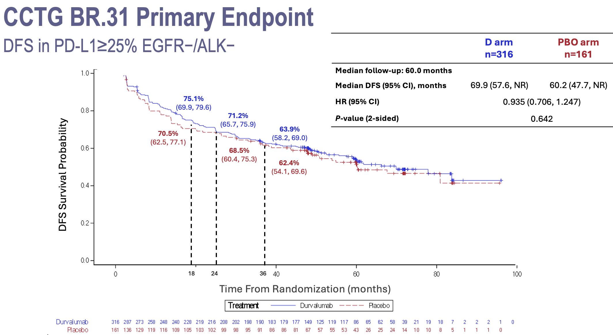
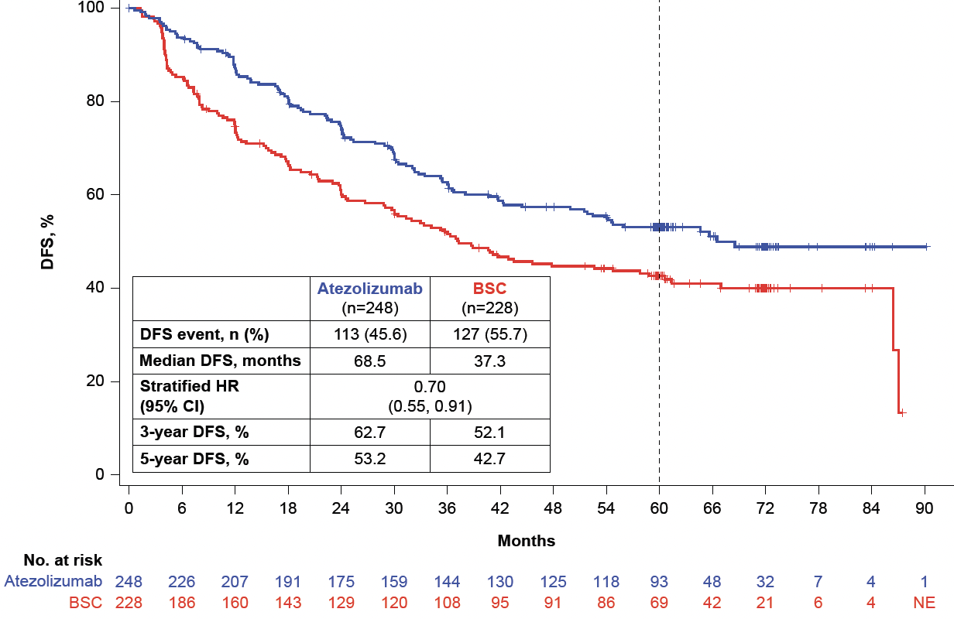
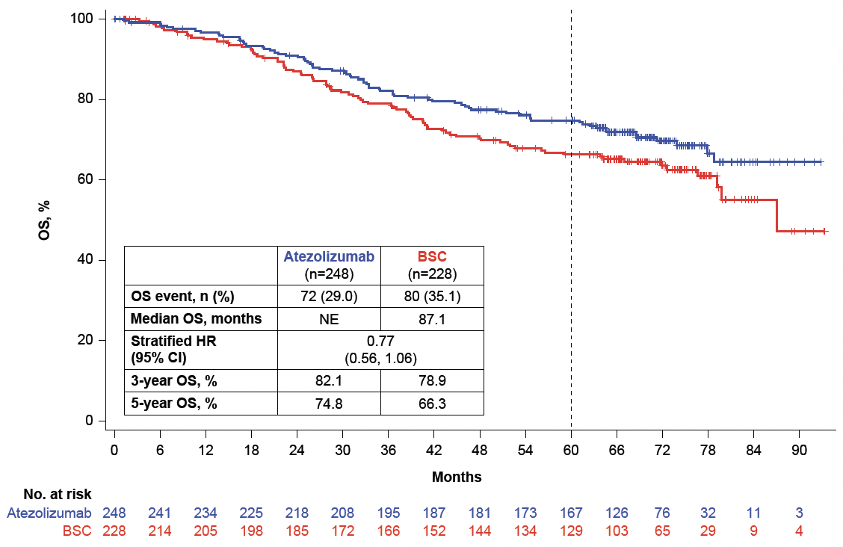
Adjuvant ICI: IMpower010 DFS+OS; KN091/BR.31 DFS
IMpower010 PD-L1 TC ≥1% stage II-IIIA population-
>60 mo f/up: DFS and OS
CCTG BR.31 Primary Endpoint
DFS in PD-L>25% EGFR-/ALK-
KN091DFS, Overall Population
HR 0.76 (95% CI 0.63-0.91)
P = 0.0014
 | Events | Median
Pembro | 35.9% | 53.6 mo
Placebo | 44.3% | 42.0 mo
Altorki et al. IMpower010 Prior Therapies
https://bit.ly/36gV0j6
Paz-Ares ESMO plenary 2022, O’Brien ASCO 2022, Lancet Oncol 2023
Notes:
Slide Notes
On the left side of the slide, we see these disease-free survival results with 5 years of follow up with patients who had a tumor PD-L1 expression of at least 1%, stage 2 to 3A. We see that these curves actually separate very early and stay separated. Most of that in the patients with high PD-L1 expression, just like in the pure neoadjuvant setting. When we look at overall survival, we also see these curves separating. Most of this benefit is in those with the high PD-L1 expression.
When we look at the PEARLS trial or KEYNOTE-O91, there is a nice robust disease-free survival benefit, with a hazard ratio of 0.76. PD-L1 level had no impact, which was a bit odd because it’s had an impact in every other trial that used pembrolizumab. The most recent trial, BR.31, which evaluated durvalumab, was absolutely, completely negative, even in those with the highest PD-L1 expression. So you have one trial that was positive regardless of PD-L1 expression, one trial that was very positive with high PD-L1 expression, and one trial that was totally negative in the adjuvant setting.
Wakelee HA, Altorki NK, Zhou C, et al. IMpower010: primary results of a phase III global study of adjuvant atezolizumab versus best supportive care following adjuvant chemotherapy in resected stage IB‑IIIA non–small cell lung cancer. J Clin Oncol. 2021;39(15_suppl):8500.​
Felip E, Altorki N, Zhou C, et al. Adjuvant atezolizumab after adjuvant chemotherapy in resected stage IB–IIIA non–small-cell lung cancer (IMpower010): a randomised, multicentre, open-label, phase 3 trial. Lancet. 2021;398(10308):1344-1357.​
Felip E, Altorki N, Zhou C, et al. IMpower010: updated overall survival analysis of a randomized study of atezolizumab vs best supportive care after adjuvant chemotherapy in resected stage IB–IIIA NSCLC. Abstract presented at: World Conference on Lung Cancer (WCLC); Vienna, Austria; August 6-9, 2022. Abstract PL03.09.​
Wakelee HA, Sergeant F, Zhang J, et al. Updated 5‑year outcomes from IMpower010: adjuvant atezolizumab versus best supportive care in resected stage IB‑IIIA non–small cell lung cancer (NCT02486718). J Clin Oncol. 2024;42(17_suppl):LBA8035.​
Goss G, Reck M, Reckamp KL, et al. Adjuvant durvalumab in early-stage, PD-L1–positive NSCLC: primary results of the ADRIATIC phase III trial presented at Annals of Oncology. Ann Oncol. 2024;359(Suppl 2):1238.​
​

Slide 22
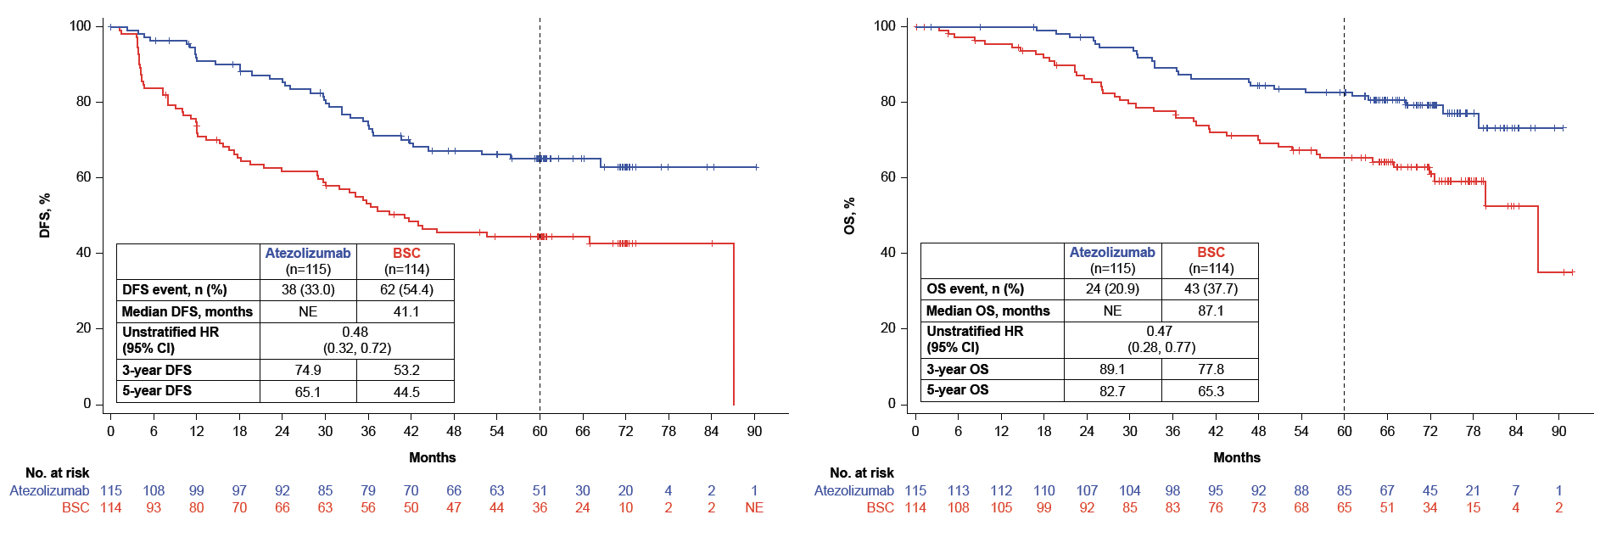
IMpower010: 5-Yr Overall Survival – Select Subsets
DFS and OS in the stage I-IlIA PD-L1 TC ≥50% population
NO benefit in ITT or All randomized stage II-IIIA
Notes:
Wakelee HA, Altorki N, Zhou C, et al. IMpower010: 5-year overall survival (OS) in stage II–IIIA NSCLC PD-L1 TC ≥50% subgroup. Abstract presented at: American Society of Clinical Oncology (ASCO) Annual Meeting; Chicago, Illinois; May 31-June 4, 2024. Abstract LBA8035.

Slide 23
Adjuvant ICI Key Points
Everyone gets surgery (DFS endpoint)
Driver mutations – Known for ALL
pCR/MPR/MRD are very relevant, but MRD detection methods not sensitive enough YET
PD-L1 results are confusing across trials
DFS, disease-free survival; ICI, immune checkpoint inhibitor; MPR, major pathologic response; MRD, minimal residual disease; pCR, pathologic complete response; PD-L1, programmed death-ligand 1.
Notes:
Slide Notes
So, when we think about adjuvant therapy, everyone gets surgery. Driver mutations are known because patients already had surgery or the tumor is out. The pathologic CR, MPR, and MRD seem rather relevant, it is unclear know how to look for MRD because the assays aren't sensitive enough. Finally, the impact of PD-L1 results differ across the trials.

Slide 24
Putting It All Together:
Perioperative ICI
Neo-Adjuvant + Adjuvant
Notes:
Slide Notes
So then, what if we put it all together? That perioperative immune checkpoint inhibitor where you're doing neoadjuvant and adjuvant. We've had 5 trials reported out.

Slide 25
AEGEAN: A Phase 3 Trial of Neoadjuvant Durvalumab + Chemotherapy Followed by Adjuvant Durvalumab in Patients With Resectable NSCLC
~30% stage II; ~ 1/3 each PD-L1 group (0, 1-49, 50+%); 6% known EGFRmut
Study population
Treatment-naïve
ECOG PS 0 or 1
Resectable NSCLC*
(stage IIA–IIIB[N2]; AJCC 8th ed)
Lobectomy, sleeve resection, or bilobectomy as planned surgery*
Confirmed PD-L1 status†
No documented EGFR/ALK
aberrations*
Durvalumab 1500 mg IV +
platinum-based CT‡
Q3W for 4 cycles
Durvalumab 1500 mg IV
Q4W for 12 cycles
Surgery §
Randomization stratified by:
Disease stage (II vs III)
PD-L1 expression (≥1% vs <1%)
R
1:1
Placebo IV +
platinum-based CT‡
Q3W for 4 cycles
Placebo IV
Q4W for 12 cycles
Surgery §
N=802 randomized
*The protocol was amended while enrollment was ongoing to exclude (1) patients with tumors classified as T4 for any reason other than size; (2) patients with planned pneumonectomies; and (3) patients with documented EGFR/ALK aberrations. †Ventana SP263 immunohistochemistry assay. ‡Choice of CT regimen determined by histology and at the investigator’s discretion. For non-squamous: cisplatin + pemetrexed or carboplatin + pemetrexed. For squamous: carboplatin + paclitaxel or cisplatin + gemcitabine (or carboplatin + gemcitabine for patients who have comorbidities or who are unable to tolerate cisplatin per the investigator’s judgment). §Post-operative radiotherapy (PORT) was permitted where indicated per local guidance. ¶All efficacy analyses reported in this presentation were performed on the mITT population, which includes all randomized patients who did not have documented EGFR/ALK aberrations.
Endpoints: All efficacy analyses performed on a modified population that excludes patients with documented EGFR/ALK aberrations¶
Primary: pCR by central lab (per IASLC 2020¹) EFS using BICR (per RECIST v1.1) | Key secondary: MPR by central lab (per IASLC 2020¹) DFS using BICR (per RECIST v1.1) OS
AJCC, American Joint Committee on Cancer; ALK, anaplastic lymphoma kinase; BICR, blinded independent central review; CT, chemotherapy; DFS, disease-free survival; ECOG, Eastern Cooperative Oncology Group; EGFR, epidermal growth factor receptor; EFS, event-free survival; IASLC, International Association for the Study of Lung Cancer; ICI, immune checkpoint inhibitor; IV, intravenous; NSCLC, non-small cell lung cancer; OS, overall survival; PD-L1, programmed death-ligand 1; PORT, post-operative radiotherapy; PS, performance status; pCR, pathologic complete response; Q3W, every 3 weeks; Q4W, every 4 weeks; RECIST, Response Evaluation Criteria in Solid Tumors.
Heymach JV, et al. N Engl J Med. 2023;389:1672-1684. 1. Travis WD, et al. J Thorac Oncol. 2020;15(5):709-740.
Notes:
Slide Notes
In the perioperative trial, such as the AEGEAN trial, patients had theoretically resectable disease. Most of the trials conducted in the perioperative setting excluded EGFR and ALK-known driver mutations. Generally, patients were randomized to receive chemotherapy or chemotherapy plus ICI, then undergo surgery.
Heymach JV, Mitsudomi T, Harpole D, et al. Neoadjuvant atezolizumab in resectable non–small-cell lung cancer. N Engl J Med. 2023;389(18):1672-1684.​
Travis WD, Brambilla E, Nicholson AG, et al. The 2021 WHO classification of lung tumors: impact of advances since 2015. J Thorac Oncol. 2020;15(5):709-740.

Slide 26
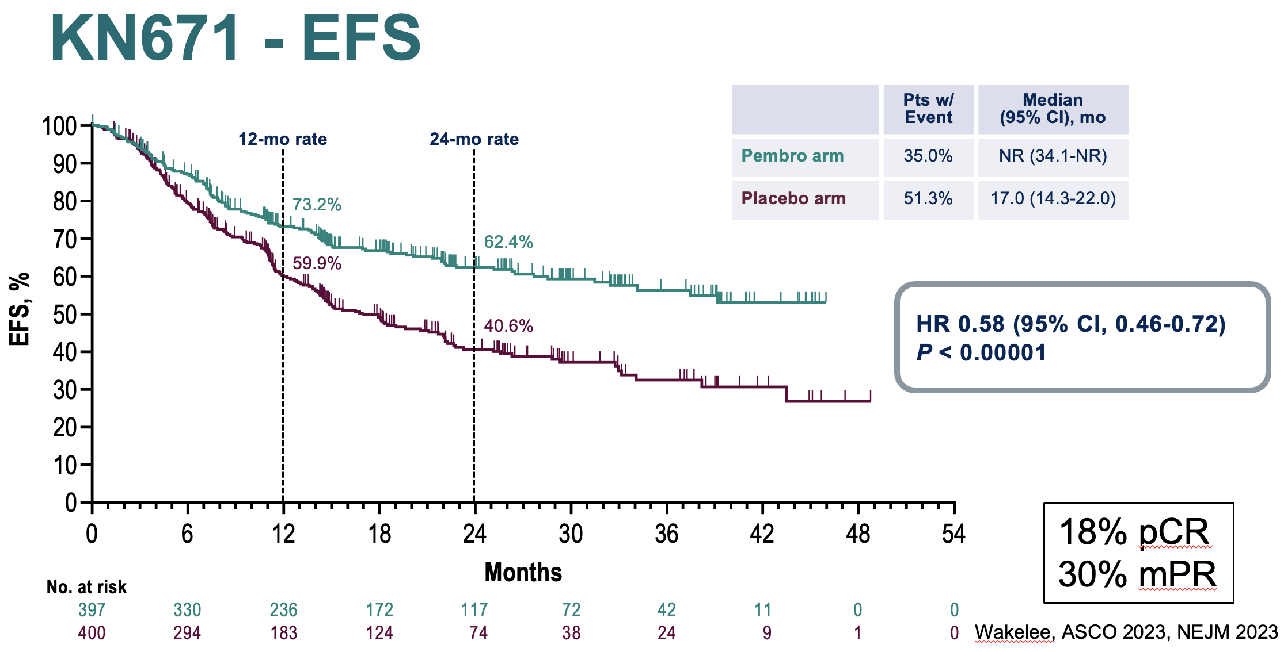
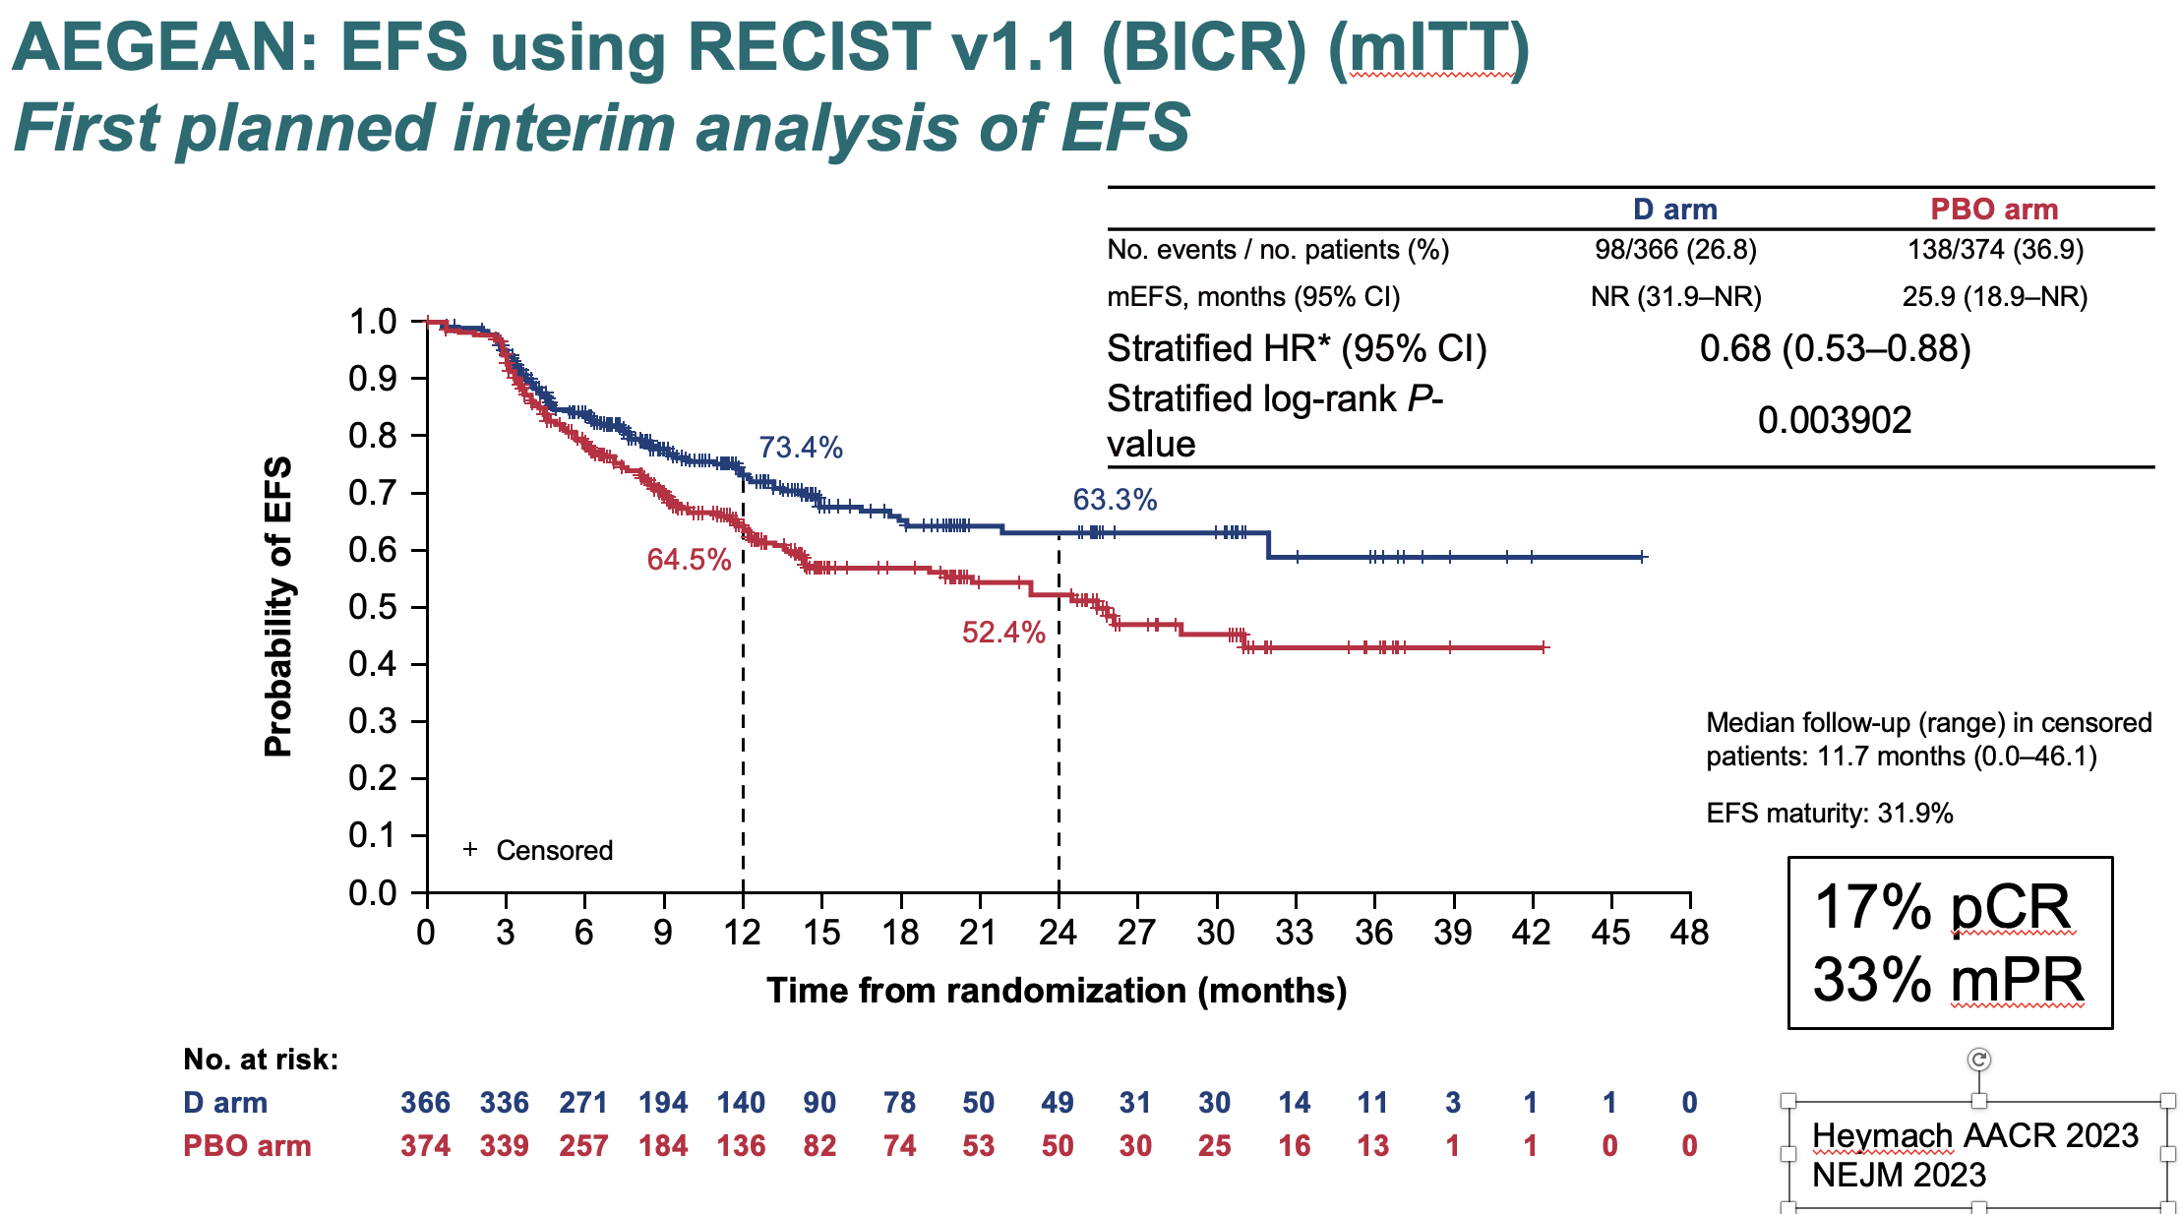
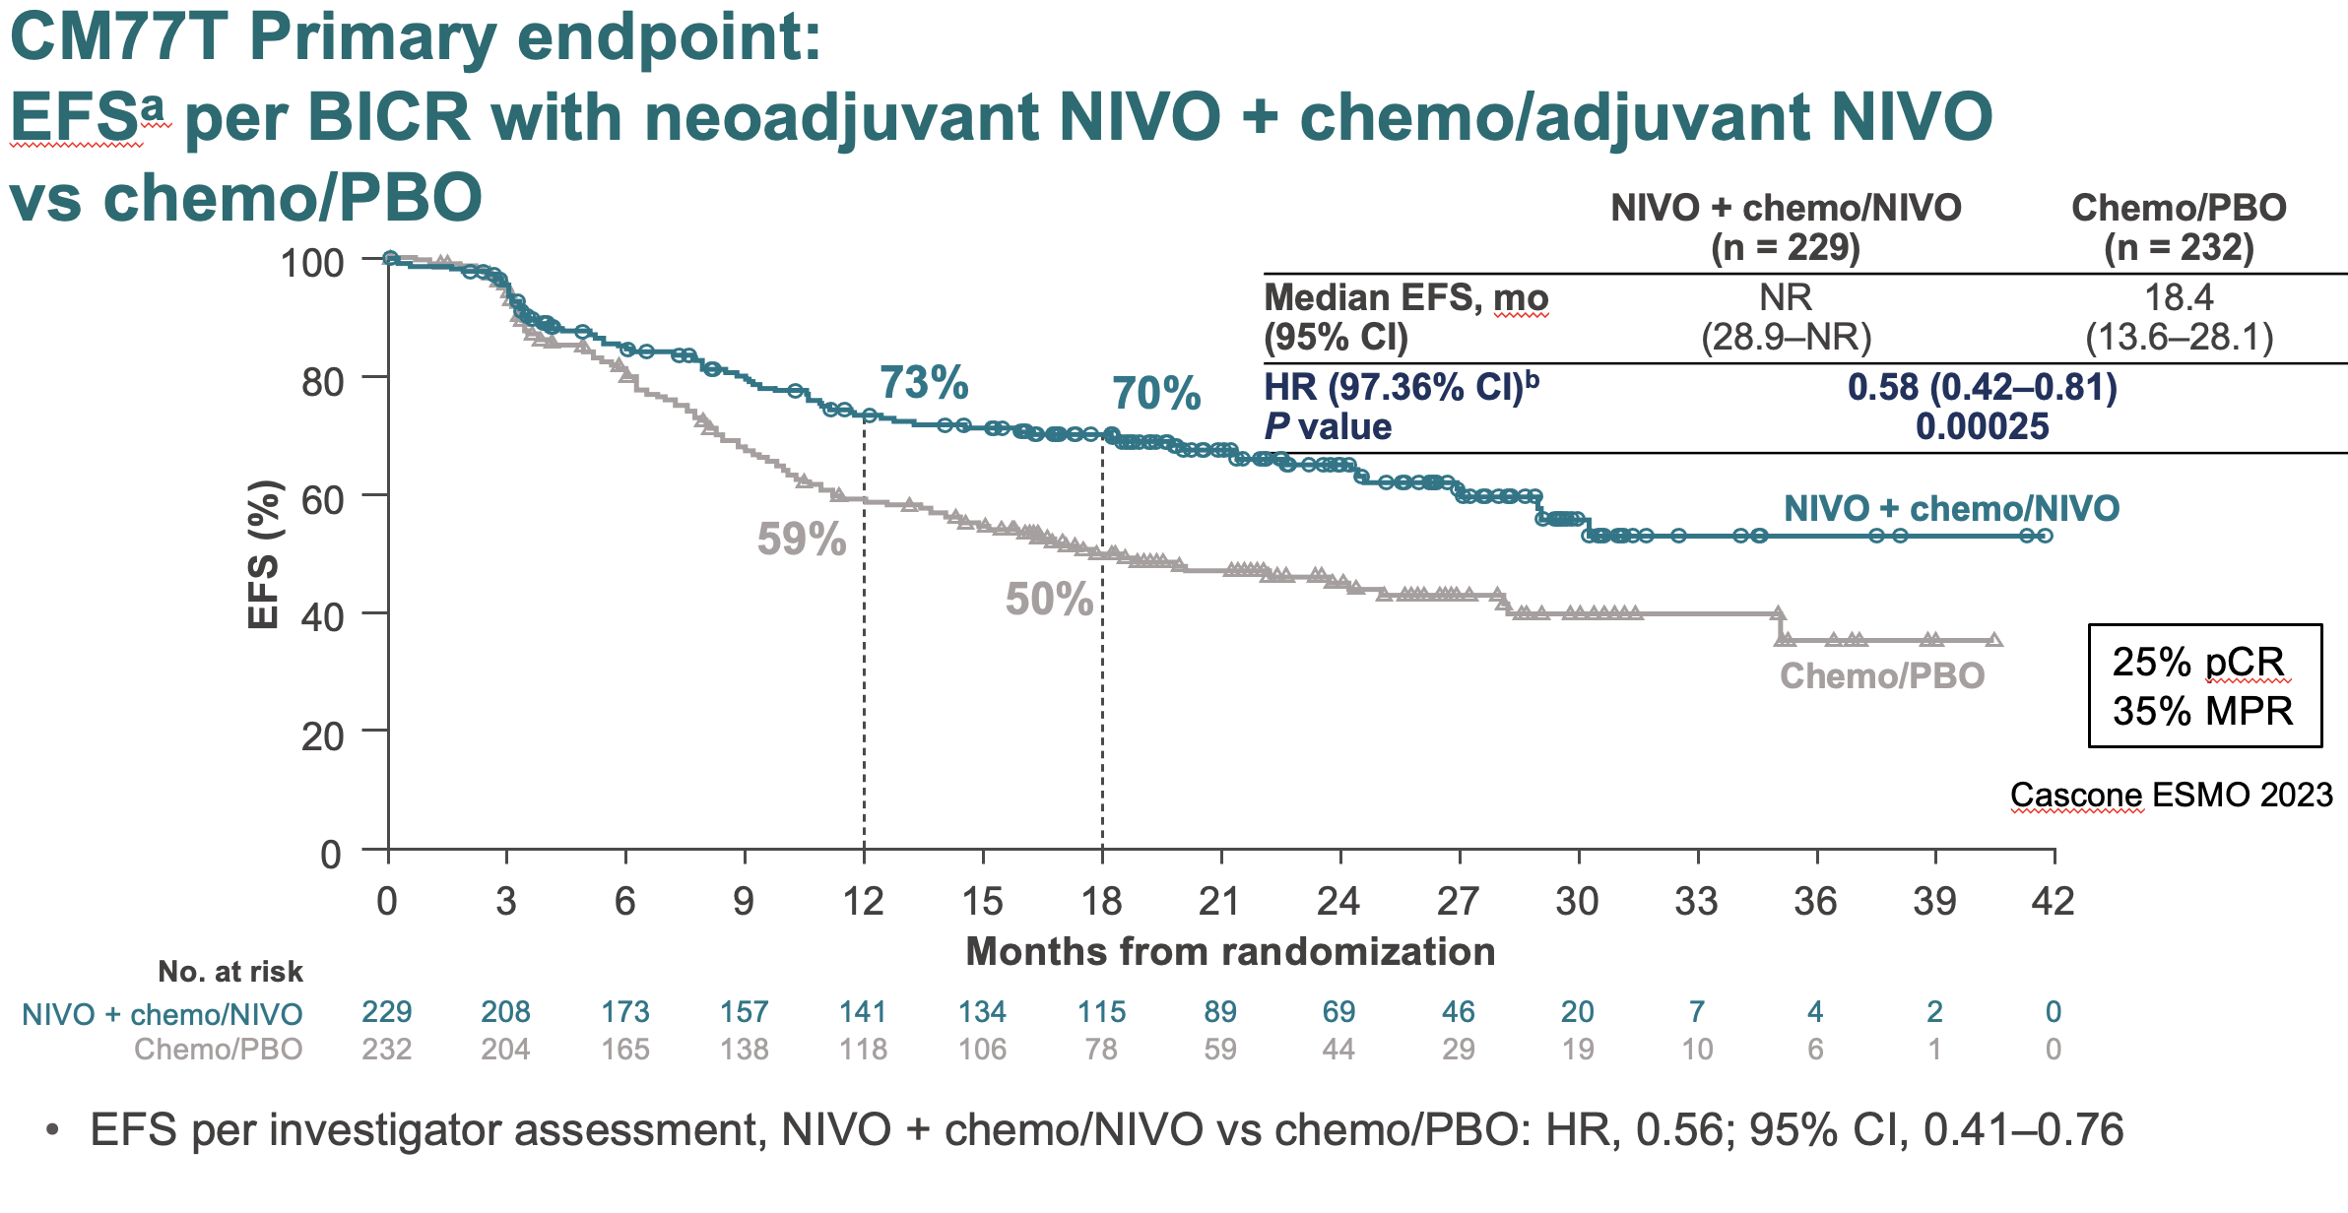
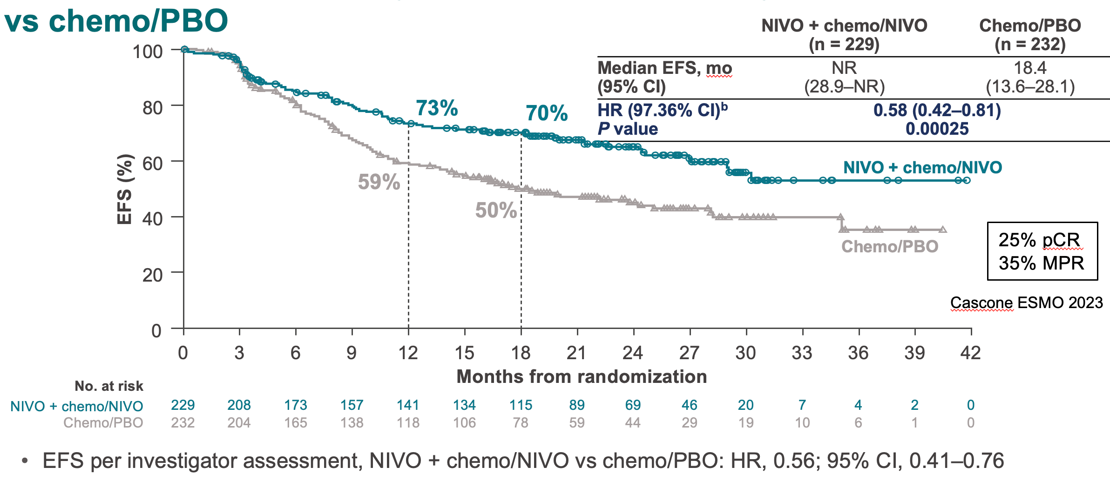
Peri-Operative ICI: EFS From AEGEAN, KN671, and CM77T
Notes:
Slide Notes
Event-free survival in all of these trials has been positive, with hazard ratios around 0.68, 0.7, around that range. Three trials, with similar results.
Heymach JV, Harpole D, Mitsudomi T, et al. AEGEAN: a phase III trial of neoadjuvant durvalumab plus chemotherapy followed by adjuvant durvalumab in resectable non–small cell lung cancer. Cancer Res. 2023;83(8 Suppl):CT005. ​
Heymach JV, Kim AW, Spicer J, et al. Neoadjuvant nivolumab plus chemotherapy improves outcomes in resectable stage II to III non–small cell lung cancer [abstract CT005 data]. N Engl J Med. 2023;389(18):1672-1684. ​
Wakelee HA, Liberman M, Kato T, et al. KEYNOTE‑671: neoadjuvant pembrolizumab plus platinum-based chemotherapy followed by resection and adjuvant pembrolizumab vs chemotherapy alone in early-stage NSCLC. J Clin Oncol. 2023;41(17 Suppl):LBA100.​
Wakelee HA, Liberman M, Kato T, et al. Perioperative pembrolizumab for early-stage non–small-cell lung cancer. N Engl J Med. 2023;389(6):491-503. ​
Cascone T, Awad MM, Spicer JD, et al. CheckMate 77T: phase III study comparing neoadjuvant nivolumab plus chemotherapy followed by adjuvant nivolumab in resectable stage II–IIIb NSCLC. Ann Oncol. 2023;34(Suppl 2):S1295.​

Slide 27
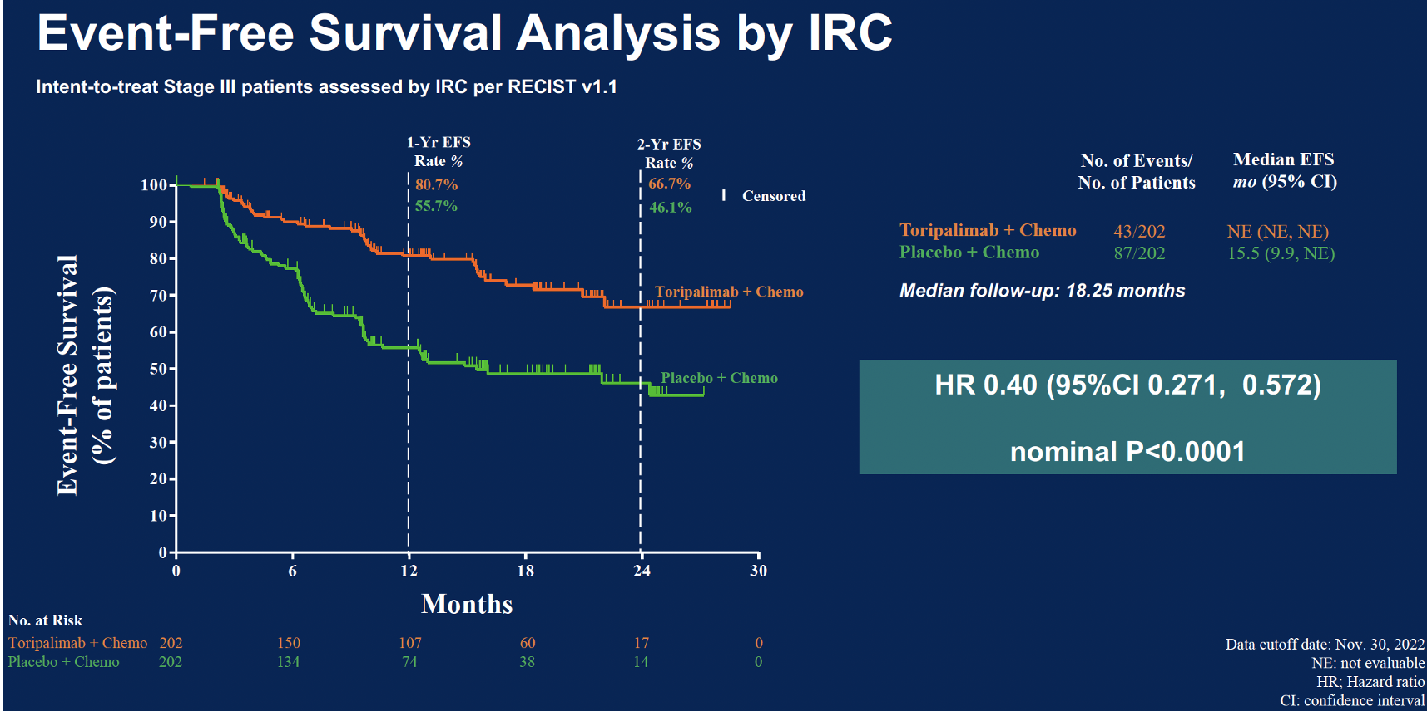
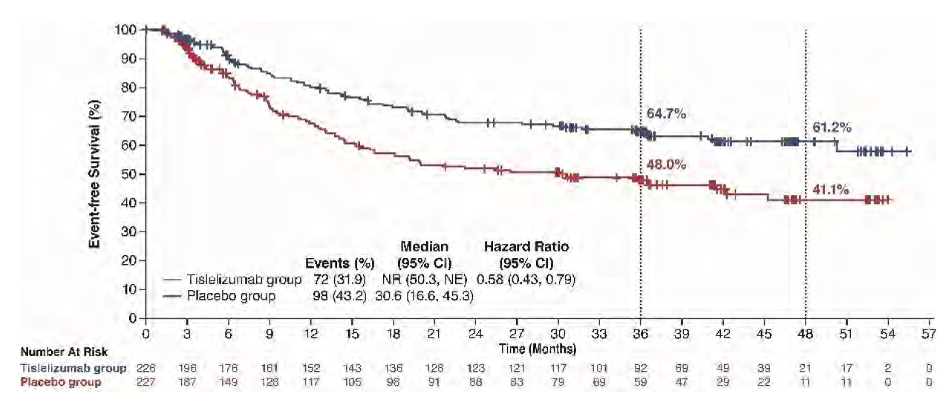
Perioperative ICI:
EFS from NEOTORCH and RATIONALE-315
NEOTORCH
RATIONALE 315 Event-Free Survival
~25% pCR (stage III)
BICR, blinded independent central review; CI, confidence interval; EFS, event-free survival; IRC, independent review committee; ITT, intent-to-treat; NE, not estimable; NR, not reached; PBO, placebo; pCR, pathologic complete response; RECIST, Response Evaluation Criteria in Solid Tumors.​
1. Lu S, et al. J Clin Oncol. 2024;41(36_suppl): 425126. 2. Lu S, et al. JAMA. 2024;331(3):201-211. 3. Yue D, et al. IASCLC WCLC 2025. Abstract MA04.08.
Notes:
Slide Notes
Two more trials that were conducted in Asia. These trials showed very similar results. All positive event-free survival.
Lu S, Wu L, Zhang W, et al. Perioperative toripalimab plus platinum‑doublet chemotherapy versus chemotherapy alone in resectable stage II/III non–small cell lung cancer: interim event‑free survival results from the randomized phase III Neotorch trial. J Clin Oncol. 2024;41(36_suppl):425126.​
Lu S, Zhang W, Wu L, et al. Perioperative toripalimab plus chemotherapy for resectable non–small cell lung cancer. JAMA. 2024;331(3):201‑211. ​
Yue D, Wang W, Liu H, et al. Perioperative tislelizumab for resectable non-small cell lung cancer: final analysis of RATIONALE-315. Abstract presented at: IASLC World Conference on Lung Cancer; Barcelona, Spain; September 6-9, 2025. Abstract MA04.08.

Slide 28
AEGEAN: EFS Using RECIST v1.1 (BICR) by Subgroup (mITT) – PD-L1 Matters
 |  |  | Median EFS, months (95% CI) |  |  | HR (95% CI)
Subgroup |  | n | D arm (N=366) | PBO arm (N=374)
All patients |  | 740 | NR (31.9–NR) | 25.9 (18.9–NR) |  | 0.68 (0.53–0.88)
Age at randomization | <65 years ≥65 years | 358 382 | NR (NR–NR) NR (17.9–NR) | NR (18.9–NR) 24.5 (13.6–31.1) |  | 0.71 (0.47–1.04) 0.69 (0.48–0.97)
Sex | Male Female | 530 210 | NR (31.9–NR) NR (17.5–NR) | 22.9 (14.3–31.1) NR (13.6–NR) |  | 0.61 (0.44–0.82) 0.95 (0.58–1.56)
ECOG PS | 0 1 | 506 234 | NR (31.9–NR) NR (21.8–NR) | 25.4 (14.3–NR) 25.9 (14.3–NR) |  | 0.65 (0.47–0.89) 0.78 (0.49–1.22)
Race* | Asian Non-Asian | 307 433 | NR (NR–NR) 31.9 (21.8–NR) | 25.4 (13.9–NR) 26.2 (14.3–NR) |  | 0.60 (0.40–0.90) 0.76 (0.54–1.06)
Smoking | Current Former Never | 190 443 107 | NR (NR–NR) NR (31.9–NR) NR (NR–NR) | 14.3 (8.1–NR) 25.9 (19.5–NR) 24.5 (14.3–NR) |  | 0.48 (0.28–0.80) 0.79 (0.57–1.10) 0.76 (0.35–1.58)
Histology | Squamous Non-squamous | 360 375 | NR (31.9–NR) NR (NR–NR) | 26.2 (13.0–NR) 25.4 (14.3–NR) |  | 0.71 (0.49–1.03) 0.69 (0.48–0.99)
Disease stage (AJCC 8th ed.) | Stage II Stage IIIA Stage IIIB | 214 338 186 | NR (NR–NR) NR (NR–NR) 31.9 (11.7–NR) | 31.1 (25.4–NR) 19.5 (11.7–NR) 18.9 (11.8–NR) |  | 0.76 (0.43–1.34) 0.57 (0.39–0.83) 0.83 (0.52–1.32)
PD-L1 expression at baseline† | TC <1% TC 1–49% TC ≥50% | 247 277 216 | NR (14.9–NR) NR (31.9–NR) NR (NR–NR) | 20.6 (13.9–NR) 25.4 (12.2–NR) 26.2 (14.3–NR) |  | 0.76 (0.49–1.17) 0.70 (0.46–1.05) 0.60 (0.35–1.01)
Planned neoadjuvant platinum agent | Cisplatin Carboplatin | 196 544 | NR (NR–NR) NR (31.9–NR) | 31.1 (14.3–NR) 25.4 (14.3–NR) |  | 0.59 (0.35–1.00) 0.73 (0.54–0.98)
0.25
0.5
1
2
3
4
AJCC, American Joint Committee on Cancer; BICR, blinded independent central review; CI, confidenceinterval; D, durvalumab; EFS, event-free survival; HR, hazard ratio; mITT, modified intent-to-treat; NR,not reached; PBO, placebo; PS, performance status; TC, tumor cells.​
Heymach JV, et al. N Engl J Med. 2023;389:1672-1684. ​
HR
Favors D
Favors PBO
Notes:
Heymach JV, Mitsudomi T, Harpole D, et al. Neoadjuvant atezolizumab in resectable non–small-cell lung cancer. N Engl J Med. 2023;389(18):1672-1684.​

Slide 29
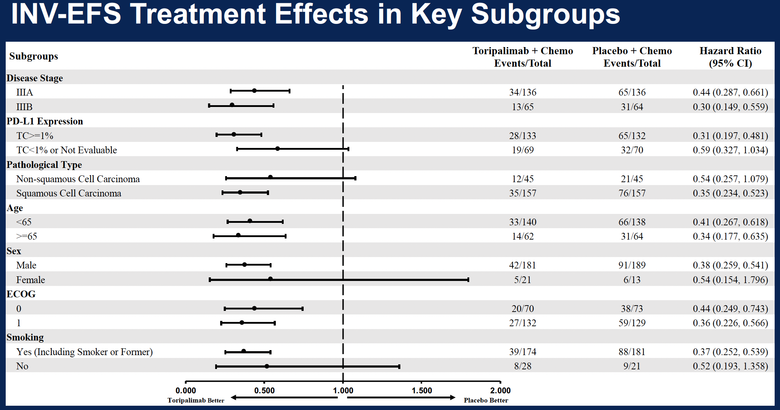
NEOTORCH: PD-L1 Matters
INV-EFS Treatment Effects in Key Subgroups
Notes:
Lu S, Wu L, Zhang W, et al. Perioperative toripalimab plus platinum‑doublet chemotherapy versus chemotherapy alone in resectable stage II/III non–small cell lung cancer: interim event‑free survival results from the randomized phase III Neotorch trial. J Clin Oncol. 2024;41(36_suppl):425126.​
Lu S, Zhang W, Wu L, et al. Perioperative toripalimab plus chemotherapy for resectable non–small cell lung cancer. JAMA. 2024;331(3):201‑211.​

Slide 30
KN671: EFS in Subgroups – PD-L1 Matters
Notes:
Wakelee HA, Liberman M, Kato T, et al. KEYNOTE‑671: neoadjuvant pembrolizumab plus platinum-based chemotherapy followed by resection and adjuvant pembrolizumab vs chemotherapy alone in early-stage NSCLC. J Clin Oncol. 2023;41(17 Suppl):LBA100. ​
Wakelee HA, Liberman M, Kato T, et al. Perioperative pembrolizumab for early-stage non–small-cell lung cancer. N Engl J Med. 2023;389(6):491-503.​

Slide 31
CM77T EFS Subgroup Analysis – PD-L1 Matters
 | Median EFS,ª mo |  | Unstratified HR (95% CI) | Unstratified HR
 | NIVO + chemo/NIVO (n = 229) | Chemo/PBO (n = 232)
Overall (N = 461) | NR | 18.4 |  | 0.59
< 65 years (n = 202) ≥ 65 years (n = 259) | NR NR | 16.7 20.1 |  | 0.55 0.61
Male (n = 327) Female (n = 134) | NR 30.2 | 16.7 18.8 |  | 0.53 0.71
North America (n = 44) Europe (n = 250) Asia (n = 115) | 30.2 NR NR | 9.4 23.7 13.9 |  | 0.59 0.61 0.47
ECOG PS 0 (n = 288) ECOG PS 1 (n = 173) | NR 29.0 | 20.1 17.3 |  | 0.57 0.61
Stage II (n = 162) Stage III (n = 297) | NR 30.2 | NR 13.4 |  | 0.81 0.51
Squamous (n = 234) Non-squamous (n = 227) | NR 28.9 | 17.0 18.4 |  | 0.46 0.72
Current/former smoker (n = 417) Never smoker (n = 44) | NR 19.7 | 17.0 25.0 |  | 0.54 1.32
PD-L1 < 1% (n = 186)^{b} PD-L1 ≥ 1% (n = 256)^{b} | 29.0 NR | 19.8 15.8 |  | 0.73 0.52
PD-L1 1–49% (n = 159)^{b} PD-L1 ≥ 50% (n = 97)^{b} | 30.2 NR | 28.1 8.0 |  | 0.76 0.26
Cisplatin (n = 97) Carboplatin (n = 347) | 27.0 NR | 15.8 17.3 |  | 0.61 0.53
0.125
0.25
0.5
1
2
4
Favors NIVO + chemo/NIVO
Favors chemo/PBO
Notes:
Cascone T, Awad MM, Spicer JD, et al. CheckMate 77T: phase III study comparing neoadjuvant nivolumab plus chemotherapy followed by adjuvant nivolumab in resectable stage II–IIIb NSCLC. Ann Oncol. 2023;34(Suppl 2):S1295. ​

Slide 32
KN671 Overall Survival, IA3
Median Follow-Up: 41.1 (range, 0.4–75.3) Months
Notes:
Slide Notes
KEYNOTE-671 is the only one of these trials that showed definitive overall survival. This is with a shorter follow-up than we needed for the overall survival in the neoadjuvant-only group in CheckMate 816. KN671 demonstrated robust overall survival and a hazard ratio very similar to what we saw in the CheckMate 816.
Majem M, Garassino MC, Zhao G, et al. Perioperative pembrolizumab (pembro) plus neoadjuvant chemotherapy (chemo) in early-stage non-small-cell lung cancer (NSCLC): A 4-year update of KEYNOTE-671. ESMO Immuno-Oncol Technol. 2024;24(5):LBA3.

Slide 33
KN671 Overall Survival in Subgroups, IA2
Notes:
Majem M, Tarruella M, Tiseo M, et al. LBA3: Perioperative pembrolizumab plus chemotherapy in resectable NSCLC—ESMO Immuno‑Oncology 2024. ESMO Immuno‑Oncology and Technology. 2024;24(5_suppl):LBA3.​
​

Slide 34
KN671: 4-Year Outcomes by Nodal Status
Measure | Node Negative (cN0) |  | Node Positive (cN1/cN2)
 | Pembrolizumab n = 148 | Placebo n = 142 | Pembrolizumab n = 148 | Placebo n = 142
mEFS, mo (95% CI) | 69.1 (37.5-NR) | 19.6 (14.3-25.8) | 47.6 (27.7-68.9) | 17.9 (14.0-22.2)
HR (95% CI) | 0.56 (0.40-0.77) |  | 0.57 (0.45-0.72)
mOS, mo (95% CI) | NR (NR-NR) | NR (47.6-NR) | NR (63.7-NR) | NR (45.7-NR)
HR (95% CI) | 0.70 (0.47-1.04) |  | 0.77 (0.58-1.01)
mPR, % (95% CI) | 33.1 (25.6-41.3) | 10.6 (6.0-16.8) | 28.2 (22.7-34.4) | 11.2 (7.7-15.7)
Difference (95% CI) | 22.5 (13.3-13.7) |  | 17.0 (10.2-23.9)
pCR, % (95% CI) | 20.3 (14.1-27.7) | 4.9 (2.0-9.9) | 16.5 (12.1-21.8) | 3.5 (1.6-6.5)
Difference (95% CI) | 15.3 (8.1-23.1) |  | 13.0 (8.1-18.5)
Notes:
Wakelee H, Demedts I, Langleben A, et al. Perioperative pembrolizumab in non-small cell cancer (NSCLC): 4-year outcomes by nodal status in the KEYNOTE-671 study. Abstract presented at: IASLC World Conference on Lung Cancer; Barcelona, Spain; September 6-9, 2025. Abstract MA04.0.4.

Slide 35
Peri-Operative ICI
5 trials with consistent EFS benefit
OS proven in KN671
PD-L1—very important in all trials
Driver mutations—excluded or ? benefit
Stage—benefit across stages
pCR/MPR/MRD—very relevant
However, increased toxicity risk (more therapy), increased costs (more therapy), and 20% risk no surgery
EFS, event-free survival; ICI, immune checkpoint inhibitor; KN671, KEYNOTE-671; MPR, major pathologic response; MRD, minimal residual disease; OS, overall survival; pCR, pathologic complete response; PD-L1, programmed death-ligand 1.
Notes:
Slide Notes
We have 5 trials in the perioperative setting that showed consistent event-free survival benefit. Overall survival was proven in KEYNOTE-671. PD-L1 was very important in all of the trials. Driver mutations were excluded, but benefit was not really seen, even when they were included. There was benefit across disease stages. Pathologic CR, MPR, and MRD were all important. But more therapy, more toxicity, increased costs because of more therapy, and 20% of patients do not continue on to surgery.

Slide 36
Neoadjuvant Risk of NO surgery
16-22% NO surgery
Trial | Stages | % Completing Surgery
CM816 | 6% IB, 31% II, 63% III | 84%
AEGEAN | 29% II, 71% III | 78%
NEOTORCH | Only III presented | 82%
KN671 | 30% II, 70% III | 82%
CM77T | 35% II, 65% III | 78%
RATIONALE-315 | 41% II, 58% III | 84%
Notes:
Slide Notes
In each of these trials, pure adjuvant or perioperative, about 20% of patients do not go to surgery. And this reinforces: Whatever you do first, you get. Whatever you do second, you probably will get.

Slide 37
Key Questions
How do we decide whether to proceed with neoadjuvant, adjuvant or perioperative?
Multidisciplinary tumor board critical!
Ideally each case discussed by med onc, rad onc and thoracic surgery, with radiology and pathology present, BEFORE any intervention
If no mechanism exists to bring everyone together at one time, then other communication with input from all disciplines remains critical
Clear advantages of neoadjuvant/ perioperative approaches AND there are some patients where surgery first is the correct plan (ie, some Stage II); whatever intervention is done first will happen, whatever comes next has 20% chance of not happening
Must know PD-L1 status and tumor mutation status (at least EGFR/ALK)
EFS, event-free survival; ICI, immune checkpoint inhibitor; KN671, KEYNOTE-671; MPR, major pathologic response; MRD, minimal residual disease; OS, overall survival; pCR, pathologic complete response; PD-L1, programmed death-ligand 1.
Notes:
Slide Notes
Here are some key questions. How do we decide whether to go with neoadjuvant, adjuvant, or perioperative? Well, we need multidisciplinary tumor board discussions. Everybody should have their case discussed by Med-Onc, Rad-Onc, and thoracic surgery with radiology and pathology weighing in, and pulmonary, before you do anything. If you can't, if you don't have the mechanism to do that, you want to at least have everybody kind of weighing in through e-mail or some other discussion. Again, all HIPAA compliant, of course. And then there's some clear advantages to neoadjuvant and perioperative, like we talked about before. Getting that immune checkpoint inhibitor in early, so you get those most robust responses. But keeping in mind, if you go with surgery first, you definitely get surgery. That's the right plan for some patients. And if you start with surgery, some patients aren't going to get that immune checkpoint inhibitor, which is really important, especially if they have high PD-L1 expression. And we've got to know the PD-L1 expression and you've got to know at least EGFR and ALK before making your decisions.

Slide 38
Key Questions
What about IrAE management?
How do IrAEs impact surgery?
irAE, immune-related adverse event.

Slide 39
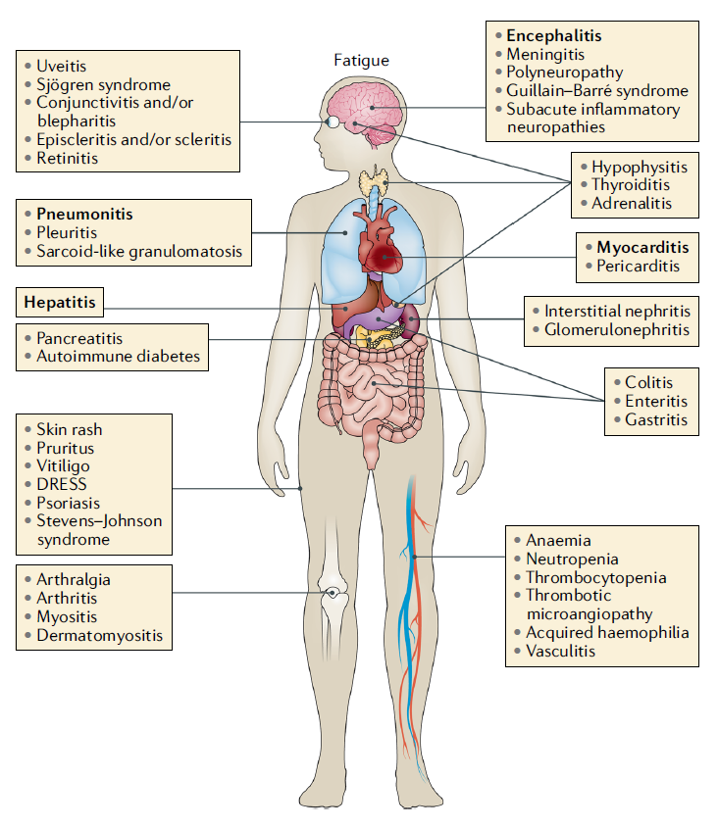
Immune-Related Adverse Events by Site
Notes:
Slide Notes
So what about immune-related adverse events in management? How do those impact surgery? An immune-related adverse event can happen to any organ, and it can happen at any time. We're specifically, really seeing a lot with endocrine though. Thyroid, pituitary, seeing a lot of skin issues, potentially diarrhea.
Martins F, Sofiya L, Sykiotis GP, et al. Adverse effects of immune-checkpoint inhibitors: epidemiology, management and surveillance. Nat Rev Clin Oncol. 2019;16(9):563-580. ​

Slide 40
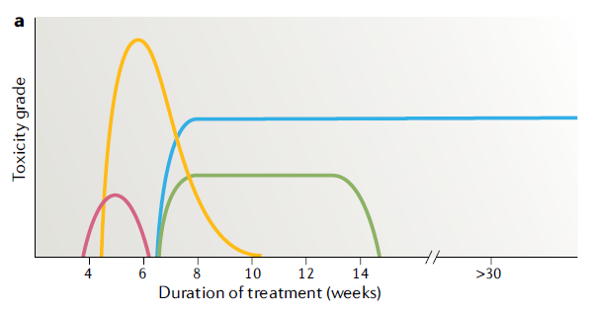
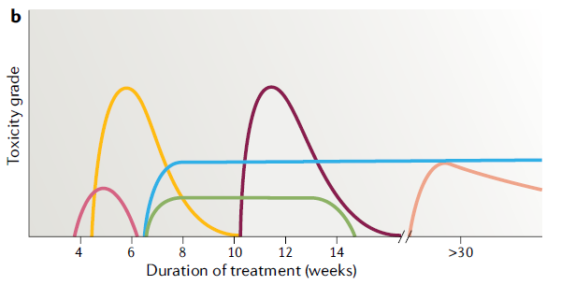
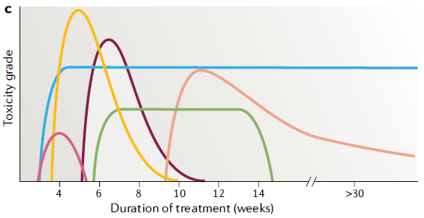
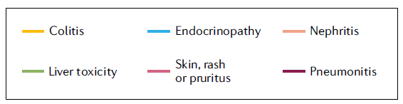
Immune-Related Adverse Events
Ipilimumab (Anti-CTLA-4)
Anti-PD-1 or Anti-PD-L1
Anti-CTLA-4 + Anti-PD-(L)1
Notes:
Martins F, Sofiya L, Sykiotis GP, et al. Adverse effects of immune-checkpoint inhibitors: epidemiology, management and surveillance. Nat Rev Clin Oncol. 2019;16(9):563-580. ​

Slide 41
CM816 Safety Summary
Patients, n (%) | NIVO + chemo (n = 176) |  | Chemo (n = 176)
 | Any grade | Grade 3–4 | Any grade | Grade 3–4
All AEs | 165 (94) | 76 (43) | 173 (98) | 79 (45)
TRAEs | 147 (84) | 63 (36) | 159 (90) | 67 (38)
All AEs leading to discontinuation | 18 (10) | 10 (6) | 20 (11) | 7 (4)
TRAEs leading to discontinuation | 18 (10) | 10 (6) | 17 (10) | 6 (3)
All SAEs | 30 (17) | 19 (11) | 24 (14) | 17 (10)
Treatment-related SAEs | 21 (12) | 15 (8) | 18 (10) | 14 (8)
Surgery-related AEs | 67 (45) | 17 (11) | 66 (49) | 20 (15)
Treatment-related deaths | 0 |  | 3 (2)
  Grade 5 surgery-related AEs occurred in 2 patients in the NIVO + chemo arm (1 each due to pulmonary embolism and aortic rupture); both were unrelated to study drug
Notes:
Forde PM, et al. Overall survival with neoadjuvant nivolumab + chemotherapy in patients with resectable NSCLC in CheckMate 816. J Clin Oncol. 2025;43(suppl 17):LBA8000.​
Forde PM, Spicer JD, Provencio M, et al. Overall survival with neoadjuvant nivolumab plus chemotherapy in lung cancer. N Engl J Med. Published online June 2, 2025.​ doi:10.1056/NEJMoa2502931
​
​

Slide 42
IMpower010: Immune-Mediated AEs
imAEs occuring in ≥1% of patients
imAEs occuring in <1% of patients
 | Atezolizumab (n=495) |  | BSC (n=495)
n (%) | Any grade | Grade 3-4 | Any grade | Grade 3-4
Any immune-mediated AEs | 256 (51.7)^{b} | 39 (7.9%) | 47 (9.5) | 5 (0.6)
Rash | 91 (18.4) | 7 (1.4) | 11 (2.2) | 0
Hepatitis (diagnosis and laboratory abnormalities) | 86 (17.4) | 20 (4.0) | 22 (4.4) | 1 (0.2)
Hepatitis (laboratory abnormalities) | 81 (16.4) | 16 (3.2) | 21 (4.2) | 1 (0.2)
Hepatitis (diagnosis) | 7 (1.4) | 4 (0.8) | 1 (0.2) | 0
Hypothyroidism | 86 (17.4) | 0 | 3 (0.6) | 0
Hyperthyroidism | 32 (6.5) | 2 (0.4) | 4 (0.8) | 0
Pneumonitis | 19 (3.8)^{c} | 4 (0.8) | 3 (0.6) | 0
Infusion-related reaction | 7 (1.4) | 1 (0.2) | 0 | 0
Adrenal insufficiency | 6 (1.2) | 2 (0.4) | 0 | 0
 | Atezolizumab (n=495) |  | BSC (n=495)
n (%) | Any Grade | Grade 3-4 | Any grade | Grade 3-4
Meningoencephalitis | 4 (0.8) | 3 (0.6) | 0 | 0
Colitis | 4 (0.8) | 2 (0.4) | 1 (0.2) | 0
Diabetes mellitus | 4 (0.8) | 0 | 1 (0.2) | 0
Myositis (myositis and rhabdomyolysis) | 4 (0.8) | 0 | 1 (0.2) | 0
Pancreatitis | 2 (0.4) | 1 (0.2) | 1 (0.2) | 1 (0.2)
Encephalitis | 2 (0.4) | 2 (0.4) | 0 | 0
Severe cutaneous adverse reaction | 2 (0.4) | 0 | 0 | 0
Autoimmune hemolytic anemia | 2 (0.4) | 0 | 0 | 0
Myocarditis | 2 (0.4)^{c} | 0 | 0 | 0
Meningitis | 2 (0.4) | 1 (0.2) | 0 | 0
Guillain-Barre syndrome | 1 (0.2) | 1 (0.2) | 0 | 0
Ocular inflammatory toxicity | 1 (0.2) | 0 | 1 (0.2) | 1 (0.2)
Hypophysitis | 1 (0.2) | 0 | 0 | 0
Nephritis | 1 (0.2) | 0 | 0 | 0
Vasculitis | 0 | 0 | 1 (0.2) | 1 (0.2)
Clinical cutoff: January 21, 2021. ª Data are from the safety population (all randomized patients who received ≥1 atezolizumab dose or for BSC, had ≥1 post-baseline assessment). ^{b} Includes 2 (0.4%) Grade 5 events. ^{c} Includes 1 (0.2%) Grade 5 event.
Notes:
Wakelee HA, Altorki NK, Zhou C, et al. IMpower010: primary results of a phase III global study of adjuvant atezolizumab versus best supportive care following adjuvant chemotherapy in resected stage IB‑IIIA non–small cell lung cancer. J Clin Oncol. 2021;39(15_suppl):8500.​
​

Slide 43
Immune-Related Adverse Events Management
Hold ICI
High suspicion for irAEs in patients on checkpoint inhibitors
Consider other diagnoses (infection, cancer progression, etc.)
Immunosuppression (usually 1-2 mg/kg prednisone or equivalent for grade 3+ irAE)
If steroid responsive, usually need to keep on steroids for 4-6 weeks
ICI, immune checkpoint inhibitor; irAE, immune-related adverse event.
Notes:
Slide Notes
Management of immune-related adverse-events begins with holding the immune checkpoint inhibitor. You want to have a very high suspicion for irAEs in patients receiving ICI therapy. You want to make sure your patients know if they end up in a different emergency room, to mention that they're on that drug. You got to think about other things that can mimic that. And then, usually it's immunosuppression with steroids.

Slide 44
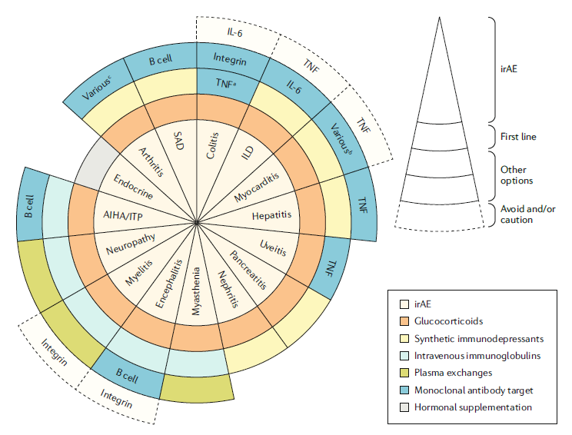
Immune-Related Adverse Events Management
AE, adverse event; AIHA, autoimmune hemolytic anemia; IL-6, interleukin-6; ILD, interstitial lung disease; irAE, immune-related adverse event; ITP, immune thrombocytopenia; SAD, severe adverse drug reaction; TNF, tumor necrosis factor.
Ramos-Casals M, et al. Nat Rev Dis Primers. 2020;6(1):38.
Notes:
Ramos-Casals M, Brahmer JR, Callahan MK, et al. Immune-related adverse events of checkpoint inhibitors. Nat Rev Dis Primers. 2020;6(1):38.

Slide 45
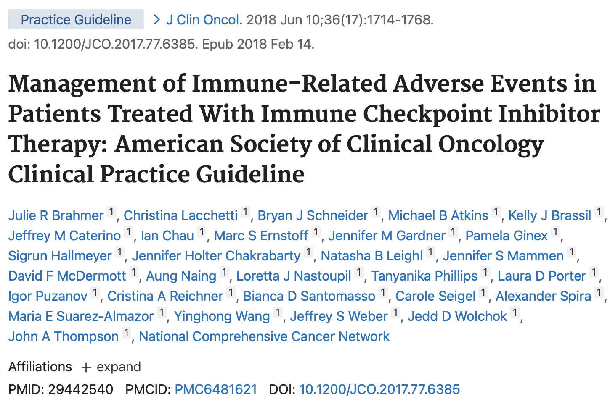
Notes:
Slide Notes
This paper from 2018 still provides good guidance on the management of irAEs in patients receiving ICI therapy.
Brahmer JR, Lacchetti C, Schneider BJ, et al. Management of immune‑related adverse events in patients treated with immune checkpoint inhibitor therapy: American Society of Clinical Oncology clinical practice guideline. J Clin Oncol. 2018;36(17):1714‑1768.​

Slide 46
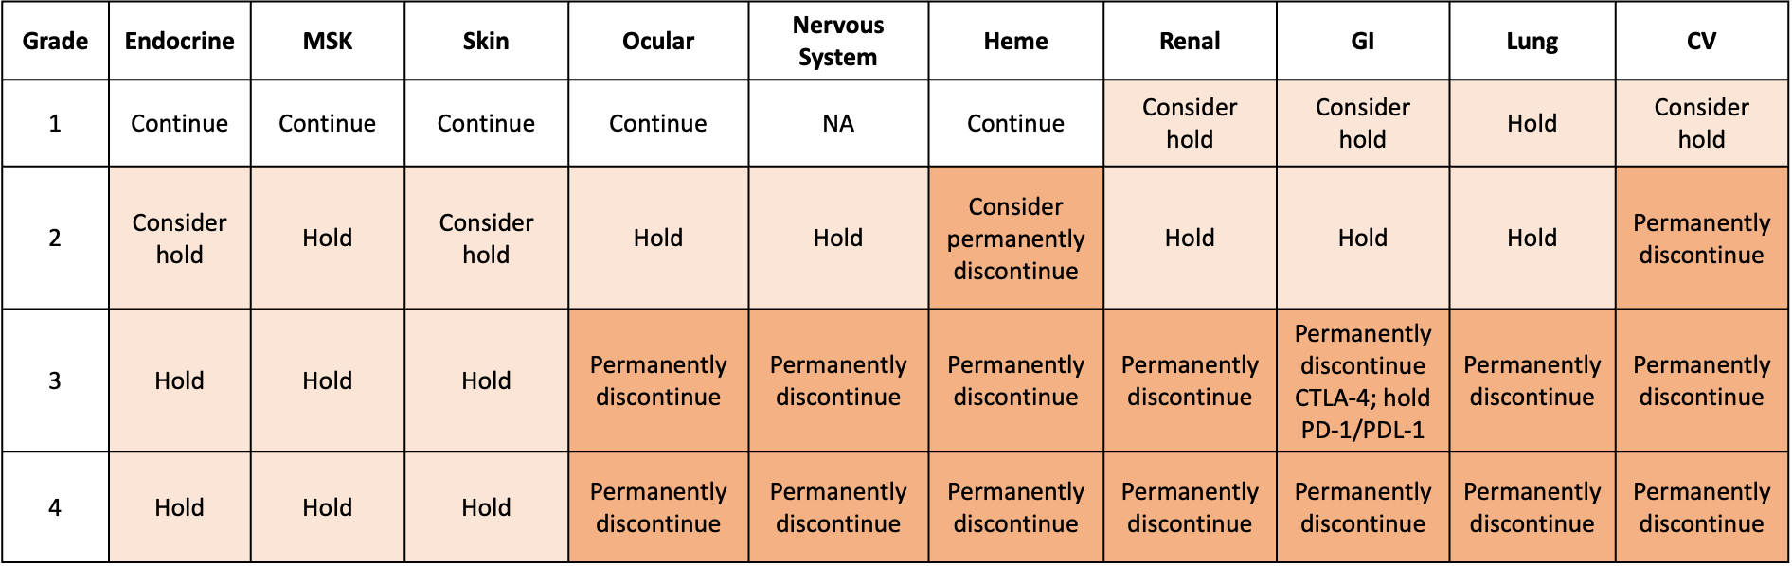
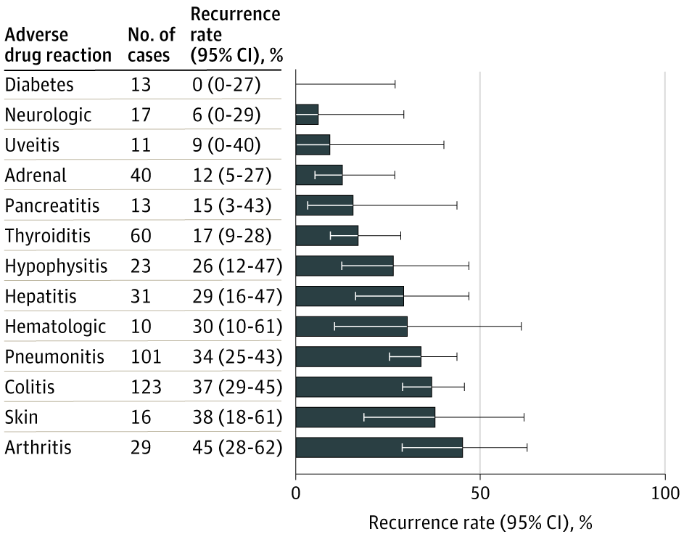
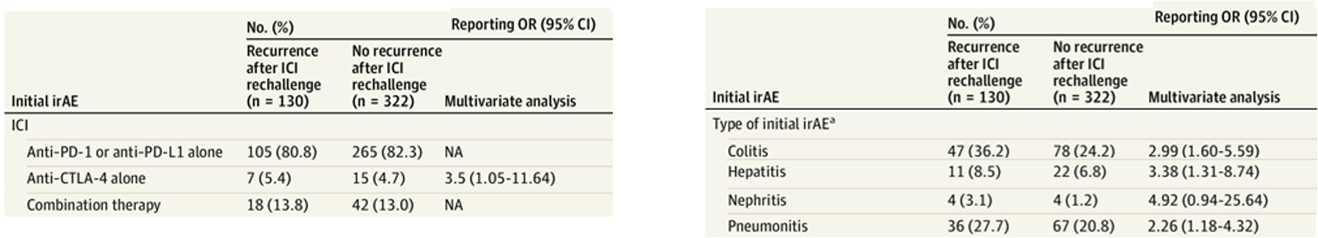
Decision to Resume Immune Checkpoint Inhibitor After an Immune Event
Rate of recurrence according to initial event
ASCO 2018 Guidelines: When to permanently discontinue ICI
Factors associated with recurrence of the same immune-related adverse event
Notes:
Slide Notes
The top left figure is adapted from the 2018 ASCO guidelines on management of immune-related adverse events​
-The recommendations are based on organ involvement and grade of event​
-For this patient with a grade 3 GI event, the guidelines suggest to permanently discontinue the anti-CTLA-4 agent and can consider resuming the anti-PD(L)1 agent​
​
The panel on the top right and bottom is from a large observational study of 24,000 immune related adverse events. ​
-The figure on the top right shows the rate of recurrence according to the initial event. Rate of recurrence was most frequent in skin and arthritis​
-The table on the bottom shows which factors are associated with recurrence of the same immune related adverse event. This occurred most frequently with anti-CTLA-4 therapy alone and if the event was nephritis ​
Brahmer JR, Lacchetti C, Schneider BJ, et al. Management of immune‑related adverse events in patients treated with immune checkpoint inhibitor therapy: American Society of Clinical Oncology clinical practice guideline. J Clin Oncol. 2018;36(17):1714‑1768.​
Dolladille C, Ederhy S, Sassier M, et al. Immune checkpoint inhibitor rechallenge after immune‑related adverse events in patients with cancer. JAMA Oncol. 2020;6(6):865‑871.​
​
​
​

Slide 47
Immune-Related Adverse Events Summary
irAEs are common​
irAEs can manifest in ANY organ​
New symptom on IO…assume irAE​
Steroids and stopping drug(s) are the first step​
Other immune modulation may be needed​
Work with subspecialists​
irAE tumor boards are very helpful!​
IO, immuno-oncology; irAE, immune-related adverse event.

Slide 48
Key Questions
What does the adjuvant ICI component add to neoadjuvant?
What is the optimal duration of ICI therapy?
How does ctDNA analysis help?
What are future steps?
ctDNA, circulating tumor DNA; ICI, immune checkpoint inhibitor.

Slide 49
Key Questions
What does the adjuvant ICI component add to neoadjuvant?
What is the optimal duration of ICI therapy?
How does ctDNA analysis help?
What are future steps?
ctDNA, circulating tumor DNA; ICI, immune checkpoint inhibitor.

Slide 50
Perioperative vs Neoadjuvant Nivolumab for Resectable NSCLC: Patient-Level Data Analysis of CheckMate 77T vs CheckMate 816
Methods: Perioperative NIVO vs Neoadjuvant NIVO + chemo
Surgery
Analysis patient populations
Neoadjuvant NIVO + chemo
(3 cycles)
Patients who had surgery
CheckMate 816¹
Neoadjuvant NIVO + chemo
(up to 4 cycles)
Patients who had surgery and
received ≥ 1 dose of adjuvant NIVO
CheckMate 77T²
Endpoint
EFS (BICR) landmarked from time of surgery
In lieu of a head-to-head trial, exploratory propensity score weighting analyses (ATTa and ATEb) were performed to allow simplified reproduction of a randomized trial by adjusting for clinically relevant baseline demographics and disease characteristicsc between study populations and reducing the confounding effects of these factors
  Subgroup analyses were not weighted due to smaller sample sizes
Median duration of follow-upd: 29.5 months (CheckMate 816) and 33.3 months (CheckMate 77T)
Notes:
Forde PM, Peters S, Donington J, et al. Perioperative vs neoadjuvant nivolumab for resectable non–small cell lung cancer: patient‑level data analysis of CheckMate 77T vs CheckMate 816. Abstract presented at: World Conference on Lung Cancer; San Diego, California; September 7‑10, 2024. Abstract PL02.08.​

Slide 51
Landmark EFS (BICR) From Definitive Surgery
(+1 Cycle Adj on CM77T)
 | Weighted (ATE)^{b}
 | Periop NIVOª (n = 139.4^{c}) | Neoadj NIVO + chemo (n = 147.5^{c})
HR (95% CI) | 0.61 (0.39–0.97) | 0.97 (0.83–1.15)
HR (95% CI): ATT weighted analysis, 0.56 (0.35–0.90); unweighted analysis, 0.59 (0.38–0.92)
ATE, average treatment effect; ATT, average treatment effect in treated; BICR, blinded independent central review; CI, confidence interval; EFS, event-free survival; HR, hazard ratio; NIVO, nivolumab.
Forde PM, et al. WCLC 2024. Abstract PL02.08.​
Notes:
Forde PM, Peters S, Donington J, et al. Perioperative vs neoadjuvant nivolumab for resectable non–small cell lung cancer: patient‑level data analysis of CheckMate 77T vs CheckMate 816. Abstract presented at: World Conference on Lung Cancer; San Diego, California; September 7‑10, 2024. Abstract PL02.08.​

Slide 52
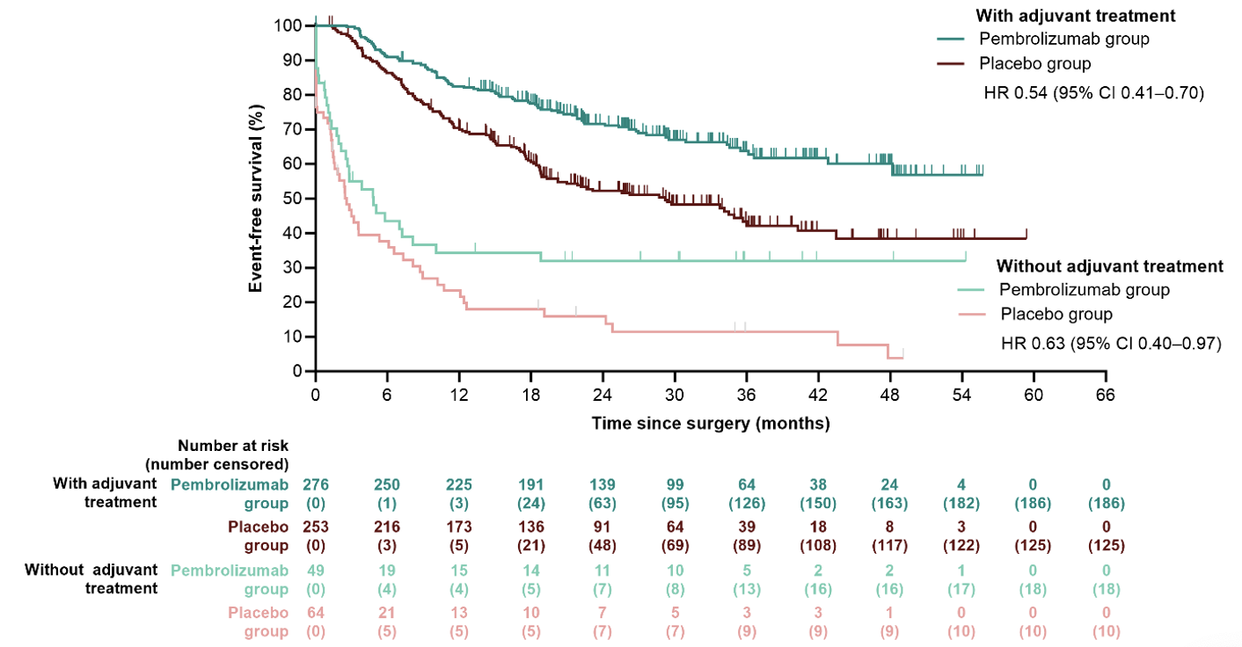
KN671—Comparing Those Who Did or Did Not Get Adj Therapy, Those Who Did Not Did Poorly Postoperatively
KN671 – subgroups
Garassino ESMO2024
Beware the patients who do not get adjuvant therapy – small numbers but poor outcomes
These are Excluded from 77T subset but NOT from 816 subset
EXAMPLE KN671: EFS in patients who did or did not receive adjuvant therapy
Benefit Seen Regardless of ADJ Therapy
15% on Pembro arm
20% on Placebo arm
Who had surgery Did NOT get ADJ
Notes:
Forde PM, Peters S, Donington J, et al. Perioperative vs neoadjuvant nivolumab for resectable non–small cell lung cancer: patient‑level data analysis of CheckMate 77T vs CheckMate 816. Abstract presented at: World Conference on Lung Cancer; San Diego, California; September 7‑10, 2024. Abstract PL02.08.​

Slide 53
Patient-Reported Outcomes With Perioperative Nivolumab by Nodal Status in CheckMate 77T
Exploratory analysis of HRQoL by nodal status using NSCLC-SAQ and EQ-5D-3L VAS
Findings showed that patients with stage III N2 disease had a lower risk of HRQoL deterioration and delayed TTDD with nivolumab vs placebo
  This included patients with simple lobectomy or complete resection based on NSCLC-SAQ total scores (HR, 0.45; 95% CI, 0.26-0.79) and EQ-5D-3L VAS (HR, 0.53; 95% CI, 0.31-0.92)
Notes:
Spicer JD, Provencio Pulla M, Cascone T, et al. Patient-reported outcomes with perioperative nivolumab by nodal status in patients with resectable NSCLC from CheckMate 77T. Abstract presented at: IASLC World Conference on Lung Cancer; Barcelona, Spain; September 6-9, 2025. Abstract MA04.05.

Slide 54


Adjuvant After Neoadjuvant Adds Financial Toxicities
Neoadjuvant
3-4 cycles
$
Perioperative
3-4 cycles
13 cycles
$$$
Excluding blood work, admissions for toxicity, visits etc
Slide courtesy of Marina Chiara Garassino, MD.

Slide 55
More Treatment = More Toxicity
Martin F, et al. Nat Rev Clin Oncol. 2019;16(9):563-580.
Notes:
Martins F, Sofiya L, Sykiotis GP, et al. Adverse effects of immune-checkpoint inhibitors: epidemiology, management and surveillance. Nat Rev Clin Oncol. 2019;16(9):563-580. ​
​

Slide 56
Key Questions
What does the adjuvant ici component add to neoadjuvant?
What is the optimal duration of ICI therapy?
How does ctDNA analysis help?
What are future steps?

Slide 57
Adjuvant ICI—Driver Mutation Negative
Impower010, KN091, BR.31
Perioperative ICI—Neoadjuvant + Adjuvant
Driver Mutation Negative
AEGEAN; NEOTORCH; KN671; CM77T; RATIONALE-315
Every Trial Arbitrarily Used 1
Year of Adjuvant Therapy

Slide 58
IO Course Lengths in NSCLC Regimens
(Per Design of Major Phase 3 RCTs)
Indefinite
Notes:
Sequist LS, Wakelee HA, Spicer J, et al. Sprint versus marathon‑style durations of immunotherapy in resectable non–small cell lung cancer: transcript from the 2024 ASCO debate session. Abstract presented at: American Society of Clinical Oncology (ASCO) Annual Meeting; Chicago, Illinois; June 2-5, 2024. Abstract LB4500.​

Slide 59

How Long of a Course for Stage IV NSCLC?
In Support of a Shorter Course (2y)
Good 5y OS w/ 2y course across RCTs
Logical to stop if immune primed
Limit financial toxicity
Limit biologic toxicity
In Support of a Longer Course
Fear of stopping; fear of progression
CM153 supports longer duration (> 1yr)
Rechallenge does not always work
15-20% 5 yr OS
regardless of duration of ICI in metastatic NSCLC
Notes:
Sequist LS, Wakelee HA, Spicer J, et al. Sprint versus marathon‑style durations of immunotherapy in resectable non–small cell lung cancer: transcript from the 2024 ASCO debate session. Abstract presented at: American Society of Clinical Oncology (ASCO) Annual Meeting; Chicago, Illinois; June 2-5, 2024. Abstract LB4500.​

Slide 60
Metastatic Checkmate 153: PFS From Randomization
 | Median, months (95% CI) | PFS rate, %
 |  | 6-month | 1-year
Continuous tx | NR (NR) | 80 | 65
1-year tx^{b} | 10.3 (6.4, 15.2) | 69 | 40
PFS HR: 0.42 (95% CI: 0.25, 0.71)
100
80
OS HR: 0.63
(95% CI: 0.33, 1.20)
60
PFS (%)
40
1 yr Tx had more patients with squamous histology and fewer with PR/CR at time of randomization
20
0
0
3
6
9
12
15
18
21
24
Time post-randomization (months)
No. at risk
No. at risk
Continuous tx
76
60
53
49
35
22
10
3
0
Continuous tx
76
60
53
49
35
22
10
3
0
1-year tx
87
50
43
33
21
16
5
1
0
1-year tx
87
50
43
33
21
16
5
1
0
Notes:
Spigel DR, McLeod M, Hussein M, et al. Randomized results of fixed-duration (1-year) versus continuous nivolumab in previously treated advanced non–small cell lung cancer: CheckMate 153. Abstract presented at: ESMO Congress; Madrid, Spain; September 8–12, 2017. Abstract 1297O.​

Slide 61
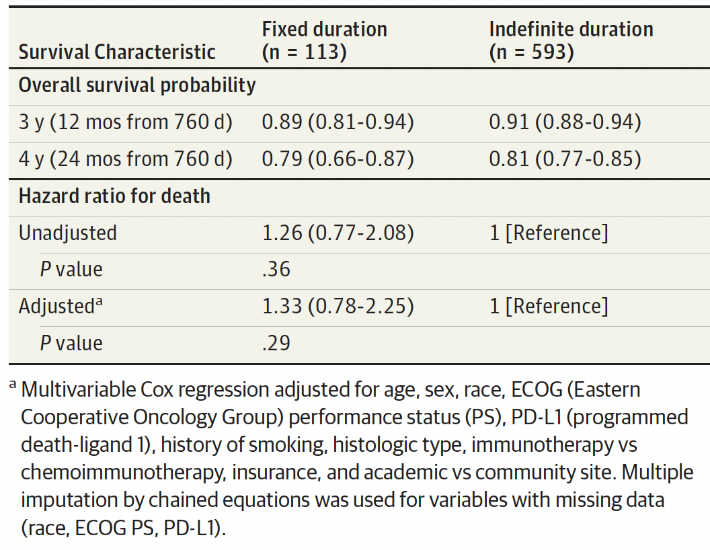
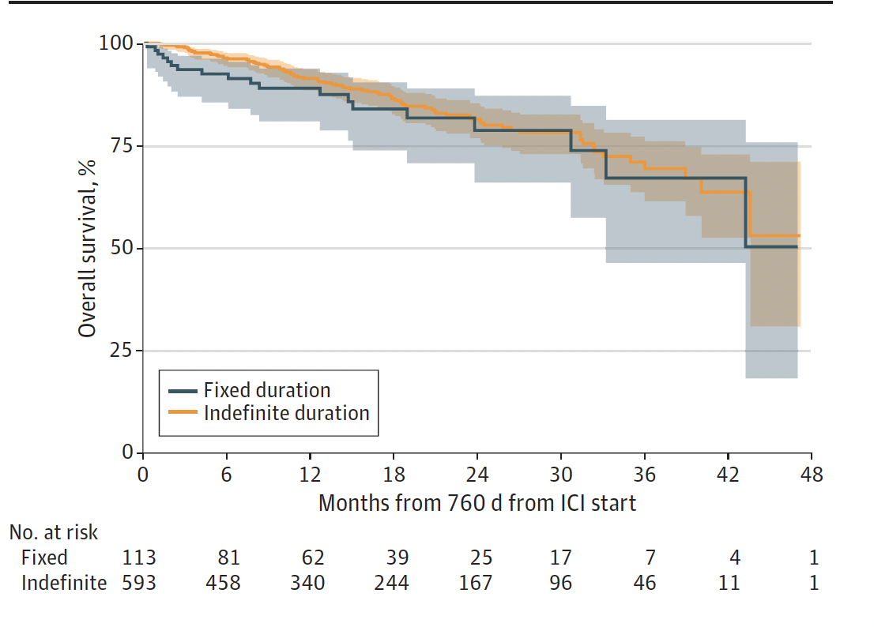
Real World Analysis of IO x 2 years vs Indefinite Duration—NO clear difference
Notes:
Sun L, Bleiberg B, Hwang WT, et al. Association Between Duration of Immunotherapy and Overall Survival in Advanced Non‑Small Cell Lung Cancer. JAMA Oncol. 2023;9(8):1075-1082. ​

Slide 62
Even in stage IV we do not know the answer to the duration question for ICI
Maybe ctDNA/MRD will hold the answer
ctDNA, circulating tumor DNA; ICI, immune checkpoint inhibitor; MRD, minimal residual disease.

Slide 63
Key Questions
What does the adjuvant ICI component add to neoadjuvant?
What is the optimal duration of ICI therapy?
How does ctDNA analysis help?
What are future steps?
ctDNA, circulating tumor DNA; ICI, immune checkpoint inhibitor; MRD, minimal residual disease.

Slide 64
ctDNA
Hope for the Future to Determine Need for Adjuvant
Notes:
Slide Notes
What about CT DNA? This may be helpful in the future for helping us determine who is done after just surgery alone. Is it just CT DNA? Is that going to help us enough? Is it those with path CR? Is that enough? What about those patients who have minimal residual disease, less than 10% viable tumor? Maybe this will help us determine who actually can be done.

Slide 65
An Example of a First-Generation Tumor Informed Assay: Cancer Personalized Profiling by Deep Sequencing: CAPP-Seq
CAPP-Seq:
~300 genes recurrently mutated in NSCLC and SCLC
Ultra-deep sequencing (>20,000x)
Point mutations, insertions/deletions, rearrangements, and copy number alterations
Analytic sensitivity
  Generalized: ~0.002%
  Personalized: ~0.00025%
Notes:
Newman AM, Bratman SV, Alizadeh AA, et al. Potential clinical utility of ultrasensitive circulating tumor DNA detection with CAPP-Seq. Nat Med. 2014;15(6):715-719.
Newman AM, Lovejoy AF, Klass DM, et al. Integrated digital error suppression for improved detection of circulating tumor DNA. Nat Biotechnol. 2016; 34:547-555.

Slide 66
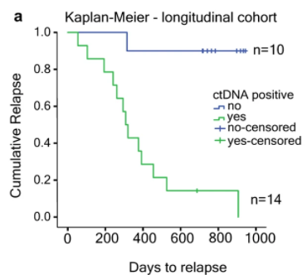
Background- ctDNA MRD Detection in Localized NSCLC 2 Early Assays: (CAPP-SEQ/ Signatera)
Stages I-III NSCLC
Tumor-informed assay
(Signatera™)
ctDNA preceded radiographic progression in 72% of patients by a median of 5.2 months
Notes:
Slide Notes
Here are two different early studies. One was from Stanford, with CAPP-Seq. Patients had their treatment with definitive treatment for early-stage and then ctDNA was assessed. If we didn't find it, no recurrence. If we did, patients developed rapid recurrence. This trial established the benchmark in 2017. Another group conducted a study with very similar results published in 2017, which went on to become the Signatera assay.
Chaudhuri A., Chabon JJ, Lovejoy AF. Early detection of molecular residual disease in localized lung cancer by circulating tumor DNA profiling. Cancer Discov. 2017;7:1394-1403.
Abbosh C, Birkbak NJ, Wilson GA, et al. Phylogenetic ctDNA analysis depicts early-stage lung cancer evolution. Nature. 2017;545(7655):446-451.

Slide 67
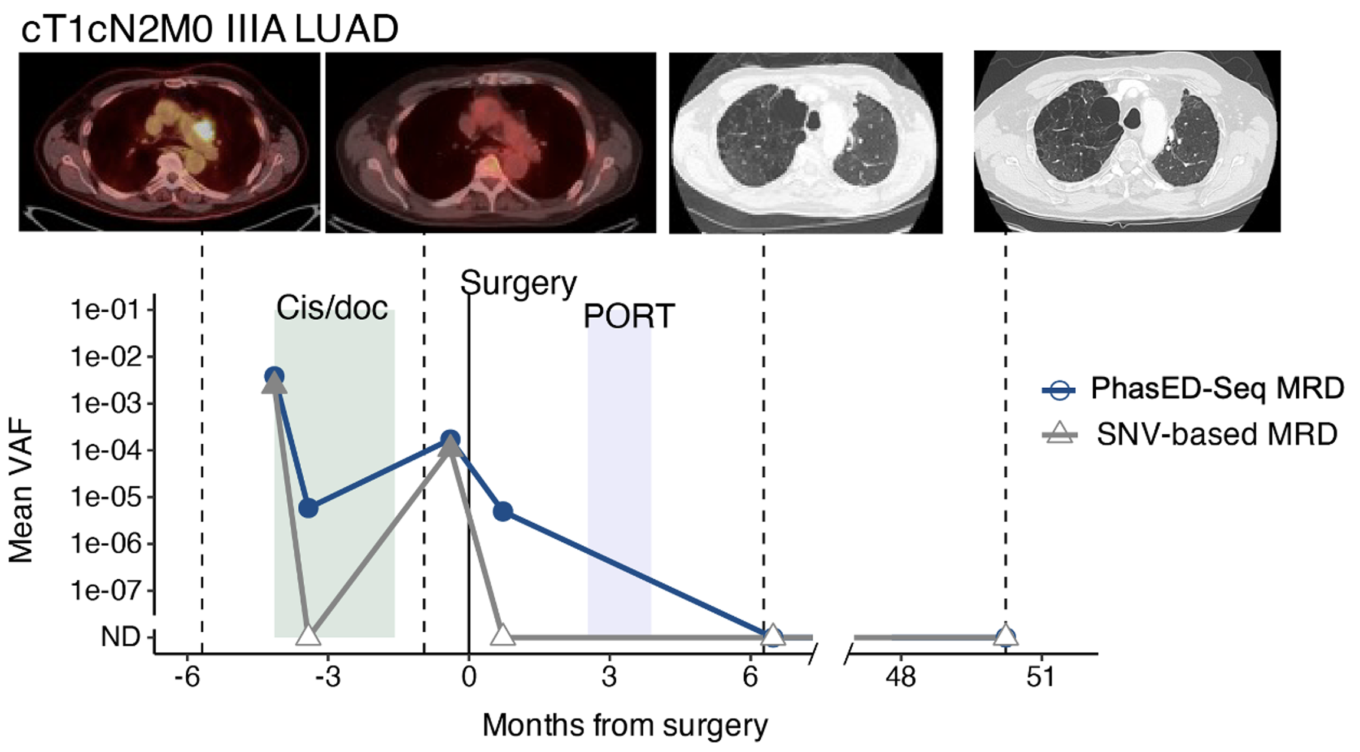
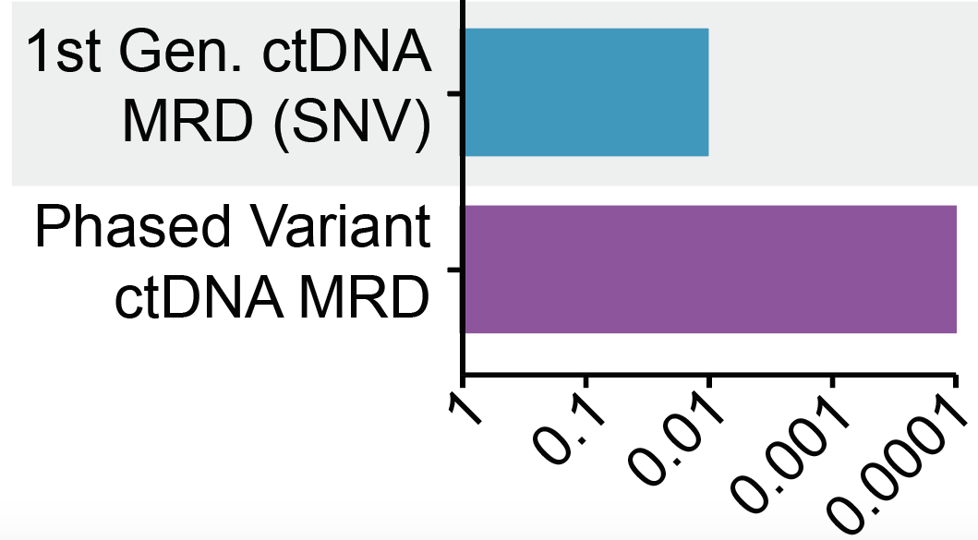
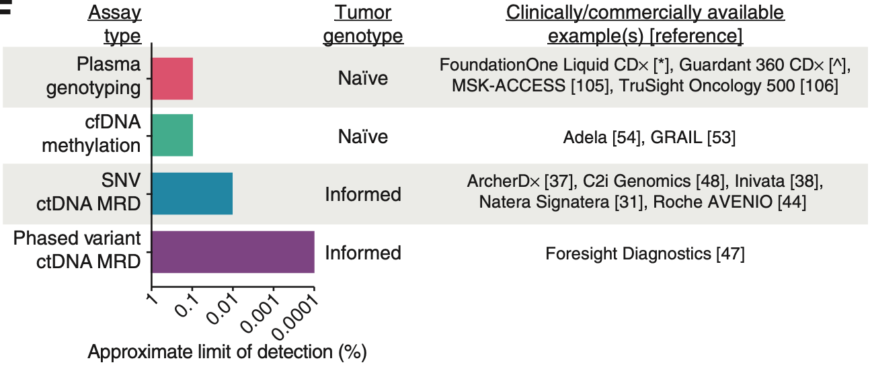
Ultrasensitive ctDNA MRD Detection With PhasED-Seq
PhasED-Seq is 100x more sensitive than 1st generation MRD methods
PhasED-Seq detects MRD when
1st generation MRD methods report false negatives
1ST generation MRD methods
PhasED-Seq
100 parts per million
1 part per million
Notes:
Kurtz DM, Soo J, Co Ting Keh L, et al.; Stanford Cancer Institute. Enhanced detection of minimal residual disease by targeted sequencing of phased variants in circulating tumor DNA. Nat Biotechnol. 2021;39(12):1537-1547.​

Slide 68
CM816 ctDNA Clearance and OS by ctDNA Clearance
Among concurrently randomized patients, 89 (25%) had evaluable ctDNA levels, and 86 (24%) had detectable ctDNA levels at baseline^{1,a}
ctDNA clearance rate^{1,b}
OS
100
80
80
NIVO + chemo (ctDNA clearance)
60
56%^{c}
Chemo (ctDNA clearance)
60
OS (%)
40
40
 | HR (95% CI) ctDNA clearance vs no ctDNA clearance
NIVO + chemo | 0.31 (0.10–0.90)
Chemo | 0.58 (0.20–1.64)
Chemo
(no ctDNA clearance)
Patients with ctDNA clearance (%)
35%^{d}
NIVO + chemo
(no ctDNA clearance)
20
20
0
0
0
6
12
18
24
30
36
42
48
54
60
66
72
NIVO + chemo
Chemo
Months from randomization
n/N
24/43
15/43
No. at risk
ctDNA clearance
24
22
22
22
22
22
22
20
19
12
9
2
0
ctDNA clearance
15
15
15
14
13
13
13
13
10
8
6
4
0
No ctDNA clearance
19
17
16
13
11
10
10
10
9
7
3
2
0
No ctDNA clearance
28
24
22
19
18
16
16
15
15
11
7
2
0
Notes:
Slide Notes
In CheckMate 816, ctDNA clearance was seen. Clearance was more likely associated with nivolumab. Regarding overall survival, patients who achieved ctDNA clearance had very high rates of long-term survival.
Spicer J, Girard N, Provencio M, et al. Neoadjuvant nivolumab (NIVO) + chemotherapy (chemo) vs chemo in patients (pts) with resectable NSCLC: 4-year update from CheckMate 816. J Clin Oncol. 2024;42(suppl 17): LBA 8010.

Slide 69
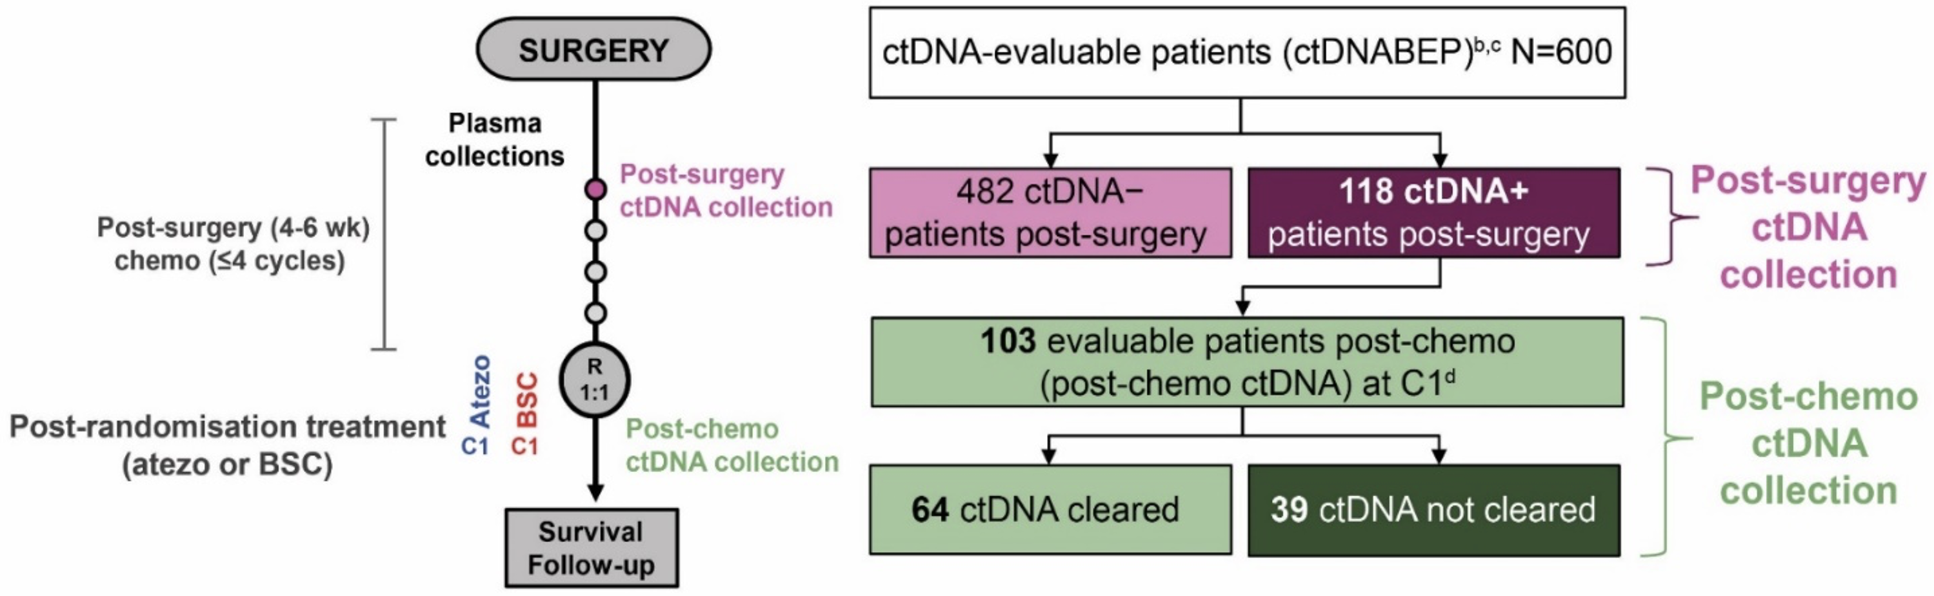
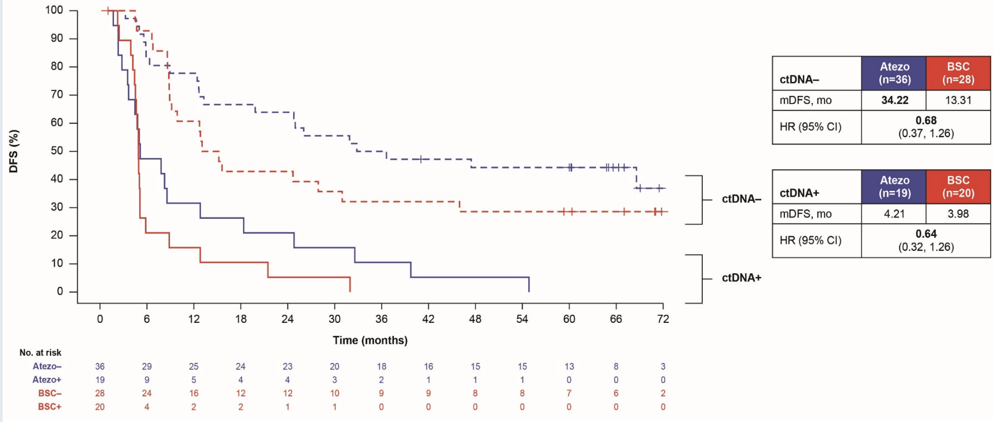
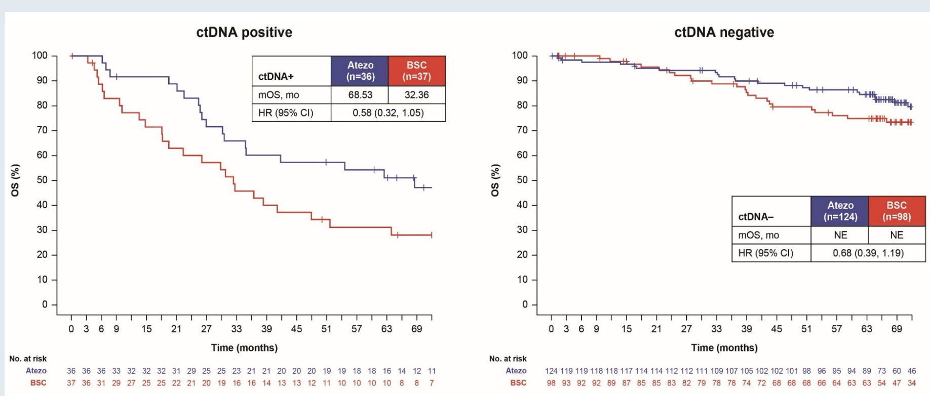
IMpower010: ctDNA Status and 5-Yr DFS
Signatera Assay
Time to DFS by treatment arm and cDNA status post-chemotherapy in the stage II-IIIA cDNA-evaluable populationª
OS by ctDNA status in the PD-L1 TC >1% stage II-IIIA ctDNA-evaluable population
Notes:
Wakelee HA, Altorki NK, Zhou C, et al. IMpower010: disease-free survival (DFS) final analysis and second overall survival (OS) interim analysis results after ≥5 years of follow-up in resected stage IB–IIIA NSCLC adjuvant atezolizumab vs best supportive care. J Clin Oncol. 2024;42(suppl 17):LBA8035.
Wakelee HA, Reck M, Felip E, et al. 1211P IMpower010: ctDNA status and 5-year disease‑free survival follow‑up in patients with resected NSCLC who received adjuvant chemotherapy followed by atezolizumab or best supportive care. Ann Oncol. 2024;35(suppl 2):S779‑S780.

Slide 70
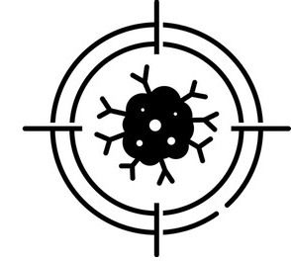

AEGEAN Study Design
Phase 3, Global, Randomized Double-Blind, Placebo-Controlled Study
    Durvalumab 1500 mg IV +
    platinum-based CT‡
    Q3W for 4 cycles
Durvalumab 1500 mg IV
Q4W for 12 cycles
Surgery§
Study population
Resectable NSCLC*
(stage IIA–IIIB[N2]; AJCC 8th ed.)
Tx-naïve
ECOG PS 0 or 1
Lobectomy, sleeve resection, or bilobectomy as planned surgery*
Confirmed PD-L1 status†
No documented EGFR/ALK
aberrations*
Tumor
Normal
Neoadjuvant
Adjuvant
Pre-surgery
MRD
Landmark
C1D1
R
1:1
C1D1
C2D1
C3D1
C4D1
C3/4D1
C10/11D1
pCR/MPR
assessment£
Plasma collection timepoints for ctDNA analysis¶
Whole exome sequencing (WES)
of Tx-naïve diagnostic biopsies & germline blood to identify variants for ctDNA analysis
    Placebo IV +
    platinum-based CT‡
    Q3W for 4 cycles
Placebo IV
Q4W for 12 cycles
Surgery§
Randomization stratified by:
Disease stage (II vs III)
PD-L1 expression (≥1% vs <1%)
N=802 randomized
Notes:
Slide Notes
The design of the AEGEAN trial included multiple time-points of blood draw for ctDNA analysis.
Zhao J, Reuther J, Scozzaro K, et al. Personalized Cancer Monitoring Assay for the Detection of ctDNA in Patients With Solid Tumors. Mol Diagn Ther. 2023;27(6):753-768.
Travis WD, Dacic S, Wistuba I, et al.; IASLC Pathology Group. IASLC multidisciplinary recommendations for pathologic assessment of lung cancer resection specimens after neoadjuvant therapy. J Thorac Oncol. 2020;15(5):709-740.

Slide 71
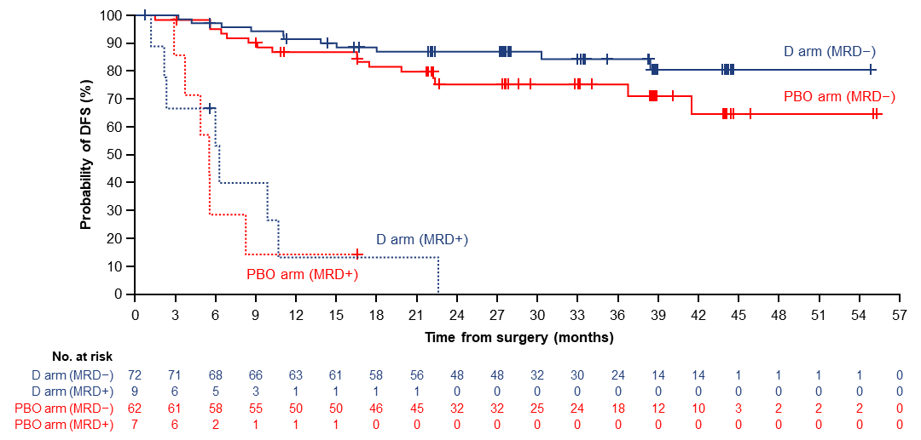
AEGEAN Association of MRD at Post-surgical Landmark with DFS*
Among MRD-evaluable patients (n=168, total across both arms), 10.1% were MRD+ at the post-surgical landmark†
DFS outcomes were worse in MRD+ vs MRD− patients, with trends favoring the D vs PBO arm1
Overall, 12-month DFS rates were 14.3% (95% CI: 2.4–36.3) vs 89.3% (95% CI: 82.6–93.5) in all MRD+ vs MRD− patients, respectively
 | D arm | PBO arm
HR for MRD+ vs MRD− | 21.28 (95% CI: 7.70–58.83) | 14.29 (95% CI: 4.94–41.36)
HR for D vs PBO arm (MRD−) | 0.56 (95% CI: 0.26–1.20) | −
HR for D vs PBO arm (MRD+) | 0.78 (95% CI: 0.26–2.36) | −
Notes:
Slide Notes
At the landmark time-point, patients with no evidence of ctDNA and those with MRD-negative disease, whether they were on the durvalumab or placebo arm, did much better. Those with any evidence of ctDNA had recurrences.
Reck M, Gale D, Zhu Z, et al. Associations of circulating tumor DNA clearance during neoadjuvant treatment with pathologic response and event-free survival in resectable NSCLC. Abstract presented at: ESMO Congress; Barcelona, Spain; October 20 -24, 2024. Abstract LBA49.

Slide 72
AEGEAN: Majority of MRD+ Patients Had Persistent ctDNA During Neoadjuvant Tx and Progressed Rapidly After Surgery
All MRD+ vs 87.8% of MRD− patients had ctDNA detected at baseline, and a higher proportion of MRD+ vs MRD− patients
(70.6% vs 31.9%) had ctDNA detected at the pre-surgical visit
In addition, 58.8% of MRD+ vs 21.2% of MRD− patients had persistent ctDNA detection at all evaluable timepoints during neoadjuvant Tx
Notes:
Reck M, Gale D, Zhu Z, et al. Associations of circulating tumor DNA clearance during neoadjuvant treatment with pathologic response and event-free survival in resectable NSCLC. Abstract presented at: ESMO Congress; Barcelona, Spain; October 20 -24, 2024. Abstract LBA49.

Slide 73
Patterns of Progression and Recurrence With Perioperative Durvalumab in AEGEAN
Measure | Durvalumab (n = 366) | Placebo (n = 374)
Total EFS events, n (%) | 124 (33.9) | 165 (44.1)
PD precluding surgery | 28 (7.7) | 36 (9.6)
PD after surgery not undertaken for reasons other than PD | 3 (0.8) | 5 (1.3)
PD preventing completion of surgery | 5 (1.4) | 13 (3.5)
PD after surgery not completed for reasons other than PD | 0 | 5 (1.3)
RECIST v1.1 recurrence | 53 (14.5) | 83 (22.2)
Death without PD or recurrence | 38 (10.4) | 33 (8.8)
Median time to recurrence (range),* mo
Any location | 8.2 (1-39) | 5.6 (1041)
Locoregional only | 8.4 (1-22) | 6.0 (1-28)
Distant only | 7.2 (1-39) | 5.6 (1-41)
Notes:
Cobo Dols M, Reck M, Harpole D, et al. Patterns of progression and recurrence with perioperative durvalumab in patients with resectable NSCLC from AEGEAN. Abstract presented at: IASLC World Conference on Lung Cancer; Barcelona, Spain; September 6-9, 2025. Abstract MA04.09.

Slide 74
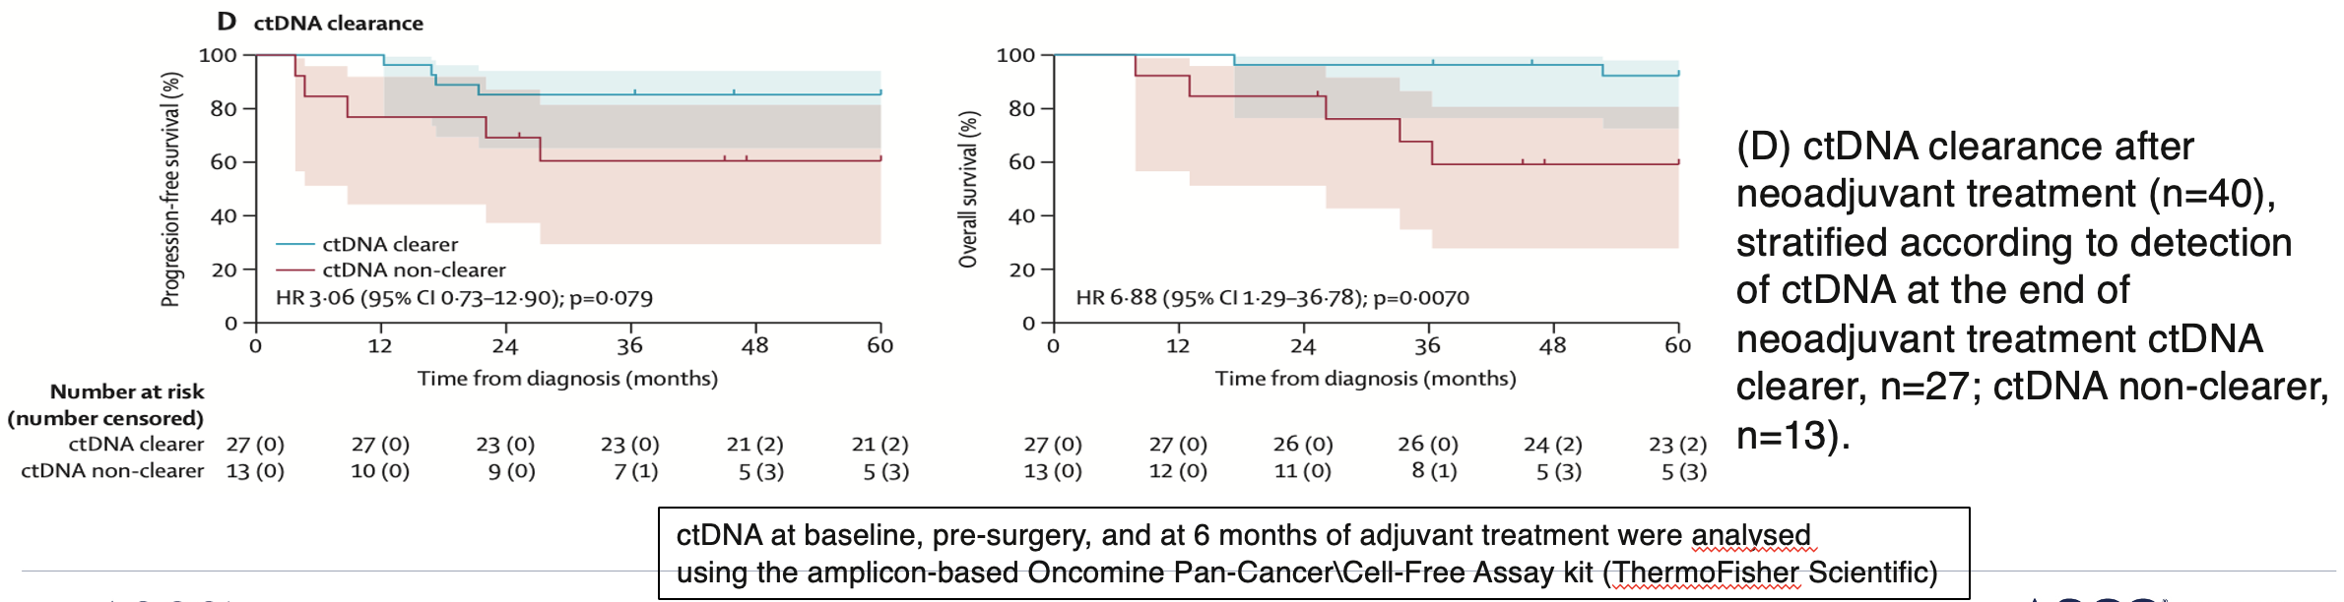
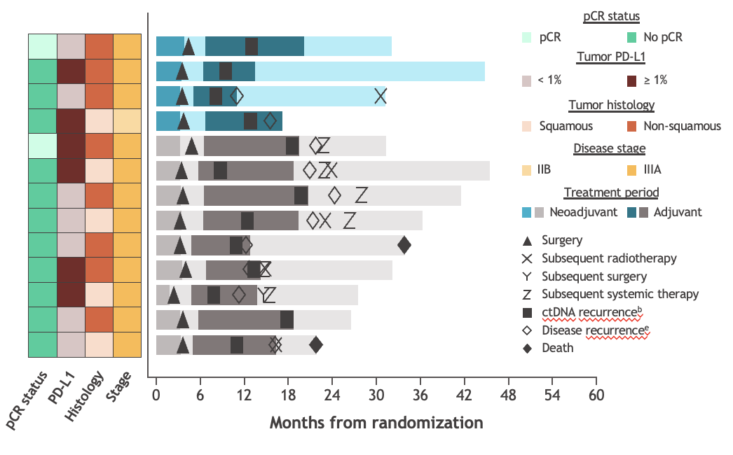
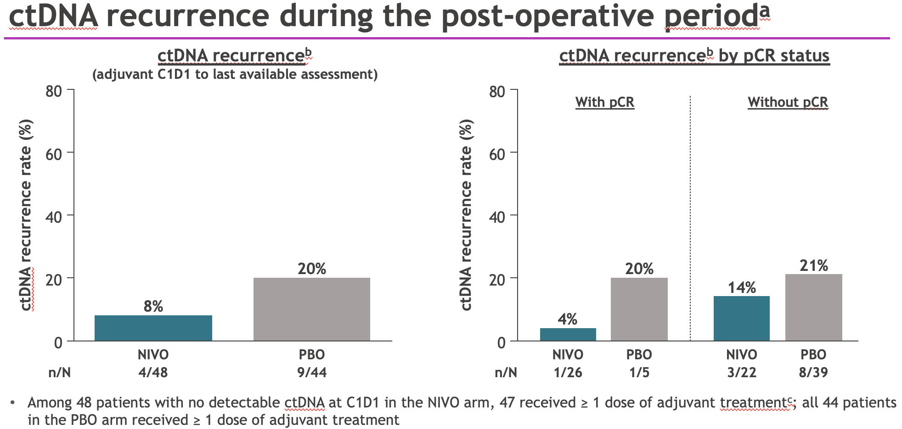
CM77T ctDNA
Outcomes in patients with cDNA recurrenced
cDNA recurrence during the post-operative periodª
Notes:
Wakelee H, Callahan M, Spigel D, et al. Correlative analyses of circulating tumor DNA dynamics in CM77T neoadjuvant/adjuvant nivolumab‑based trial. Abstract presented at: American Society of Clinical Oncology (ASCO) Annual Meeting; Chicago, Illinois; June 2-6, 2023. Abstract LBA4000.​
Provencio M, Nadal E, Insa A, et al. Neoadjuvant chemotherapy and nivolumab in resectable non–small-cell lung cancer (NADIM): a multicenter, single-arm, phase II trial. Lancet Oncol. 2024;25(11):1453-1464.​

Slide 75
Key Questions
What does the adjuvant ICI component add to neoadjuvant?
What is the optimal duration of ICI therapy?
How does ctDNA analysis help?
What are future steps?

Slide 76
Novel Agents in Early-Stage NSCLC

Slide 77
What Can We Add to PD-(L)1?
CTLA-4

Slide 78
CheckMate 816: Neoadjuvant Nivo/Ipi vs CT in
Early-Stage NSCLC
Key Eligibility Criteria
Newly diagnosed, resectable, stage IB (≥ 4 cm)–IIIA NSCLC
(per AJCC TNM 7th edition)
ECOG performance status 0–1
No known sensitizing EGFR mutations or ALK alterations
Stratified by
Stage (IB–II vs IIIA),
tumor PD-L1^{b} (≥ 1% vs < 1%^{c}),
and sex
NIVO 360 mg Q3W (3 cycles)
+ chemo^{d} Q3W (3 cycles)
Surgery
(within
6 weeks
post-treatment)
Optional adjuvant chemo ± RT
Chemo^{e} Q3W (3 cycles)
(n = 108)
Chemo^{e} Q3W (3 cycles)
Radiologic
restaging
Follow-up
R
NIVO 3 mg/kg Q2W (3 cycles)
+ IPI 1 mg/kg (cycle 1 only)^{f}
(n = 113)
Exploratory analysis population^{g}
Primary analysis (NIVO + chemo vs chemo)
Exploratory analysis (NIVO + IPI vs chemo)
Primary endpoints
pCR by BIPR
EFS by BICR
Secondary endpoints
MPR by BIPR
OS
TTDM
EFS by BICR
pCR and MPR by BIPR
OS
EFS, pCR, and MPR by 4-gene inflammatory signature score
Notes:
Awad MM, Cascone T, Spicer J, et al. CheckMate 816: Phase III neoadjuvant nivolumab + ipilimumab versus chemotherapy in resectable stage IB–IIIA NSCLC—3‑year event‑free survival outcomes. Abstract presented at: European Society for Medical Oncology (ESMO) Congress 2023; Madrid, Spain; October 20‑24, 2023. Abstract 1261O.​

Slide 79
CM816 EFSª With Neoadjuvant
NIVO + IPI vs Chemo
NI: 29 (26%) cancelled surgery: 74% definitive surgery
Chemo: 21 (19%) cancelled surgery: 76% definitive surgery
Notes:
Awad MM, Cascone T, Spicer J, et al. CheckMate 816: Phase III neoadjuvant nivolumab + ipilimumab versus chemotherapy in resectable stage IB–IIIA NSCLC—3‑year event‑free survival outcomes. Abstract presented at: European Society for Medical Oncology (ESMO) Congress 2023; Madrid, Spain; October 20‑24, 2023. Abstract 1261O.​

Slide 80
CM816 OS With Neoadjuvant NIVO + IPI vs Chemo
Notes:
Awad MM, Cascone T, Spicer J, et al. CheckMate 816: Phase III neoadjuvant nivolumab + ipilimumab versus chemotherapy in resectable stage IB–IIIA NSCLC—3‑year event‑free survival outcomes. Abstract presented at: European Society for Medical Oncology (ESMO) Congress 2023; Madrid, Spain; October 20‑24, 2023. Abstract 1261O.​

Slide 81
CM816: Baseline 4-Gene Inflammatory Signature Scoreª and EFS^{b}
Maybe we can choose who will benefit from the CTLA4 additional therapy?
NIVO + IPI
Chemo
Notes:
Awad MM, Cascone T, Spicer J, et al. CheckMate 816: Phase III neoadjuvant nivolumab + ipilimumab versus chemotherapy in resectable stage IB–IIIA NSCLC—3‑year event‑free survival outcomes. Abstract presented at: European Society for Medical Oncology (ESMO) Congress 2023; Madrid, Spain; October 20‑24, 2023. Abstract 1261O.​

Slide 82
What Can We Add to PD-(L)1?
Other immune modulatory

Slide 83
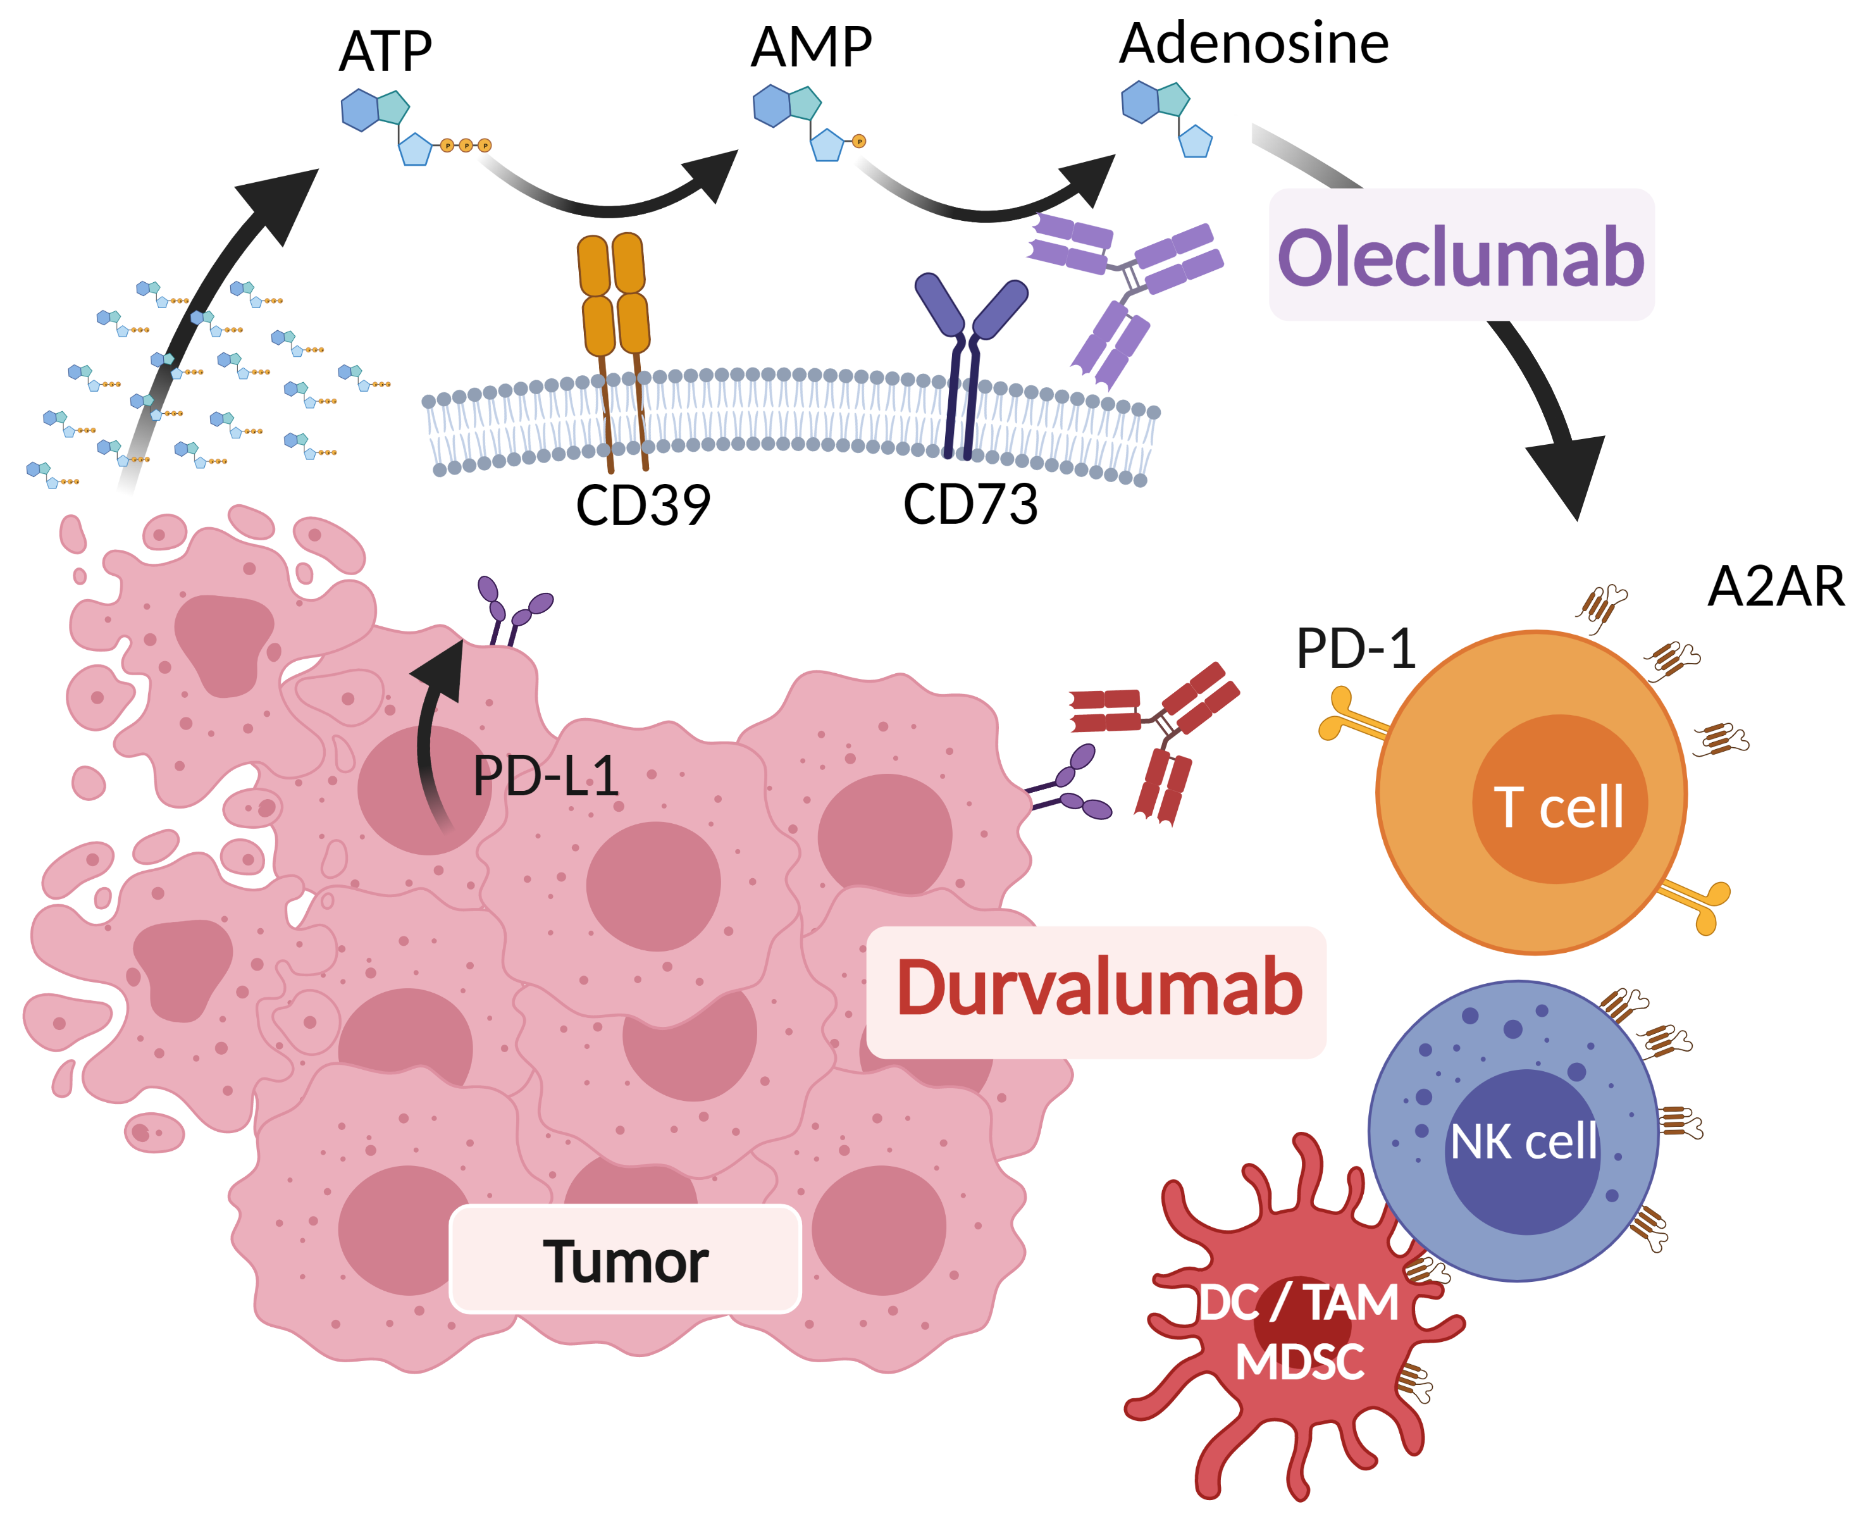
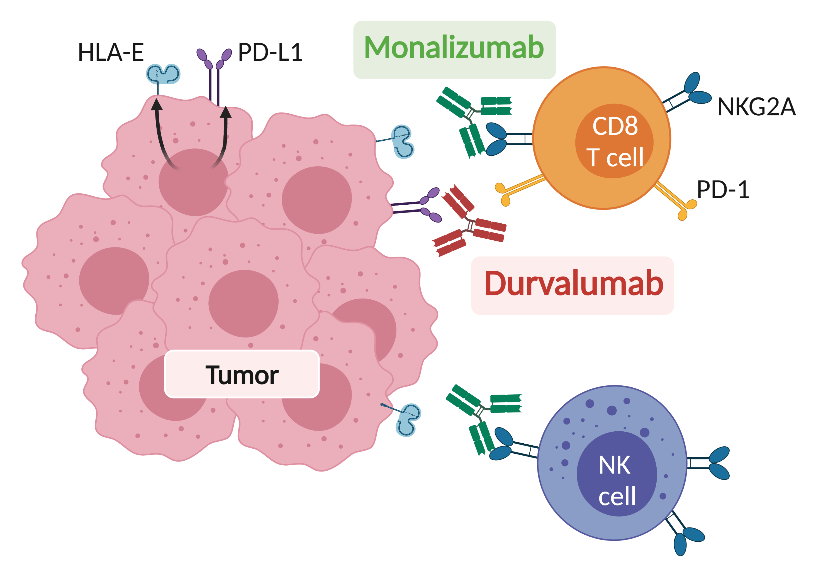
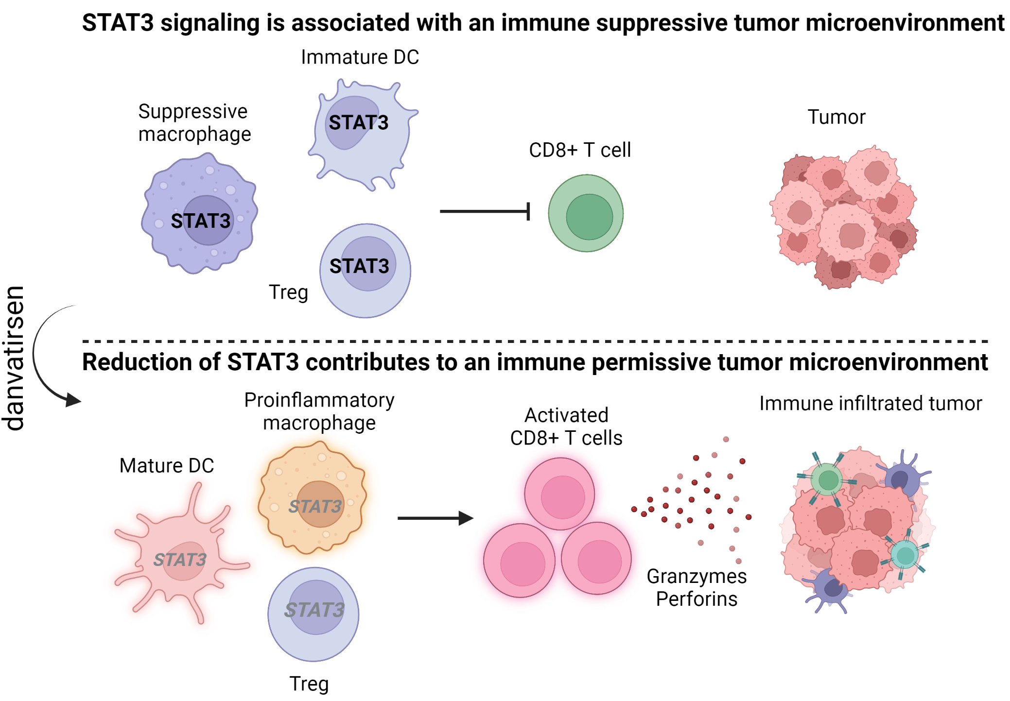
NeoCOAST Platform Study: Neoadjuvant Durva + Novel ICI Agents in Resectable NSCLC (Ph2)
Oleclumab (anti-CD73)
Monalizumab (anti-NKG2A)
Danvatirsen (anti-STAT3 ASO)
Danvatirsen
Notes:
Cascone T, Awad MM, Spicer JD, et al. LBA1 CheckMate 77T: Phase III study comparing neoadjuvant nivolumab (NIVO) plus chemotherapy (chemo) vs neoadjuvant placebo plus chemo followed by surgery and adjuvant NIVO or placebo for previously untreated, resectable stage II–IIIb NSCLC. Ann Oncol. 2023;34(supplement 2):S1295.

Slide 84
NeoCOAST: Neoadjuvant durvalumab +/– novel agents in resectable, early-stage (I [>2cm] to IIIA) NSCLC
Stage I (>2cm) to IIIA NSCLC*
Fully resectable
ECOG PS 0 or 1
No prior systemic therapy
Adequate organ and marrow function
N=84
One 28-day treatment cycle
 | Durva (n=27) | Durva + Ole (n=21) | Durva + Mona (n=20) | Durva + Danva (n=16)
Overall MPR (n/N, %) | 3/27 (11%) | 4/21 (19%) | 6/20 (30%) | 5/16 (31%)
PD-L1+ | 0/6 (0%) | 2/5 (40%) | 3/6 (50%) | 0/2 (0%)
PD-L1– | 0/3 (0%) | 1/6 (16.7%) | 0/2 (0%) | 0/5 (0%)
PD-L1 NE | 3/18 (17%) | 1/10 (10%) | 3/12 (25%) | 5/9 (56%)
Durva Q4W
Days
29–42
Day
105
Durva Q4W + Ole Q2W
Surgery
End of study
R
Stratification by lymph node involvement
(Yes/No)
Durva Q4W + Mona Q2W
7-day lead in period
Danva
(Days 1, 3, and 5)
Durva Q4W + Danva QW†
Follow up
Primary endpoint: MPR rate (proportion of patients with ≤10% residual viable tumour cells in resected tumour specimen and sampled nodes at surgery) per investigator assessment.
A single cycle of neoadjuvant durva combined with ole, mona, or danva produced numerically improved MPR rates (19–31.3%) compared with durva alone (11.1%).¹
MPR was associated with baseline tumour PD-L1 expression in durva + ole and durva + mona arms.
Notes:
Cascone T, Garcia-Campelo R, Spicer J, et al. NeoCOAST: open-label, randomized, phase 2, multidrug platform study of neoadjuvant durvalumab alone or combined with novel agents in patients (pts) with resectable, early-stage non-small-cell lung cancer (NSCLC). Cancer Res. 2022;82(12_Supplement):CT011-CT011.
Spicer J, Cascone T, et al. NeoCOAST: neoadjuvant durvalumab ± novel agents in resectable, early-stage (I [>2 cm]–IIIA) non–small cell lung cancer. Abstract presented at: ESMO Congress 2022; Paris, France; September 9-13, 2022. Abstract LBA38.​
Cascone T, Kar G, Spicer JD, et al. Neoadjuvant durvalumab alone or combined with novel immuno-oncology agents in resectable lung cancer: the phase II NeoCOAST platform trial. Cancer Discov. 2023;13(11):2394-2411.

Slide 85
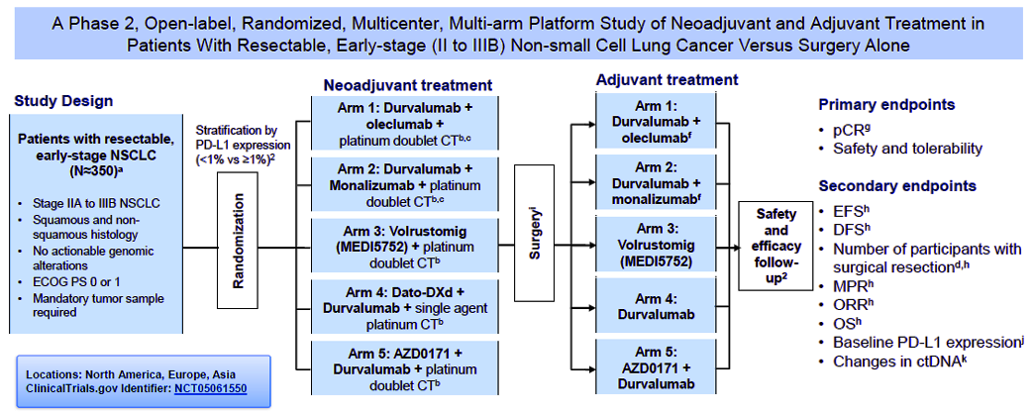
NEOCOAST-2:
Study of Neoadjuvant and Adjuvant Treatment in Resectable NSCLC
MEDI5752 Volrustomig - PD-1/CTLA-4 Bispecific
Dato-DXd – Trop-2 ADC
AZD0171- MAb to Leukemia inhibitory factor (LIF)
Notes:
A phase 2, randomized, open-label, multicenter, multiarm platform study of neoadjuvant and adjuvant durvalumab ± novel agents in resectable non–small-cell lung cancer (NeoCOAST‑2). ClinicalTrials.gov identifier: NCT05061550. Updated June 12, 2025. https://clinicaltrials.gov/study/NCT05061550.
Cascone T, Kar G, Spicer JD, et al. NeoCOAST: neoadjuvant durvalumab alone or combined with novel immuno‑oncology agents in resectable non–small‑cell lung cancer: phase II platform trial. Abstract presented at: AACR Annual Meeting; New Orleans, Louisiana; April 8‑13, 2022. Poster CT124.​
Guisier F, Insa A, Liberman M, et al. A phase II platform trial of neoadjuvant durvalumab with novel agents in early-stage resectable NSCLC: design and early translational results. Presented at: ASCO 2023; June 2‑6, 2023; Chicago, IL. Abstract TPS8604.​

Slide 86
NeoCOAST-2: Promising pCR and mPR rates across treatment arms
Arm 1
Oleclumab + durvalumab + CT
Arm 2
Monalizumab + durvalumab + CT
Arm 4
Dato-DXd + durvalumab + CT
mITT*
N=60
mITT*
N=60
mITT*
N=44
65.9%
53.3%
45.0%
34.1%
pCR and mPR rate (%)
26.7%
20.0%
pCR
mPR
pCR
mPR
pCR
mPR
Pathological assessment performed locally or centrally†
Notes:
Cascone T, Guisier F, Bonanno L, et al. NeoCOAST‑2: efficacy and safety of neoadjuvant durvalumab plus novel anticancer agents, with chemotherapy, and adjuvant durvalumab ± novel agents in resectable non–small cell lung cancer. Abstract presented at: IASLC World Conference on Lung Cancer (WCLC); San Diego, California; September 8-11, 2024;. Abstract PL02.07.​

Slide 87
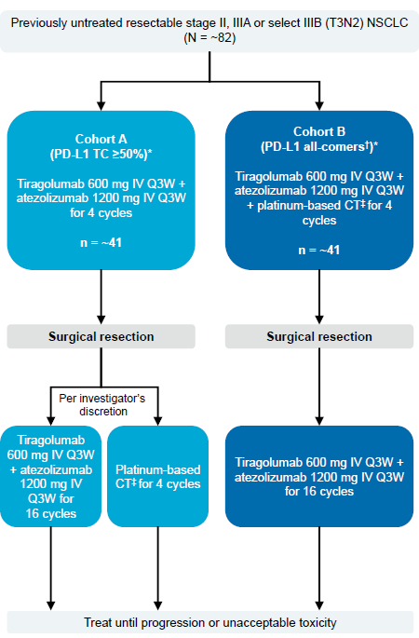
SKYSCRAPER-05: Design
Phase 2, open-label, multicenter study
Primary endpoints: mPR, surgical feasibility and safety
Secondary endpoints: pCR, EFS
Notes:
Pass H, Kim AW, Felip E, et al. SKYSCRAPER-05: Phase II study of neoadjuvant atezolizumab (Atezo) + tiragolumab (Tira) with or without platinum-based chemotherapy (CT) in patients (pts) with locally advanced resectable stage II‒IIIB NSCLC. Abstract presented at: European Society of Medical Oncology Congress; Paris, France, September 9-13, 2022. Abstract 970TiP.
Pass H, Felip E, Shu CA, et al. SKYSCRAPER-05: Phase II study of perioperative tiragolumab + atezolizumab ±chemotherapy in locally advanced resectable NSCLC. Abstract presented at: IASLC World Conference on Lung Cancer; Barcelona, Spain; September 6-9, 2025. Abstract OA02.01.

Slide 88
SKYSCRAPER-05: Results
Clinical cut-off: 2/14/2024 (Cohort A, n = 8; Cohort B, n = 42)
Cohort A Terminated early due to the evolving treatment landscape
Cohort B: PD-L1 <1%: 57% of patients, PD-L1 = 1-49%: 24% of patients; and 19% of patients had tumors that were, PD-L1 ≥ 50% of patients
Overall, 96% of patients received a resection: pneumonectomy, 4%; lobectomy/bilobectomy, 90% a; R0 resection, 96%
Cohort B findings: MPR: 51% (95% CI: 35-67), pCR, 29% (95% CI: 17-46); EFS, immature
mPR and pCR achieved across all PD-L1 subgroups
Safety profile consistent with expectations
Notes:
Pass H, Felip E, Shu CA, et al. SKYSCRAPER-05: Phase II study of perioperative tiragolumab + atezolizumab ±chemotherapy in locally advanced resectable NSCLC. Abstract presented at: IASLC World Conference on Lung Cancer; Barcelona, Spain; September 6-9, 2025. Abstract OA02.01.

Slide 89
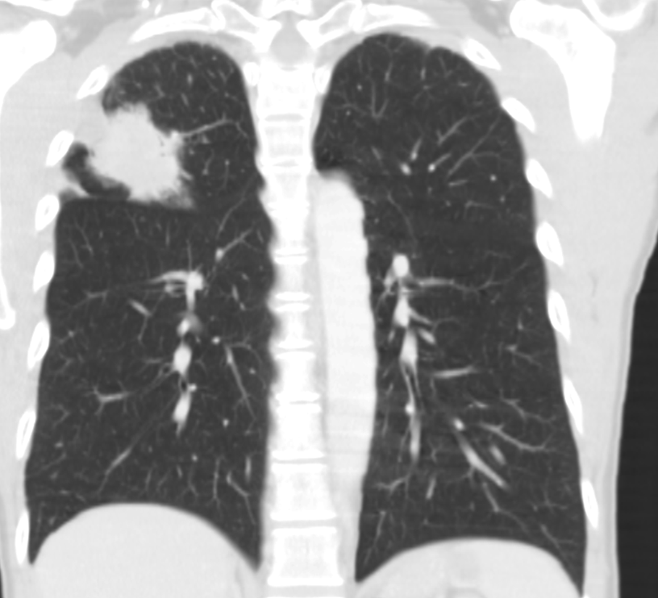
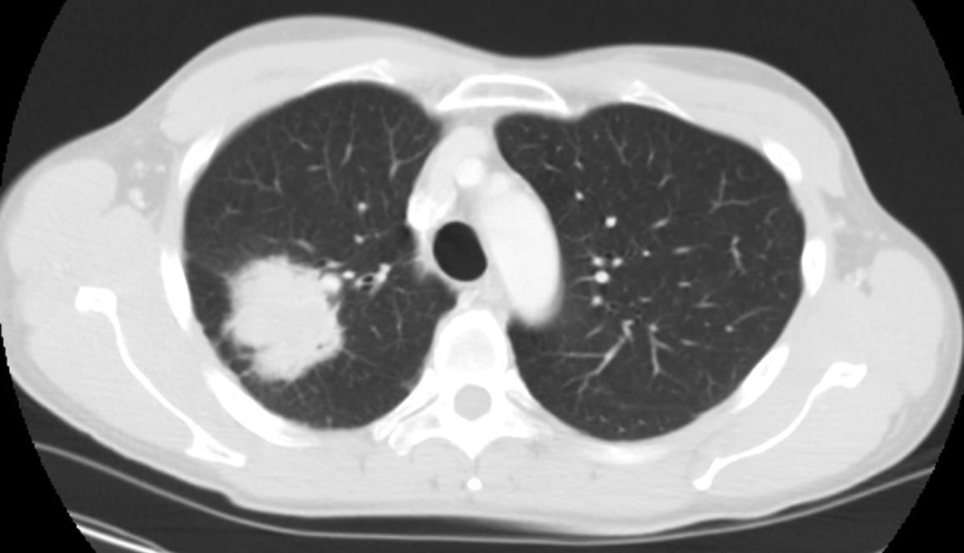
Case
A 61 y.o. man who works in marketing has mild hypertension, hyperlipidemia and a history of smoking 1 pack of cigarettes daily since he was 18 years old. He presents to his PCP with unexpected weight loss, blood-streaked sputum, and low-grade fevers. After a suspicious CXR, a CT thorax shows a 5 cm mass in the right upper lobe abutting the major fissure and posterior minor fissure without obvious hilar or mediastinal adenopathy.
cm, centimeter; CT, computed tomography; CXR, chest X-ray; PCP, primary care provider.
Notes:
Slide Notes
Sixty-one-year-old patient. He's got some hypertension, hyperlipidemia, he’s smoked for a long time, started early. He presents to his primary care doctor with some blood sputum and some fevers. Gets an X-ray that doesn’t look good, and then had the CT scan, which looks very concerning.

Slide 90
Case Follow-up/Question:
In addition to biopsy of the primary mass, after tumor board discussion the team decides he should undergo EBUS to sample mediastinal and hilar lymph nodes and that tissue should be sent for PD-L1, EGFR/ALK
Some on the tumor board argue for him to head
straight to surgery
EBUS confirms adenocarcinoma, PD-L1 40%, EGFR/ALK are both negative and there were some surprise positive
findings at level 7
ALK, anaplastic lymphoma kinase; EBUS, endobronchial ultrasound; EGFR, epidermal growth factor receptor; PD-L1, programmed death-ligand 1.
Notes:
Slide Notes
So, in addition to biopsying that primary mass, after tumor board, they talk about doing an endobronchial ultrasound to look at lymph nodes and also to have enough tissue to send for PD-L1, EGFR, and ALK. Most people agree, some of the surgeons are saying they should go straight to surgery, but his PD-L1 is 40%. EGFR and ALK are negative, but he did have some lymph nodes. So neoadjuvant treatment has started. He has 3 cycles chemo and immune therapy.

Slide 91
Case Follow-up/Question:
Based on these results (N2+, PD-L1 40%, no driver mutation) the team decides he should proceed to neo-adjuvant ICI therapy with chemotherapy and nivolumab
He completes 3 cycles and is doing relatively well but reports increasing fatigue and is noted to have a high TSH and low T4
ACTH and Cortisol levels are normal
IrAE of hypothyroidism diagnosed and thyroid hormone
replacement started
Within 2 weeks symptoms have improved with normalization
in TSH and T4
ACTH, adrenocorticotropic hormone; ICI, immune checkpoint inhibitor; irAE, immune-related adverse event; N2, level 2 mediastinal lymph node; PD-L1, programmed death-ligand 1; T4, thyroxine; TSH, thyroid-stimulating hormone.
Notes:
Slide Notes
He starts to feel really tired. TSH is checked; it's high. T4 is low. They check for ACTH and cortisol levels. Important, because you want to make sure you're not dealing with more than just thyroid dysfunction in the endocrine system. Started on thyroid replacement, starts to feel better. Goes to surgery. He still has some viable residual tumor, but it's much improved from where it was at the beginning.

Slide 92
Case Follow-up/Question:
Once his thyroid replacement therapy is stabilized, he has a successful right upper lobectomy. Pathology finds a 2 cm residual adenocarcinoma with significant treatment effect (20% residual viable tumor), with 1/5 hilar lymph nodes involved with minimal residual tumor and 0/12 mediastinal lymph nodes involved with tumor.
Do you continue with additional adjuvant immune therapy (ie CM77T or stop at this time CM816)?
What if he had a pCR? Would you give adjuvant therapy?
CM77T, CheckMate 77T trial; CM816, CheckMate 816 trial; pCR, pathologic complete response.
Notes:
Slide Notes
And so then the question is, do you continue additional treatment or not? He didn't have a major pathological response, but it was good. What if he'd had a path CR? Would you give adjuvant treatment?

Slide 93
Question From Our Case
Who determines resectability among the multidisciplinary team,
and when?
Do we have to wait for OS data to mature before ICI selection?
Which biomarkers are ready for practice right now to help inform treatment planning? - do you obtain ctDNA?
If irAEs develop pre-resection, how long to delay surgery to manage irAEs?
Do patients achieving a pCR need adjuvant therapy?
What is the sentiment around potential for subcutaneous administration of ICIs?
ctDNA, circulating tumor DNA; ICI, immune checkpoint inhibitor; irAE, immune-related adverse event; OS, overall survival; pCR, pathologic complete response.
Notes:
Slide Notes
So questions from our case. Who determines resectability? Do we have to wait for overall survival data to mature before we make decisions? Which biomarkers are ready? What about CT DNA? I don't think it's quite there, but getting there. If immune-related adverse events develop, how do you decide when to go to surgery? Do patients with a path CR need adjuvant, and what is the sentiment about potential for subcutaneous immune checkpoint inhibitors? A lot of excitement about that.

Slide 94
Conclusions
Neo-Adjuvant, Adjuvant or Peri-operative PD-(L)1 ICI - SOC for early NSCLC (w/o driver mutation or contraindication)
Accurately STAGE and discuss at Multidisciplinary Tumor Board
  TEST for EGFR, ALK, PD-L1 (and others)
  Adjuvant targeted therapy SOC for EGFR/ALK+ NSCLC
  Neo-Adjuvant EGFR therapy with Osimertinib + data – NeoADAURA
Stage III - Neo-Adjuvant/Peri-Operative ICI SOC for all operable stage III
Stage I/II - more controversial - surgery first/ adj approaches can be an option
More work needed on biomarkers of response and comparative trials!
The additional benefit of Adjuvant is LIKELY after Neo-Adjuvant therapy
ctDNA will be critical for optimal management
Novel Agents Needed!
EXCITING TIMES FOR EARLY-STAGE NSCLC
ALK, anaplastic lymphoma kinase; ctDNA, circulating tumor DNA; EGFR, epidermal growth factor receptor; ICI, immune checkpoint inhibitor; NSCLC, non–small cell lung cancer; PD-L1, programmed death-ligand 1; SOC, standard of care.
Notes:
Slide Notes
In conclusion, whether you give neoadjuvant, adjuvant, or perioperative, they're all reasonable approaches for certain patients. Multidisciplinary tumor board discussions are critical. Testing for EGFR, ALK, PD-L1 is critical. If you do find EGFR and ALK, we've got great data for adjuvant now in both of those settings, and neoadjuvant with the NeoADAURA. For Stage 3, chemo immune therapy up-front, critical. Stage 1 and 2, maybe some can go to surgery.

Slide 95
Optimizing Perioperative Therapy in Early-Stage NSCLC:
A Multidisciplinary Approach

