Slide 1
TROP2-Targeted ADCs in TNBC and HR+ mBC:
Advancing Care Through Clinical Evidence and Interdisciplinary Collaboration

Slide 2
DISCLAIMER
This slide deck in its original and unaltered format is for educational purposes and is current as of May 2026. All materials contained herein reflect the views of the faculty, and not those of AXIS Medical Education, the CME provider, or the commercial supporter. Participants have an implied responsibility to use the newly acquired information to enhance patient outcomes and their own professional development. The information presented in this activity is not meant to serve as a guideline for patient management. Any procedures, medications, or other courses of diagnosis or treatment discussed or suggested in this activity should not be used by clinicians without evaluation of their patients’conditions and possible contraindications and/or dangers in use, review of any applicable manufacturer’s product information, and comparison with recommendations of other authorities.

Slide 3
DISCLOSURE OF UNLABELED USE
This activity may contain discussion of published and/or investigational uses of agents that are not indicated by the FDA. The planners of this activity do not recommend the use of any agent outside of the labeled indications.
The opinions expressed in the activity are those of the faculty and do not necessarily represent the views of the planners. Please refer to the official prescribing information for each product for discussion of approved indications, contraindications, and warnings.
USAGE RIGHTS
This slide deck is provided for educational purposes and individual slides may be
used for personal, non-commercial presentations only if the content and references
remain unchanged. No part of this slide deck may be published in print or
electronically as a promotional or certified educational activity without prior written
permission from AXIS. Additional terms may apply. See Terms of Service on
www.axismeded.com for details.

Slide 4
Learning Objectives
Upon completion of this activity, participants should be better able to:
Differentiate available TROP2-targeted ADCs for metastatic HR+ and triple negative BC
Integrate patient- and disease-specific characteristics to guide therapeutic selection in the treatment of metastatic HR+ and triple negative BC
Implement prophylactic strategies to improve treatment tolerability and preserve quality of life in the management of mBC
Collaborate across disciplines to monitor and manage treatment-related toxicities, improving treatment adherence and outcomes

Slide 5
Setting the Stage:
The Urgent Need for Innovation in mBC Treatment

Slide 6
Unmet Treatment Need in HR+, HER2-Negative (HER2−) mBC
Current treatment landscape and outcomes – mPFS
1L
ET + CDK4/6i
No prior
CDK4/6i
24.8–28.2 mo^{1–3}
2L+
ET + targeted therapies
Prior
CDK4/6i
2.8–5.5 mo^{4,5}
ET monotherapy
Prior
CDK4/6i
1.9–2.6 mo^{4,5}
3L+
Single-agent CT
Mostly CT
naïve (mBC)
6.2–7.1 mo^{6–8}
T-DXd
(HER2-low)
Prior ET
and CT
13.2 mo⁹
Chemotherapy is utilized widely for management of endocrine-resistant HR+/HER2– MBC, but can be associated with low response rate, poor prognosis, and significant toxicity including myelosuppression and peripheral neuropathy, highlighting need for better therapies in this setting.
1. Finn RS, et al. N Engl J Med. 2016;375;1925-1936. 2. Hortobagyi GN, et al. Ann Oncol. 2018;29:1541-1547. 3. Johnston S, et al. NPJ Breast Cancer. 2019;5:5​. 4. Turner NC, et al; CAPItello-291 Study Group. N Engl J Med. 2023;388:2058-2070. 5. Bidard FC, et al. J Clin Oncol. 2022;40:3246-3256. 6. O’Shaughnessy J, et al. JAMA Netw Open. 2021;4:e214103. 7. O’Shaughnessy J, et al. Cancer Res. 2021;81(4_suppl):GS4-01. 8. Robert NJ, et al. J Clin Oncol. 2011;29:1252-1260. 9. Curligiano G, et al. J Clin Oncol. 2024;42(17): LBA1000.
Notes:
Outcomes for patients with HR+, HER2– mBC decline after ≥1 line of ET-based therapies post CDK4/6i
Standard chemotherapy offers limited benefit
T-DXd has demonstrated efficacy after CT in HER2-low mBC
There clearly is an unmet treatment need in hormone receptor-positive HER2-negative metastatic breast cancer. With CDK4/6 inhibitors in the first line, we get a PFS of anywhere from 2 to 3 years. But after that, generally in the second line and third line, we really have lower progression-free survivals and a poorer prognosis, especially with endocrine-targeted therapies in the second line, current therapies after CDK4/6 resistance are about 5 to 7 months, and third line and beyond with single-agent chemo is about 7 months, with trastuzumab deruxtecan is anywhere from 10 to 13 months.

Slide 7
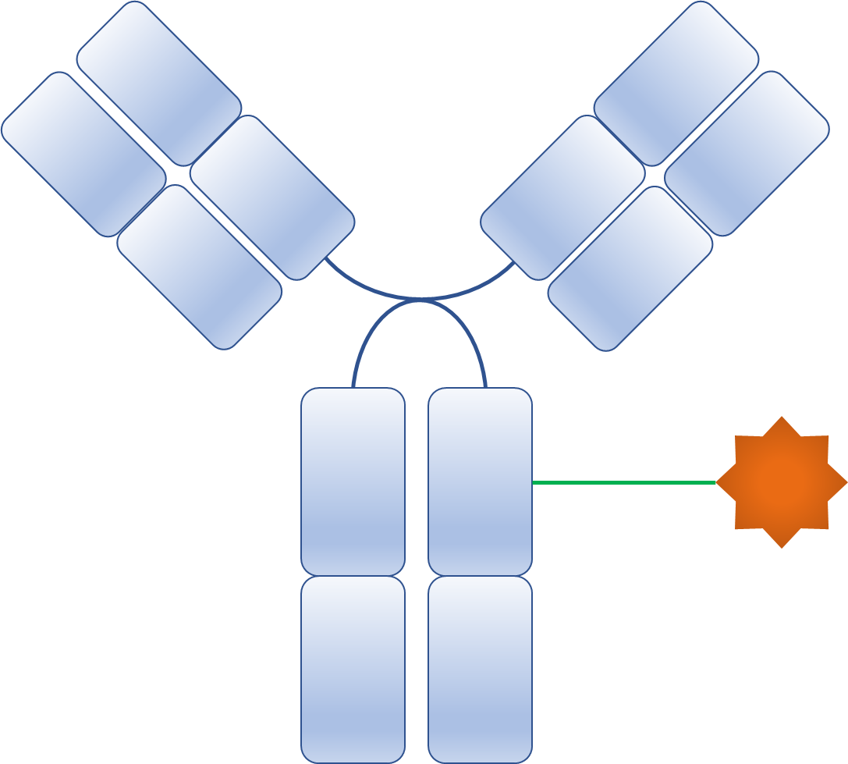

ADCs: Selective Delivery of Toxic Payload
6. Bystander Effect
1. Binding of an ADC to antigen
2. Internalization to the early endosome
Trop-2
Trop-2
Clathrin
5. Apoptosis of the cancer cell
H⁺
Lysosomes
H⁺
3. Degradation of ADCs in the lysosome
4. Release and action of payload
Notes:
Antibody-drug conjugates are comprised of an antibody to a particular antigen. They're internalized into the endosome, degraded in the lysosome, and then the payload is released. We also have cleavable payloads which we can actually have release of the payload in the extracellular space as well, leading to what's called a bystander effect.
The idea of antibody drug conjugate is that once an ADC molecule recognizes tumor antigen, it binds to the transmembrane antigen and becomes internalized via receptor-mediated endocytosis. It is trafficked to the lysosome, get degraded and releases the payload.

Slide 8
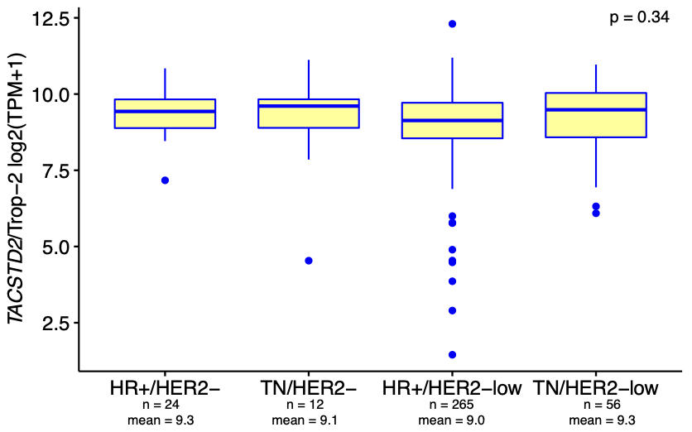
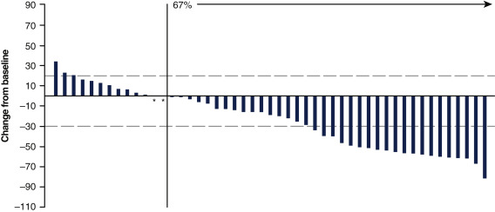
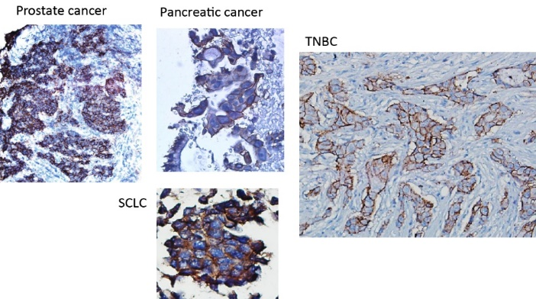
Rationale for TROP2 ADC: HR+ MBC
Best Percent Change From Baseline in the Sum of the Diameters of the Target Lesions With SG in HR+ MBC
HR+ Breast Cancer
Confirmed
ORR = 31.5%
Notes:
TROP-2 in particular is an antigen found on trophoblast cells. However, it turns out is expressed at fairly high levels on hormone receptor-positive metastatic breast cancer. About 60% to 70% have fairly substantial expression. The early trials of TROP-2 ADCs confirm a response rate in this setting of about 31% to 32%.

Slide 9
Clinical Evidence Review: Distinguishing TROP2-Targeted ADCs in HR+ mBC
TROPiCS-02
TROPION-Breast01
OptiTROP-Breast02
Notes:
We now have three large randomized phase 3 trials of three different TROP-2–targeted ADCs in hormone receptor-positive metastatic breast cancer.

Slide 10
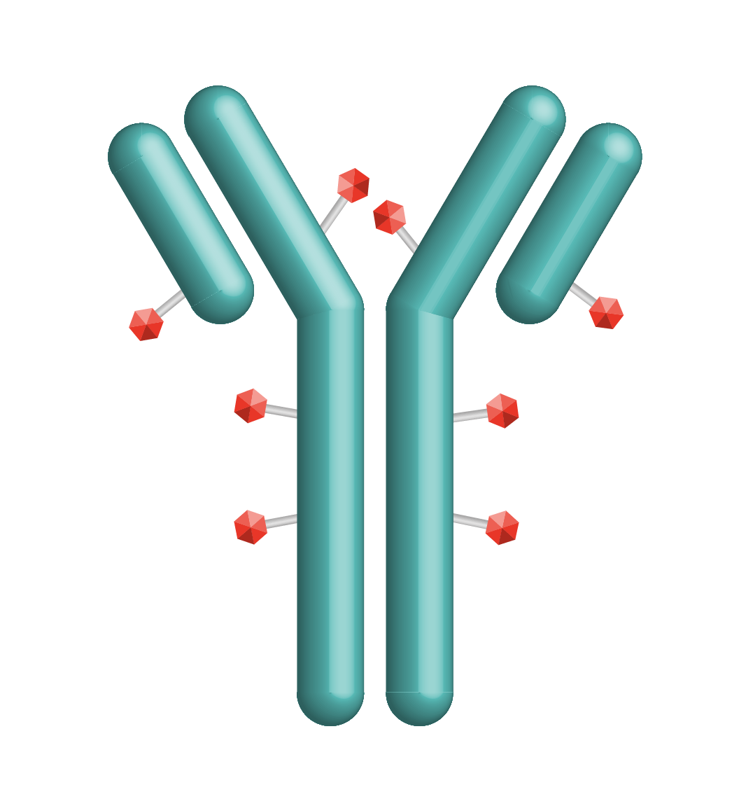
Sacituzumab Govitecan (SG):
First-in-Class TROP2 ADC
SG is distinct from other ADCs
Antibody highly specific for Trop-2
High drug-to-antibody ratio (7.6:1)
Internalization and enzymatic cleavage by tumor cell not required for the liberation of SN-38 from the antibody
Hydrolysis of the linker also releases the SN-38 cytotoxic extracellularly in the tumor microenvironment, providing a bystander effect
Humanized anti‒TROP2 antibody
Linker for SN-38
Hydrolyzable linker for payload release
SN-38 payload
SN-38 more potent than parent compound, irinotecan
Nagayama A, et al. Ther Adv Med Oncol. 2020;12:1758835920915980.
Cardillo TM, et al. Bioconjugate Chem. 2015;26(5):919-931.
Notes:
The first one is sacituzumab govitecan. This has an antibody-drug ratio of 7.6 to 1. It has a linker which is hydrolyzable, it's a CL2 linker. And this hydrolyzable and low pH and for SN-38, which is a metabolite of irinotecan, the antigen is TROP-2 antibody, and again, SN-38 is more potent than irinotecan.

Slide 11
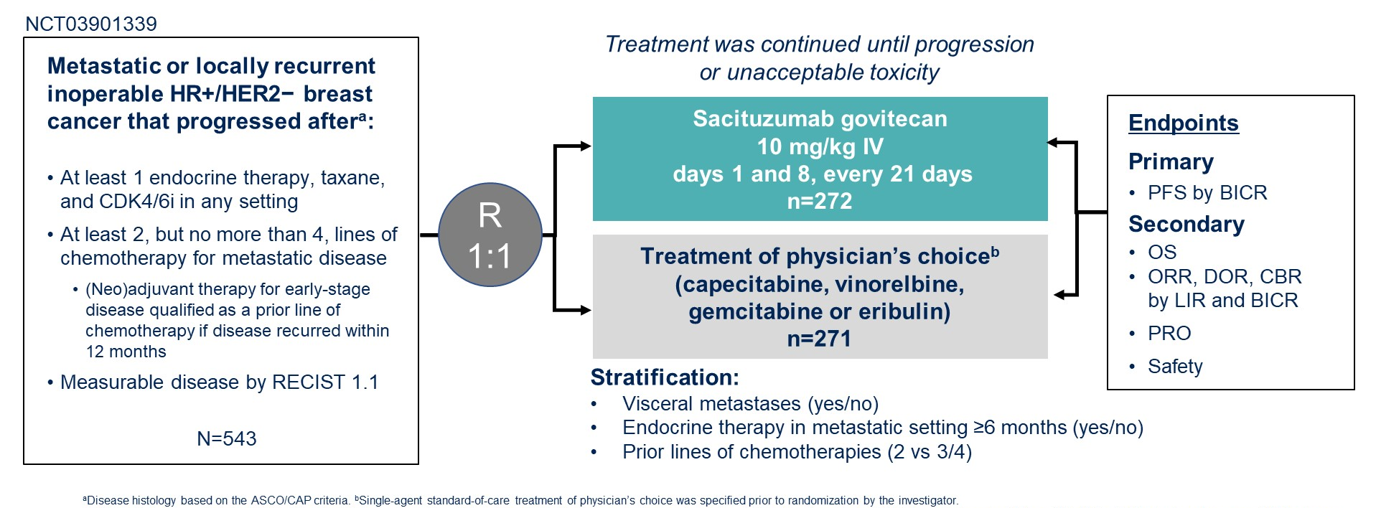
TROPiCS-02: A Phase 3 Study of SG in HR+/HER2- Locally Recurrent Inoperable or Metastatic Breast Cancer
Treatment was continued until progression or unacceptable toxicity
Metastatic or locally recurrent inoperable HR+/HER2- breast cancer that progressed afterª:
﻿﻿At least 1 endocrine therapy, taxane, and CDK4/6i in any setting
﻿﻿At least 2, but no more than 4, lines of chemotherapy for metastatic disease
  ﻿﻿(Neo)adjuvant therapy for early-stage disease qualified as a prior line of chemotherapy if disease recurred within 12 months
﻿﻿Measurable disease by RECIST 1.1
N=543
Sacituzumab govitecan (SG)
10 mg/kg IV
days 1 & 8, every 21 days
n=267
Endpoints
Primary
PFS by BICR
Secondary
﻿﻿OS
﻿﻿ORR, DOR, CBR by LIR and BICR
﻿﻿PRO
﻿﻿Safety
R
1:1
Treatment of physician's choice^{b} (capecitabine, vinorelbine, gemcitabine or eribulin)
n=271
Stratification:
﻿Visceral metastases (yes/no)
﻿Endocrine therapy in metastatic setting ≥6 months (yes/no)
﻿Prior lines of chemotherapies (2 vs 3/4)
NCT03901339
ªDisease histology based on the ASCO/CAP criteria. Single-agent standard-of-care treatment of physician's choice was specified prior to randomization by the investigator.
Rugo HS, et al. _{ASCO} 2022. Abstract LBA1001.
Notes:
The TROPiCS-02 trial took 532 women with metastatic or locally recurrent inoperable hormone receptor-positive HER2-negative metastatic breast cancer progressing after at least one endocrine therapy, taxane, and a CDK4/6 inhibitor in any setting, at least two but not more than four lines of chemo for metastatic disease and with measurable disease by RECIST 1.1, randomized into sacituzumab govitecan or treatment of physician’s choice, which was various chemos, capecitabine, vinorelbine, gemcitabine, or eribulin.

Slide 12
TROPiCs-02: PFS
Rugo HS, et al. J Clin Oncol. 2022;40(20):3365-3376.
Notes:
As the progression-free survival was improved, and what is really interesting, even though it's only 4 months to 5.5 months, the hazard ratio was statistically significant at 0.66. As you can see looking at these Kaplan-Meier curves, within the first 3 months, about 60% of the patients progressed on the physician’s choice of chemotherapy, where only 20% progressed on the sacituzumab govitecan. This actually was maintained. So about 20% of the patients had a clinically meaningful benefit to this therapy in terms of PFS that did appear actually to be sustained, as you can see from these Kaplan-Meier curves.

Slide 13
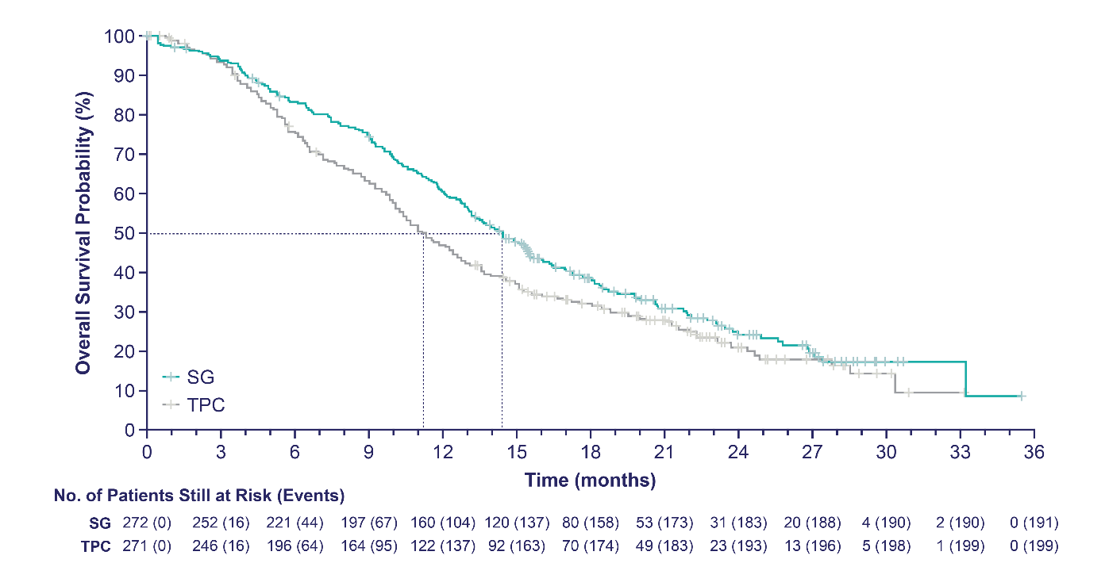
TROPiCs-02: Overall Survival
12 months
SG demonstrated a statistically significant improvement in OS vs TPC with 21% reduction in the risk of death
  Having met statistical significance, no further formal statistical testing of OS will occur
Patients who received SG survived a median of 3.2 months longer than those who received TPC
 | SG (n=272) | TPC (n=271)
Number of events | 191 | 199
Median OS, mo (95% CI) | 14.4 (13.0–15.7) | 11.2 (10.1–12.7)
Stratified HR (95% CI) | 0.79 (0.65–0.96)
Stratified Log Rank P value | P=0.020
12-month OS rate, % (95% CI) | 61 (55–66) | 47 (41–53)
Median follow-up was 12.5 months.
Rugo HS, et al. ESMO 2022. Abstract 15530. Rugo HS, et al. Lancet. 2023;402(10411):1423-1433.
Notes:
Looking forward, this did result in overall survival. Relative risk reduction was about 21%. Hazard ratio of 0.79. P value was significant. 12-month OS rate was 61% versus 47%.

Slide 14
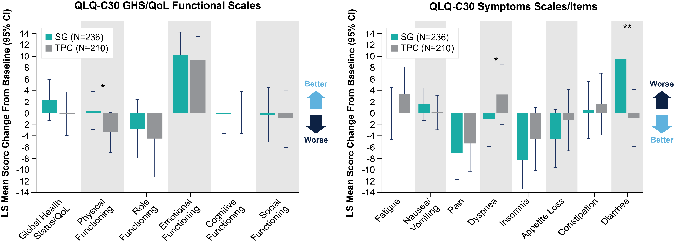
TROPiCs-02: Change From Baseline in HRQoL Status, Functioning, and Symptoms
Overall, the SG arm showed a trend in improvement for most assessments when compared with TPC
*P < 0.05. **P < 0.001.
Rugo HS, et al. ESMO 2022. Abstract 15530.
Notes:
As seen in this slide, an improvement was measured by a positive change in the functional scale or a negative change in the symptom scale
Patients in the SG arm showed a trend for improvement in most HRQoL domains
For QLQ-C30 functions and symptoms, statistically significant improvements in physical functioning and dyspnea were observed for patients receiving SG versus TPC
It is worth noticing the direction of change for the scales shown here. For example, while physical functioning was slightly improved with SG, it was deteriorating in the TPC arm. Same results are seen with global health status/QoL, dyspnea, but the opposite for diarrhea favoring TPC
No statistically significant differences between SG and TPC were observed for the other domains

Slide 15

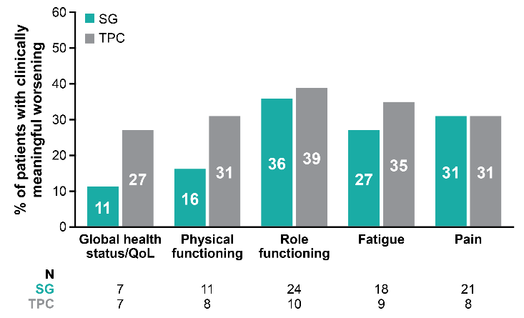
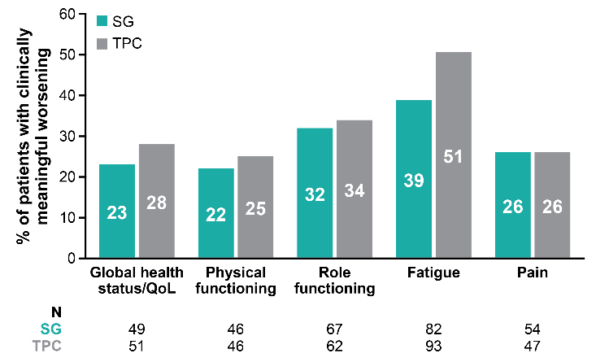
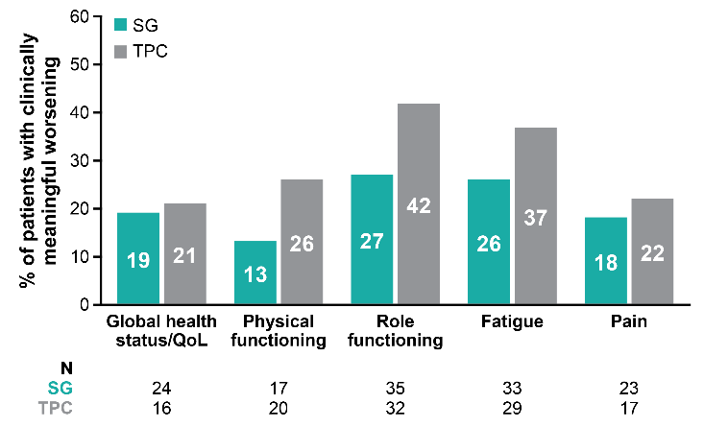

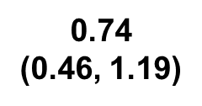
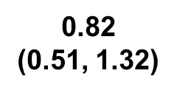
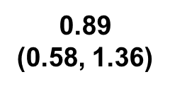
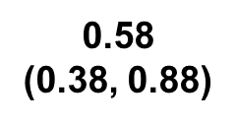
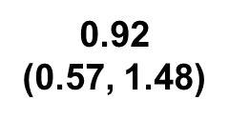
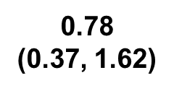
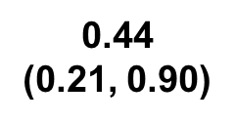
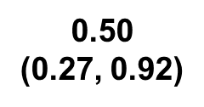
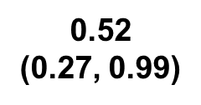
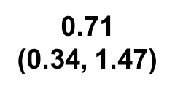
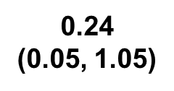
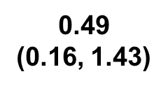
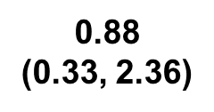
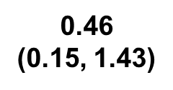
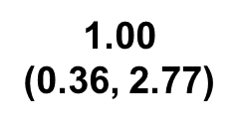
TROPiCs-02: Proportion of Patients with Clinically Meaningful Worsening of QoL
Cycle 2
Cycle 6
Cycle 11
Over time, a greater proportion of patients receiving TPC experienced clinically meaningful worsening of QoL vs those who received SG
Notes:
In these figures, each bar represents the proportion of patients with clinically meaningful worsening for each primary-focused HRQoL domain
As you can see, the proportions of patients with clinically meaningful worsening were higher in the TPC arm than in the SG arm across most timepoints
For example, over time, the proportion of patients with clinically meaningful worsening of HRQoL outcomes for TPC increased from 25% to 26% to 31%, while the proportion of patients with clinically meaningful worsening of HRQoL outcomes for SG decreased from 22% to 13% to 16%
For fatigue, the proportion of patients with clinically meaningful worsening of HRQoL outcomes for SG also decreased from 39% to 26% to 27% while the proportion for TPC decreased from 51% to 37% to 35%

Slide 16
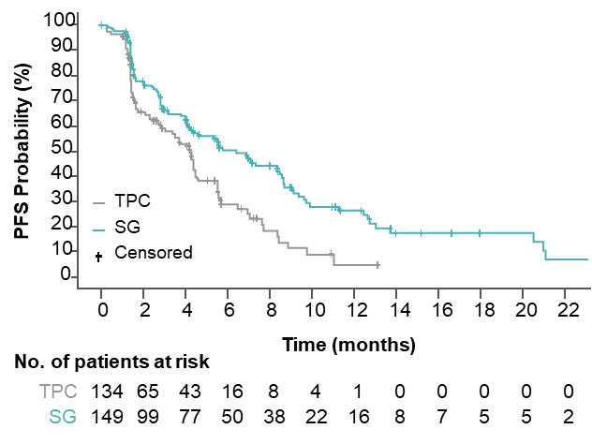
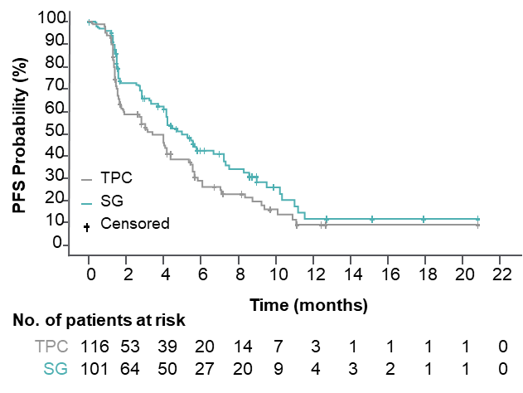
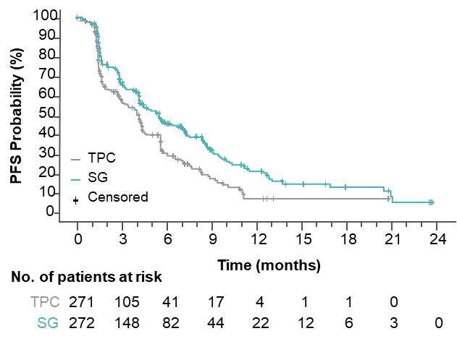
TROPiCs-02: Efficacy by HER2 Status
HER2-Lowª
HER2 IHC0
ITT¹
 | SG (n=149) | TPC (n=134)
Median PFS, mo | 6.4 | 4.2
HR (95% CI) | 0.58 (0.42–0.79), P<0.001
 | SG (n=101) | TPC (n=116)
Median PFS, mo | 5.0 | 3.4
HR (95% CI) | 0.72 (0.51–1.00), P=0.05
 | SG (n=272) | TPC (n=271)
Median PFS, mo (95% CI) | 5.5 (4.2–7.0) | 4.0 (3.1–4.4)
HR (95% CI) | 0.66 (0.53–0.83), P=0.0003
Within the HER2-low population, median PFS with SG vs TPC for the IHC1+ and IHC2+ subgroups was 7.0 vs 4.3 (HR, 0.57) and 5.6 vs 4.0 (HR, 0.58) months, respectively
The hazard ratio for median PFS in a sensitivity analysis of the HER2-low subgroup (excluding ISH-unverified) was similar (HR, 0.53)
ªHER2-low defined as IHC1+, or IHC2+ and ISH-negative/unverified. ^{b}39 patients with HER2 IHC2+ did not have ISH data documentation available for verification and were presumed to be HER2-low, consistent with the trial eligibility criteria to enroll HER2-negative patients.
1. Rugo HS, et al. J Clin Oncol. 2022;40(20):3365-3376.
Schmid P, et al. ESMO 2022. Abstract 214MO.
Notes:
SG significantly improved PFS vs TPC in both HER2-negative subgroups with a hazard ratio of 0.58 in patients with HER2-Low disease and 0.72 in the HER2 IHC-0 group
These results were consistent with that of the intent-to-treat population with a hazard ratio of 0.66

Slide 17
TROPiCs-02: Efficacy by TROP2 Expression
No impact of TROP2 expression on efficacy
<100 Subgroup
≥100 Subgroup
100
100
80
 | SG (n = 96) | TPC (n = 96)
Median PFS, mo (95% CI) | 5.3 (4.1–6.0) | 4.0 (2.8–5.6)
HR (95% CI) | 0.77 (0.54–1.09)
80
 | SG (n = 142) | TPC (n = 128)
Median PFS, mo (95% CI) | 6.4 (4.0–8.3) | 4.1 (2.1–4.5)
HR (95% CI) | 0.60 (0.44–0.81)
60
60
PFS probability (%)
PFS probability (%)
40
40
20
TPC
SG
20
TPC
SG
0
0
3
6
9
12
15
18
21
0
0
3
6
9
12
15
18
21
24
Number
Time (months)
Time (months)
SG
a
t risk (
e
v
e
n
ts)
Number
a
t risk (
e
v
e
n
ts)
TPC
96 (0)
53 (27)
24 (47)
13 (54)
5 (59)
0 (62)
SG
142(0)
77 (46)
50 (62)
25 (76)
15 (83)
10 (85)
4 (86)
2 (87)
0 (88)
96 (0)
39 (36)
19 (49)
10 (56)
2 (60)
0 (60)
TPC
128(0)
52 (48)
18 (72)
6 (78)
2 (81)
1 (81)
1 (81)
0 (81)
100
<100 Subgroup
100
≥100 Subgroup
 | SG (n = 96) | TPC (n = 96)
Median OS, mo (95% CI) | 14.6 (12.7–18.1) | 11.3 (10.0–13.3)
HR (95% CI) | 0.75 (0.54–1.04)
80
80
 | SG (n = 142) | TPC (n = 128)
Median OS, mo (95% CI) | 14.4 (12.7–16.4) | 4.1 (9.9–12.9)
HR (95% CI) | 0.83 (0.62–1.11)
60
60
OS probability (%)
OS probability (%)
40
40
20
TPC
SG
20
TPC
SG
0
0
3
6
9
12
15
18
21
24
27
30
33
0
0
3
6
9
12
15
18
21
24
27
30
33
36
Time (months)
Time (months)
a
t risk (
e
v
e
n
ts)
a
t risk (
e
v
e
n
ts)
Number
Number
SG
96 (0)
90 (3)
79 (13)
72 (20)
57 (35)
43 (53)
28 (53)
18 (60)
9 (64)
5 (66)
1 (66)
1 (66)
SG
142(0)
132(9)
116(24)
102(37)
86(53)
61(73)
42(83)
28(90)
16(96)
10(98)
2 (99)
1 (99)
0 (99)
TPC
96 (0)
91 (5)
75 (21)
61 (34)
47 (48)
32 (62)
23 (68)
16 (72)
9 (74)
6 (75)
3 (76)
1 (76)
TPC
128(0)
117(8)
89(34)
78(45)
55(68)
41(79)
32(80)
22(83)
9(86)
4 (87)
1 (87)
0 (88)
Rugo HS, et al. Lancet. 2023;402(10411):1423-1433.
Notes:
Survival benefit was consistent across Trop-2 expression-level subgroups.

Slide 18
Datopotamab Deruxtecan (Dato-DXd)
Patients with relapsed/refractory advanced or metastatic TNBC have poor clinical outcomes¹
Dato-DXd is a differentiated TROP2-directed ADC designed with 3 components^{2,3}:
  A humanized anti-TROP2 IgG1 mAb
  A topoisomerase I inhibitor payload
  (exatecan derivative, DXd)
  A tetrapeptide-based cleavable linker
Dato-DXd has demonstrated highly encouraging antitumor activity and manageable AEs in the NSCLC cohort⁴
  6 mg/kg has been selected as the dose for expansion into other advanced tumor types
  Humanized
  Anti-TROP2 IgG1 mAb
Deruxtecan^{5,a}
Cleavable Tetrapeptide-Based Linker
Topoisomerase I Inhibitor
Payload (DXd)
ªActual drug positions may vary.
1. Bardia A, et al; ASCENT Clinical Trial Investigators. N Engl J Med. 2021;384(16):1529-1541. 2. Okajima D, et al. AACR-NCI-EORTC 2019. Abstract C026. 3. Nakada T, et al. Chem Pharm Bull (Tokyo). 2019;67(3):173-185. 4. Spira A, et al. WCLC 2020. Abstract 3407. 5. Krop I, et al. SABCS 2019. Abstract GS1-03.
Notes:
There are other TROP-2 ADCs that have been developed. Datopotamab deruxtecan is a humanized anti–TROP-2 antibody with a topoisomerase inhibitor payload. In this case, an exatecan derivative DXd and a tetrapeptide-based cleavable linker.

Slide 19
TROPION-Breast01: Study Design
Randomized, phase 3, open-label, global study (NCT05104866)
Key inclusion criteria:
Patients with HR+/HER2– breast cancer* (HER2‒ defined as IHC 0/1+/2+; ISH negative)
Previously treated with 1–2 lines
of chemotherapy (inoperable/metastatic setting)
Experienced progression on ET and for whom ET was unsuitable
ECOG PS 0 or 1
Dato-DXd
6 mg/kg IV Day 1 Q3W
(n=365)
Endpoints:
Dual primary: PFS by BICR per RECIST v1.1, and OS
Secondary endpoints included: ORR,
PFS (investigator assessed), TFST,
safety, PROs
1:1
Investigator’s choice of chemotherapy (ICC)
as per protocol directions†
(eribulin mesylate D1,8 Q3W; vinorelbine D1,8 Q3W;
gemcitabine D1,8 Q3W; capecitabine D1–14 Q3W)
(n=367)
Randomization stratified by:
Lines of chemotherapy in unresectable/metastatic setting (1 vs 2)
Geographic location (US/Canada/Europe vs ROW)
Previous CDK4/6 inhibitor (yes vs no)
Treatment continued until PD, unacceptable tolerability, or other discontinuation criteria
Detailed description of the statistical methods published previously.¹
*Per American Society of Clinical Oncology/College of American Pathologists (ASCO/CAP) guidelines. †ICC was administered as follows: eribulin mesylate, 1.4 mg/m² IV on Days 1 and 8, Q3W; vinorelbine, 25 mg/m² IV on Days 1 and 8, Q3W; or gemcitabine, 1000 mg/m² IV on Days 1 and 8, Q3W; capecitabine, 1000 or 1250 mg/m² orally twice daily on Days 1 to 14, Q3W (dose per standard institutional practice).
Bardia A, et al; TROPION-Breast01 Investigators. J Clin Oncol. 2025;43(3):285-296.
1. Bardia A, et al. Future Oncol. 2024;20(8):423-436.
Notes:
In the TROPION-Breast01 trial, patients with hormone receptor-positive HER2-negative metastatic breast cancer that had progressed with at least one or two lines of chemo were randomized to Dato-DXd or investigator’s choice of chemotherapy, in this case eribulin, vinorelbine, gemcitabine, or cape. This was about 360 patients per arm, and there were dual primary endpoints of PFS and OS in this study.

Slide 20
TROPION-Breast01: PFS
PFS by BICR: primary endpoint
1.0
0.9
0.8
0.7
0.6
0.5
0.4
0.3
0.2
0.1
0
 | Dato-DXd | ICC
Median PFS, months (95% CI) | 6.9 (5.7–7.4) | 4.9 (4.2–5.5)
HR (95% CI) | 0.63 (0.52–0.76)
P-value | <0.0001
Probability of PFS
53.3%
37.5%
38.5%
25.5%
Dato-DXd (n=365)
18.7%
14.6%
ICC (n=367)
0
3
6 9
Time from randomization (months)
12
15
Number at risk
Dato-DXd 365
ICC 367
249
205
158
93
66
26
15
8
4
1
PFS by investigator assessment: Median 6.9 vs 4.5 months; HR 0.64 (95% CI 0.53‒0.76)
PFS by BICR was consistent across subgroups
Notes:
PFS was improved. Again, very similar hazard ratio to TROPiCS- 02, about a hazard ratio of 0.63. That was statistically significant. Absolute benefit was 6.9 months with Dato-DXd versus 4.9 months with investigator choice of chemo. And about 25% of the patients progressed on investigator choice of chemotherapy in the first 2 months, versus only about probably 15%. So about 15% of patients had a benefit here, again very similar to the TROPiCS-02 data but in a second- and third-line setting.

Slide 21
TROPION-Breast01: Time to First Subsequent Therapy
1.0
 | Dato-DXd | ICC
Median TFST, months (95% CI) | 8.2 (7.4–8.9) | 5.0 (4.6–5.7)
HR (95% CI) | 0.53 (0.45–0.64)
0.8
Probability of no first
subsequent therapy
0.6
0.4
0.2
Dato-DXd (n=365)
ICC (n=367)
0.0
0
3
6
9
12
15
18
Time from randomization (months)
Number at risk
Dato-DXd
365
304
231
110
36
7
0
ICC
367
256
147
65
13
4
0

Slide 22
TROPION-Breast01: PFS by BICR in Subgroups
Prior CDK4/6 Inhibitor
Prior duration of CDK4/6 inhibitor: ≤12 months
Prior duration of CDK4/6 inhibitor: >12 months
1.0
 | Dato-DXd | ICC
Median PFS, months (95% CI) | 6.9 (5.5–8.1) | 4.2 (4.0–5.5)
HR (95% CI) | 0.61 (0.45–0.81)
1.0
 | Dato-DXd | ICC
Median PFS, months (95% CI) | 7.1 (5.6–8.5) | 5.0 (4.1–5.7)
HR (95% CI) | 0.61 (0.45–0.82)
0.8
0.8
0.6
0.6
Probability of PFS
Probability of PFS
0.4
0.4
0.2
0.2
Dato-DXd (n=151)
Dato-DXd (n=153)
0.0
ICC (n=136)
0.0
ICC (n=164)
0
3
6
9
12
15
18
0
3
6
9
12
15
18
Time from randomization (months)
Time from randomization (months)
No. at risk
No. at risk
Dato-DXd
151
106
63
26
8
2
0
Dato-DXd
153
102
70
28
6
1
0
ICC
136
74
35
7
0
0
0
ICC
164
90
40
13
7
1
0
Notes:
Given the fact that this was post CDK4/6, it's interesting to note that it didn't matter the duration of prior CDK4/6 inhibitor here, that generally what the benefit was, still that hazard ratio of 0.61 with a benefit of about 2 to 3 months over investigator’s choice of chemotherapy, whether you had a rapid progression on CDK4/6 inhibitor or more than 12-month progression on CDK4/6 inhibitor.

Slide 23
TROPION-Breast01: Overall Survival
 | Dato-DXd | ICC
OS events, n (%) | 223 (61) | 213 (58)
Median OS, months (95% CI) | 18.6 (17.3–20.1) | 18.3 (17.3–20.5)
HR (95% CI) | 1.01 (0.83–1.22)
1.0
Maturity: 59.6%
Median follow-up: 22.8 months
Protocol prespecified OS sensitivity analysis based on the stratification factors according to the eCRF*:
HR 0.99 (95% CI: 0.82–1.20)
0.9
0.8
0.7
0.6
Probability of OS
0.5
0.4
0.3
0.2
Dato-DXd (n=365)
0.1
ICC (n=367)
0
0
3
6
9
12
15
18
21
24
27
30
33
36
Number at risk
Time from randomization (months)
Dato-DXd
365
349
331
299
259
227
180
118
49
12
1
ICC
367
335
309
283
249
213
175
123
51
9
1
Data cutoff: July 24, 2024. Pre-specified P-value boundary for OS analysis: ⍺=0.0427.
*Mis-stratification between interactive response technology (where data entered could not be changed by the site) and eCRF (where data could be corrected by sites) was <5%.
Pistilli B, et al. ESMO Virtual Plenary 2025. Abstract VP1-2025.
Notes:
Additionally, though, there was no difference in overall survival, which is about 18 months in both arms of the study.

Slide 24
TROPION-Breast01: Overall Survival Adjusted for Subsequent ADC Therapy
Post-hoc Sensitivity Analysis Using IPCW Method
1.0
 | Dato-DXd | ICC
OS events, n (%) | 195 (53) | 177 (48)
Median OS, months | 19.1 | 17.5
HR (95% CI) | 0.86 (0.70–1.06)
0.9
0.8
0.7
0.6
Probability of OS
0.5
0.4
0.3
0.2
Dato-DXd (n=365)
0.1
ICC (n=367)
0
0
3
6
9
12
15
18
21
24
27
30
33
Number at risk
Time from randomization (months)
Dato-DXd
365
348
327
290
245
212
163
105
43
12
2
ICC
367
329
285
243
196
158
120
79
29
8
2
Data cutoff: July 24, 2024.
Pistilli B, et al. ESMO Virtual Plenary 2025. Abstract VP1-2025.
Robins JM. American Statistical Association; 1993:24-33.
Robins JM, Finkelstein DM. Biometrics. 2000;56(3):779-788.
Sherry AD, et al. BMJ Oncology. 2024;3:e000322.
Notes:
And if you actually censored the use of another antibody-drug conjugate in the control arm, in this case most people in the control arm, at least those treated in the United States, were likely given trastuzumab deruxtecan for HER2-low disease. But if you censor those patients, you can see here still not statistically significant, but a little bit of a trend from 17.5 months to 19 months. But still, nonetheless, it's not a surprise because there were so many other therapies the patients received after they progressed on Dato-DXd or the control, that I think it's difficult to see a survival advantage in this population.

Slide 25
TROPION-Breast01: TTD in Global Health Status/Quality of Life
TTD* in GHS/QoL (confirmed)
1.0
0.8
0.6
Probability of
no deterioration
0.4
0.2
Dato-DXd (n=365)
ICC (n=367)
0.0
0
3
6
9
12
15
18
No. at risk
Time from randomization (months)
Dato-DXd
365
145
90
37
6
1
0
ICC
367
101
54
19
3
1
0
TTD* | Median TTD, months (first instance) |  | HR (95% CI) | Median TTD, months (confirmed) |  | HR (95% CI)
 | Dato-DXd | ICC |  | Dato-DXd | ICC
GHS/QoL | 3.4 | 2.1 | 0.85 (0.68–1.06) | 9.0 | 4.8 | 0.76 (0.58–0.98)
*TTD in pain, physical functioning and GHS/QoL are secondary endpoints. The primary analysis was based on time to first deterioration, defined as the time from date of randomization to date of first deterioration. Sensitivity analysis was based on time to confirmed deterioration, which required deterioration to be confirmed at a subsequent timepoint. Deterioration was defined as change from baseline that reached a clinically meaningful deterioration threshold (16.6 for GHS/QoL and pain, 13.3 for physical functioning).
Bardia A, et al. ESMO 2023. Abstract LBA11.

Slide 26
TROPION-Breast01: Overall Safety Summary
TRAEs, n (%)¹ | Dato-DXd (n=360) | ICC (n=351)
All grades | 337 (94) | 303 (86)
Grade ≥3 | 75 (21) | 157 (45)
Associated with dose reduction | 75 (21) | 106 (30)
Associated with dose interruption | 43 (12) | 86 (25)
Associated with discontinuation | 9 (3) | 9 (3)
Associated with death | 0 | 1 (0.3)
Serious TRAEs | 21 (6) | 32 (9)
Grade ≥3 | 17 (5) | 31 (8)
Most common TRAEs leading to dose interruption:
  Dato-DXd: fatigue*, infusion-related reaction, ILD, stomatitis (each 1%)
  ICC: neutropenia† (17%), leukopenia‡ (3%)
No TRAEs led to discontinuation in ≥1% of patients in either arm
One treatment-related death in the ICC arm due to febrile neutropenia
*Fatigue includes the preferred terms of fatigue, asthenia, and malaise. †Neutropenia includes the preferred terms neutropenia and neutrophil count decreased. ‡Leukopenia includes the preferred terms of white blood cell count decreased and leukopenia.
Bardia A, et al. ESMO 2023. Abstract LBA11.
Bardia A, et al; TROPION-Breast01 Investigators. J Clin Oncol. 2025;43(3):285-296.

Slide 27
TROPION-Breast01:
Adverse Events of Clinical Interest
Neutropenia* | Dato-DXd (n=360) | ICC (n=351)
Treatment-related neutropenia*, n (%)
Any grade | 39 (11) | 149 (42)
Grade ≥3 | 4 (1) | 108 (31)
Leading to dose interruption | 0 | 60 (17)
Leading to dose reduction | 1 (0.3) | 45 (13)
Leading to dose discontinuation | 0 | 1 (0.3)
G-CSF usage, n (%)
On treatment | 10 (3) | 81 (22)
Post-treatment† | 1 (0.3) | 30 (8)
Stomatitis‡ | Dato-DXd (n=360) | ICC (n=351)
Treatment-related stomatitis‡, n (%)
Any grade | 180 (50) | 46 (13)
Grade 3 | 23 (6) | 9 (3)
Leading to dose interruption | 5 (1) | 3 (1)
Leading to dose reduction | 44 (12) | 5 (1)
Leading to dose discontinuation | 1 (0.3) | 0
*Neutropenia includes the preferred terms neutropenia and neutrophil count decreased. Treatment-related febrile neutropenia occurred in 0 patients in the Dato-DXd arm and 8 patients (2.3%; all grade ≥3) in the ICC arm. †Administered after discontinuation of study treatment. ‡As part of the Oral Care Protocol specified in the study protocol, daily use of prophylaxis with a steroid-containing mouthwash (e.g., dexamethasone oral solution or a similar mouthwash regimen using an alternative steroid advocated by institutional/local guidelines) was highly recommended.
Bardia A, et al. ESMO 2023. Abstract LBA11.

Slide 28
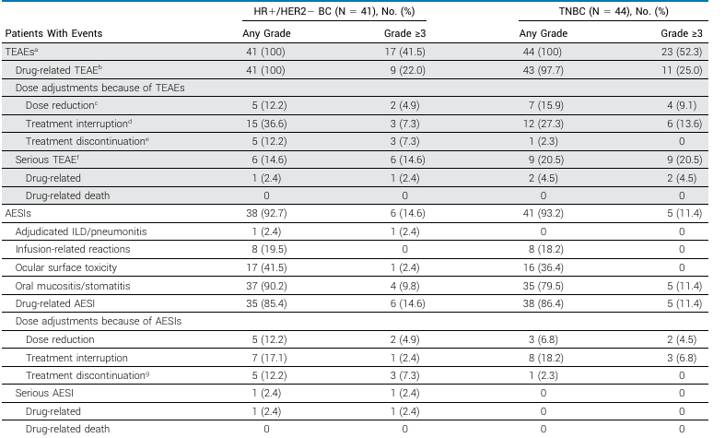
TROPION-Breast01: Adverse Events of Special Interest With Datopotamab Deruxtecan
Bardia A, et al. J Clin Oncol. 2024;42(19):2281-2294.

Slide 29
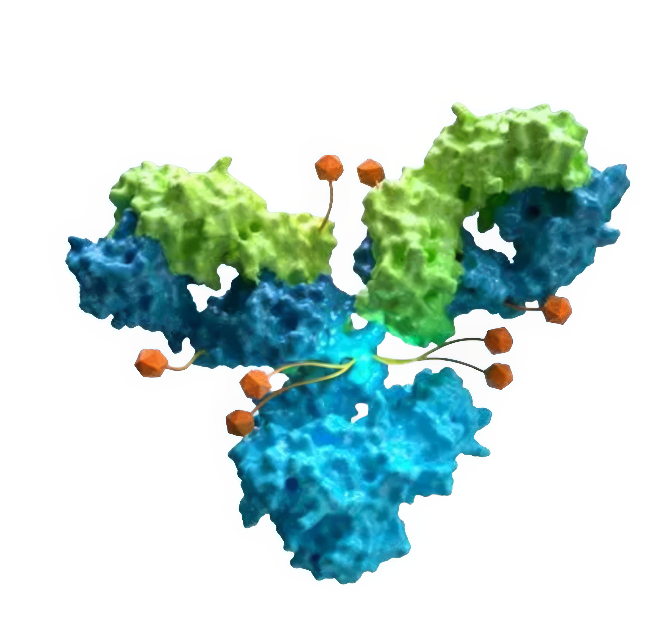
Sacituzumab Tirumotecan (Sac-TMT)
TROP2 ADC developed with a proprietary Kthiol (pyrimidine-thiol) linker conjugated to a novel topoisomerase I inhibitor at DAR 7.4
Antibody
hRS7, a recombinant humanized anti-TROP2 antibody with high affinity
Payload
Novel topo I inhibitor (a belotecan derivative), highly active
Average DAR: 7.4 (range: 7-8)
Bystander effect
Methylsulfonyl derivatization enhances linker stability and toxin permeability
Linker
Kthiol conjugation: irreversible coupling to improve stability of ADC
Payload release: intracellular cleavage and extracellular hydrolysis in TME
Balanced stability: balance between efficacy and safety to expand therapeutic window
Fang W, et al. J Clin Oncol. 2024;42(16_suppl):8502.
Notes:
The last of the three drugs is sac-TMT, or sacituzumab tirumotecan. This is an antibody-drug conjugate with a novel pyrimidine thiol linker conjugated to a novel topoisomerase inhibitor with a drug-to-antibody ratio of 7.4. It has improved stability of the antibody-drug conjugate, but you can get extracellular hydrolysis of the linker, even though it is more stable, allowing a bystander effect.

Slide 30
OptiTROP-Breast02: Study Design
Key Eligibility
﻿﻿HR+/HER2- BC*
﻿﻿Prior 1 - 4 lines of chemotherapy
﻿﻿At least one endocrine therapy, CDK 4/6 inhibitor, and taxane in any setting
Sac-TMT
5 mg/kg IV, Q2W
Primary endpoints
• PFS by BICR per RECIST v1.1
Secondary endpoints
• PFS (investigator assessed)
• OS
• ORR, DCR and
R
1:1
Investigator choice chemo (eribulin, capecitabine, gemcitabine or vinorelbine)
N=399
Stratification Factors:
﻿﻿﻿Lines of chemotherapy (1 vs > 1)
﻿﻿﻿HER2 status (zero vs low) *
﻿﻿﻿Endocrine therapy ≥ 6 months (yes vs no) †
Statistical considerations:
Pre-specified IA for PFS was performed when all patients had the opportunity to have 1 post-baseline scan and at least 188 PFS events were occurred
Pre-specified IA for OS: approximately 165 OS events occurred
Lan-DeMets O'Brien-Fleming a-spending function for both PFS and OS IA
*HER2-BC includes two subtypes: HER2-zero and HER2-low. HER2-zero: No staining, or barely perceptible staining with a proportion > 0% but ≤ 10%; HER2-low defined as IHC1+, or IHC2+/ISH-negative. † If no prior endocrine therapy in advanced setting, assess if (neo)adjuvant endocrine therapy duration ≥ 2 years.
Li M, et al. ESMO 2025. Abstract LBA23.
Notes:
The OptiTROP-Breast02 study was presented last year at ESMO. Again, very similar to the other two studies we talked about, women who had hormone receptor-positive HER2-negative metastatic breast cancer had prior one to two lines of chemotherapy and had to have at least one endocrine therapy, CDK4/6 inhibitor, and a taxane in any setting. Received sac-TMT at 5 mg/kg every 2 weeks versus investigator’s choice of chemotherapy, eribulin, cape, gem, or vinorelbine. Primary endpoint was PFS. Again, I think that it was a stepwise statistical trial. In other words, if you met the PFS endpoint, then you could go to the OS endpoint of this particular study.

Slide 31
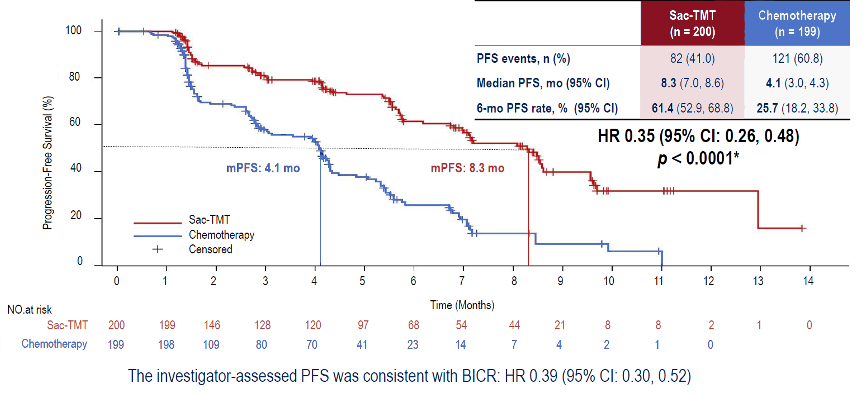
OptiTROP-Breast02: PFS
Li M, et al. ESMO 2025. Abstract LBA23.
Notes:
And you can see here, PFS was really quite dramatic with this particular drug. It's actually a doubling or more of progression-free survival. Sac-TMT is 8.3 months versus 4.1 months with chemotherapy, with a PFS rate of 61% versus chemotherapy alone of 25%. That seems to be a little bit lower than the other two trials. The control arm didn't perform as well, which is one kind of issue with this particular study. It was done mostly, if not all, in a Chinese population, and so therefore it wasn't as diverse a population, so that is a potential limitation of this data. But nonetheless, the hazard ratio is 0.35, which is statistically significant.

Slide 32
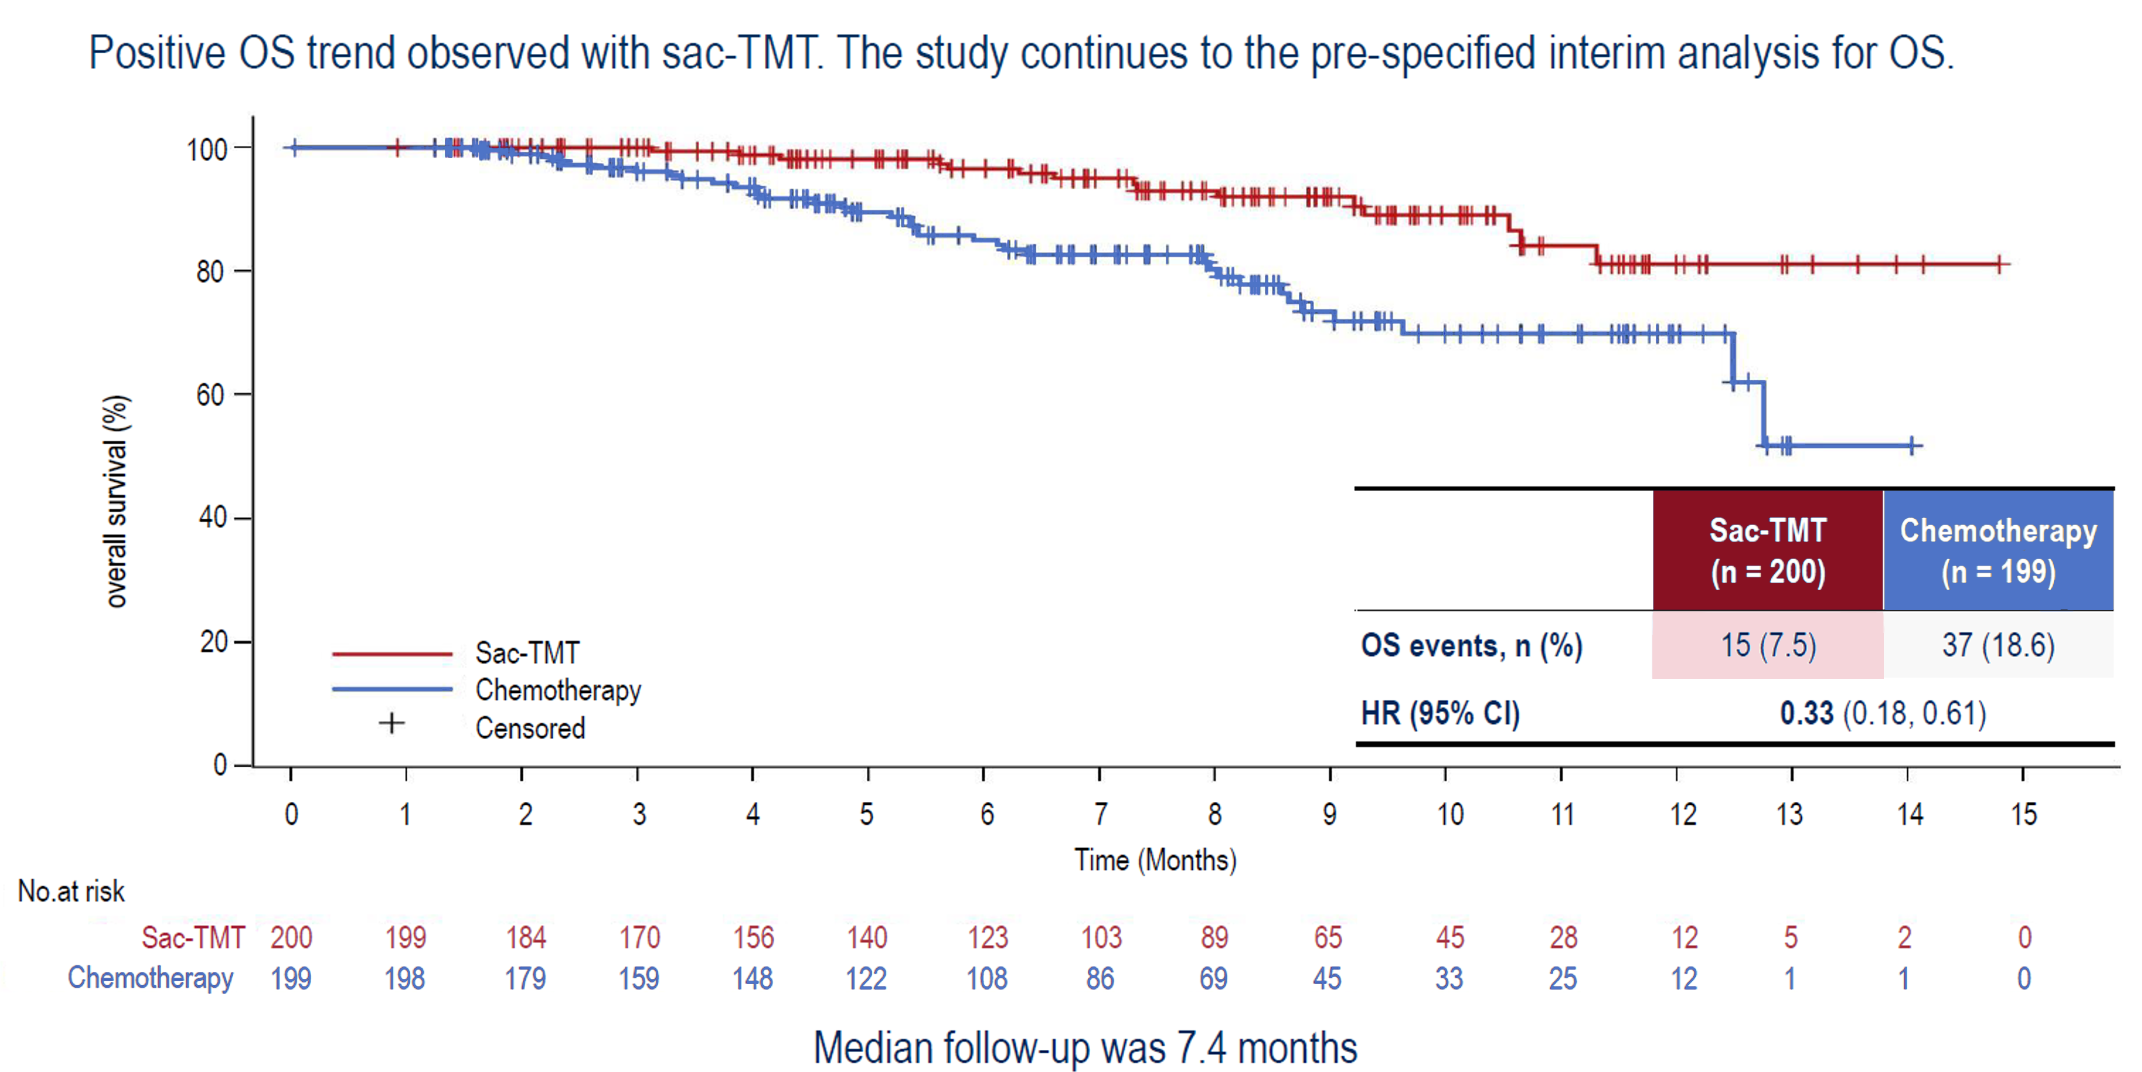
OptiTROP-Breast02: Overall Survival
Li M, et al. ESMO 2025. Abstract LBA23.
Notes:
And fairly dramatic data with an actual overall survival benefit, the hazard ratio for death was 0.33, again subject to a very short follow-up, only 7.4 months, so to be continued here.

Slide 33
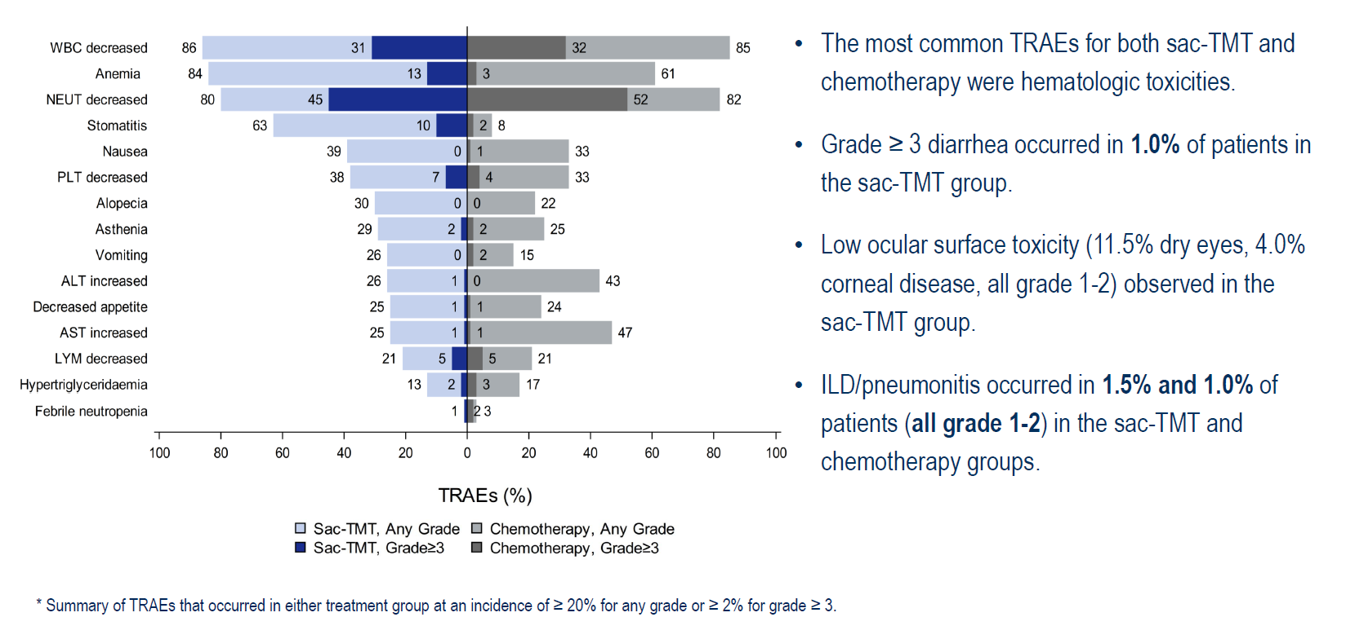
OptiTROP-Breast02: Common TRAEs*
Li M, et al. ESMO 2025. Abstract LBA23.

Slide 34
NCCN Guidelines: Recurrent Unresectable or Stage IV HR+ and HER2− Breast Cancer
HR+ and HER2− With Visceral Crisis or Endocrine Refractory
First-line | No germline BRCA1/2 PV and/or HER2 IHC 0+, 1+, or 2+/ISH-negative | Systemic chemotherapy (category 1, preferred)
 |  | Trastuzumab deruxtecan (other recommended)
 | Germline BRCA 1/2 PV | PARP inhibitor (category 1, preferred)
Second-line | HER2 IHC 1+ or 2+/ISH-negative | Trastuzumab deruxtecan (category 1, preferred)
 | HER2 IHC 0+ | Trastuzumab deruxtecan (other recommended)
 | Not a candidate for trastuzumab deruxtecan | Sacituzumab govitecan (category 1, preferred)
 |  | Systemic chemotherapy
 |  | Targeted therapy
 |  | For HER2 IHC 0, 1+, or 2+/ISH-negative: datopotomab deruxtecan (other recommended)
Notes:
So at this point in time, the NCCN guidelines do recommend for hormone receptor-positive disease that has either visceral crisis or endocrine-refractory disease, they recommend trastuzumab deruxtecan for those patients that are HER2-low, or those patients who are HER2 IHC 0 or not a candidate for trastuzumab deruxtecan. Generally, you could give sacituzumab govitecan, which is category 1, or generally datopotamab deruxtecan also. So these both are in the NCCN guidelines for second-line chemotherapy and beyond in this setting. So we do have two interesting agents. OptiTROP was not approved yet by the NCCN, given the limitations, as I described before, but nonetheless, I think it's something that we are actively pursuing in the US population and further phase 3 clinical trials.

Slide 35
Discussion: Selection and Sequencing in Clinical Practice
When to introduce ADCs in endocrine-refractory mBC
Practical sequencing of ADCs and the expanding
endocrine therapy landscape
Notes:
Note: The Phase 3 ASCENT-07 study investigating sacituzumab govitecan-hziy versus chemotherapy as a first-line treatment post-endocrine therapy in HR+/HER2-negative metastatic breast cancer patients did not meet the primary endpoint of progression-free survival (PFS) as assessed by Blinded Independent Central Review (BICR) according to RECIST v1.1 criteria. Overall survival is a key secondary endpoint and was not mature at the time of the primary analysis; however, an early trend was observed favoring patients treated with Trodelvy compared to chemotherapy. The ASCENT-07 study will continue to further assess overall survival. Sacituzumab govitecan-hziy remains a standard of care for pre-treated HR+/HER2-negative metastatic breast cancer based on the demonstrated overall survival results seen in the TROPiCS-02 study. https://www.gilead.com/news/news-details/2025/gilead-provides-update-on-phase-3-ascent-07-study

Slide 36
Current and Emerging Evidence Supporting TROP2-Targeted ADCs in TNBC
ASCENT
ASCENT-03
ASCENT-04
TROPION-Breast02
OptiTROP-Breast01
Notes:
So now we'll talk a little bit about triple-negative breast cancer.

Slide 37
ASCENT: SG vs Chemotherapy in Previously Treated mTNBC
Metastatic TNBC
≥2 chemotherapies for advanced disease
OR
>1 therapy for advanced disease progressing within 12 months of (neo)adjuvant
therapy
N=529
Sacituzumab Govitecan (SG)
10 mg/kg IV
days 1 & 8, every 21 days (n=267)
Continue treatment until progression or unacceptable toxicity
Endpoints Primary
PFS*
Secondary
﻿﻿PFS for the full population
﻿﻿OS, ORR, DOR, TTR, safety
R
1:1
Treatment of Physician's
Choice (TPC)
(n=262)
Data cutoff: March 11, 2020
PFS and OS were significantly longer with sacituzumab govitecan than with single-agent chemotherapy
  mPFS: 4.8 vs. 1.7 months (HR 0.41)
  mOS: 11.8 vs. 6.9 months (HR 0.51)
April 2021: FDA granted regular approval to sacituzumab govitecan for patients with unresectable locally advanced or mTNBC who have received two or more prior systemic therapies, at least one of them for metastatic disease
NCT02574455
Stratification factors
﻿Number of prior chemotherapies (2-3 vs >3)
﻿Geographic region (North America vs Europe)
﻿Presence/absence of known brain metastases (Yes/No)
Notes:
The first one is sacituzumab, and we have the ASCENT study, which is published in the New England Journal of Medicine almost 5 years ago now. And this took women with metastatic breast cancer and patients with metastatic breast cancer, occasional man, with more than two chemotherapies for advanced disease, and at least one in the advanced setting; 529 patients were randomized to physician’s choice of chemo or sacituzumab govitecan. The primary endpoint was PFS. Secondary endpoint was OS.
PFS was improved from 1.7 months to 4.8 months with a hazard ratio of 0.41. Overall survival was improved from 7 months to about 12 months with a hazard ratio of 0.51. And actually, the FDA granted a regular approval to sacituzumab for patients with unresectable, locally advanced or metastatic breast cancer who had received two or more prior systemic therapies, at least one of them for metastatic disease.
TPC: eribulin (1.4 mg per square meter of body-surface area [North America] or 1.23 mg per square meter [Europe] intravenously on days 1 and 8 of a 21-day cycle), vinorelbine (25 mg per square meter intravenously on day 1 weekly), capecitabine (1000 to 1250 mg per square meter orally twice daily on days 1 to 14 of a 21-day cycle), or gemcitabine (800 to 1200 mg per square meter intravenously on days 1, 8, and 15 of a 28-day cycle).

Slide 38
Treatment Related Adverse Effects:
Sacituzumab Govitecan vs TPC
 |  |  | SG (n=258) |  |  | TPC (n=224)
TRAE |  |  | All grade % | Grade 3, % | Grade 4, % | All grade, % | Grade 3, % | Grade 4, %
Hematologic | Neutropenia | Neutropenia Febrile neutropenia Anemia Leukopenia | 63 | 34 | 17 | 43 | 20 | 13
 | Anemia |  | 34 | 8 | 0 | 24 | 5 | 0
 | Leukopenia |  | 16 | 9 | 1 | 11 | 4 | 1
 | Febrile neutropenia |  | 6 | 5 | 1 | 2 | 2 | <1
Gastrointestinal | Diarrhea |  | 59 | 10 | 0 | 12 | <1 | 0
 | Nausea |  | 57 | 2 | <1 | 26 | <1 | 0
 | Vomiting |  | 29 | 1 | <1 | 10 | <1 | 0
Other | Fatigue | Fatigue Alopecia Decreased appetite Hyperglycemia Hypomagnesemia Hypophosphatemia | 45 | 3 | 0 | 30 | 5 | 0
 | Alopecia |  | 46 | 0 | 0 | 16 | 0 | 0
Key grade ≥3 TRAEs (SG vs TPC): neutropenia (51% vs 33%), diarrhea (10% vs <1%), leukopenia (10% vs 5%), anemia (8% vs 5%), and febrile neutropenia (6% vs 2%)
No severe cardiovascular toxicity; no grade >2 neuropathy or grade >3 interstitial lung disease with SG
Bardia A, et al; ASCENT Clinical Trial Investigators. N Engl J Med. 2021;384(16):1529-1541.

Slide 39
ASCENT-03: Study Design
Treatment was continued until BICR-verified progression or unacceptable toxicity
Patients with previously untreated, locally advanced inoperable or metastatic TNBCª:
  Not candidates for PD-(L)1 inhibitors:
  PD-L1 negative^{b} tumors (CPS < 10)
  PD-L1 positive^{b} tumors (CPS ≥ 10) and previously treated with a PD-(L)1 inhibitor in curative setting
  Ineligible for a PD-(L)1 inhibitor due to a comorbidity
  ≥ 6 months since treatment in curative setting
  Previously treated, stable CNS metastases were allowed
Sacituzumab Govitecan (SG)
10 mg/kg IV
days 1 & 8, every 21 days (n=279)
Continue treatment until progression or unacceptable toxicity
Endpoints Primary
PFS by BICR^{d}
Secondary
OS
ORR, DOR, TTR by BICR^{d}
Safety
QOL
  N = 558
R
1:1
Chemotherapy
Paclitaxel 90 mg/m2 OR nab-Paclitaxel 100 mg/m2
(days 1, 8, and 15 of 28-day cycles) OR
Gemcitabine 1000 mg/m2 + Carboplatin AUC2
(days 1 and 8 of 21-day cycles)
(n = 279)
Eligible patients were offered crossover to 2L SG, provided through the study, following BICR-verified disease progression
NCT02574455
Stratification factors
US/Canada/Western Europe vs rest of the world
De novo mTNBCc vs recurrent within 6 to 12 months of treatment vs recurrent after > 12 months from treatment in curative setting
Notes:
Now, I think the natural trial to do was a trial like ASCENT-03, which is to try sacituzumab govitecan as first-line therapy. And so ASCENT-03, which was initially presented at ESMO this year, published in New England Journal of Medicine late last year, took patients with previously untreated, locally advanced inoperable metastatic breast cancer who were not candidates for PD-1/L1 inhibitors, either they were CPS less than 10 or CPS greater than 10 and previously treated with a PD-1/L1 inhibitor in the curative setting or ineligible due to comorbidities, and they had to have at least 6 months since treatment in the curative setting.
They were randomized to sacituzumab or govitecan or chemotherapy with paclitaxel, and they had paclitaxel or gemcitabine/carboplatin. Now, 81% of the patients actually in the chemotherapy arm crossed over to second-line sacituzumab govitecan. That's an important aspect of this trial.

Slide 40
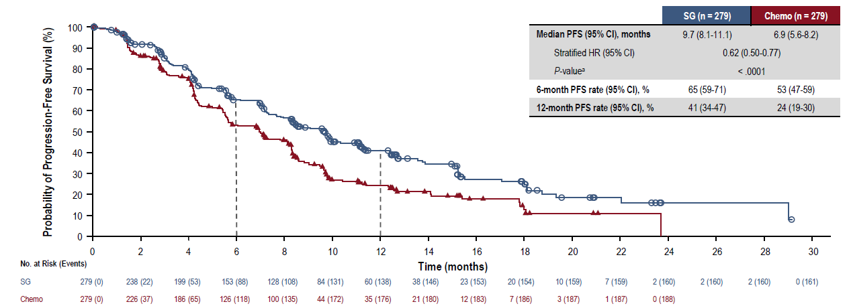
ASCENT-03: Sacituzumab Govitecan vs Chemotherapy in Previously Untreated Metastatic TNBC – PFS
SG demonstrated statistically significant and clinically meaningful improvement in PFS vs chemo by BICR analysis, with a 38% reduction in risk of disease progression or death
Cortes J, et al. ESMO 2025. Abstract LBA20.
Notes:
As you can see here, sacituzumab did improve over chemotherapy with a hazard ratio of 0.62, 7 months in the chemo arm versus a little under 10 months in the sacituzumab arm. And again, this is really maintained at 12 months and beyond. The 12-month PFS is 41% sacituzumab versus 24% with chemo. And so that's the first trial in the first line. So now this is potentially moving this drug to the first line.

Slide 41
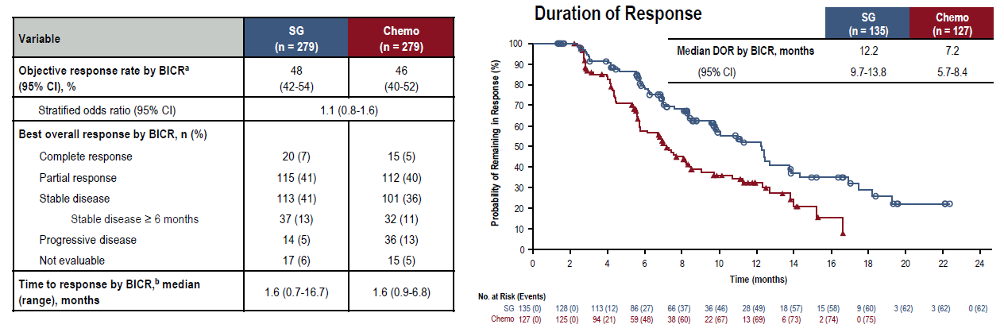
ASCENT-03: Tumor Response
Objective response rates were similar in both treatment groups; however, duration of response was substantially longer with SG vs chemo
Data cutoff date: April 2, 2025. *Objective response rate is defined as the proportion of patients who achieved a best overall response of complete response/partial response. *Time to response (months) = (date of first documented confirmed complete or
partial response - date of randomization + 1130.4375.
Cortes J, et al. ESMO 2025. Abstract LBA20.

Slide 42
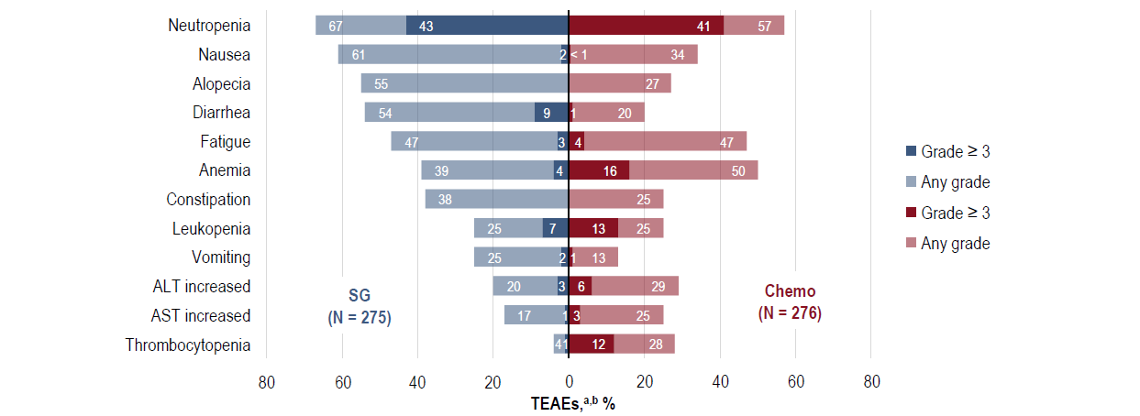
ASCENT-03: Safety Summary — Most Common AEs
The AEs observed are consistent with the known safety profile of SG
Data cutoff date: April 2, 2025. *TEAs were included if they occurred in ≥ 20% of patients in either group. *Combined preferred terms of Neutropenia includes neutrophil count decreased, Fatigue includes asthenia, Anemia includes hemoglobin decreased and red blood cell count decreased, Leukopenia includes white blood cell count decreased, and Thrombocytopenia includes platelet count decreased.
Cortes J, et al. ESMO 2025. Abstract LBA20.

Slide 43
ASCENT-04: KEYNOTE-D19 Study Design
Previously untreated, locally advanced unresectable, or metastatic TNBCª:
PD-L1-positive (CPS ≥ 10 by the 22C3 assay^{b})
﻿﻿≥ 6 months since treatment in curative setting (prior anti-PD-
(L]1 use allowed)
N = 443
SG + pembro^{d}
(SG 10 mg/kg IV, days 1 and 8 of
21-day cycles; pembro 200 mg,
day 1 of 21-day cycles)
n = 221
End points
Primary
PFS by BICRe
Secondary
﻿﻿OS
﻿﻿ORR, DOR by BICR^{e}
﻿﻿Safety
﻿﻿QoL
All treatment, including SG or chemo, was continued until BICR-verified disease progression or unacceptable toxicity
R
1:1
Chemo* + pembro^{d}
(paclitaxel 90 mg/m² OR nab-paclitaxel
100 mg/m² on days 1, 8, & 15 of 28-day cycles, OR gemcitabine 1000 mg/m² + carboplatin
AUC 2 on days 1 & 8 of 21-day cycles; pembro
200 mg on day 1 of 21-day cycles)
n = 222
Stratification factors:
De novo mTNBC^{c} vs recurrent within 6 to 12 months from completion of treatment in curative setting vs recurrent > 12 months from completion of treatment in curative setting
﻿US/Canada/Western Europe vs the rest of the world
﻿Prior exposure to anti-PD-(L)1 (yes vs no)
*Eligible patients who experienced BICR-verified disease progression were offered to cross-over to receive 2L SG monotherapy
ClinicalTrials.gov identifier: NCT05382296.
ªTNBC status determined according to standard American Society of Clinical Oncology-College of American Pathologists criteria. ^{b}Dako. Agilent Technologies. ^{c}Up to 35% de novo mTNBC Pembro was administered for a maximum of 35 cycles. •Per RECIST v1.1.
Tolaney SM, et al; ASCENT-04/KEYNOTE-D19 Clinical Trial Investigators. N Engl J Med. 2026;394(4):354-366.
Notes:
For PD-1/L1-positive patients, these are patients now with a CPS greater than 10, in ASCENT-04, 443 of these patients are randomized to sacituzumab and pembrolizumab or chemotherapy and pembrolizumab with a primary endpoint of PFS and secondary endpoints of overall survival.

Slide 44
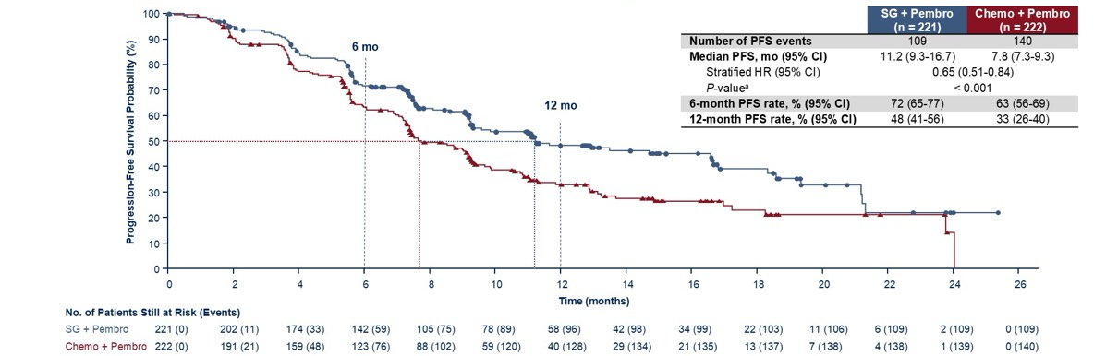
Progression-Free Survival by BICR
ASCENT-04: Progression-Free Survival by BICR
SG + pembro demonstrated statistically significant and clinically meaningful improvement in PFS vs chemo + pembro by BICR analysis, with a 35% reduction in risk of disease progression or death
Data cutott date: March 3. 20251
"Two sided P-value from stratified log-rank test.
Tolaney SM, et al; ASCENT-04/KEYNOTE-D19 Clinical Trial Investigators. N Engl J Med. 2026;394(4):354-366.
Notes:
And you can see here, giving chemo with sacituzumab resulted in a PFS of 11 months versus about 7.5 months, 7.8 months with chemo and pembro, for a hazard ratio again of about 0.56. A 6-month PFS rate of 72%, 12-month PFS rate of about 50%. So this is clearly an improvement over the standard and really does represent, potentially, as we're going to say at the end, a new standard of care to give the antibody-drug conjugates earlier in the treatment of triple-negative breast cancer.

Slide 45
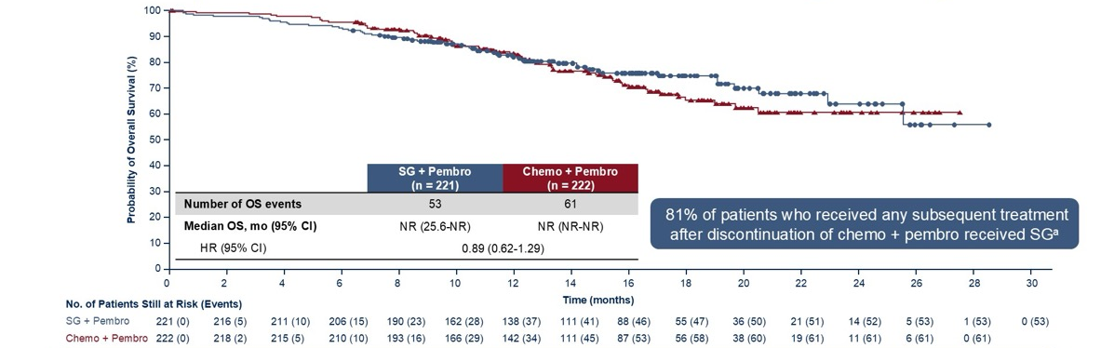
Slide 10
ASCENT-04: Descriptive Overall Survival
at Primary Analysis
OS data were immature (maturity rate, 26%), however, a positive trend in improvement was observed for SG + pembro vs chemo + pembro
Data cutoff date: March 3, 2025. Median follow-up was 14.0 months (range. 0.1-28.6),
*Or the 96 patients who received so monotherapy as subsequent anticancer therapy. 77 received it as part of the protocol-specified crossover after meeting ali crossover eligibility cateria, including BTCR-ventication of disease progression, the remaining 19 patients received subsequent SG monotherapy as commercial supply.
Tolaney SM, et al; ASCENT-04/KEYNOTE-D19 Clinical Trial Investigators. N Engl J Med. 2026;394(4):354-366.
Notes:
Overall survival was not reached, but again, not a lot of events had occurred here, 53 overall survival events out of 221 with the sacituzumab arm versus 61 in the chemo arm. But again, 81% of the patients did cross over. So while there was a trend, it's unclear, given the fact there is a survival advantage of sacituzumab in the second line, whether this will actually result in improved overall survival.

Slide 46
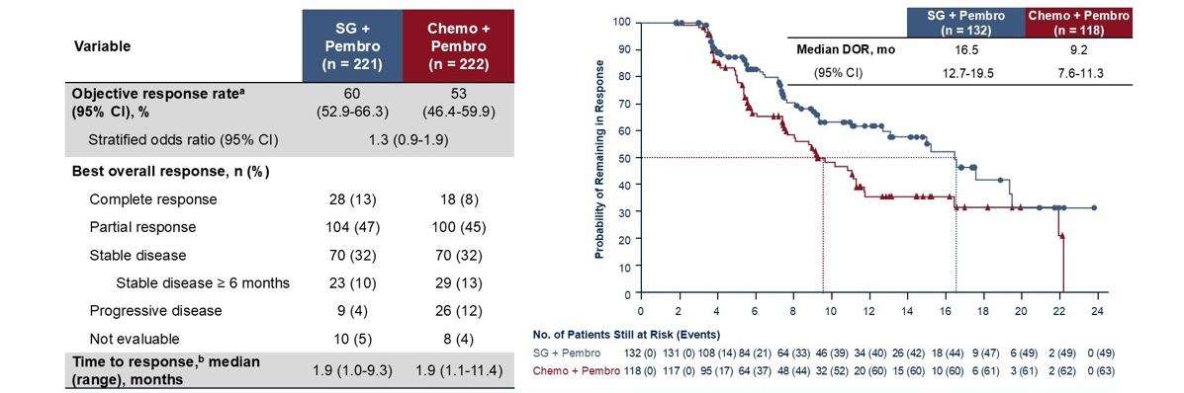
Tumor Responses and Duration of Response by BICR
ASCENT-04: Tumor Responses and Duration of Response by BICR
A substantially longer duration of response and a higher overall response rate (including an increased complete response rate) was observed for SG + pembro vs chemo + pembro
Data cutoff date: March 3. 2025.
*Objective response rate is defined as the proportion of patients who achieved a best overall response of complete response/partial response; Time to response (months) = (date of first documented complete or partial response - date of randomization + 1/30.4375
Tolaney SM, et al; ASCENT-04/KEYNOTE-D19 Clinical Trial Investigators. N Engl J Med. 2026;394(4):354-366.

Slide 47
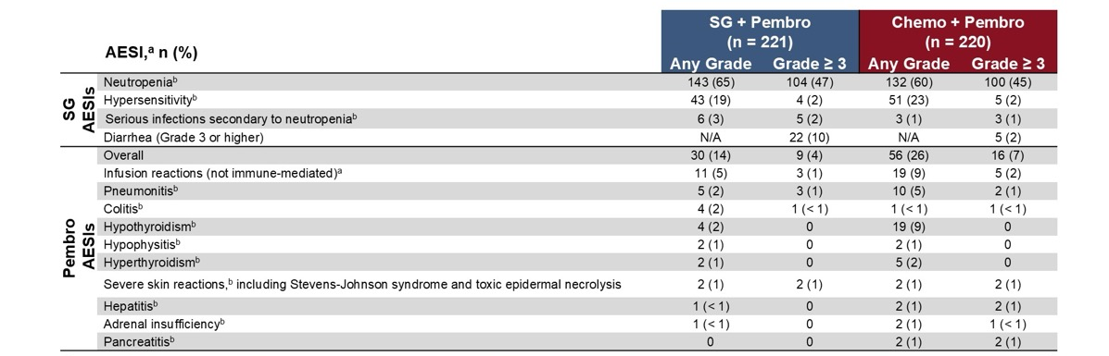
Adverse Events of Special Interest
ASCENT-04: Adverse Events of Special Interest
AESIs were consistent with the known safety profiles of each agent; no new safety concerns were observed and no increased rates of AESIs were observed when combining SG with pembro
AESIs were adverse events determined based on a prespecified list of Medcal Dictionary for Regulatory Activities (MedDRA) terms, which was updated with each new version of MeDRA, Immune mediated adverse events were determined based on a prespecified list of Medica
Dictionary for Regulatory Activities (MedDRA) terms, which was updated with each new version of MedDRA and specified as immune-mediated by the investigator. Data cutoff date: March 3, 2025
'AESIs observed in ≥1% of patients in either group are presented. "Grouped term.
Tolaney SM, et al; ASCENT-04/KEYNOTE-D19 Clinical Trial Investigators. N Engl J Med. 2026;394(4):354-366.

Slide 48
TROPION-Breast02: Study Design
Randomized, phase 3, open-label, global study (NCT05374512)
Key inclusion criteria:
Patients with histologically or cytologically documented locally recurrent inoperable or metastatic TNBC*
No prior chemotherapy or targeted systemic therapy in the locally recurrent inoperable or metastatic setting
Immunotherapy not an option†
ECOG PS 0 or 1
No minimum DFI‡
Dato-DXd
6 mg/kg IV Day 1 Q3W
(n=323)
Endpoints Dual primary:
OS
PFS by BICR per RECIST v1.1
Secondary included:
PFS (investigator-assessed)
ORR, DoR
Safety
R
1:1
Investigator’s choice of
chemotherapy (ICC)#
Paclitaxel, nab-paclitaxel, capecitabine, eribulin mesylate/eribulin, carboplatin
(n=321)
Randomization stratified by:
Geographic region (US/Canada/Europe vs other geographic regions)
PD-L1 status (high [CPS ≥10] vs low [CPS <10])§
DFI history (de novo vs prior DFI 0–12 months vs prior DFI >12 months)¶
Treatment continued until investigator-assessed RECIST v1.1 progressive disease, unacceptable toxicity, or another discontinuation criterion was met
Following progression or discontinuation of study treatment, patients could receive subsequent
therapies, including approved ADCs or chemotherapy, at the investigator’s discretion^{ǁ}
*According to ASCO/CAP criteria. †Including patients with PD-L1-low tumours, or patients with PD-L1-high tumours with (a) disease relapse after prior PD-(L)1 inhibitor therapy for early-stage breast cancer, (b) comorbidities precluding PD-(L)1 inhibitor therapy, or (c) no regulatory access to PD-(L)1 inhibitor therapy. ‡DFI defined as time between date of completion of treatment with curative intent and date of first documented local or distant disease recurrence. §Recruitment of patients with PD-L1-high tumours who would otherwise be eligible for pembrolizumab if regulatory access was available was capped at ~10% of randomized patients.
Recruitment of patients with DFI 0–12 months was capped at ~20% of randomized patients. #If no prior taxane, or prior taxane in the (neo)adjuvant setting and DFI >12 months: paclitaxel 80 mg/m2 IV, D1, 8, 15, Q3W, or nab-paclitaxel 100 mg/m2 IV, D1, 8, 15, Q4W; if prior taxane and DFI 0–12 months: capecitabine 1000 or 1250 mg/m2 orally twice daily, D1–14, Q3W (dose determined by standard institutional practice), or eribulin mesylate 1.4 mg/m2 / eribulin 1.23 mg/m2 IV, Day 1, 8, Q3W, or carboplatin AUC6 IV, D1, Q3W. ǁIn the Dato-DXd vs ICC arm, 65% vs 72% of patients received any subsequent therapy in any treatment line; 14% vs 30% received a subsequent ADC (sacituzumab govitecan, sacituzumab tirumotecan, trastuzumab deruxtecan).
Dent R, et al ESMO 2025. Abstract LBA21.
Notes:
Dato-DXd was also tested as first-line therapy in the TROPION-Breast02 study. And these are patients, again, with triple-negative breast cancer, had no minimum disease-free interval after progression, were randomized to Dato-DXd or investigator’s choice of chemotherapy with dual primary endpoint of overall survival and PFS. This, again, is first line.

Slide 49
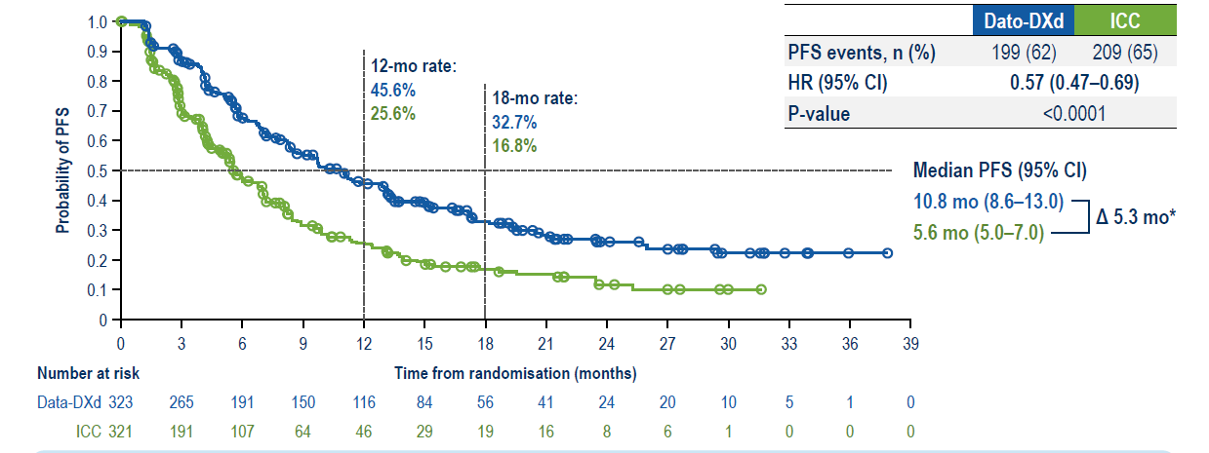
TROPION-Breast02: First-Line Dato-DXd in Locally Recurrent or Metastatic TNBC – PFS
Dato-DXd demonstrated a statistically significant and clinically meaningful improvement in PFS compared with ICC, reducing the risk of progression or death by 43%
Dent R, et al ESMO 2025. Abstract LBA21.
Notes:
And as you can see here, the PFS hazard ratio is 0.57, 5.6 months in the control arm and almost 11 months sacituzumab arm, again statistically significant.

Slide 50
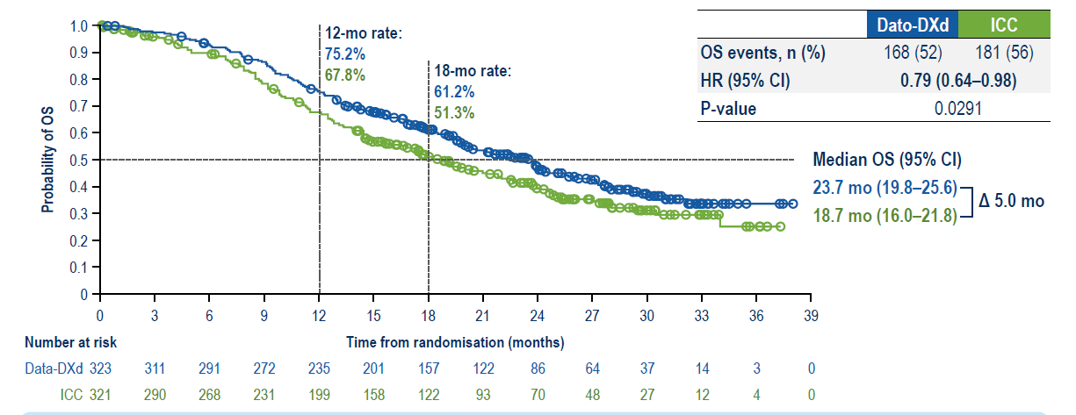
TROPION-Breast02: Overall Survival
Dato-Dd demonstrated a statistically significant and clinically meaningful improvement in OS compared with ICC, reducing the risk of death by 21%
Dent R, et al ESMO 2025. Abstract LBA21.
Notes:
There was also a statistically significant survival advantage here. As you can see here, the hazard ratio is 0.79 with a 12-month overall survival rate of 75% versus 67% with the investigator’s choice of chemotherapy. The median OS was about 2 years versus about a year and a half for the chemotherapy control arm. So again, this is for patients who are PD-1/L1 negative or unable to receive a checkpoint inhibitor as first-line therapy.
And as you can see in this population, like the ASCENT-03 and -04 study, or ASCENT-03 in particular, there was a statistically significant PFS benefit. And in this case, unlike ASCENT-03, there was an overall survival benefit.

Slide 51
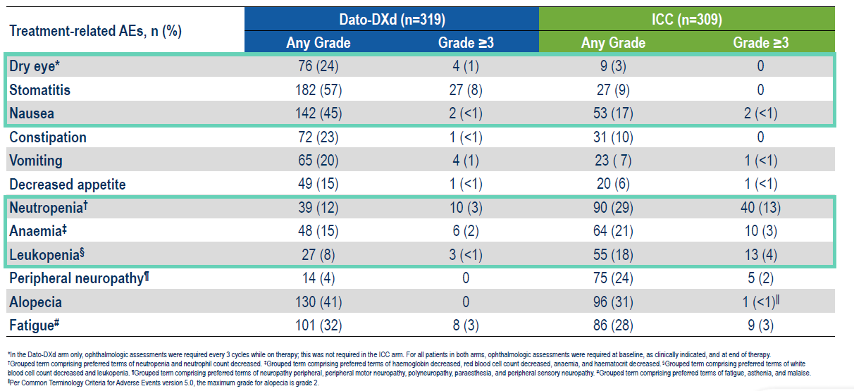
TROPION-Breast02: Most Common TRAEs
(≥15% of Patients)
Dent R, et al ESMO 2025. Abstract LBA21.

Slide 52
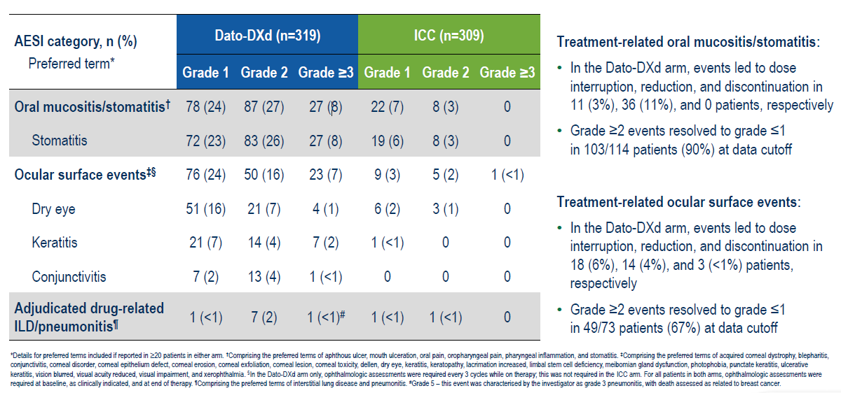
TROPION-Breast02: TRAEs for Dato-DXd
Dent R, et al ESMO 2025. Abstract LBA21.

Slide 53
OptiTROP-Breast01: Sac-TMT in Previously Treated Locally Recurrent or Metastatic TNBC
Patients with locally recurrent or metastatic TNBC
Relapsed or refractory to 2 or more prior chemotherapy regimens for unresectable, locally advanced or metastatic disease
For prior therapy, 1 could be in the (neo)adjuvant setting, provided progression occurred during treatment or within 12 months after treatment discontinuation
Received taxane(s) in any setting
Sac-TMT,
5 mg/kg IV, every 2 weeks
Endpointsª
Primary
PFS by BICR
Secondary
OS
PFS by investigator assessment
ORR, DOR
Treatment until disease progression, unacceptable toxicity or any other reason for discontinuation
R
1:1
Physician's choice of chemotherapy: eribulin, capecitabine, gemcitabine, or vinorelbine
Stratification factors
﻿Line of prior therapy (2-3 vs >3)
Presence of liver metastases (yes vs no)
Tumor assessment
Every 6 weeks for the first year and every 12 weeks afterward.
Xu B, et al. J Clin Oncol. 2024;42(16_suppl):104.
Notes:
The final study really to talk about is the OptiTROP-Breast01 study. This is sac-TMT in previously treated or locally recurrent or metastatic breast cancer. And again, these are patients who have relapsed or are refractory to two or more prior chemotherapy regimens. Again, at least one of them could be in the neoadjuvant setting. This was sac-TMT versus physician’s choice of chemotherapy and treatment until disease progression, with a primary endpoint being PFS by a blinded independent review, the secondary endpoint being overall survival.

Slide 54
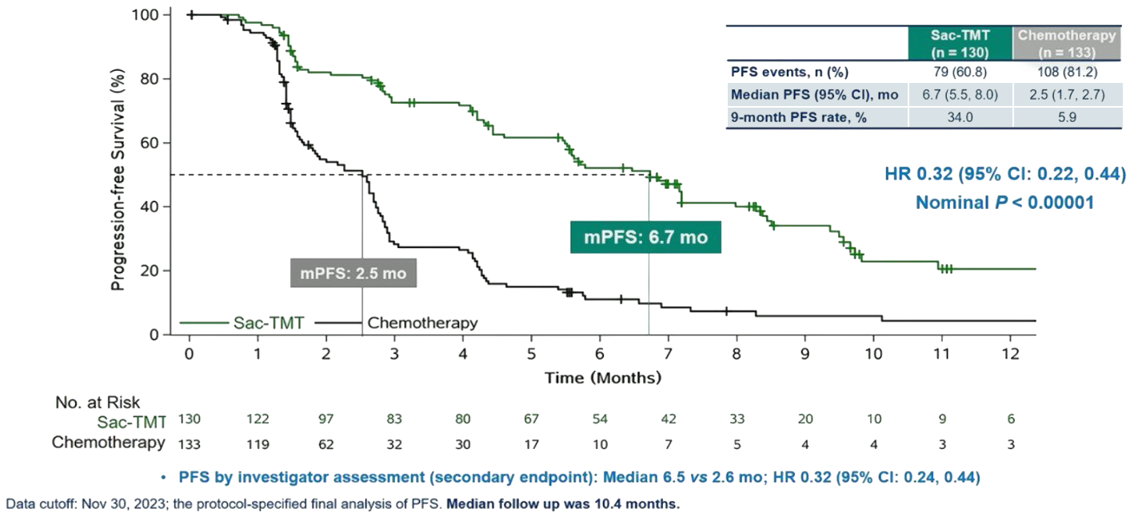
OptiTROP-Breast01: PFS by BICR (Final Analysis)
Xu B, et al. J Clin Oncol. 2024;42(16_suppl):104.
Notes:
As you can see here, this data was recently presented at ASCO 2024. And as you can see here, the PFS again was fairly dramatic. The PFS difference was 2.5 months in the chemotherapy arm and was 6.7 months in the sac-TMT arm, with a 9-month PFS rate of 34% versus 6% in the chemotherapy arm, a hazard ratio 0.32.
So again, the criticism of that last trial is that it was performed mostly in a Han Chinese population, and I think that whether we get those improved survival advantage in a more genomically heterogeneous population is unclear.

Slide 55
OptiTROP-Breast01: Tumor Response and Best Change in Target Lesions by BICR
In the overall population, the difference in ORR was 33.1%
(95% GI: 23.0, 43.2) favoring sac-TMT (P < 0.00001).
Median DOR was 7.1 mo with sac-TMT and 3.0 mo with chemotherapy (HR 0.50; 95% Cl 0.22, 1.13).
Xu B, et al. J Clin Oncol. 2024;42(16_suppl):104.
Sac-TMT ORR: 45.4%
High TROP2 expression
Low/medium TROP2 expression
Data cutoff: Nov 30, 2023; the protocol-specified final analysis of PFS.

Slide 56
NCCN Guidelines: Recurrent Unresectable or Stage IV TNBC
HR-Negative and HER2-Negative (Triple-Negative Breast Cancer)
First-line | PD-L1 CPS ≥10 regardless of germline BRCA1/2 PV status | Chemotherapy + pembrolizumab (category 1, preferred)
 |  | Sacitizumab govitecan + pembrolizumab (category 1, preferred)
 | PD-L1 CPS <10 and no germline BRCA1/2 PV | Sacitizumab govitecan (category 1, preferred)
 |  | Datopotamab deruxtecan (preferred)
 |  | Systemic chemotherapy
 | PD-L1 CPS <10 and germline BRCA1/2 PV | PARP inhibitor (category 1, preferred)
 |  | Platinum (category 1, preferred)
Second-line | Germline BRCA1/2 PV | PARP inhibitor (category 1, preferred)
 | Any | Sacitizumab govitecan (category 1, preferred)
 |  | Systemic chemotherapy or targeted agents
 | No germline BRCA1/2 PV and HER2 IHC 1+ or 2+/ISH-negative | Trastuzumab deruxtecan (other recommended)
Notes:
The guidelines at this point in time have now been changed. The most recent guidelines from the NCCN from early 2026, and you can see here for patients with a CPS greater than 10, regardless of BRCA status, the preferred regimen at this point in time is sacituzumab govitecan and pembro as category 1. With a CPS less than 10 and no germline BRCA mutations, I think that sacituzumab govitecan or datopotamab deruxtecan are both recommended by the NCCN. In the second line, if you've got a germline BRCA mutation, I think a PARP inhibitor is preferred, or if you haven't had sacituzumab at that point, that would be a reasonable place to put it per the NCCN guidelines.

Slide 57
Discussion: Selection and Sequencing in Clinical Practice
Criteria for identifying appropriate patients for ADC therapy
Looking ahead: future directions with ADCs in TNBC

Slide 58
Optimizing ADC Tolerability Through Interdisciplinary Care
Notes:
Prophylactic measures and interdisciplinary collaboration are essential to monitoring and managing ADC-related adverse events.

Slide 59
Sacituzumab Govitecan
Adverse Reaction | Management
Neutropenia | Patient education: contact healthcare provider immediately if experiencing any signs of infection Fever, chills, cough, shortness of breath, or burning/pain when urinating Primary prophylaxis: G-CSF is recommended starting in the first cycle in all patients at increased risk of febrile neutropenia Older patients, patients with previous neutropenia, poor performance status, organ dysfunction, or multiple comorbidities Monitor ANC during treatment Withhold for ANC <1500/mm³ or neutropenic fever Treat with G-CSF and administer prophylaxis in subsequent cycles
Diarrhea | Monitor patients with diarrhea Give fluid and electrolytes as needed Primary prophylaxis: loperamide At onset, evaluate for infectious causes and if negative promptly initiate loperamide Grade 3/4: withhold until resolved to ≤ Grade 1 and reduce subsequent doses
Nausea/Vomiting | Premedication Withhold for Grade 3 nausea or Grade 3/4 vomiting, resume when resolved to ≤ Grade 1
Infusion-related reactions | Premedication Monitor during infusion and for at least 30 minutes after completion Grade 1-3: slow infusion rate or interrupt infusion Grade 4: permanently discontinue
TRODELVY (sacituzumab govitecan-hziy). Prescribing information. Gilead Sciences, Inc; 2025.
Notes:
For sacituzumab govitecan, primary prophylaxis should include G-CSF for neutropenia, and loperamide for diarrhea. Premedication is also recommended for nausea/vomiting and infusion-related reactions.

Slide 60
Real World Data Evaluating Primary Prophylaxis with G-CSF and Loperamide
PRIMED Phase 2 trial in patients with TNBC or HR+/HER2- advanced breast cancer^{1,2}
  Prophylactic use of G-CSF and loperamide resulted in a significant decrease in frequency and intensity of sacituzumab govitecan-related neutropenia and diarrhea
  Minimized AE-related dosage adjustments, treatment interruptions, and discontinuations
Real-world analysis in patients with previously treated metastatic TNBC³
  Sacituzumab govitecan exhibited effectiveness and a manageable safety profile, aligning with results from the ASCENT study and other real-world investigations
  Low occurrence of neutropenia in patients who received prophylactic G-CSF
Real-world studies in metastatic TNBC patients undergoing sacituzumab govitecan therapy⁴
  More individuals received secondary prophylactic treatment with G-CSF rather than primary prophylactic G-CSF
  Patients who received G-CSF showed a longer median duration of sacituzumab govitecan treatment compared to those who did not
Notes:
Real-world data evaluating primary prophylaxis with G-CSF and loperamide show reduced sacituzumab govitecan-related neutropenia and diarrhea.

Slide 61
Datopotamab Deruxtecan
Adverse Reaction | Management
Ocular surface toxicity | Monitor patients for ocular adverse reactions during treatment Primary prophylaxis: preservative-free lubricating eye drops at least 4x daily and as needed Advise patients to avoid using contact lenses during treatment Ophthalmology visit for baseline ophthalmic exam at treatment initiation, annually while on treatment, at end of treatment, and as clinically indicated Promptly refer patients to an eye care professional for any new or worsening ocular signs and symptoms Withhold, reduce the dose, or permanently discontinue based on severity
Mucositis/ Stomatitis | Primary prophylaxis: steroid-containing mouthwash 4x daily and as needed Hold ice chips or ice water in mouth during infusion Monitor for signs and symptoms of stomatitis If stomatitis occurs, increase the frequency of mouthwash and administer other topical treatments as clinically indicated Withhold, reduce the dose, or permanently discontinue based on severity
ILD/Pneumonitis | Monitor for new or worsening respiratory signs and symptoms (dyspnea, cough, fever) If ILD/pneumonitis is suspected, withhold and initiate corticosteroids Grade ≥2: Permanently discontinue
Infusion-related reactions | Premedication Monitor patients for infusion-related reactions in a setting where cardiopulmonary resuscitation medication and equipment are available Monitor patients for at least 1 hour for the first 2 cycles of infusions If there are no infusion-related reactions observed, monitor patients for at least 30 minutes for all subsequent cycles of infusions
DATROWAY (datopotamab deruxtecan-dlnk). Prescribing information. Daiichi Sankyo, Inc.; 2025.
Notes:
For datopotamab deruxtecan, primary prophylaxis should include eye drops and steroid-containing mouthwash. Monitoring is needed for ILD/pneumonitis.

Slide 62
Discussion: Interdisciplinary Collaboration
Prophylactic Measures
to Improve Adherence and Outcomes
AE Management Insights
Interdisciplinary Management Strategies
Quality-of-life preservation as a shared goal across the care team
Avoiding early discontinuation through prophylaxis and early intervention when needed
Real world data evaluating primary prophylaxis with G-CSF and loperamide
Use of EMR alerts
Standardized antiemetic pathways
Dose modification thresholds
Management strategies to mitigate side effects and maintain dose intensity
Patient education and supportive care measures to enhance treatment adherence
Integrating pharmacists and nursing for proactive AE control

Slide 63
Practical Application:
Case-Based Learning Lab

Slide 64
Case 1
55-YEAR-OLD WOMAN
History and Diagnosis
Metastatic HR+ MBC (HER2 IHC = 1+)
Disease progression on various endocrine based therapies, most recently capecitabine
PS = 1
No organ dysfunction
Known history of inflammatory bowel disease
Labs
gBRCA = Negative
PIK3CA and ESR1 WT

Slide 65
Case Study: Question
Which therapy would you consider next?
Eribulin
Navelbine
Sacituzumab govitecan (SG)
Trastuzumab deruxtecan (T-DXd)
Unsure
Notes:
Correct answer: d) Trastuzumab deruxtecan (T-DXd)

Slide 66
Case 1
55-YEAR-OLD WOMAN
History and Diagnosis
Progression
Metastatic HR+ MBC (HER2 IHC = 1+)
Disease progression on various endocrine based therapies, most recently capecitabine
PS = 1
No organ dysfunction
Known history of inflammatory bowel disease
Patient started T-DXd
4 months after treatment developed symptomatic drug-related pneumonitis (grade 2)
T-DXd was discontinued
Labs
gBRCA = Negative
PIK3CA and ESR1 WT

Slide 67
Case Study: Question
Which therapy would you consider next?
Eribulin
Navelbine
Sacituzumab govitecan (SG)
Datopotamab deruxtecan (Dato-DXd)
Unsure
Notes:
Correct answer: c) Sacituzumab govitecan (SG)

Slide 68
NCCN Guidelines: Recurrent Unresectable or Stage IV HR+ and HER2− Breast Cancer
HR+ and HER2− With Visceral Crisis or Endocrine Refractory
First-line | No germline BRCA1/2 PV and/or HER2 IHC 0+, 1+, or 2+/ISH-negative | Systemic chemotherapy (category 1, preferred)
 |  | Trastuzumab deruxtecan (other recommended)
 | Germline BRCA 1/2 PV | PARP inhibitor (category 1, preferred)
Second-line | HER2 IHC 1+ or 2+/ISH-negative | Trastuzumab deruxtecan (category 1, preferred)
 | HER2 IHC 0+ | Trastuzumab deruxtecan (other recommended)
 | Not a candidate for trastuzumab deruxtecan | Sacituzumab govitecan (category 1, preferred)
 |  | Systemic chemotherapy
 |  | Targeted therapy
 |  | For HER2 IHC 0, 1+, or 2+/ISH-negative: datopotomab deruxtecan (other recommended)

Slide 69
Case 1
55-YEAR-OLD WOMAN
History and Diagnosis
Progression
Metastatic HR+ MBC (HER2 IHC = 1+)
Disease progression on various endocrine based therapies, most recently capecitabine
PS = 1
No organ dysfunction
Known history of inflammatory bowel disease
Patient started T-DXd
4 months after treatment developed symptomatic drug-related pneumonitis (grade 2)
T-DXd was discontinued
Patient started SG
On C2D1 presents with ANC = 800
Labs
gBRCA = Negative
PIK3CA and ESR1 WT

Slide 70
Case Study: Question
What would you recommend next?
Continue SG
Give G-CSF and continue SG
Hold SG, give G-CSF, and consider resuming SG once ANC recovers to grade 1 or less
Permanently discontinue SG
Unsure
Notes:
Correct answer: c) Hold SG, give G-CSF, and consider resuming SG once ANC recovers to grade 1 or less

Slide 71
Case 2
45-YEAR-OLD WOMAN
History and Diagnosis
De novo TNBC metastatic to the liver
PS = 1
No organ dysfunction
Hypertension
Labs
HER2 IHC = 1+
gBRCA = negative
CPS score on liver biopsy <10

Slide 72
Case Study: Question
Which therapy would you consider next?
Paclitaxel
Eribulin
Sacituzumab govitecan (SG)
Trastuzumab deruxtecan (T-DXd)
Unsure
Notes:
Correct answer: c) Sacituzumab govitecan (SG)

Slide 73
NCCN Guidelines: Recurrent Unresectable or Stage IV TNBC
HR-Negative and HER2-Negative (Triple-Negative Breast Cancer)
First-line | PD-L1 CPS ≥10 regardless of germline BRCA1/2 PV status | Chemotherapy + pembrolizumab (category 1, preferred)
 |  | Sacitizumab govitecan + pembrolizumab (category 1, preferred)
 | PD-L1 CPS <10 and no germline BRCA1/2 PV | Sacitizumab govitecan (category 1, preferred)
 |  | Datopotamab deruxtecan (preferred)
 |  | Systemic chemotherapy
 | PD-L1 CPS <10 and germline BRCA1/2 PV | PARP inhibitor (category 1, preferred)
 |  | Platinum (category 1, preferred)
Second-line | Germline BRCA1/2 PV | PARP inhibitor (category 1, preferred)
 | Any | Sacitizumab govitecan (category 1, preferred)
 |  | Systemic chemotherapy or targeted agents
 | No germline BRCA1/2 PV and HER2 IHC 1+ or 2+/ISH-negative | Trastuzumab deruxtecan (other recommended)

Slide 74
Case 2
45-YEAR-OLD WOMAN
History and Diagnosis
Progression
De novo TNBC metastatic to the liver
PS = 1
No organ dysfunction
Hypertension
Patient started SG
On C2D1 presents with ANC = 750
Labs
HER2 IHC = 1+
gBRCA = negative
CPS score on liver biopsy < 10

Slide 75
Case Study: Question
What would you recommend next?
Continue SG
Give G-CSF and continue SG
Hold SG, give G-CSF, and consider resuming SG once ANC recovers to grade 1 or less
Permanently discontinue SG
Unsure
Notes:
Correct answer: c) Hold SG, give G-CSF, and consider resuming SG once ANC recovers to grade 1 or less

Slide 76
Summary
TROP2 ADCs have revolutionized care of patients with HR+ mBC and TNBC
  Sacituzumab govitecan
    Approved for patients with unresectable locally advanced or metastatic HR+/HER2- breast cancer who have received endocrine-based therapy and ≥2 additional systemic therapies in the metastatic setting
    Approved for patients with unresectable locally advanced or mTNBC who have received ≥2 prior systemic therapies, at least one of them for metastatic disease
  Datopotamab deruxtecan
    Approved for patients with unresectable or metastatic HR+/HER2- breast cancer who have received prior endocrine-based therapy and chemotherapy for unresectable or metastatic disease
    Approved for patients with unresectable or mTNBC who are not candidates for PD-1/PD-L1 inhibitor therapy
  Sacituzumab tirumotecan
    In advanced stages of clinical development in phase 3 clinical trials
Movement of TROP ADCs into first-line treatment of TNBC
Prophylactic measures and interdisciplinary collaboration are essential
Notes:
In summary, TROP-2 ADCs really have revolutionized the care of patients with hormone receptor-positive metastatic breast cancer and triple-negative breast cancer. The real effort now is to move all of these TROP-2 ADCs into first-line treatment of metastatic disease.

Slide 77
Glossary
ADC, antibody-drug conjugate
ANC, absolute neutrophil count
BICR, blinded independent central review
CDK, cyclin-dependent kinase
CDK4/6i, cyclin-dependent kinase 4/6 inhibitor
CT, chemotherapy
DAR, drug-to-antibody ratio
Dato-DXd, datopotamab deruxtecan
ECOG PS, Eastern Cooperative Oncology Group performance status
ET, endocrine therapy
HER2, human epidermal growth factor receptor 2
HR, hazard ratio
HR, hormone receptor
HR+, hormone receptor–positive
ILD, interstitial lung disease
LIR, local independent review
LYM, lymphocyte
mBC, metastatic breast cancer
mPFS, median progression-free survival
ORR, overall response rate
PD-L1, programmed cell death ligand 1
PFS, progression-free survival
SG, sacituzumab govitecan
TACSTD2, tumor associated calcium signal transducer 2
T-DXd, trastuzumab deruxtecan
TFST, time to first subsequent therapy
TME, tumor microenvironment
TNBC, triple-negative breast cancer
TPC, treatment of physician's choice
TROP2, trophoblast cell-surface antigen 2
TTD, time to deterioration

