Slide 2
DISCLAIMER
This slide deck in its original and unaltered format is for educational purposes and is current as of January 2025. All materials contained herein reflect the views of the faculty, and not those of AXIS Medical Education, the CME provider, or the commercial supporter. Participants have an implied responsibility to use the newly acquired information to enhance patient outcomes and their own professional development. The information presented in this activity is not meant to serve as a guideline for patient management. Any procedures, medications, or other courses of diagnosis or treatment discussed or suggested in this activity should not be used by clinicians without evaluation of their patients’conditions and possible contraindications and/or dangers in use, review of any applicable manufacturer’s product information, and comparison with recommendations of other authorities.

Slide 3
DISCLOSURE OF UNLABELED USE
This activity may contain discussion of published and/or investigational uses of agents that are not indicated by the FDA. The planners of this activity do not recommend the use of any agent outside of the labeled indications.
The opinions expressed in the activity are those of the faculty and do not necessarily represent the views of the planners. Please refer to the official prescribing information for each product for discussion of approved indications, contraindications, and warnings.
USAGE RIGHTS
This slide deck is provided for educational purposes and individual slides may be
used for personal, non-commercial presentations only if the content and references
remain unchanged. No part of this slide deck may be published in print or
electronically as a promotional or certified educational activity without prior written
permission from AXIS. Additional terms may apply. See Terms of Service on
www.axismeded.com for details.

Slide 4
Learning Objectives
Upon completion of this activity, participants should be better able to:
Compare the novel MOA and the selectivity of reversible, noncovalent BTK inhibitors to that of irreversible, covalent BTK inhibitors
Apply real-world clinical evidence and clinical trial data on the efficacy and tolerability of reversible, noncovalent BTK inhibitors to incorporate them into evidence-driven treatment sequencing for patients with CLL/SLL or MCL
Integrate monitoring and management strategies for adverse events related to the use of reversible, noncovalent BTK inhibitors

Slide 5
Mechanisms and Advantages of BTK Inhibitors
Notes:
To start, let’s review the mechanisms and advantages that we see with BTK inhibitors.

Slide 6
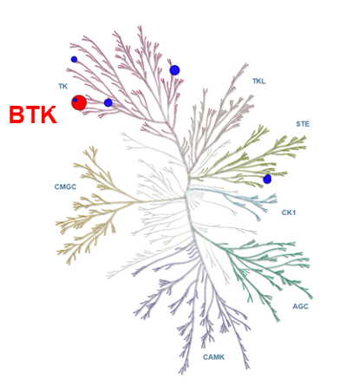
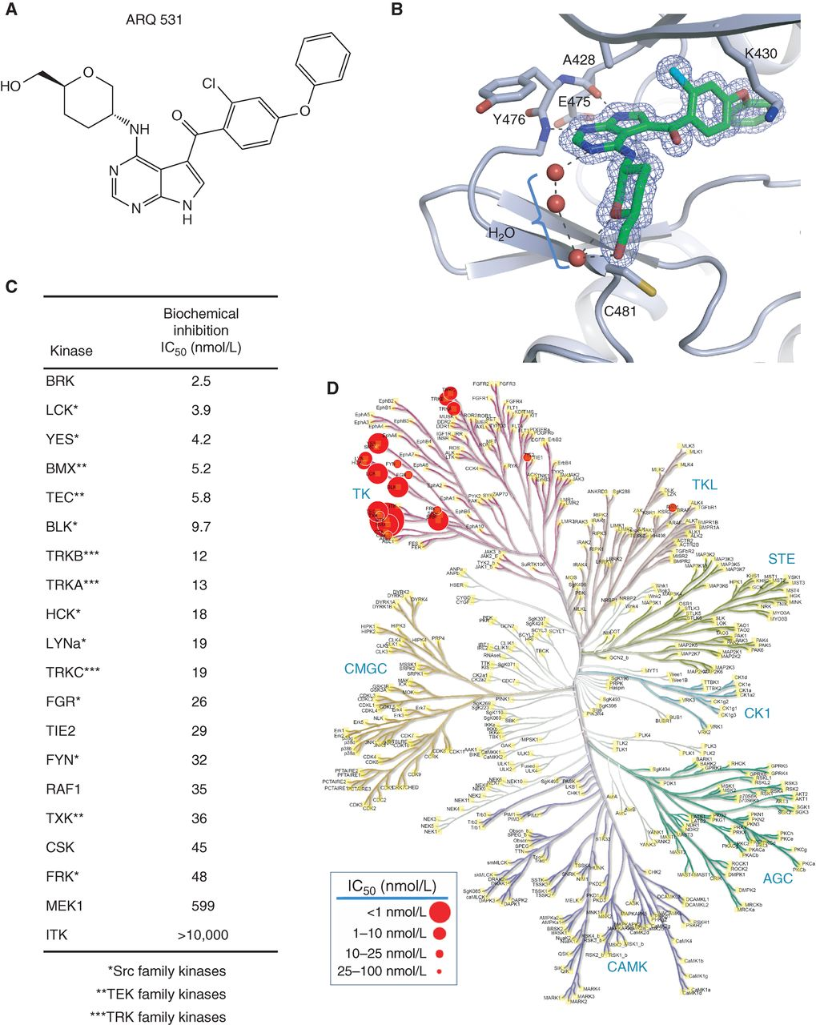
Covalent and Non-Covalent BTK Inhibitors Differ in Specificity, MOA, and Potential for Off-Target Effects
Covalent/ Irreversible
Ibrutinib
Acalabrutinib
Zanubrutinib
Noncovalent/ Reversible
Pirtobrutinib/LOXO-305
Nemtabrutinib/ARQ-531
Notes:
Kaptein A, de Bruin G, Emmelot-van Hoek M et al. Potency and selectivity of BTK inhibitors in clinical development for B-cell malignancies. Blood. 2018;132(suppl 1):1871.
First, we're fortunate now to have a variety of covalent and noncovalent BTK inhibitors, and these kinome plots differ in terms of their specificity, mechanism of action and potential for off-target effects. The three approved covalent or irreversible BTK inhibitors, including ibrutinib, acalabrutinib and zanubrutinib. Ibrutinib has the most off-target effects, whereas acalabrutinib and zanubrutinib are more selective for BTK. There's also a new class of noncovalent, or reversible, BTK inhibitors, including pirtobrutinib and nemtabrutinib. Pirtobrutinib is particularly selective for BTK, and nemtabrutinib also is fairly selective, although it does have a few off-target effects.
Additional Notes
Bruton tyrosine kinase (BTK) plays a crucial role as a nonreceptor tyrosine kinase in signal transduction through the B cell antigen receptor and various cell surface receptors in normal and malignant B lymphocytes (Burger, 2019). Activation of BTK triggers several downstream signaling pathways, including the phosphoinositide 3-kinase (PI3K)-AKT pathway and nuclear factor-κB (NFκB), which promote B-cell survival, proliferation, and differentiation (Burger, 2019). BTK signaling occurs in secondary lymphatic organs and is responsible for the proliferation of malignant B-cells, including those in chronic lymphocytic leukemia (CLL)/small lymphocytic lymphoma (SLL) and mantle cell lymphoma (MCL) (Burger, 2019; Pal Singh, 2018). Consequently, BTK has garnered significant interest, and small-molecule inhibitors targeting this kinase have demonstrated excellent anti-tumor activity in clinical studies (Byrd, 2013).
BTK inhibitors can be categorized as covalent (irreversible) or non-covalent (reversible) based on their binding mechanisms. Covalent BTK inhibitors bind to a specific cysteine residue at position 481 (C481) in the kinase domain of BTK, inhibiting its activity (Pal Singh, 2018). In contrast, non-covalent BTK inhibitors were developed to improve the pharmacological characteristics of covalent inhibitors while retaining their potency against BTK mutations. Unlike covalent inhibitors, non-covalent agents do not rely on binding to the specific cysteine residue and effectively inhibit both wild-type BTK and mutant BTK with C481 substitutions (Wang, 2022b). Despite the effectiveness of BTK inhibitors in treating BCM, treatment failure frequently occurs due to the development of resistance or intolerance, leading to discontinuation rates as high as 40% (Coutre, 2019). The primary cause of resistance to these BTK inhibitors in CLL/SLL and MCL is often attributed to point mutations that affect the binding site of covalent BTK inhibitors, specifically C481 (Nakhoda, 2023). Since BTK inhibitors like ibrutinib, acalabrutinib, and zanubrutinib form a covalent bond with C481, mutations in this region can hinder their efficacy (Burkart, 2022; Gomez, 2019). Consequently, outcomes for patients who experience disease progression while on BTK inhibitors are typically poor, underscoring the urgent need for alternative therapies to address this unmet medical need (Burkart, 2022). The approval of multiple BTK inhibitors for treating CLL/SLL and MCL has introduced increased complexity in clinical decision-making for patient care.

Slide 7
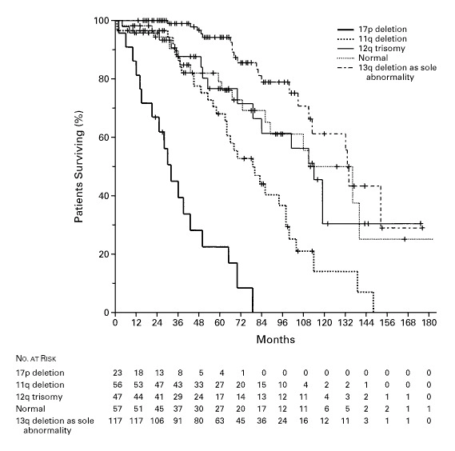
Covalent BTK Inhibitors Have Revolutionized the Treatment of CLL
Chemotherapy
Ibrutinib
100
90
Overall survival
80
70
60
50
Survival, %
Progression-free survival
40
30
20
10
0
0
1
2
3
4
5
6
7
8
Year
Number at Risk
Overall Survival
Progression-free survival
34
34
31
31
30
29
30
28
29
26
29
23
26
19
7
6
0
0
Notes:
Döhner H, Stilgenbauer S, Benner A, et al. Genomic aberrations and survival in chronic lymphocytic leukemia. N Engl J Med. 2000;343(26):1910-1916.
Ahn IE, Tian X, Wiestner A. Ibrutinib for chronic lymphocytic leukemia with TP53 alterations. N Engl J Med. 2020;383(5):498-500.
Itsara A, Sun C, Bryer E, et al. Long-term outcomes in chronic lymphocytic leukemia treated with ibrutinib: 10-year follow-up of a phase 2 study. Abstract presented at: American Society of Hematology Annual Meeting; San Diego, California; December 9-12, 2023. Abstract 201.
It's really important to understand that covalent BTK innovators really have revolutionized the treatment of CLL. One example of this is for patients with high-risk disease, defined by deletion 17p. On the left, you can see the historical results for those patients who are treated in an era of chemotherapy. And that dark line represents patients with deletion 17p where there was a median overall survival only in the range of about a year and a half to two years. On the right you can see longer term follow up from a single agent study of ibrutinib in patients with deletion 17p CLL, and the overall survival is still in the range of 80% with 6 years of follow up. So, really a dramatic improvement in the outcome for these high-risk patients, but also for patients even with lower genetic risk CLL.

Slide 8
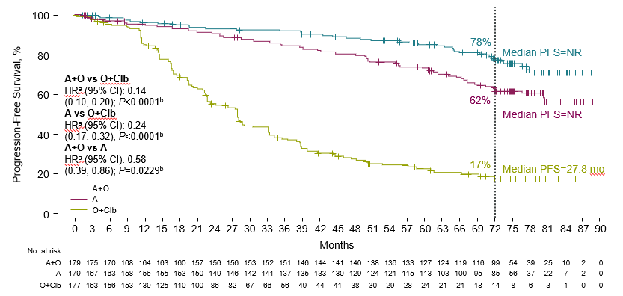
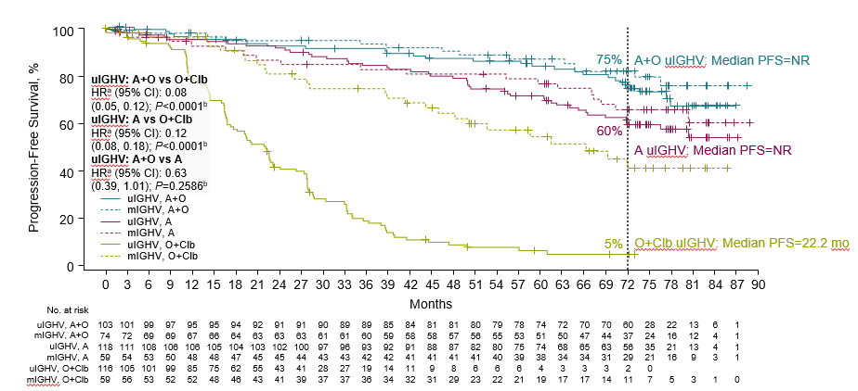
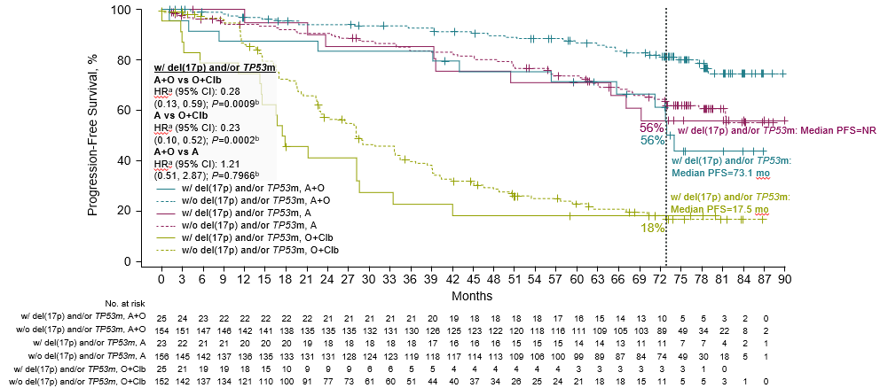
Acalabrutinib ± Obinutuzumab vs Chlorambucil + Obinutuzumab in Treatment-Naive CLL: 6-Year Follow-Up from ELEVATE-TN Trial
PFS for Overall Population
PFS by IGHV status
PFS by TP53 status
Notes:
Sharman JP, Egyed M, Jurczak W, et al. Acalabrutinib ± obinutuzumab vs obinutuzumab + chlorambucil in treatment-naive chronic lymphocytic leukemia: 6-year follow-up of Elevate-TN. Abstract presented at: American Society of Hematology Annual Meeting; San Diego, California; December 9-12, 2023. Abstract 636.
Previous reports of ELEVATE-TN (NCT02475681) at median follow-up of up to 58.2 months demonstrated superior efficacy of acalabrutinib (A) ± obinutuzumab (O) compared with O + chlorambucil (Clb) in patients with treatment-naive (TN) chronic lymphocytic leukemia (CLL). Herein, updated results at 74.5 months of follow-up are reported. Patients received A monotherapy, A+O, or O+Clb. Patients who progressed on O+Clb could cross over to A monotherapy. Investigator (INV)-assessed progression-free survival (PFS), INV-assessed overall response rate (ORR), overall survival (OS), and safety were evaluated. With a median follow-up of 74.5 months, the efficacy and safety of A+O and A monotherapy were maintained in patients with TN CLL, including in patients with high-risk genetic features. At 6 years of follow-up, PFS was significantly longer in patients treated with A+O vs A. Median OS was NR in any treatment arm and was significantly longer in patients treated with A+O vs O+Clb.

Slide 9
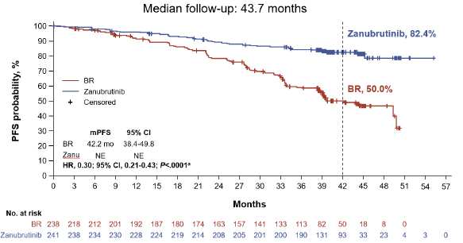
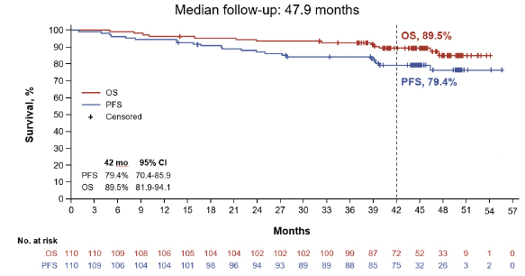
Efficacy Data from Phase 3 Open-Label SEQUOIA Study of Zanubrutinib vs. BR in Treatment-Naive CLL/SLL
PFS in non-del(17p)
PFS in del(17p)
CR/Cri rates: Zanubrutinib, 17.4%; BR, 21.8%
CR/Cri rate,14.5%
Notes:
Tam CS, Brown JR, Kahl BS, et al. Zanubrutinib versus bendamustine and rituximab in untreated chronic lymphocytic leukaemia and small lymphocytic lymphoma (SEQUOIA): a randomised, controlled, phase 3 trial [published correction appears in Lancet Oncol. 2023;24(3):e106]. Lancet Oncol. 2022;23(8):1031-1043.
Shadman M, Munir T, Robak T, et al. Zanubrutinib vs bendamustine + rituximab in patients with treatment-naive chronic lymphocytic leukemia/small lymphocytic lymphoma: extended follow-up of the SEQUOIA study. Abstract presented at: 17th International Conference on Malignant Lymphoma; Lugano, Switzerland; June 13-17, 2023. Abstract 154.
Zanubrutinib is a next-generation, selective Bruton tyrosine kinase inhibitor with efficacy in relapsed chronic lymphocytic leukemia (CLL) and small lymphocytic lymphoma (SLL). We compared zanubrutinib with bendamustine–rituximab to determine its effectiveness as frontline therapy in patients with CLL or SLL. Zanubrutinib significantly improved progression-free survival versus bendamustine–rituximab, with an acceptable safety profile consistent with previous studies. These data support zanubrutinib as a potential new treatment option for untreated CLL and SLL.
Updated efficacy and safety results from the SEQUOIA study after approximately 18 months of additional follow-up (data cutoff 31 Oct 2022) are reported. With extended follow-up in the SEQUOIA study, the efficacy of ZANU was maintained in pts w/o del(17p) with a safety profile aligned with long term follow-up for the BTKi class. In addition to the previously reported benefit in pts with unmutated IGHV, longer follow-up now shows benefit in those with mutated IGHV as well, and pts with del(17p) continue to demonstrate PFS benefits consistent with the randomized cohort. Rates of atrial fibrillation remain low and no new safety signals were identified. ZANU continues to be well tolerated over time with low rates of treatment discontinuation and remains a valuable frontline treatment option for CLL/SLL.

Slide 10
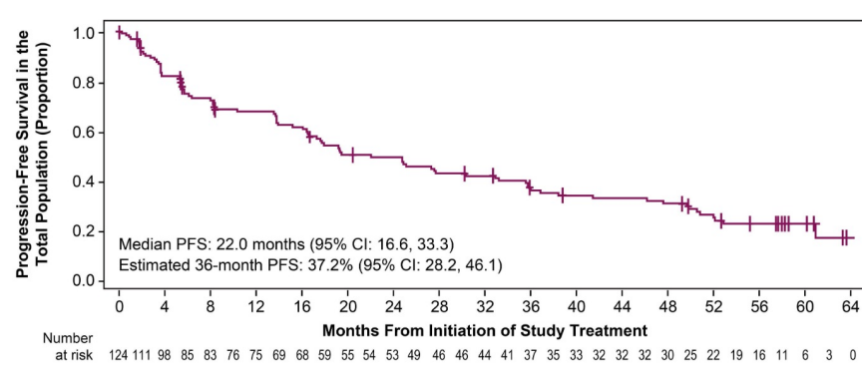
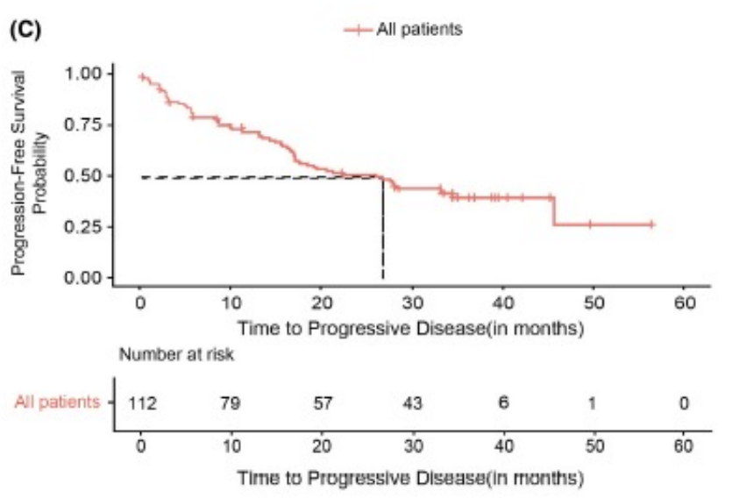
Second-Generation BTK Inhibitors a Preferred Option for 2nd Line MCL Treatment
Acalabrutinib
Zanubrutinib
Median Follow-up 38.1 months
Notes:
Le Gouill S, Długosz-Danecka M, Rule S, et al. Final results and overall survival data from a phase II study of acalabrutinib monotherapy in patients with relapsed/refractory mantle cell lymphoma, including those with poor prognostic factors. Haematologica. 2024;109(1):343-350.
Song Y, Zhou K, Zou D, et al. Long-term outcomes of second-line versus later-line zanubrutinib treatment in patients with relapsed/refractory mantle cell lymphoma: An updated pooled analysis. Cancer Med. 2023;12(18):18643-18653.
Left: Progression-free survival in the total population (A). In the total population, ORR and CR rates were 81.5% (95% confidence interval [CI]: 73.5-87.9) and 47.6% (95% CI: 38.5-56.7), respectively. With a median follow-up of 38.1 months, median DOR (mDOR) and median PFS (mPFS) were 28.6 months (95% CI: 17.5-39.1) and 22.0 months (95% CI: 16.6-33.3), respectively.
Right: Progression‐free survival (PFS) in R/R MCL patients treated with zanubrutinib. (C) overall pooled population. We previously reported results of a pooled analysis of two zanubrutinib studies in relapsed or refractory (R/R) MCL showing better survival outcomes when zanubrutinib is used in second-line versus later-line. Here, we present an updated pooled analysis with a longer follow-up of 35.2 months. Zanubrutinib in second-line treatment was associated with significantly improved OS compared with later-line treatment of R/R MCL. The PFS was similar between the two groups (HR, 0.78 [95% CI: 0.443, 1.373]; p = 0.389) but with numerically longer median PFS in the second-line versus later-line group (27.8 vs. 22.1 months).

Slide 11
Covalent BTK Inhibitors in CLL in Frontline Setting
Ibrutinib
As monotherapy
+ rituximab
Acalabrutinib
As monotherapy
Zanubrutinib
As monotherapy
+ obinutuzumab
+ obinutuzumab
Notes:
Wierda WG, Brown J, Abramson JS, et al. NCCN Clinical Practice Guidelines in Oncology (NCCN Guidelines®) for Chronic Lymphocytic Leukemia/Small Lymphocytic Lymphoma (Version 2.2023). © 2023 National Comprehensive Cancer Network, Inc. To view the most recent and complete version of the NCCN Guidelines®, go online to NCCN.org. ​

Slide 12
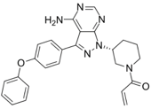
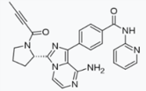
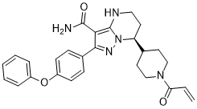
Application in the Community-Based Setting: Resistance/Intolerance
BTK C481 mutations confer resistance to the covalent BTK inhibitors ibrutinib, acalabrutinib, and zanubrutinib
Ibrutinib
Acalabrutinib
Zanubrutinib
Y223
C481
Y551
PH
TH
SH3
SH2
Kinase
Structure of the Bruton’s tyrosine kinase
K430
M477
D539
E475
Y476
BTK resistance contributes to disease progression and diminishes the efficacy of all covalent BTK inhibitors in CLL; resistance mechanisms less well understood in MCL¹⁻⁸
Notes:
1. Woyach JA, Ruppert AS, Guinn D, et al. BTK^{C481S}-mediated resistance to ibrutinib in chronic lymphocytic leukemia. J Clin Oncol. 2017;35(13):1437-1443. 2. Lampson BL, Brown JR. Are BTK and PLCG2 mutations necessary and sufficient for ibrutinib resistance in chronic lymphocytic leukemia? Expert Rev Hematol. 2018;11(3):185-194. 3. Burger JA, Barr PM, Robak T, et al. Long-term efficacy and safety of first-line ibrutinib treatment for patients with CLL/SLL: 5 years of follow-up from the phase 3 RESONATE-2 study. Leukemia. 2020;34(3):787-798. 4. Byrd JC, Harrington B, O'Brien S, et al. Acalabrutinib (ACP-196) in relapsed chronic lymphocytic leukemia. N Engl J Med. 2016;374(4):323-332. 5. Hershkovitz-Rokah O, Pulver D, Lenz G, Shpilberg O. Ibrutinib resistance in mantle cell lymphoma: clinical, molecular and treatment aspects. Br J Haematol. 2018;181(3):306-319. 6. Woyach JA, Furman RR, Liu TM, et al. Resistance mechanisms for the Bruton's tyrosine kinase inhibitor ibrutinib. N Engl J Med. 2014;370(24):2286-2294. 7. Woyach JA, Huang Y, Rogers K, et al. Resistance to acalabrutinib in CLL is mediated primarily by BTK mutations. Blood. 2019;134(suppl 1):504.
8. Xu L, Tsakmaklis N, Yang G, et al. Acquired mutations associated with ibrutinib resistance in Waldenström macroglobulinemia. Blood. 2017;129:2519-2525.
Acquired Resistance to Covalent BTK Inhibitors Is Generally Driven by Mutations in BTK at the C481 Site
Now, in the community setting, we've been using these drugs for several years now, particularly ibrutinib. And we've noticed that patients eventually will develop resistance in many cases. And most commonly, a mutation can arise in the BTK gene itself at the cysteine 481 (C481) position. When that mutation arises, it confers resistance to all three of these covalent BTK inhibitors. And we do think that these mutations contribute to disease progression and diminish the efficacy of all of these covalent BTK inhibitors in CLL. A variety of other mutations that have been described, primarily in the kinase domain. The resistance mechanisms in mantle cell lymphoma are less well understood, currently.

Slide 13
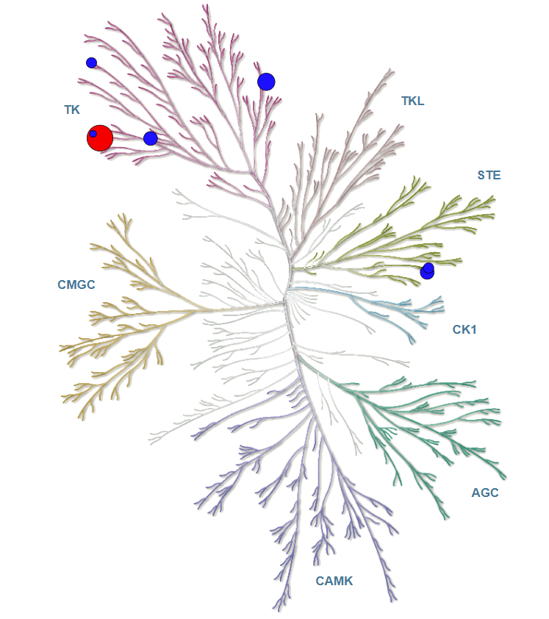
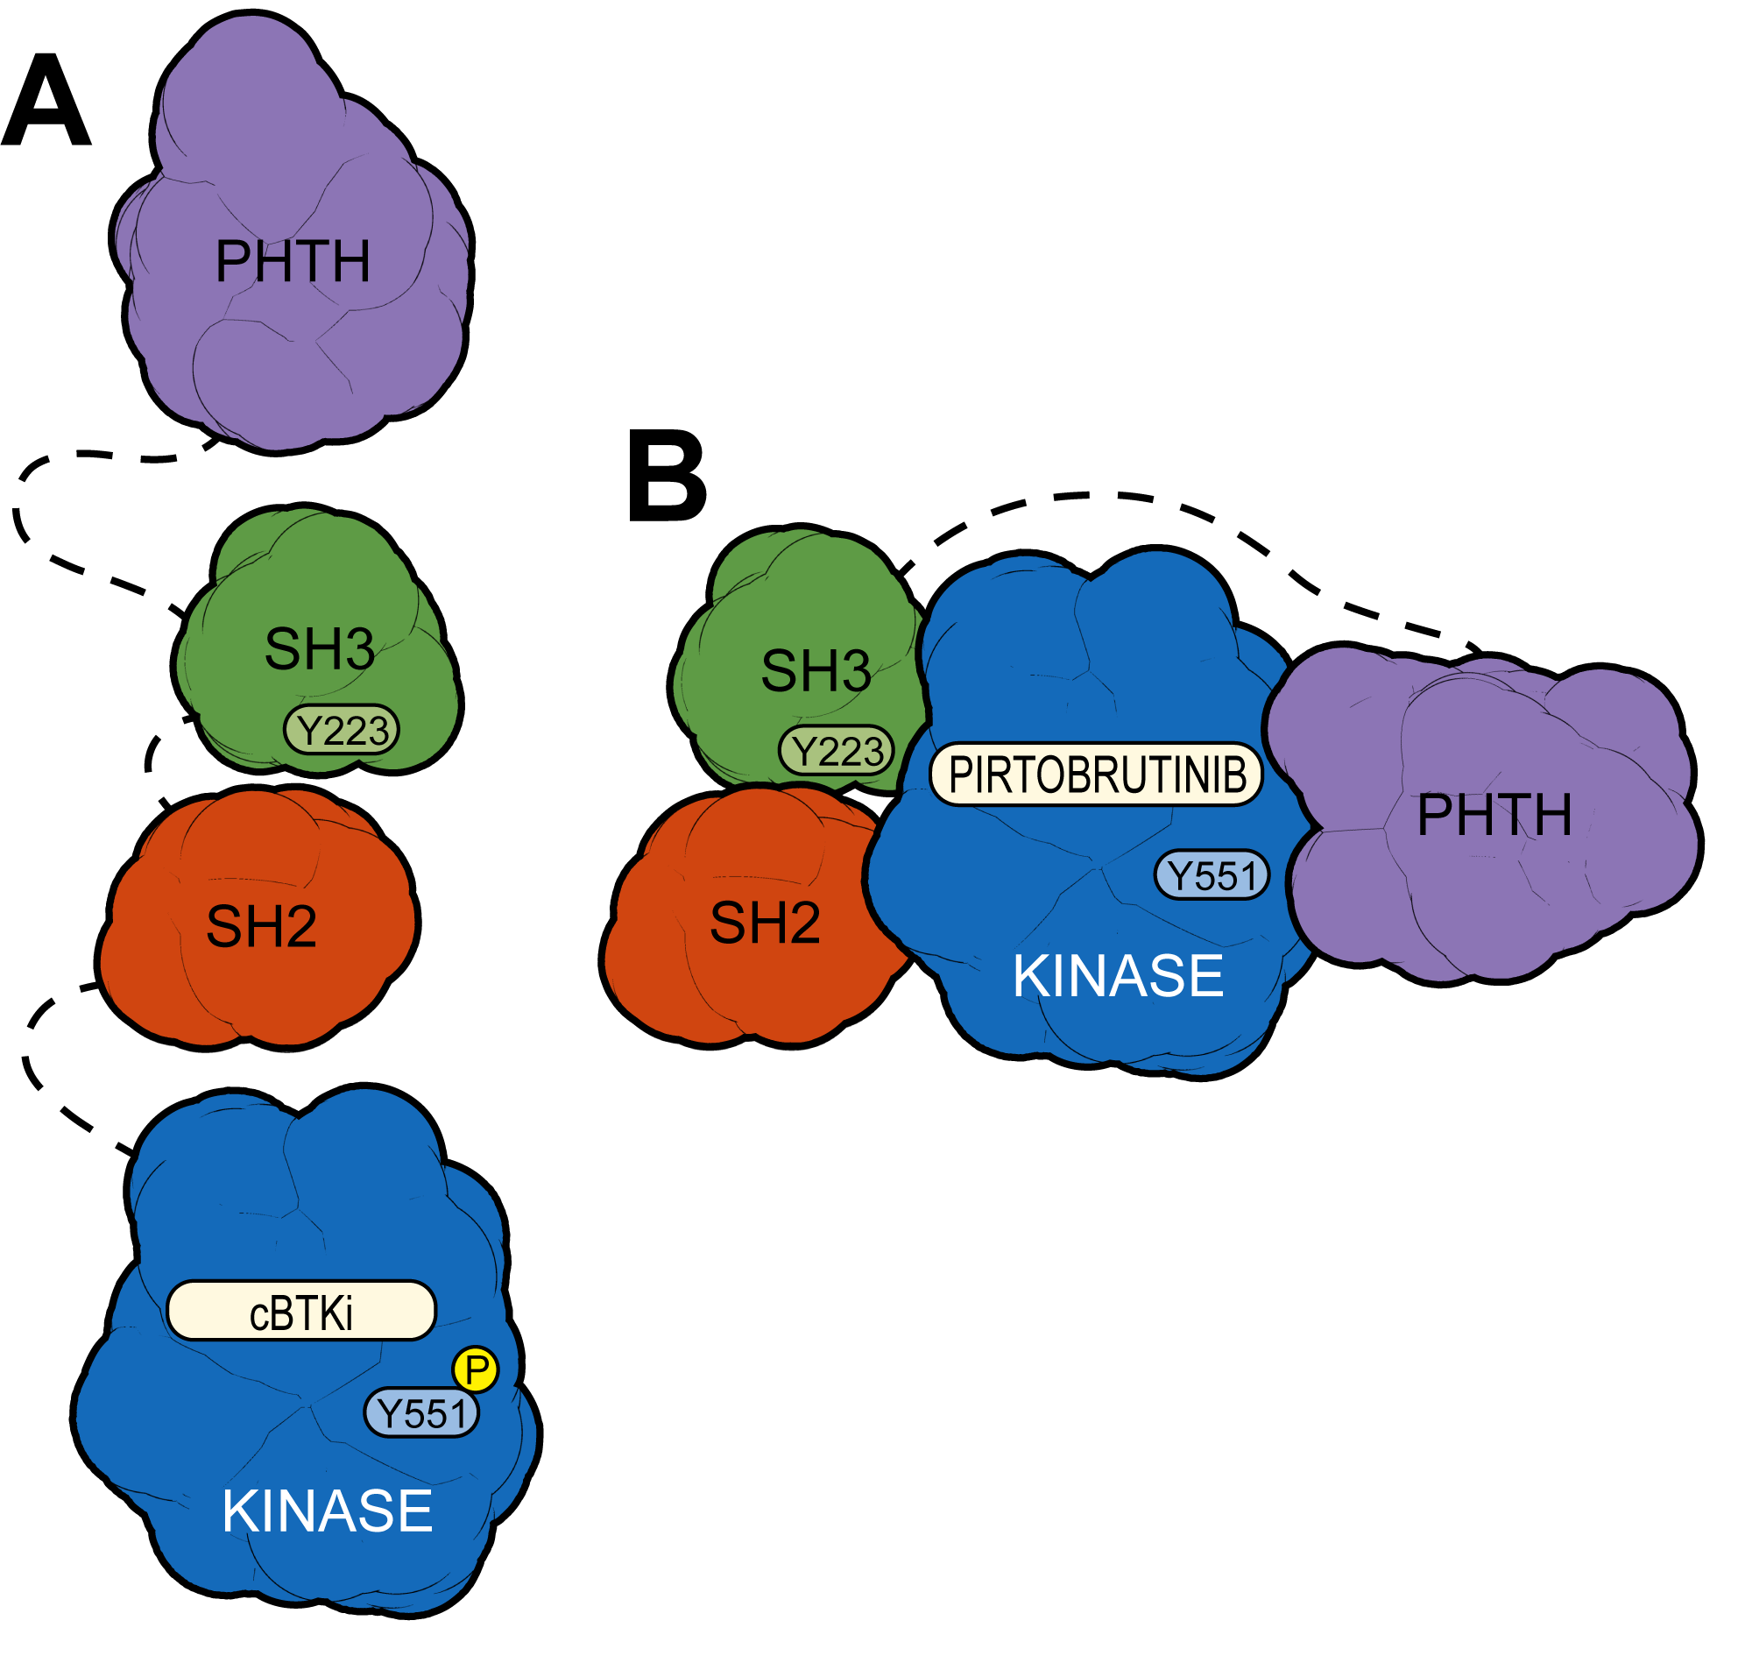
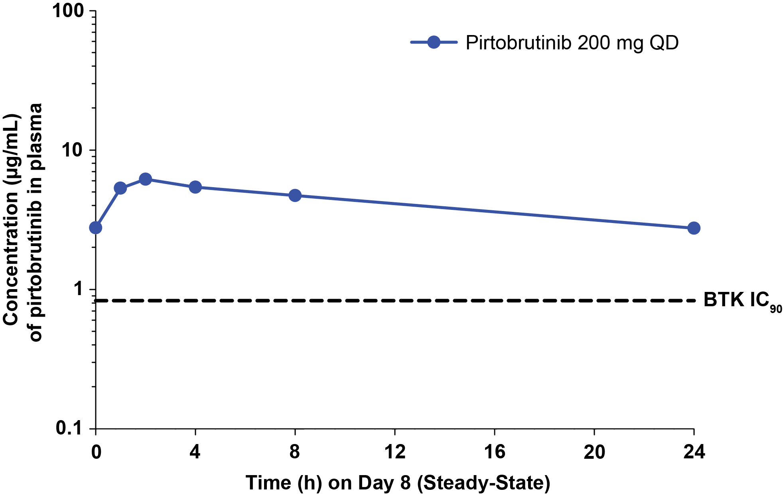
Pirtobrutinib is a Highly Selective, Noncovalent (Reversible) BTK Inhibitor
Highly selective for BTK^{1,2}
Plasma exposures exceeded BTK IC₉₀
throughout dosing interval
Pirtobrutinib may stabilize/maintain BTK in a closed inactive conformation³
IC₅₀ <10 nM
10 nM < IC₅₀ <50 nM
50 nM < IC₅₀ <100 nM
100 nM < IC₅₀ <200 nM
200 nM < IC₅₀ <500 nM
BTK
Inhibits both WT and C481-mutant BTK with equal low nM potency³
Steady state plasma exposure corresponding to 96% BTK target inhibition and a half-life of about 20 hours³
In contrast to covalent BTK inhibitors, pirtobrutinib appears to stabilize BTK in a closed, inactive conformation, blocking access to upstream kinases and phosphorylation of Y551,​ thus inhibiting scaffolding interactions that support kinase-independent BTK signaling³
Notes:
1. Mato AR, Shah NN, Jurczak W, et al. Pirtobrutinib in relapsed or refractory B-cell malignancies (BRUIN): a phase 1/2 study. Lancet. 2021;397(10277):892-901. 2. Brandhuber B, Gomez E, Smith S, et al. LOXO-305, a next generation reversible BTK inhibitor, for overcoming acquired resistance to irreversible BTK inhibitors. Clin Lymphoma Myeloma Leuk. 2018;18(suppl 1):S216.
3. Gomez EB, Ebata K, Randeria HS, et al. Preclinical characterization of pirtobrutinib, a highly selective, noncovalent (reversible) BTK inhibitor. Blood. 2023;142(1):62-72.
Pirtobrutinib is a highly selective, noncovalent or reversible BTK inhibitor. It's highly selective for BTK. The plasma exposures of pirtobrutinib have exceeded the IC₉₀ for BTK inhibition throughout the dosing interval, and that's with daily dosing at 200 mg. Pirtobrutinib actually acts to stabilize or maintain BTK in a closed or inactive confirmation, allowing it to potentially overcome the C481 mutations. So, from a biochemical standpoint, pirtobrutinib can inhibit the wild-type and C481-mutant BTK at equal low nanomolar potency. The steady state plasma exposure corresponds to about 96% BTK target inhibition with a half-life of about 20 hours.

Slide 14
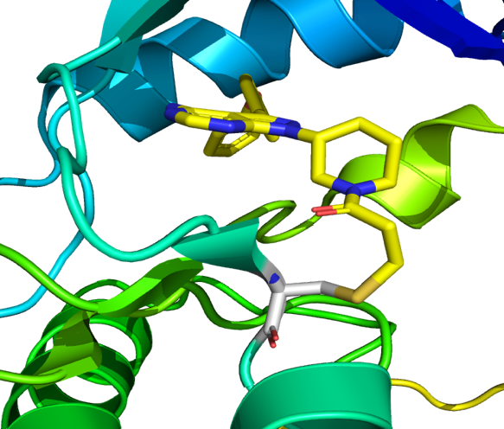
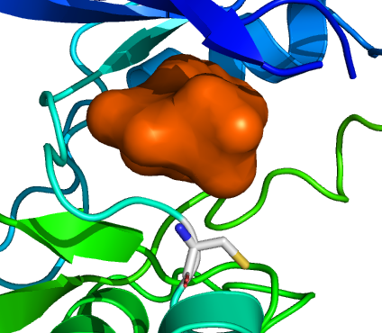
How Noncovalent BTK Inhibitors Overcome Resistance
Covalent BTK Inhibitors (Ibrutinib, Acalabrutinib, and Zanubrutinib) Require WT BTK for Activity¹
Pirtobrutinib Is a Noncovalent BTK Inhibitor That Is Potent Against Both WT and C481-Mutated BTK²
Ibrutinib
BTK inhibition, regardless of BTK mutation
Pirtobrutinib
C481
Covalently bound to C481
C481
Does not require C481 to bind to the kinase domain
Notes:
1. Wang E, Mi X, Thompson MC, et al. Mechanisms of resistance to noncovalent Bruton's tyrosine kinase inhibitors. N Engl J Med. 2022;386(8):735-743.
2. Aslan B, Kismali G, Iles LR, et al. Pirtobrutinib inhibits wild-type and mutant Bruton's tyrosine kinase-mediated signaling in chronic lymphocytic leukemia. Blood Cancer J. 2022;12(5):80.
These are some of the unique features of pirtobrutinib, which allow it to be active even in the presence of resistance mutations to covalent inhibitors. Ibrutinib requires the C481 to covalently bind to BTK. Pirtobrutinib can inhibit BTK regardless of what's there at C481, it does not require this domain binding in order to inhibit the enzyme.

Slide 15
BTK Inhibitors Overview
BTK Inhibitor | Ibrutinib | Acalabrutinib | Zanubrutinib | Pirtobrutinib | Nemtabrutinib
Generation | First | Second | Second | Third | Third
FDA approval (Earliest FDA approval) | (2014) CLL/SLL, WM, cGVHD | (2018) CLL/SLL, R/R MCL | (2019) CLL/SLL, R/R MCL, WM, R/R MZL | (2023) R/R MCL after 2+ lines of tx including BTKi (2023) CLL/SLL after 2+ lines of tx including BTKi and BCL-2i | In clinical trials
Mechanism of action | Covalent | Covalent | Covalent | Noncovalent | Noncovalent
Dosing | 420 mg daily | 100 mg twice daily | 160 mg twice daily or 320 mg daily | 200 mg daily | 65 mg daily (Phase II dosing)
Notes:
IMBRUVICA® (ibrutinib). Prescribing information. Janssen Biotech; 2022.
CALQUENCE® (acalabrutinib). Prescribing information. AstraZeneca Pharmaceuticals; 2022.
BRUKINSA® (zanubrutinib). Prescribing information. BeiGene USA; 2023.
JAYPIRCA (pirtobrutinib). Prescribing information. Eli Lilly; 2023.
Montoya S, Thompson MC. Non-covalent Bruton’s tyrosine kinase inhibitors in the treatment of chronic lymphocytic leukemia. Cancers (Basel). 2023;15(14):3648.
FDA.gov. FDA grants accelerated approval to pirtobrutinib for chronic lymphocytic leukemia and small lymphocytic lymphoma. December 7, 2023. https://www.fda.gov/drugs/resources-information-approved-drugs/fda-grants-accelerated-approval-pirtobrutinib-chronic-lymphocytic-leukemia-and-small-lymphocytic
Here's an overview of all five of the BTK inhibitors we've been discussing. So, the three covalent inhibitors, and then the two noncovalent inhibitors. They've been roughly, kind of, termed in terms of first generation with ibrutinib, second generation with acalabrutinib and zanubrutinib, and now third generation with pirtobrutinib and nemtabrutinib. The approvals of these drugs across different indications with ibrutinib going back all the way to 2014 with the initial indications in CLL/SLL, Waldenström’s, and eventually, chronic graft versus host disease. Acalabrutinib, with indications in CLL and mantle cell lymphoma. And zanubrutinib, the most recent of the covalent inhibitors, with indications in CLL/SLL, mantle cell, Waldenström’s, and relapsed/refractory marginal cell lymphoma. With pirtobrutinib the indications are much more recent. So, 2023 is the most recent, of these BTK inhibitors. An initial approval in relapsed/refractory mantle cell, and more recently, in terms of relapsed/refractory CLL. Nemtabrutinib is not yet approved but is currently in clinical trials. The dosing dose differ between these different drugs, and, in general, these drugs are given either once daily or twice daily, depending on their pharmacokinetic profiles.

Slide 16
Clinical Efficacy and Safety Profiles of BTK Inhibitors
Notes:
Let's dive a little bit more deeply now into the clinical efficacy and safety profiles of BTK inhibitors.

Slide 17
Resistance and Intolerance to Covalent BTK Inhibitors Affect Outcomes in CLL
Ibrutinib discontinuation from 4 sequential studies
Ibrutinib acquired resistance in patients with progressive CLL
0.4
0.3
Other events
25%
Cumulative Incidence of
Discontinuation of Ibrutinib Therapy
0.2
Disease progression
19%
0.1
Transformation
0
1
2
3
4
5
6
Time (years)
Front-line: Ibrutinib discontinuation rate at 5 years = 41%
Relapse/refractory: Predicted ibrutinib discontinuation rate at 5 years + 53.7% (4 sequential studies)
The appearance of BTK C481 mutations is the dominant reason for progressive CLL after covalent BTK inhibitors
BTK C481 mutations prevent covalent BTK inhibitors from effective target inhibition
Notes:
1. Woyach JA, Ruppert AS, Guinn D, et al. BTK^{C481S}-mediated resistance to ibrutinib in chronic lymphocytic leukemia. J Clin Oncol. 2017;35(13):1437-1443.
2. Lampson BL, Brown JR. Are BTK and PLCG2 mutations necessary and sufficient for ibrutinib resistance in chronic lymphocytic leukemia? Expert Rev Hematol. 2018;11(3):185-194. 3. Woyach JA, Furman RR, Liu TM, et al. Resistance mechanisms for the Bruton's tyrosine kinase inhibitor ibrutinib. N Engl J Med. 2014;370(24):2286-2294. 4. Byrd JC, Harrington B, O'Brien S, et al. Acalabrutinib (ACP-196) in relapsed chronic lymphocytic leukemia. N Engl J Med. 2016;374(4):323-332. 5. Xu L, Tsakmaklis N, Yang G, et al. Acquired mutations associated with ibrutinib resistance in Waldenström macroglobulinemia. Blood. 2017;129(18):2519-2525. 6. Hershkovitz-Rokah O, Pulver D, Lenz G, Shpilberg O. Ibrutinib resistance in mantle cell lymphoma: clinical, molecular and treatment aspects. Br J Haematol. 2018;181(3):306-319. 7. Burger JA, Barr PM, Robak T, et al. Long-term efficacy and safety of first-line ibrutinib treatment for patients with CLL/SLL: 5 years of follow-up from the phase 3 RESONATE-2 study. Leukemia. 2020;34(3):787-798. 8. Woyach J, Huang Y, Rogers K, et al. Resistance to acalabrutinib in CLL is mediated primarily by BTK mutations. Abstract presented at: American Society of Hematology Annual Meeting; Orlando, Florida; December 7-10, 2019. Abstract 504.
First, in the early studies of ibrutinib, the most common reasons for discontinuation initially were other events including infection and atrial fibrillation and other adverse events. But as patients stayed on ibrutinib for longer, we see that disease progression and Richter’s transformation can arise. And so, when we look in the frontline setting by 5 years, about 40% of patients will have discontinued ibrutinib. On the right, you can see the different acquired resistance mutations in patients progressing on ibrutinib, and the most common reason would be BTK mutations. But there's also mutations that can occur downstream of BTK in PLC gamma, which can provide further resistance to this therapy. In the relapsed/refractory setting, the discontinuation rates are even higher, closer to 54% of patients by 5 years. And again, the dominant reason for progression is the BTK C481 mutations.

Slide 18
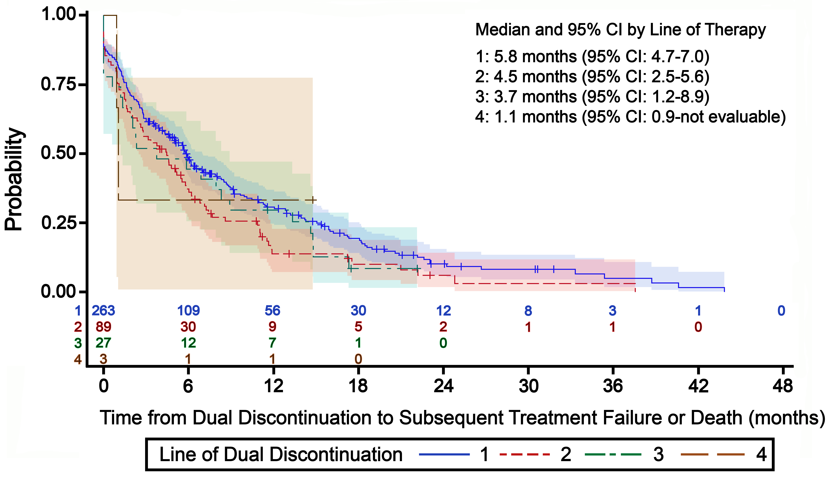
Limited Therapeutic Options and Poor Outcomes after Covalent BTK Inhibitor Treatment Represent a Major Unmet Medical Need in CLL/SLL
Time from cBTKi/BCL2i Discontinuation to Subsequent Treatment Failure or Death⁴
The vast majority of patients discontinue cBTKi for either progression or intolerance¹⁻³
Limited prospective data and treatment options in the post-cBTKi setting currently exist
Venetoclax (BCL2i) based regimens have often been a next treatment option after cBTKi for patients with CLL/SLL
An increasing number of patients who have discontinued cBTKi have also discontinued venetoclax
Outcomes are poor and there is a need for additional treatment options⁴
Notes:
1. Woyach JA, Ruppert AS, Guinn D, et al. BTK^{C481S}-mediated resistance to ibrutinib in chronic lymphocytic leukemia. J Clin Oncol. 2017;35(13):1437-1443.
2. Barr PM, Owen C, Robak T, et al. Up to 8-year follow-up from RESONATE-2: first-line ibrutinib treatment for patients with chronic lymphocytic leukemia. Blood Adv. 2022;6(11):3440-3450.
3. Byrd JC, Woyach JA, Furman RR, et al. Final results of the phase 1/2 study of acalabrutinib monotherapy in treatment-naive chronic lymphocytic leukemia with >6 years of follow-up. Abstract presented at: American Society of Hematology Annual Meeting; New Orleans, Louisiana; December 10-13, 2022. Abstract 4431.
4. Mato AR, Hess LM, Chen Y, et al. Outcomes for patients with chronic lymphocytic leukemia (CLL) previously treated with both a covalent BTK and BCL2 inhibitor in the United States: a real-world database study. Clin Lymphoma Myeloma Leuk. 2023;23(1):57-67.
So, from the real-world setting, there are also some data to help us understand the outcomes for patients who progress after covalent BTK inhibitors. This really has become a growing unmet need in CLL or SLL. And we see that patients, who discontinue often have, a short progression-free survival, regardless of line of therapy from which they progressed. So, we also have a growing number of patients who have discontinued after both the covalent BTK inhibitors and venetoclax. And the outcomes for those patients are particularly poor, so-called double-refractory patients.

Slide 19
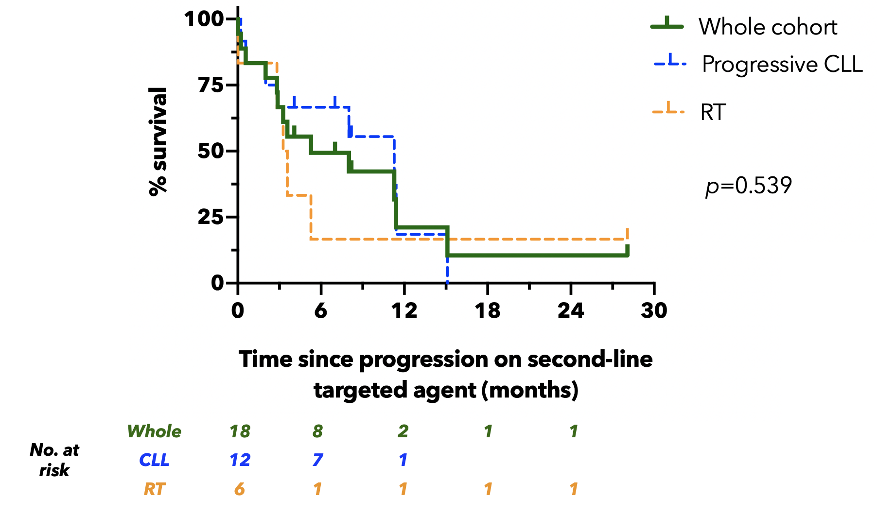
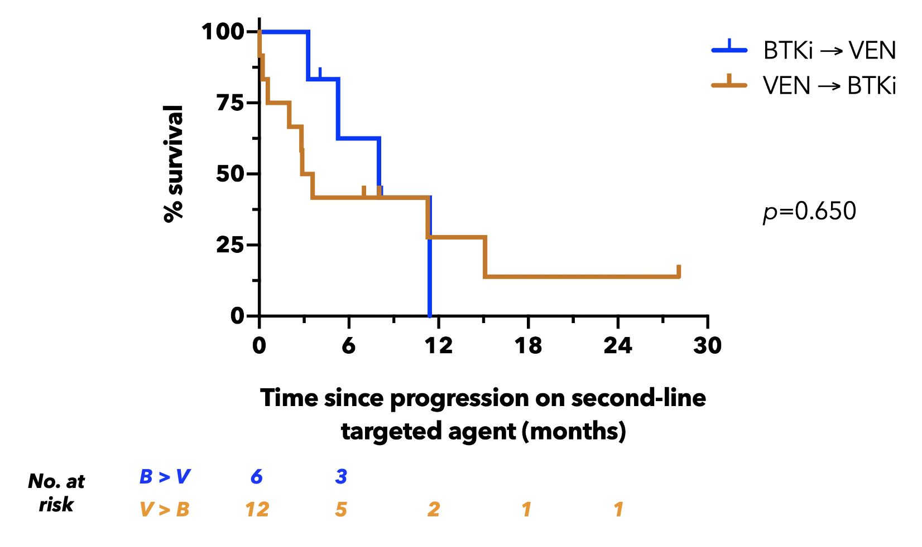
Outcomes for “Double Class Resistant” CLL Are Poor
2011 to 2020: 165 pts treated with Ven or BTKi → 42 double exposed → 18 double refractory
Whole cohort median OS: 5.3 months
No difference in OS between progressive CLL (11.3 months) and RT (3.4 months)
No difference in OS between BTKi → VEN (8 months) and VEN → BTKi (3.2 months)
Notes:
Lew TE, Lin VS, Cliff ER, et al. Outcomes of patients with CLL sequentially resistant to both BCL2 and BTK inhibition. Blood Adv. 2021;5(20):4054-4058.
An important goal of therapy is the avoidance, or delay of development of “double class refractory” disease, which is associated with a dismal prognosis; median overall survival of just 5 months.
This is a study from the group in Australia looking over the past decade or so at their patients treated with venetoclax, or covalent BTK inhibitor. Forty-two of them were exposed to both drugs, and 18 patients were considered truly double-refractory to both mechanisms. So, for the whole cohort of these patients, the median overall survival was only just over 5 months and there was no difference between whether patients progressed with CLL or Richter’s transformation. It didn't matter whether patients had gone from a BTK inhibitor to venetoclax or vice versa. In both scenarios the survival subsequently was quite short.

Slide 20
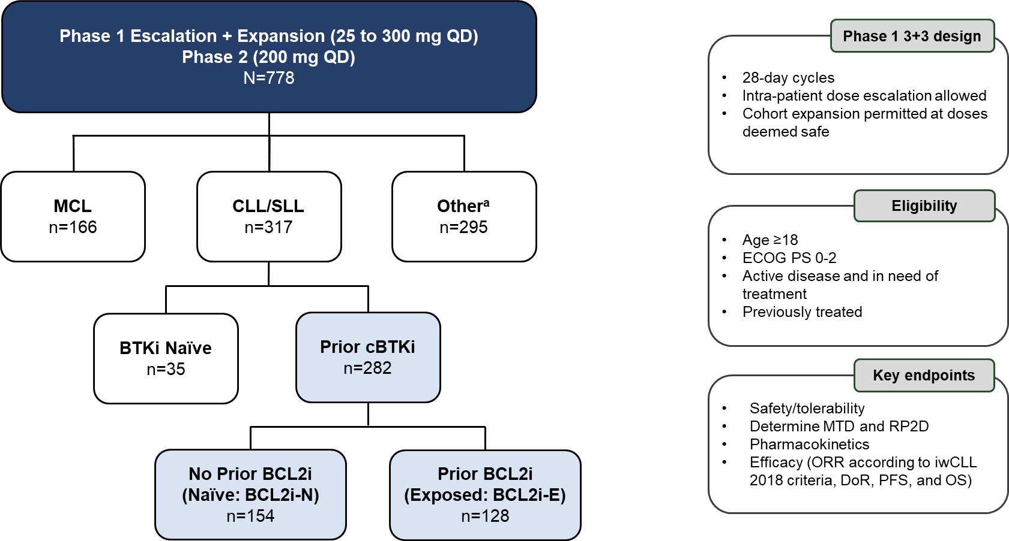
Pirtobrutinib in CLL/SLL Phase 1/2 BRUIN Study: Design, Eligibility and Enrollment
Notes:
Woyach JA, Brown JR, Ghia P, et al. Pirtobrutinib in post-cBTKi CLL/SLL: ~30 months follow-up and subgroup analysis with/without prior BCL2i from the phase 1/2 BRUIN study. Abstract presented at: American Society of Hematology Annual Meeting; San Diego, California; December 9-12, 2023. Abstract 325.
So, this is really where pirtobrutinib has made the biggest difference from the Phase 1/2 BRUIN study. We can see the 317 patients with CLL and SLL, and of those, about 282 had prior treatment with a covalent BTK inhibitor.
Additional Notes
The treatment of chronic lymphocytic leukemia/small lymphocytic lymphoma (CLL/SLL) has benefited from covalent (c) Bruton tyrosine kinase inhibitors (BTKi), However, therapy can fail due to progression or intolerance. Sequential treatment with B-cell lymphoma 2 protein inhibitor (BCL2i) venetoclax, either as monotherapy or combined with an anti-CD20 monoclonal antibody, has been the primary treatment option for CLL/SLL patients (pts) whose disease has progressed on cBTKi. Pirtobrutinib is a highly selective, non-covalent (reversible) BTKi that demonstrated promising efficacy in patients with relapsed or refractory CLL/SLL (Mato et al, NEJM, 2023). Here, we report on the efficacy of pirtobrutinib treatment in CLL/SLL in the post-cBTKi setting, including subgroups with or without prior BCL2i, using data from the BRUIN study (NCT03740529) with more than 2 years follow-up.
Pts with previously treated CLL/SLL were eligible for treatment with pirtobrutinib in the multicenter Phase 1/2 BRUIN study. Key endpoints included ORR (including partial response with lymphocytosis; PR-L) as assessed by an independent review committee per 2018 iwCLL response criteria, DoR, PFS, OS, and safety. A data cut of 05MAY2023 was utilized.

Slide 21
BRUIN Study: Baseline Characteristics of Patients with CLL/SLL who Received Prior Covalent BTK Inhibitor
Characteristics | Prior cBTKi (n=282) | BCL2i-N (n=154) | BCL2i-E (n=128)
Median age, years (range) | 69 (36-88) | 69 (36-87) | 68 (41-88)
Male, n (%) | 192 (68) | 106 (69) | 86 (67)
Rai staging, n (%)
0-II | 147 (52) | 94 (61) | 53 (41)
III-IV | 120 (43) | 58 (38) | 62 (48)
Missing | 15 (5) | 2 (1) | 13 (10)
Bulky Lymphadenopathy ≥5 cm, n (%) | 88 (31) | 42 (27) | 46 (36)
ECOG PS, n (%)
0 | 144 (51) | 89 (58) | 55 (43)
1 | 118 (42) | 56 (36) | 62 (48)
2 | 20 (7) | 9 (6) | 11 (9)
Median number of prior lines of systemic therapy, (range) | 4 (1-11) | 3 (1-9) | 5 (1-11)
Prior therapy, n (%)
BTK inhibitor | 282 (100) | 154 (100) | 128 (100)
Anti-CD20 antibody | 251 (89) | 127 (83) | 124 (97)
Chemotherapy | 228 (81) | 114 (74) | 114 (89)
BCL2 inhibitor | 128 (45) | 0 (0) | 128 (100)
PI3K inhibitor | 71 (25) | 17 (11) | 54 (42)
CAR T | 17 (6) | 2 (1) | 15 (12)
Allogeneic stem cell transplant | 7 (3) | 1 (1) | 6 (5)
Characteristics | Prior cBTKi (n=282) | BCL2i-N (n=154) | BCL2i-E (n=128)
Median time from diagnosis to first dose, years (IQR) | 11 (8-15) | 11 (7-15) | 12 (8-15)
Reason for any prior BTKi discontinuationª, n (%)
Progressive disease | 217 (77) | 110 (71) | 107 (84)
Toxicity/Other | 64 (23) | 43 (28) | 21 (16)
Baseline Molecular Characteristics^{b} | Prior cBTKi (n=282) | BCL2i-N (n=154) | BCL2i-E (n=128)
Mutation status, n/n available (%)
BCL2 mutated | 19/246 (8) | 0/133 (0) | 19/113 (17)
BTK C481-mutant | 96/245 (39) | 57/138 (41) | 39/107 (36)
PLCG2-mutant | 18/245 (7) | 10/138 (7) | 8/107 (8)
High Risk Molecular Features, n/n available (%)
17p deletion and/or TP53 mutation | 104/217 (48) | 57/123 (46) | 47/94 (50)
IGHV unmutated | 193/225 (86) | 100/125 (80) | 93/100 (93)
Complex Karyotype | 33/73 (45) | 17/41 (42) | 16/32 (50)
11q deletion | 47/202 (23) | 28/115 (24) | 19/87 (22)
Notes:
Woyach JA, Brown JR, Ghia P, et al. Pirtobrutinib in post-cBTKi CLL/SLL: ~30 months follow-up and subgroup analysis with/without prior BCL2i from the phase 1/2 BRUIN study. Abstract presented at: American Society of Hematology Annual Meeting; San Diego, California; December 9-12, 2023. Abstract 325.
In total, 282 pts with CLL/SLL who received prior cBTKi were included in this analysis. Median age was 69 years (range, 36-88), 68% were male, and median number of prior therapies was 4 (range, 1-11). Of 282 pts, 154 (55%) had not received prior-BCL2i therapy (Naïve; BCL2i-N) and 128 (45%) had (Exposed; BCL2i-E). BCL2i-N pts were exposed to fewer prior therapies than BCL2i-E pts (median prior therapies 3 and 5, respectively), including anti-CD20 antibody (83% and 97%), chemotherapy (74% and 89%), PI3K inhibitor (11% and 42%), CAR-T cell therapy (1% and 12%), and hematopoietic cell transplantation (1% and 6%).

Slide 22
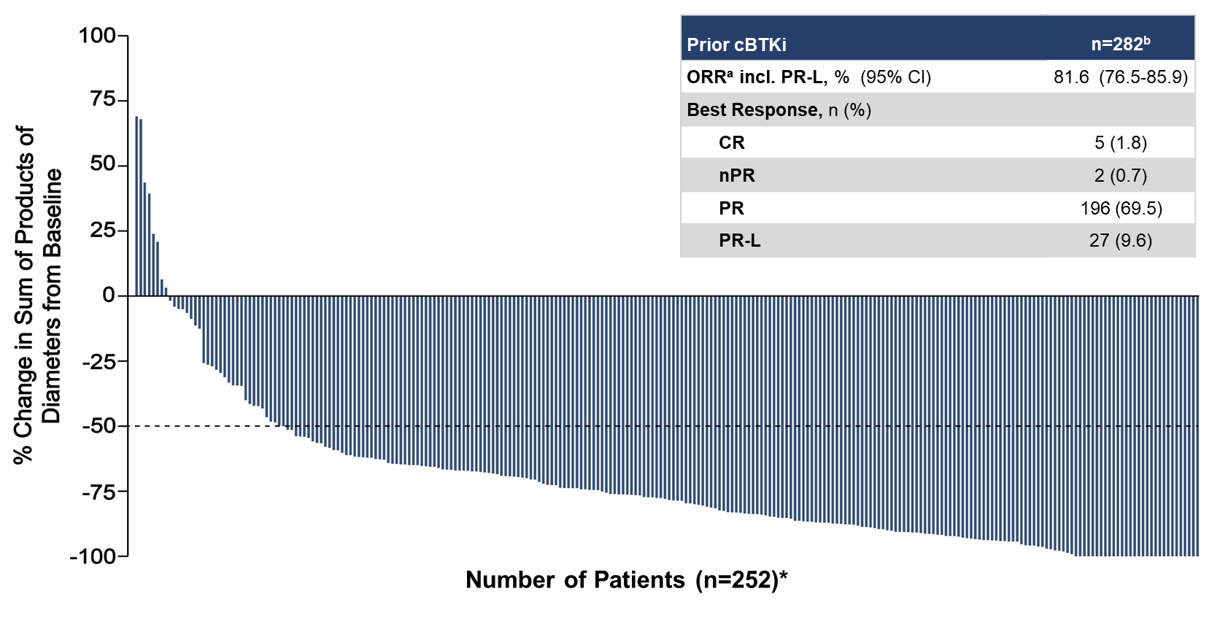
BRUIN Study: Pirtobrutinib Efficacy in All Patients With CLL/SLL Who Received Prior Covalent BTK Inhibitor
Prior cBTKi | n=282^{b}
ORRª incl. PR-L, % (95% CI) | 82 (76.5-85.9)
Best Response, n (%)
CR | 5 (1.8)
nPR | 2 (0.7)
PR | 196 (69.5)
PR-L | 27 (9.6)
Notes:
Woyach JA, Brown JR, Ghia P, et al. Pirtobrutinib in post-cBTKi CLL/SLL: ~30 months follow-up and subgroup analysis with/without prior BCL2i from the phase 1/2 BRUIN study. Abstract presented at: American Society of Hematology Annual Meeting; San Diego, California; December 9-12, 2023. Abstract 325.
In the updated data set that was presented at the ASH meeting in 2023, the waterfall plot for lymph node decrease was quite impressive. So, most patients had a significant reduction in their lymphadenopathy, and the overall response rate was 82% for single-agent pirtobrutinib in this relapsed setting.
Additional Notes
The ORR for all post-cBTKi pts was 72% (95% CI, 66.4-77.1), and ORR including PR-L was 82% (95% CI, 76.5-85.9). Post-cBTKi pts included a subgroup of 19 pts with one prior line of cBTKi-containing therapy and second line therapy of pirtobrutinib, who had ORR including PR-L of 89.5% (CI 95%, 66.9-98.7). The ORR including PR-L was 83.1% (95% CI, 76.2-88.7) for BCL2i-N pts, and 79.7% (95% CI, 71.7-86.3) for BCL2i-E pts. Median DoR was 18.4 months (95% CI, 15.3-20.4) for all cBTKi pre-treated pts, 24.9 months (95% CI, 18.4-32.0) for BCL2i-N, and 14.8 months (95% CI, 12.0-17.4) for BCL2i-E. With a median follow up of 27.5 months, the median PFS was 19.4 months (95% CI, 16.6-22.1) among all cBTKi pre-treated pts, 23.0 months (95% CI, 19.6-28.4) for BCL2i-N, and 15.9 months (95% CI, 13.6-17.5) for BCL2i-E (Figure). With a median follow up of 29.3 months, the median OS was not estimable for all cBTKi pre-treated pts, BCL2i-N, and BCL2i-E; the 24-month OS rates were 73.2% (95% CI, 67.4-78.2), 83.1% (95% CI,75.9-88.2), 60.6% (50.9-68.9), respectively.

Slide 23
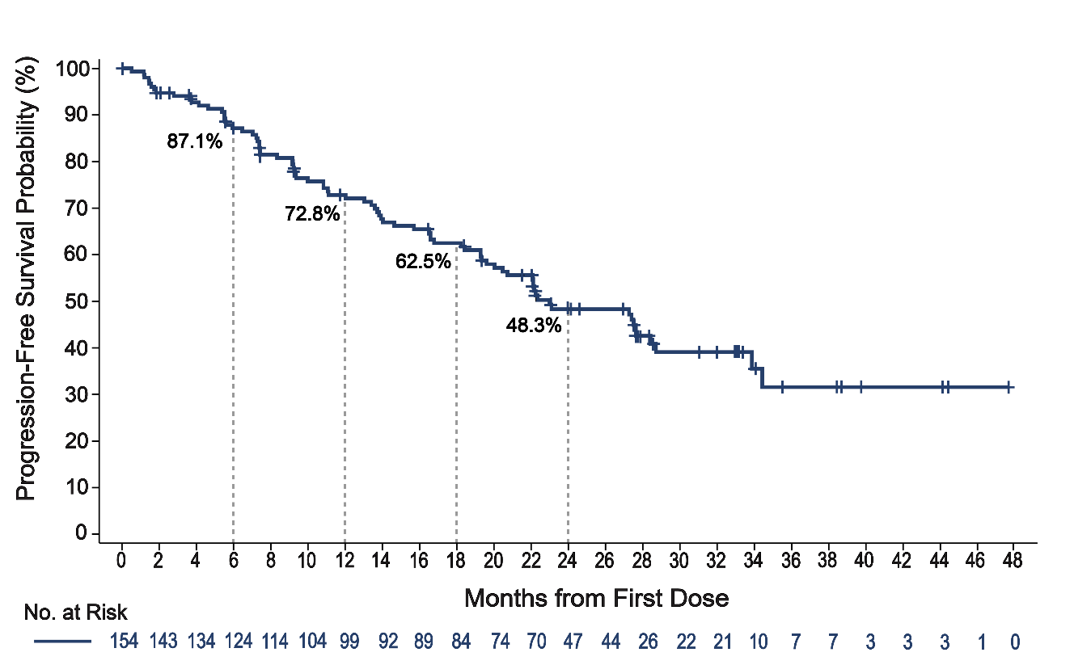
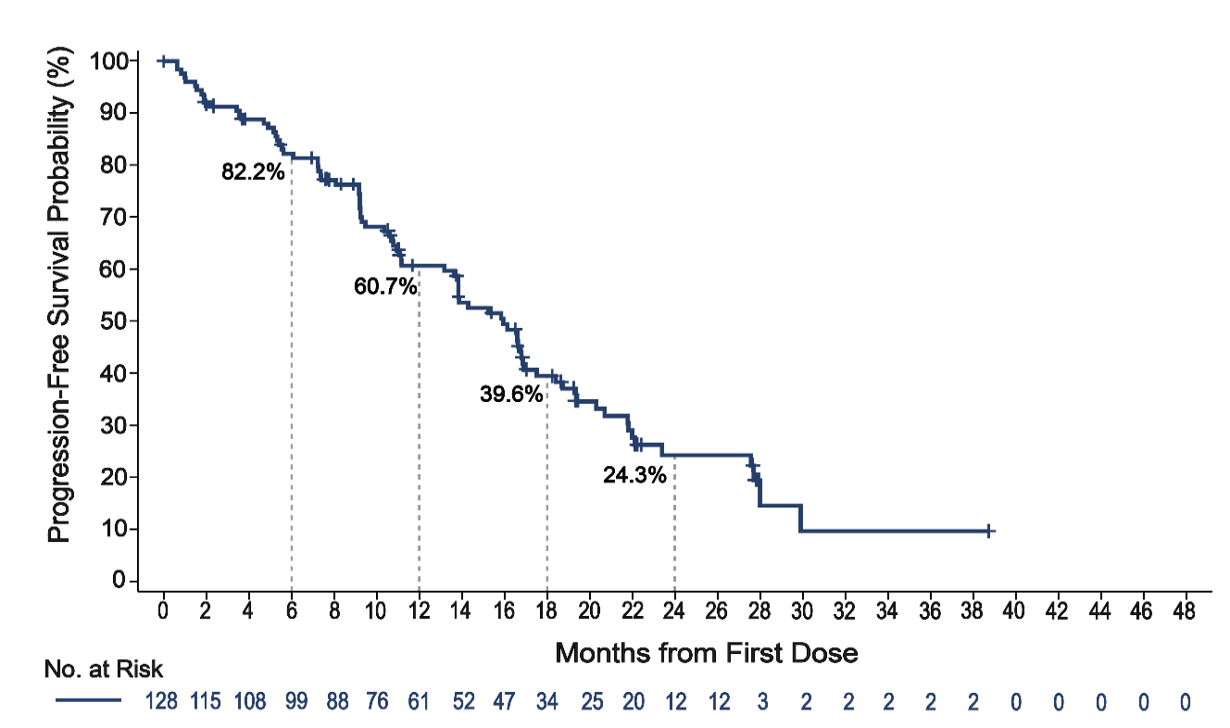
BRUIN Study: Pirtobrutinib Progression-Free Survival With Prior Covalent BTK Inhibitor, With or Without Prior BCL2 Inhibitor
BCL2i-Naive
BCL2i-Experienced
Median: 95% CI: Median Follow-up: Events/Total: | 23.0 months 19.6-28.4 27.6 months 79/154
Median: 95% CI: Median Follow-up: Events/Total: | 15.9 months 13.6-17.5 22.2 months 81/128
Median PFS for entire study population: 19.4 months
Notes:
Woyach JA, Brown JR, Ghia P, et al. Pirtobrutinib in post-cBTKi CLL/SLL: ~30 months follow-up and subgroup analysis with/without prior BCL2i from the phase 1/2 BRUIN study. Abstract presented at: American Society of Hematology Annual Meeting; San Diego, California; December 9-12, 2023. Abstract 325.
The durability was particularly good for patients who had not previously had a BCL2 inhibitor, so-called BCL2i-naïve, where the median PFS was just under 2 years. In BCL2i-experienced patients, it was a bit shorter of a PFS at about 16 months. And the median PFS for the entire study population was about 19 months.
Pirtobrutinib continues to demonstrate promising and durable efficacy in pts with post-cBTKi heavily pretreated CLL/SLL. ORR was high regardless of prior BCL2i status. Longer PFS was observed in BCL2i-N pts than BCL2i-E pts, likely due to the more heavily pretreated status of the BCL2i-E population which can be associated with poorer prognosis. Pirtobrutinib was well-tolerated with low-rates of discontinuation due to drug-related toxicity among both BTKi-N and BTKi-E pts. These results suggest that continuation of BTK pathway inhibition following a cBTKi may be an important sequencing approach to consider in the treatment of CLL/SLL.

Slide 24
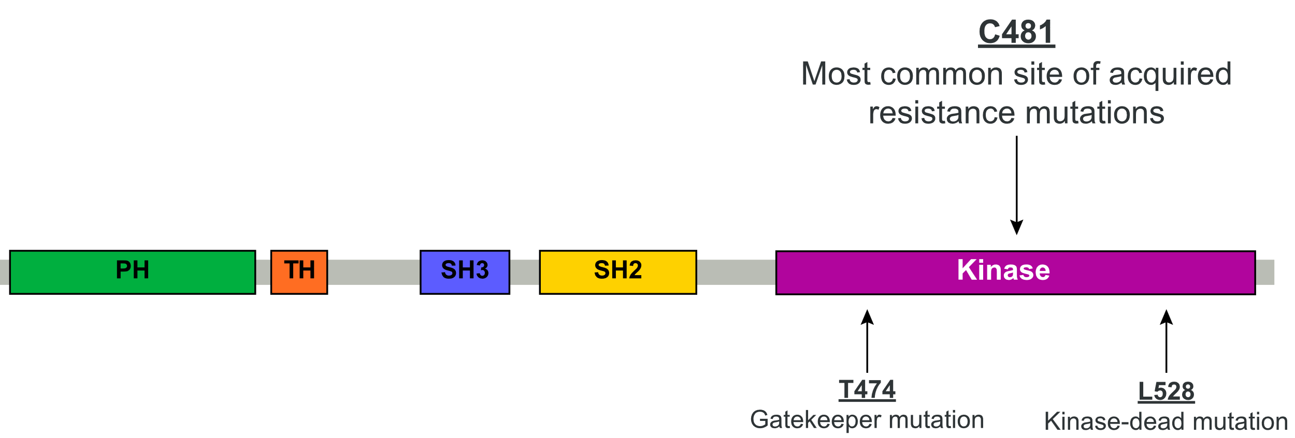
Pirtobrutinib Noncovalent Binding Inhibits Both WT and C481-Mutated BTK
BTK sites with known cBTKi resistance mutations
Pirtobrutinib may stabilize BTK in a closed inactive conformation⁹
cBTKi
Pirtobrutinib
The majority of patients discontinue covalent BTK inhibitors (cBTKi) due to intolerance or progression ^{1,2,3}
BTK C481 substitutions are the most common resistance mechanism to cBTKi ^{4,5,6}
Acquired mutations have been identified in a limited number of patients treated with pirtobrutinib ^{7,8}
Inactive conformation of BTK by pirtobrutinib:
blocks access to upstream kinases and phosphorylation of Y551
inhibits both WT and C481-mutant BTK with equal low nM potency ^{7,9}
may inhibit kinase-independent BTK signaling ⁹
Notes:
Brown JR, Desikan SP, Nguyen B, et al. Genomic evolution and resistance during pirtobrutinib therapy in covalent BTK-inhibitor (cBTKi) pre-treated chronic lymphocytic leukemia patients: updated analysis from the BRUIN study. Abstract presented at: American Society of Hematology Annual Meeting; San Diego, California; December 9-12, 2023. Abstract 326.
1. Woyach JA, Ruppert AS, Guinn D, et al. BTK^{C481S}-mediated resistance to ibrutinib in chronic lymphocytic leukemia. J Clin Oncol. 2017;35(13):1437-1443. 2. Barr PM, Owen C, Robak T, et al. Up to 8-year follow-up from RESONATE-2: first-line ibrutinib treatment for patients with chronic lymphocytic leukemia. Blood Adv. 2022;6(11):3440-3450. 3. Byrd JC, Woyach JA, Furman RR, et al. Final results of the phase 1/2 study of acalabrutinib monotherapy in treatment-naive chronic lymphocytic leukemia with >6 years of follow-up. Abstract presented at: American Society of Hematology Annual Meeting; New Orleans, Louisiana; December 10-13, 2022. Abstract 4431.
4. Estupiñán HY, Wang Q, Berglöf A, et al. BTK gatekeeper residue variation combined with cysteine 481 substitution causes super-resistance to irreversible inhibitors acalabrutinib, ibrutinib and zanubrutinib. Leukemia. 2021;35(5):1317-1329. 5. Handunnetti SM, Anderson MA, Burbury K, et al. Three year update of the phase II ABT-199 (Venetoclax) and ibrutinib in mantle cell lymphoma (AIM) study. Abstract presented at: American Society of Hematology Annual Meeting; Orlando, Florida; December 7-10, 2019. Abstract 756. 6. Blombery P, Thompson ER, Lew TE, et al. Enrichment of BTK Leu528Trp mutations in patients with CLL on zanubrutinib: potential for pirtobrutinib cross-resistance. Blood Adv. 2022;6(20):5589-5592. 7. Wang E, Mi X, Thompson MC, et al. Mechanisms of Resistance to Noncovalent Bruton's Tyrosine Kinase Inhibitors. N Engl J Med. 2022;386(8):735-743. 8. Naeem A, Utro F, Wang Q, et al. Pirtobrutinib targets BTK C481S in ibrutinib-resistant CLL but second-site BTK mutations lead to resistance. Blood Adv. 2023;7(9):1929-1943. 9. Gomez EB, Ebata K, Randeria HS, et al. Preclinical characterization of pirtobrutinib, a highly selective, noncovalent (reversible) BTK inhibitor. Blood. 2023;142(1):62-72.

Slide 25
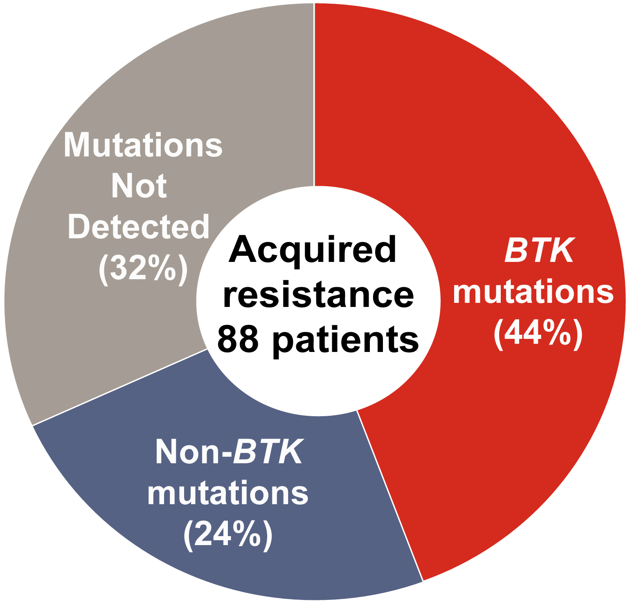
Acquired Mutations Were Detected at PD in 68% of Patients
138 acquired mutations
68% (60/88) acquired mutations at PD
44% (39/88) had at least one acquired BTK mutation at PD
64% (25/39) who acquired a BTK mutation had a BTK mutation at baseline
56% (49/88) did not acquire a BTK mutation
The most frequently acquired non-BTK mutation was TP53
32% (28/88) had no acquired mutations detected at PD
20%
10%
Notes:
Brown JR, Desikan SP, Nguyen B, et al. Genomic evolution and resistance during pirtobrutinib therapy in covalent BTK-inhibitor (cBTKi) pre-treated chronic lymphocytic leukemia patients: updated analysis from the BRUIN study. Abstract presented at: American Society of Hematology Annual Meeting; San Diego, California; December 9-12, 2023. Abstract 326.
The majority of patients (pts) discontinue covalent (c) Bruton tyrosine kinase (BTK) inhibitors (BTKi) for either progression or intolerance. BTK Cysteine 481 substitution is known to contribute to cBTKi acquired resistance to ibrutinib, acalabrutinib, and zanubrutinib. Pirtobrutinib, a highly selective, non-covalent (reversible) BTKi has favorable oral pharmacology that enables continuous BTK inhibition throughout the daily dosing interval regardless of intrinsic rate of BTK turnover. Pirtobrutinib has demonstrated broad efficacy in pts with chronic lymphocytic leukemia (CLL) following prior therapy, including those treated with a prior cBTKi, independent of BTK C481 mutational status (Mato et al, NEJM, 2023). Here we report the largest systematic evaluation of genomic evolution in pts with CLL treated with pirtobrutinib conducted to date, using a larger cohort of pts and longer follow-up than previously reported. Relapsed cBTKi pre-treated CLL pts in the phase 1/2 BRUIN trial (NCT03740529) who subsequently developed disease progression (PD) on pirtobrutinib monotherapy were included. Targeted next-generation sequencing (NGS) was centrally performed on peripheral blood mononuclear cells collected at baseline and within four months of PD.
Despite this cohort representing the first relapsing CLL patients from BRUIN and presenting with frequent baseline BTK mutations, response to pirtobrutinib was high, with an ORR of 83%, and substantial clearance of BTK C481 clones. At progression, the majority of pts (56%) either acquired non-BTK mutations or did not acquire any resistance mutations in this targeted panel, suggesting alternative resistance mechanisms. A smaller group of patients (44%) displayed emergence of non-C481 clones, particularly gatekeeper T474 and kinase-impaired L528W mutations. Whether similar patterns of resistance would manifest if pirtobrutinib was utilized in earlier lines of therapy or prior to cBTKi treatment remains uncertain.

Slide 26
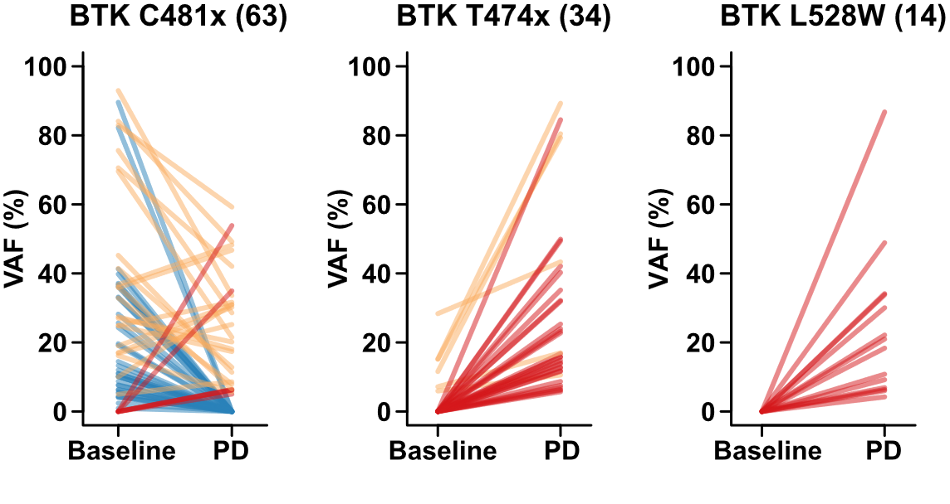
The Majority of BTK Acquired Mutations Were T474x and L528W
Decrease/clearance of C481xª clones observed at progression in 84% (36/43) patients (clearance = 23/43, 53%)
BTK C481S/Y/R, T474xª, L528W, other kinase mutations arose at/near progression (55 mutations in 39 patients, VAF range 3-86%)
ORR was similar across groups regardless of the acquired BTK mutation (T474x, 22/23, 96%; L528W; 11/14, 79%)
26
Notes:
Brown JR, Desikan SP, Nguyen B, et al. Genomic evolution and resistance during pirtobrutinib therapy in covalent BTK-inhibitor (cBTKi) pre-treated chronic lymphocytic leukemia patients: updated analysis from the BRUIN study. Abstract presented at: American Society of Hematology Annual Meeting; San Diego, California; December 9-12, 2023. Abstract 326.
One of the interesting aspects of this BRUIN study is that they were able to track the resistance mutations in real time in these patients on the study. And one of the things that was predicted with pirtobrutinib, and now has borne out in terms of the data, is that from baseline to time of progressive disease, a decrease in the fraction of mutations in the BTK C481. So, this is what we would have predicted because we know that pirtobrutinib is active in the setting of that mutation. However, comparing baseline to time of progression on pirtobrutinib, we see rising of the T474 and L528W mutations. So, these are actually mutations that seem to confer resistance to pirtobrutinib and are now posing a new challenge that we must face in terms of figuring out ways to overcome that.

Slide 27
Pirtobrutinib FDA Approval in CLL/SLL
December 2023: the Food and Drug Administration granted accelerated approval to pirtobrutinib for adults with CLL/SLL who have received at least two prior lines of therapy, including a BTK inhibitor and a BCL-2 inhibitor
BRUIN Trial (NCT03740529)
ORR: 72%
Median DoR: 12.2 months
ASH 2023 updated data:
Prior BTK inhibitor (n=282)
ORR: 81.6%
mPFS: 19.4 months
Prior covalent BTK inhibitor and BCL-2 inhibitor (n=128)
ORR: 79.7%
mPFS: 15.9 months
Notes:
FDA.gov. FDA grants accelerated approval to pirtobrutinib for chronic lymphocytic leukemia and small lymphocytic lymphoma. December 7, 2023. https://www.fda.gov/drugs/resources-information-approved-drugs/fda-grants-accelerated-approval-pirtobrutinib-chronic-lymphocytic-leukemia-and-small-lymphocytic
Woyach JA, Brown JR, Ghia P, et al. Pirtobrutinib in post-cBTKi CLL/SLL: ~30 months follow-up and subgroup analysis with/without prior BCL2i from the phase 1/2 BRUIN study. American Society of Hematology Annual Meeting and Exposition; San Diego, California; December 9-12, 2023. Abstract 325.
So, with regard to pirtobrutinib’s approval in CLL and SLL, this is pretty recent, just December of 2023. The label is for patients who have had at least 2 prior lines of therapy, including a covalent BTK inhibitor and a BCL2 inhibitor. And again, this was based largely on the BRUIN trial that we just reviewed, where the updated data suggested close to 82% of patients responding with a median of about a year and a half or a little bit longer in terms of progression-free survival.
As assessed by an independent review committee using 2018 iwCLL criteria.

Slide 28
BELLWAVE-001: Nemtabrutinib Demonstrated Robust and Durable Clinical Responses in Pretreated CLL^{1,2}
Nemtabrutinib: Noncovalent, Reversible Inhibitor of Both WT and Ibrutinib-Resistant C481S-Mutated BTK
n (%) [95% CI] | CLL/SLL 65 mg QD n = 57 | CLL/SLL Cohort Aª n = 25 | CLL/SLL Cohort B^{b} n = 10
ORR | 30 (53) [39-66] | 15 (60) [39-79] | 4 (40) [12-74]
CR | 2 (4) [0.4-12] | 0 (0) [0-14] | 1 (10) [0.3-45]
PR | 15 (25) [15-40] | 5 (20) [7-41] | 2 (20) [3-56]
PR-L | 13 (23) [13-36] | 10 (40) [21-61] | 1 (10) [0.3-45]
SD | 17 (30) [18-43] | 8 (32) [15-54] | 3 (30) [7-65]
PD | 2 (4) [0.4-12] | 0 (0) [0-14] | 2 (20) [3-56]
No assessment | 8 (14) [6-26] | 2 (8) [1-26] | 1 (10) [0.3-45]
Notes:
Woyach J, Flinn IW, Awan FT, et al. Nemtabrutinib (MK-1026), a non-covalent inhibitor of wild-type and C481S mutated Bruton tyrosine kinase for B-cell malignancies: efficacy and safety of the phase 2 dose-expansion BELLWAVE-001 study. Abstract presented at: Annual Meeting of the European Hematology Association; June 10, 2022. Abstract P682. 2. A Study of nemtabrutinib (MK-1026) (ARQ 531) in participants with selected hematologic malignancies. ClinicalTrials.gov identifier: NCT03162536. Updated March 8, 2024. https://clinicaltrials.gov/study/NCT03162536
Pirtobrutinib is not the only noncovalent BTK inhibitor being explored in CLL and SLL. The other is nemtabrutinib. And this was explored in the BELLWAVE-001 trial, which really did demonstrate robust and durable clinical responses in patients with relapsed/refractory CLL. With about 57 patients treated at the recommended Phase 2 dose of 65 milligrams, the overall response rate is in the range of about 53%, including in patients who had, mutation in C481S, as well as patients who did not.

Slide 29
BELLWAVE-001: Nemtabrutinib Is Effective Against BTK Resistance Mutations¹
 | PFS Events, n/N, % | PFS Median (95% CI), mo
All CLL/SLL | 13/57 (23) | NE (10.6-NE)
Cohort A | 8/25 (32) | 15.7 (7.6-NE)
Cohort B | 3/10 (30) | NE (5.0-NE)
Cohort B
All CLL/SLL
Progression-Free Survival, %
Cohort A: patients with R/R CLL/SLL who received ≥2 prior therapies, including covalent BTKi, and who have a C481S mutation
Cohort A
Time, mo
No. at Risk
All | 57 | 28 | 19 | 14 | 7 | 2
Cohort A | 25 | 15 | 10 | 7 | 2 | 0
Cohort B | 10 | 4 | 2 | 2 | 1 | 0
Notes:
Woyach J, Flinn IW, Awan FT, et al. Nemtabrutinib (MK-1026), a non-covalent inhibitor of wild-type and C481S mutated Bruton tyrosine kinase for B-cell malignancies: efficacy and safety of the phase 2 dose-expansion BELLWAVE-001 study. Abstract presented at: Annual Meeting of the European Hematology Association; June 10, 2022. Abstract P682.
The progression-free survival for nemtabrutinib in these different cohorts. Cohort A is patients who had a covalent, BTK inhibitor and who have a C481S resistance mutation. Cohort B, these patients did not have a resistance mutation. The PFS looks similar between these two groups. With the median PFS actually not reached yet at the time of this evaluation.

Slide 30
Ongoing Phase 3 Trials With Noncovalent BTK Inhibitors in CLL
Noncovalent BTKi | Phase 3 Trial | Study Arms | Population
Pirtobrutinib | BRUIN CLL-321 (NCT04666038) | pirtobrutinib vs idelalisib + R or BR | Prior BTKi required
 | BRUIN CLL-322 (NCT04965493) | pirtobrutinib + venetoclax + R vs venetoclax + R | Prior BTKi allowed
 | BRUIN CLL-313 (NCT05023980) | pirtobrutinib vs BR | Treatment-naive patients
 | BRUIN CLL-314 (NCT05254743) | pirtobrutinib vs ibrutinib | BTKi-naive patients
Nemtabrutinib | BELLWAVE-008 (NCT05624554) | nemtabrutinib vs FCR or BR | Previously untreated CLL; no TP53 mutation/del(17p)
 | BELLWAVE-010 (NCT05947851) | nemtabrutinib + venetoclax vs venetoclax + R | Following at least 1 prior therapy
 | BELLWAVE-011 (NCT06136559) | nemtabrutinib vs ibrutinib or acalabrutinib | Treatment-naive patients
Notes:
There's a number of ongoing Phase 3 trials with these noncovalent BTK inhibitors in CLL.
Several with pirtobrutinib, including relapsed/refractory studies, where pirtobrutinib is being compared to a PI3-kinase inhibitor, idelalisib, with rituximab or bendamustine and rituximab, a separate study where pirtobrutinib was being combined with venetoclax and rituximab and being compared to venetoclax and rituximab alone.
Then, frontline studies of pirtobrutinib versus bendamustine and rituximab and pirtobrutinib versus ibrutinib.
With nemtabrutinib, there's also a frontline study comparing to chemoimmunotherapy, and then there's a relapsed/refractory study of nemtabrutinib with venetoclax compared to rituximab with venetoclax.

Slide 31
Phase 3 BRUIN CLL-321 Trial
First randomized phase III study among CLL/SLL patients with relapsed/refractory disease who were previously treated with cBTKi comparing pirtobrutinib versus investigator’s choice of IdelaR or BR
Patients randomized 1:1 to receive pirtobrutinib monotherapy (200mg QD), or IdelaR or BR, and stratified by prior use of venetoclax and del(17p) status
Primary endpoint: PFS assessed by IRC
In this heavily pretreated patient population with poor prognosis, pirtobrutinib treatment led to a significant improvement in PFS compared to IdelaR or BR, along with a more favorable safety profile
Reduction in risk of relapse, disease or death by 46%
PFS results consistent across key subgroups associated with a poor prognosis, including patients who received prior venetoclax and those with TP53 mutations and/or 17p deletions, unmutated IGHV status and complex karyotype
 | Pirtobrutinib (n=119) | IdelaR or BR (n=119)
Median IRC-assessed PFS, months | 14.0 | 8.7
HR | 0.54
Investigator-assessed PFS, months | 15.3 | 9.2
HR | 0.48
Median EFS, months | 14.1 | 7.6
HR | 0.39
Median TTNT or death, months | 23.9 | 10.9
HR | 0.37
Sharman JP, et al. ASH 2024. Abstract 886. BR, bendamustine plus rituximab; cBTKi, covalent Bruton tyrosine kinase inhibitors; CLL, chronic lymphocytic leukemia; EFS, event-free survival; IdelaR, idelalisib plus rituximab; IGHV, immunoglobulin heavy chain variable gene; IRC, independent review committee; PFS, progression-free survival; QD, once a day; SLL, small lymphocytic lymphoma; TTNT, time to next treatment.
Notes:
Sharman JP, Munir T, Grosicki S, et al. BRUIN CLL-321: Randomized phase III trial of pirtobrutinib versus idelalisib plus rituximab (IdelaR) or bendamustine plus rituximab (BR) in BTK inhibitor pretreated chronic lymphocytic leukemia/small lymphocytic lymphoma. Abstract presented at: American Society of Hematology Annual Meeting; San Diego, California; December 7-10, 2024. Abstract 886.

Slide 32
Covalent BTK Inhibitor Resistance is Common and Not Well Understood in MCL
Most patients will ultimately experience disease progression
Post-progression outcomes historically poor (OS <1 year)
Mechanisms less well understood compared to CLL
Options:
Noncovalent BTKi
CAR T
Trials
Notes:
Hess G, Dreyling M, Oberic L, et al. Real-world experience among patients with relapsed/refractory mantle cell lymphoma after Bruton tyrosine kinase inhibitor failure in Europe: The SCHOLAR-2 retrospective chart review study. Br J Haematol. 2023;202(4):749-759.
Covalent BTK inhibitor resistance is common, but also not very well understood in mantle cell lymphoma. The majority of patients with mantle cell lymphoma will progress on their covalent BTK inhibitor, and usually within a much shorter time-frame than what we were just describing for patients with CLL. On the right, you can see that time-frame reflected, in terms of a short overall survival for all patients who progress after BTK inhibitors, and particularly in mantle cell, the options are much more limited for these patients as compared to CLL. We do have the noncovalent BTK inhibitor, pirtobrutinib, that we'll see data for. Also, CAR T-cells or clinical trials.

Slide 33
In MCL, Real-World Data Confirm That Outcomes Are Poor After Progression on Covalent BTK Inhibitor Therapy
Post-ibrutinib OS for patients progressing on ibrutinib and receiving additional treatment versus no further treatment
Progression on BTKi likely involves therapeutic resistance
Overall post-ibutinib OS was 1.4 months
0.4 months for patients receiving no further therapy
Notes:
McCulloch R, Lewis D, Crosbie N, et al. Ibrutinib for mantle cell lymphoma at first relapse: a United Kingdom real-world analysis of outcomes in 211 patients. Br J Haematol. 2021;193(2):290-298.
So, these are some real-world data in mantle cell lymphoma suggesting, again, that outcomes are poor after progression on covalent BTK inhibitor. Patients who received additional therapy did do better. The median survival there was closer to a year, whereas patients who were not able to even receive additional therapy had a very short survival of just 0.4 months. Overall, in the post-pirtobrutinib setting, the survival in this real-world series was just 1.4 months, and patients who were able to move on to R-BAC chemotherapy did have a longer survival. But again, this is retrospective real-world data. So, it's more likely that the fitter patients were able to get chemoimmunotherapy, and so that is one of the confounding aspects of this analysis.

Slide 34
Although BTK Inhibitors Are a Step Forward in MCL, More Needs to Be Done in Later-Line Care
Based on retrospective claims data from the United States between 2015 and 2021 (N = 696)
Majority of patients received no treatment in the 3L setting
Data demonstrate clear unmet needs for 3L care in MCL
Notes:
Garg M, Satija A, Song Y, et al. Economic burden and treatment patterns among patients with mantle cell lymphoma in the US: a retrospective claims analysis. Abstract presented at: American Society of Hematology Annual Meeting; New Orleans, Louisiana; December 10-13, 2022. Abstract 3534.
So, in mantle cell lymphoma, although the BTK inhibitors are a step forward, we certainly need more options in later lines of care. Some more retrospective claims data from the US from 2015 to 2021 shows in these, about, 700 patients or so that the majority of mantle cell patients actually did not receive any treatment in the third-line setting, and that's often because they were so sick. After second-line setting, many of these patients moved on to hospice, for example. Where in the frontline setting majority patients are getting bendamustine-based chemotherapy. In the second-line setting, small-molecule agents like BTK inhibitors become more commonly used. And then patients not getting any additional therapy. So, it really does speak to the need for better therapies in the later lines of therapy for mantle cell lymphoma.

Slide 35
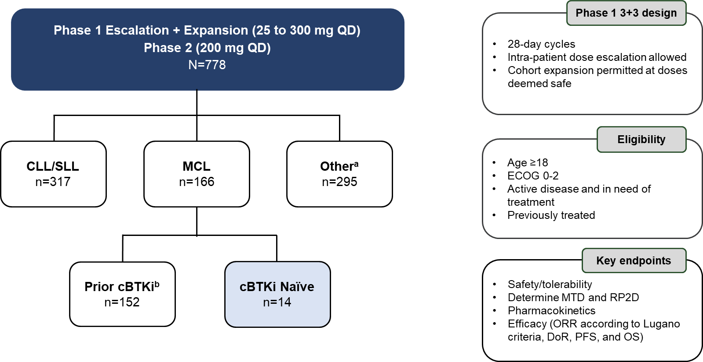
Pirtobrutinib in MCL Phase 1/2 BRUIN Study: Design, Eligibility and Enrollment
Notes:
Cohen JB, Shah NN, Jurczak W, et al. Pirtobrutinib in relapsed/refractory (R/R) mantle cell lymphoma (MCL) patients with prior cBTKi: safety and efficacy including high-risk subgroup analyses from the phase 1/2 BRUIN study. American Society of Hematology Annual Meeting and Exposition; San Diego, California; December 9-12, 2023. Abstract 981.
So, the BRUIN study of pirtobrutinib also included a cohort of 166 patients with relapsed/refractory mantle cell lymphoma, and we'll review those data now.
Additional Notes
Despite the efficacy of covalent (c) Bruton tyrosine kinase inhibitors (BTKi) in R/R MCL, disease relapse arises through evolution of resistance mechanisms or development of cBTKi intolerance. Pirtobrutinib, a highly selective, non-covalent (reversible) BTKi has favorable oral pharmacology that enables continuous BTK inhibition throughout the daily dosing interval regardless of the intrinsic rate of BTK turnover. Pirtobrutinib is the first BTKi to demonstrate durable efficacy following prior cBTKi therapy in heavily pre-treated R/R MCL and was well-tolerated with a low frequency of treatment discontinuation due to toxicity (Wang et al., JCO, 2023). Pirtobrutinib is approved in the USA to treat relapsed or refractory MCL after at least two lines of systemic therapy including a prior cBTKi. Here, we report updated results of pirtobrutinib therapy in all patients (pts), including those with biologically high-risk R/R MCL with a median survival follow-up of 24.2 months (range, 18.2-29.8).
Pts with R/R MCL received pirtobrutinib monotherapy in the multicenter Phase 1/2 BRUIN trial (NCT03740529). Efficacy was assessed in all cBTKi pre-treated pts, as well as in cBTKi treatment-naïve pts. Key endpoints included overall response rate (ORR) as assessed by independent review committee per Lugano 2014 criteria, duration of response (DOR), progression-free survival (PFS), overall survival (OS), and safety. Pts were included across the dose escalation range and expansion (25-300 mg/day) with 93% (n=141) receiving at least one dose of 200 mg/day, the FDA-approved dose. A data cut of 05 May 2023 was utilized.

Slide 36
BRUIN Study: Baseline Characteristics of Patients With MCL
Characteristics | Prior cBTKi n=152 | cBTKi Naïve n=14
Median age, years (range) | 70 (46-88) | 67 (60-86)
Male, n (%) | 120 (79) | 10 (71)
Histology, n (%)
Classic/leukemic | 120 (79) | 11 (79)
Pleomorphic/Blastoid | 32 (21) | 3 (21)
ECOG PS, n (%)
0 | 93 (61) | 5 (36)
1 | 56 (37) | 8 (57)
2 | 3 (2) | 1 (7)
sMIPI score, n (%)
Low risk (0-3) | 30 (20) | 3 (21)
Intermediate risk (4-5) | 79 (52) | 5 (36)
High risk (6-11) | 43 (28) | 6 (43)
Bulky Lymphadenopathy (cm), n (%)
<5 | 94 (62) | 8 (57)
≥5 | 36 (24) | 5 (36)
No Measurable Lymph Node | 22 (15) | 1 (7)
Bone marrow involvement, n (%)
Yes | 81 (53) | 4 (29)
No | 71 (47) | 10 (71)
Median number of prior lines of systemic therapy, n (range) | 3 (1-9) | 2 (1-3)
Characteristics | Prior cBTKi n=152 | cBTKi Naïve n=14
Prior therapy, n (%)
BTK inhibitor | 152 (100) | 0 (0)
Anti-CD20 antibody | 147 (97) | 14 (100)
Chemotherapy | 137 (90) | 14 (100)
Immunomodulator | 26 (17) | 1 (7)
Stem cell transplant | 33 (22) | 7 (50)
Autologous | 30 (20) | 7 (50)
Allogeneic | 7 (5) | 0 (0)
BCL2 inhibitor | 24 (16) | 0 (0)
CAR T | 13 (9) | 0 (0)
PI3K inhibitor | 6 (4) | 1 (7)
Reason discontinued any prior BTKiª, n (%)
Progressive disease | 128 (84) | -
Toxicity / Other | 21 (14) | -
Unknown | 3 (2) | -
TP53 Mutation status, n (%)
Yes | 30 (20) | 3 (21)
No | 30 (20) | 4 (29)
Missing | 92 (61) | 7 (50)
Ki-67 index, n (%)
<30% | 18 (12) | 2 (14)
≥30% | 45 (30) | 6 (43)
Missing | 89 (59) | 6 (43)
Notes:
Cohen JB, Shah NN, Jurczak W, et al. Pirtobrutinib in relapsed/refractory (R/R) mantle cell lymphoma (MCL) patients with prior cBTKi: safety and efficacy including high-risk subgroup analyses from the phase 1/2 BRUIN study. American Society of Hematology Annual Meeting and Exposition; San Diego, California; December 9-12, 2023. Abstract 981.
Among all 152 pts with R/R MCL who received a prior cBTKi, the median age was 70 years (range, 46-88), and 52% had intermediate-risk and 28.3% had high-risk sMIPI scores. Median prior lines of therapy were 3 (range, 1-9), including an anti-CD20 antibody (96.7%), chemotherapy (90.1%), immunomodulator (17.1%), stem cell transplant (21.7%), BCL-2 inhibitor (15.8%), CAR-T cell therapy (8.6%), and PI3K inhibitor (3.9%). Among pts with high-risk biomarker data available, 30/60 (50%) had TP53 mutations and 45/63 (71%) had a Ki-67 index of ≥30%.

Slide 37
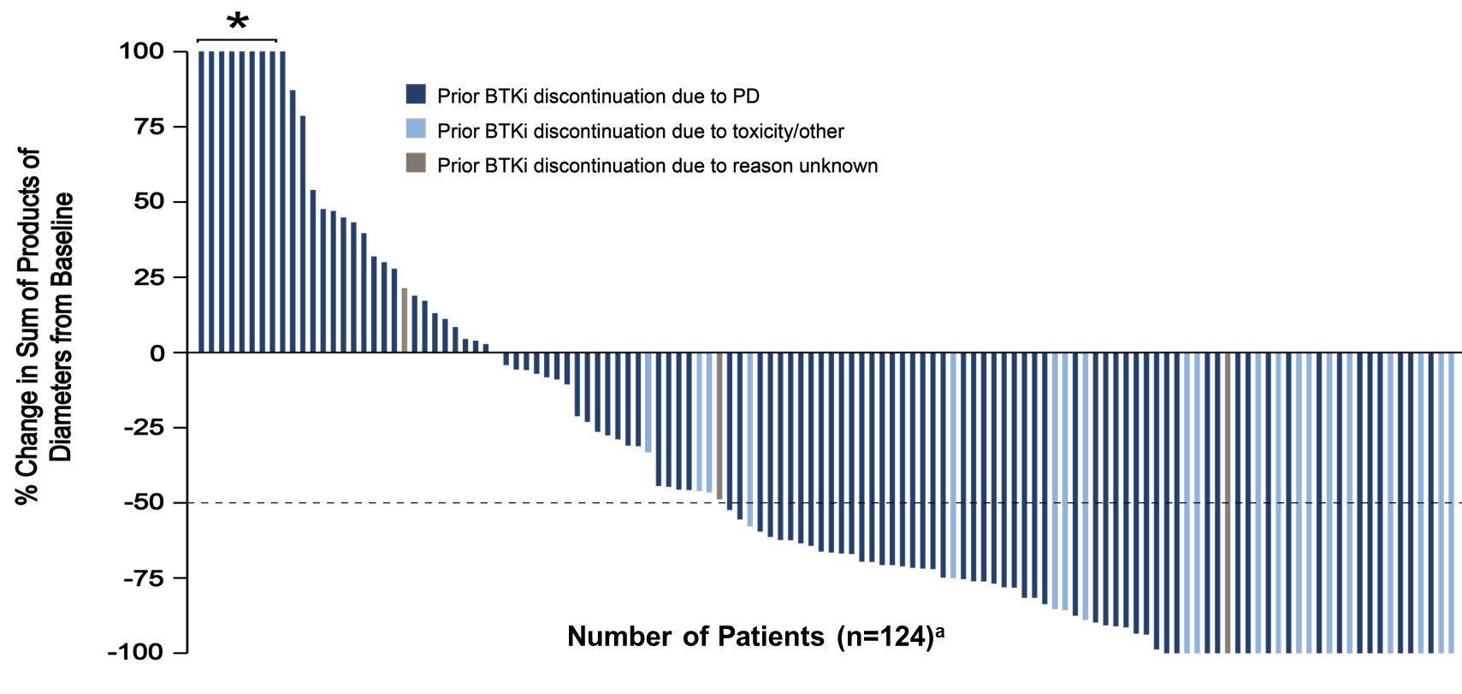
BRUIN Study: Pirtobrutinib Efficacy in Patients With MCL Who Received Prior Covalent BTK Inhibitor
Prior cBTKi | n=152
ORR^{b}, % (95% CI) | 49.3 (41.1-57.6)
Best Response, n (%)
CR | 24 (15.8)
PR | 51 (33.6)
Prior cBTKi | n=152
ORR^{b}, % (95% CI) | 49.3 (41.1-57.6)
Best Response, n (%)
CR | 24 (15.8)
PR | 51 (33.6)
Median Time to First Response was 1.8 months (range: 0.8-13.8)
Notes:
Cohen JB, Shah NN, Jurczak W, et al. Pirtobrutinib in relapsed/refractory (R/R) mantle cell lymphoma (MCL) patients with prior cBTKi: safety and efficacy including high-risk subgroup analyses from the phase 1/2 BRUIN study. American Society of Hematology Annual Meeting and Exposition; San Diego, California; December 9-12, 2023. Abstract 981.
The waterfall plot looking at lymph node decrease with the different colors here representing patients who discontinued their prior BTK inhibitor due to progressive disease, versus patients who discontinued the prior BTK inhibitor due to toxicity. And regardless of reason for discontinuation, the majority of patients did have a decrease in lymph node size, and the overall response rate was close to 50% in this very difficult-to-treat population.
Additional Notes
The ORR for cBTKi pre-treated pts was 49.3% (95% CI, 41.1-57.6), including 15.8% complete responses (n=24) and 33.6% partial responses (n=51), whilst cBTKi naïve pts (n=14) had an ORR of 85.7% (95% CI, 57.2-98.2). The ORR among 128 pts who had discontinued a prior cBTKi due to PD and 21 pts who had discontinued for toxicity/other reasons was 43.0% and 90.5%, respectively. Among the 75 responding cBTKi pre-treated pts, the median DOR was 21.6 months (95% CI, 9.2-27.2) at a median follow-up of 24 months. The 18- and 24-month DOR rates were 51.9% (95% CI, 37-64.8) and 38.9% (95% CI, 22.7-54.8), respectively. ORR and DOR by high-risk subgroups (including blastoid/pleomorphic variants, Ki-67 index ≥30%, and TP53 mutations) are shown in Table 1. The 18- and 24-month DOR rates among 12 responding cBTKi naïve pts were both 90.0% (95% CI, 47.3-98.5). The median PFS and OS for cBTKi pre-treated pts was 5.6 months (95% CI, 5.3-9.2), and 23.5 months (95% CI, 17.1-NE), respectively.

Slide 38
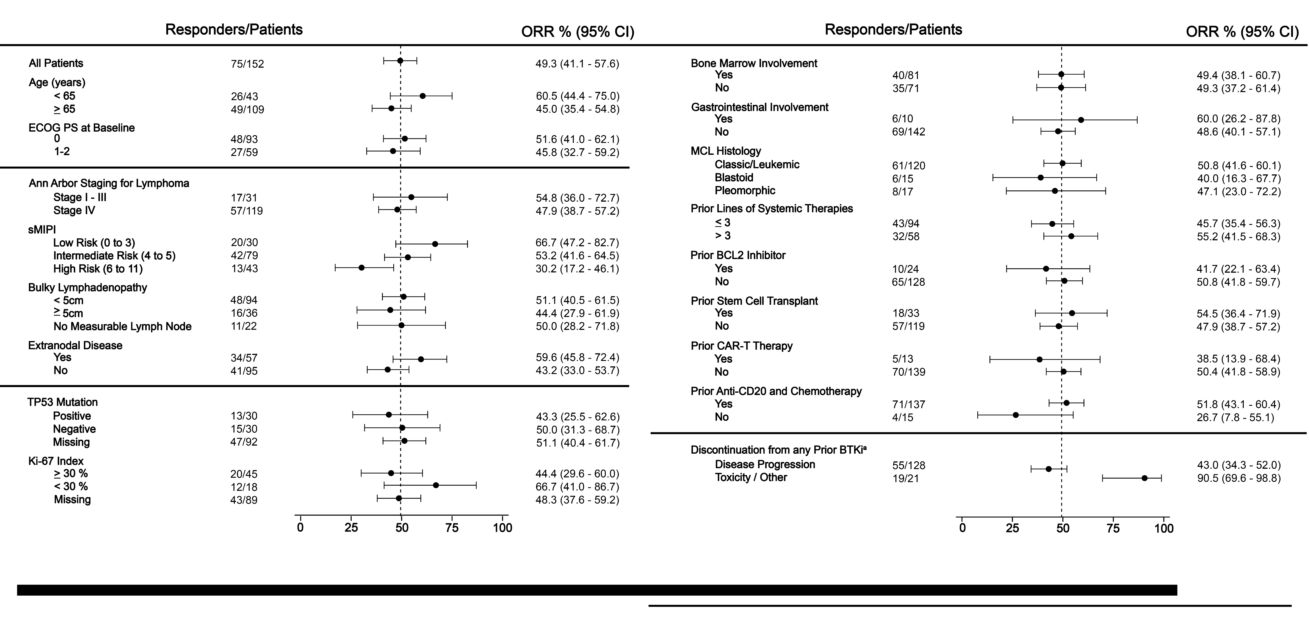
BRUIN Study: Overall Response Rate in Prior Covalent BTK Inhibitor Patients With MCL, Including High-Risk Subgroups
Notes:
Cohen JB, Shah NN, Jurczak W, et al. Pirtobrutinib in relapsed/refractory (R/R) mantle cell lymphoma (MCL) patients with prior cBTKi: safety and efficacy including high-risk subgroup analyses from the phase 1/2 BRUIN study. American Society of Hematology Annual Meeting and Exposition; San Diego, California; December 9-12, 2023. Abstract 981.
Here, you can see in these forest plots the different factors that may have influenced overall response rate in mantle cell lymphoma. Whether looking at various genetic subgroups, clinical characteristics, or histology, in general, there wasn't one particular group that benefited more than another. Really pirtobrutinib was quite active across all the different groups. The one factor I think that did seem to have significance, patients who had previously discontinued a BTK inhibitor due to toxicity, seemed to have an even higher overall response rate at close to 90% compared to those patients who had progressed on their prior covalent BTK inhibitor, where the response rate was more in the range of 43%.

Slide 39
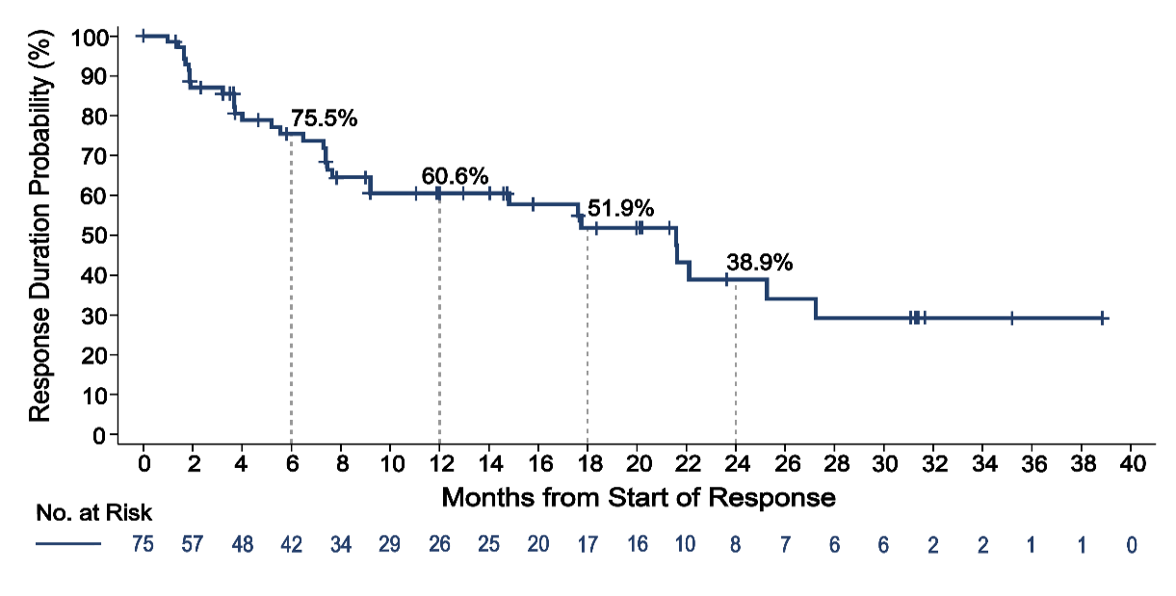
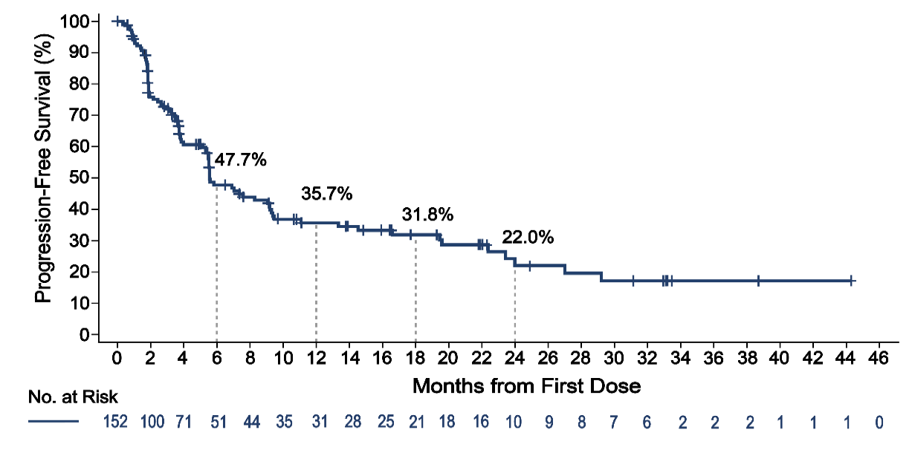
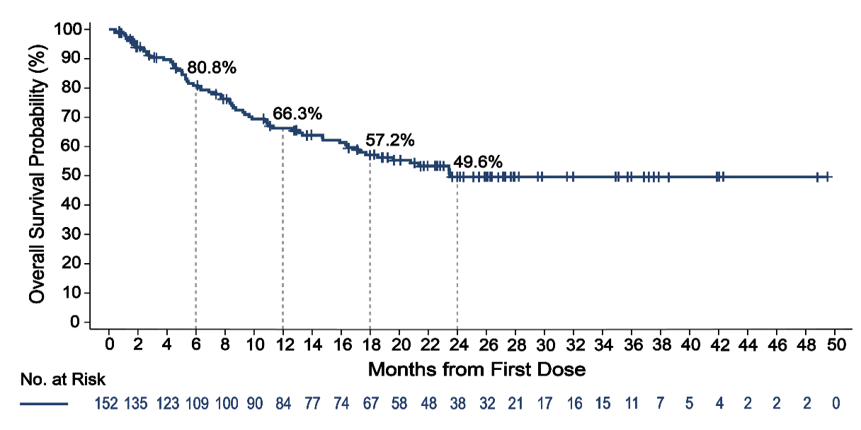
BRUIN Study: Pirtobrutinib Outcomes in Prior Covalent BTK Inhibitor Patients With MCL
Duration of Response
Progression-Free Survival
Median DoR: 95% CI: Median Follow-up: Events/Total: | 21.6 months 9.2-27.2 14.7 months 32/75
Median PFS: 95% CI: Median Follow-up: Events/Total: | 5.6 months 5.3-9.2 15.9 months 88/152
Overall Survival
Median OS: 95% CI: Median Follow-up: Events/Total: | 23.5 months 17.1-NE 24.2 months 64/152
Notes:
Cohen JB, Shah NN, Jurczak W, et al. Pirtobrutinib in relapsed/refractory (R/R) mantle cell lymphoma (MCL) patients with prior cBTKi: safety and efficacy including high-risk subgroup analyses from the phase 1/2 BRUIN study. American Society of Hematology Annual Meeting and Exposition; San Diego, California; December 9-12, 2023. Abstract 981.
With regard to durability, if patients do respond, these responses can be durable. And so, you see the duration of response median is about 21.6 months. However, many patients don't respond and as such, the median progression-free survival is a relatively short 5.6 months. That being said, I think the overall survival is promising with a median of about 2 years. It suggests that patients who do respond probably can be bridged to other types of therapy, for example, cellular therapies like CAR T-cells or even allogeneic transplantation.

Slide 40
BRUIN Study: Pirtobrutinib Outcomes in Prior Covalent BTK Inhibitor Patients With MCL by High-Risk Subgroups
Ki-67 index
TP53 status
 | < 30% | > 30%
Median PFS, mos 95% CI: Events/Total: | 19.5 3.5-NE 10/18 | 5.3 3.0-9.1 31/45
 | Unmutated | Mutated
Median PFS, mos 95% CI: Events/Total: | 6.9 3.7-16.6 19/30 | 3.7 1.8-5.5 21/30
 | Median DoR (95% CI) | Median OS (95% CI)
Ki-67
< 30% | 17.7 (1.9-N.E.) | NE (9.4-NE)
≥ 30% | 21.6 (5.6-27.2) | 23.4 (13.1-NE)
 | Median DoR (95% CI) | Median OS (95% CI)
TP53
Unmutated | 14.8 (1.9-NE) | NE (10.7-NE)
Mutated | 17.6 (1.7-NE) | 15.9 (7.8-NE)
Notes:
Cohen JB, Shah NN, Jurczak W, et al. Pirtobrutinib in relapsed/refractory (R/R) mantle cell lymphoma (MCL) patients with prior cBTKi: safety and efficacy including high-risk subgroup analyses from the phase 1/2 BRUIN study. American Society of Hematology Annual Meeting and Exposition; San Diego, California; December 9-12, 2023. Abstract 981.
Pirtobrutinib continues to demonstrate durable efficacy and a favorable safety profile in heavily pre-treated R/R MCL pts with prior cBTKi therapy. High ORRs were observed in pts who had PD on a prior cBTKi, and in pts with high-risk disease features including blastoid/pleomorphic variants, elevated Ki-67 index, and TP53 mutations.

Slide 41
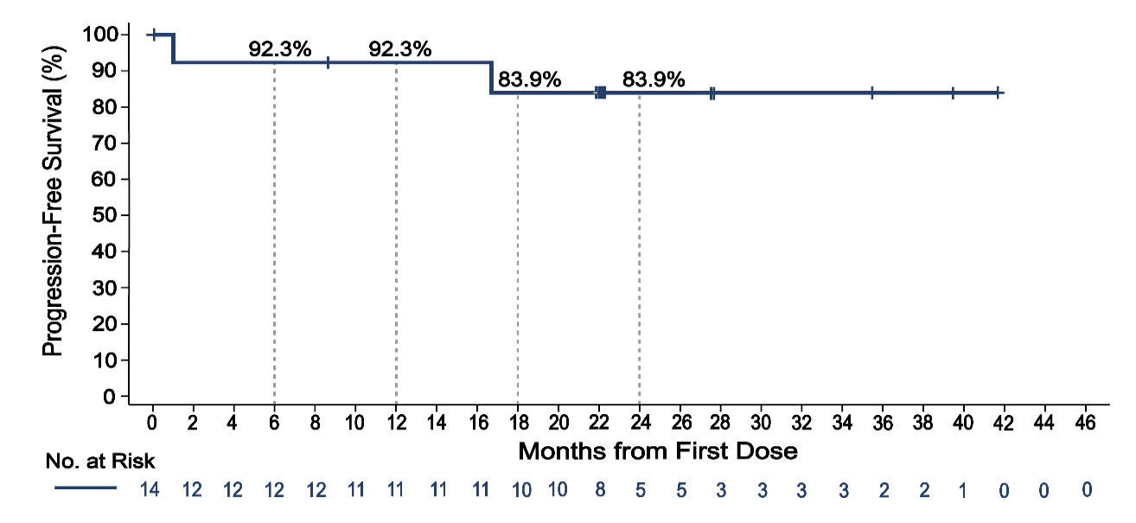
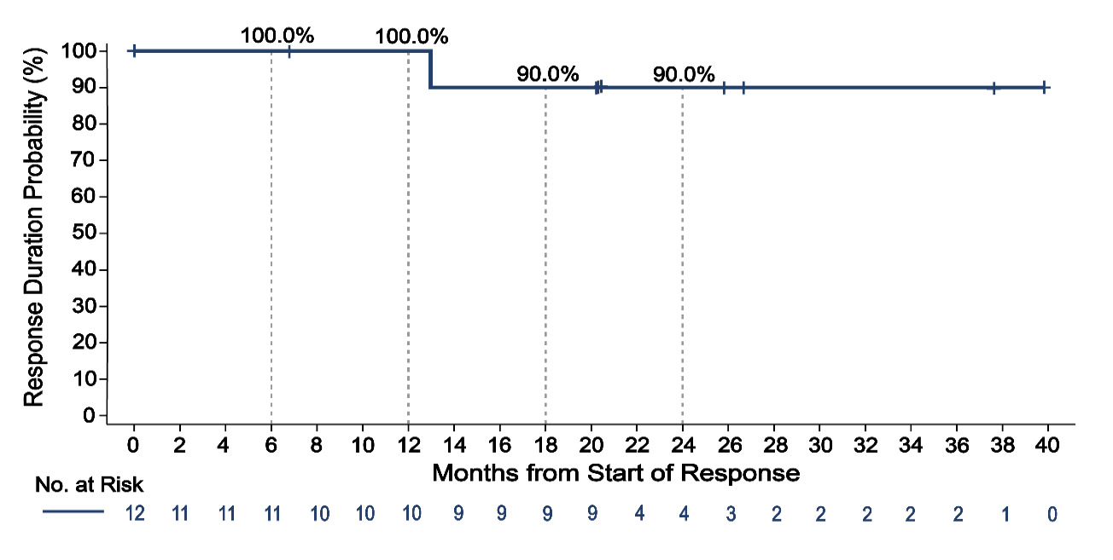
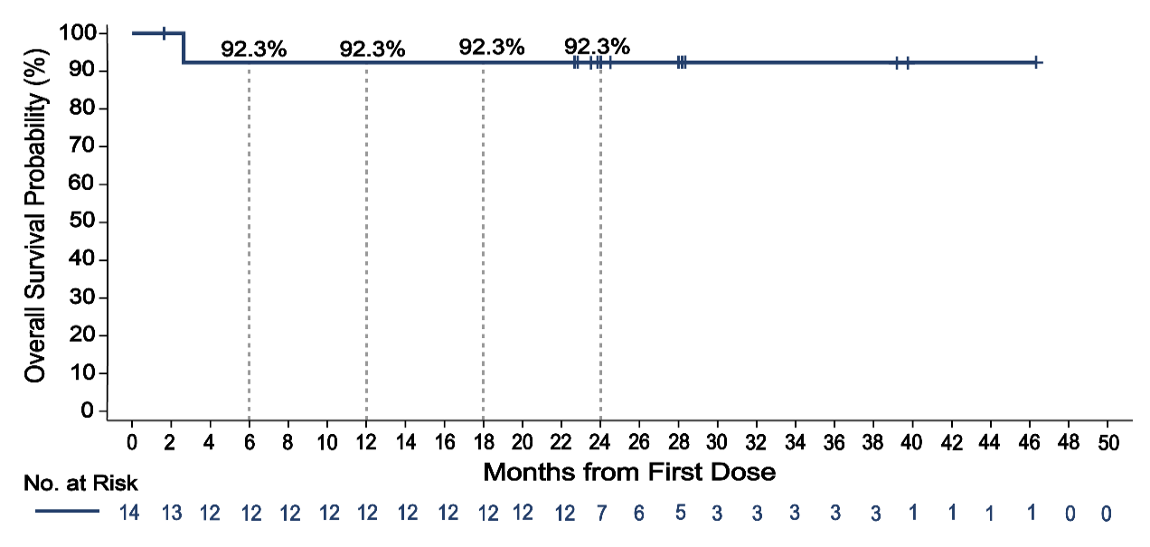
BRUIN Study: Pirtobrutinib Outcomes in Covalent BTK Inhibitor-Naïve Patients With MCL
Duration of Response
Progression-Free Survival
Median PFS: 95% CI: Median Follow-up: Events/Total: | NE months 16.7-NE 22.3 months 2/14
Median DoR: 95% CI: Median Follow-up: Events/Total: | NE months 13.0-NE 20.3 months 1/12
Overall Survival
cBTKi Naive Cohort:
The ORR was 85.7% (95% CI: 57.2-98.2)
6 CR (42.9%) and 6 PR (42.9%)
Median OS: 95% CI: Median Follow-up: Events/Total: | NE months NE-NE 24.5 months 1/14
Notes:
Cohen JB, Shah NN, Jurczak W, et al. Pirtobrutinib in relapsed/refractory (R/R) mantle cell lymphoma (MCL) patients with prior cBTKi: safety and efficacy including high-risk subgroup analyses from the phase 1/2 BRUIN study. American Society of Hematology Annual Meeting and Exposition; San Diego, California; December 9-12, 2023. Abstract 981.
There was a smaller group of patients in the BRUIN study with mantle cell lymphoma who were covalent BTK inhibitor-naive. And you can see the results look much better for this group. The overall response rate is about 86%, including 43% complete remissions, and duration of response, progression-free survival, and overall survival are all quite high, suggesting that this is a drug that could be potentially moved up into an earlier line of therapy, maybe even before covalent BTK inhibitors, in mantle cell lymphoma.

Slide 42
Pirtobrutinib FDA Approval in MCL
January 2023: the Food and Drug Administration granted accelerated approval to pirtobrutinib for relapsed or refractory MCL after at least two lines of systemic therapy, including a BTK inhibitor
BRUIN Trial (NCT03740529)
ORR: 50%
CR: 13%
DOR: 8.3 months
ASH 2023 updated data:
Prior covalent BTK inhibitor (n=152)
ORR of 49.3%
CR: 15.8%
PR: 33.6%
Median DoR: 21.6 months
Median PFS: 5.6 months
Median OS: 23.5 months
Notes:
FDA.gov. FDA grants accelerated approval to pirtobrutinib for relapsed or refractory mantle cell lymphoma. January 27, 2023. https://www.fda.gov/drugs/resources-information-approved-drugs/fda-grants-accelerated-approval-pirtobrutinib-relapsed-or-refractory-mantle-cell-lymphoma
Cohen JB, Shah NN, Jurczak W, et al. Pirtobrutinib in relapsed/refractory (R/R) mantle cell lymphoma (MCL) patients with prior cBTKi: safety and efficacy including high-risk subgroup analyses from the phase 1/2 BRUIN study. American Society of Hematology Annual Meeting and Exposition; San Diego, California; December 9-12, 2023. Abstract 981.
So, the original approval for pirtobrutinib was in mantle cell lymphoma back in January of 2023. This is an accelerated approval for relapsed or refractory mantle cell after at least 2 lines of systemic therapy, including a BTK inhibitor.
As assessed by an independent review committee using Lugano criteria

Slide 43
Ongoing Phase 3 Trials With Noncovalent BTK Inhibitors in MCL
Noncovalent BTKi | Phase 3 Trial | Study Arms | Population
Pirtobrutinib | BRUIN MCL-321 (NCT04662255) | pirtobrutinib vs investigator’s choice of BTKi (ibrutinib, acalabrutinib, or zanubrutinib) | Previously treated and BTKi-naïve
Notes:
Wang M, Eyre TA, Shah NN, et al. BRUIN MCL-321: A phase 3, open-label, randomized study of pirtobrutinib versus investigator choice of BTK inhibitor in patients with previously treated, BTK inhibitor naïve mantle cell lymphoma. J Clin Oncol. 2023;41(16_suppl):TPS7587.
With regard to ongoing Phase 3 trials with the noncovalent BTK inhibitors in mantle cell, right now, it's mainly this one trial, which is the BRUIN MCL-321 trial. This is pirtobrutinib versus investigator’s choice of other covalent BTK inhibitor, and it could be ibrutinib, acalabrutinib, or zanubrutinib. And this is looking primarily at a previously treated population, but does also include BTK inhibitor-naive patients.

Slide 44
Management Strategies for Adverse Events
Notes:
So, let's talk now in a little more detail about management strategies for adverse events on BTK inhibitors.

Slide 45
What Are the Implications of Covalent and Noncovalent BTKi Selectivity for Off-Target Effects?
Less selective BTK inhibitors (eg, ibrutinib) have more off-target effects,
which contribute to more toxicity compared with more selective agents
Potential off-target effects include:
Notes:
Kaptein A, de Bruin G, Emmelot-van Hoek M, et al. Potency and selectivity of BTK inhibitors in clinical development for B-cell malignancies. Blood. 2018;132(suppl 1):1871.
When we see these kinome plots, really one of the things that comes to mind is whether the off-target effects may be related to some of the different toxicities that are observed. In theory, because ibrutinib has a number of different off-target effects, we would say that it is more likely to have effects on, other kinases that could lead to different toxicities, compared to the more selective agents, where if we're only targeting BTK and not targeting other kinases as much, maybe we'll see less toxicities. And so, some of these theoretical risks, which we've seen now, bear out in practice include, targeting TEC kinase, which we think is related to the leading risks of BTK inhibitors, as well as possibly the cardiovascular toxicities we observe. One of the off-target effects of ibrutinib is actually to target EGFR. We think this may be related to the increased incidence of rash, diarrhea, and arthralgia that we see with this drug.

Slide 46
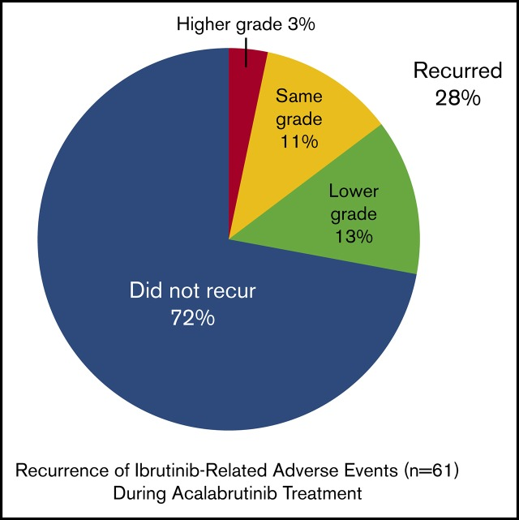
Phase I/II ACE-CL-001 Trial: Acalabrutinib in Ibrutinib-Intolerant Cohort
Among 33 patients who could not tolerate ibrutinib, 23 remained on acalabrutinib
No acalabrutinib dose reductions occurred
Of 61 ibrutinib-related AEs, 72% did not recur and 13% recurred at a lower grade with acalabrutinib
ORR: 76%
Median PFS: not reached
1-yr PFS: 83.4%
Notes:
Awan FT, Schuh A, Brown JR, et al. Acalabrutinib monotherapy in patients with chronic lymphocytic leukemia who are intolerant to ibrutinib. Blood Adv. 2019;3(9):1553-1562.
The Bruton tyrosine kinase (BTK) inhibitor ibrutinib improves patient outcomes in chronic lymphocytic leukemia (CLL); however, some patients experience adverse events (AEs) leading to discontinuation. Acalabrutinib is a potent, covalent BTK inhibitor with greater selectivity than ibrutinib. We evaluated the safety and efficacy of 100 mg of acalabrutinib twice daily or 200 mg once daily in patients with CLL who discontinued ibrutinib because of intolerance as determined by the investigators. Among 33 treated patients (61% men; median age, 64 years; range, 50-82 years), median duration of prior ibrutinib treatment was 11.6 months (range, 1-62 months); median time from ibrutinib discontinuation to acalabrutinib start was 47 days (range, 3-331 days). After a median of 19.0 months (range, 0.2-30.6 months), 23 patients remained on acalabrutinib; 10 had discontinued (progressive disease, n = 4; AEs, n = 3). No acalabrutinib dose reductions occurred. During acalabrutinib treatment, the most frequent AEs included diarrhea (58%), headache (39%), and cough (33%). Grade 3/4 AEs occurred in 58%, most commonly neutropenia (12%) and thrombocytopenia (9%). Of 61 ibrutinib-related AEs associated with intolerance, 72% did not recur and 13% recurred at a lower grade with acalabrutinib. Overall response rate was 76%, including 1 complete and 19 partial responses and 5 partial responses with lymphocytosis. Among 25 responders, median duration of response was not reached. Median progression-free survival (PFS) was not reached; 1-year PFS was 83.4% (95% confidence interval, 64.5%-92.7%). Acalabrutinib was well tolerated with a high response rate in patients who were previously intolerant to ibrutinib.

Slide 47
ELEVATE RR Trial: Lower Cumulative Incidence of Atrial Fibrillation and Hypertension With Acalabrutinib
Afib/Flutter, Any Grade
Hypertension, Any Grade
Overall, AEs led to treatment discontinuation in
14.7% of acalabrutinib-treated pts vs 21.3% of ibrutinib-treated pts
Notes:
Byrd JC, Hillmen P, Ghia P, et al. Acalabrutinib versus ibrutinib in previously treated chronic lymphocytic leukemia: results of the first randomized phase III trial. J Clin Oncol. 2021;39(31):3441-3452.
Among Bruton's tyrosine kinase inhibitors, acalabrutinib has greater selectivity than ibrutinib, which we hypothesized would improve continuous therapy tolerability. We conducted an open-label, randomized, noninferiority, phase III trial comparing acalabrutinib and ibrutinib in patients with chronic lymphocytic leukemia (CLL). Patients with previously treated CLL with centrally confirmed del(17)(p13.1) or del(11)(q22.3) were randomly assigned to oral acalabrutinib 100 mg twice daily or ibrutinib 420 mg once daily until progression or unacceptable toxicity. All-grade atrial fibrillation/atrial flutter incidence was significantly lower with acalabrutinib versus ibrutinib (9.4% v 16.0%; P = .02); among other selected secondary end points, grade 3 or higher infections (30.8% v 30.0%) and Richter transformations (3.8% v 4.9%) were comparable between groups and median overall survival was not reached in either arm (hazard ratio, 0.82; 95% CI, 0.59 to 1.15), with 63 (23.5%) deaths with acalabrutinib and 73 (27.5%) with ibrutinib. Treatment discontinuations because of adverse events occurred in 14.7% of acalabrutinib-treated patients and 21.3% of ibrutinib-treated patients. In this first direct comparison of less versus more selective Bruton's tyrosine kinase inhibitors in CLL, acalabrutinib demonstrated noninferior PFS with fewer cardiovascular adverse events.

Slide 48
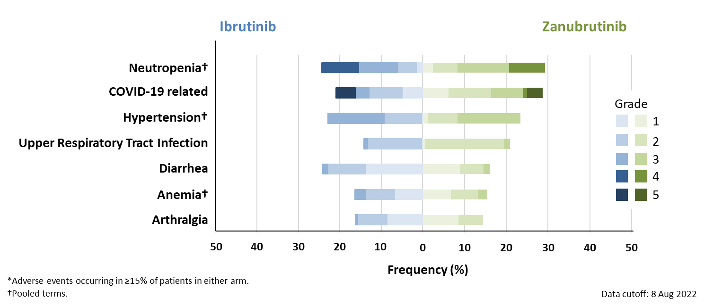
ALPINE Trial: Ibrutinib vs. Zanubrutinib in R/R CLL Most Common Adverse Events*
Adverse Events Leading to | Zanubrutinib (N=324) | Ibrutinib (N=324)
Dose reduction | 40 (12.3) | 55 (17.0)
Dose interruption | 162 (50.0) | 184 (56.8)
Treatment discontinuation | 50 (15.4) | 72 (22.2)
Notes:
Brown JR, Eichhorst B, Hillmen P, et al. Zanubrutinib or ibrutinib in relapsed or refractory chronic lymphocytic leukemia. N Engl J Med. 2023;388(4):319-332.
In a multinational, phase 3, head-to-head trial, ibrutinib, a Bruton’s tyrosine kinase (BTK) inhibitor, was compared with zanubrutinib, a BTK inhibitor with greater specificity, as treatment for relapsed or refractory chronic lymphocytic leukemia (CLL) or small lymphocytic lymphoma (SLL). In prespecified interim analyses, zanubrutinib was superior to ibrutinib with respect to overall response (the primary end point). We randomly assigned, in a 1:1 ratio, patients with relapsed or refractory CLL or SLL who had received at least one previous course of therapy to receive zanubrutinib or ibrutinib until the occurrence of disease progression or unacceptable toxic effects. The safety profile of zanubrutinib was better than that of ibrutinib, with fewer adverse events leading to treatment discontinuation and fewer cardiac events, including fewer cardiac events leading to treatment discontinuation or death. In patients with relapsed or refractory CLL or SLL, progression-free survival was significantly longer among patients who received zanubrutinib than among those who received ibrutinib, and zanubrutinib was associated with fewer cardiac adverse events.

Slide 49
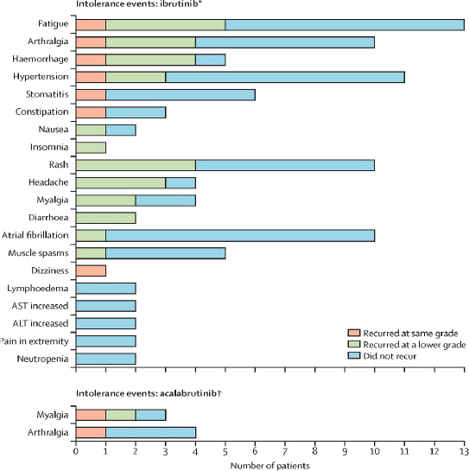
BGB-3111-215 (BTKi Intolerance Trial): Low Recurrence of BTK Inhibitor Intolerance on Zanubrutinib
Intolerable AEs experienced on ibrutinib or acalabrutinib were unlikely to recur with zanubrutinib
75% of ibrutinib and acalabrutinib intolerance events did not recur with zanubrutinib
<10% recurrence of a prior intolerance event led to zanubrutinib discontinuation
Zanubrutinib was effective; 90% of patients’ disease was controlled or responded to therapy
Notes:
Shadman M, Flinn IW, Levy MY, et al. Zanubrutinib in patients with previously treated B-cell malignancies intolerant of previous Bruton tyrosine kinase inhibitors in the USA: a phase 2, open-label, single-arm study. Lancet Haematol. 2023;10(1):e35-e45.
We hypothesized that zanubrutinib, a highly selective next-generation Bruton tyrosine kinase (BTK) inhibitor, would be a safe and active treatment for patients intolerant of ibrutinib, acalabrutinib, or both. We aimed to assess whether zanubrutinib would prolong treatment duration by minimising treatment-related toxicities and discontinuations in patients with previously treated B-cell malignancies. This ongoing, phase 2, multicentre, open-label, single-arm study was done in 20 centres in the USA. Patients aged 18 or older with previously treated B-cell malignancies (chronic lymphocytic leukaemia, small lymphocytic lymphoma, mantle cell lymphoma, Waldenström macroglobulinaemia, or marginal zone lymphoma) who became intolerant of ibrutinib, acalabrutinib, or both, were orally administered zanubrutinib 160 mg twice daily or 320 mg once daily per investigator. Most intolerance events (81 [70%] of 115 for ibrutinib; 15 [83%] of 18 for acalabrutinib) did not recur with zanubrutinib. Of the recurring events, seven (21%) of 34 ibrutinib intolerance events and two (67%) of three acalabrutinib intolerance events recurred at the same severity with zanubrutinib; 27 (79%) ibrutinib intolerance events and one (33%) acalabrutinib intolerance event recurred at a lower severity with zanubrutinib. No events recurred at higher severity. No grade 4 intolerance events recurred. 64 (96%) of 67 patients had one or more adverse events with zanubrutinib; the most common adverse events were contusion (in 15 [22%] of 67 patients), fatigue (14 [21%]), myalgia (ten [15%]), arthralgia (nine [13%]), and diarrhoea (nine [13%]). Atrial fibrillation occurred in three (4%) patients (all grade 2). Eight (12%) of 67 patients had serious adverse events (anaemia, atrial fibrillation, bronchitis, COVID-19, COVID-19 pneumonia, febrile neutropenia, salmonella gastroenteritis, transfusion reaction, trigeminal nerve disorder, and urinary tract infection). No treatment-related deaths occurred. Patients intolerant of previous BTK inhibitors have limited treatment options. These results suggest that zanubrutinib, a safe and viable treatment for patients with B-cell malignancies, might fill that unmet need for those who exhibit intolerance to ibrutinib or acalabrutinib.

Slide 50
BRUIN Trial: Pirtobrutinib Safety Profile of CLL Patients Who Received Prior Covalent BTK Inhibitor
 | Treatment-Emergent AEs in Patients with CLL/SLL (n=282)
 | All Cause AEs, (≥25%), % |  | Treatment-Related AEs, %
Adverse Event | Any Grade | Grade ≥3 | Any Grade | Grade ≥3
Fatigue | 36.9 | 1.8 | 3.5 | 0.0
Neutropenia^{b,c} | 34.4 | 28.4 | 19.5 | 15.2
Diarrhea | 28.4 | 0.4 | 7.8 | 0.0
Cough | 27.3 | 0.0 | 1.8 | 0.0
Contusion | 26.2 | 0.0 | 17.4 | 0.0
Covid-19 | 25.9 | 4.6 | 0.7 | 0.0
AEs of Interestª | Any Grade | Grade ≥3 | Any Grade | Grade ≥3
Infections^{d} | 74.1 | 30.9 | 12.8 | 4.3
Bruising^{e} | 30.1 | 0.0 | 19.1 | 0.0
Rash^{f} | 24.5 | 1.1 | 5.7 | 0.4
Arthralgia | 22.7 | 1.4 | 4.3 | 0.0
Hemorrhage^{g} | 13.5 | 2.1 | 4.6 | 1.1
Hypertension | 14.2 | 4.3 | 3.5 | 0.4
Atrial Fibrillation/Flutter^{h,i} | 4.6 | 1.8 | 1.4 | 0.7
Median time on treatment was 18.7 months (prior cBTKi), 24.3 months (BCL2i-N) and 15.3 months (BCL2i-E)
11 (3.9%; 9 BCL2i-N, 2 BCL2i-E) patients had Treatment-Related AEs leading to pirtobrutinib dose reduction
7 (2.5%; 4 BCL2i-N, 3 BCL2i-E) patients had Treatment-Related AEs leading to pirtobrutinib discontinuation
Safety profiles of BCL2i-N and BCL2i-E subgroups were similar and are described via the QR code
Notes:
Woyach JA, Brown JR, Ghia P, et al. Pirtobrutinib in post-cBTKi CLL/SLL: ~30 months follow-up and subgroup analysis with/without prior BCL2i from the phase 1/2 BRUIN study. Abstract presented at: American Society of Hematology Annual Meeting; San Diego, California; December 9-12, 2023. Abstract 325.
So, in the BRUIN trial, they looked in detail at the safety profile of pirtobrutinib in CLL patients, and these were the patients, again, who had received prior covalent BTK inhibitors, and then came on this study of pirtobrutinib. In general, this drug is very well-tolerated. Very few grade 3 or higher events, just some neutropenia in about 15% of patients, primarily, and some infections, but the rates of other issues that we see with BTK inhibitors, like bleeding risks, AFib/flutter, hypertension, are quite low with pirtobrutinib. And this was with a reasonable amount of time on therapy. Median time on treatment here was about 18 months, and so overall the safety profile looks quite favorable for this drug.

Slide 51
BRUIN Trial: Pirtobrutinib and Venetoclax Safety Profile
No DLTs were observed
Pirtobrutinib dose was reduced in 1 patient who experienced treatment-related diarrhea and thrombocytopenia
Two cases of clinical TLS related to venetoclax dose escalation
Grade 3 case resolved spontaneously after 24 hours
Grade 4 case resolved after short-term IV fluids and dialysis
Both patients completed all 24 cycles of combination therapy
 | Treatment-emergent AEs in Patients Treated with PV (n=15)
 | All-cause AEs (≥25​%) , % |  | Treatment-related AEs, %
Adverse Event​ (AE) | Any Grade​ | Grade ≥3​ | Any Grade​ | Grade ≥3​
Neutropeniaª | 7 (46.7) | 7 (46.7) | 7 (46.7) | 7 (46.7)
Nausea | 9 (60.0) | 0 (0.0) | 7 (46.7) | 0 (0.0)
Fatigue | 8 (53.3) | 0 (0.0) | 5 (33.3) | 0 (0.0)
Diarrhea | 7 (46.7) | 2 (13.3) | 4 (26.7) | 2 (13.3)
Hypophosphatemia | 5 (33.3) | 0 (0.0) | 2 (13.3) | 0 (0.0)
Constipation | 4 (26.7) | 0 (0.0) | 3 (20.0) | 0 (0.0)
Cough | 4 (26.7) | 0 (0.0) | 1 (6.7) | 0 (0.0)
Platelet Count Decreased | 4 (26.7) | 1 (6.7) | 4 (26.7) | 1 (6.7)
Vomiting | 4 (26.7) | 0 (0.0) | 2 (13.3) | 0 (0.0)
Anemia | 3 (20.0) | 3 (20.0) | 2 (13.3) | 2 (13.3)
Tumor Lysis Syndrome | 2 (13.3) | 2 (13.3) | 2 (13.3) | 2 (13.3)
Pyrexia | 3 (20.0) | 1 (6.7) | 1 (6.7) | 1 (6.7)
AEs of Interest^{b} | Any Grade | Grade ≥3 | Any Grade | Grade ≥3
Infections^{c} | 12 (80.0) | 4 (26.7) | 7 (46.7) | 3 (20.0)
Bruising^{d} | 3 (20.0) | 0 (0.0) | 3 (20.0) | 0 (0.0)
Rash^{e} | 1 (6.7) | 0 (0.0) | 1 (6.7) | 0 (0.0)
Arthralgia | 4 (26.7) | 0 (0.0) | 2 (13.3) | 0 (0.0)
Hemorrhage^{f} | 1 (6.7) | 0 (0.0) | 1 (6.7) | 0 (0.0)
Hypertension | 3 (20.0) | 1 (6.7) | 2 (13.3) | 0 (0.0)
Atrial Fibrillation/Flutter^{g} | 0 (0.0) | 0 (0.0) | 0 (0.0) | 0 (0.0)
Notes:
Roeker LE, Woyach JA, Cheah CY, et al. Fixed-duration pirtobrutinib combined with venetoclax ± rituximab in relapsed/refractory chronic lymphocytic leukemia: updated results, including MRD data, from the BRUIN phase 1b study. Abstract presented at: American Society of Hematology Annual Meeting; San Diego, California; December 9-12, 2023. Abstract 3269.
Fixed-duration pirtobrutinib combined with venetoclax ± rituximab in pts with R/R CLL
Pts with R/R CLL were eligible for pirtobrutinib combined with venetoclax ± rituximab in the phase 1b portion of the multicenter phase 1/2 BRUIN study (NCT03740529). Prior cBTKi therapy was allowed, but not prior venetoclax. Pts were enrolled into sequential cohorts, first in the pirtobrutinib + venetoclax (PV) cohort and then the PV + rituximab (PVR) cohort. Pirtobrutinib 200 mg QD was started on cycle 1 day 1, and venetoclax was started on cycle 2 day 1 with the standard 5-week dose ramp to 400 mg QD target dose. PV was given for up to 24 cycles; each cycle was 28 days. For the PVR cohort, rituximab was given at 375 mg/m ² on cycle 1 day 1 and then 500 mg/m ² on day 1 of cycles 2-6.

Slide 52
BRUIN Trial: Pirtobrutinib and Venetoclax Plus Rituximab Safety Profile
No DLTs were observed
Treatment-related pirtobrutinib and venetoclax dose reductions occurred in 2 patients
1 patient with thrombocytopenia
1 patient with neutropenia
Treatment-related discontinuations occurred in 2 patients
1 patient with neutropenia
1 patient with a UTI
 | Treatment-emergent AEs in Patients Treated with PVR (n=10)
 | All-cause AEs (≥25​%) , % |  | Treatment-related AEs, %
Adverse Event​ (AE) | Any Grade​ | Grade ≥3​ | Any Grade​ | Grade ≥3​
Neutropeniaª | 7 (70.0) | 6 (60.0) | 7 (70.0) | 6 (60.0)
Diarrhea | 6 (60.0) | 0 (0.0) | 6 (60.0) | 0 (0.0)
Fatigue | 5 (50.0) | 1 (10.0) | 2 (20.0) | 0 (0.0)
Nausea | 4 (40.0) | 0 (0.0) | 4 (40.0) | 0 (0.0)
Constipation | 4 (40.0) | 0 (0.0) | 1 (10.0) | 0 (0.0)
Infusion Related Reaction | 4 (40.0) | 2 (20.0) | 4 (40.0) | 2 (20.0)
Anemia | 3 (30.0) | 1 (10.0) | 2 (20.0) | 1 (10.0)
Back Pain | 3 (30.0) | 1 (10.0) | 1 (10.0) | 0 (0.0)
Chills | 3 (30.0) | 0 (0.0) | 3 (30.0) | 0 (0.0)
Dry Mouth | 3 (30.0) | 0 (0.0) | 1 (10.0) | 0 (0.0)
Platelet Count Decreased | 2 (20.0) | 1 (10.0) | 2 (20.0) | 1 (10.0)
Hypertension Urgency | 1 (10.0) | 1 (10.0) | 1 (10.0) | 1 (10.0)
AEs of Interest^{b} | Any Grade | Grade ≥3 | Any Grade | Grade ≥3
Infections^{c} | 9 (90.0) | 4 (40.0) | 2 (20.0) | 1 (10.0)
Bruising^{d} | 2 (20.0) | 0 (0.0) | 2 (20.0) | 0 (0.0)
Rash^{e} | 3 (30.0) | 0 (0.0) | 1 (10.0) | 0 (0.0)
Arthralgia | 4 (40.0) | 0 (0.0) | 1 (10.0) | 0 (0.0)
Hemorrhage^{f} | 2 (20.0) | 1 (10.0) | 1 (10.0) | 1 (10.0)
Hypertension | 1 (10.0) | 1 (10.0) | 0 (0.0) | 0 (0.0)
Atrial Fibrillation/Flutter^{g} | 0 (0.0) | 0 (0.0) | 0 (0.0) | 0 (0.0)
Notes:
Roeker LE, Woyach JA, Cheah CY, et al. Fixed-duration pirtobrutinib combined with venetoclax ± rituximab in relapsed/refractory chronic lymphocytic leukemia: updated results, including MRD data, from the BRUIN phase 1b study. Abstract presented at: American Society of Hematology Annual Meeting; San Diego, California; December 9-12, 2023. Abstract 3269.
Fixed-duration pirtobrutinib combined with venetoclax ± rituximab in pts with R/R CLL
Pts with R/R CLL were eligible for pirtobrutinib combined with venetoclax ± rituximab in the phase 1b portion of the multicenter phase 1/2 BRUIN study (NCT03740529). Prior cBTKi therapy was allowed, but not prior venetoclax. Pts were enrolled into sequential cohorts, first in the pirtobrutinib + venetoclax (PV) cohort and then the PV + rituximab (PVR) cohort. Pirtobrutinib 200 mg QD was started on cycle 1 day 1, and venetoclax was started on cycle 2 day 1 with the standard 5-week dose ramp to 400 mg QD target dose. PV was given for up to 24 cycles; each cycle was 28 days. For the PVR cohort, rituximab was given at 375 mg/m ² on cycle 1 day 1 and then 500 mg/m ² on day 1 of cycles 2-6.

Slide 53
BELLWAVE-001 Trial: Nemtabrutinib Safety Profile
Treatment-related Adverse Events, n (%) | All Patients at 65 mg QD N=112
 | All | Grade ≥3
Any treatment-related AEs | 82 (73) | 45 (40)
Treatment-related AEs ≥ 5%
Dysgeusia | 23 (21) | 0 (0)
Neutropenia | 22 (20) | 19 (17)
Fatigue | 14 (13) | 2 (2)
Thrombocytopenia | 13 (12) | 5 (4)
Nausea | 13 (12) | 0 (0)
Hypertension | 11 (10) | 4 (4)
Diarrhea | 11 (10) | 2 (2)
Notes:
Woyach J, Flinn IW, Awan FT, et al. Efficacy and safety of nemtabrutinib, a wild-type and C481S-mutated Bruton tyrosine kinase inhibitor for B-cell malignancies: updated analysis of the open-label phase 1/2 dose-expansion Bellwave-001 study. Abstract presented at: American Society of Hematology Annual Meeting; New Orleans, Louisiana; December 10-13, 2022. Abstract 3114.
With nemtabrutinib, the safety profile, this is in 112 patients treated at the recommended phase 2 dose of 65 milligrams daily. Certainly any treatment related AE's or common, but grade 3 or higher events are less common. Neutropenia being the most common one again seen in terms of grade 3 or higher toxicities in about 19% of patients. One of the unique toxicities seen with nemtabrutinib is dysgeusia, which can occur in a little over 20% of patients. This does tend to be mild and transient, fortunately. And then again, you do see some of the other issues around hypertension and diarrhea that we see with other BTK inhibitors.

Slide 54
BRUIN Trial: Pirtobrutinib Safety Profile in R/R MCL Patients
 | Treatment-Emergent AEs in Patients with MCL (n=166)
 | All Cause AEs, (≥15%), % |  | Treatment-Related AEs, %
Adverse Event | Any Grade | Grade ≥3 | Any Grade | Grade ≥3
Fatigue | 31.9 | 3.0 | 21.1 | 2.4
Diarrhea | 22.3 | 0.0 | 12.7 | 0.0
Dyspnea | 17.5 | 1.2 | 9.0 | 0.6
Anemia | 16.9 | 7.8 | 7.2 | 2.4
Thrombocytopenia | 15.1 | 7.8 | 7.8 | 3.0
AEs of Interestª | Any Grade | Grade ≥3 | Any Grade | Grade ≥3
Infections^{b} | 42.8 | 19.9 | 15.7 | 3.6
Bruising^{c} | 16.3 | 0.0 | 11.4 | 0.0
Rash^{d} | 14.5 | 0.6 | 9.0 | 0.0
Arthralgia | 9.0 | 1.2 | 2.4 | 0.0
Hemorrhage^{e} | 10.2 | 2.4 | 4.2 | 0.6
Hypertension | 4.2 | 0.6 | 1.8 | 0.0
Atrial Fibrillation/Flutter^{f,g} | 3.6 | 1.8 | 0.6 | 0.0
Median time on treatment was 5.5 months for the MCL cohort
Discontinuations due to TRAEs occurred in 3% (n=5) of patients with MCL
Dose reductions due to TRAEs occurred in 5% (n=8) of patients with MCL
Notes:
Cohen JB, Shah NN, Jurczak W, et al. Pirtobrutinib in relapsed/refractory (R/R) mantle cell lymphoma (MCL) patients with prior cBTKi: safety and efficacy including high-risk subgroup analyses from the phase 1/2 BRUIN study. American Society of Hematology Annual Meeting and Exposition; San Diego, California; December 9-12, 2023. Abstract 981.
Similarly, in mantle cell lymphoma, we again see very low rates of treatment-related grade 3 or higher AEs with pirtobrutinib. You do see some lower-grade diarrhea in about 13% of patients. You see infections and bruising in about 11% of patients. Median time on treatment here was a lot shorter in the mantle cell cohort, about 5 1/2 months, but that's mostly because patients were discontinuing due to disease progression rather than discontinuing due to AEs.

Slide 55
Pirtobrutinib Adverse Event Summary
Infections | Monitor for signs and symptoms of infection, evaluate promptly, and treat appropriately
 | Based on severity, reduce dose, temporarily withhold, or permanently discontinue
 | Consider prophylaxis, including vaccinations and antimicrobial prophylaxis, in patients who are at increased risk for infections, including opportunistic infections
Hemorrhage | Monitor for bleeding and manage appropriately
 | Based on severity of bleeding, reduce dose, temporarily withhold, or permanently discontinue
Cytopenias | Monitor complete blood counts during treatment
 | Based on severity, reduce dose, temporarily withhold, or permanently discontinue
Cardiac Arrhythmias | Monitor for symptoms of arrhythmias (eg, palpitations, dizziness, syncope, dyspnea) and manage appropriately
 | Based on severity, reduce dose, temporarily withhold, or permanently discontinue
Second Primary Malignancies | Monitor and advise patients to use sun protection
Embryo-Fetal Toxicity | Advise females of potential risk to a fetus and recommend use of effective contraception
Most common adverse reactions (≥20%) | Fatigue, musculoskeletal pain, diarrhea, COVID-19, bruising, and cough
Grade 3 or 4 laboratory abnormalities (≥10%) | Neutropenia, thrombocytopenia, anemia, and lymphopenia
Notes:
JAYPIRCA (pirtobrutinib). Prescribing information. Eli Lilly and Company; 2023.
So, kind of summarizing the adverse events for pirtobrutinib, certainly in any of these B cell malignancies like CLL or mantle cell lymphoma, we worry about infections. We have to monitor closely for these and consider prophylaxis, including vaccinations and antimicrobial prophylaxis, for patients that increase risk. Hemorrhage is not common with pirtobrutinib, but minor bleeding issues like bruising can be seen. We do sometimes see cytopenias that require us to more closely monitor the CBC and occasionally provide growth factor support. We have not commonly seen cardiac arrhythmias on pirtobrutinib, but given that it is a BTK inhibitor it is something that we watch for. Our patients, particularly with CLL are at a higher risk of secondary primary malignancies. So, we need to be mindful of that, particularly sun protection is important in these patients. There is some potential for embryo fetal toxicity, so certainly patients need to be on effective contraception if they're using these drugs. And then you see in terms of the most common adverse reactions, fatigue, very common in this population, musculoskeletal pain, diarrhea, COVID infections, bruising and cough. In terms of grade 3 or 4 lab abnormalities, the most common is actually probably neutropenia, but you can see thrombocytopenia or anemia.

Slide 56
Managing BTK Inhibitor Common and Serious AEs
Rash
Topical steroids¹ Oral antihistamines
Hair/Nail Changes
Biotin supplementation¹ Application of nail oil¹
Diarrhea
Loperamide¹ Hydration¹ Bedtime dosing¹
Nausea
Bedtime dosing² Antiemetics
Arthralgia/Myalgia
Exercise Avoid frequent NSAIDs¹ Alternative supplements/treatments²
Headache
Caffeine¹ Acetaminophen¹ Avoid NSAIDs/aspirin-containing products¹
Infection
No standard recommendations for routine screening or prophylaxis; practices differ across institutions¹ Monitor closely¹ Be aware of drug-drug interactions with antifungal agents¹ May consider holding BTKi for severe infection¹
Notes:
1. Lipsky A, Lamanna N. Managing toxicities of Bruton tyrosine kinase inhibitors. Hematology Am Soc Hematol Educ Program. 2020;2020(1):336-345.
2. Brown JR. How I treat CLL patients with ibrutinib. Blood. 2018;131(4):379-386.
The NCCN has considerations for antiviral and PJP with BTKi, especially in patients with other risk factors.
So, what are some tips and tricks in terms of managing BTK inhibitor toxicities? Mostly kind of common things that you'd expect with rash, they do tend to be responsive to topical steroids and oral antihistamine. We do also see hair and nail changes sometimes on BTK inhibitors and particularly those nail changes can be helped by biotin supplementation or application of nail oil. We manage diarrhea, symptomatically, sometimes even altering the dosing of the timing of dosing, doing it at bedtime instead of in the morning, for example, can be helpful. Similarly, with nausea, we can adjust the dosing timing that can sometimes be helpful. Arthralgias and myalgias are common with BTK inhibitors. I find that when my patients are regularly exercising, that can actually be helpful there. Some selective NSAID use is OK, but we try to avoid more frequent NSAID use and there are some alternative supplements and treatments that various patients have found to be helpful. Headache is not that common with BTK inhibitors, with the exception of acalabrutinib where it is seen a little bit more commonly when patients are first starting the drug. I do recommend patients increase their caffeine intake and use acetaminophen. And that usually takes care of it. And that headache usually goes away within a couple of weeks of starting acalabrutinib. For infection, there's no standard recommendation in terms of routine screening or prophylaxis. There is a lot of variation across different institutions in terms of what to do here. Certainly, we monitor patients closely for infection. We need to stay aware of drug, drug interactions if we need to use particular antimicrobials, especially antifungal agents. And generally, my practice is for patients who develop a severe infection when they're on BTK inhibitors, I will usually hold the BTK inhibitor until the infection is clearly resolving.

Slide 57
Additional Considerations for Optimizing BTK Inhibitor Therapy in CLL and MCL
Interprofessional collaboration is key for optimizing safety
Assessment and monitoring (leveraging expertise of APPs, nursing, pharmacists)
Management protocols (toxicity management pathways/algorithms either within a group or through online resources)
Incorporating patient goals/preferences
Patient-reported outcomes data on quality of life are lacking
Individualized discussion is key, taking into account logistics and specific co-morbidities of particularly patients
Notes:
Interprofessional collaboration is really one of the keys to optimize safety. We really want to leverage the expertise of our whole team. So, if we work with AP's, nurses and pharmacists, they all have different expertise that can be complementary to our own as the MD's and so utilizing all those folks to help manage the toxicities can be quite helpful. It's often also helpful if there's management protocols. We've also done this in our practice. We've developed toxicity management pathways and algorithms with BTK inhibitors. You can do this within your own group or there's online resources to help with. And as we think about utilizing these treatments in CLL and mantle cell lymphoma, incorporating patient goals and preferences really is also crucial. We don't have that much data in terms of patient reported outcomes or quality of life in these trials. So, I think in general, the individualized discussion is one of the keys often there's certain logistical considerations of starting these different treatments. We want to think about specific comorbidities of particular patients. And these all factor into our recommendations about which BTK inhibitor to use and which kind of order of covalent, noncovalent, and other therapies that we have available.

Slide 58
Case-Based Learning Lab

Slide 59
Relapsed/Refractory CLL Case
A 59-year-old man with hypertension but no other medical conditions is diagnosed with Rai stage 1 CLL
Prognostic markers show normal FISH, unmutated IGHV, TP53 wild type
Over the next 3 years he gradually develops cytopenias and palpable lymphadenopathy up to 4-5 cm
Now at age 62 years, he needs frontline therapy for CLL
He achieves a PR on ibrutinib and stays in remission for about 8 years, but now at age 70 develops progressive bulky lymphadenopathy and repeat genetic testing reveals a TP53 mutation

Slide 60
Relapsed/Refractory CLL Clinical Course
A 59-year-old man with hypertension but no other medical conditions is diagnosed with Rai stage 1 CLL
Prognostic markers show normal FISH, unmutated IGHV, TP53 wild type
Over the next 3 years he gradually develops cytopenias and palpable lymphadenopathy up to 4-5 cm
Now at age 62 years, he needs frontline therapy for CLL
He achieves a PR on ibrutinib and stays in remission for about 8 years, but now at age 70 develops progressive bulky lymphadenopathy and repeat genetic testing reveals a TP53 mutation
He starts venetoclax and achieves a PR with undetectable MRD and small residual lymphadenopathy
After 18 months on venetoclax, he develops steadily progressive lymph nodes which are now bulky

Slide 61
Relapsed/Refractory CLL Case Study Audience Question
What would you recommend for this patient as the next line of therapy?
Zanubrutinib
BR
Pirtobrutinib
Acalabrutinib + Obinutuzumab
Unsure

Slide 62
Relapsed/Refractory CLL Case Study Rationale for Best Answer
What would you recommend for this patient as the next line of therapy?
Zanubrutinib
BR
Pirtobrutinib
Acalabrutinib + Obinutuzumab
Unsure
Notes:
Learning Objective: 2. Apply real-world clinical evidence and clinical trial data on the efficacy and tolerability of reversible, non-covalent BTK inhibitors to the planning of evidence-driven treatment sequencing for patients with CLL/SLL or MCL

Slide 63
Relapsed/Refractory CLL Case Study Conclusion
Patients with double-refractory CLL are difficult to treat, particularly in the community setting, where access to clinical trials can be more limited
Rechallenging with cBTKi in a patient already refractory to a different cBTKi is unlikely to be effective and carries a risk of side effects
A ncBTKi such as pirtobrutinib can provide effective disease control with excellent tolerability in double-refractory CLL

Slide 64
Relapsed/Refractory MCL Case
A 59-year-old woman with no major co-morbidities presents with a 25 lb. unintentional weight loss over the last 6 months, and CT scans revealed widespread lymphadenopathy
Biopsy reveals stage IV MCL with Ki-67 45% and no TP53 mutation
She is treated with frontline BR and achieves a CR, then receives autoSCT followed by 3 years of rituximab maintenance
One year after transplant, she develops drenching night sweats with a rising LDH and recurrent lymphadenopathy, and she is started on acalabrutinib

Slide 65
Relapsed/Refractory MCL Clinical Course
A 59-year-old woman with no major co-morbidities presents with a 25 lb. unintentional weight loss over the last 6 months, and CT scans revealed widespread lymphadenopathy
Biopsy reveals stage IV MCL with Ki-67 45% and no TP53 mutation
She is treated with frontline BR and achieves a CR, then receives autoSCT followed by 3 years of rituximab maintenance
One year after transplant, she develops drenching night sweats with a rising LDH and recurrent lymphadenopathy, and she is started on acalabrutinib
She achieves PR on acalabrutinib which lasts for about 2 years, but then redevelops progressive lymphadenopathy

Slide 66
Relapsed/Refractory MCL Case Study Audience Question
How would you treat this patient now?
Zanubrutinib
Pirtobrutinib
Bortezomib
BR
Unsure

Slide 67
Relapsed/Refractory MCL Case Study Rationale for Best Answer
How would you treat this patient now?
Zanubrutinib
Pirtobrutinib
Bortezomib
BR
Unsure
Notes:
Learning Objective: 2. Apply real-world clinical evidence and clinical trial data on the efficacy and tolerability of reversible, non-covalent BTK inhibitors to the planning of evidence-driven treatment sequencing for patients with CLL/SLL or MCL

Slide 68
Relapsed/Refractory MCL Case Study Conclusion
For MCL patients who progress after CIT/autoSCT and covalent BTKi, noncovalent BTKi such as pirtobrutinib are able to achieve response in about half of patients and are a well-tolerated treatment option
For fit patients in this setting, CAR T-cell therapy with brexu-cel should also be considered
Noncovalent BTKi monotherapy is unlikely to achieve long term remission, and therefore could be used as a bridge to CAR T in those who are candidates or to a clinical trial in those who are not

Slide 69
Key Takeaways
ncBTKi may provide benefit for patients with progression on cBTKi
The safety profiles for these agents are generally favorable
Consider patient comorbidities and disease status when determining appropriate treatment
Consider expectations of therapy and patient preference
With many questions still unanswered, active participation in clinical trials remains crucial to further improve outcomes
Notes:
In summary, the noncovalent BTK inhibitors may provide benefit for patients with progression on covalent BTK inhibitors. In general, the safety profiles for these drugs are good, but we do need to be mindful of the common toxicities and manage them as needed. As we're helping patients to decide on which therapies to embark on, we do want to consider what their specific comorbidities are as well as what their disease status is. That will help us to optimize the therapy for patients. Often patients have particular expectations or preferences around which therapies they choose, and so we want to take that into account. And although we have a lot of new data in this area, there's still many questions that are unanswered and so I would encourage you if you have patients who are interested in clinical trials, to actively encourage them to participate in these trials. I think the trials really are the way that we'll be able to further improve outcomes for patients in the future.

