Slide 1
Tagraxofusp in Blastic Plasmacytoid Dendritic Cell Neoplasm With/Without Central Nervous System Involvement and Intrathecal Chemotherapy as Primary Treatment or Prophylaxis: an Italian Experience
European Hematology Association (EHA) Annual Congress 2022 • June 9–17, 2022
Session Date and Time: Friday, June 10, 2022 – 16:30 – 17:45 CEST
P530
Giulia Rivoli¹, Germana Beltrami¹, Anna Maria Raiola¹, Alida Dominietto¹, Marcell Riggi², Emanuele Angelucci¹
¹Ematologia e terapie cellulari, IRCCS Ospedale Policlinico San Martino, Genova, Italy; ²Stemline Therapeutics Switzerland GmbH, Zug, Switzerland

Slide 2
Introduction (I)
P530
Blastic plasmacytoid dendritic cell neoplasm (BPDCN) is a highly aggressive hematologic malignancy derived from plasmacytoid dendritic cells (pDCs) that overexpress CD123, the interleukin-3 (IL-3) receptor alpha subunit^{1,2}
BPDCN is typically characterized by skin, bone marrow, and lymph node involvement at presentation³
Despite initial response at the medullary and skin level, patients often relapse with central nervous system (CNS) involvement, in part due to the CNS acting as a sanctuary for systemic chemotherapy⁴
The precise frequency of CNS involvement is currently unknown. Retrospective studies have found CNS involvement in approximately 10% of patients at diagnosis and in 30% at time of first relapse^{1,5}
A recent small prospective study using flow cytometry showed higher incidence of CNS involvement both at diagnosis (60%) and relapse (100%), suggesting occult CNS involvement in asymptomatic patients⁶
Achieving complete clearance of disease in the meningeal compartment is essential. Intrathecal (IT) chemotherapy is administered both as prophylactic and primary treatment, and its use in combination with systemic treatment can lead to long-term remissions^{6,7}
Currently, there is no standard treatment for patients with CNS+ BPDCN and new approaches that combine CNS-directed prophylaxis or treatment and targeted systemic therapy may improve long-term outcomes for patients with BPDCN, especially for those with occult CNS involvement
References: 1. Feuillard et al., Blood 2002;99:1556–1563. 2. Garnache-Ottou et al., Blood Adv 2019;3:4238–4251. 3. Guru Murthy GS, et al. Leuk Res. 2018;73:21–23. 4. Pemmaraju N, et al. Blood Adv. 2022;6:3027-3035. 5. Martín-Martín L, et al. Oncotarget. 2015;6(22):19204–19216. 6. Martín-Martín L, et al. Oncotarget. 2016;7(9):10174–10181. 7. Pagano L, et al. Haematologica. 2013;98(2):239–246.

Slide 3
Introduction (II)
P530
Tagraxofusp (TAG, SL-401) is a first-in-class CD123-targeted therapy consisting of recombinant human IL-3 fused to a truncated diphtheria toxin payload⁸
TAG was approved by the US Food and Drug Administration for the treatment of patients ≥2 years of age with newly diagnosed or relapsed/refractory BPDCN in 2018,⁹ and by the European Medicines Agency (EMA) for the treatment of BPDCN in first-line adult patients in 2021¹⁰
In the pivotal trial (NCT02113982), although CNS screening was not mandatory, TAG treatment resulted in durable long-term responses with a well-characterized and manageable safety profile in adult patients with BPDCN^{11,12}
Recent analyses of a BPDCN database and current NCCN guidelines recognize that CNS screening is increasingly important^{13,14}
Before EMA approval, TAG first became available in Europe in August 2019 via an Expanded Access Program (EAP) for the treatment of patients with BPDCN, including those with baseline CNS involvement.
Preliminary results from the EAP are presented at the meeting (Abstract code: P531)
Herein, we report a single-center experience of TAG therapy in patients with BPDCN with or without CNS involvement who were enrolled in the TAG EAP
The aim was to determine whether CNS treatment or prophylaxis combined with systemic TAG therapy impacts patient prognosis and efficacy of systemic treatment with TAG
References: 8. Frankel et al., Blood. 2014;124(3):385-392. 9. ELZONRIS® (tagraxofusp-erzs) [prescribing information]. New York, NY: Stemline Therapeutics; 2018. 10. ELZONRIS [summary of product characteristics]. Amsterdam, the Netherlands: Stemline Therapeutics B.V.; 2021. 11. Pemmaraju N, et al. N Engl J Med. 2019;380(17):1628–1637. 12. Pemmaraju N, et al. HemaSphere. 2021;5:SUPPL 2 (171). Abstract EP427. 13. Pemmaraju et al. Blood. 2021;138(15):1373-1377. 14. NCCN Clinical Practice Guidelines in Oncology (NCCN Guidelines®). Acute Myeloid Leukemia v1.2022.

Slide 4
Methods
P530
Retrospective analysis of patients with BPDCN enrolled in the European TAG EAP from August 2019 to December 2021 at our institution
For inclusion in the EAP, patients required BPDCN diagnosis confirmed by hematopathology with biomarkers, including positivity for CD123, CD4, and CD56
CNS involvement was assessed by lumbar puncture, and presence of BPDCN cells in cerebrospinal fluid (CSF) was confirmed by cytopathology and 8-color flow cytometry for identification of CD123+ pDCs
All patients were treated with intravenous TAG infusions at 12 mcg/kg once daily on days 1–5 of a 21-day cycle for 1 to 4 cycles, depending on response and the potential to bridge to hematopoietic stem cell transplant (HSCT)
Patients were hospitalized during the first cycle of TAG. In subsequent cycles, TAG was administered in an outpatient setting if no severe complications occurred during the first cycle
IT chemotherapy consisted of cytarabine and dexamethasone ± methotrexate, and was administered at each cycle either as prophylaxis for patients without CNS involvement or as primary-intention treatment in patients with CNS+ disease
Data were collected through retrospective chart review and summarized descriptively
Efficacy assessments included CSF examination for CNS response, tumor response, and survival. Tumor response criteria were the same used for the pivotal trial¹¹
For safety assessments, adverse events (AEs) were monitored, and AE severity was graded according to the National Cancer Institute Common Terminology Criteria for Adverse Events v5.0
Reference: 11. Pemmaraju N, et al. N Engl J Med. 2019;380(17):1628–1637.

Slide 5
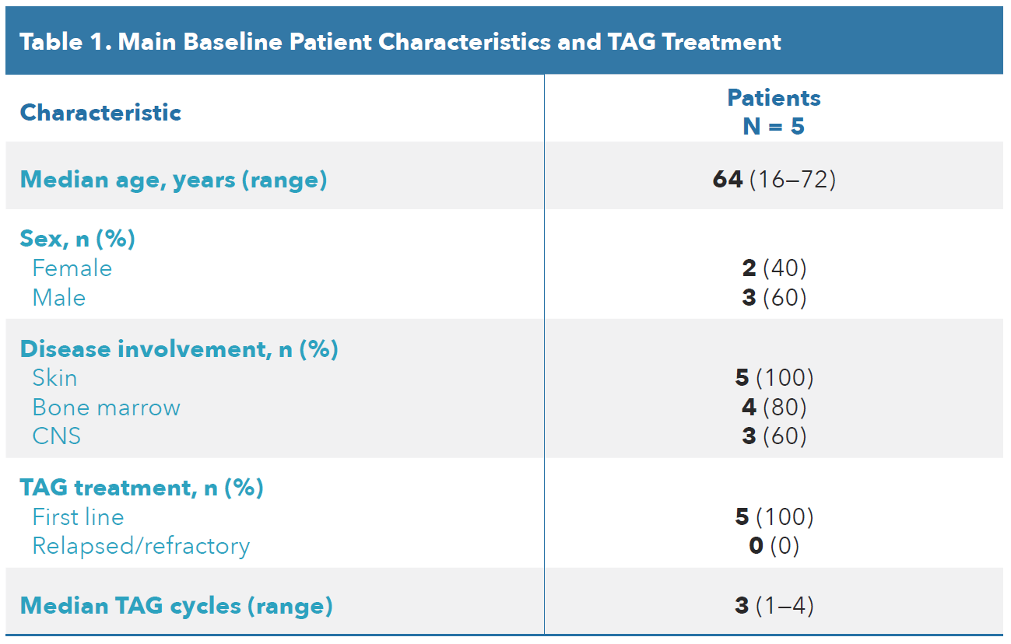
Results (I)
P530
Patients
Clinical data from 5 patients with BPDCN who were enrolled in the TAG EAP at our institution are presented
The median age was 64 years (range 16–72) and most patients were male (60%) (Table 1)
All patients received TAG as first-line treatment for BPDCN
The median number of TAG cycles received was 3 (range 1–4). All patients received TAG at 12 mcg/kg
Three patients received IT chemotherapy as primary-intention treatment and 2 patients as prophylaxis
Individual case details for each patient are presented in Figure 1 and Tables 2–4
CNS, central nervous system; TAG, tagraxofusp.

Slide 6
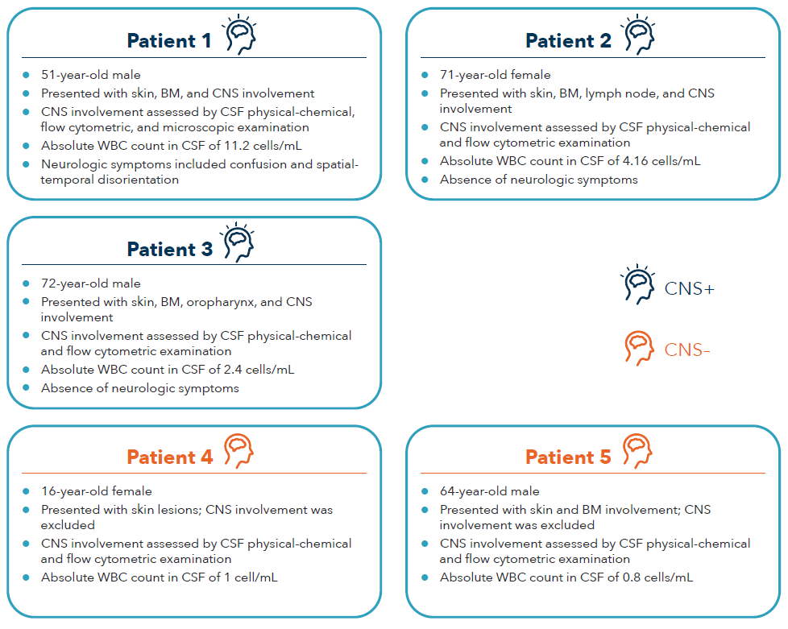
Results (II)
P530
Figure 1. Patient Cases: BPDCN at Presentation
BM, bone marrow; BPDCN, blastic plasmacytoid dendritic cell neoplasm; CNS, central nervous system; CSF, cerebrospinal fluid; WBC, white blood cell.

Slide 7
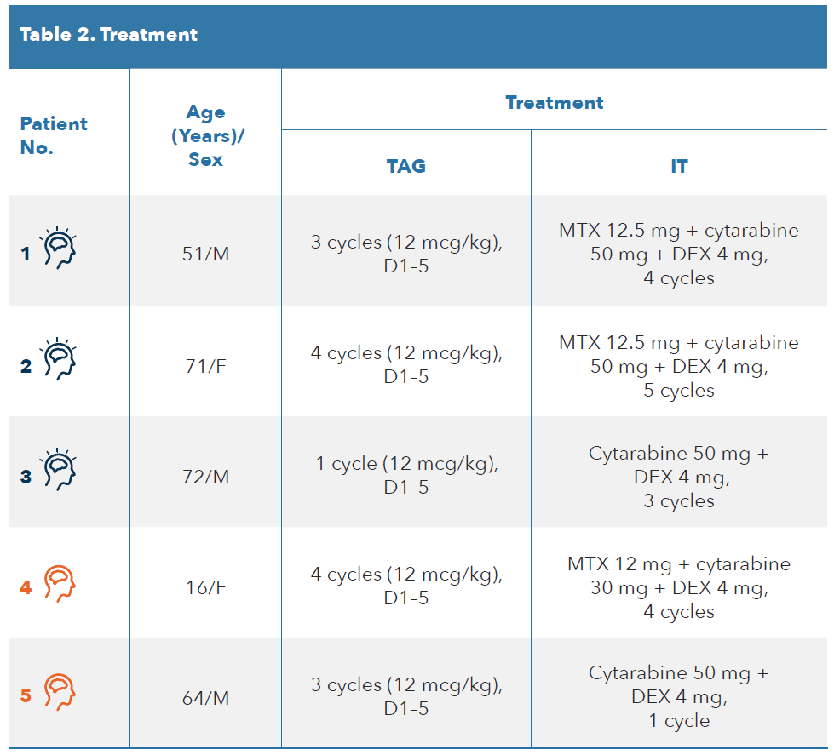
Results (III)
P530
D, day; DEX, dexamethasone; F, female; IT, intrathecal; M, male; MTX, methotrexate; TAG, tagraxofusp.

Slide 8
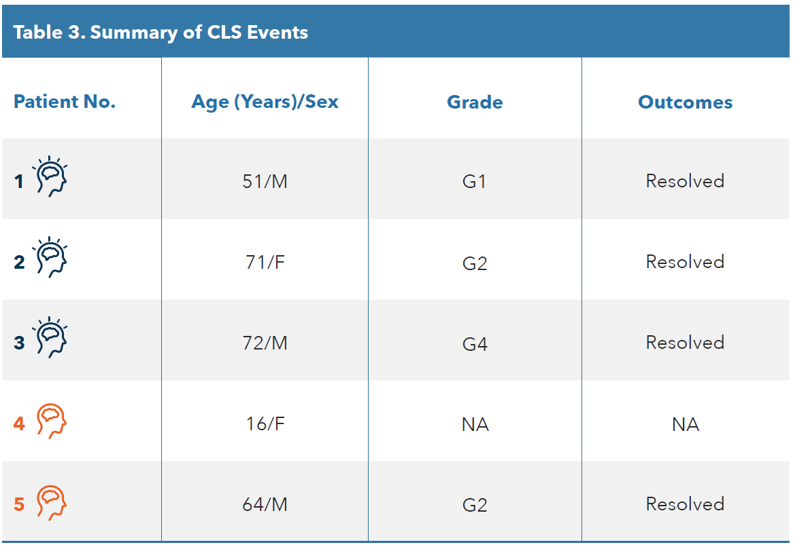
Results (IV)
P530
Safety
Capillary leak syndrome (CLS) was the most common AE, occurring in 4/5 patients (G1, n = 1; G2, n = 2; G4, n = 1); all cases resolved
Other AEs – pulmonary aspergillosis (n=1) and sepsis (n=1) – were reported
There were no AEs associated with the IT chemotherapy
CLS, capillary leak syndrome; F, female; G, grade; M, male; N/A, not applicable.

Slide 9
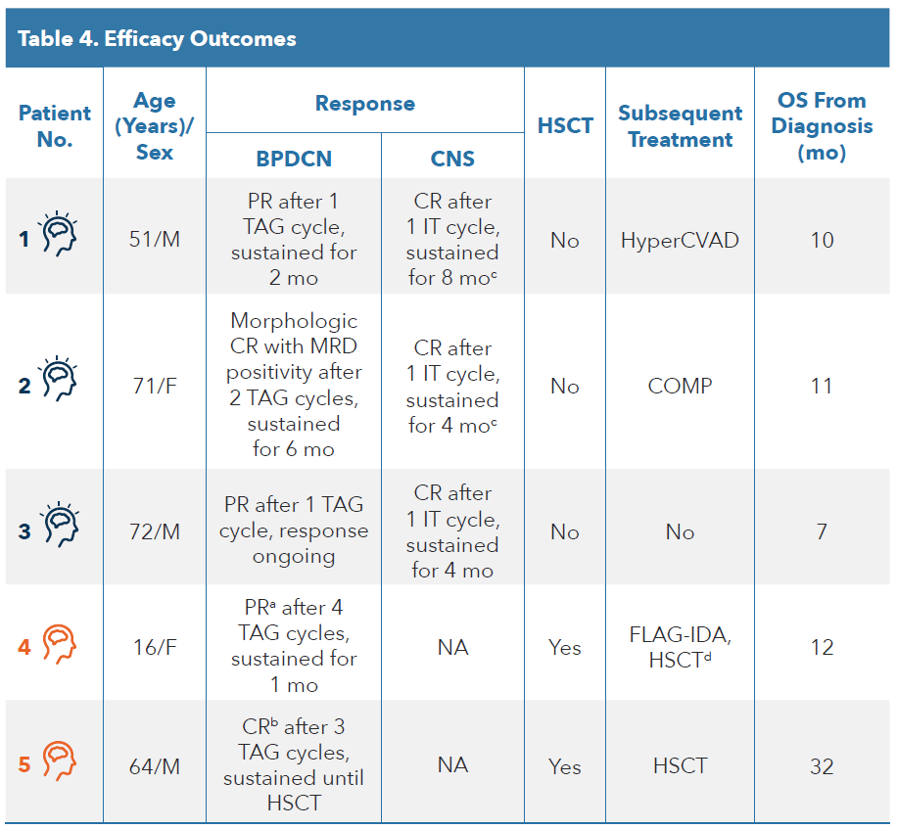
Results (V)
P530
Efficacy
All patients achieved a response, irrespective of baseline CNS involvement (Table 4)
Two patients, both without CNS involvement, were bridged to HSCT
All 5 patients are alive at the time of this analysis
BPDCN, blastic plasmacytoid dendritic cell neoplasm; CNS, central nervous system; COMP, cyclophosphamide, non-pegylated liposomal doxorubicin, vincristine, prednisone; CR, complete response; FLAG-IDA, fludarabine, high dose cytarabine, idarubicin, and granulocyte-colony stimulating factor; G, grade; HSCT, hematopoietic stem cell transplant; hyperCVAD, hyperfractionated cyclophosphamide, vincristine, doxorubicin, dexamethasone; IT, intrathecal; M, male; mo, months; MRD, minimal residual disease; NA, not applicable; OS, overall survival; PR, partial response; TAG, tagraxofusp.

Slide 10
Conclusions
P530
These preliminary results confirm the feasibility of IT chemotherapy in combination with systemic TAG therapy
Baseline CNS involvement did not appear to impact TAG efficacy, with 2 (40%) patients achieving CR and 3 (60%) PR
Two patients were bridged to HSCT
IT chemotherapy effectively cleared disease from the CSF, with all 3 patients with baseline CNS involvement achieving CNS CR
No unexpected safety events occurred when TAG was administered concomitantly with CNS prophylaxis or treatment
Capillary leak syndrome, when reported, was managed with treatment and resolved subsequently
Despite the limited number of patients analyzed, this single-center experience shows high frequency of patients with CNS+ BPDCN at the time of diagnosis and suggests that patients should be routinely checked for CNS involvement
Analysis of CSF by flow cytometry for CD123+ cells has higher sensitivity than physical-chemical, or microscopical techniques and allows identification of patients with minimal CNS involvement
Tagraxofusp with IT chemotherapy in patients with BPDCN was associated with promising efficacy in patients with CNS disease, with no unexpected safety events

Slide 11
Disclosures
G. Rivoli: Nothing to disclose.
G. Beltrami: Nothing to disclose.
A.M. Raiola: Nothing to disclose.
A. Dominietto: Nothing to disclose.
M. Riggi: Employee of Menarini Stemline.
E. Angelucci: Consultancy agreement with Menarini/Stemline, honoraria from Novartis and Celgene, involvement in local advisory boards for Bluebird Bio, Glaxo, Gilead, and Roche, and participation in DMC for Celgene, Vertex Pharmaceuticals Incorporated, and CRISPR Therapeutics.
Editorial and medical writing assistance was provided by Iratxe Abarrategui, PhD, CMPP, from Aptitude Health, The Hague, the Netherlands, and funding of this was supported by Stemline Therapeutics Inc., New York, NY. The authors are fully responsible for all content and editorial decisions for this poster.

